Slide 1
AC Power Analysis
Chapter #11

Slide 2
After completing this chapter, you will learn
the difference between instantaneous power and average power
the AC version of maximum power transfer theorem
about the concepts of effective or rms value
about the complex power, apparent power and power factor
Understand the principle of conservation of AC power
about power factor correction

Slide 3
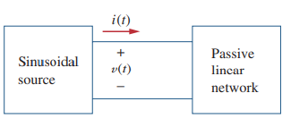
11.1 Instantaneous and Average Power
Definition
The instantaneous power, p(t) (in watts) is the power at any instant of time.
It is the rate at which an element absorbs energy

Slide 4
When p(t) is positive, power is absorbed by the circuit; that is, power is transferred from the source to the circuit. When p(t) is negative, power is absorbed by the source; that is, power is transferred from the circuit to the source. This is possible because of the storage elements (capacitors and inductors) in the circuit.

Slide 5
The instantaneous power changes with time and is therefore difficult to measure. The average power is more convenient to measure. In fact, the wattmeter, the instrument for measuring power, responds to average power.
Definition
The average power, in watts, is the average of the instantaneous power over one period.

Slide 6
Consider two special cases
This implies a purely resistive circuit or resistive load R
This implies we have a purely reactive circuit.

Slide 7
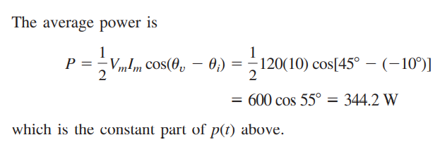
Example:
Find the instantaneous power and the average power absorbed by the passive linear network.
Solution:

Slide 8
Practice Problem 11.1
Example:
Solution:

Slide 9
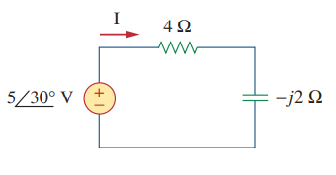
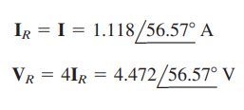
Practice Problem 11.2
Example:
For the circuit shown in below, find the average power supplied by the source and the average power absorbed by the resistor.
Solution:

Slide 10
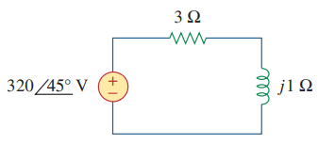
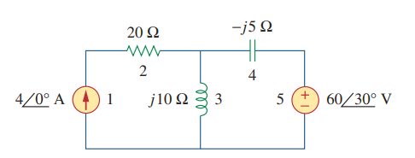
Practice Problem 11.3
For the circuit below, calculate the average power absorbed by the resistor and inductor. Find the average power supplied by the voltage source.
Example:
Determine the average power generated by each source and the average power absorbed by each passive element.

Slide 11
Solution:

Slide 12
Notice that the inductor and the capacitor absorb zero average power and that the total power supplied by the current source equals the power absorbed by the resistor and the voltage source OR
indicating that power is conserved

Slide 13
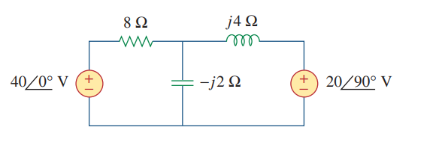
Practice Problem 11.4
Calculate the average power absorbed by each of the five elements in the circuit shown below.

Slide 14
11.2 Maximum Average Power Transfer
Finding the maximum average power which can be transferred from a linear circuit to a Load connected.
a) Circuit with a load
b) Thevenin Equivalent circuit
Represent the circuit to the left of the load by its Thevenin equiv.
Load Z_{L} represents any element that is absorbing the power generated by the circuit.
Find the load Z_{L} that will absorb the Maximum Average Power from the circuit to which it is connected.

Slide 15
Maximum Average Power Transfer Condition
For Maximum average power transfer to a load impedance Z_{L ,} we must choose Z_{L} as the complex
conjugate of the Thevenin impedance Z_{Th}.

Slide 16
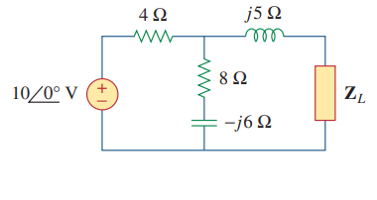
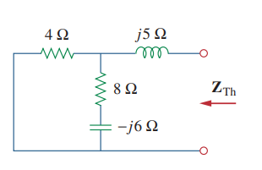
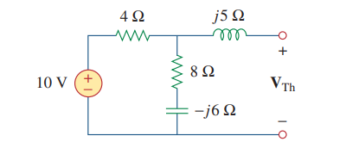
Example:
Determine the load impedance that maximizes the average power drawn from the circuit shown below. What is the maximum average power?
Solution:

Slide 17
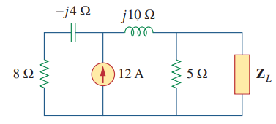
Practice Problem 11.5
For the circuit shown below, find the load impedance that absorbs the maximum average power. Calculate that maximum average power.

Slide 18
Maximum Average Power for Resistive Load
When the load is PURELY RESISTIVE, the condition for maximum power transfer is:
Now the maximum power can not be obtained from the P_{max} formula given before.
Maximum power can be calculated by finding the power of R_{L} when X_{L}=0.

Slide 19
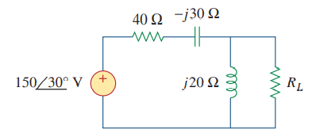
Example:
In the circuit shown below, find the value of that will absorb the maximum average power. Calculate that power
Solution:

Slide 20
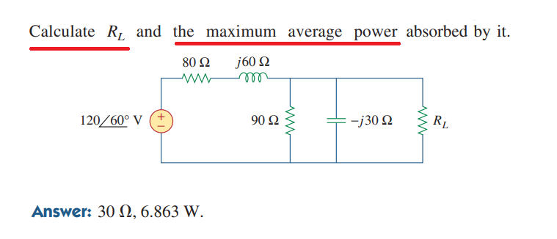
Practice Problem 11.6

Slide 21
11.3 Effective or RMS Value
Definition
The effective value of a periodic current is the dc current that delivers the same average power to a resistor as the periodic current

Slide 22
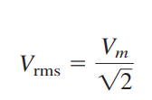
For the sinusoid
The average power for resistive loads using the (RMS) value is:

Slide 23
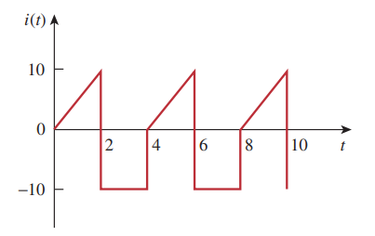
Example:
Determine the rms value of the current waveform in figue below. If the current is passed through a 2 Ohm resistor, find the average power absorbed by the resistor.
Solution:

Slide 24
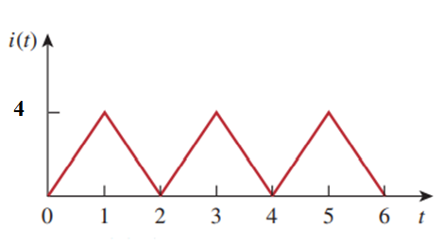
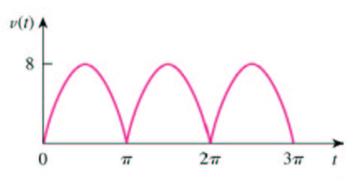
Practice Problem 11.7
Find the rms value of the current waveform shown below. If the current flows through a resistor, calculate the average power absorbed by the resistor
Practice Problem 11.8

Slide 25
How to determine the rms value of the sum of multiple currents or voltages ?
Example:
Solution:

Slide 26
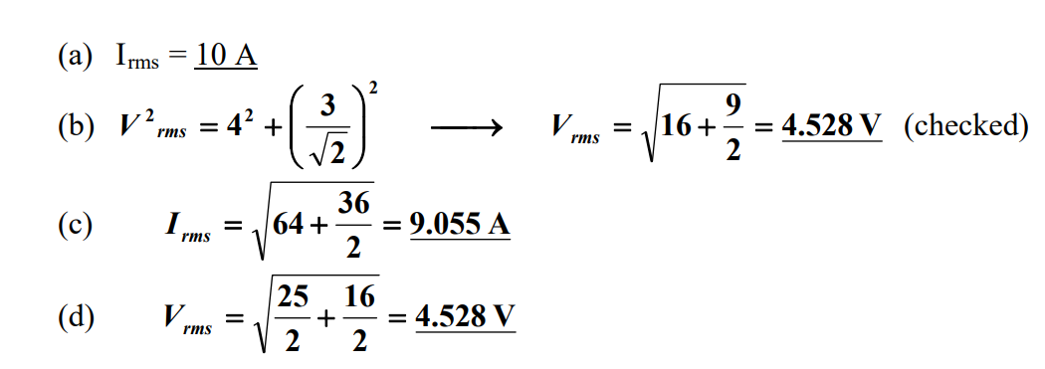
Example:
Solution:

Slide 27
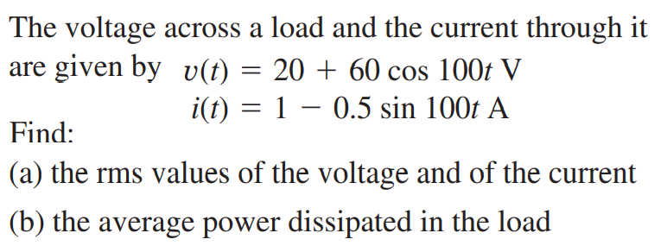
Example:
Solution:

Slide 28
11.4 Apparent Power and Power Factor
The Average Power depends on the rms value of voltage and current and the phase angle between them.
The Apparent Power ( S ) is the product of the rms value of voltage and current. It is measured in Volt amperes (VA).
The Power Factor (pf) is the cosine of the phase difference between voltage and current. It is also the cosine of the angle of load impedance. The power factor may also be regarded as the ratio of the real power dissipated to the apparent power of the load.

Slide 29
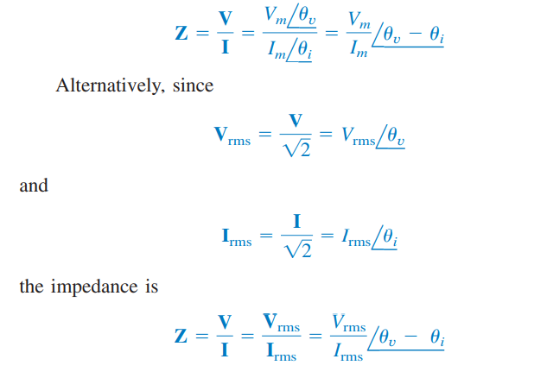

Slide 30
Not all the apparent power is consumed if the circuit is partly reactive.
Purely resistive load (R) | θ_{v}– θ_{i} = 0, Pf = 1 | P/S = 1, all power are consumed
Purely reactive load (L or C) | θ_{v}– θ_{i} = ±90º, pf = 0 | P = 0, no real power consumption
Resistive and reactive load (R and L/C) | θ_{v}– θ_{i} > 0 θ_{v}– θ_{i} < 0 | Lagging - inductive load Leading - capacitive load P/S < 1, Part of the apparent power is consumed

Slide 31
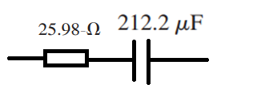
Example:
A series-connected load draws a current when the applied voltage is
Find the apparent power and the power factor of the load. Determine the element values that form the series-connected load.
Solution:

Slide 32
Practice Problem 11.9

Slide 33
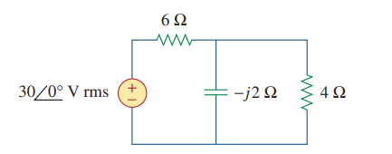
Example:
Determine the power factor of the entire circuit below as seen by the source. Calculate the average power delivered by the source.
Solution:

Slide 34
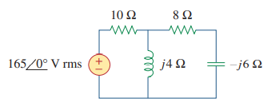
Practice Problem 11.10
Calculate the power factor of the entire circuit below as seen by the source.
What is the average power supplied by the source?

Slide 35
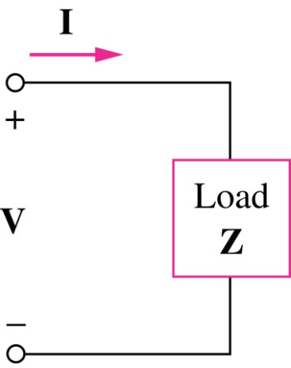
11. 5 Complex Power
Complex power S is important in power analysis because it contains all the information pertaining to the power absorbed by a given load.

Slide 36
The REAL Power is the only useful power delivered to the load.
The REACTIVE Power represents the energy exchange between the source and reactive part of the load. It is being transferred back and forth between the load and the source
The unit of Q is volt-ampere reactive (VAR)

Slide 37
Real Power is the actual power dissipated by the load.
Reactive Power is a measure of the energy exchange between source and reactive part of the load.

Slide 38
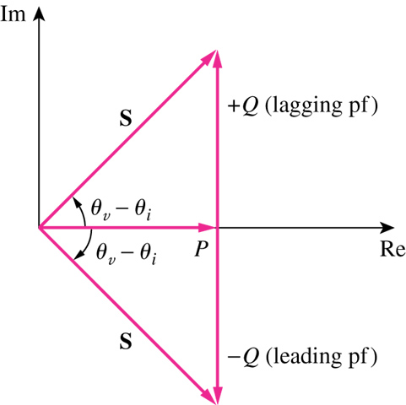
The COMPLEX Power is represented by the POWER TRIANGLE similar to IMPEDANCE TRIANGLE. Power triangle has four items: P, Q, S and θ.
a) Power Triangle
b) Impedance Triangle
Power Triangle

Slide 39
Example:
Solution:

Slide 40
Practice Problem 11.11

Slide 41
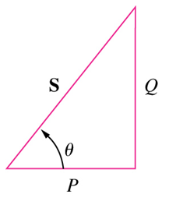
Example:
Solution:

Slide 42
Practice Problem 11.12

Slide 43
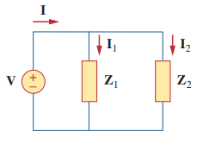
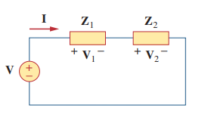
3. 6 Conservation of AC Power
Consider the circuit below where two load impedances Z 1 and Z2 are connected in parallel across an ac source V.
If the loads are connected in series with the voltage source, as shown below.

Slide 44
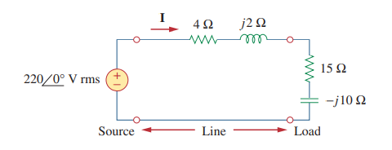
Example:
Figure below shows a load being fed by a voltage source through a transmission line. The impedance of the line is represented by the impedance and a return path. Find the real power and reactive power absorbed by: (a) the source, (b) the line, and (c) the load
Solution:

Slide 45
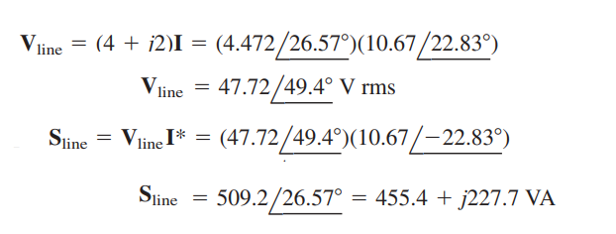

Slide 47
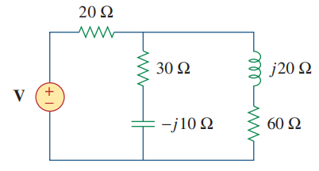
Practice Problem 11.13
In the circuit shown below, the resistor absorbs an average power of 240 W. Find V and the complex power of each branch of the circuit. What is the overall complex power of the circuit? (Assume the current through the resistor has no phase shift.)

Slide 48
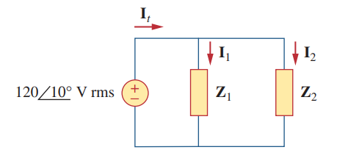
Example:
Solution:

Slide 49
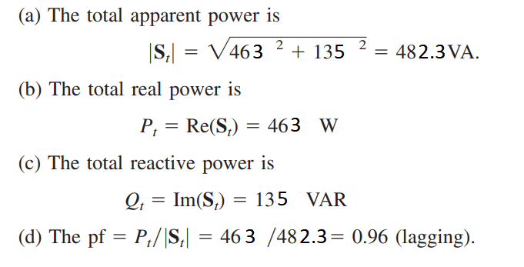

Slide 50
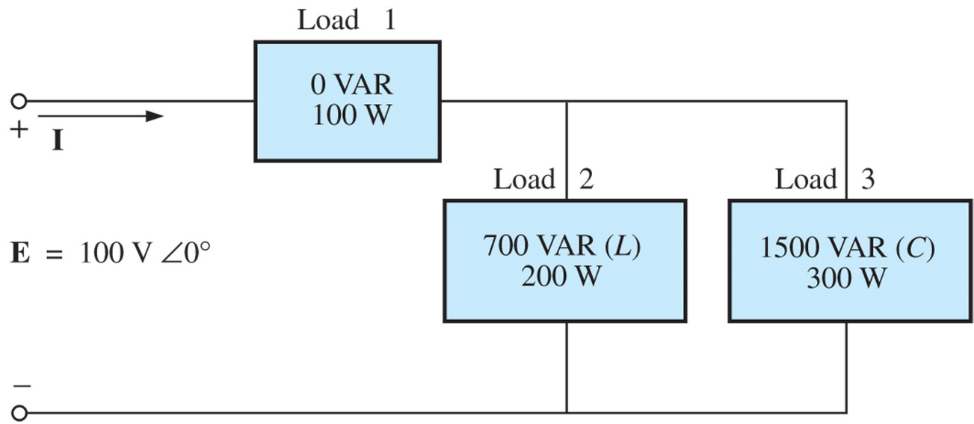
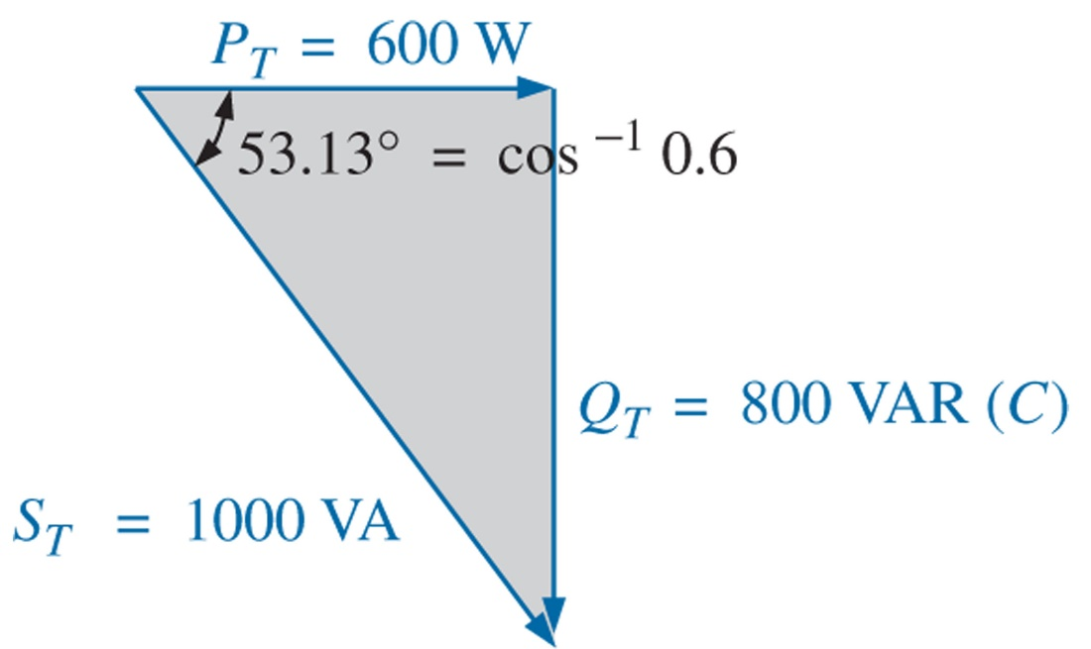
Example:
Finding the total COMPLEX Power of the three loads.
Solution:

Slide 51
Practice Problem 11.14

Slide 52
3.7 Power Factor Correction
Most domestic loads (such as washing machines, air conditioners, and refrigerators) and industrial loads (such as induction motors) are inductive and operate at a low lagging power factor. Although the inductive nature of the load cannot be changed, we can increase its power factor. Since most loads are inductive, a load’s power factor is improved or corrected by deliberately installing a capacitor in parallel with the load,

Slide 53
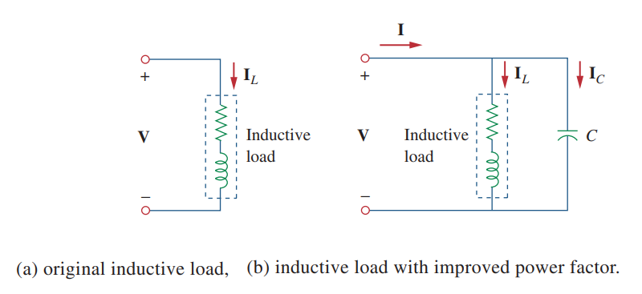
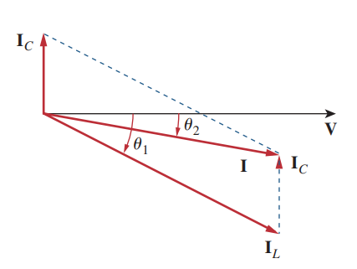

Slide 54
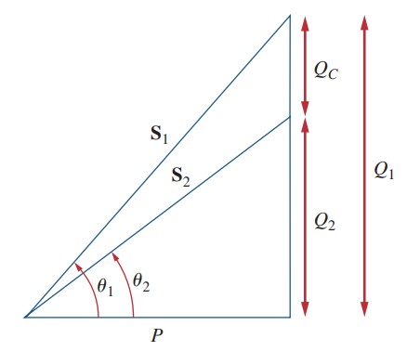
In this case, an inductor should be connected across the load for power factor correction. The required shunt inductance L can be calculated from

Slide 55
Example:
When connected to a 120-V (rms), 60-Hz power line, a load absorbs 4 kW at a lagging power factor of 0.8. Find the value of capacitance necessary to raise the pf to 0.95.
Solution:

Slide 56
Practice Problem 11.15
Find the value of parallel capacitance needed to correct a load of 140 kVAR at 0.85 lagging pf to unity pf. Assume that the load is supplied by a 110-V (rms), 60-Hz line.
Answer: 30.69 mF.

Slide 57
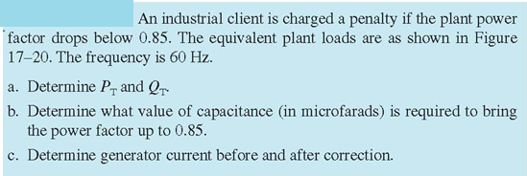
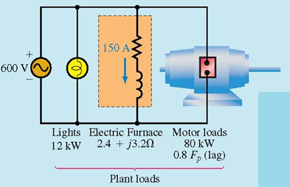
Example:

Slide 58
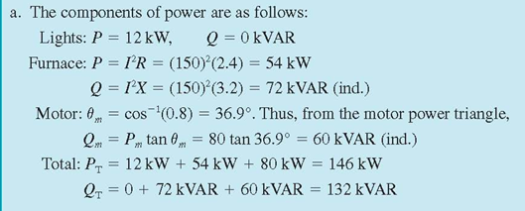
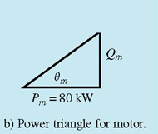
Solution:

Slide 59
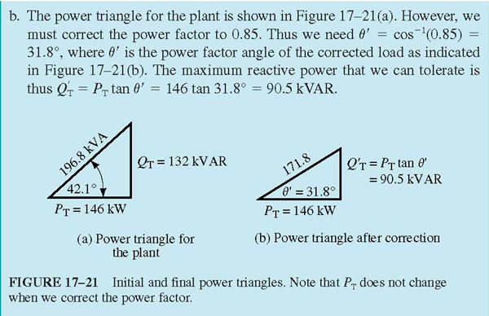

Slide 60
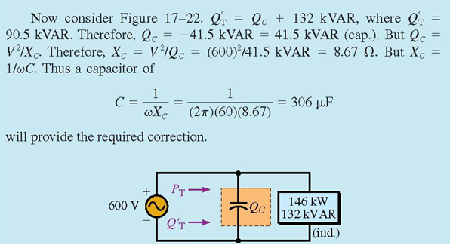

Slide 61
