Slide 1
ELECTRONIC
INFE242
Lecture-2: SemIconductors

Slide 2
In this chapter we are going to introduce brifly the properties and physics of semiconductors. The objective is to provide a basis for understanding the physical operation of diodes and the transistors in order to enable their effective use in the design of circuit.

Slide 3
As their name implies, semiconductors are materials whose conductivity lies between that of conductors, such as cooper, and insulators, such as glass. There are two types of semiconductor; single element (pure) semiconductors, such as germanium and silicon, which are in group IV in periodic table; and compound semiconductors, such as gallium-arsenide, which are formed by combining elements from groups III and V or group II and VI. Compound semiconductors are useful in special electronic circuit applications as well as in application that involve light, such as light emmiting diodes (LED’s). Of the two elemental semiconductors, germanium was used in fabrication of very early transistors (late 1940s, 1950s).

Slide 4
A silicon atom has four valence electrons, and thus it requires another four to complete it outer most shell. This is achived by sharing one of its valence electrons with each of its four neighboring atoms. Each pair of shared electrons forms a covalent bond.
The figure is a two dimensional of the silicon crystal. The circules represent the inner core of silicon atoms, with +4 indicating its positive charge of +4q, which neutraliszed by the charge of the four valence electrons. At sufficiently low temperature (i.e. 0 K) covalent bonds are intact. This means that there is no any free electron to conduct electric current. Thus at this conditions the silicon behave as an insulator.
Fig. 3.1

Slide 5
  At room temperature, sufficient thermal energy exists to break some of the covalent bonds. In the following figure when a covalent bond is broken, an electron is freed. So the free electron can wander a way from its parent atom, and it becomes available to conduct electric current, if an electric source is applied to the crystal.
As the electron leaves its parent atom, it leave behind a net positive charge, equal to the magnitude of the electron charge. Thus an electron from a neighboring atom may be attracted to this positive atom but creates a new hole in the other atom. This proces may repeat itself, with the result that we effectively have a positively chaged carrier, or hole, moving through the silicon crystal structure and being available to conduct electric current.
Fig. 3.2

Slide 6
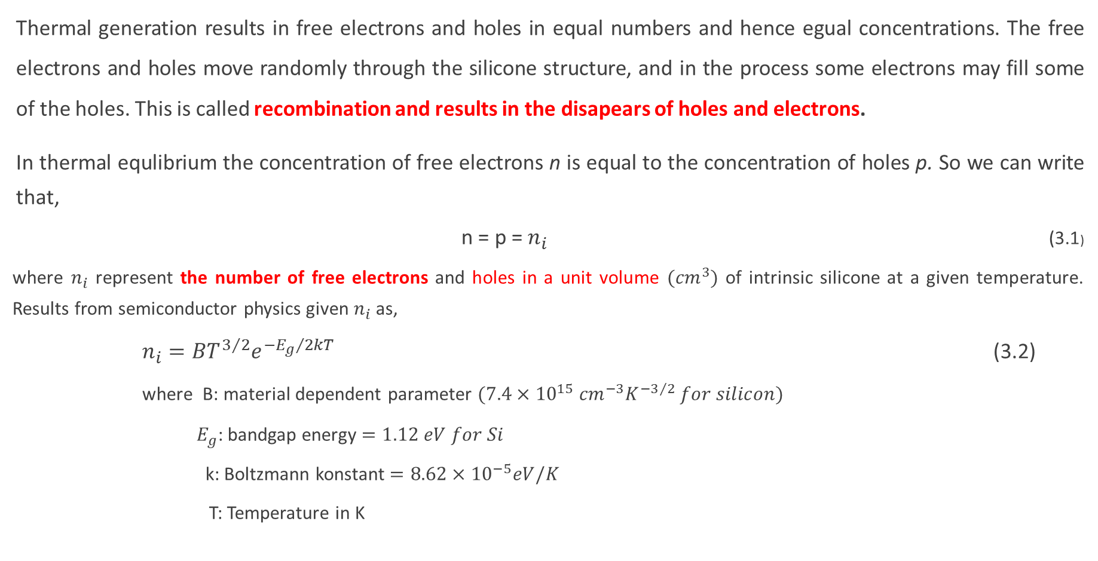
Thermal generation results in free electrons and holes in equal numbers and hence egual concentrations. The free electrons and holes move randomly through the silicone structure, and in the process some electrons may fill some of the holes. This is called recombination and results in the disapears of holes and electrons.
In thermal equlibrium the concentration of free electrons n is equal to the concentration of holes p. So we can write that,
                n = p = $n_{i}$ (3.1)
                where $n_{i}$ represent the number of free electrons and holes in a unit volume $({cm}^{3})$ of intrinsic silicone at a given temperature. Results from semiconductor physics given $n_{i}$ as,
                $n_{i}=BT^{3/2}e^{{{−E}_{g}}/{2kT}}$ (3.2)
                where B: material dependent parameter $(7.4×{10}^{15} {cm}^{−3}K^{{−3}/2} for silicon)$
                $E_{g}$: bandgap energy $=1.12 eV for Si$
                k: Boltzmann konstant $=8.62×{10}^{−5}eV/K$
                T: Temperature in K

Slide 7
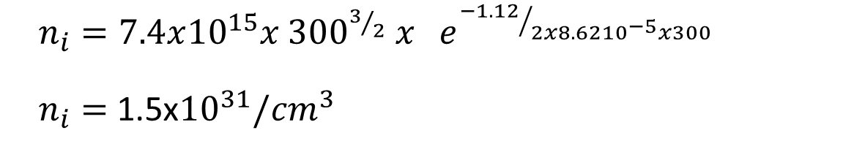

Example 2.1
Calculate the value of ni in silicon at room temperature (300 K).
Solution 2.1
$$n_{i}=BT^{3/2}e^{{{−E}_{g}}/{2kT}}$$
$n_{i}=7.4x{10}^{15}x {300}^{3/2} x{ e}^{{−1.12}/{2x8.62{10}^{−5}x300}}$
$n_{i}=$1.5x${10}^{31}/{cm}^{3}$

Slide 8
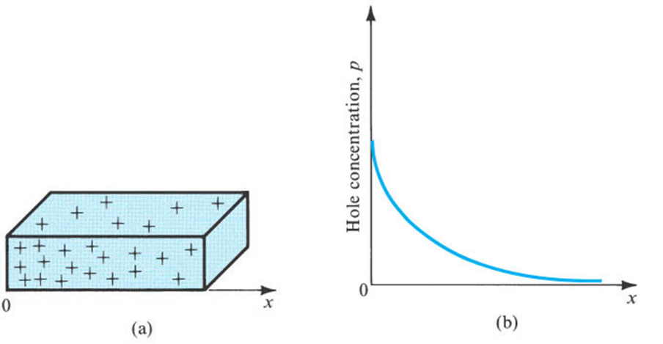
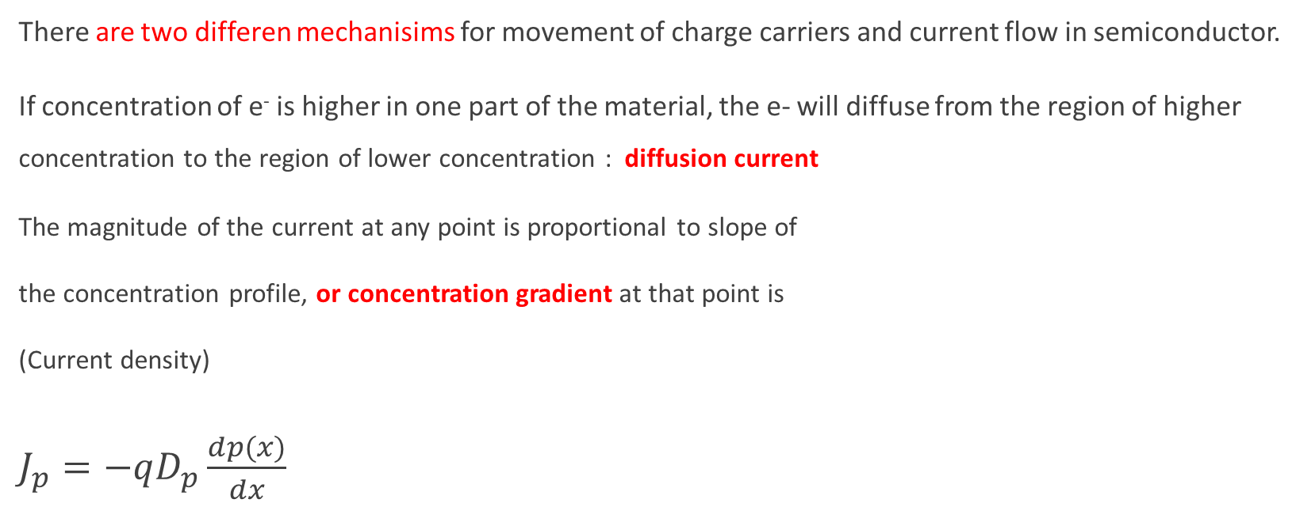
Current Flow in Semiconductor
Difusion and Drift Current
There are two differen mechanisims for movement of charge carriers and current flow in semiconductor.
If concentration of e⁻ is higher in one part of the material, the e- will diffuse from the region of higher concentration to the region of lower concentration : diffusion current
The magnitude of the current at any point is proportional to slope of
the concentration profile, or concentration gradient at that point is
(Current density)
$J_{p}=−qD_{p}\frac{dp(x)}{dx}$
Fig. 3.6 A bar of silicon a) which holes are injected
b) The holes diffuse in x direction

Slide 9
shows silicon bar that the holes are injected
Shows hole diffusion in x direction
Shows electron diffusion and electron current direction which are oppisite

Slide 10
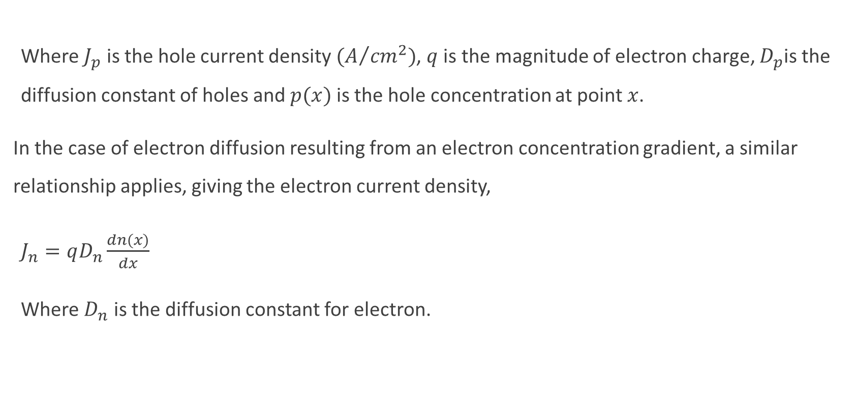
Where $J_{p}$ is the hole current density $(A/{{cm}^{2})}$, $q$ is the magnitude of electron charge, $D_{p}$is the diffusion constant of holes and $p(x)$ is the hole concentration at point $x$.
In the case of electron diffusion resulting from an electron concentration gradient, a similar relationship applies, giving the electron current density,
$J_{n}=qD_{n}\frac{dn(x)}{dx}$
Where $D_{n}$ is the diffusion constant for electron.

Slide 11

Carrier drift
Carrier drift occurs when an electric field is applied. Holes move in the direction of E field, and electrons move in the reverse direction.
Drift velocity $v_{p−drift}=µ_{p}E$ Where $µ_{p}$ is the hole mobility $({{cm}^{2}}/{V.s)}$
for electron $v_{n−drift}=−µ_{n}E$ Where $µ_{n}$ is the electron mobility
An electric field E is applied in a bar of silicon causes the holes to drift in the direction of E field and the free electrons to drift in the opposite direction.

Slide 12
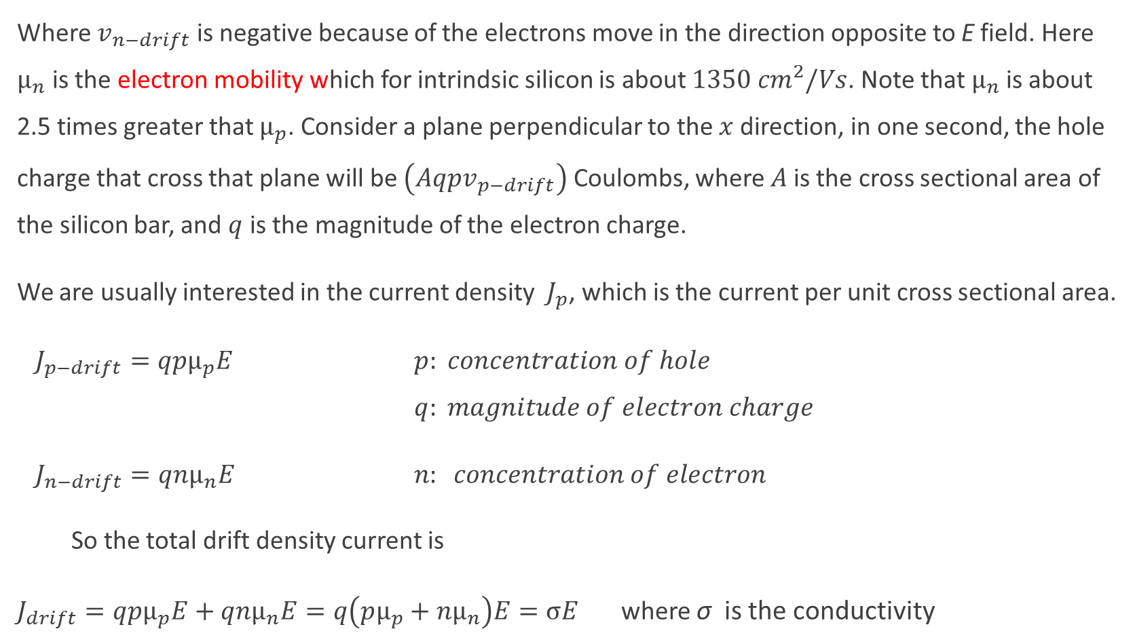
Where $v_{n−drift}$ is negative because of the electrons move in the direction opposite to E field. Here $µ_{n}$ is the electron mobility which for intrindsic silicon is about ${1350 cm}^{2}/Vs$. Note that${ µ}_{n}$ is about 2.5 times greater that $µ_{p}$. Consider a plane perpendicular to the $x$ direction, in one second, the hole charge that cross that plane will be $\left(Aqpv_{p−drift}\right)$ Coulombs, where $A$ is the cross sectional area of the silicon bar, and $q$ is the magnitude of the electron charge.
We are usually interested in the current density $J_{p}$, which is the current per unit cross sectional area.
$J_{p−drift}=qpµ_{p}E$ $p: concentration of hole$ $q: magnitude of electron charge$
$J_{n−drift}=qnµ_{n}E$ $n: concentration of electron$
So the total drift density current is
$J_{drift}=qpµ_{p}E+qnµ_{n}E=q\left(pµ_{p}+nµ_{n}\right)E=σE$ where σ is the conductivity

Slide 13
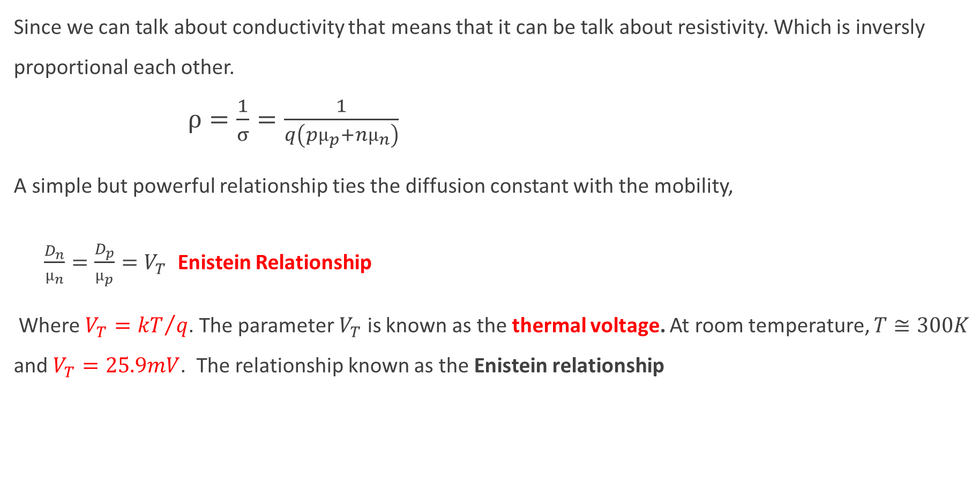
Since we can talk about conductivity that means that it can be talk about resistivity. Which is inversly proportional each other.
$ρ=\frac{1}{σ}=\frac{1}{q\left(pµ_{p}+nµ_{n}\right)}$
A simple but powerful relationship ties the diffusion constant with the mobility,
$\frac{D_{n}}{µ_{n}}=\frac{D_{p}}{µ_{p}}=V_{T}$ Enistein Relationship
Where $V_{T}={kT}/q$. The parameter $V_{T}$ is known as the thermal voltage. At room temperature, $T≅300K$ and $V_{T}=25.9mV$. The relationship known as the Enistein relationship

Slide 14
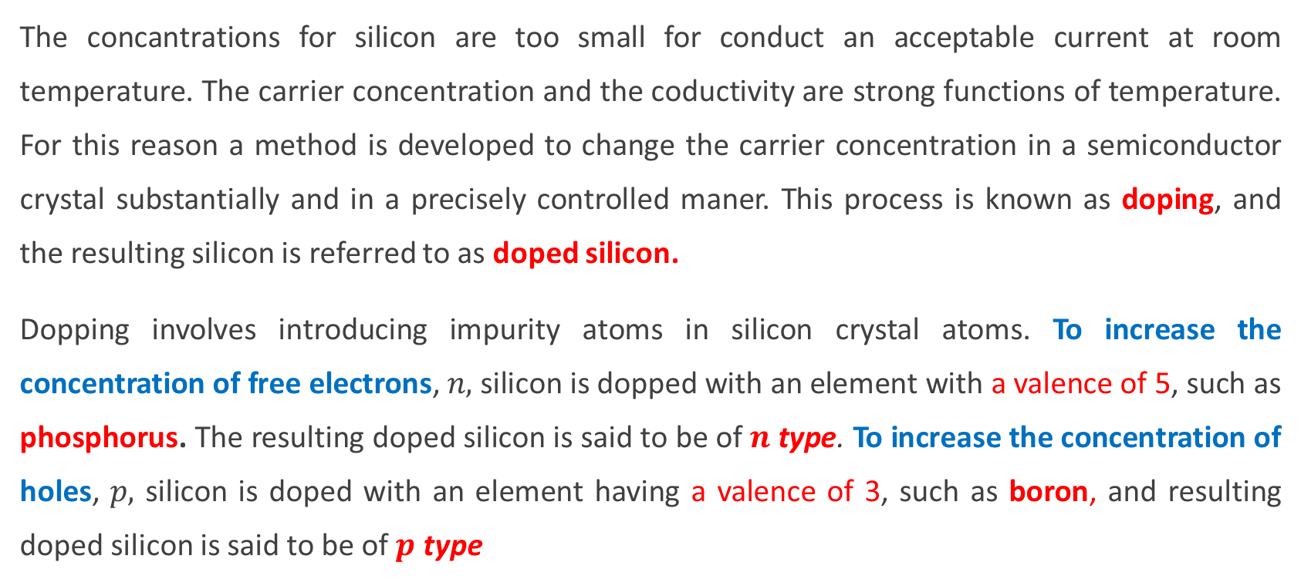
Doped semiconductor
The concantrations for silicon are too small for conduct an acceptable current at room temperature. The carrier concentration and the coductivity are strong functions of temperature. For this reason a method is developed to change the carrier concentration in a semiconductor crystal substantially and in a precisely controlled maner. This process is known as doping, and the resulting silicon is referred to as doped silicon.
Dopping involves introducing impurity atoms in silicon crystal atoms. To increase the concentration of free electrons, $n,$ silicon is dopped with an element with a valence of 5, such as phosphorus. The resulting doped silicon is said to be of $n$ type. To increase the concentration of holes, $p,$ silicon is doped with an element having a valence of 3, such as boron, and resulting doped silicon is said to be of $p$ type

Slide 15
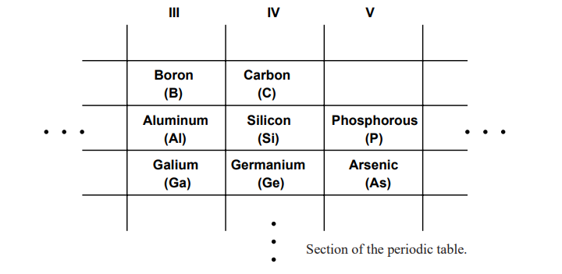

Slide 16
The following figure shows doped silicon atom for n type and p type
Fig. 3.3 A silicon crystal is doped by a pentavalent element (n type)
Fig. 3.4 A silicon crystal doped with boron, a trivalent impurity (p type)

Slide 17
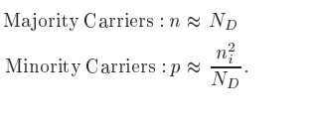
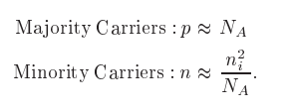
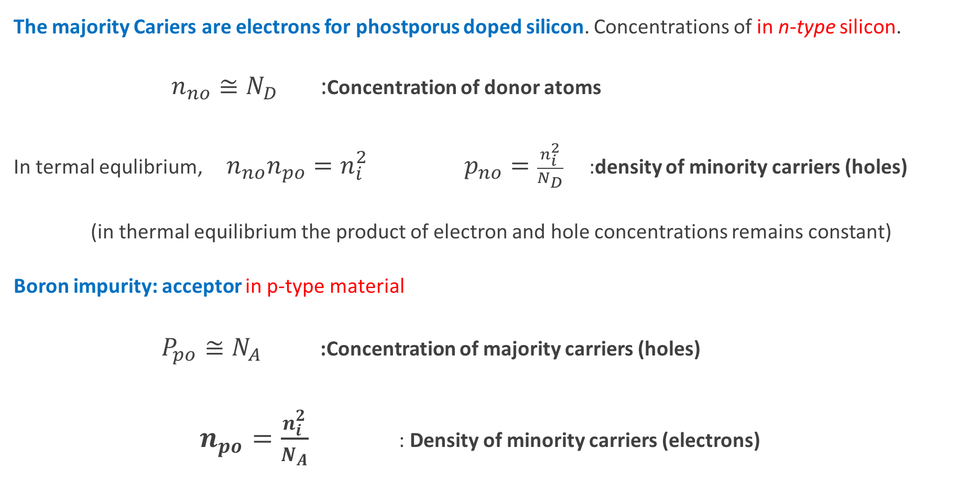
The majority Cariers are electrons for phostporus doped silicon. Concentrations of in n-type silicon.
$n_{no}≅N_{D}$ :Concentration of donor atoms
In termal equlibrium, $n_{no}n_{po}=n_{i}^{2}$ $p_{no}=\frac{n_{i}^{2}}{N_{D}}$ :density of minority carriers (holes)
(in thermal equilibrium the product of electron and hole concentrations remains constant)
Boron impurity: acceptor in p-type material
$P_{po}≅N_{A}$ :Concentration of majority carriers (holes)
$n_{po}=\frac{n_{i}^{2}}{N_{A}}$ : Density of minority carriers (electrons)

Slide 18


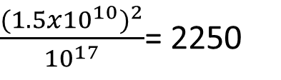
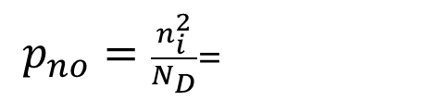
Example 2.2
Let the intrinsic carrier density $n_{i}$
is given by 1.5x10¹⁰ /cm³ at 300 K. Consider an n-type silicon in which the dopant
concantration N_{D} is 10¹⁷ /cm³. Find the electron and the hole concantrations at 300 K.
Solution 2.2
The concentration of free electrons in the n-type silicon
$n_{no}≅N_{D}$= 10¹⁷
The concentration of holes, $p_{no}$, that are generated
$p_{no}=\frac{n_{i}^{2}}{N_{D}}=$
$\frac{{(1.5x{10}^{10})}^{2}}{{10}^{17}}$= 2250

Slide 19
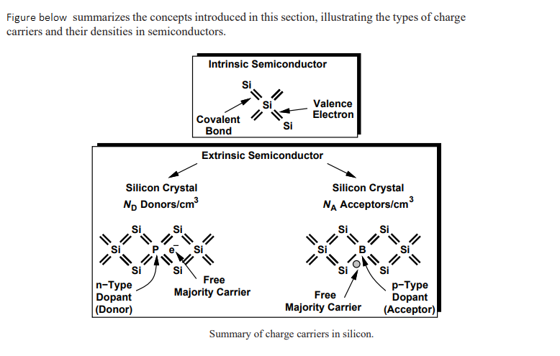

Slide 20
The p-n junction
Until now we are talk about the p-type and n-type material. Now the basic p-n junction implements a diode.
Fig. 3.8 Simplified physical structure of p-n junction

Slide 21
The Fig. 3.9 shows a p-n junction under open-circuit conditions, that is the external terminals are left open. The «+» signs in the p-type material denote the majority holes. The charge of this holes is neutrolized by an equal amount of bound negative charge associated with the acceptor atoms. In the n-type material the majotity electrons are indicated by «-» signs. For simplicity, these bound charges are not shown in the diagram.
Fig. 3.9 a) The p-n junction with no applied voltage (open-circuited terminal)
b) The potential distribution along an axis perpendicular to the junction

Slide 22
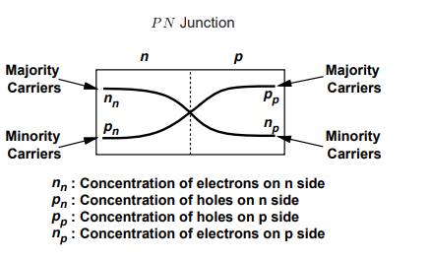

Diffusion current ID
Because the concentration of holes is high in the p region and low in the n region, holes diffuse across the junction from the p side to the n side. Similarly, electrons diffuse accros the junction from the n side to the p side. These two current component add together to form the diffusion currend $I_{D}$ whose direction is from the p side to the n side as indicated in the following figure

Slide 23
Depletion Region
The holes that diffuse across the junction into the n region quickly recombine with some of the majority electrons present there and disappear from this scene. This recombination process results also in the disappearance of some free electrons from the n type material. Thus some of the boud charges will no longer be neutrolised by free electrons. And this charge is said to be uncovered. Since recombinations takes place close to the junction there will be a region close to the junjtion that is depleted of free electrons and containes uncovered electrons.

Slide 24
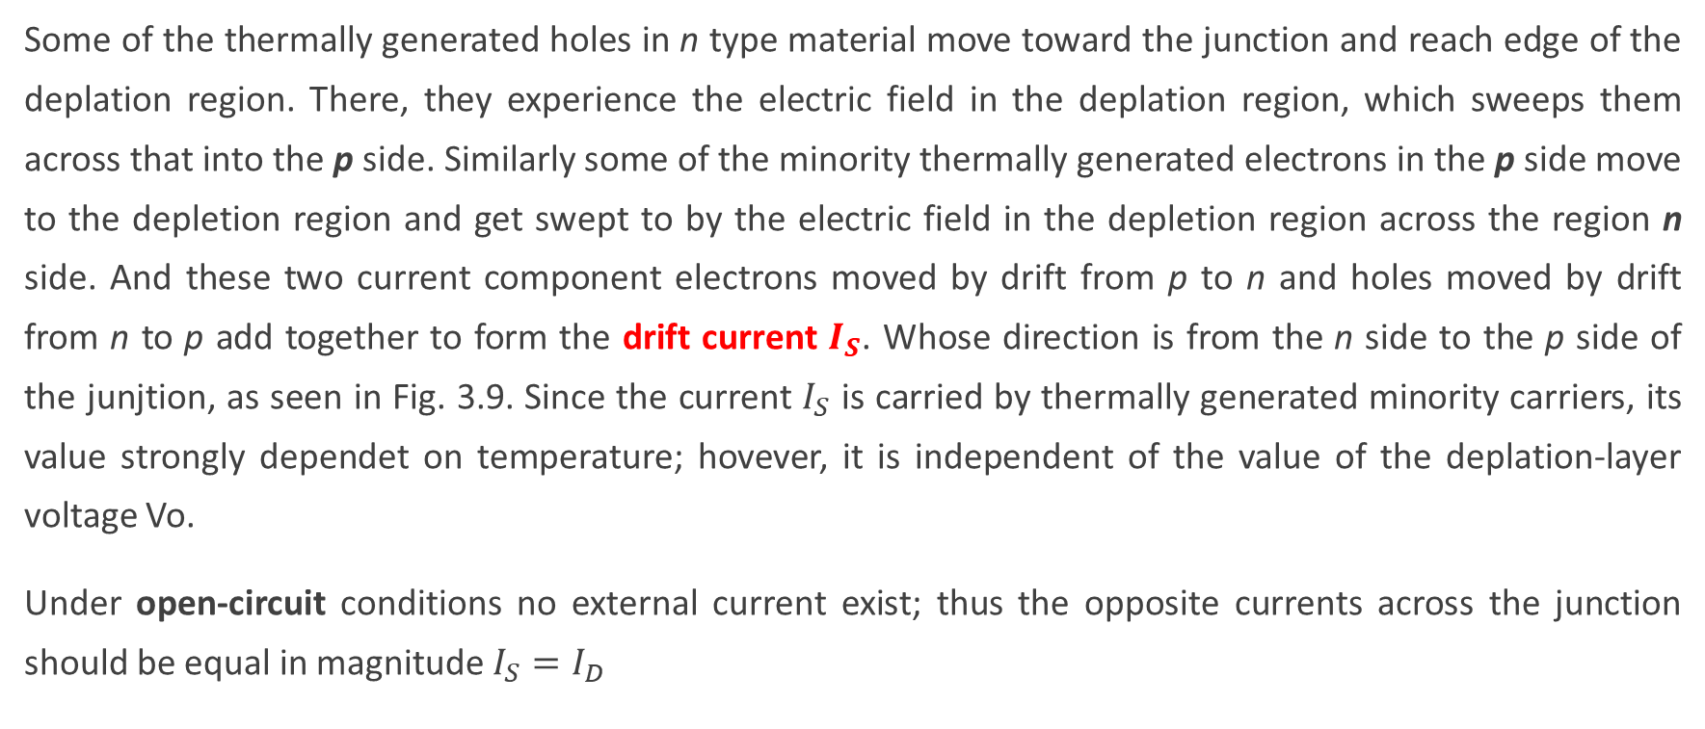
The drift current $I_{S}$
Some of the thermally generated holes in n type material move toward the junction and reach edge of the deplation region. There, they experience the electric field in the deplation region, which sweeps them across that into the p side. Similarly some of the minority thermally generated electrons in the p side move to the depletion region and get swept to by the electric field in the depletion region across the region n side. And these two current component electrons moved by drift from p to n and holes moved by drift from n to p add together to form the drift current $I_{S}$. Whose direction is from the n side to the p side of the junjtion, as seen in Fig. 3.9. Since the current $I_{S}$ is carried by thermally generated minority carriers, its value strongly dependet on temperature; hovever, it is independent of the value of the deplation-layer voltage Vo.
Under open-circuit conditions no external current exist; thus the opposite currents across the junction should be equal in magnitude $I_{S}=I_{D}$

Slide 25
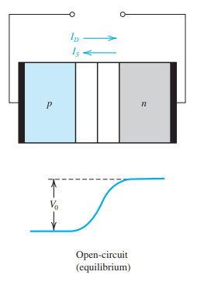
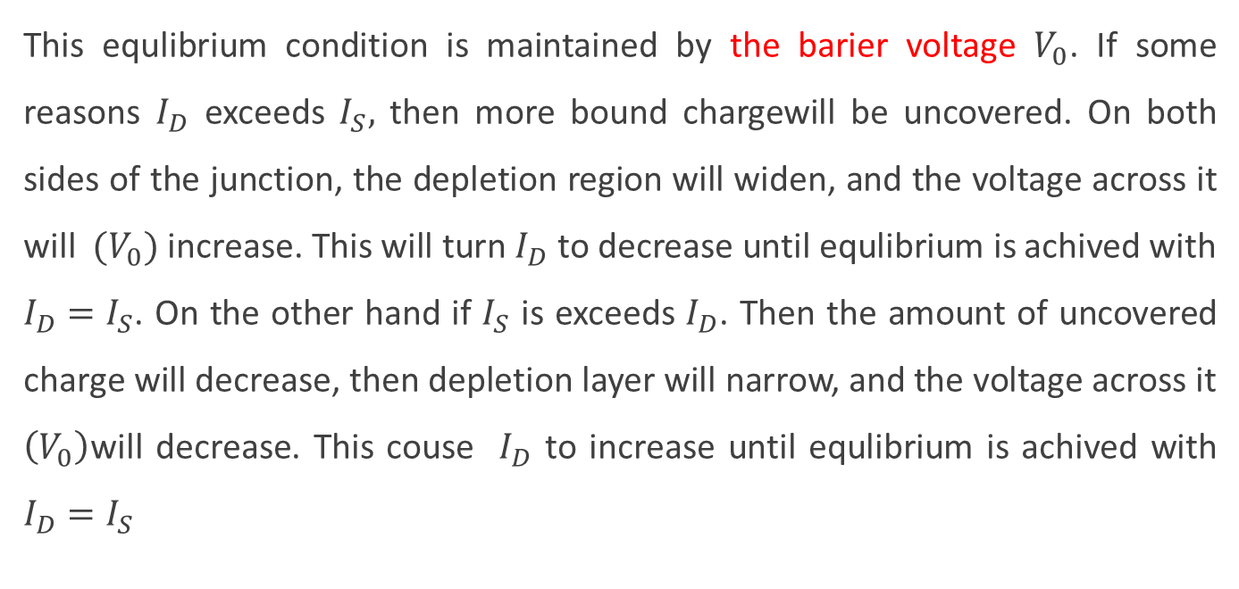
This equlibrium condition is maintained by the barier voltage $V_{0}$. If some reasons $I_{D}$ exceeds $I_{S},$ then more bound chargewill be uncovered. On both sides of the junction, the depletion region will widen, and the voltage across it will $(V_{0})$ increase. This will turn $I_{D}$ to decrease until equlibrium is achived with $I_{D}=I_{S}$. On the other hand if $I_{S}$ is exceeds $I_{D}$. Then the amount of uncovered charge will decrease, then depletion layer will narrow, and the voltage across it $\left(V_{0}\right)$will decrease. This couse $I_{D}$ to increase until equlibrium is achived with $I_{D}=I_{S}$

Slide 26
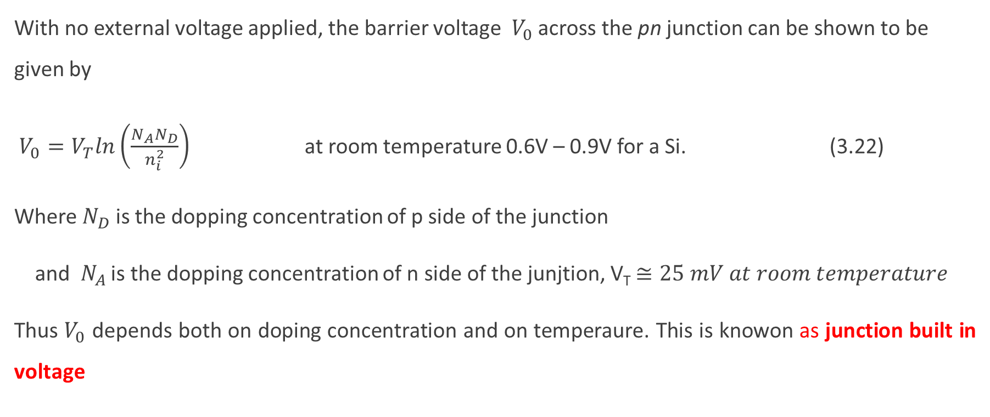
The junction built in voltage
With no external voltage applied, the barrier voltage$V_{0}$ across the pn junction can be shown to be given by
$V_{0}=V_{T}ln\left(\frac{N_{A}N_{D}}{n_{i}^{2}}\right)$ at room temperature 0.6V – 0.9V for a Si. (3.22)
Where $N_{D}$ is the dopping concentration of p side of the junction
and $N_{A}$ is the dopping concentration of n side of the junjtion, V_{T} $≅25 mV at room temperature$
Thus $V_{0}$ depends both on doping concentration and on temperaure. This is knowon as junction built in voltage

Slide 27
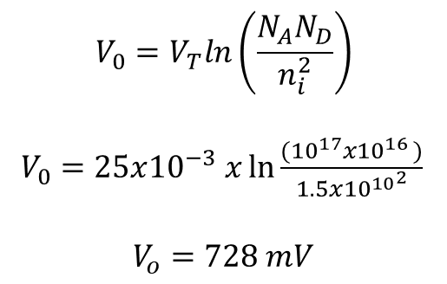
Example 2.3
For a pn junction with N_{A} = 10¹⁷ /cm³ , N_{D} = 10¹⁶ /cm³ and T= 300 K. Find the built –in voltage. Use n_{i} =1.5x10¹⁰ /cm³
Solution 2.3
$$V_{0}=V_{T}ln\left(\frac{N_{A}N_{D}}{n_{i}^{2}}\right)$$
$V_{0}=25x{10}^{−3} x\ln{\frac{({10}^{17}x{10}^{16 })}{{1.5x{10}^{10}}^{2}}}$
$$V_{o}=728 mV$$

Slide 28
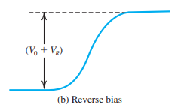
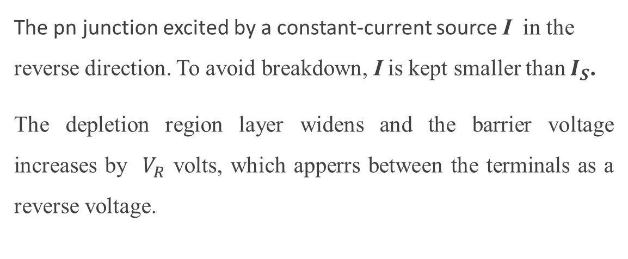
The pn junction under reverse bias condition
The pn junction excited by a constant-current source I in the reverse direction. To avoid breakdown, I is kept smaller than $I_{S}$.
The depletion region layer widens and the barrier voltage increases by $V_{R}$ volts, which apperrs between the terminals as a reverse voltage.

Slide 29
The current I is carried by electrons flowing in the external circuit from the n material to the p material. Electron material and holes leave the p material. The free electrons leaveing the n material cause the positive bound charge to increase. Similarly, the holes leaving the p material result in an increase in the negative bound charge. Thus the reverse current I increases the width of, and the charge stored in, the depletion layer. This results in a higher voltage across the depletion region: a greater barrier voltage, which causes the diffusion current I_{D} to decrease. The drift current I_{S}, being independent of the barrier voltage, remains constant. Finally, equilibrium is reached when I_{S} - I_{D} = I

Slide 30
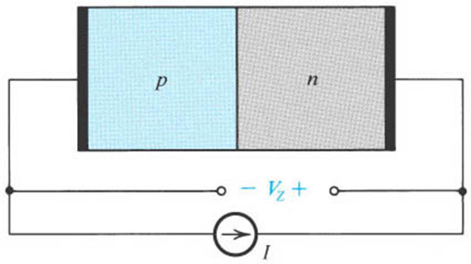
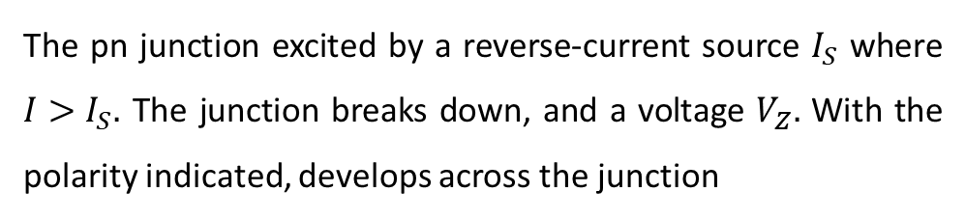
The pn Junction in the Breakdown Region
The pn junction excited by a reverse-current source $I_{S}$ where $I>I_{S}.$ The junction breaks down, and a voltage $V_{Z}.$ With the polarity indicated, develops across the junction
The current I move holes from the p material through the external circuit into the n material and electrons from the n material into the p material. More and more of the bound charge is uncovered: the depletion layer widens and the barrier voltage rises. This causes the diffusion current to decrease; eventually it will be reduced to almost zero. Nevertheless, this is not sufficient to reach a steady state, since I is greater than I_{s}. Therefore widening of the depletion layer continues until a sufficiently high junction voltage develops, at which point a new mechanism sets in to supply the charge carriers needed to support the current I. This mechanism for supplying reverse currents in excess of I_{s} can take one of two forms depending on the pn junction materialstructure. The two breakdown mechanisims are the zener effect and avalanche effect.

Slide 31
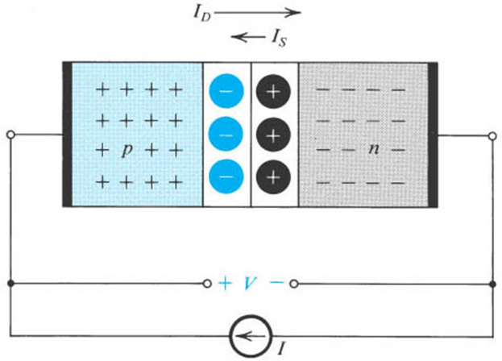
The pn Junction Under Forward-Bias Conditions
The pn junction excited by a constant-current source supplying a current I in the forward direction. The depletion layer narrows and the barrier voltage decreases by V volts, which appears as an external voltage in the forward direction
The current I causes majority carriers to be supplied to both sides of the junction by the external circuit: holes to the p material and electrons to the n material. These majority carriers neutralize some of the uncovered bound charge, causing less charge to be stored in the depletion layer. Thus the depletion layer narrows and the depletion barrier voltage reduces. The reduction in barrier voltage enables more holes to cross the barrier from the p material into the n material and more electrons from the n side to cross into the p side. Thus the diffusion current I_{D} increases until equilibrium is achieved with I_{D} - I_{S} = I, the externally supplied forward current.

Slide 32
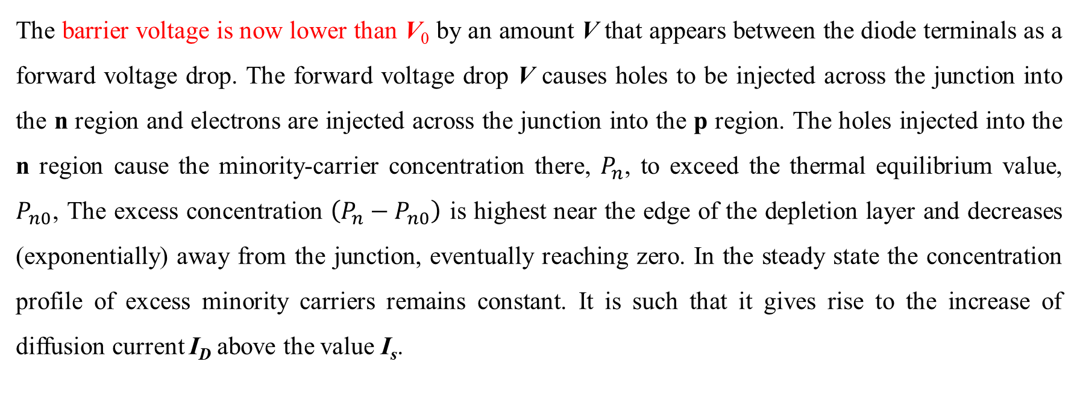
The barrier voltage is now lower than V₀ by an amount V that appears between the diode terminals as a forward voltage drop. The forward voltage drop V causes holes to be injected across the junction into the n region and electrons are injected across the junction into the p region. The holes injected into the n region cause the minority-carrier concentration there, $P_{n}$, to exceed the thermal equilibrium value, $P_{n0}$, The excess concentration $\left(P_{n}−P_{n0}\right)$ is highest near the edge of the depletion layer and decreases (exponentially) away from the junction, eventually reaching zero. In the steady state the concentration profile of excess minority carriers remains constant. It is such that it gives rise to the increase of diffusion current I_{D} above the value I_{s}.

Slide 33
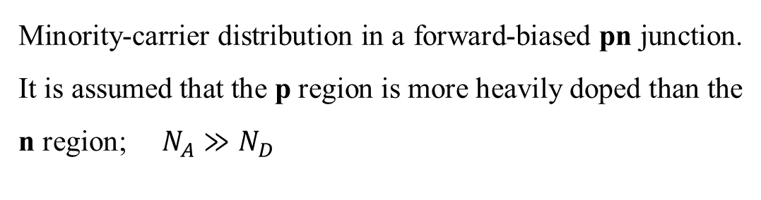
Minority-carrier distribution in a forward-biased pn junction. It is assumed that the p region is more heavily doped than the n region; $N_{A}≫N_{D}$

Slide 34
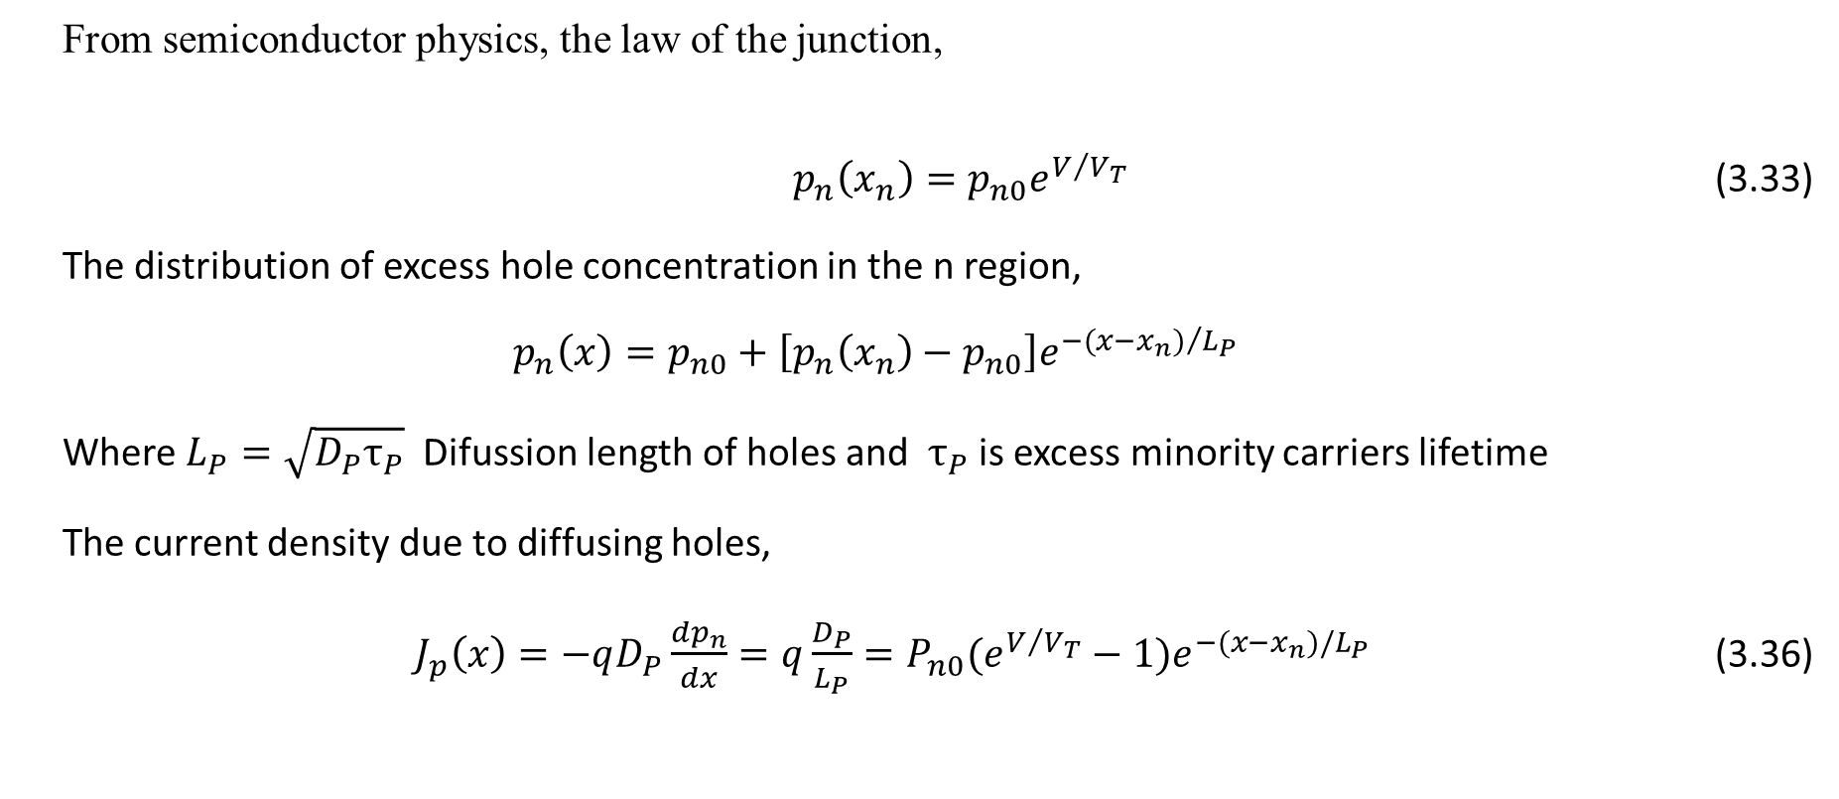
The Current – Voltage Relationship
    From semiconductor physics, the law of the junction,
    $p_{n}\left(x_{n}\right)=p_{n0}e^{V/{V_{T}}}$ (3.33)
    The distribution of excess hole concentration in the n region,
    $$p_{n}\left(x\right)=p_{n0}+\left[p_{n}\left(x_{n}\right)−p_{n0}\right]e^{−{(x−x_{n})}/{L_{P}}}$$
    Where $L_{P}=\sqrt{D_{P}τ_{P}}$ Difussion length of holes and $τ_{P}$ is excess minority carriers lifetime
    The current density due to diffusing holes,
    $J_{p}\left(x\right)=−qD_{P}\frac{{dp}_{n}}{dx}=q\frac{D_{P}}{L_{P}}=P_{n0}(e^{V/{V_{T}}}−1)e^{−(x−x_{n})/L_{P}}$ (3.36)

Slide 35
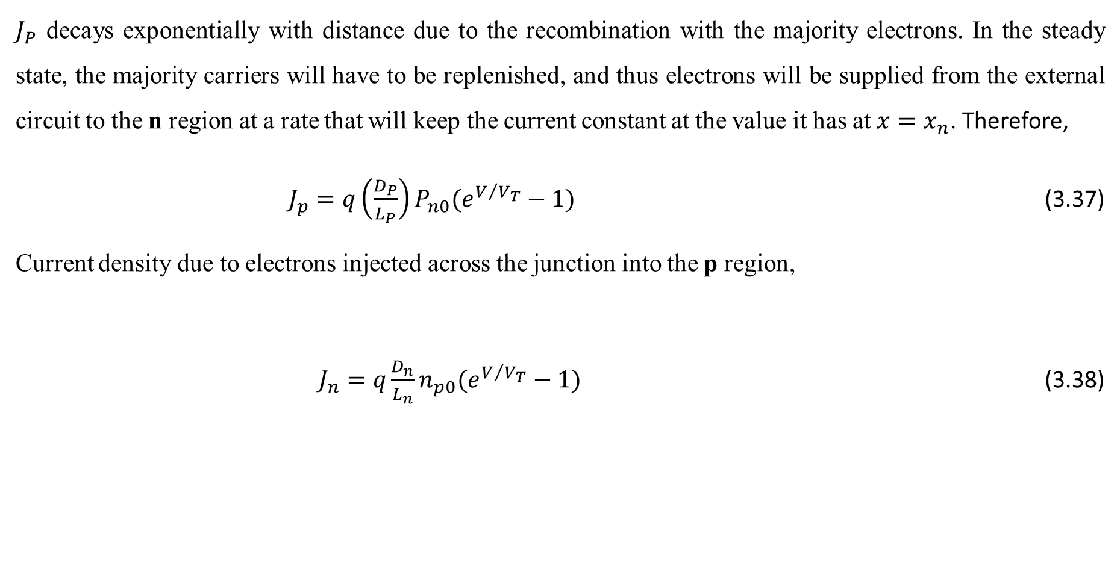
$J_{P}$ decays exponentially with distance due to the recombination with the majority electrons. In the steady state, the majority carriers will have to be replenished, and thus electrons will be supplied from the external circuit to the n region at a rate that will keep the current constant at the value it has at $x=x_{n}$. Therefore,
$J_{p}=q\left(\frac{D_{P}}{L_{P}}\right)P_{n0}(e^{V/{V_{T}}}−1)$ (3.37)
Current density due to electrons injected across the junction into the p region,
$J_{n}=q\frac{D_{n}}{L_{n}}n_{p0}(e^{V/{V_{T}}}−1)$ (3.38)

Slide 36
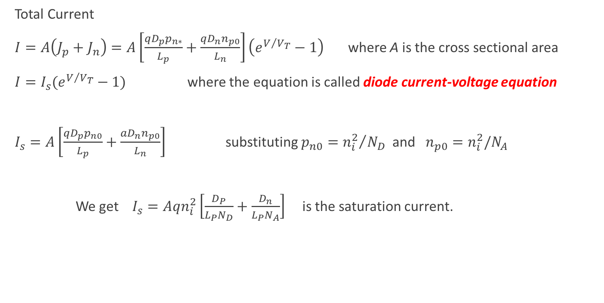
Total Current
$I=A\left(J_{p}+J_{n}\right)=A\left[\frac{{qD}_{p}p_{n∗}}{L_{p}}+\frac{{qD}_{n}n_{p0}}{L_{n}}\right]\left(e^{V/{V_{T}}}−1\right)$ where A is the cross sectional area
$I=I_{s}(e^{V/{V_{T}}}−1)$ where the equation is called diode current-voltage equation
$I_{s}=A\left[\frac{{qD}_{p}p_{n0}}{L_{p}}+\frac{{aD}_{n}n_{p0}}{L_{n}}\right]$ substituting $p_{n0}={n_{i}^{2}}/{N_{D}}$ and $n_{p0}=n_{i}^{2}/N_{A}$
We get $I_{s}=Aqn_{i}^{2}\left[\frac{D_{P}}{L_{P}N_{D}}+\frac{D_{n}}{L_{P}N_{A}}\right]$ is the saturation current.

