Slide 1
Bipolar junction (BJT) Transistors
Lecture-4

Slide 2
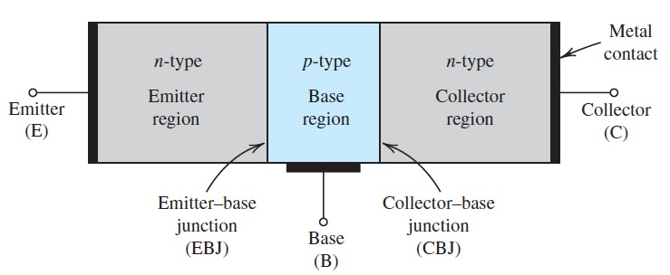
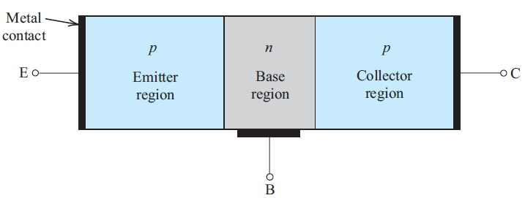
1. BJT Devices
As shown in the Fig. 5.1 the BJT transistor consist of three semiconductor regions: the emitter region (n type), The base region (p type), and the collector region (n type). Such a transistor is called an npn transistor. Another transistor, a dual of npn as shown in Fig. 5.3, has a p-type emitter, an n-type base, and a p-type collector, and is appropriatelly called pnp transistor
Fig.5.2 pnp type transistor
Fig.5.1 npn type transistor

Slide 3
The transistor consist of two pn junjtions, the emitter-base junction (EBJ) and the collector-base junction (CBJ). Depending on bias condition (forward or reverse) of each of these junction, different modes of operation of the BJT are obtained, as shown in Table 5.1.
The active mode, which is also called forward active mode, is the one used if the transistor is to operate as an amplifier. Switching applications utilize both the cutt off mode and the saturation mode.
Mode | EBJ | CBJ
Cutoff | Reverse | Reverse
Active | Forward | Reverse
Saturation | Forward | Forward
Table 5.1

Slide 4
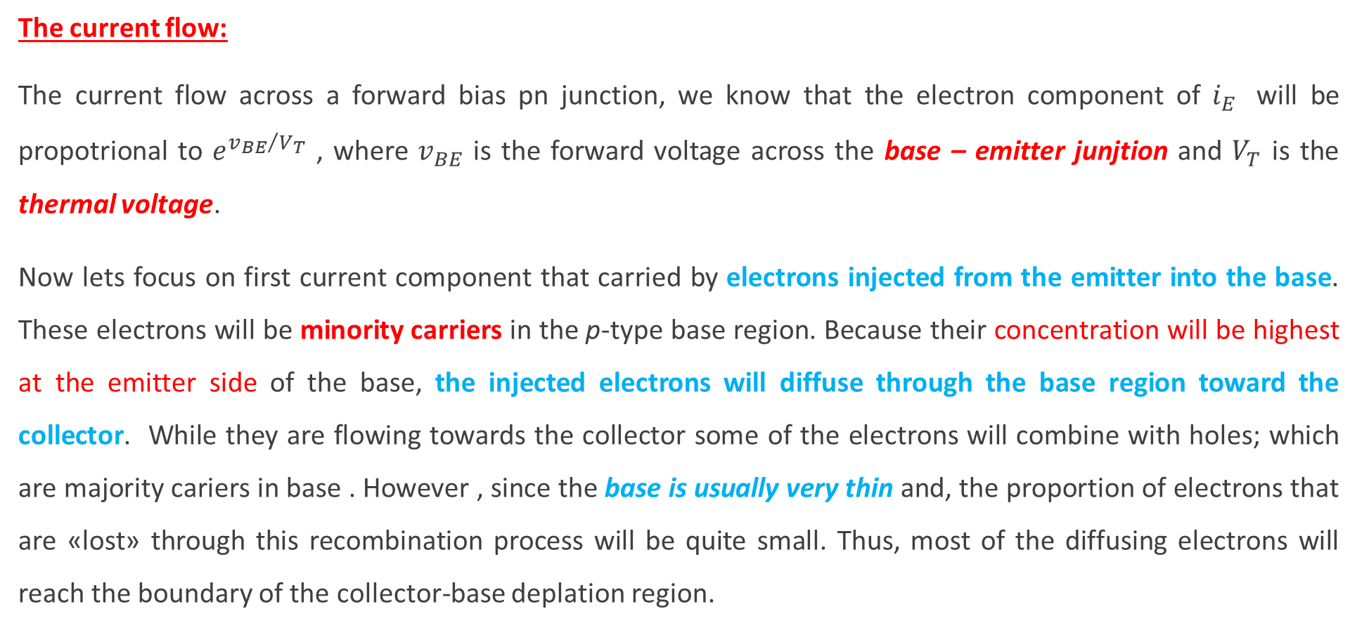
Operation of the npn Transistor in the Active Mode
The current flow:
The current flow across a forward bias pn junction, we know that the electron component of $i_{E}$ will be propotrional to $e^{{v_{BE}}/{V_{T}}}$ , where $v_{BE}$ is the forward voltage across the base – emitter junjtion and $V_{T}$ is the thermal voltage.
Now lets focus on first current component that carried by electrons injected from the emitter into the base. These electrons will be minority carriers in the p-type base region. Because their concentration will be highest at the emitter side of the base, the injected electrons will diffuse through the base region toward the collector. While they are flowing towards the collector some of the electrons will combine with holes; which are majority cariers in base . However , since the base is usually very thin and, the proportion of electrons that are «lost» through this recombination process will be quite small. Thus, most of the diffusing electrons will reach the boundary of the collector-base deplation region.

Slide 5
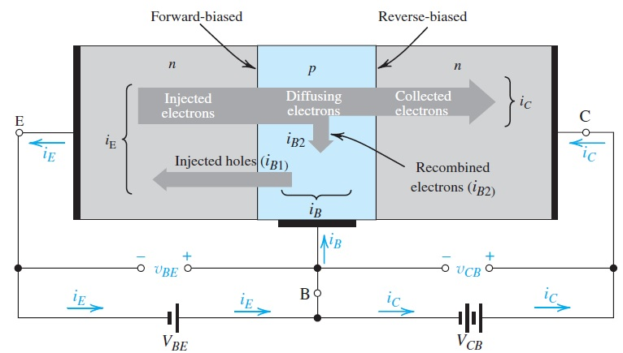
Because the collector is more positive than the base these successful electrons will be swept across the CBJ deplation region in to the collector. They will thus get collected and constitute the collector $i_{C}$
Fig. 5.3 Current flow in an npn transistor biased to operateing the active mode.

Slide 6

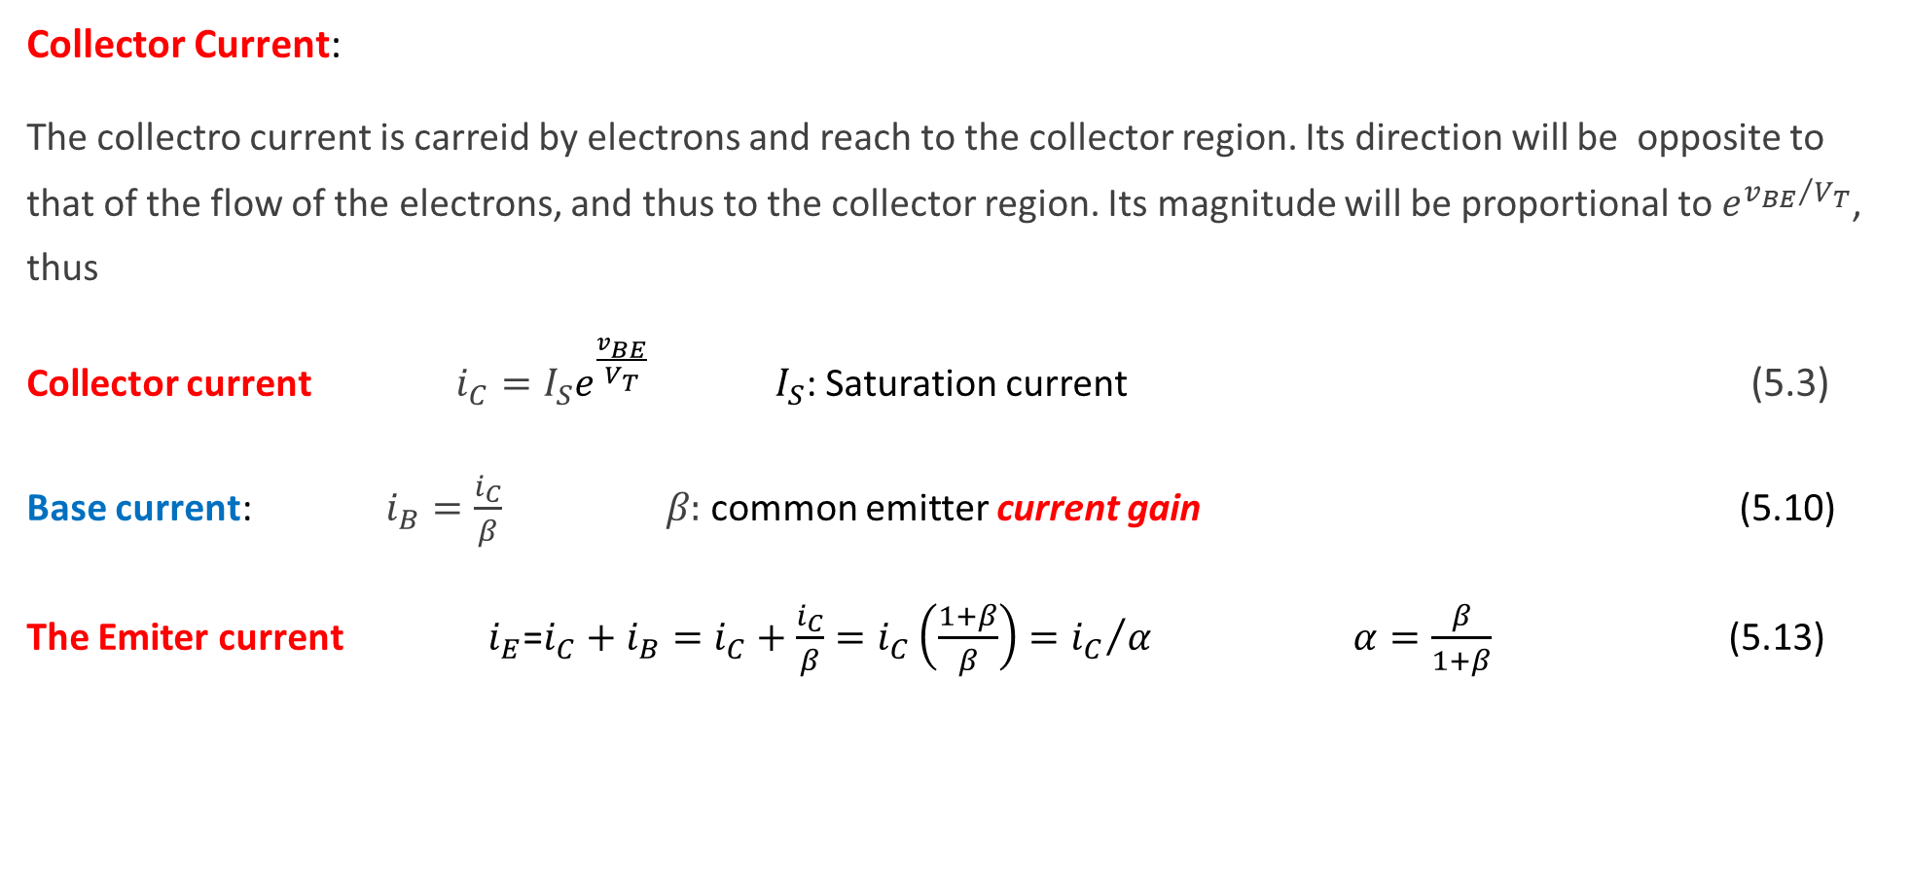
Collector Current:
The collectro current is carreid by electrons and reach to the collector region. Its direction will be opposite to that of the flow of the electrons, and thus to the collector region. Its magnitude will be proportional to $e^{{v_{BE}}/{V_{T}}}$, thus
Collector current $i_{C}=I_{S}e^{\frac{v_{BE}}{V_{T}}}$ $I_{S}$: Saturation current (5.3)
Base current: $i_{B}=\frac{i_{C}}{β}$ 𝛽: common emitter current gain (5.10)
The Emiter current $i_{E}$=$i_{C}+i_{B}=i_{C}+\frac{i_{C}}{β}=i_{C}\left(\frac{1+β}{β}\right)={i_{C}}/α$ $α=\frac{β}{1+β}$ (5.13)
β is in the range 50 to 200
$α$ is the common base current gain

Slide 7
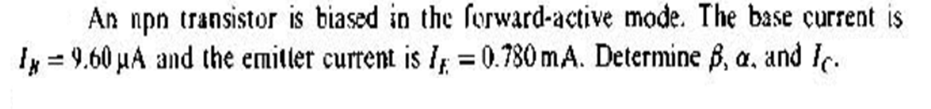
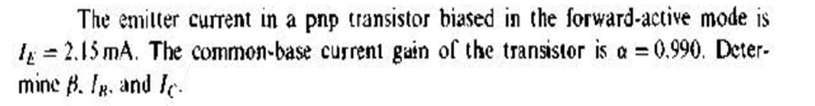
Practice Problem 4.1

Slide 8
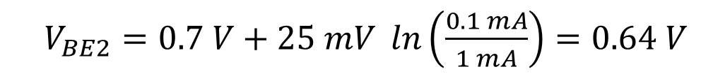
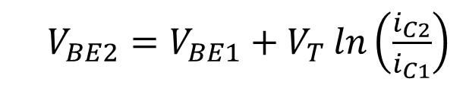
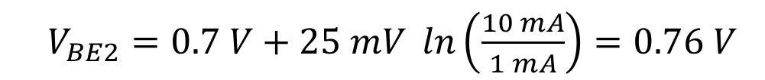
Consider an npn transistor with v_{BE} = 0.7 V at i _{C} = 1 mA. Find v_{BE} at i _{C} = 0.1 mA and 10 mA
$V_{BE2}=V_{BE1}+V_{T}\ln\left(\frac{i_{C2}}{i_{C1}}\right)$
Do you know how to derive it?
$V_{BE2}=0.7 V+25 mV \ln\left(\frac{0.1 mA}{1 mA}\right)=0.64 V$
$V_{BE2}=0.7 V+25 mV \ln\left(\frac{10 mA}{1 mA}\right)=0.76 V$

Slide 9
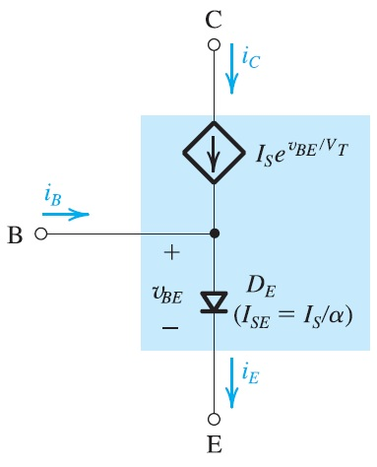
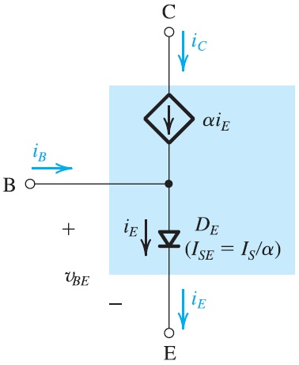
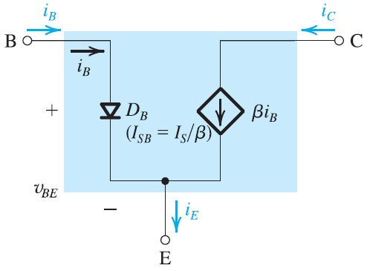
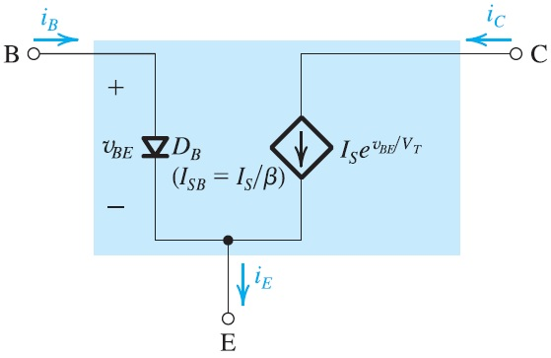
Large-signal equivalent-circuit models of the npn BJT operating in the forward active mode.

Slide 10
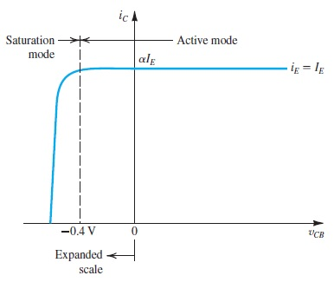
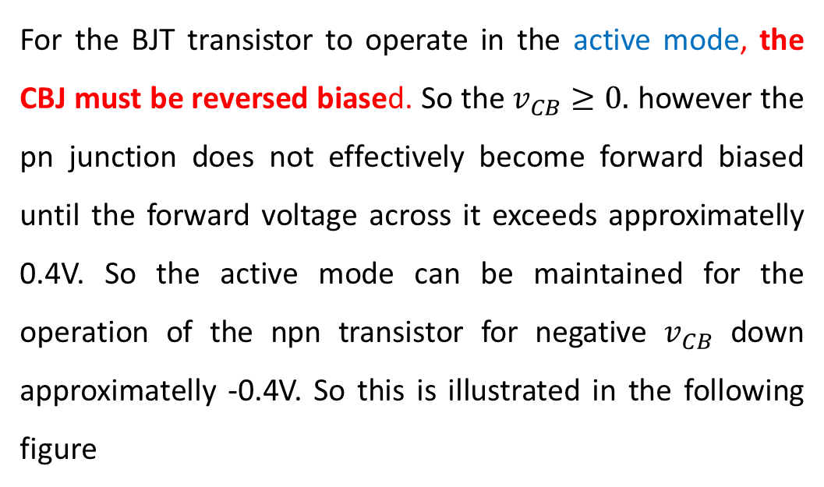

For the BJT transistor to operate in the active mode, the CBJ must be reversed biased. So the $v_{CB}≥0.$ however the pn junction does not effectively become forward biased until the forward voltage across it exceeds approximatelly 0.4V. So the active mode can be maintained for the operation of the npn transistor for negative $v_{CB}$ down approximatelly -0.4V. So this is illustrated in the following figure
The i_{c}-v_{CB} characteristic of an npn transistor fed with a constant emitter current I_{E} .
The transistor enters the saturation mode of operation for v_{CB} < −0.4 V, and the collector current diminishes.
Fig.5.9 $i_{C}−v_{CB}$Characteristic
IC is independent of vCB in the active mode

Slide 11

Operation in the Saturation Mode
For v_{CB} going negative to approximately −0.4 V, below this value of v_{CB} , the CBJ begins to conduct sufficiently that the transistor leaves the active mode and enters the saturation mode of operation, where I_{C} decreases.
We observe that this ratio will be lower than the value of β. Furthermore, the ratio will decrease as v_{BC} is increased and the transistor is driven deeper into saturation.
Because (i_{C}/i_{B} ), of a saturated transistor can be set to any desired value lower than β by adjusting v _{BC},
this ratio is known as forced β and denoted β _{forced} .

Slide 12
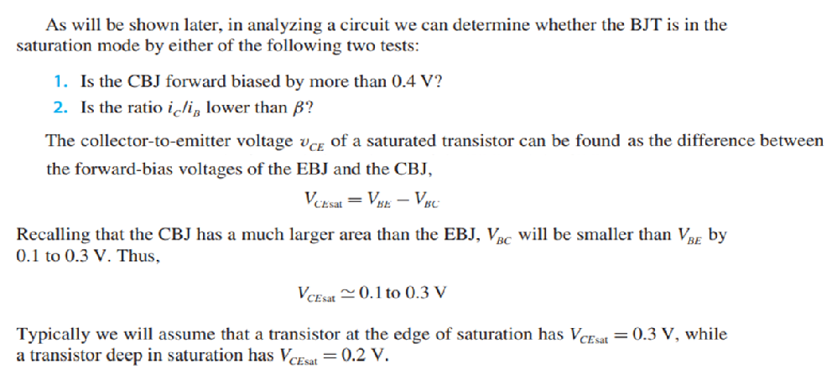

Slide 13
2. Current –voltage characteristic
Fig. 5.13 Circuit symbols for BJT transistors
Fig. 5.14 Voltage polarities and current flow in a transistor operating in active region

Slide 14
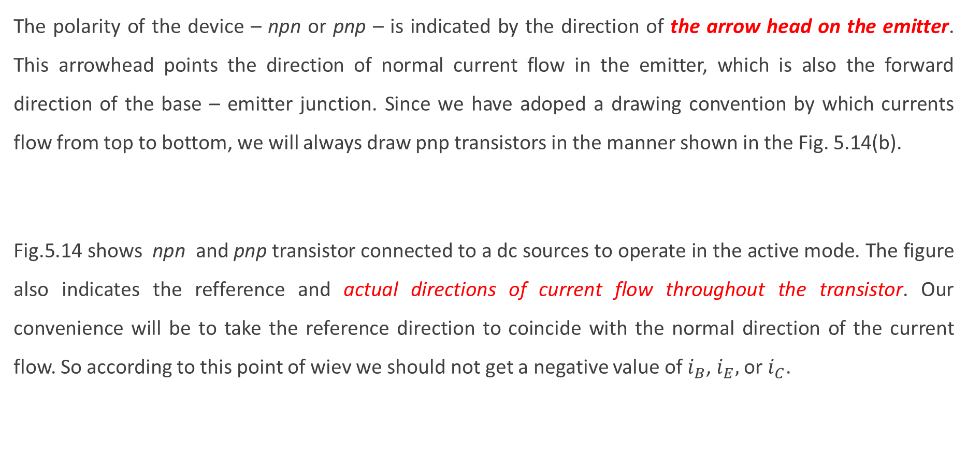
The polarity of the device – npn or pnp – is indicated by the direction of the arrow head on the emitter. This arrowhead points the direction of normal current flow in the emitter, which is also the forward direction of the base – emitter junction. Since we have adoped a drawing convention by which currents flow from top to bottom, we will always draw pnp transistors in the manner shown in the Fig. 5.14(b).
Fig.5.14 shows npn and pnp transistor connected to a dc sources to operate in the active mode. The figure also indicates the refference and actual directions of current flow throughout the transistor. Our convenience will be to take the reference direction to coincide with the normal direction of the current flow. So according to this point of wiev we should not get a negative value of $i_{B}$, $i_{E},$ or $i_{C}$.

Slide 15
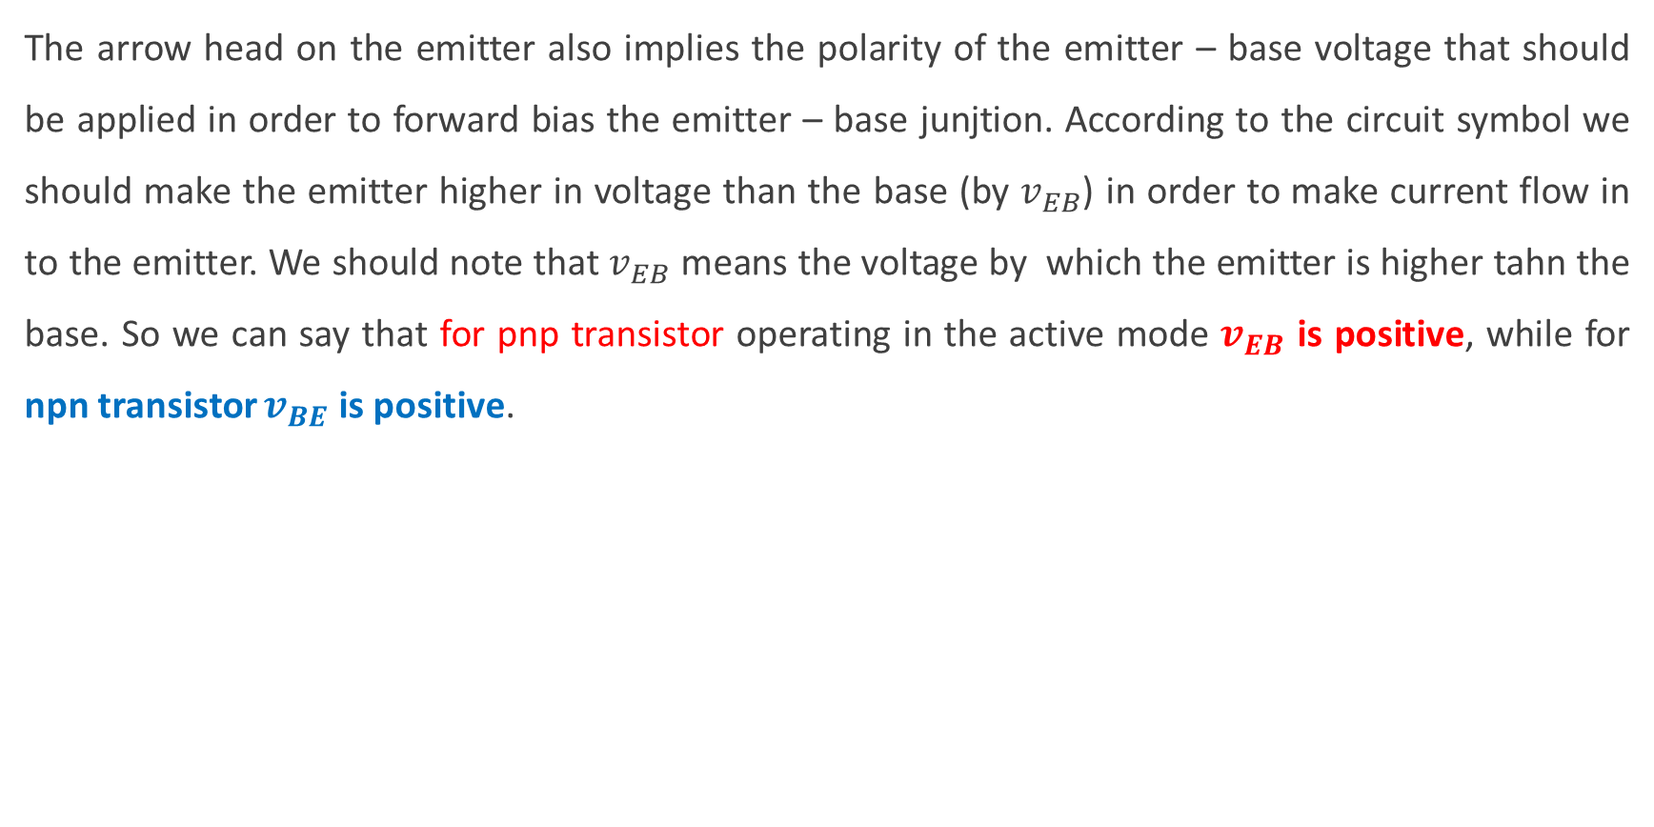
The arrow head on the emitter also implies the polarity of the emitter – base voltage that should be applied in order to forward bias the emitter – base junjtion. According to the circuit symbol we should make the emitter higher in voltage than the base (by $v_{EB}$) in order to make current flow in to the emitter. We should note that $v_{EB}$ means the voltage by which the emitter is higher tahn the base. So we can say that for pnp transistor operating in the active mode $v_{EB}$ is positive, while for npn transistor $v_{BE}$ is positive.

Slide 16
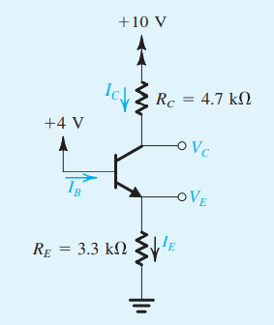







Example 4.1
Determine all node voltages and branch currents. We will assume that β =100
Solution 4.1
Assuming that V _{BE} is approximately 0.7 V
The emitter voltage will be
The emitter current I_{E}
We can evaluate the collector current from
The value of α is obtained from
The collector current I_{C}
We are now in a position to use Ohm’s law
to determine the collector voltage V_{C}
The base current I_{B}

Slide 17

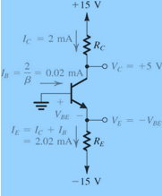
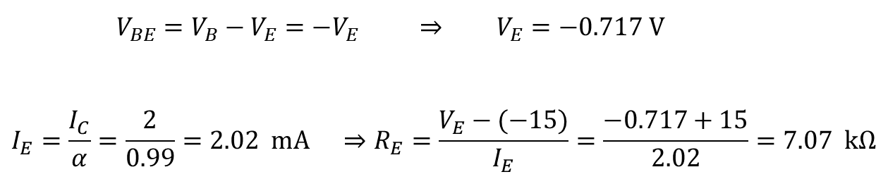
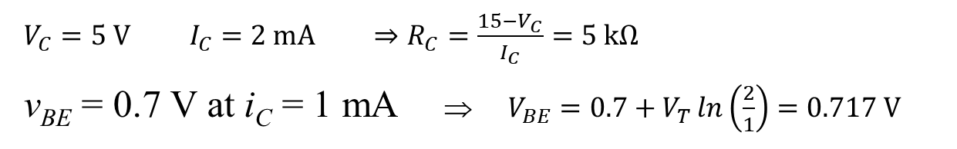
Example 4.2
The transistor in the circuit below has β = 100 and exibits a v_{BE} of 0.7 V at i_{C} = 1 mA. Design, the circuit so that a current of 2 mA flows through the collector and a voltage of +5 V appears at the collector.
Solution 4.2
$V_{C}=5 \text{V} I_{C}=2 \text{mA}$ $⇒R_{C}=\frac{15−V_{C}}{I_{C}}=5 \text{k}Ω$
v_{BE} = 0.7 V at i_{C} = 1 mA ⇒ $V_{BE}=0.7+V_{T}\ln\left(\frac{2}{1}\right)=0.717 \text{V}$
$V_{BE}=V_{B}−V_{E}=−V_{E} ⇒ V_{E}=−0.717 \text{V}$
$$I_{E}=\frac{I_{C}}{α}=\frac{2}{0.99}=2.02 \text{mA} ⇒R_{E}=\frac{V_{E}−(−15)}{I_{E}}=\frac{−0.717+15}{2.02}=7.07 \text{k}Ω$$

Slide 18
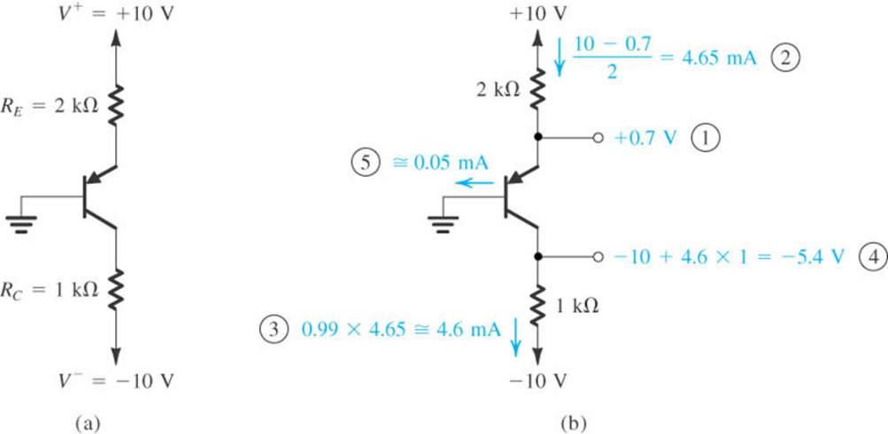
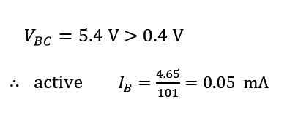
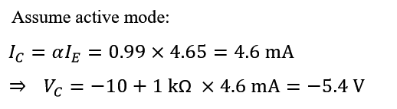

Example 4.3
Determine all node voltages and branch currents.
Write if the transistors are operating in cut-off, saturation or active region
β = 100
Solution 4.6

Slide 19
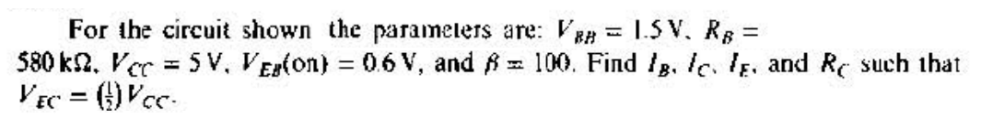
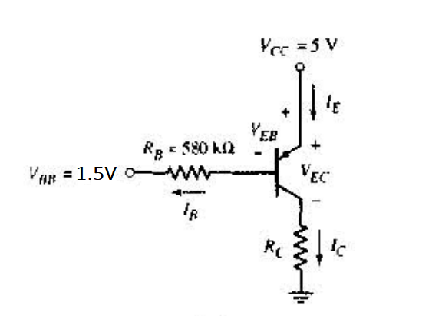
Practice Problem 4.2

Slide 20
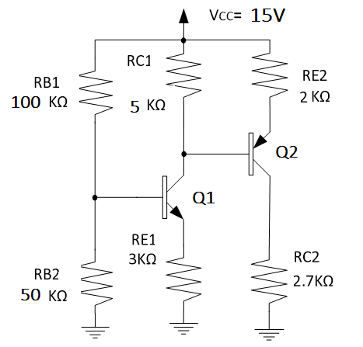
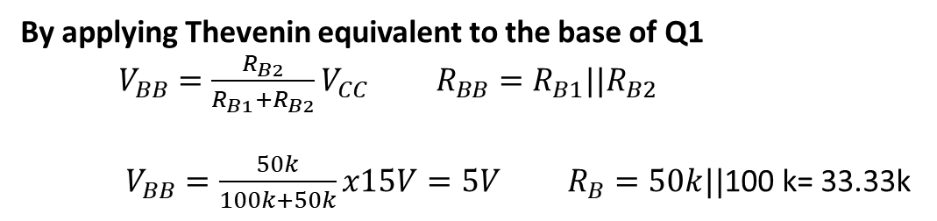
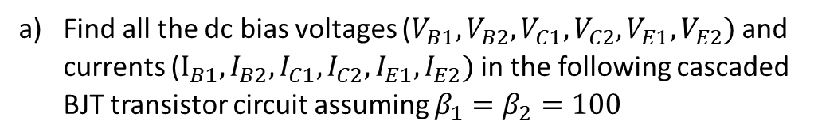
Example 4.4
For the following BJT transistor circuit.
Find all the dc bias voltages ($V_{B1}, V_{B2}, V_{C1}, V_{C2}, V_{E1}, V_{E2})$ and currents ($I_{B1}, I_{B2}, I_{C1}, I_{C2}, I_{E1}, I_{E2})$ in the following cascaded BJT transistor circuit assuming $β_{1}=β_{2}=100$
b) Write if the transistors are operating in cut-off, saturation or active region
Solution 4.4
a)
By applying Thevenin equivalent to the base of Q1
$V_{BB}=\frac{R_{B2}}{R_{B1}+R_{B2}}V_{CC} R_{BB}=R_{B1}||R_{B2}$
$V_{BB}=\frac{50k}{100k+50k}x15V=5V R_{B}=50k||$100 k= 33.33k

Slide 21
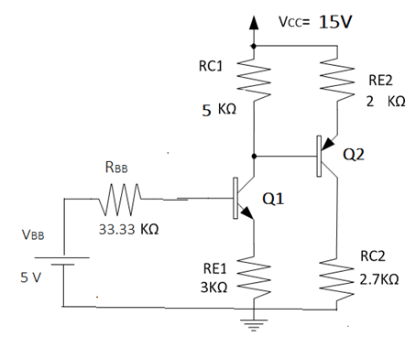
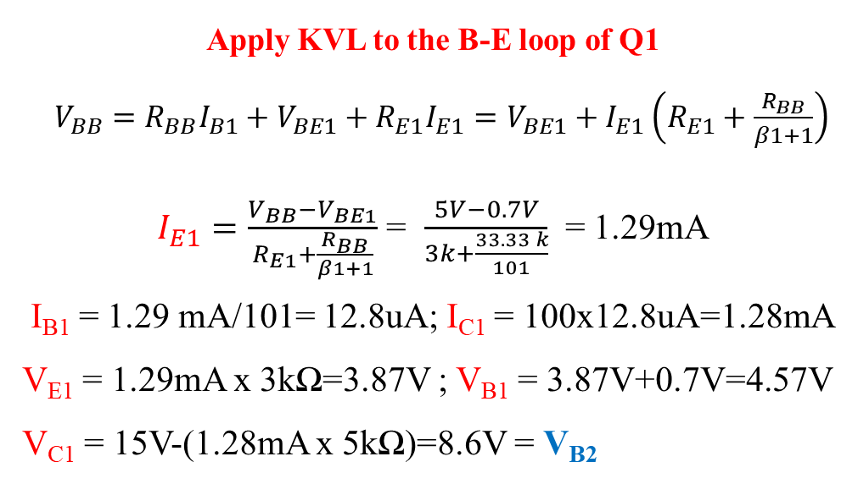
Apply KVL to the B-E loop of Q1
$V_{BB}=R_{BB}I_{B1}+V_{BE1}+R_{E1}I_{E1}=V_{BE1}+I_{E1}\left(R_{E1}+\frac{R_{BB}}{β1+1}\right)$ $I_{E1}=\frac{V_{BB}−V_{BE1}}{R_{E1}+\frac{R_{BB}}{β1+1}}$ = $\frac{5V−0.7V}{3k+\frac{33.33 k}{101}}$ = 1.29mA
I_{B1} = 1.29 mA/101= 12.8uA; I_{C1} = 100x12.8uA=1.28mA
V_{E1} = 1.29mA x 3kΩ=3.87V ; V_{B1} = 3.87V+0.7V=4.57V
V_{C1} = 15V-(1.28mA x 5kΩ)=8.6V = V_{B2}
V_{E2} = V_{C1} + 0.7 V = 8.6V+0.7 V= 9.3 V; I_{E2} = $\frac{15V−9.3V}{2k}$ = 2.85 mA ; I_{B2} = 2.85 mA/101= 28.2uA and
I_{C2} = 100 x 28.uA=2.82mA ; V_{C2} = 2.82 mA x 2.7k = 7.62V

Slide 22
b)
V_{CE1} = V_{C1 –} V_{E1} = 8.6V – 3.87 V= 4.73 V $→ Q1 is at active mode$
V_{EC2} = V_{E2 –} V_{C2} = 9.3 V – 7.62 V = 1.68 V $→ Q2 is at active mode$

Slide 23
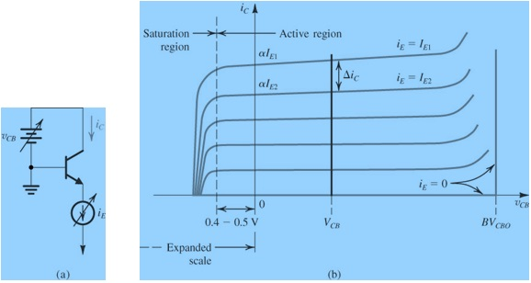

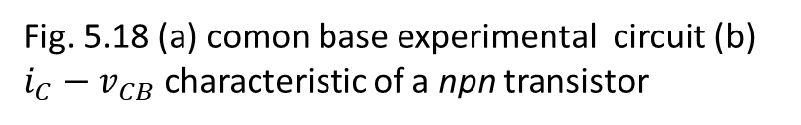
The Common-Base Characteristics (i_{C} – v_{CB})
One way to explain the operation of the transistor is to plot $i_{C}$ versus $v_{CB}$ for various values of $i_{E}$. In Fig. 5.18 the base voltage is kept constant on ground level. Here the base serves as common terminal between the input and the output terminal. So the resulting characteristics are known as the common base characteristics.
Fig. 5.18 (a) comon base experimental circuit (b) $i_{C}−v_{CB}$ characteristic of a npn transistor

Slide 24
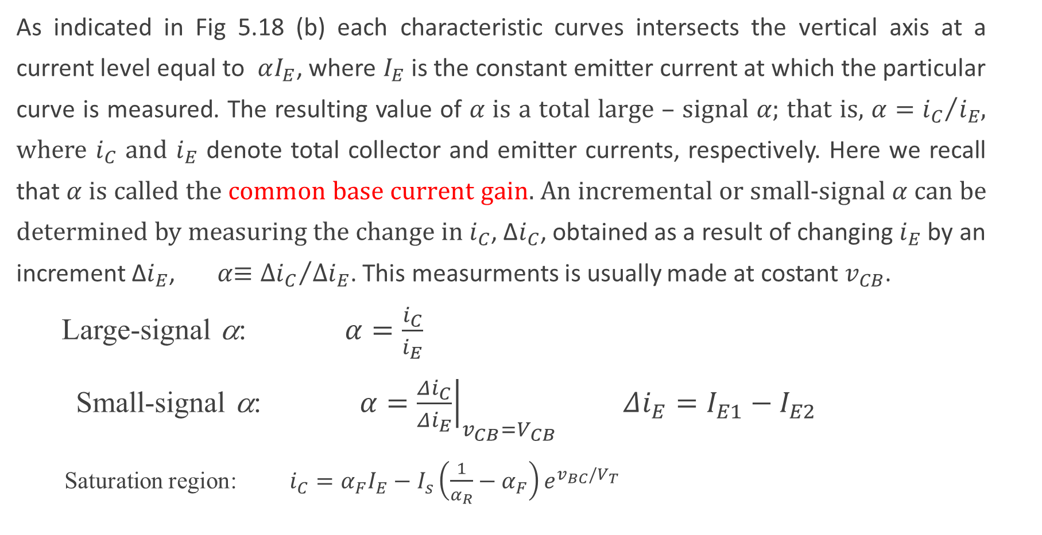
As indicated in Fig 5.18 (b) each characteristic curves intersects the vertical axis at a current level equal to $αI_{E}$, where $I_{E}$ is the constant emitter current at which the particular curve is measured. The resulting value of 𝛼 is a total large – signal 𝛼; that is, $α={i_{C}}/{i_{E}}$, where $i_{C}$ and $i_{E}$ denote total collector and emitter currents, respectively. Here we recall that 𝛼 is called the common base current gain. An incremental or small-signal 𝛼 can be determined by measuring the change in $i_{C}$, Δ$i_{C}$, obtained as a result of changing $i_{E}$ by an increment Δ$i_{E}$, 𝛼$≡{{Δi}_{C}}/{{Δi}_{E}}$. This measurments is usually made at costant $v_{CB}$.
Large-signal α: $α=\frac{i_{C}}{i_{E}}$
Small-signal α: $α={\left.\frac{Δi_{C}}{Δi_{E}}\right|}_{v_{CB}=V_{CB}} Δi_{E}=I_{E1}−I_{E2}$
Saturation region: $i_{C}=α_{F}I_{E}−I_{s}\left(\frac{1}{α_{R}}−α_{F}\right)e^{v_{BC}/V_{T}}$

Slide 25
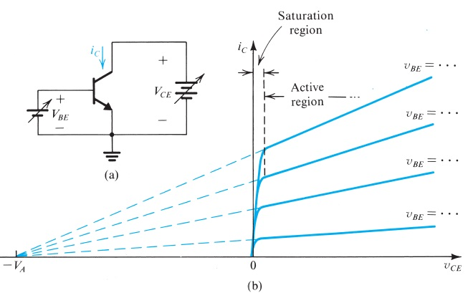
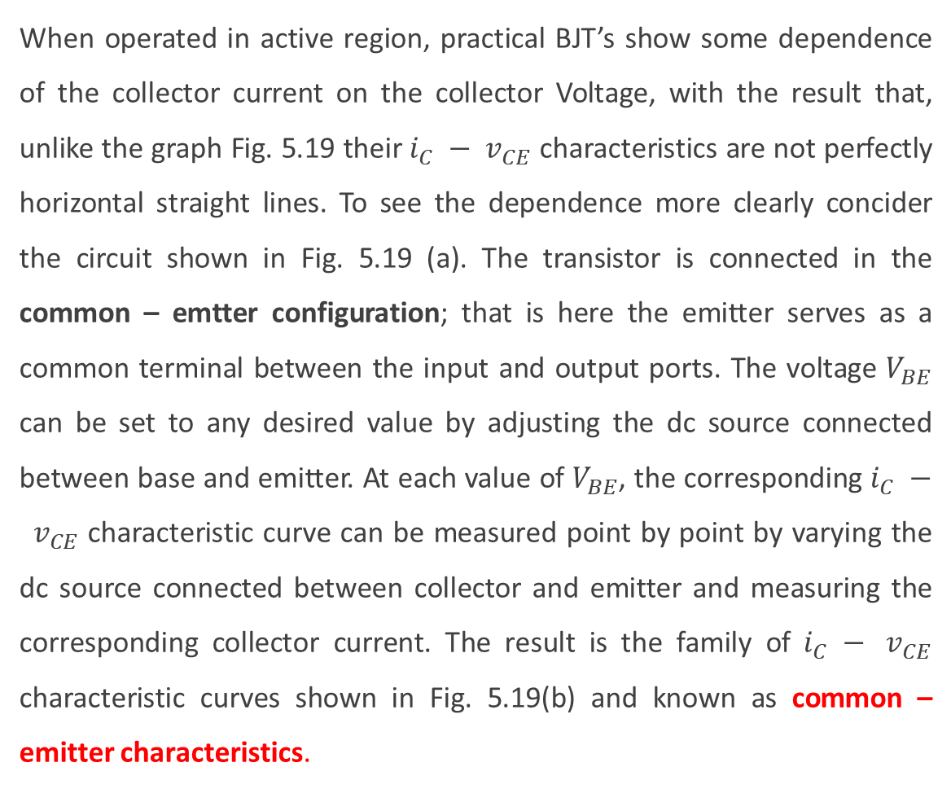
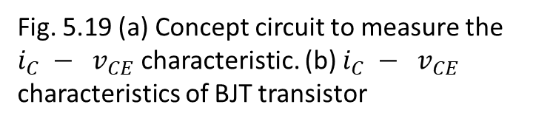
Dependence of $i_{C}$ on the Collector voltage – The Early Effect
When operated in active region, practical BJT’s show some dependence of the collector current on the collector Voltage, with the result that, unlike the graph Fig. 5.19 their $i_{C} − v_{CE}$ characteristics are not perfectly horizontal straight lines. To see the dependence more clearly concider the circuit shown in Fig. 5.19 (a). The transistor is connected in the common – emtter configuration; that is here the emitter serves as a common terminal between the input and output ports. The voltage $V_{BE}$ can be set to any desired value by adjusting the dc source connected between base and emitter. At each value of $V_{BE}$, the corresponding $i_{C} − v_{CE}$ characteristic curve can be measured point by point by varying the dc source connected between collector and emitter and measuring the corresponding collector current. The result is the family of $i_{C} − v_{CE}$ characteristic curves shown in Fig. 5.19(b) and known as common – emitter characteristics.
Fig. 5.19 (a) Concept circuit to measure the $i_{C} − v_{CE}$ characteristic. (b) $i_{C} − v_{CE}$ characteristics of BJT transistor

Slide 26


The collector current
$i_{C}=I_{s}e^{v_{BE}/V_{T}}\left(1+\frac{v_{CE}}{V_{A}}\right)$ (5.36)
The voltage $V_{A}$ is a positive number and it is a parameter for the particular BJT, with typical values in the range of 10 to 100V. $V_{A}$ is called Early voltage.
Output resistance: $r_{o}={\left[{\left.\frac{∂i_{C}}{∂v_{CE}}\right|}_{v_{BE}=const.}\right]}^{−1}$ (5.37)
$r_{o}=\frac{V_{A}+V_{CE}}{I_{C}}$ (5.38)
$r_{o}=\frac{V_{A}}{I_{C}^{′}}$ (5.38a)
where

Slide 27
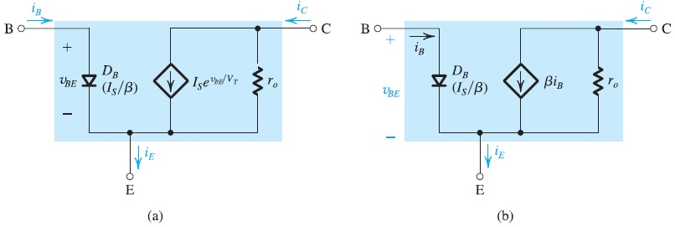
Fig. 5.20 Large signal equivalent model for a BJT npn transistor operating in active region including $r_{O}$

Slide 28
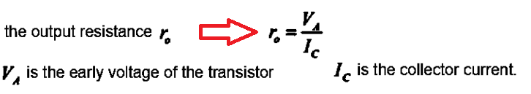

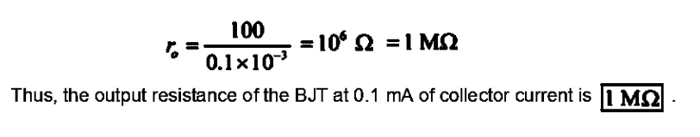
Example 4.3
Find the output resistance of a BJT for which V_{A} = 100 V at I_{C} = 0.1mA
Solution 4.2

Slide 29
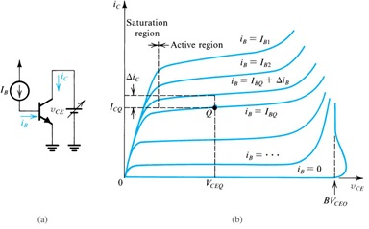

Comon emitter characteristics
An alternative way of expressing the transistor common – emitter characteristics is illutrated in fig 5:21. The base current $i_{B}$ rather than the base - emitter voltage $v_{BE}$ as a parameter. That is each $i_{C}−v_{CE}$ curve is measured with constant current $i_{B}$
Fig. 5.21 Common emitter characteristics

Slide 30
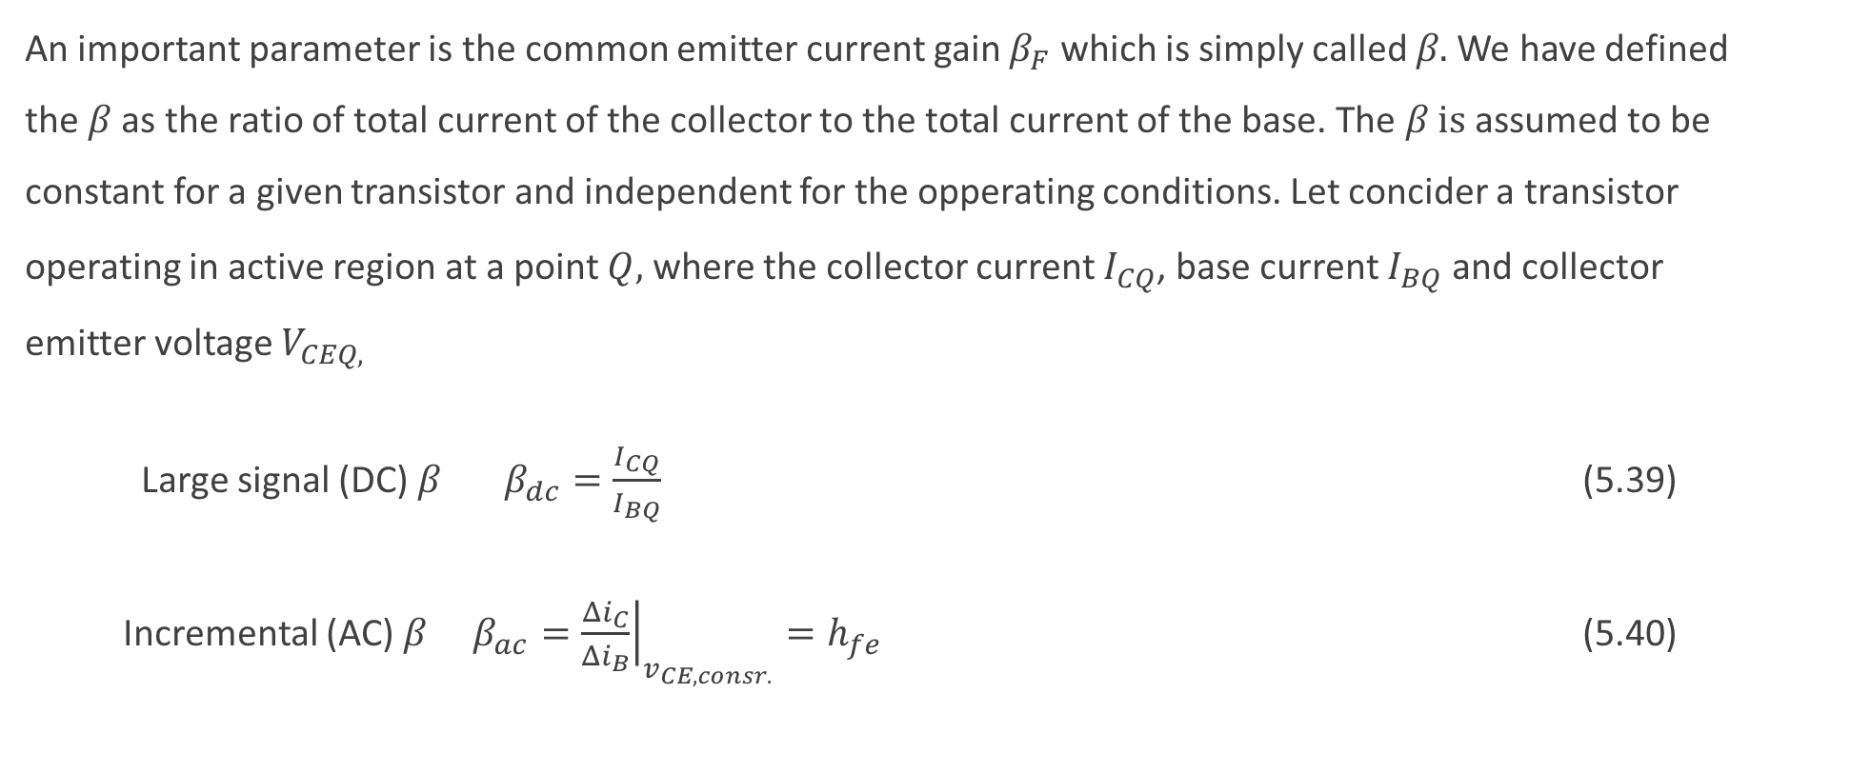
The Common - Emitter Current Gain 𝛽
An important parameter is the common emitter current gain $β_{F}$ which is simply called 𝛽. We have defined the 𝛽 as the ratio of total current of the collector to the total current of the base. The 𝛽 is assumed to be constant for a given transistor and independent for the opperating conditions. Let concider a transistor operating in active region at a point $Q,$ where the collector current $I_{CQ}$, base current $I_{BQ}$ and collector emitter voltage $V_{CEQ,}$
Large signal (DC) 𝛽 $β_{dc}=\frac{I_{CQ}}{I_{BQ}}$ (5.39)
Incremental (AC) 𝛽 $β_{ac}={\left.\frac{{Δi}_{C}}{{Δi}_{B}}\right|}_{v_{CE,consr.}}=h_{fe}$ (5.40)

Slide 31
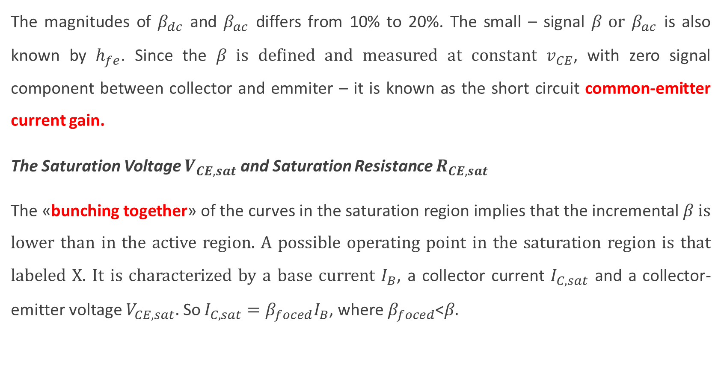
The magnitudes of $β_{dc}$ and $β_{ac}$ differs from 10% to 20%. The small – signal 𝛽 or $β_{ac}$ is also known by $h_{fe}$. Since the 𝛽 is defined and measured at constant $v_{CE}$, with zero signal component between collector and emmiter – it is known as the short circuit common-emitter current gain.
The Saturation Voltage $V_{CE,sat}$ and Saturation Resistance $R_{CE,sat}$
The «bunching together» of the curves in the saturation region implies that the incremental 𝛽 is lower than in the active region. A possible operating point in the saturation region is that labeled X. It is characterized by a base current $I_{B}$, a collector current $I_{C,sat}$ and a collector-emitter voltage $V_{CE,sat}.$ So $I_{C,sat}=β_{foced}I_{B}$, where $β_{foced}$<𝛽.

Slide 32
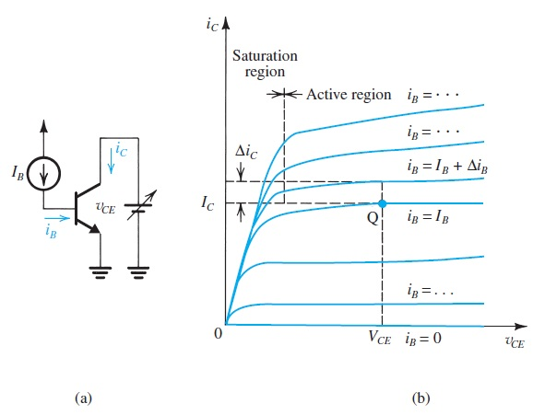
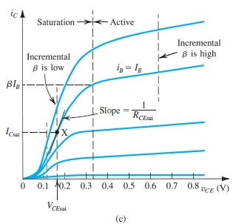
Fig.5.23 common emitter characteristic (a) Basic C. E. circuit (b) Expanded scale to Show some detail in saturation region (c) A much greater expansion is seen on c

Slide 33

Since $I_{C,sat}$ is established by the designer, a saturated transistor is said to be operating at a forced 𝛽 given by, $β_{forced}=\frac{I_{C,sat}}{I_{B}}$ (5.41)
Thus, $β_{forced}<$ $β_{F}$ (5.42)
The ratio of $β_{F}$ to $β_{forced}$ is known as the overdrive factor. The greater the overdrive factor, the deeper the transistor is driven in to saturation and the lower $V_{CE,sat}$ becomes.
The $i_{C} − v_{CE}$ curves in saturation are rather steep, indicating that the saturated transistor exhibits a low collector—to-emitter resistance $R_{CE,sat}$
$R_{CE,sat}≡{\left.\frac{{∂v}_{CE}}{{∂i}_{B}}\right|}_{\begin{aligned}i_{B}=I_{B} \\ i_{C}=I_{C,sat}\end{aligned}}$ (5.43)
Typically, $R_{CE,,sat}$ ranges from few ohms to few tens of ohms.

Slide 34

Transistor operated in saturation mode with a constant base current I_{B}.

Slide 35



Example 4.4
For the circuit shown below, it is required to determine the value of the voltage VBB that results in the transistor operating (a) in the active mode with V_{CE} = 5 V (b) at the edge of saturation (c) deep in saturation with β _{forced} = 10. For simplicity, assume that VBE remains constant at 0.7 V. The transistor β is specified to be 50.
Solution 4.2

Slide 36




Slide 37

3. BJT as an Amplifier and as a Switch
Large signal operation and transfer characteristic
There are two major application areas of transistor; as an amplifier, and as a digital circuit switch. When BJT operated in active mode, it act as a voltage-controlled current source. Changes in the base-emitter voltage $v_{BE}$ give rise to changes in the collector current $i_{C}$. So, in the active mode the BJT can be used to implement a transconductance amplifier. Voltage amplification can be obtained simply by passing the collector current through a resistance $R_{C}$.
1. Cutoff Region: $v_{1}=v_{BE}<0.5V$ transistor in cutoff $v_{0}=V_{CC}$
2. Active region: Load line equation: $v_{O}=v_{CE}=V_{CC}−R_{C}i_{C}$ (5.50)
$i_{C}=I_{s}e^{v_{BE}/V_{T}} ⇒ v_{O}=v_{CE}=V_{CC}−R_{C}I_{s}e^{v_{I}/V_{T}}$ (5.51)
3. Saturation region: $v_{CE}<0.4V$

Slide 38



Fig. 5.26 (a) Basic Common-emitter amplifier circuit (b) Transfer characteristic of the circuit operated at point Q

Slide 39

Small Signal Amplifier Gain
To operate the transistor as a linear amplifier, it must be biased at a point in active region. Fig.5.26(b) shows such a bias point, labeled Q and characterized by a dc base – emitter voltage $V_{BE}$ and a dc collector-emitter voltage $V_{CE}$. If the collector current at this value of $V_{BE}$ is denoted $I_{C}$ that is,
Q-point: $V_{CE}, V_{BE}, I_{C} ⇒$ $I_{C}=I_{S}e^{{V_{BE}}/{V_{T}}}$ (5.53)
$V_{CE}=V_{CC}−R_{C}I_{C}$ (5.54)
Small-signal gain:
$A_{v}={\left.\frac{dv_{O}}{dv_{I}}\right|}_{v_{I}=V_{BE}}$ (5.55)
$⇒ \frac{dv_{O}}{dv_{I}}=−\frac{R_{C}I_{s}}{V_{T}}e^{v_{I}/V_{T}}$ $A_{v}=−\frac{R_{C}I_{s}}{V_{T}}e^{V_{BE}/V_{T}}=−\frac{R_{C}I_{C}}{V_{T}}$ = $−\frac{V_{CC} −V_{CE}}{V_{T}}$ (5.56)

Slide 40



The expression is used to obtain the small-signal voltage gain of the BJT amplifier
We see that maximum gain is achieved when V_{CE} is at its minimum value of about 0.3 V,

Slide 41




Example 4.5
Consider an amplifier circuit using a BJT having I_{S} = 10 ⁻¹⁵ A, a collector resistance R_{C} = 6.8 kΩ, and a power supply V_{CC} = 10 V
(a) Determine the value of the bias voltage V _{BE} required to operate the transistor at V_{CE} = 3.2 V. What is the corresponding value of I_{C}?
(b) Find the voltage gain Av at this bias point. If an input sine-wave signal of 5-mV peak amplitude is superimposed on V _{BE}, find the amplitude of the output sine-wave signal (assume linear operation).
Solution 4.5

Slide 42

Practice Problem 4.3

Slide 43


Graphical Analysis
Consider the follofing circuit.
Fig. 5.28 Grafical constuction for the determination of DC bias point of base current.
5.27 Basic amplifier to be analysed
Fig.5.29 Load line of BJT transistor

Slide 44

Lets concider the circuit in Fig. 5.27. First we have to find the dc bias point. Toward the end by setting $i_{B}=0$, the $I_{B}$ base current should be found. Then we should consider the $i_{C}−v_{CE}$ characteristic to find the operating point corresponding to the base current.
Load line: $v_{BE}=V_{BB}−R_{B}i_{B}$ Intersection with the input characteristic determines the quiescent point $I_{B},V_{BE}$ for the Fig. 5.28.
The load line for Fig. 5.29 can be foud by, $v_{CE}=V_{CC}−R_{C}i_{C}$ Intersection with the output characteristics determines the quiescent point $I_{C},V_{CE}$. Which we can write $i_{C}=\frac{V_{CC}−v_{CE}}{R_{C}}$ where
$i_{C}=\frac{V_{CC}}{R_{C}}−\frac{1}{R_{C}}v_{CE}$ which represents the linear relationship between $v_{CE}$ and $i_{C}$. $−\frac{1}{R_{C}}$ is known as the load line gradient.

Slide 45


Small signal operation
Fig. 5.30. Grafical representation of $i_{B}, v_{BE}, i_{C}, and v_{CE},$ when a signal component $v_{i}$is superimposed on the dc voltage $V_{BB}$

Slide 46

Input circuit: $v_{BB}=V_{BB}+v_{i} v_{i}: \text{small}\text{−}\text{signal} \text{input} \text{voltage} \text{to} \text{be} \text{amplified}\text{.}$
$⇒v_{BE}=V_{BE}+v_{be} v_{be}:\text{small}\text{−}\text{signal} \text{component} \text{of} \text{base}\text{−}\text{emitter} \text{voltage}\text{.}$
$⇒i_{B}=I_{B}+i_{b} i_{b}:\text{small}\text{−}\text{signal} \text{component} \text{of} \text{base} \text{current}\text{.}$
Output circuit: $⇒i_{C}=I_{C}+i_{c} i_{c}:\text{small}\text{−}\text{signal} \text{component} \text{of} \text{collector} \text{current}\text{.}$
$⇒v_{CE}=V_{CE}+v_{ce} v_{ce}:\text{small}\text{−}\text{signal} \text{component} \text{of} \text{collector}\text{−}\text{emitter} \text{voltage}\text{, }\text{amplified} \text{signal}\text{.}$

Slide 47



The location of dc bias point in $i_{C}−v_{CE}$ plane significantly effects the maximum allowable signal swing at the collector. In Fig.5.30 (b) the positive peaks of $v_{CE}$ can not go beyond $V_{CC}$, otherwise transistor enter in cutoff region. Similarly, the negative peaks of $v_{CE}$ can not be below a few tenths of volts (usualy 0.3V), otherwise the transistor enters the saturation region. So the bias point on fig:5.30(b) allows equal swing in each direction.
Consider the fig.5.31 Load line A corresponds small collector resistance $R_{C}$ and results an operating point $Q_{A}$. So the $V_{CE}$ is close to $V_{CC}$. So the positve swing of $v_{ce}$ will be limited. Similarly load line B corresponds large collector resistance $R_{C}$ and results an operating point $Q_{B}$so the the $V_{CE}$ too low. And negative swing of $v_{ce}$ is also limited.
Fig 5.31 Effect of bias point location on allowable signal swing

Slide 48


Operation as a Switch
Cutoff and saturation modes are utilized in operation as a switch. Now consider the following common emitter circuit which the input varies. Suppose the input voltage $v_{1}$ is less than 0.5V, the transistor will be in cutoff; this means that the $i_{B}=0,$ $i_{C}=0$, and $v_{C}=V_{CC}$, So the node C is disconnected from the ground, which the switch is open posiiton or OFF position. To turn the transistor ON, we have to increase $v_{1}$ obove 0.5V. In order for a resonable current flow for $v_{BE}$ should be arround 0.7V and $v_{1}$ higher. So the base current will be,
$i_{B}=\frac{v_{1}−V_{BE}}{R_{B}}$ (5.60)
The collector current,
$i_{C}=βi_{B}$ (5.61)
Fig. 5.32 Basic Common emitter circuit

Slide 49

For active mode $v_{CB}>−0.4V$
For edge of saturation $v_{CB}=−0.4 \text{V} v_{C}=v_{B}−0.4=0.7−0.4=0.3 \text{V}$
$I_{C(EOS)}=\frac{V_{CC}−0.3}{R_{C}} I_{B(EOS)}=\frac{I_{C(EOS)}}{β}$ $V_{I(EOS)}=R_{B}I_{B(EOS)}+V_{BE}$
$I_{Csat}=\frac{V_{CC}−V_{CEsat}}{R_{C}} ⇒β_{forced}=\frac{I_{Csat}}{I_{B}}$

Slide 50



Example 4.5
$50<β<150$. Find R_{B} that results in saturation with overdrive at least 10.
Solution 4.5

Slide 51
Practice Problem 4.4
The BJT in the circuit below has β = 100 , V_{BE} = 0.7 V and V_{CEsat} = 0.2 V.
For V_{S} = 3 V find the collector voltage V_{C}, the collector current I_{C} and the base current I_{B}. State whether the transistor is active, in saturation or in cut-off.
For V_{S} = 4 V find the collector voltage V_{C}, the collector current I_{C} and the base current I_{B}. State whether the transistor is active, in saturation or in cut-off.
Calculate the overdrive factors for (a) and (b) if the transistor is in saturation.

Slide 52

Practice Problem 4.5
The BJT in the circuit shown has $α≅1$ and V_{CEsat} = 0.2 V. At the edge of conduction V_{BE} = 0.5 V. For active operation and saturation V_{BE} = 0.7 V.
For V_{B} = 0 V, find the collector and emitter voltages V_{C}, V_{E}.
Find the value of V_{B} at which the transistor enters cut-off.
Find the value of V_{B} at which the transistor enters saturation.

Slide 53



Biasing the BJT Amplifiers
Classical Biasing
There are two type of biasing in classical biasing
In circuit (a) $V_{BE}$ is fixed.
In circuit (b) $I_{B}$ is fixed.
These biasing schemes lead to wide variations in $I_{C}$ and $V_{CE}$.
Bias point dependent on device characteristics and temperature.

Slide 54


Biasing circuit using a single power supply.
Biasing circuit with emitter resistance added to improve stability of the bias point.
Thevenin equivalent of the base circuit.
Reduced dependence of bias point on device characteristics and temperature compared to previous circuit.
Thevenin equivalent: $V_{BB}=\frac{R_{2}}{R_{1}+R_{2}}V_{CC} R_{B}=R_{1}||R_{2}$
KVL: $V_{BB}=R_{B}I_{B}+V_{BE}+R_{E}I_{E}=V_{BE}+I_{E}\left(R_{E}+\frac{R_{B}}{β+1}\right)$ $I_{E}=\frac{V_{BB}−V_{BE}}{R_{E}+\frac{R_{B}}{β+1}}$
Design constraints (for bias stability): $V_{BB}≫V_{BE}$
and $R_{E}≫\frac{R_{B}}{β+1}$

Slide 55







Example 4.7
Design the bias network of the amplifier shown below to establish a current I_{E} = 1 mA using a power supply V_{CC} = +12 V. The transistor is specified to have a nominal β value of 100
Solution 4.7
Rule of thumb: $V_{B}=\frac{1}{3}V_{CC}\text{, }V_{C}=\frac{2}{3}V_{CC} ⇒V_{CE}=\frac{1}{3}V_{CC}$
Note: This rule allows an output voltage swing of one third of the power supply in small signal operation.
$⇒V_{B}=4 \text{V} V_{E}=4−0.7=3.3 \text{V} ⇒ R_{E}=\frac{3.3}{1}=3.3 \text{k}Ω$
Then,
$V_{B}=\frac{R_{2}}{R_{1}+R_{2}}V_{CC}=4 \text{V} (\text{base} \text{current} \text{neglected})$
Let $R_{1}+R_{2}=120 \text{k}Ω$
$⇒R_{2}=\frac{4}{12}×120=40 \text{k}Ω ⇒R_{1}=80 \text{k}Ω$
A more accurate value for I_{E} can be obtained by choosing $R_{E}=3 \text{k}Ω$.
$I_{C}=αI_{E}=0.99×1=0.99 \text{mA}$
When base current is taken into account,
$I_{E}=\frac{4−0.7}{3.3kΩ+\frac{(80||40)kΩ}{101}}=0.93 \text{mA}$
$RC=\frac{V_{CC}−V_{C}}{I_{C}}=\frac{12−7.3}{0.99}≅4.7 \text{k}Ω$
This value is not the target value.

Slide 56


Two Power supply Bias Agremenrt
Lets consider the following circuit, by writing the KVL equation for the loop «L». Note that if the transistor is to be used base grounded, then $R_{B}$ can be eliminated. On the other hand if the input signal is to be coupled to the base than the base resistance is needed.
$R_{B}I_{B}+V_{BE}+R_{E}I_{E}−V_{EE}=0$ $⇒$ $I_{E}=\frac{V_{EE}−V_{BE}}{R_{E}+\frac{R_{B}}{β+1}}$ (5.73)
Fig. 5.45 Biasing the BJT using two powersupply

Slide 57



Collector to base feedback resistor
Considering the following circuit,
KVL equation loop:
$V_{CC}=R_{B}I_{B}+V_{BE}+R_{C}I_{E}$
$I_{E}=\frac{V_{CC}−V_{BE}}{R_{C}+\frac{R_{B}}{β+1}}$ (5.74)
For bias stability $R_{C}≫\frac{R_{B}}{β+1}$
Fig. 5.46 A common emitter amplifier using a feedback base resistor

Slide 58

Small Signal Operation
First of all the dc bias conditions are considered. This is done by setting the signal $v_{be}$ to zero. So the circuit reduces to the circuit in Fig. 5.48 (b), and the following relationship for the dc current and voltages can be written as follows,
$I_{C}=I_{S}e^{{V_{BE}}/{V_{T}}}$ (5.78)
$I_{E}={I_{C}}/α$ (5.79)
$I_{B}={I_{C}}/β$ (5.80)
$V_{C}=V_{CE}=V_{CC}−I_{C}R_{C}$ (5.81)
For BJT operate in active region $V_{C}>V_{B}−0.4$

Slide 59


Collector current and transconductance
Fig 5.48 (a)Common emitter BJT amplifier (b) the BJT operate as an amplifier with eliminated $v_{be}$

Slide 60

Basic Transistor Amplifier Configurations
Our next step is to replace the transistor in each of the three circuits by an appropriate equivalent-circuit model and analyze the resulting circuits to determine important characteristic parameters of the particular amplifier configuration.

Slide 61


The Hybrid-π Model (Small-signal BJT equivalent circuit)
Fig. 5.50 The BJT amplifier in Fig 5.48(a) with dc sources ($V_{BE} and V_{CC})$ eliminated
Fig. 5.51 (a) the BJT operates as voltage controled current source (b) the BJT as current controled current source

Slide 62

Instantaneous base-emitter voltage,
$v_{BE}=V_{BE}+v_{be}$
$⇒i_{C}=I_{s}e^{v_{BE}/V_{T}}=I_{s}e^{(V_{BE}+v_{be})/V_{T}}=I_{s}e^{V_{BE}/V_{T}}.e^{v_{be}/V_{T}}=I_{C}e^{v_{be}/V_{T}}$ (5.82)
$⇒i_{C}≅I_{C}(1+\frac{v_{be}}{V_{T}})$ small-signal approximation (5.83)
$⇒i_{c}≅\frac{I_{C}}{V_{T}}v_{be}=g_{m}v_{be}$ (5.86)
$g_{m}=\frac{I_{C}}{V_{T}}={\left.\frac{∂i_{C}}{∂v_{BE}}\right|}_{i_{C}=I_{C}}\text{ : }\text{transconductance}$ (5.87)

Slide 63

$i_{c}≅\frac{I_{C}}{V_{T}}v_{be}=g_{m}v_{be}$
$g_{m}=\frac{I_{C}}{V_{T}}={\left.\frac{∂i_{C}}{∂v_{BE}}\right|}_{i_{C}=I_{C}}\text{ : }\text{transconductance}$
Small-signal base-emitter resistance,
$r_{π}≜\frac{v_{be}}{i_{b}}=\frac{β}{g_{m}}=\frac{V_{T}}{I_{B}}$
Small-signal emitter current,
$r_{e}≜\frac{v_{be}}{i_{e}}=\frac{V_{T}}{I_{E}}=\frac{α}{g_{m}} \text{emitter} \text{input} \text{resistance}$
$∴v_{be}=r_{π}i_{b}=r_{e}i_{e}$

Slide 64

Voltage Gain
Total collector voltage,
$v_{C}=V_{CC}−i_{C}R_{C}$
$v_{C}=V_{CC}−(I_{C}+i_{c})R_{C}=(V_{CC}−I_{C}R_{C})−i_{c}R_{C} =V_{C}−i_{c}R_{C}$ (5.101)
V_{C} is the DC bias voltage at the collector.
Small-signal collector voltage,
$v_{c}=−i_{c}R_{C}=−g_{m}v_{be}R_{C}$ (5.102)
Amplifier voltage gain,
$A_{v}≜\frac{v_{c}}{v_{be}}=−g_{m}R_{C}$ (5.103)

Slide 65



Example 4.7
Basic amplifier circuit
DC bias circuit
Small-signal equivalent circuit

Slide 66


Slide 67


Slide 68


Assume that v_{i} has a triangular waveform:

Slide 69




Slide 70



Slide 71
Small-signal Model with Output Resistance
Small-signal parameters:
V_{A}: Early voltage

Slide 72

Single Stage BJT Amplifier
The Basic stucture of the amplifier
This basic structure will be used for analyzing the three configurations of BJT amplifiers:
Common-emitter (CE)
Common-base (CB)
Common-collector (CC)
Current-source biasing is used.
Fig. 5.59 Basic stucture of Common-Emitter (CE) Amplifier

Slide 73

Steps for small-signal analysis:
Short-circuit DC sources.
Open-circuit current source.
Short-circuit coupling (C_{C1}, C_{C2}) and emitter bypass (C_{E}) capacitors.
Replace BJT by its small-signal equivalent.
small-signal equivalent circuit of the CE amplifier:
Fig. 5.60 (a) Common Emitter amplifier

Slide 74


Small-signal equivalent circuit of the CE amplifier
Input Resistance: $R_{in}=\frac{v_{i}}{i_{i}}=R_{B}||R_{ib}$ (5.109)
$R_{ib}=r_{π}$ (5.110)
If $R_{B}≫r_{π} ⇒R_{in}≃r_{π}$ (a few kΩ)
Voltage Gain: $A_{v}=\frac{v_{o}}{v_{i}}$
$v_{o}=−g_{m}v_{π}(r_{o}||R_{C}||R_{L})$
$v_{π}=v_{i} ⇒ A_{v}=−g_{m}\left(r_{o}\left|\left|R_{C}\right|\right|R_{L}\right)$ (5.116)
Open-Circuit Voltage Gain:
$A_{vo}={\left.\frac{v_{o}}{v_{i}}\right|}_{R_{L}=∞}=−g_{m}(r_{o}||R_{C})$ (5.117)
Fig. 5.60 (b) Equivqlent circuit obtaine by replacinh Hyprid 𝜋 model

Slide 75

Output Resistance: is found looking into the output terminals while v_{sig} is short-circuited.
$v_{sig}=0 ⇒ v_{π}=0$ controlled current source becomes open-circuit.
$R_{out}=R_{C}||r_{o}$ (5.119)
Overall voltage Gain: $G_{v}=\frac{v_{o}}{v_{sig}}=\frac{v_{o}}{v_{i}}\frac{v_{i}}{v_{sig}}=\frac{v_{i}}{v_{sig}}A_{v}$
$\frac{v_{i}}{v_{sig}}=\frac{(R_{B}||r_{π})}{(R_{B}||r_{π})+R_{sig}} ⇒ G_{v}=−\frac{(R_{B}||r_{π})}{(R_{B}||r_{π})+{\begin{aligned} \\ R\end{aligned}}_{sig}}g_{m}(r_{o}||R_{C}||R_{L})$ (5.121)
Short-Circuit Current Gain: $A_{is}=\frac{i_{os}}{i_{i}}$
$i_{os}=−g_{m}v_{π} v_{π}=v_{i}=R_{in}i_{i} ⇒A_{is}=−g_{m}R_{in}$
If $R_{B}≫r_{π} ⇒R_{in}≃r_{π} ⇒A_{is}=−g_{m}r_{π}=−β$ (5.124)

Slide 76







Example 4.7
V_{CC} = 12 V , βo = 100, V _{T} = 25 mV, V_{A} = 100 V
$I_{E}=\frac{4.17−0.7}{13kΩ+\frac{(104.34)kΩ}{101}}=0.\text{247} \text{mA}$
$$V_{B}= \frac{160k}{300k+160 k}x 12V=4.17V$$
$I_{B}= \frac{0.247mA}{101}=2.445$uA
$I_{C}=$ 100 x 2.445uA= 0.245mA

Slide 77





$$g_{m}=\frac{0.245mA}{25mV}=9.8mƱ$$
$$r_{o}= \frac{100V}{0.245mA}=408 kΩ$$

Slide 78



Voltage Gain: $A_{v}=\frac{v_{o}}{v_{i}}=−g_{m}\left(r_{o}\left|\left|R_{C}\right|\right|R_{L}\right)$= $g_{m}\left(R_{C}||R_{L}\right)$ Because ro is higher
$A_{v}=−9.8x{10}^{−3} x 18x{10}^{3}=−176.4$ V/V
Overall voltage Gain:
: $G_{v}=\frac{v_{o}}{v_{sig}}=\frac{v_{o}}{v_{i}}\frac{v_{i}}{v_{sig}}=\frac{v_{i}}{v_{sig}}A_{v}$ = 0.902 x -176.4 = - 159.11 V/V
$\frac{v_{i}}{v_{sig}}=\frac{(R_{B}||r_{π})}{(R_{B}||r_{π})+R_{sig}}$ = $\frac{9.29 k}{9.29k+1k}=0.902$

Slide 79

The Common-Emitter (CE) Amplifier with an Emitter Resistance
Fig. 5.61(a) Common Emitter amplifier using emitter resistance

Slide 80


small-signal equivalent circuit:
Output resistance of the BJT is omitted to simplify the analysis.
Input Resistance: $R_{in}=\frac{v_{i}}{i_{i}}=R_{B}||R_{ib}$
$R_{ib}=\frac{v_{i}}{i_{b}} v_{i}=r_{π}i_{b}+R_{e}\left(i_{b}+βi_{b}\right)$
$=\left[r_{π}+(1+β)R_{e}\right]i_{b}$
$⇒R_{ib}=r_{π}+\left(1+β\right)R_{e}=\left(1+β\right)\left(R_{e}+r_{e}\right)$
$$r_{e}=\frac{r_{π}}{1+β}$$
Fig. 5.61(b) Common Emitter amplifier replacing hybrit 𝜋 model ommiting output resistance

Slide 81

Voltage Gain: $A_{v}=\frac{v_{o}}{v_{i}}$
$v_{o}=−βi_{b}(R_{C}||R_{L}) i_{b}=\frac{v_{i}}{R_{ib}}$
$⇒A_{v}=\frac{v_{o}}{v_{i}}=−β\frac{R_{C}||R_{L}}{R_{ib}}=−\frac{β}{1+β}\left(\frac{R_{C}||R_{L}}{R_{e}+r_{e}}\right)≅−α\left(\frac{R_{C}||R_{L}}{R_{e}+r_{e}}\right)$ (5.129)
Open-Circuit Voltage Gain: $A_{vo}=−α\left(\frac{R_{C}}{R_{e}+r_{e}}\right)$
Output Resistance $R_{out}=R_{C}$ (5.153)
Overall voltage Gain: $G_{v}=\frac{v_{o}}{v_{sig}}=\frac{R_{in}}{R_{in}+R_{sig}}A_{v}=−\frac{R_{in}}{R_{in}+R_{sig}}α\left(\frac{R_{C}||R_{L}}{R_{e}+r_{e}}\right)$

Slide 82

Short-Circuit Current Gain: $A_{is}=\frac{i_{os}}{i_{i}}$
$i_{os}=−βi_{b} i_{i}=\frac{v_{i}}{R_{in}} ⇒A_{is}=−β\frac{R_{in}i_{b}}{v_{i}}=−β\frac{R_{in}i_{b}}{R_{ib}i_{b}}=−β\frac{R_{in}}{R_{ib}}$
$R_{in}=R_{B}||R_{ib} ⇒A_{is}=−β\frac{R_{B}||R_{ib}}{R_{ib}}$
If $R_{B}≫R_{ib} ⇒A_{is}≅−β$

Slide 83




Slide 84






$$V_{B}= \frac{10k}{10k+47 k}x 10V=1.75V$$
$I_{E}=\frac{1.75−0.7}{0.94 kΩ+\frac{(47||10)kΩ}{151}}=1.0\text{56} \text{mA}$
$I_{B}= \frac{1.056mA}{151}=6.$993uA
$I_{C}=$ 150 x 6.993uA= 1.049mA
$$g_{m}=\frac{1.05mA}{25mV}=42 mƱ$$
$$r_{π}=\frac{150}{42}=3.57 kΩ$$

Slide 85



Input Resistance: $R_{in}=\frac{v_{i}}{i_{i}}=R_{B}||R_{ib}$= 8.25k||74.54k = 7.42k
${where R}_{ib}=r_{π}+\left(1+β\right)R_{e}$= 3.57k+(151 x 0.47k) = 74.54 kΩ
Voltage Gain: $A_{v}=\frac{v_{o}}{v_{i}}=\frac{− βi_{b} x R_{c}}{R_{ib}x i_{b}}=− β \frac{R_{c}}{R_{ib}}=−150 \frac{4.27k}{74.54k}=−8.59$
Output Resistance $R_{out}=R_{C}$= 4.27 kΩ

Slide 86

Overall voltage Gain: $G_{v}=\frac{v_{o}}{v_{sig}}=\frac{R_{in}}{R_{in}+R_{sig}}A_{v}=$
$$\frac{7.42k}{0.6k+7.42k} x −8.59=− 7.94$$
$$V_{o}=10 mV x \left|−7.94\right|=79.4 mV$$

Slide 87


Practice Problem 4.6

Slide 88

Practice Problem 4.7

