Slide 1
7. Fundamentals of Logic
After completing this chapter, you will be able to:
• Describe the binary concept and the functions of gates
• Draw the logic symbol, construct a truth table, and state the Boolean equation for the AND, OR, and NOT functions
• Construct circuits from Boolean expressions and derive Boolean equations for given logic circuits

Slide 2
7.1 The Binary Concept
The term binary principle refers to the idea that many things can be thought of as existing in only one of two states. These states are 1 and 0. The 1 and 0 can represent ON or OFF, open or closed, true or false, high or low, or any other two conditions. The key to the speed and accuracy with which binary information can be processed is that there are only two states, each of which is distinctly different. There is no in-between state so when information is processed the outcome is either yes or no.
A logic gate is a circuit with several inputs but only one output that is activated by particular combinations of input conditions. The two-state binary concept, applied
to gates, can be the basis for making decisions.

Slide 3
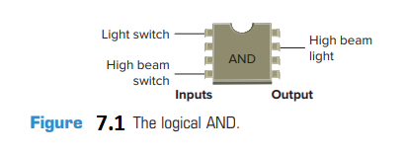
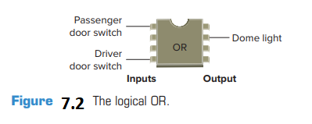
The high beam automobile lighting circuit of Figure 7.1 is an example of a logical AND decision. For this application, the high beam light can be turned on only when the light switch AND the high beam switch are closed.
The dome light automobile circuit of Figure7.2 is an example of a logical OR decision. For this application, the dome light will be turned on whenever the passenger door witch OR the driver door switch is activated.

Slide 4
7.2 AND, OR, and NOT Functions
The operations performed by digital equipment are based on three fundamental logic functions: AND, OR, and NOT. Each function has a rule that will determine the outcome and a symbol that represents the operation. For the purpose of this discussion, the outcome or output is called Y and the signal inputs are called A, B, C, and so on. Also, binary 1 represents the presence of a signal or the occurrence of some event, and binary 0 represents the absence of the signal or nonoccurrence of the event

Slide 5
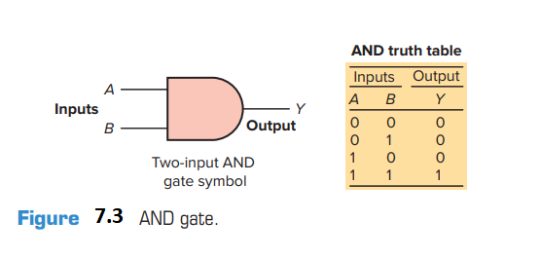
The AND Function
The symbol drawn in Figure 7.3 is that of an AND gate. An AND gate is a device with two or more inputs and one output. The AND gate output is 1 only if all inputs are 1. The AND truth table in Figure 7.3 shows the resulting output from each of the possible input combinations.
Logic gate truth tables show each possible input to the gate or circuit and the resultant output depending upon the combination of the input(s).
Since logic gates are digital ICs (Integrated Circuits)
their input and output signals can be in only one of two possible digital states, i.e., logic 0 or logic 1. Thus, the logic state of the output of a logic gate depends on the logic states of each of its individual inputs.

Slide 6
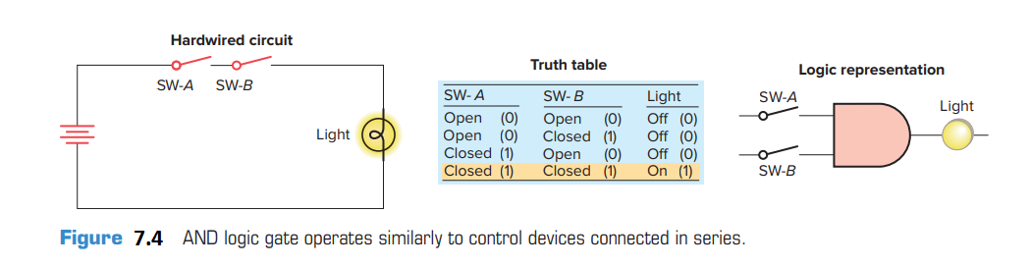
The basic rules that apply to an AND gate are:
• If all inputs are 1, the output will be 1.
• If any input is 0, the output will be 0.
The AND logic gate operates similarly to control devices connected in series, as illustrated in Figure 7.4. The light will be on only when both switch A and switch B are closed.

Slide 7
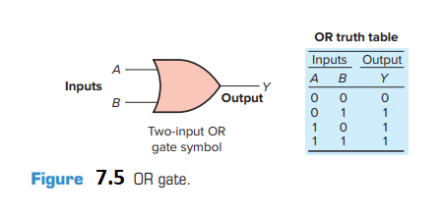
The OR Function
The symbol drawn in Figure 7.5 is that of an OR gate. An OR gate can have any number of inputs but only one output. The OR gate output is 1 if one or more inputs are 1. The truth table in Figure 7.5 shows the resulting output Y from each possible input combination.

Slide 8
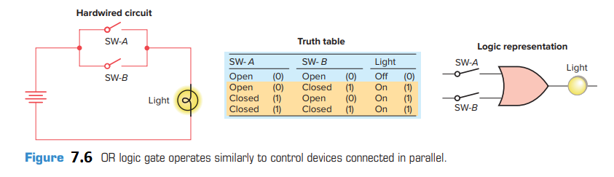
Figure 7.6 illustrates the four possible combinations of inputs for a 2-input OR gate. The basic rules that apply to an OR gate are:
• If one or more inputs are 1, the output is 1.
• If all inputs are 0, the output will be 0.
The OR logic gate operates similarly to control devices connected in parallel, as illustrated in Figure 7.6. The light will be on if switch A or switch B or both are closed

Slide 9
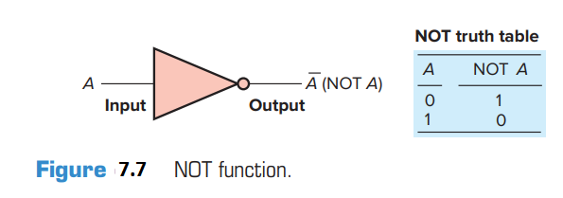
The NOT Function
The symbol drawn in Figure 7.7 is that of a NOT function. Unlike the AND and OR functions, the NOT function can have only one input. The NOT output is 1 if the input is 0. The output is 0 if the input is 1. The result of the NOT operation is always the inverse of the input, and the NOT function is, therefore, called an inverter. The NOT function is often depicted by using a bar across the top of the letter, indicating an inverted output. The small circle at the output of the inverter is referred to as a bubble and indicates that an inversion of the logical function has taken place.

Slide 10
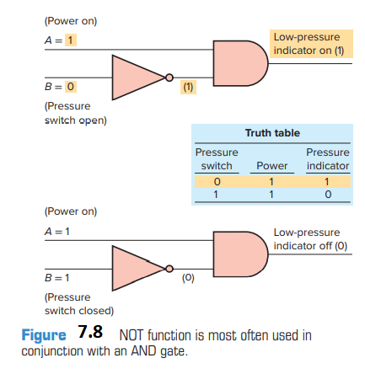
The NOT function is most often used in conjunction with the AND or the OR gate. Figure 7.8 shows the NOT function connected to one input of an AND gate for a low pressure indicator circuit. If the power is on (1) and the pressure switch is not closed (0), the warning light will be on (1).
The NOT symbol placed at the output of an AND gate would invert the normal output result. An AND gate with an inverted output is called a NAND gate. The NAND gate symbol and truth table are shown in Figure 7.9. The NAND function is often used in integrated circuit logic arrays and can be used in programmable controllers to solve complex logic.

Slide 11
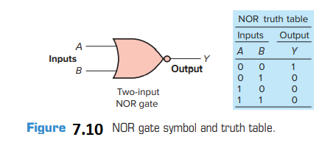
The NAND function is often used in integrated circuit logic arrays and can be used in programmable controllers to solve complex logic.
The same rule about inverting the normal output result applies if a NOT symbol is placed at the output of the OR gate. The normal output is inverted, and the function is referred to as a NOR gate. The NOR gate symbol and truth
table are shown in Figure 7.10.

Slide 12
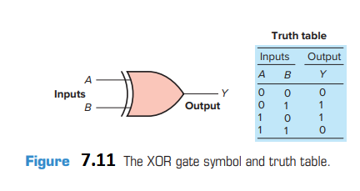
The Exclusive-OR (XOR) Function
An often-used combination of gates is the exclusive-OR (XOR) function. The XOR gate symbol and truth table are shown in Figure 7.11. The output of this circuit is HIGH only when one input or the other is HIGH, but not both. The exclusive-OR gate is commonly used for the comparison of two binary numbers.

Slide 13

7.2 Boolean Algebra
The mathematical study of the binary number system and logic is called Boolean algebra. The purpose of this algebra is to provide a simple way of writing complicated combinations of logic statements. There are many applications where Boolean algebra could be applied to solving PLC programming problems
Figure 7.12 summarizes the basic operators of Boolean algebra as they relate to the basic AND, OR, and NOT functions. Inputs are represented by capital letters A, B, C, and so on, and the output by a capital Y. The dot (•), or no symbol, represents the AND operation, an addition sign (+) represents the OR operation, the circle with an addition sign represents the exclusive-OR operation, and a bar over the letter represents the NOT operation.

Slide 14
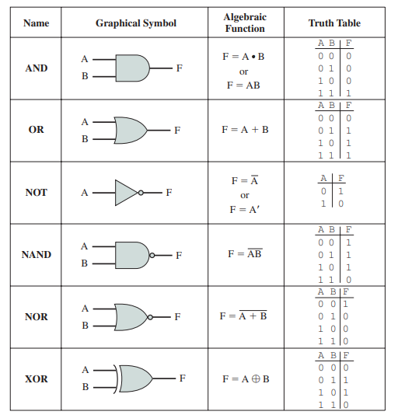


Slide 15
An understanding of the technique of writing simplified Boolean equations for complex logical statements is a useful tool when creating digital circuits. Some laws of Boolean algebra are different from those of ordinary algebra.

Slide 16
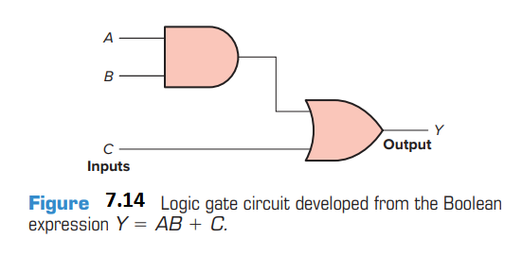
7.3 Developing Logic Gate Circuits from Boolean Expressions
As logic gate circuits become more complex, the need to express these circuits in Boolean form becomes greater. Figure 7.14 shows a logic gate circuit developed from the Boolean expression Y = AB + C. The procedure is as follows:
Boolean expression: Y = AB + C
Gates required: (by inspection)
1 - AND gate with input A and B
1 - OR gate with input C and output from previous AND gate

Slide 17
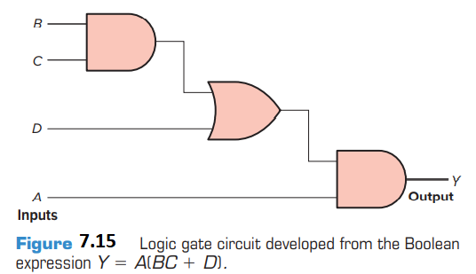
Figure 7.15 shows a logic gate circuit developed from the Boolean expression Y = A(BC + D).
The procedure is as follows:
Boolean expression: Y = A(BC + D)
Gates required: (by inspection)
1 - AND gate with inputs B and C
1 - OR gate with inputs BC and D
1 - AND gate with input A and the output from the
OR gate

Slide 18
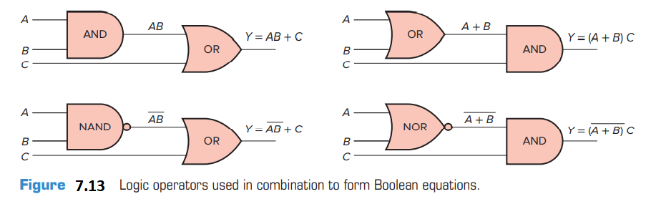
Figure 7.13 illustrates how basic logic operators are used in combination to form Boolean equation

Slide 19
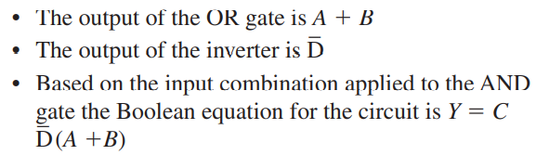
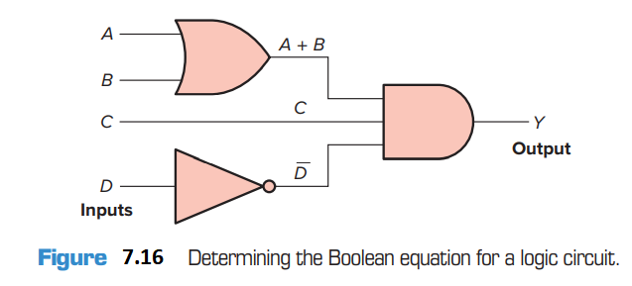
7.4 Producing the Boolean Equation for a Given Logic Gate Circuit
A simple logic gate is quite straightforward in its operation. However, by grouping these gates into combinations, it becomes more difficult to determine which combinations of inputs will produce an output. The Boolean equation for the logic circuit of Figure 7.16 is determined as follows:

Slide 20
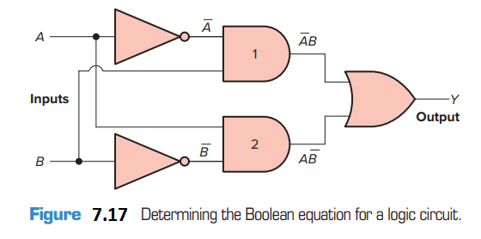
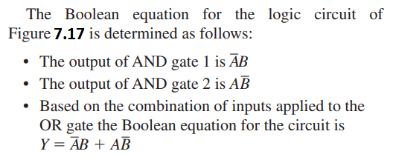

Slide 21
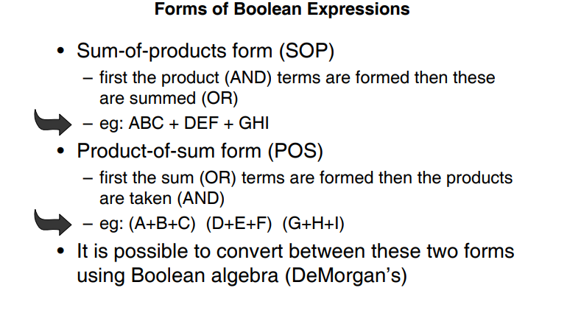
7.5 Logic Simplication & Karnaugh Map

Slide 22
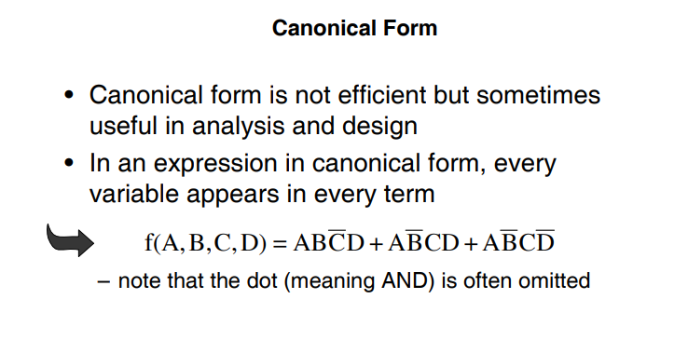

Slide 23
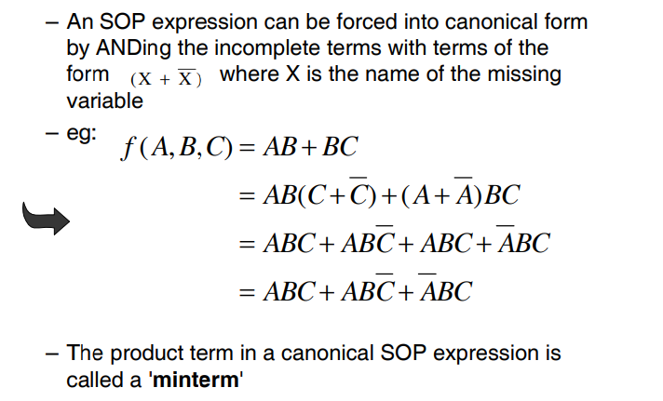

Slide 24
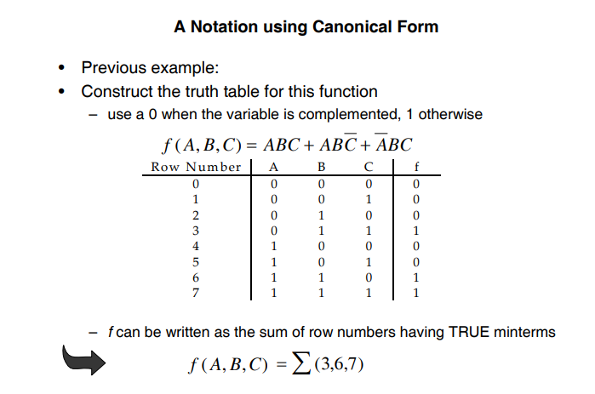

Slide 25
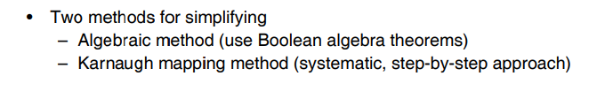
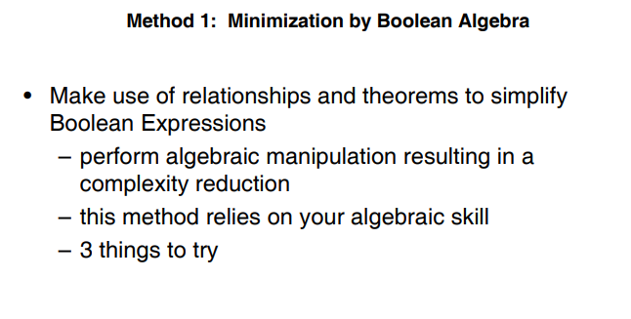

Slide 26
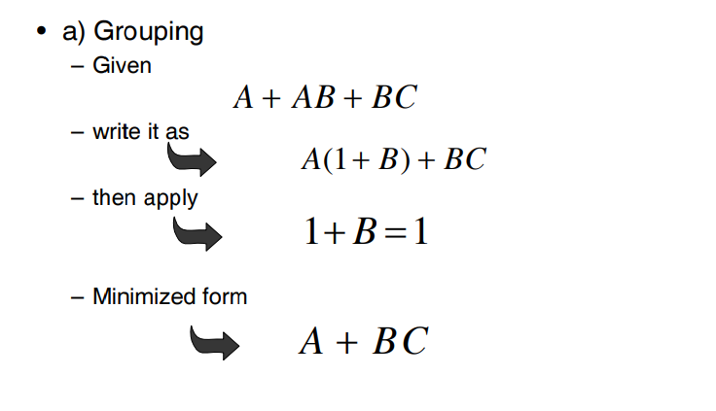

Slide 27
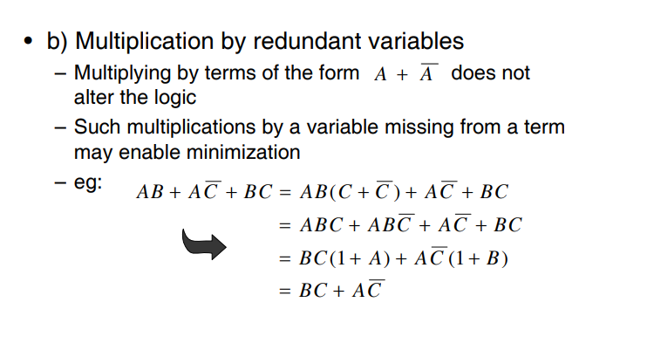

Slide 28
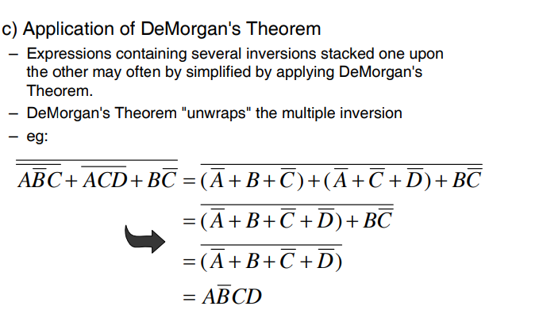

Slide 29
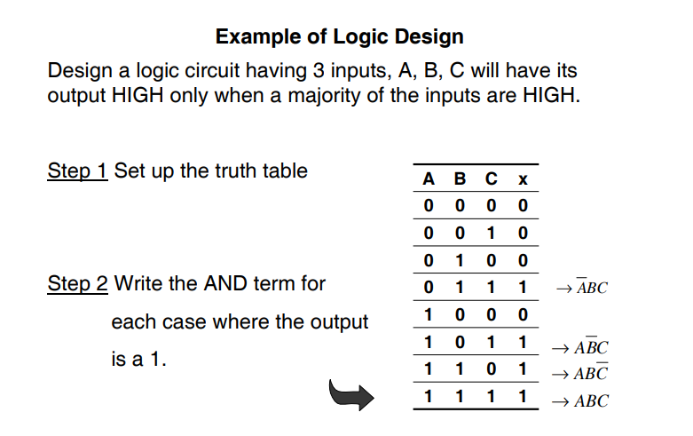

Slide 30
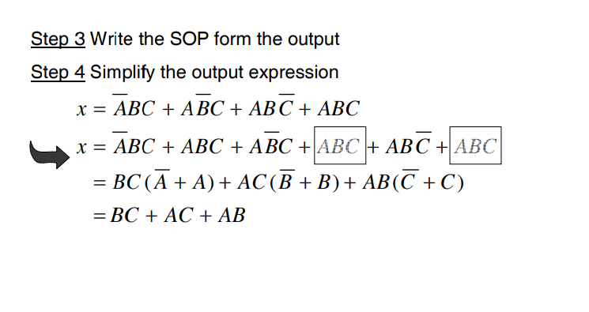

Slide 31
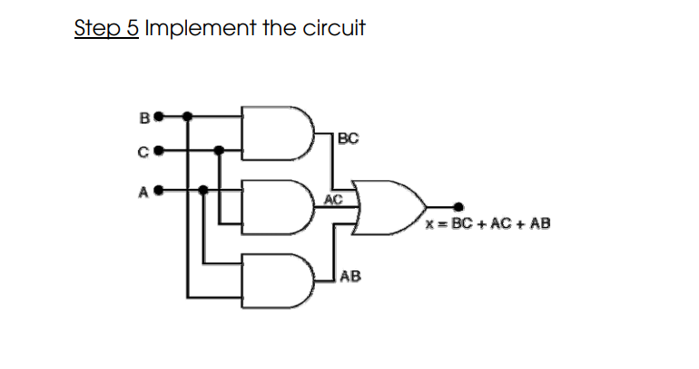

Slide 32
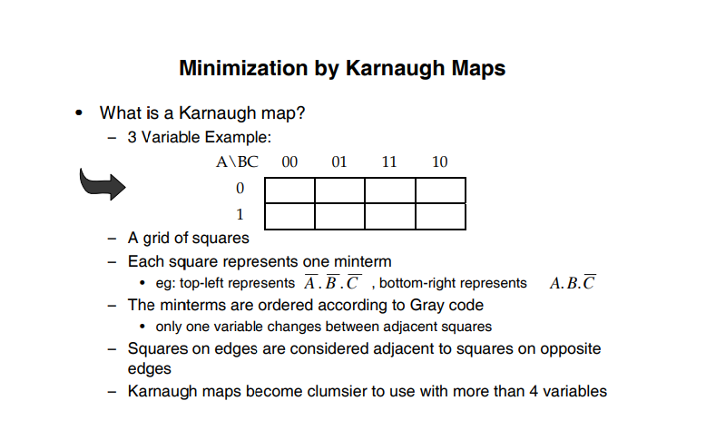

Slide 33
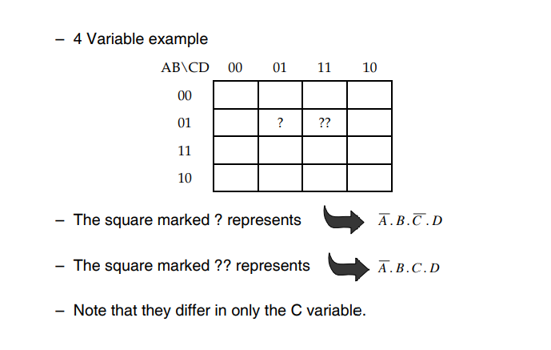

Slide 34
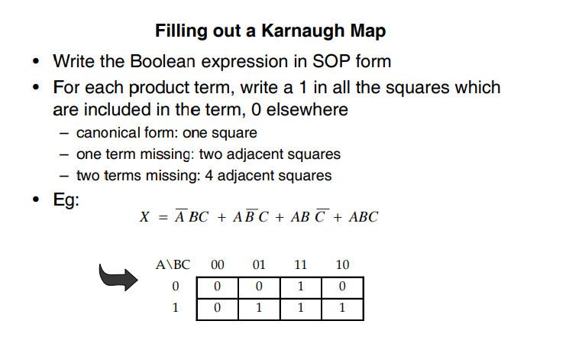

Slide 35
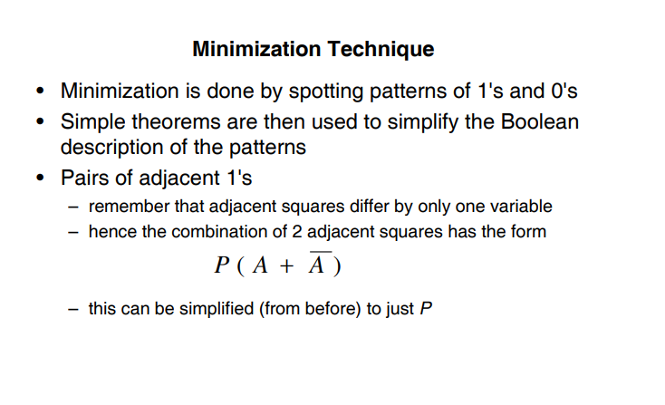

Slide 36
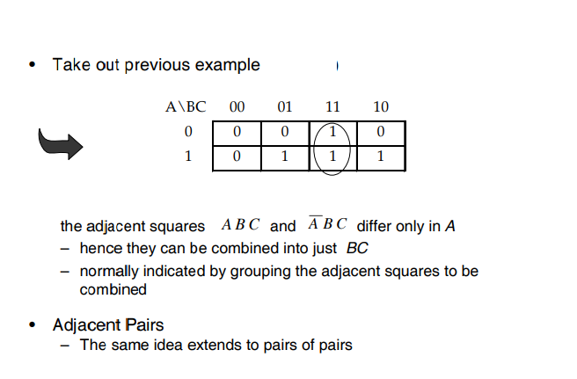


Slide 37
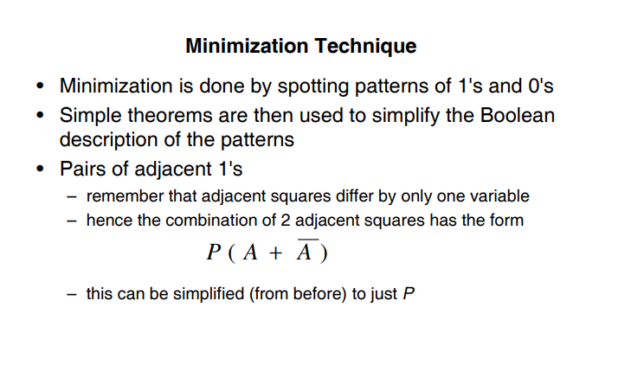

Slide 38
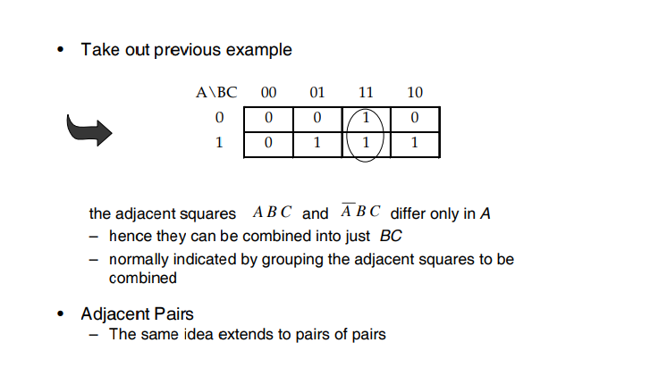

Slide 39
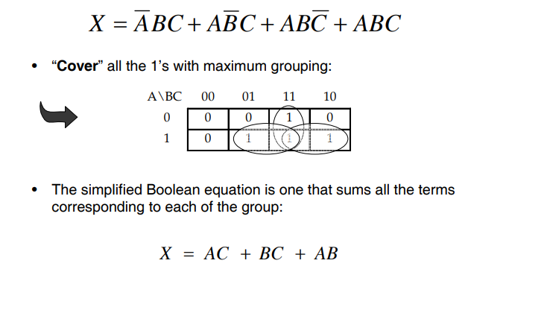

Slide 40
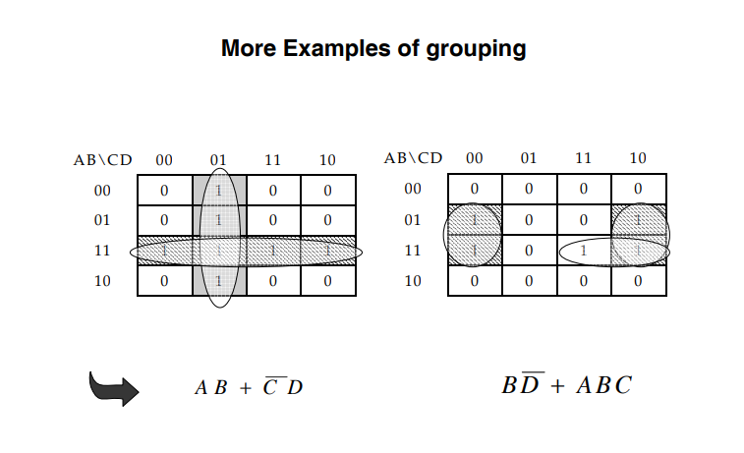

Slide 41
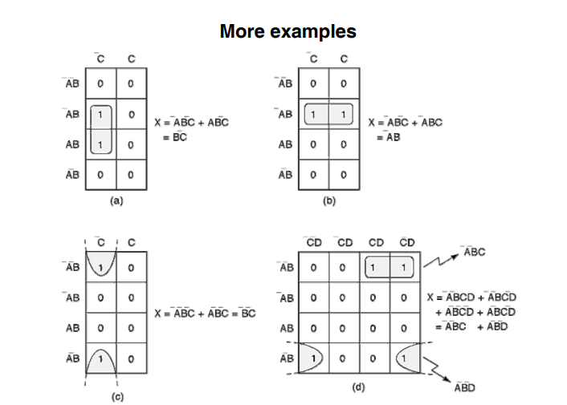

Slide 42
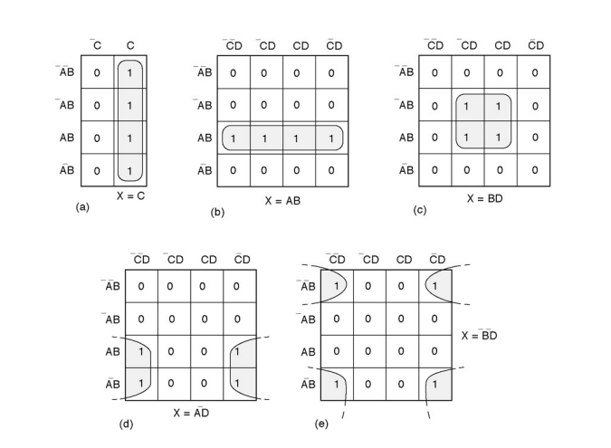

Slide 43
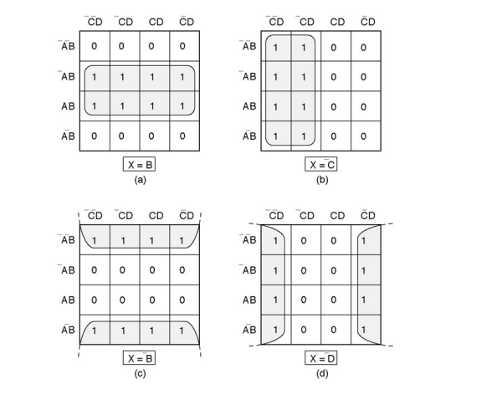

Slide 44
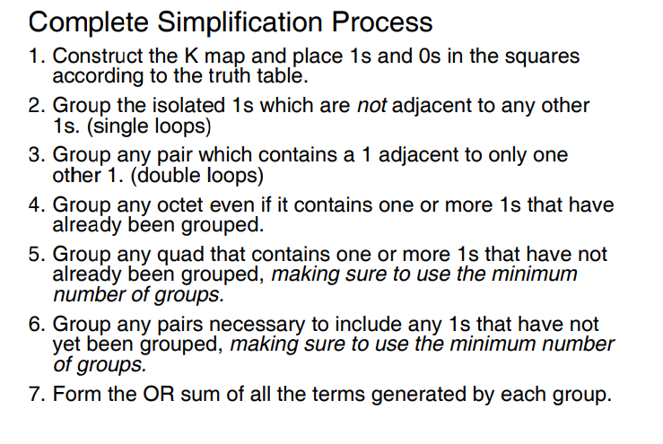

Slide 45
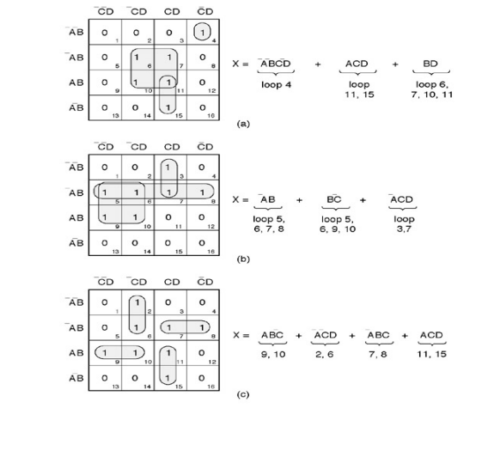

Slide 46
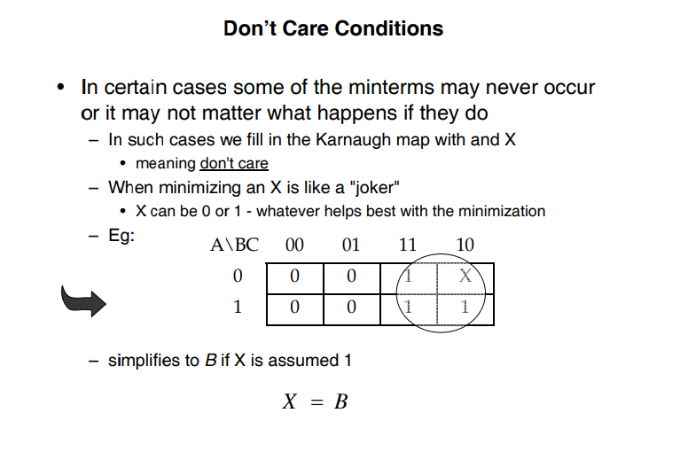

Slide 47
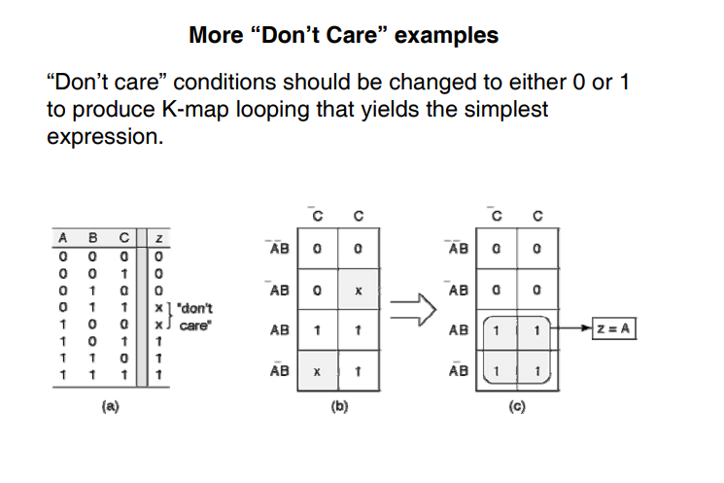

Slide 48
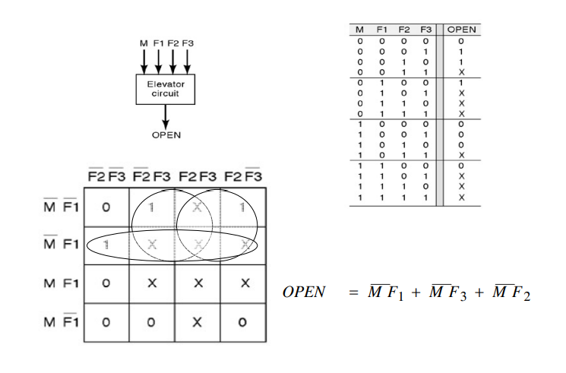

Slide 49
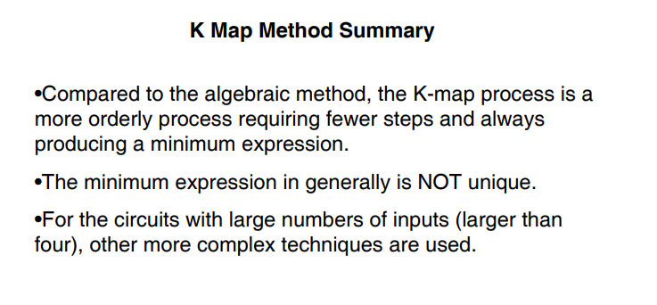

Slide 50
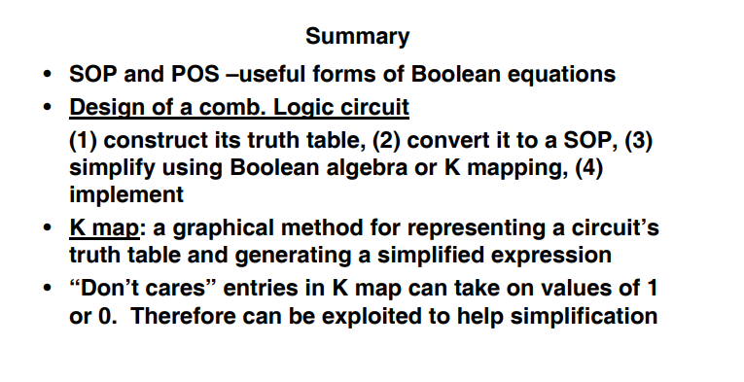

Slide 51
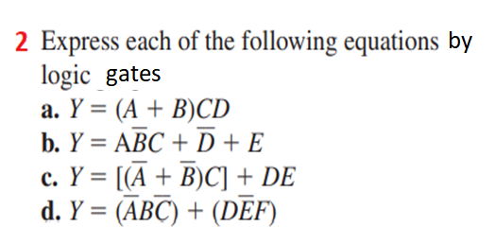


REVIEW QUESTIONS
1.Draw the logic symbol, construct a truth table, and
state the Boolean equation for each of the
following:
a. Two-input AND gate
b. NOT function
c. Three-input OR gate
d. XOR function

Slide 52


5. For the logic gate circuit shown in Figure 7.18, 7.19 Determine the Boolean equation.

Slide 53


6. It is required to have a pilot light come on when all of the following circuit requirements are met:
• All four circuit pressure switches must be closed.
• At least two out of three circuit limit switches must be closed.
• The reset switch must not be closed.
Using AND, OR, and NOT gates, design a logic circuit that will solve this hypothetical problem.
7. Write the Boolean equation for each of the logic gate circuits

Slide 54




Slide 55


7.The logic circuit of Figure 7.20 is used to activate an alarm when its output Y is logic HIGH or 1. Draw a truth table for the circuit showing the resulting output for all 16 of the possible input conditions.
8.What will be the data stored in the destination address of Figure 7.21 for each of the following logical operations? a. AND operation b. OR operation c. XOR operation

Slide 56



9.
Write the Boolean expression and draw the gate logic diagram for a control system wherein a fan is to run only when all of the following conditions are met:
• Input A is OFF
• Input B is ON or input C is ON, or both B and C are ON
• Inputs D and E are both ON
• One or more of inputs F, G, or H are ON
10.
Identify the function which generates the K-map shown

Slide 57


