Slide 1
Architecture and Hardware (ITEC582 )
Eastern Mediterranean University
School of Computing and Technology
Master of Technology
Chapter 14
Processor Structure and Function

Slide 2
Learning Objectives
After studying this chapter, you should be able to:
Distinguish between user-visible and control/status registers, and discuss the purposes of registers in each category.
Summarize the instruction cycle.
Discuss the principle behind instruction pipelining and how it works in practice.
Compare and contrast the various forms of pipeline hazards

Slide 3
1.Processor Organization
What are the tasks that a processor must accomplish?
Fetch instruction: The processor reads an instruction from memory (register, cache, main memory)
Interpret instruction: The instruction is decoded to determine what action is required
Fetch data: The execution of an instruction may require reading data from memory or an I/O module
Notes:
22

Slide 4
1.Processor Organization
Process data: The execution of an instruction may require performing some arithmetic or logical operation on data
Write data: The results of an execution may require writing data to memory or an I/O module
In order to do these things the processor needs to store some data temporarily and therefore needs a small internal memory.
These storage locations are called registers.
Notes:
22

Slide 5
1.Processor Organization
Notice that the major components of the processor are an arithmetic and logic unit (ALU) and a control unit (CU).
The ALU does the actual computation or processing of data.
What are the functions of control unit?
The control unit controls the movement of data and instructions into and out of the processor and controls the operation of the ALU.
Notes:
22

Slide 6
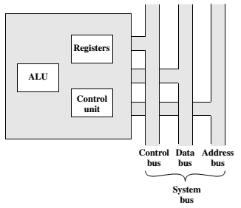
Processor Organization
CPU with the system bus

Slide 7
1.Processor Organization
ALU operates only on data in the internal processor memory.
Thus, data transfer between the various registers and ALU is needed which is the responsibility of internal processor bus.
Notes:
22

Slide 8
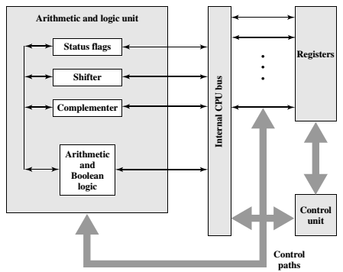
1.Processor Organization
Internal structure of the CPU

Slide 9
2.Register Organization
What general roles are performed by processor registers?
The registers in the processor perform two roles:
User-visible registers: Enable the machine- or assembly language programmer to minimize main memory references by optimizing use of registers.
Control and status registers: Used by the control unit to control the operation of the processor and operating system programs to control the execution of programs.
Notes:
22

Slide 10
User-Visible Registers
A user-visible register is one that may be referenced by means of the machine language that the processor executes.
What categories of data are commonly supported by user-visible registers?
We can characterize these in the following categories:
General purpose registers(data, address)
Data registers
Address registers
Condition codes (flags)
Notes:
24

Slide 11
General Registers or General Purpose Registers are a kind of registers which can store both data and addresses
Data registers may be used only to hold data and cannot be employed in the calculation of an operand address.
Address registers may themselves be somewhat general purpose, or they may be devoted to a particular addressing mode. Examples include the following
Segment pointers:
Index registers:
Stack pointer
What is the function of condition codes?
Condition codes
They are bits set by the processor hardware as the result of operations. For example, an arithmetic operation may produce a positive, negative, zero, or overflow result.

Slide 12
Control and Status Registers
Four registers are essential to instruction execution:
Program counter (PC): holds the address of the next instruction to be fetched
Instruction register (IR): holds the opcode which defines the type of instruction.
Memory address register (MAR): Contains the address of a location in memory
Memory buffer register (MBR): Contains a word of data to be written to memory or the word most recently read
Notes:
30

Slide 13
Control and Status Registers
Typically, the processor updates the PC after each instruction fetch so that the PC always points to the next instruction to be executed.
A branch or skip instruction will also modify the contents of the PC.
The fetched instruction is loaded into an IR, where the opcode and operand specifiers are analyzed.
Data are exchanged with memory using the MAR and MBR.
Notes:
30

Slide 14
Program Status Word (PSW)
What is a program status word?
Many processor designs include a register or set of registers, often known as the program status word (PSW), that contain status information.
The PSW typically contains condition codes plus other status information.
Notes:
31

Slide 15
Program Status Word (PSW)
Common fields or flags include the following:
Sign (sign bit of the last arithmetic operation)
Zero (set when the result is 0)
Carry (set if an operation resulted in a carry)
Equal (set if a logical compare result is equality)
Overflow (used to indicate arithmetic overflow)
Interrupt Enable/Disable (used to enable or disable interrupts)
Supervisor (used to indicate supervisor or user mode)
Notes:
31

Slide 16
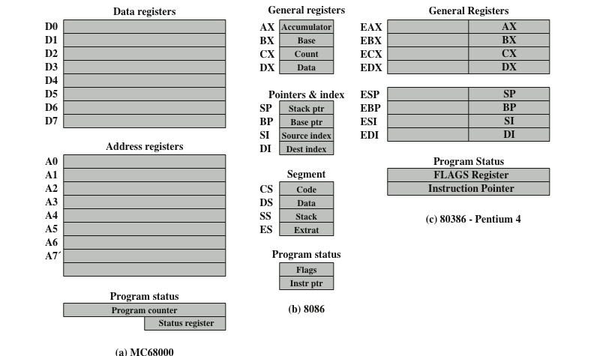
Examples to Register Organizations

Slide 17
Examples to Register Organizations
The Motorola MC68000 (16-bit microprocessor) partitions its 32-bit registers into eight data registers and nine address registers.
Data registers are used primarily for data manipulation and are also used in addressing as index registers.
The width of the registers allows 8-, 16-, and 32-bit data operations, determined by opcode.
The MC68000 also includes a 32-bit program counter and a 16-bit status register.
Notes:
31

Slide 18
Examples to Register Organizations
The Intel 8086 (16-bit microprocessor) takes a different approach to register organization. Every register is special purpose, although some registers are also usable as general purpose.
The 8086 contains four 16-bit data registers. The data registers can be used as general purpose in some instructions.
Three of the four segment registers are used in to point to the segment of the current instruction.
Notes:
31

Slide 19
Examples to Register Organizations
The Intel 80386-Pentium 4 (32-bit microprocessors) uses 32-bit registers.
However, to provide upward compatibility for programs written on the earlier machine, the 80386 retains the original register organization embedded in the new organization.
Given this design constraint, the architects of the 32-bit processors had limited flexibility in designing the register organization.
Notes:
31

Slide 20
2.Instruction Cycle
An instruction cycle includes the following stages:
Fetch: Read the next instruction from memory into the processor.
Execute: Interpret the opcode and perform the indicated operation.
Interrupt: If interrupts are enabled and an interrupt has occurred, save the current process state and service the interrupt.
Notes:
31

Slide 21
We are now introduce one additional stage, known as the indirect cycle
The Indirect Cycle
if indirect addressing is used, then additional memory accesses are required.
After an instruction is fetched, it is examined to determine if any indirect addressing is involved. If so, the required operands are fetched using indirect addressing. Following execution, an interrupt may be processed before the next instruction fetch

Slide 22
Instruction Cycle

Slide 23
Instruction Cycle
Once an instruction is fetched, its operand specifiers must be identified. Each input operand in memory is then fetched, and this process may require indirect addressing.
Register-based operands need not be fetched.
Once the opcode is executed, a similar process may be needed to store the result in main memory.
Following execution, an interrupt may be processed before the next instruction fetch.
Notes:
31

Slide 24
Instruction Cycle
Instruction Cycle State Diagram

Slide 25
Data Flow fetch cycle
During the fetch cycle;
The PC contains the address of the next instruction to be fetched. This address is moved to the MAR and placed on the address bus. The control unit requests a memory read, and the result is placed on the data bus and copied into the MBR and then moved to the IR. Meanwhile, the PC is incremented by 1, preparatory for the next fetch.
Fetch Cycle

Slide 26
Once the fetch cycle is over, the control unit examines the contents of the IR to determine if it contains an operand specifier using indirect addressing. If so, an indirect cycle is performed
The rightmost N bits of the MBR, which contain the address reference, are transferred to the MAR. Then the control unit requests a memory read, to get the desired address of the operand into the MBR.
Indirect Cycle

Slide 27
Data Flow of execute cycle
The execute cycle takes many forms; the form depends on which of the various machine instructions is in the IR.
This cycle may involve transferring data among registers, read or write from memory or I/O, and/or the invocation of the ALU.
Notes:
31

Slide 28
The current contents of the PC must be saved so that the processor can resume normal activity after the interrupt. Thus, the contents of the PC are transferred to the MBR to be written into memory. The special memory location reserved for this purpose is loaded into the MAR from the control unit. It might, for example, be a stack pointer. The PC is loaded with the address of the interrupt routine. As a result, the next instruction cycle will begin by fetching the appropriate instruction
Data flow of
Interrupt Cycle

Slide 29
3.Instruction Pipelining
To improve the performance of a CPU we have two options:
1) Improve the hardware by introducing faster circuits.
2) Arrange the hardware such that more than one operation can be performed at the same time.
Since, there is a limit on the speed of hardware and the cost of faster circuits is quite high, we have to adopt the 2nd option.

Slide 30
Pipelining is a process of arrangement of hardware elements of the CPU such that its overall performance is increased. Simultaneous execution of more than one instruction takes place in a pipelined processor.
Let us see a real life example that works on the concept of pipelined operation. Consider a water bottle packaging plant. Let there be 3 stages that a bottle should pass through, Inserting the bottle (I), Filling water in the bottle (F), and Sealing the bottle (S). Let us consider these stages as stage 1, stage 2 and stage 3 respectively. Let each stage take 1 minute to complete its operation.

Slide 31
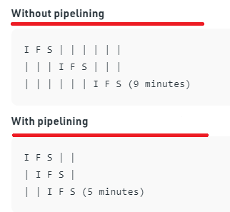
Thus, pipelined operation increases the efficiency of a system.

Slide 32
As a simple approach, consider subdividing instruction processing into two stages: fetch instruction and execute instruction.
There are times during the execution of an instruction when main memory is not being accessed. This time could be used to fetch the next instruction in parallel with the execution of the current one.
The pipeline has two independent stages. The first stage fetches an instruction and buffers it. When the second stage is free, the first stage passes it the buffered instruction. While the second stage is executing the instruction, the first stage takes advantage of any unused memory cycles to fetch and buffer the next instruction. This is called instruction prefetch or fetch overlap

Slide 33
It should be clear that this process will speed up instruction execution. If the fetch and execute stages were of equal duration, the instruction cycle time would be halved
Two-Stage Instruction Pipeline

Slide 34
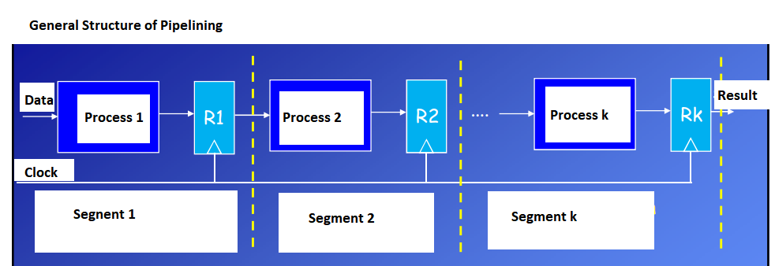
Note that this approach, which involves instruction buffering, requires more registers. In general, pipelining requires registers to store data between stages.

Slide 35
To gain further speedup, the pipeline must have more stages.(6th stage pipeline)
Consider the following decomposition of the instruction processing.
Fetch instruction (FI)
Read the next expected instruction into a buffer
Decode instruction (DI)
Determine the opcode and the operand specifiers
Calculate operands (CO)
Calculate the effective address of each source operand
Fetch operands (FO)
Fetch each operand from memory,Operands in registers need not be fetched
Execute instruction (EI)
Perform the indicated operation and store the result, if any, in the specified destination operand location
Write operand (WO)
Store the result in memory

Slide 36
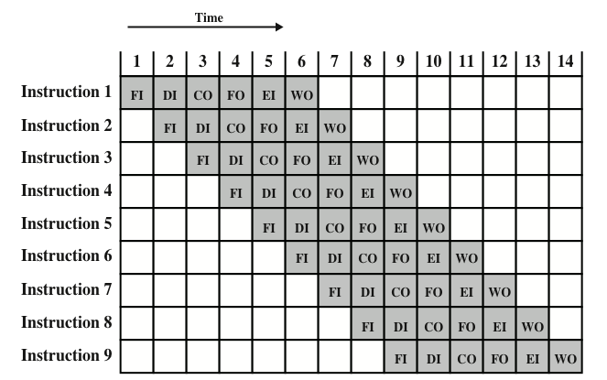
With this decomposition, the various stages will be of more nearly equal duration. For the sake of illustration, let us assume equal duration. Using this assumption, Figure below shows that a six-stage pipeline can reduce the execution time for 9 instructions from 54 time units to 14 time units
Timing diagram for instruction pipeline operation with 9 instructions.

Slide 37
Pipelining Strategy
The diagram assumes that each instruction goes through all six stages of the pipeline where each step has equal duration.
In particular, it is assumed that there are no memory conflicts.
For example, the FI, FO, and WO stages involve a memory access. However, the desired value may be in cache, or the FO or WO stage may be null.
Thus, much of the time, memory conflicts will not slow down the pipeline.

Slide 38
Pipelining Strategy
A possible difficulty is the conditional branch instruction, which can invalidate several instruction fetches.
A similar unpredictable event is an interrupt.
The number of stalls introduced during the branch operations in the pipelined processor is known as branch penalty.

Slide 39
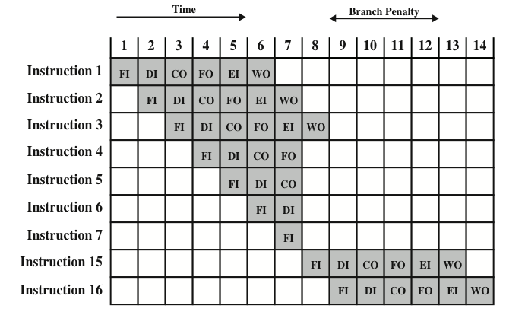
Pipelining Strategy
Example: The effect of a conditional branch on instruction pipeline operation.
Notes:
40

Slide 40
Pipelining Strategy
Assume that instruction 3 is a conditional branch to instruction 15.
Until the instruction is executed, there is no way of knowing which instruction will come next.
The pipeline, in this example, simply loads the next instruction in sequence (instruction 4) and proceeds.

Slide 41
Pipelining Strategy
This is not determined until t=7.
At this point, the pipeline must be cleared of instructions that are not useful.
During t=8, instruction 15 enters the pipeline.
No instructions complete during time units 9 through 12; this is the performance penalty incurred because we could not anticipate the branch.

Slide 42
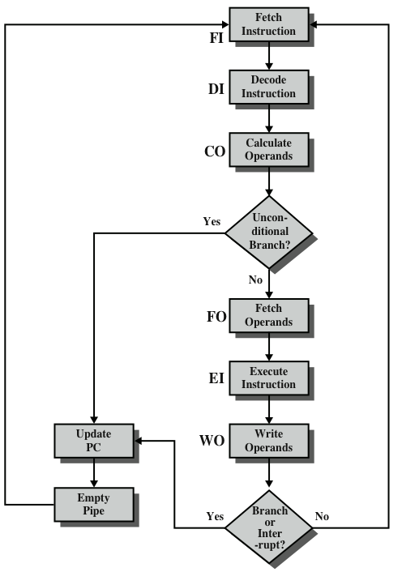
Figure indicates the logic needed for pipelining to account for branches and interrupts.

Slide 43
Pipeline Performance
The cycle time of an instruction pipeline is the time needed to advance a set of instructions one stage through the pipeline. The cycle time can be determined as

Slide 44
In general, the time delay d is equivalent to a clock pulse and
Now suppose that n instructions are processed, with no branches.
Let be the total time required for a pipeline with k stages to execute n instructions. Then
For example, the ninth instruction completes at time cycle 14

Slide 45
The speedup factor for the instruction pipeline compared to execution without the pipeline is defined as
As might be expected, at the limit
we have a k-fold speedup

Slide 46
Instruction pipelining is a powerful technique for enhancing performance but requires careful design to achieve optimum results with reasonable complexity.

Slide 47
Pipeline Hazards
Occur when the pipeline, or some portion of the pipeline, must stall because conditions do not permit continued execution.
Also referred to as a pipeline bubble.
Any condition that causes a stall in the pipeline operations can be called a hazard.
There are three types of hazards:
Resource hazard
Data hazard
Control hazard

Slide 48
Pipeline Hazards
A resource hazard occurs when two or more instructions that are already in the pipeline need the same resource.
The result is that the instructions must be executed in serial rather than parallel for a portion of the pipeline.
A resource hazard is sometimes referred to as a structural hazard.

Slide 49
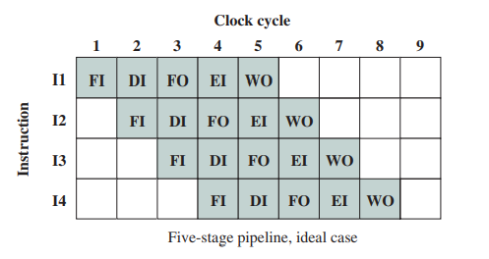
Let us consider a simple example of a resource hazard. Assume a simplified five-stage pipeline, in which each stage takes one clock cycle. Figure below shows the ideal case, in which a new instruction enters the pipeline each clock cycle.

Slide 50
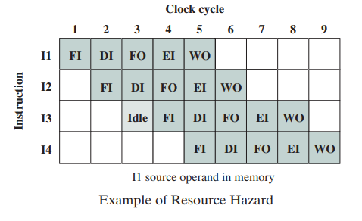
Now assume that main memory has a single port and that all instruction fetches and data reads and writes must be performed one at a time. Further, ignore the cache. In this case, an operand read to or write from memory cannot be performed in parallel with an instruction fetch.

Slide 51
This is illustrated in figure shown , which assumes that the source operand for instruction I1 is in memory, rather than a register. Therefore, the fetch instruction stage of the pipeline must idle for one cycle before beginning the instruction fetch for instruction I3. The figure assumes that all other operands are in registers.

Slide 52
Pipeline Hazards
A data hazard occurs when there is a conflict in the access of an operand location.
Assume that two instructions in a program are to be executed in sequence and both access a particular memory or register operand.
If the two instructions are executed in strict sequence, no problem occurs. [ A=A+3 ; B= 4*A ]
However, if the instructions are executed in a pipeline, then it is possible for the operand value to be updated in such a way as to produce a different result than would occur with strict sequential execution.
In other words, the program produces an incorrect result because of the use of pipelining.

Slide 53
There are three types of data hazards
Read after write (RAW):
A hazard occurs when the value produced by an instruction is required by a subsequent instruction. For example,
ADD R1, --, --;
SUB --, R1, --;

Slide 54
Write after read (WAR):
A hazard occurs when the output register of an instruction is used right after read by a previous instruction. For example,
ADD --, R1, --;
SUB R1, --, --;
Write after write (WAW): Two instructions both write to the same location. These hazards occur when the output register of an instruction is used for write after written by previous instruction. For example, (second instruction must be delayed until first one is finished)
ADD R1, --, --;
SUB R1, --, --;

Slide 55
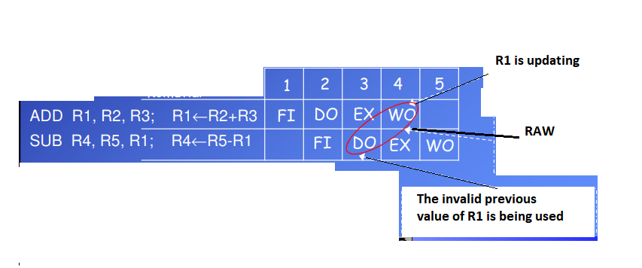
Read after write (RAW):

Slide 56
As an example, consider the following x86 machine instruction sequence:
ADD EAX, EBX /* EAX = EAX + EBX
SUB ECX, EAX /* ECX = ECX – EAX
The first instruction adds the contents of the 32-bit registers EAX and EBX and stores the result in EAX. The second instruction subtracts the contents of EAX from ECX and stores the result in ECX.

Slide 57
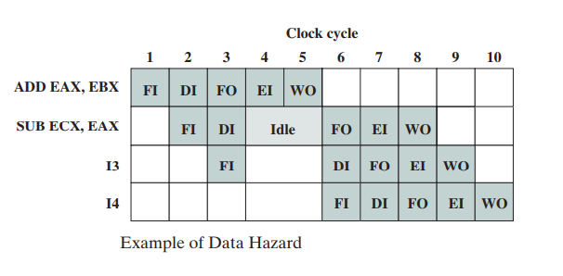
RAW hazard
The ADD instruction does not update register EAX until the end of stage 5, which occurs at clock cycle 5. But the SUB instruction needs that value at the beginning of its stage 2, which occurs at clock cycle 4. To maintain correct operation, the pipeline
must stall for two clocks cycles. Thus, in the absence of special hardware and specific avoidance algorithms, such a data hazard results in inefficient pipeline usage

Slide 58
Pipeline Hazards
Control hazard occurs when the pipeline makes the wrong decision on a branch prediction and therefore brings instructions into the pipeline that must subsequently be discarded.
Also known as branch hazard.

Slide 59
Dealing with Branches
The primary impediment, as we have seen, is the conditional branch instruction. Until the instruction is actually executed, it is impossible to determine whether the branch will be taken or not.
A variety of approaches have been taken for dealing with conditional branches:
■ Multiple streams
■ Prefetch branch target
■ Loop buffer
■ Branch prediction
■ Delayed branch

Slide 60
Delayed Branching
The idea is that a branch instruction does not cause an immediate branch, but is delayed by some number of cycles, depending on the length of the pipeline
In this case, the instruction immediately following the branch is always executed regardless of the result of the branch. The compiler will generally generate code in which each branch is followed by a NOOP instruction

Slide 61
ADD R2, R3, R4
CMP R1,0
JNE somewhere
NOOP
The compiler can now rearrange the code by observing that the ADD need not be computed before the CMP — it can be moved after the JNE, replacing the NOOP, safe in the knowledge that it will be executed.
CMP R1,0
JNE somewhere
ADD R2, R3, R4

