Slide 1
Architecture and Hardware (ITEC582 )
Eastern Mediterranean University
School of Computing and Technology
Master of Technology
Chapter 15
Reduced Instruction Set Computers (RISC)

Slide 2
After studying this chapter, you should be able to:
Provide an overview research results on instruction execution characteristics that motivated the development of the RISC approach.
Summarize the key characteristics of RISC machines.
Discuss the implication of a RISC architecture for pipeline design and performance.

Slide 3
Since the development of the stored-program computer around 1950, there have been remarkably few true innovations in the areas of computer organization and architecture. The following are some of the major advances since the birth of the computer
The family concept
Microprogrammed control unit
Cache memory
Pipelining Computer Evolution
Multiple processors
Reduced instruction set computer (RISC) architecture

Slide 4
■ The family concept:
The family concept decouples the architecture of a machine from its implementation. A set of computers is offered, with different price/performance characteristics, that presents the same architecture to the user. The differences in price and performance are due to different implementations of the same architecture. It was first introduced by IBM in 1964.
■ Microprogrammed control unit:
Suggested by Wilkes in 1951 and introduced by IBM in 1964. Microprogramming eases the task of designing and implementing the control unit and provides support for the family concept.

Slide 5
■ Cache memory:
First introduced commercially by IBM in 1968. The insertion of this element into the memory hierarchy dramatically improves performance.
■ Pipelining:
Different stages of different instructions are executed simultaneously. For example instruction pipelining
■ Multiple processors:
This category covers a number of different organizations and objectives. Multiple processors can handle different parts of the same job. Memory sharing is possible. Different caches can be used for each CPU.

Slide 6
■ Reduced instruction set computer (RISC) architecture:
This is the focus of this chapter . It was developed as an alternative
to the CISC architecture. Basic properties are as follows;
What are some typical distinguishing characteristics of RISC organization?
a limited instruction set with a fixed format,
a large number of registers
the use of a compiler that optimizes register usage, and
(3) an emphasis on optimizing the instruction pipeline

Slide 7
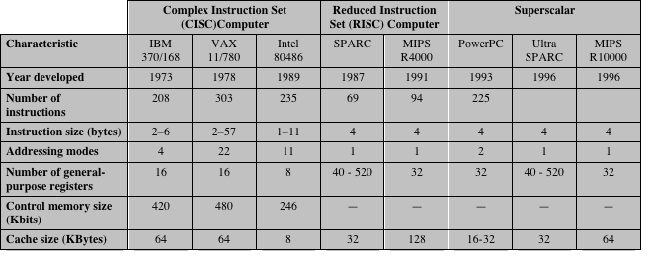
CISC, RISC, Superscalar Processors
Characteristics of some CISC, RISC, and superscalar processors are given below.

Slide 8
1.Instruction Execution Characteristics
Driving force for CISC
One of the most visible forms of evolution associated with computers is that of programming languages. As the cost of hardware has dropped, the relative cost of software has risen
Thus, the major cost in the life cycle of a system is software, not hardware.

Slide 9
This solution gave rise to a perceived problem, known as the semantic gap, the difference between the operations provided in HLLs and those provided in computer architecture.

Slide 10
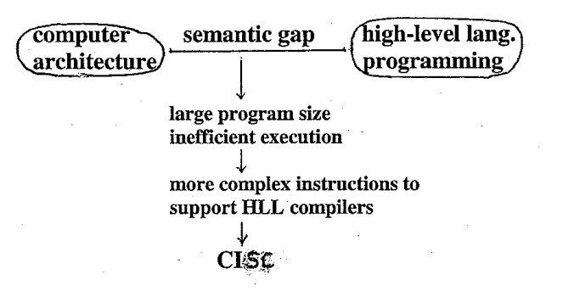
What are the symptoms of semantic gap?
Symptoms of this gap are alleged to include execution inefficiency, excessive machine program size, and compiler complexity.

Slide 11
Designers responded with architectures intended to close this gap. Key features are;
include large instruction sets,
dozens of addressing modes, and
various HLL statements implemented in hardware.
What is the purpose of developing complex instruction sets ?
( Intention of CISC)
Ease the task of the compiler writer.
Improve execution efficiency, because complex sequences of operations can be implemented in microcode.
Provide support for even more complex and sophisticated HLLs.

Slide 12
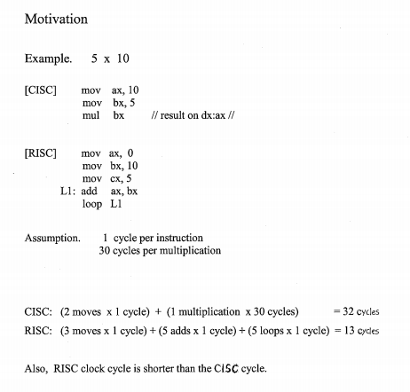

Slide 13
The various programs in High level languages are analyzed in CISC computers. Let us review these analyzes;
■ Operations performed:
These determine the functions to be performed by the processor and its interaction with memory.
■ Operands used:
The types of operands and the frequency of their use determine the memory organization for storing them and the addressing modes for accessing them
■ Execution sequencing: This determines the control and pipeline organization

Slide 14
Operations
Assignment statements predominate, suggesting that the simple movement of data is of high importance.
i.e data movement instructions
Conditional statements (IF, LOOP). These statements are implemented in machine language with some sort of compare and branch instruction. This suggests that the sequence control mechanism of the instruction set is important.

Slide 15
The questions for the machine instruction set designer is that:
Given a compiled machine language program, which statements in the source language cause the execution of the most machine-language instructions?
To get at this underlying phenomenon, the Patterson programs [PATT82a] were compiled on the VAX, PDP-11, and Motorola 68000 to determine the average number of machine instructions and memory references per statement type.

Slide 16
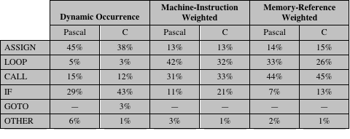
Operations
Weighted Relative Dynamic Frequency of HLL Operations

Slide 17
Operations
The second and third columns in the table shows the relative frequency of occurrence of various HLL instructions in a variety of programs.
To obtain the data in columns four and five (machine-instruction weighted), each value in the second and third columns is multiplied by the number of machine instructions produced by the compiler.
These results are then normalized so that columns four and five show the relative frequency of occurrence, weighted by the number of machine instructions per HLL statement.

Slide 18
Operations
Similarly, the sixth and seventh columns are obtained by multiplying the frequency of occurrence of each statement type by the relative number of memory references caused by each statement.
The data in columns four through seven provide measures of the actual time spent executing the various statement types.
The results suggest that the procedure call/return is the most time consuming operation in typical HLL programs.

Slide 19
Operands
The Patterson also looked at the dynamic frequency of occurrence of classes of variables.
The results show that the majority of references are to simple scalar variables.
Dynamic Percentage of Operands

Slide 20
Procedure Calls
We have seen that procedure calls and returns are an important aspect of HLL programs. The evidence (From Tables ) suggests that these are the most time-consuming operations in compiled HLL programs.
Thus, it will be profitable to consider ways of implementing these operations efficiently.
Two aspects are significant for the procedure calls:
(i)the number of parameters and variables that a procedure deals with, and
(ii) the depth of nesting.

Slide 21
Implications
Generalizing from the work of a number of researchers
Use a large number of registers or use a compiler to optimize register usage. ( i.e quick access to operands)
This is intended to optimize operand referencing. This, coupled with the locality and predominance of scalar references, suggests that performance can be improved by reducing memory references at the expense of more register references. Because of the locality of these references, an expanded register set seems practical.

Slide 22
Careful attention needs to be paid to the design of instruction pipelines
Because of the high proportion of conditional branch and procedure call instructions,
An instruction set consisting of high- performance primitives .e.g RISC

Slide 23
2.The Use of a Large Register File
The results summarized in previous section point out the desirability of quick access to operands. We have seen that there is a large proportion of assignment statements in HLL programs, and many of these are of the simple form A B.
The reason that register storage is indicated is that it is the fastest available storage device, faster than both main memory and cache
The register file is physically small, on the same chip as the ALU and control unit, and employs much shorter addresses than addresses for cache and memory.

Slide 24
Thus, a strategy is needed that will allow the most frequently accessed operands to be kept in registers and to minimize register-memory operations.
Briefly explain the two basic approaches used to minimize register-memory operations on RISC machine
Two basic approaches are possible, one based on software and the other on hardware.
The software approach is to rely on the compiler to maximize register usage. The compiler will attempt to assign registers to those variables that will be used the most in a given time period. This approach requires the use of sophisticated program-analysis algorithms.
The hardware approach is simply to use more registers so that more variables can be held in registers for longer periods of time.

Slide 25
The use of a large set of registers should decrease the need to access memory. The design task is to organize the registers in such a fashion that this goal is realized.
The problem is that the definition of local changes with each procedure call and return, operations that occur frequently.
How registers are used in procedure call and return opertaions?
On every call, local variables must be saved from the registers into memory, so that the registers can be reused by the called procedure.
On return, the variables of the calling procedure must be restored (loaded back into registers) and results must be passed back to the calling procedure

Slide 26
3.Reduced Instructions Set Architecture
Why CISC ?
There is a trend to richer instruction sets which include a larger and more complex number of instructions
Two principal reasons for this trend:
A desire to simplify compilers
A desire to improve performance

Slide 27
It is not the intent of this chapter to say that the CISC designers took the wrong direction.
Simply meant to point out some of the potential pitfalls in the CISC approach and to provide some understanding of the motivation of the RISC adherents.
The first of the reasons cited, compiler simplification.
The task of the compiler writer is to build a compiler that generates good sequences of machine instructions for HLL programs (i.e., (fast, small, fast and small) If there are machine instructions that resemble HLL statements, this task is simplified.

Slide 28
RISC researchers found that complex machine instructions are often hard to exploit because the compiler must find those cases that exactly fit the construct.
The task of optimizing the generated code to minimize code size, reduce instruction execution count, and enhance pipelining is much more difficult with a complex instruction set.
As a evidence of studies cited earlier shows that most of the instructions in a compiled programs are the relatively simple ones.
The other major reason cited is the expectation that a CISC will yield smaller, faster programs.
Let us examine both aspects of this assertion that programs will be smaller and that they will execute faster.

Slide 29
Why CISC ?
There are two advantages to smaller programs :
The program takes up less memory
There is a savings in that resource.
2. Should improve performance. This will happen in three ways
Fewer instructions means fewer instruction bytes to be fetched
In a paging environment smaller programs occupy fewer pages, reducing page faults
More instructions fit in cache(s)

Slide 30
The problem with this line of reasoning is that it is far from certain that a CISC program will be smaller than a corresponding RISC program.
In many cases, the CISC program, expressed in symbolic machine language, may be shorter (i.e., fewer instructions), but the number of bits of memory occupied may not be noticeably
smaller.

Slide 31
There are several reasons for these rather surprising results.
CISCs tend to favor simpler instructions, so that the conciseness of the complex instructions seldom comes into play.
There are more instructions on a CISC, longer opcodes are required, producing longer instructions.
Finally, RISCs tend to emphasize register rather than memory references, and the former require fewer bits.

Slide 32
The second motivating factor for increasingly complex instruction sets was that instruction execution would be faster.
The entire control unit must be made more complex, and/or
The microprogram control store must be made larger, to accommodate a richer instruction set
Either factor increases the execution time of the simple instructions

Slide 33
Characteristics of Reduced Instruction Set Architectures
One machine instruction per machine cycle
Machine cycle is the time it takes to fetch two operands from registers, perform an ALU operation, and store the result in a register.
With one-cycle instructions,
there is little or no need for microcode;
the machine instructions can be hardwire;. Such instructions should execute faster than comparable machine instructions on other machines, because it is not necessary to access a microprogram control store during instruction execution

Slide 34
Register-to-register operations
Only simple LOAD and STORE operations accessing memory. This simplifies the instruction set and therefore the control unit.
A second characteristic is that most operations should be register to register, with only simple LOAD and STORE operations accessing memory. This design feature simplifies the instruction set and therefore the control unit.

Slide 35
Simple addressing modes
Simplifies the instruction set and the control unit
Almost all RISC instructions use simple register addressing. Several additional modes, such as displacement and PC-relative, may be included.
Other, more complex modes can be synthesized in software from the simple ones.
Again, this design feature simplifies the instruction set and the control unit.

Slide 36
Simple instruction formats
Generally only one or a few formats are used
Instruction length is fixed and aligned on word boundaries. Opcode decoding and register operand accessing can occur simultaneously.
This design feature has a number of benefits.
With fixed fields, opcode decoding and register operand accessing can occur simultaneously.
Simplified formats simplify the control unit.
Instruction fetching is optimized because word-length units are fetched.
Alignment on a word boundary also means that a single instruction does not cross page boundaries

Slide 37
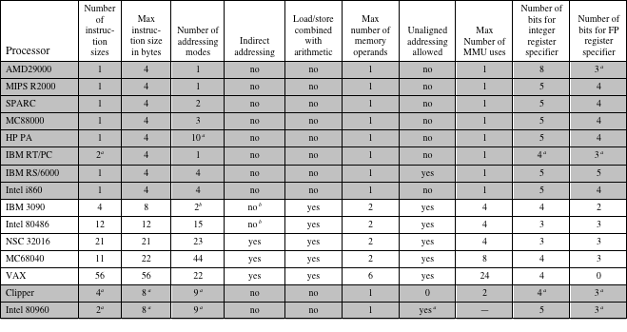
Characteristics of Some Processors

Slide 38
Characteristics of Some Processors
In the table, the first eight processors are clearly RISC architectures, the next five are clearly CISC, and the last two are processors often thought of as RISC that in fact have many CISC characteristics.

Slide 39
4. RISC Pipelining
In RISC architectures, most instructions are register to register, and an instruction cycle has the following two stages:
I: Instruction fetch.
E: Execute (Performs an ALU operation with register input and output)
For load and store operations, three stages are required:
I: Instruction fetch.
E: Execute (Calculates memory address)
D: Memory (Register-to-memory or memory-to-register operation)

Slide 40
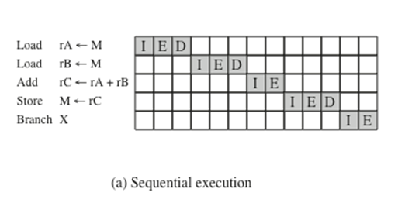
Figure (a) depicts the timing of a sequence of instructions using no pipelining. Clearly, this is a wasteful process. Even very simple pipelining can substantially improve performance.

Slide 41
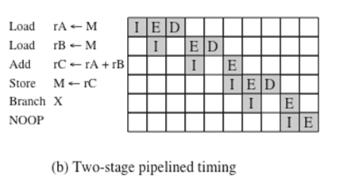
Figure (b) shows a two-stage pipelining scheme, in which the I and E stages of two different instructions are performed simultaneously. It is assumed that a single-port memory is used and that only one memory access is possible per stage.
So E and D can not be done simultaneously.
NOOP: No Operation

Slide 42
We see that the instruction fetch stage of the second instruction can be performed in parallel with the first part of the execute/ memory stage.
However, the execute/memory stage of the second instruction must be delayed until the first instruction clears the second stage of the pipeline.
This scheme can yield up to twice the execution rate of a serial scheme

Slide 43
Two problems prevent the maximum speedup from being achieved.
First, we assume that a single port memory is used and that only one memory access is possible per stage. This requires the insertion of a wait state in some instructions.
Second, a branch instruction interrupts the sequential flow of execution.
To accommodate this with minimum circuitry, a NOOP instruction can be inserted into the instruction stream by the compiler or assembler

Slide 44
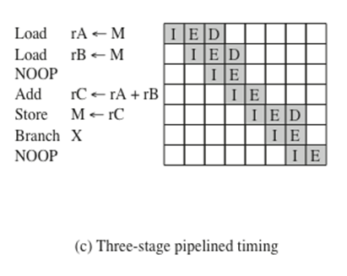
Pipelining can be improved further by permitting two memory accesses per stage which is shown in Figure (c).

Slide 45
Now, up to three instructions can be overlapped, and the improvement is as much as a factor of 3.
Again, branch instructions cause the speedup to fall short of the maximum possible.
Also, note that data dependencies have an effect. If an instruction needs an operand that is altered by the preceding instruction, a delay is required.
Again, this can be accomplished by a NOOP.

Slide 46
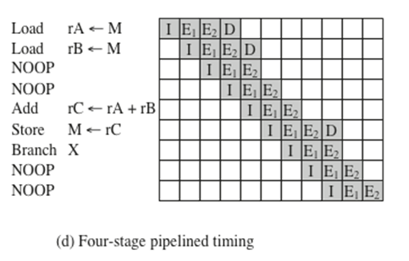
Figure (d) shows the result with a four-stage pipeline. Since E stage usually involves an ALU operation, it may be longer than other stages. In this case, we can divide into two substages:
E₁-Register file read E₂-ALU operation and register write

Slide 47
RISC Pipelining
Up to four instructions at a time can be under way, and the maximum potential speedup is a factor of 4.
Note again the use of NOOPs to account for data and branch delays
NOOP: No Operation

Slide 48
Optimization of Pipelining
Because of the simple and regular nature of RISC instructions, pipelining schemes can be efficiently employed.
There are few variations in instruction execution duration, and the pipeline can be tailored to reflect this.
However, data and branch dependencies reduce the overall execution rate.

Slide 49
To compensate for these dependencies, code reorganization techniques have been developed.
Delayed branch
A way of increasing the efficiency of the pipeline, makes use of a
branch that does not take effect until after execution of the following instruction (hence the term delayed).
The instruction location immediately following the branch is referred to as the delay slot.

Slide 50
After 102 is executed, the next instruction to be executed is 105.
To regularize the pipeline, a NOOP is inserted after this branch. However, increased performance is achieved if the instructions at 101 and 102 are interchanged.

Slide 51
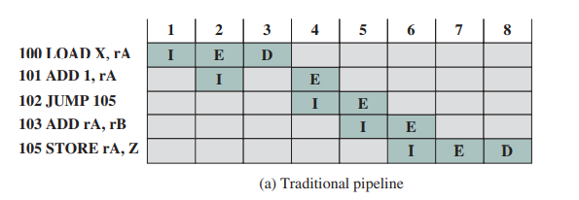
The JUMP instruction is fetched at time 4. At time 5, the JUMP instruction is executed at the same time that instruction 103 (ADD instruction) is fetched.
Because a JUMP occurs, which updates the program counter, the pipeline must be cleared of instruction 103; at time 6, instruction 105, which is the target of the JUMP, is loaded.

Slide 52
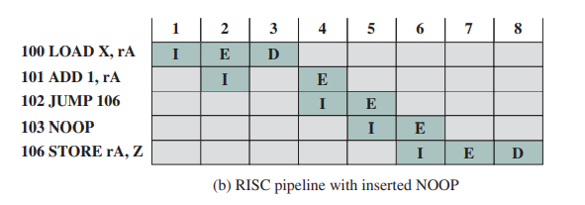
The table above shows the same pipeline handled by a typical RISC organization. The timing is the same.
However, because of the insertion of the NOOP instruction, we do not need special circuitry to clear the pipeline;
the NOOP simply executes with no effect.

Slide 53
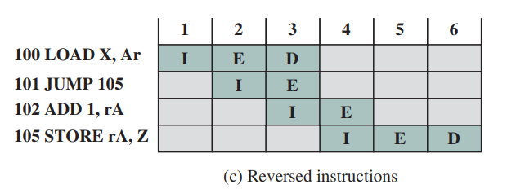
The table above shows the use of the delayed branch. The JUMP instruction is fetched at time 2, before the ADD instruction, which is fetched at time 3. Note, however, that the ADD instruction is fetched before the execution of the JUMP instruction has a chance to alter the program counter. Therefore, during time 4, the ADD instruction is executed at the same time that instruction 105 is fetched. Thus, the original semantics of the program are retained but two fewer clock cycles are required for execution.

Slide 54
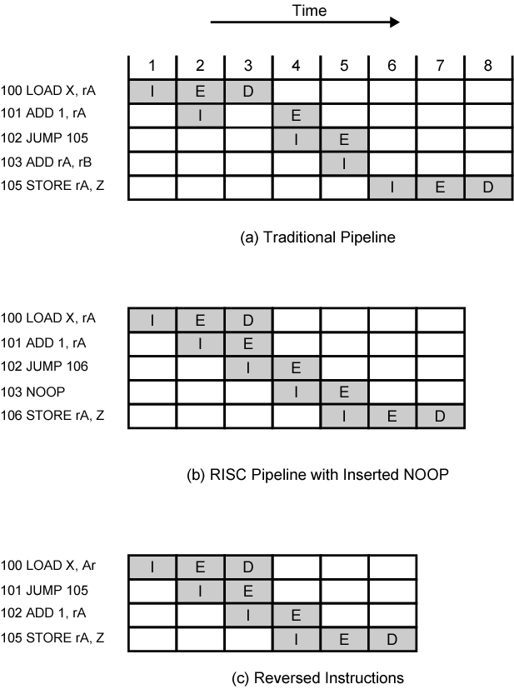
Use of Delayed Branch

Slide 55
Optimization of Pipelining
Delayed branch
Does not take effect until after execution of following instruction
This following instruction is the delay slot
Delayed Load
Register to be target is locked by processor
Continue execution of instruction stream until register required
Idle until load complete
Re-arranging instructions can allow useful work whilst loading
Loop Unrolling
Replicate body of loop a number of times
Iterate loop fewer times
Reduces loop overhead
Increases instruction parallelism
Improved register, data cache

Slide 56
RISC vs. CISC
For many years, the general trend in computer architecture and organization has been toward increasing ;
processor complexity
more instructions,
more addressing modes,
more specialized registers, and so on.
The RISC movement represents a fundamental break with the philosophy behind that trend.

Slide 57
Quantitative
compare program sizes and execution speeds
Qualitative
examine issues of high level language support and use of VLSI real estate
Problems
No pair of RISC and CISC that are directly comparable
No definitive set of test programs
Difficult to separate hardware effects from complier effects
Most comparisons done on “toy” rather than production machines
Most commercial devices are a mixture

Slide 58
RISC vs. CISC
In more recent years, the RISC vs. CISC controversy has died down to a great extent.
This is because there has been a gradual convergence of the technologies.
As chip densities and raw hardware speeds increase, RISC systems have become more complex.
At the same time, in an effort to squeeze out maximum performance, CISC designs have focused on issues traditionally associated with RISC.

