Slide 1
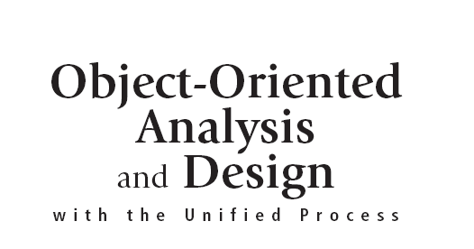

Slide 2
Objectives
Explain the purpose and various phases of the traditional systems development life cycle (SDLC)
Explain when to use an adaptive approach to the SDLC in place of the more predictive traditional SDLC
Describe how the more adaptive Unified Process (UP) life cycle uses iterative and incremental development
Explain the differences between a model, a tool, a technique, and a methodology

Slide 3
Objectives (continued)
Describe the Unified Process as a comprehensive system development methodology that combines proven best practices with the iterative UP life cycle
Describe the disciplines used in a UP development project
Describe the key features of the object-oriented approach
Explain how automated tools are used in system development

Slide 4
Overview
Traditional systems development life cycle (SDLC)
Unified Process (UP)
Iterative, incremental, adaptive approach to life cycle
Nine disciplines: six for system development, three for support
Review object-oriented (OO) concepts
Describe computer support tools such as CASE
Apply UP to the development project of RMO

Slide 5
The Systems Development Life Cycle
SDLC: process of building, deploying, using, and updating an information system
Text focus: initial development project
Chief variations of SDLC
Predictive: project planned entirely in advance
Adaptive: planning leaves room for contingencies
Pure approaches to SDLC are rare
Most projects have predictive and adaptive elements

Slide 6
Figure 2-1
Predictive versus adaptive approaches to the SDLC

Slide 7
The Traditional Predictive SDLC Approaches
Five activities or phases in a project
Planning, analysis, design, implementation, support
Pure waterfall approach (predictive SDLC)
Assumes project phases can be sequentially executed
Project drops over the “waterfall” into the next phase and there is no going back…
Modified waterfall approach
Tempers pure waterfall by recognizing phase overlap
Informs many current projects and company systems

Slide 8
WATERFALL MODEL
The waterfall model specifies a set of sequential phases for software development
Each step cannot begin until the previous step has been completed and documented.
It is document-driven.
Design is conceived as processes and data, not as objects.

Slide 9
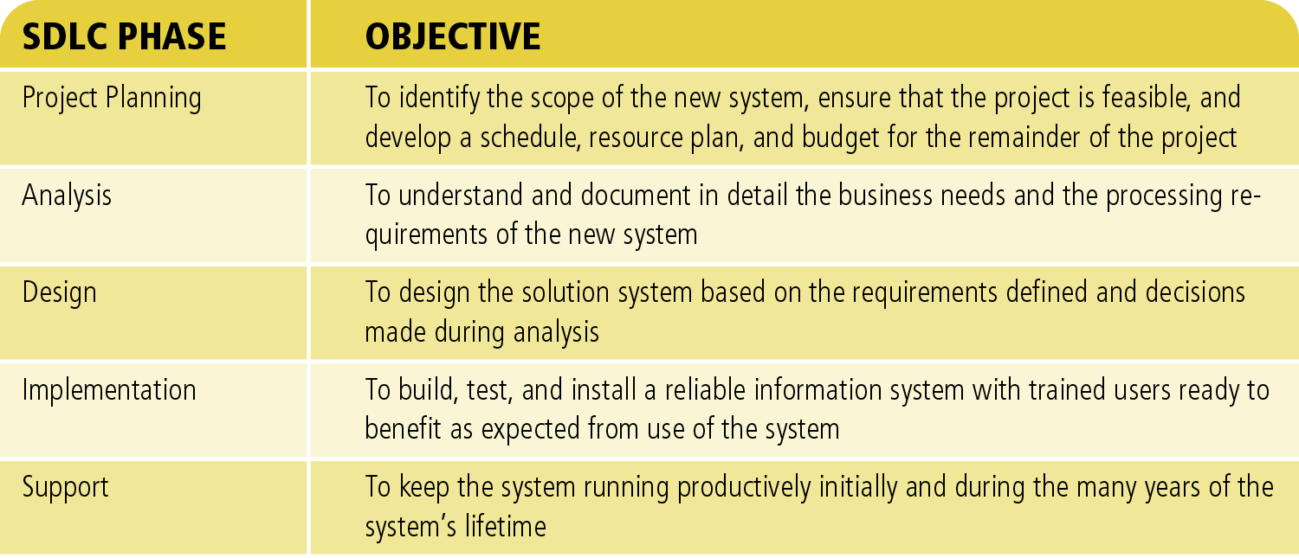
Figure 2-3
SDLC Phases and Objectives

Slide 10
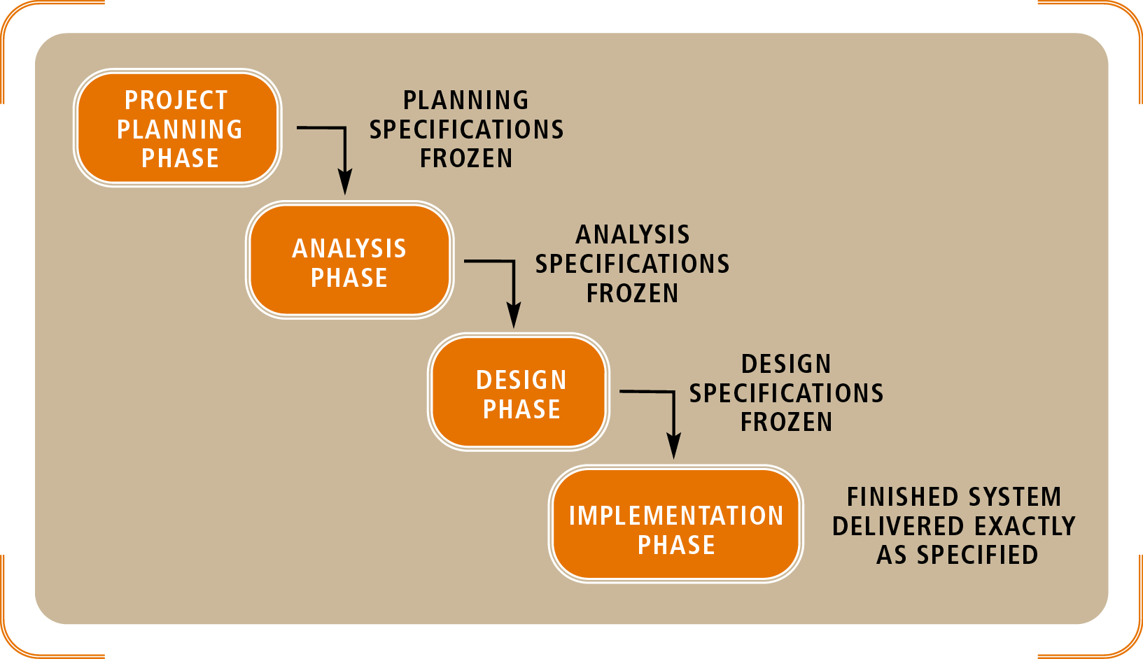
Figure 2-4
The Waterfall Approach to the SDLC

Slide 11
The Newer Adaptive Approaches to the SDLC
The spiral model: early form of adaptive SDLC
Activities radiate from center starting point
Prototypes are artifacts of each phase
Iterative problem solving: repeats activities
Several approaches to structuring iterations
Define and implement the key system functions
Focus on one subsystem at a time
Define by complexity or risk of certain components
Complete parts incrementally

Slide 12
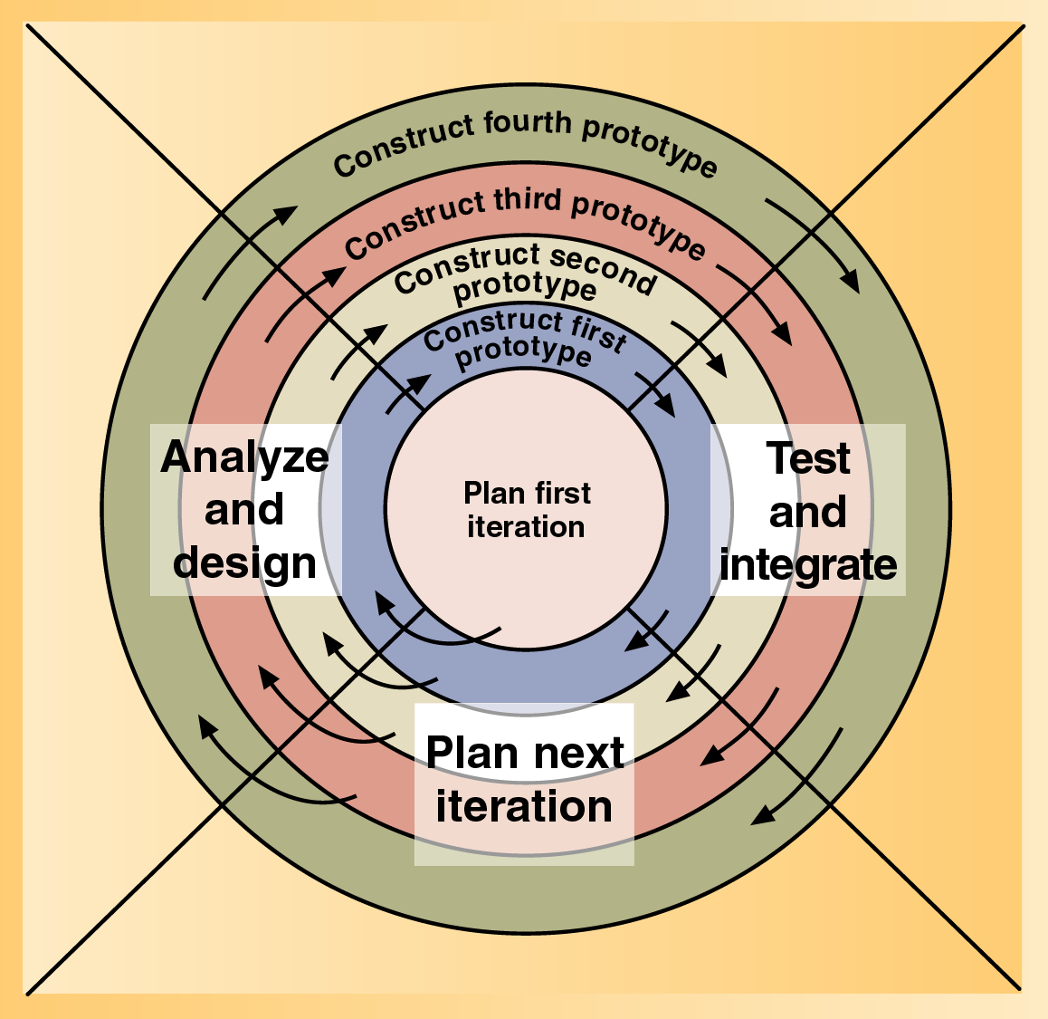
Figure 2-6
The Spiral Life Cycle Model

Slide 13
The Unified Process Life Cycle
UP life cycle
Includes (4) phases which consist of iterations
Iterations are “mini-projects”
Inception: develop and refine system vision
Elaboration: define requirements and core architecture
Construction: continue design and implementation
Transition: move the system into operational mode

Slide 14
SPIRAL MODEL
The spiral model is a risk-oriented lifecycle model that breaks a software project up into mini-projects

Slide 15
Figure 2-8
The Unified Process System Development Life Cycle

Slide 16
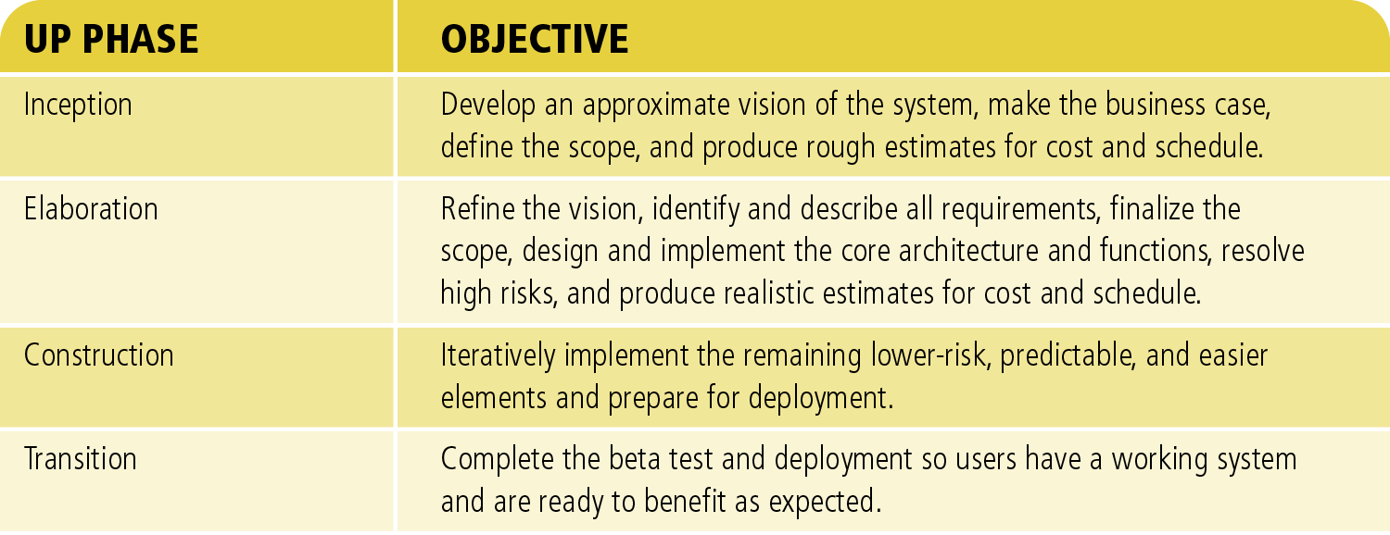
Figure 2-9
UP Phases and Objectives

Slide 17
Four Phases In The Unified Process
Inception (Make the Bussiness Case)
Elaboration (Define the system architecture)
Construction (Construct the system)
Transition (Integrate the system with the using organization)

Slide 18
Methodologies, Models, Tools, and Techniques
System development life cycle one of many models
Analysts have a wide variety of aids beyond SDLC

Slide 19
Methodologies and System Development Processes
System development methodology
Provides guidelines every activity in system development
Includes specific models, tools, and techniques
UP is a system development methodology
Process is a synonym for methodology
Methodologies supported with documentation

Slide 20
Models
Model abstract (separate) aspects of the real world
Models come in many forms
Physical analogs, mathematical, graphical
System development models are highly abstract
Depict inputs, outputs, processes, data, objects, interactions, locations, networks, and devices
Unified Modeling Language (UML): standard notation
PERT or Gantt charts: model project itself

Slide 21
Figure 2-10
Some Models used in System Development

Slide 22
Tools
Tool: software used to create models or components
Example tools
Project management software tools (Microsoft Project)
Integrated development environments (IDEs)
Code generators
Computer-aided system engineering (CASE)

Slide 23
Techniques
Technique
Collection of guidelines
Enables an analyst to complete an activity or task
Example techniques
Domain-modeling , use case modeling, software-testing, user-interviewing techniques, relational database design techniques
Proven techniques are embraced as “Best Practices”

Slide 24
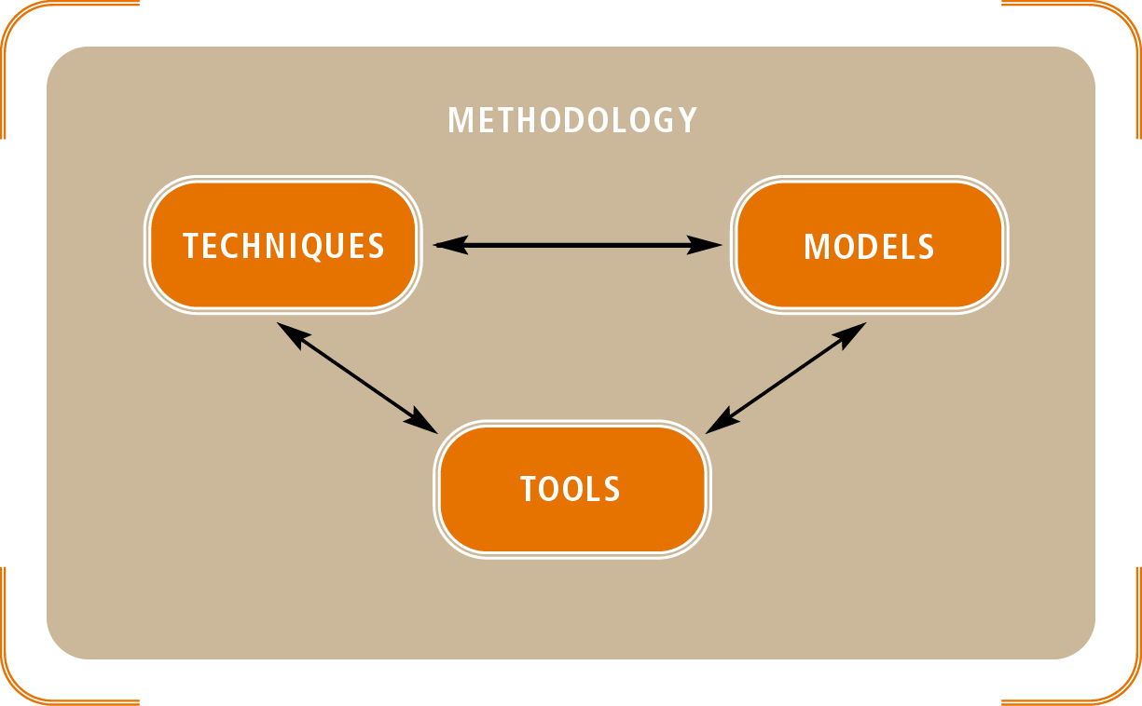
Figure 2-13
Relationships of Models, Tools, and Techniques in a System Development Methodology

Slide 25
The Unified Process as a System Development Methodology
UP: object-oriented system development methodology
UP should be tailored to organizational and project needs
Barbara Halifax selects a “lighter” UP variation for RMO’s customer support system project
Project will be use case driven

Slide 26
The Unified Process as a System Development Methodology (continued)
Use case
Activity that the system carries out
Basis for defining requirements and designs
UP defines disciplines within each phase
Discipline: set of functionally related activities
Iterations concatenate activities from all disciplines
Activities in each discipline produce artifacts; models, documents, source code, and executables

Slide 27
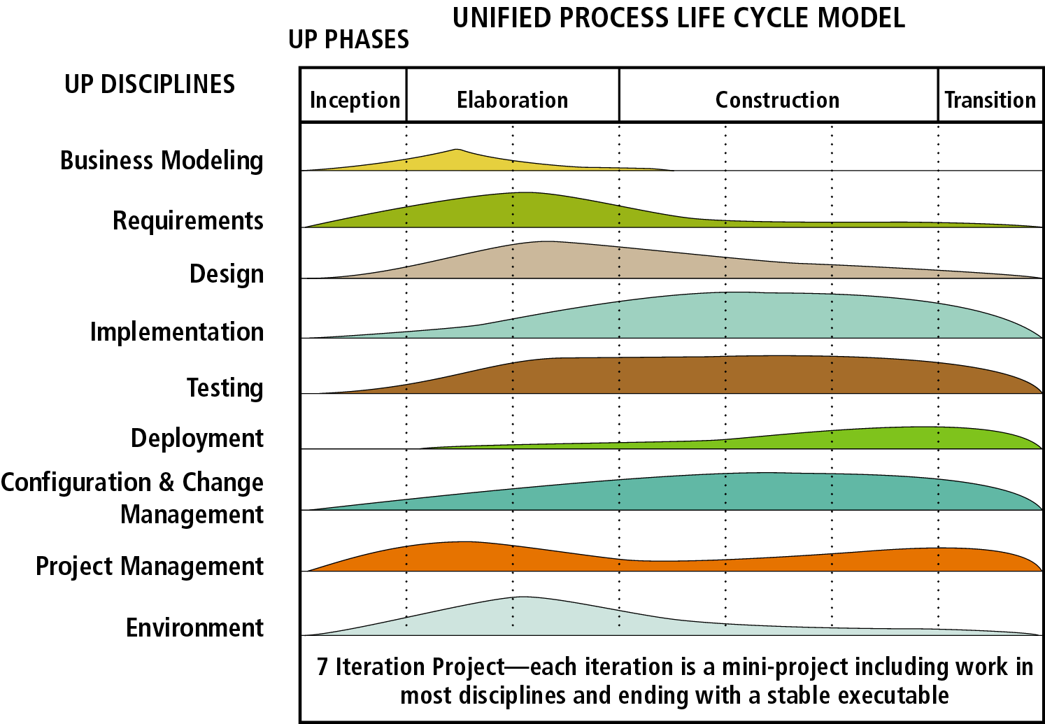
Figure 2-15
UP Life Cycle with Phases, Iterations, and Disciplines

Slide 28
The UP Disciplines
Six main UP development disciplines
Business modeling, requirements, design, implementation, testing, and deployment
Each iteration
Similar to a mini-project
Results in a completed portion of the system
Three additional support disciplines
Project management, configuration and change management, and environment

Slide 29
Nine core Discipline are:
Business Modeling
Re-envision and Re-engineering the Organization
Requirements
Define the User Requirements
Design
Design the system
Implementation
Write the software

Slide 30
Nine core Discipline are: (continued…)
Test
Test the system
Deployment
Integrate the software to the using organization
Configuration and Change management
Manage the artifacts of the evolving system
Project Management
Manage the development process
Environment
Support the development process with processes and tools

Slide 31
Project Management
Most important support discipline
Project management activities
Finalize the system and project scope
Develop the project and iteration schedule
Identify project risks and confirm feasibility
Monitor and control the project’s plan
Monitor and control communications
Monitor and control risks and outstanding issues

Slide 32
Configuration and Change Management
Configuration and change discipline pertains to:
Requirements
Design
Source code
Executables
The two activities in this discipline
Develop change control procedures
Manage models and software components

Slide 33
Environment
Development environment includes
Available facilities
Design of the workspace
Forums for team communication and interaction
Environment discipline activities
Select and configure the development tools
Tailor the UP development process
Provide technical support services

Slide 34
Overview of Object-Oriented Concepts
OOA views system as a collection of objects
Object: entity capable of responding to messages
Languages: Simula, C++, Java, C#, Visual Basic .NET
Object-oriented design (OOD)
Defines additional types of communication objects
Shows how the objects interact to complete tasks
Refines definition of objects for implementation
Object-oriented programming (OOP): object coding

Slide 35
Recognizing the Benefits of OO Development
Original application of object-oriented technology
Computer simulations
Graphical user interfaces
Rationale for use in information systems
Benefits of naturalness
Reusability

Slide 36
Objects Are More Natural
OO approach mirrors human perception: objects moving through space
OOA, OOD, and OOP imitate perceptual processes by modeling classes of objects
Some system developers resist OO development
New programmers are more receptive to OO approach
System users appreciate object-orientation
They discuss the objects involved in their work
Hierarchies are common tools for organizing knowledge

Slide 37
Classes of Objects Can Be Reused
Classes of objects have a long shelf life
Example: Customer class adaptability
Reused in systems where customer objects needed
Extended through inheritance to a new subclass
Reused during analysis, design, or programming
Classes may be stored, with implementation hidden, in class libraries

Slide 38
Understanding Object-Oriented Concepts
Object: thing with attributes and behaviors
Types of objects
User interface
Problem domain objects
Attributes are associated with data
Behaviors are associated with methods, functions, and procedures

Slide 39
Ex: A coffee mug on my desk is in a filled state because it is shaped to hold liquids and there is still coffee in it. When there is no more coffee in it, the state of the mug can be defined as empty. If it falls on the floor and breaks, it will be in a broken state.
My coffee mug is passive. It does not have behavior of its own. However, the same cannot be said of my dog or a tree outside my window. My dog barks, the tree grows etc. So, some real life objects do have behavior.

Slide 40
Figure 2-18
Attributes and Methods in Problem Domain Objects

Slide 41
Understanding Object-Oriented Concepts (continued)
Class: defines what all objects of class represent
Objects are instances of a class
Customer object is an instance of a customer class
Objects interact through messages
Objects retain memory of transactions

Slide 42
Abstract and Concrete Classes
Classes that can be instantiated into actual (real or virtual) objects are called concrete classes.
Classes that cannot be instantiated into actual (real or virtual) objects are abstract classes.

Slide 43
Abstract and Concrete Classes

Slide 44
Understanding Object-Oriented Concepts (continued

Slide 45
INSTANCE OBJECT
An object is an instance of a “thing”. It may be one of the many instances of the same “thing”. My mug is an instance in the set of possible mug.
An object is an instance of a class.
Class
A class is the descriptor for a set of objects with the same attributes and operations.
Attribute
An attribute is the type-value pair. Classes define attribute types. Objects contain attribute values.
Operation
An object contains data (attribute) and algorithms (operations) to act on these data. A procedure that implements the operation is called a method.

Slide 46
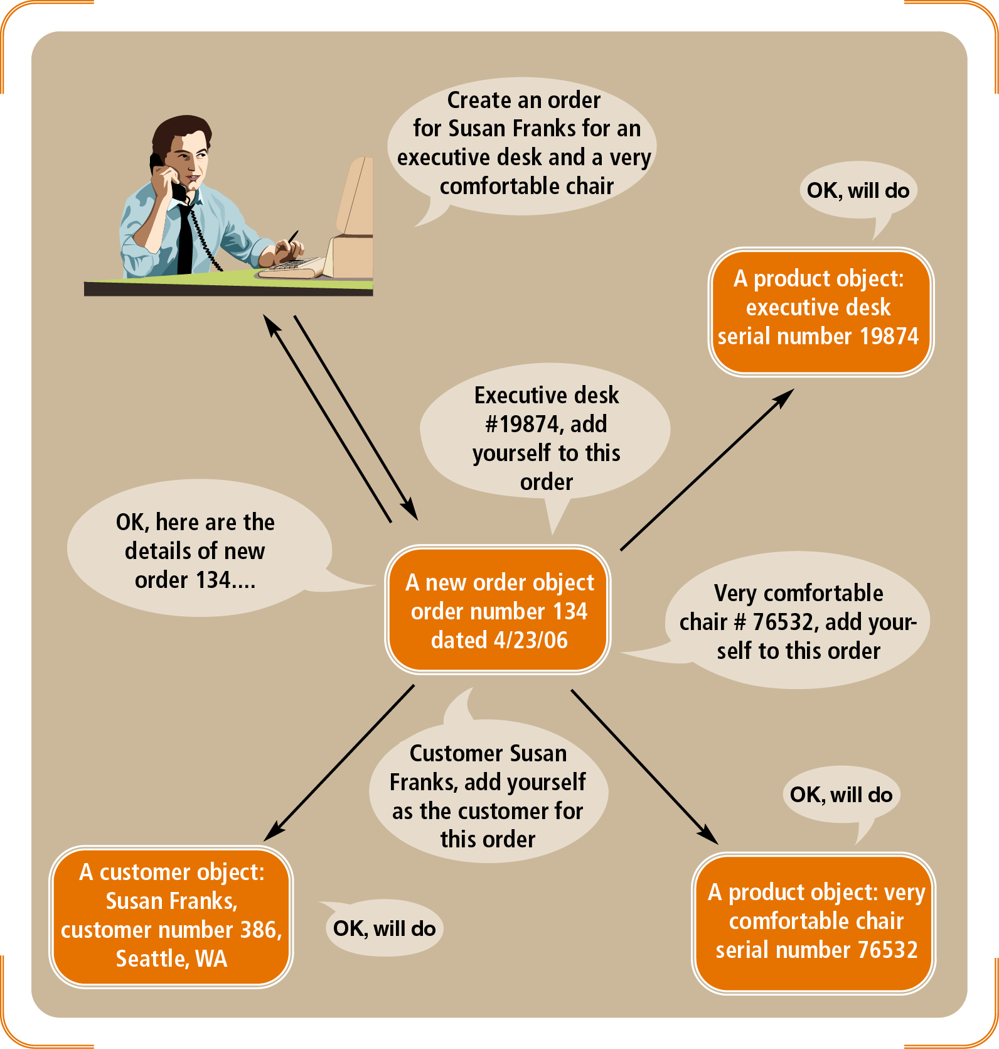
Figure 2-20
Order-processing system where objects interact by sending messages

Slide 47
Understanding Object-Oriented Concepts (continued)
Objects maintain association relationships
Encapsulation: combining attributes and methods into one unit
Information hiding: separating specification from implementation
Inheritance: extending the characteristics of a class
Polymorphism: ability for dissimilar objects to respond to the same message

Slide 48
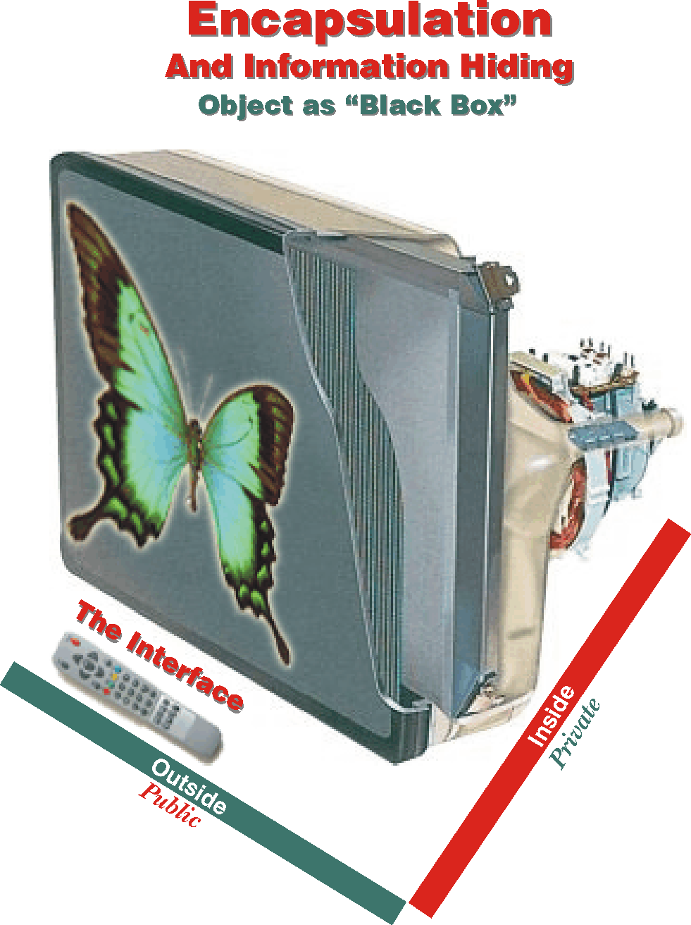
Encapsulation
Encapsulation is the packaging of data and processes within one single unit.

Slide 49
Association
is one kind of relationship between classes.
Provide a linkage between objects of given classes.
Objects needing to communicate with each other can use the linkage.
Inheritance
A generalization relationship is a kind of relationship between a more generic class (superclass or parent) and a more specialized kind of that class (subclass or child)

Slide 50
Information Hiding
Information hiding conceals and protects what goes on inside an object from the outside world.
When you use an ATM, encapsulation and information hiding ensure that:
❶ you are not burdened with the complexity of how the machine works,
❷ cannot perform operations that you are not allowed to, and
❸ cannot change the way the machine operates.

Slide 51
POLYMORPHISM
Polymorphism is the ability of objects belonging to different classes to perform the same operation differently.

Slide 52
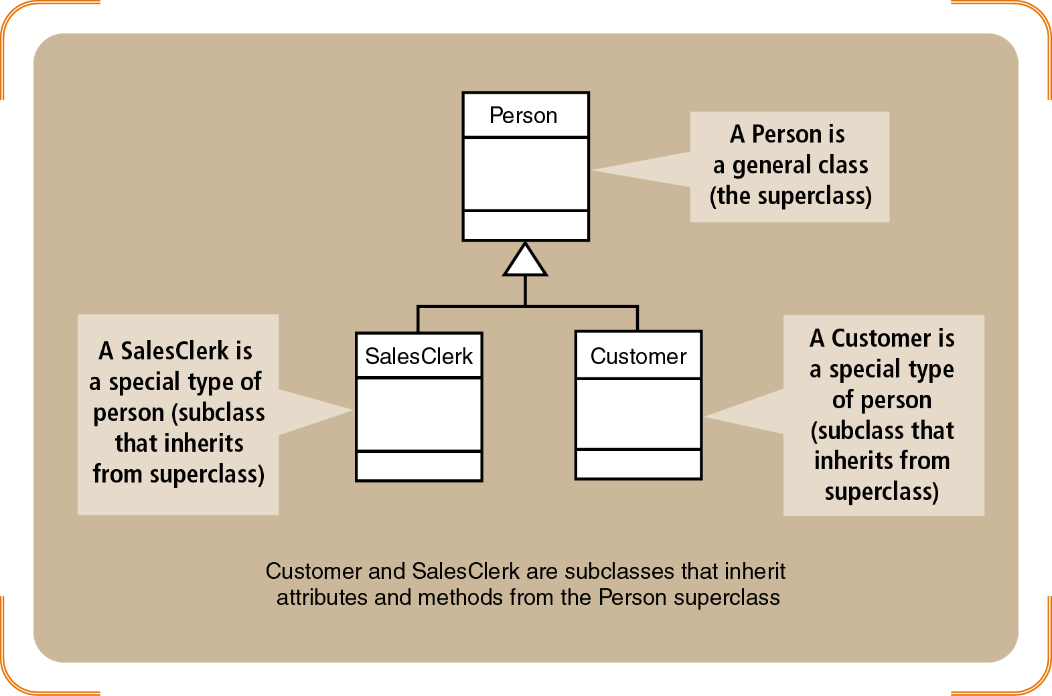
Figure 2-22
Superclasses and Subclasses

Slide 53
Tools to Support System Development
CASE (Computer Aided System Engineering)
Database repository for information system
Set of tools that help analysts complete activities
Sample artifacts: models, automatically generated code
Variations on CASE
Visual modeling tools
Integrated application development tools
Round-trip engineering tools

Slide 54
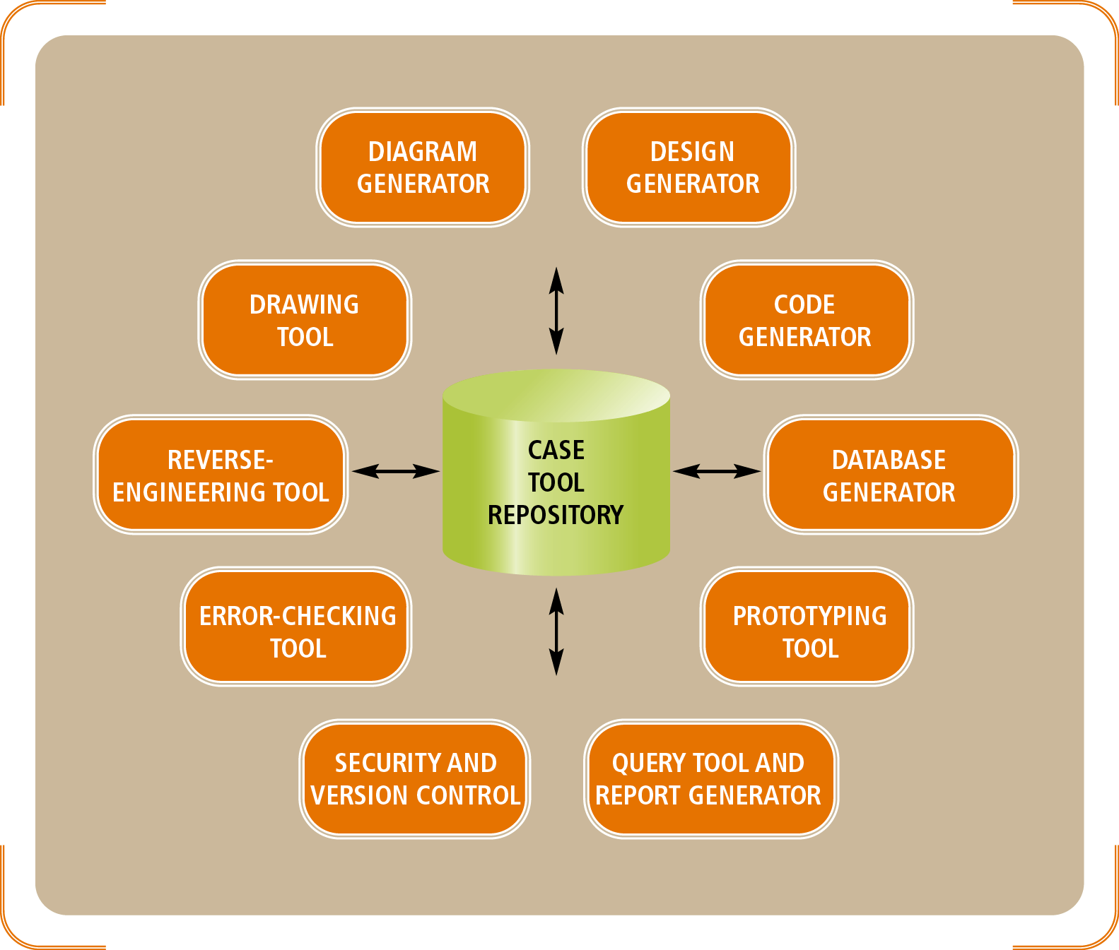
Figure 2-24
A Case Tool Repository Contains All Information About the System

Slide 55
Tools to Support System Development (continued)
Microsoft Visio: emphasizes technical drawing
Rational Rose
CASE tool supporting object-oriented approach
Strongly identified with UP methodology
Together
Pioneers round-trip engineering
synchronizes graphical models with generated program code
Leverages UML diagrams

Slide 56
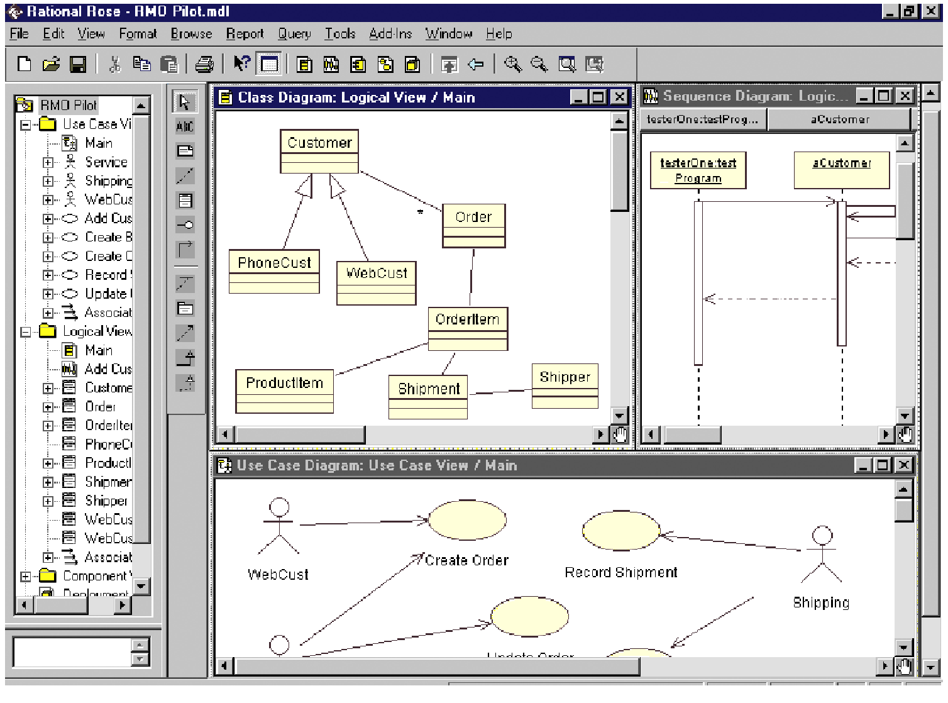
Figure 2-26
Visual Modeling Tool Rational Rose Displaying UML Diagrams

Slide 57
Tools to Support System Development (continued)
Embarcadero Describe
Visual Modeling
Round-trip engineering
Rational XDE Professional
Integrates Microsoft Visual Studio.NET IDE
Also provides visual modeling and round-trip

Slide 58
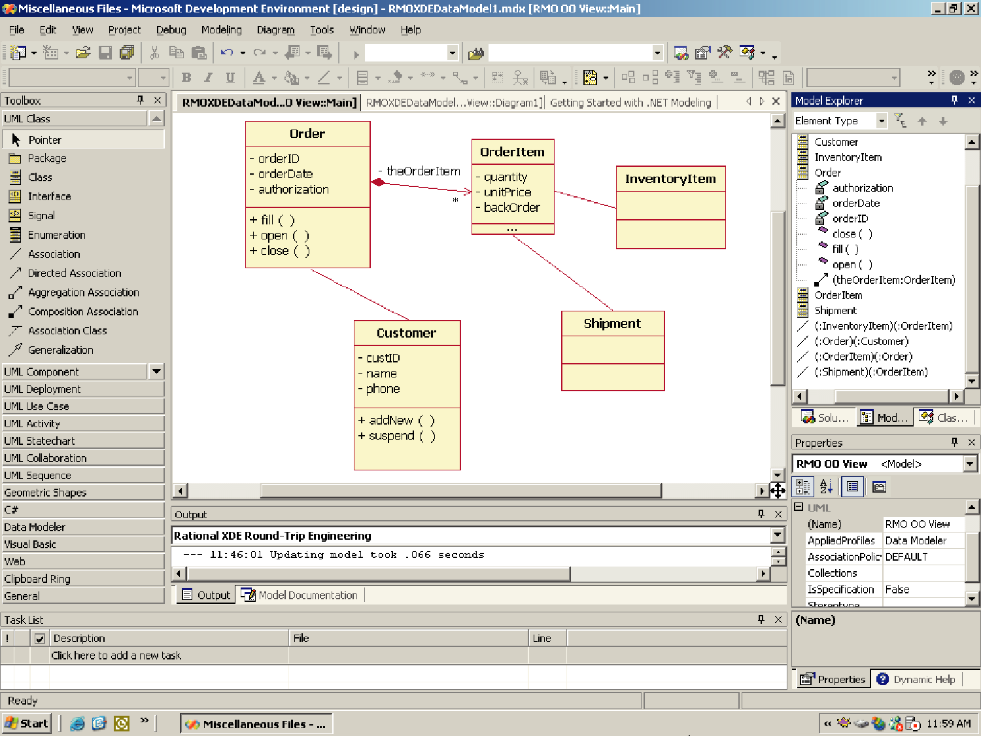
Figure 2-29
Rational XDE Professional is integrated with Visual Studio .NET

Slide 59
Summary
SDLC: set of activities required to complete system development project
Predictive SDLC: executes project in sequential phases (waterfall approach)
Adaptive SDLC: accommodates change and phase overlap
Spiral SDLC model introduces iterations (cycles)
UP is an adaptive system development methodology

Slide 60
Summary (continued)
UP life cycle includes four phases-inception, elaboration, construction, and transition
UP phases decomposed into one ore more iterations
Iterations involve work in nine UP disciplines
UP is object-oriented
Object-oriented concepts: object, class, methods, encapsulation, associations, inheritance, polymorphism
CASE: automation tools simplify development tasks

