Slide 1
EASTERN MEDITERRANEAN UNIVERSITY DEPARTMENT OF INDUSTRIAL ENGINEERING INFORMATION SYSTEMS AND TECHNOLOGY IENG 372 / MANE 372 Fall 2021-2022 Discussion Sessions
Lecturer : Khaoula Chnina

Slide 2
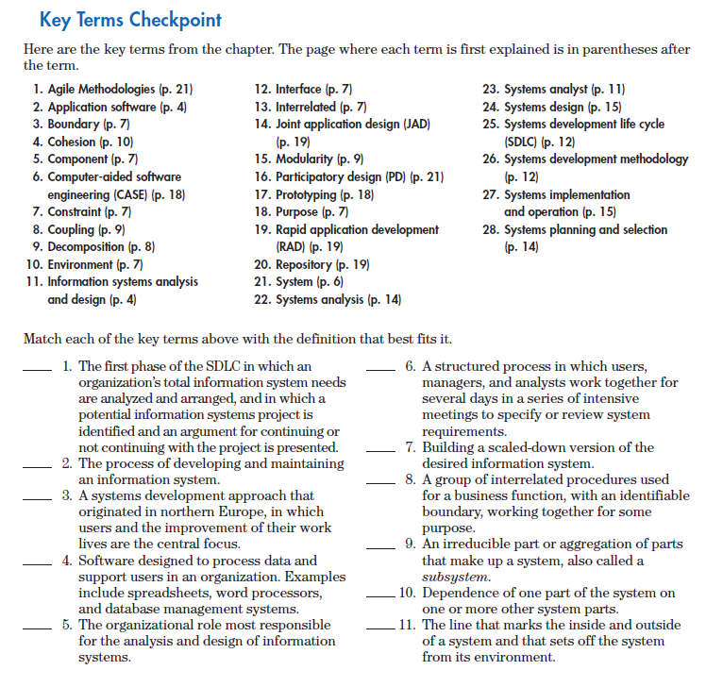
Chapter 1

Slide 3
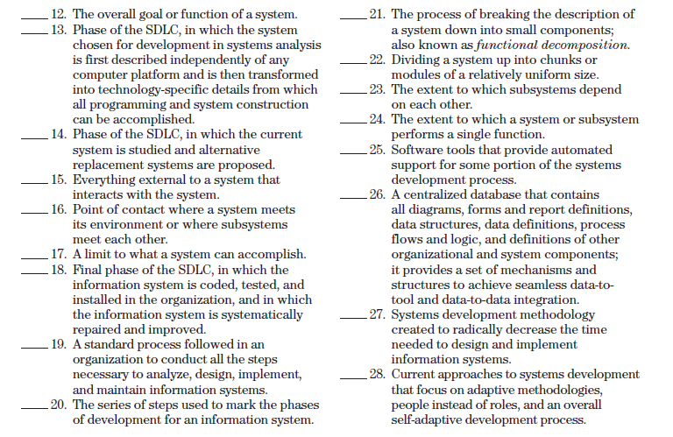

Slide 4
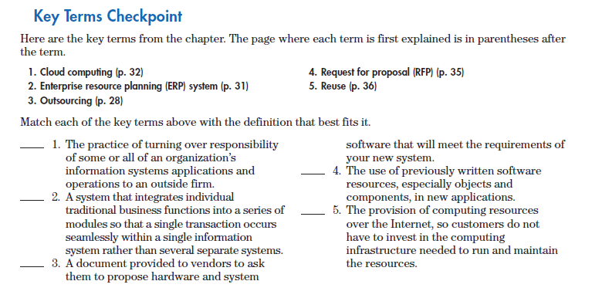
Chapter 2

Slide 5
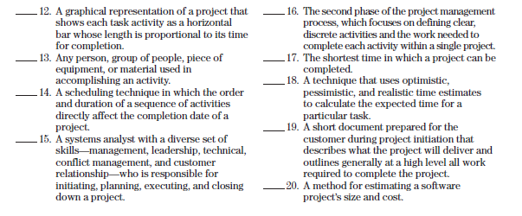
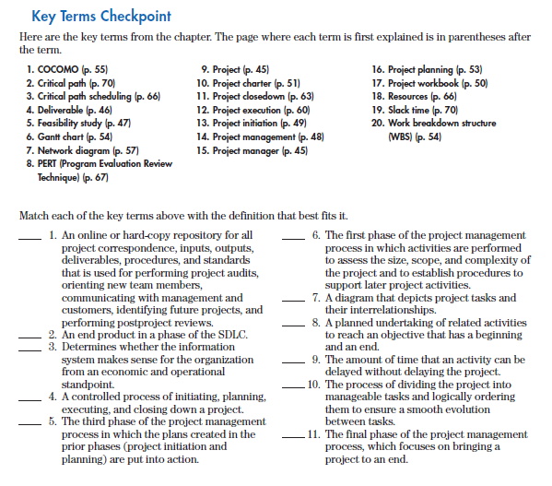
Chapter 3

Slide 6
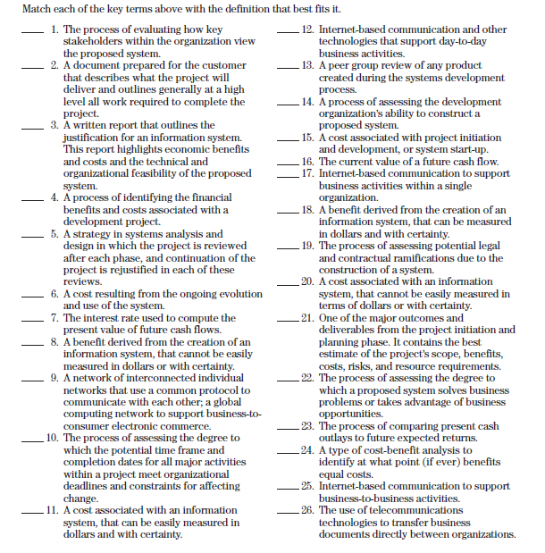
Chapter 4

Slide 7
Chapter 5

Slide 8
Chapter 6

Slide 9
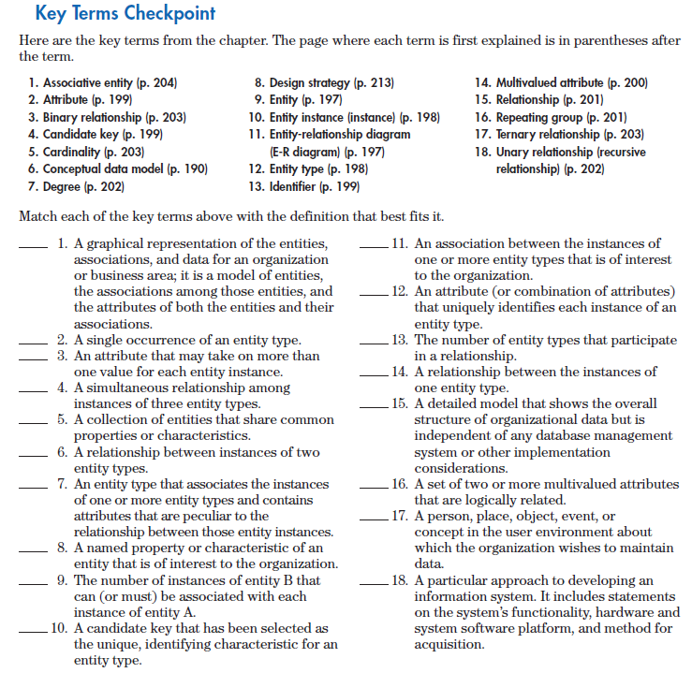
Chapter 7

Slide 10
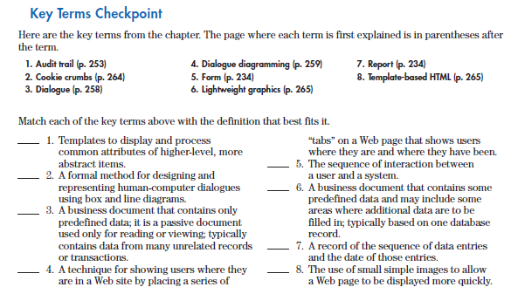
Chapter 8

Slide 11
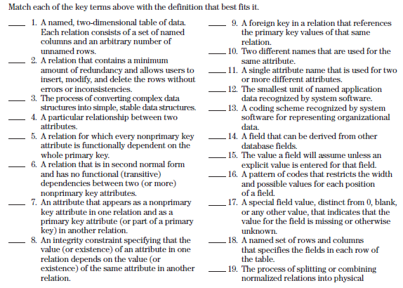
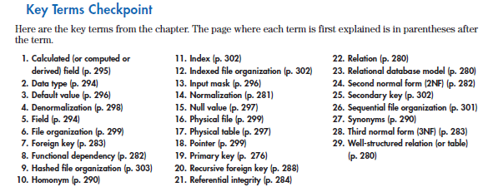
Chapter 9

Slide 12
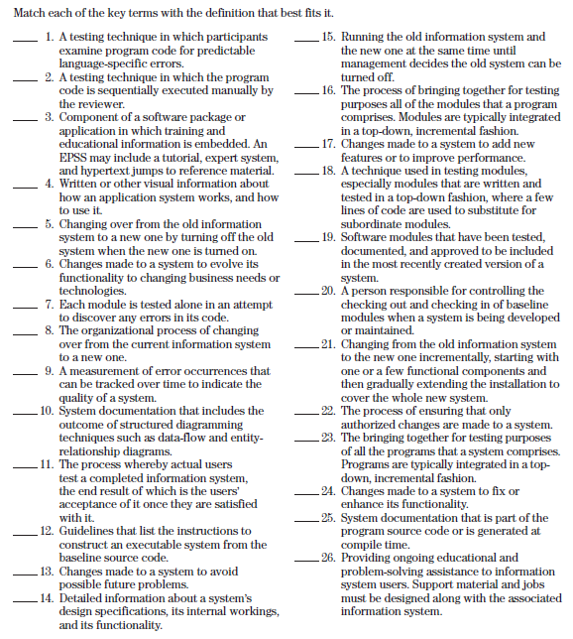
Chapter 10

