Slide 1
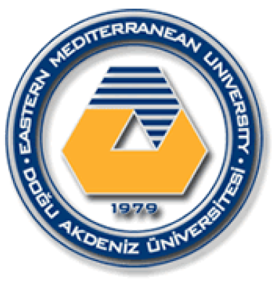
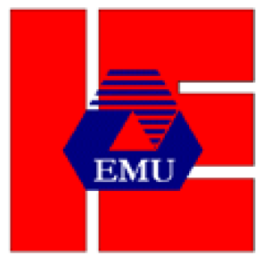
EASTERN MEDITERRANEAN UNIVERSITY DEPARTMENT OF INDUSTRIAL ENGINEERING
INFORMATION SYSTEMS AND TECHNOLOGY
IENG 372 / MANE 372
Spring 2021-2022
Chapter 4
Lecturer : Ms. Khaoula Chnina

Slide 2
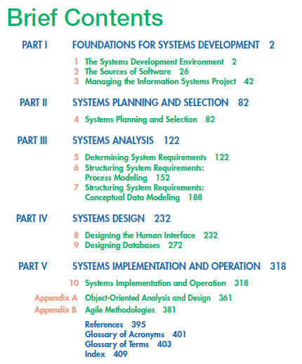

Slide 3
Chapter 4
Systems Planning and Selection
Identifying and Selecting Projects
Initiating and Planning Systems Development Projects
The Process of Initiating and Planning Systems Development Projects
Deliverables and Outcomes
Assessing Project Feasibility
Building the Baseline Project Plan
Assessing Economic Feasibility
Assessing Other Feasibility Concerns
Reviewing the Baseline Project Plan
Pine Valley Furniture WebStore: Systems Planning and Selection
The Process of Identifying and Selecting Information Systems Development Projects
Deliverables and Outcomes
Internet Basics
Pine Valley Furniture WebStore

Slide 4
Learning Objectives
Describe the steps involved when
identifying and selecting projects and
initiating and planning projects
Discuss the content of and need for a
project scope statement and baseline
project plan
Describe a structured walkthrough
Describe various methods of
cost/benefit analysis
Explain intangible and tangible costs
and benefits
Describe various methods for accessing
project feasibility
Explain recurring and one-time costs

Slide 5
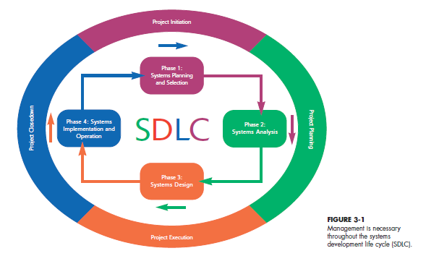
Project Management Process
Project Management Process |  | Stage 1 | Stage 2 |  | Stage 3 |  | Stage 4
SDLC |  | Phase 1 |  | Phase 2 | Phase 3 | Phase 4

Slide 6
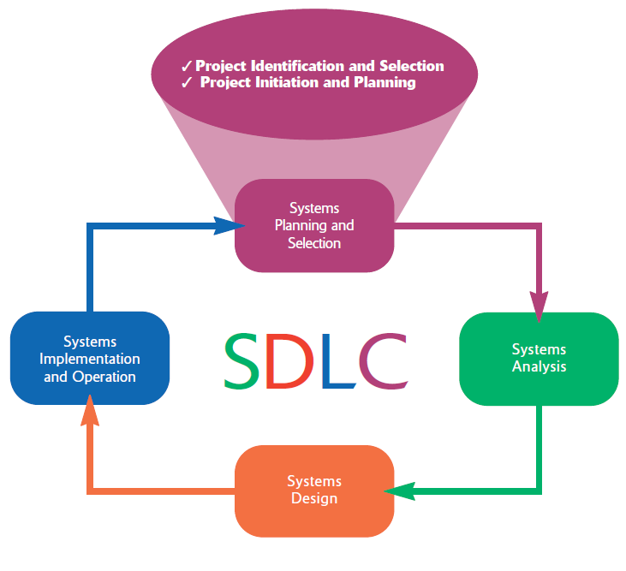
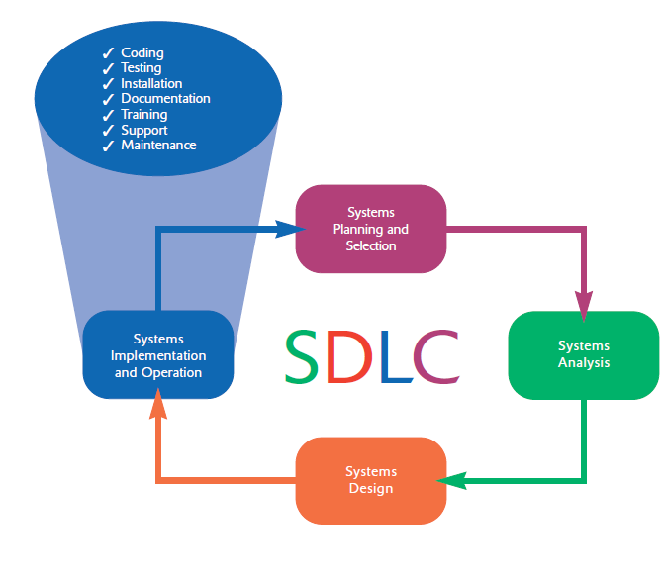
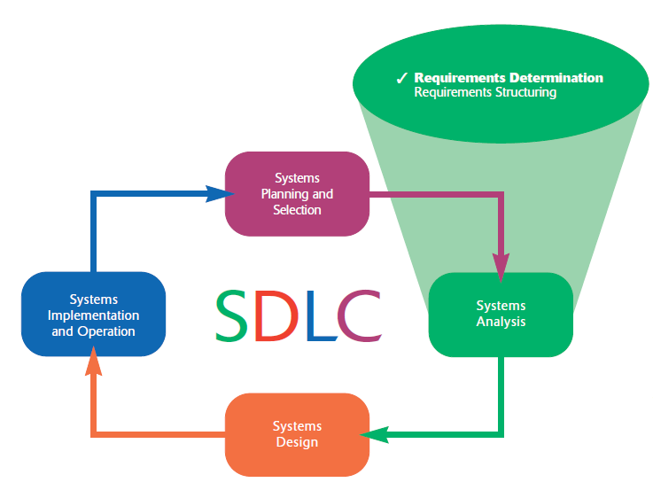
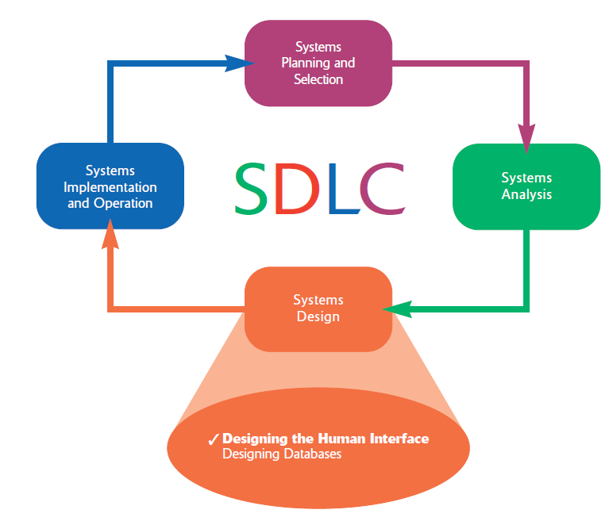

Slide 7
Stage 1 : Initiating the Project
Stage 2: Planning the Project
focuses on defining clear, discrete activities and the work needed to complete each activity within a single project.
Describe project scope, alternatives and feasibility
Divide the project into manageable tasks
Estimate resources and create a resource plan
Develop a preliminary schedule
Develop a communication plan
Determine project standards and procedures
Identify and assess risk Identify sources of risk
Create a preliminary budget
Develop a project scope statement
Set a baseline project plan
activities are performed to assess the size, scope, and complexity of the project and to establish procedures to support later project activities:
The project initiation team
Relationship with the customer
The project initiation plan
Management procedures
Establish the project management environment
Develop the project charter

Slide 8
Stage 3: Executing the Project
The plans created in the prior phases (project initiation and planning) are put into action.
Executing the baseline project plan
Monitoring project progress against the baseline project plan
Managing changes to the baseline project plan.
Maintaining the project workbook.
Communicating the project status
Stage 4: Closing Down the Project
Project closedown Is The final phase of the project management process, which focuses on bringing a project to an end.
Closing down the project
Conducting postproject reviews
Closing the customer contract

Slide 9
Phases of the Systems development life cycle (SDLC)
Phase 1: Systems planning and selection
Two primary activities.
Identification of the need for a new or enhanced system.
Information needs of the organization are examined, analyzed arranged , and projects to meet these needs are identified (Investigation and determination of scope).
The organization’s information system needs may result from:
- Requests to deal with problems in current procedures
- The desire to perform additional tasks
- The realization that information technology could be used to capitalize on an existing opportunity
A feasibility study is conducted before the second phase of the SDLC to determine the economic and organizational impact of the system.
Phase 2 : Systems Analysis
Study of current procedures and information systems and suggestion of alternative replacement systems.
Analysis has several subphases :
Determining the requirements of the system: what the users want from a proposed system. This subphase involves a careful study of any current systems, manual and computerized, that might be replaced or enhanced as part of this project.
Study and Structure of the requirements according to their interrelationships, eliminating any redundancies. And generate alternative initial designs to match the requirements.
Compare the alternatives to determine which best meets the requirements within the cost, labor, and technical levels the organization is willing to commit to the development process.
Description and recommendation of best alternative solution
0

Slide 10
Phase 3: Systems Design
Logical design (Theory):
The system could be implemented on any hardware and systems software.
concentrates on the business aspects of the system and how it will impact the functional units within the organization.
Physical design (Practice):
Turn the logical design into physical, or technical, specifications.
Convert diagrams into a structured systems design that can be converted to instructions written in a programming language.
Decision of the programming languages, database systems and file structures
Decision of hardware platform, operating system, and network environment the system will run under.
Phase 4: Systems Implementation and Operation
It is a two-step process:
Systems implementation:
Coding, testing, and installation.
Application software is installed, or loaded, on existing or new hardware.
Documentation, training programs, and ongoing user assistance
Operation:
Programmers correct the errors and make the changes that users ask for and modify the system to reflect changing business conditions.
System obsolescence, begin designing the system’s replacement, thereby completing the loop and starting the life cycle over again.

Slide 11
1- Identifying and Selecting Projects
During this activity, a senior manager, a business group, an IS manager, or a steering committee identifies and assesses all possible systems development projects that a business unit could undertake.
Those projects deemed most likely to yield significant organizational benefits, given available resources, are selected.
In some organizations, project identification and selection is a formal process in which projects are outcomes of a larger overall planning process (e.g. comparing all competing projects).
Some organizations use informal project selection processes that allow the highest-ranking IS manager to select projects independently or allow individual business units to decide on projects after agreeing on funding.
Requests for information systems development can come from three key sources : Managers and business units, IS managers, and Formal planning groups.

Slide 12
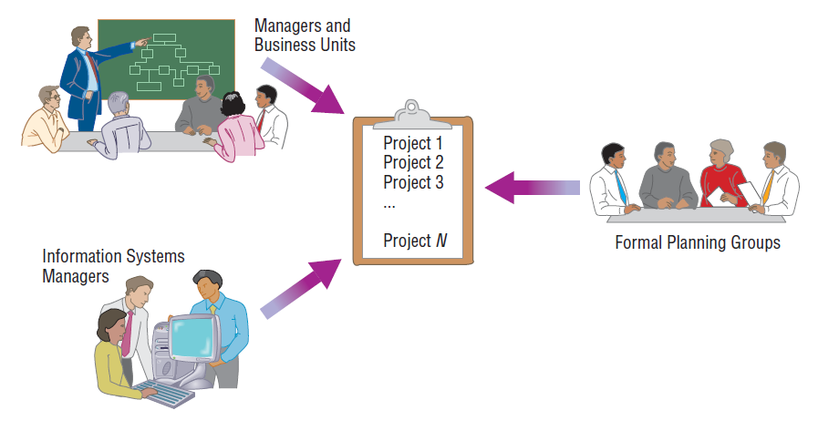
Sources of Projects :
Managers and business units : to gain needed information or to provide a new service to customers
Information systems managers : to make a system more efficient, less costly to operate, or to move a system to a new operating environment
Formal planning groups : to improve an existing system in order to help the organization meet its corporate objectives

Slide 13
The Process of Identifying and Selecting Information Systems Development Projects
A common sequence of activities regardless of how an organization executes the project identification and selection process.
Project identification and selection consists of three primary activities:
Identifying potential development projects
classifying and ranking projects
selecting projects for development
1- Identifying potential development projects.
Projects can be identified by :
Top management
Steering committees
User departments
The development group or a senior IS manager

Slide 14
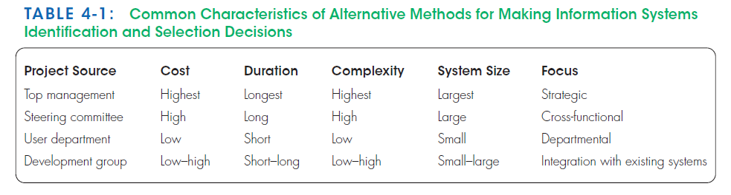
Top-Down source | top management | the CEO of a small or medium-size organization or a senior executive in a larger organization | strategic organizational focus | having better understanding of overall business objectives and constraints, they reflect the broader(global) needs of the organization.
 | steering committee | a cross section of managers with an interest in systems | reflect the diversity and have a cross-functional focus
Bottom-Up source | User departments | the head of the requesting unit or a committee from the requesting department | narrow, tactical focus | designed for a particular business need they may not reflect the overall goals (broader) of the organization
 | The development group or a senior IS manager | IS staff | based on the ease with which existing hardware and systems will integrate with the proposed project.

Slide 15
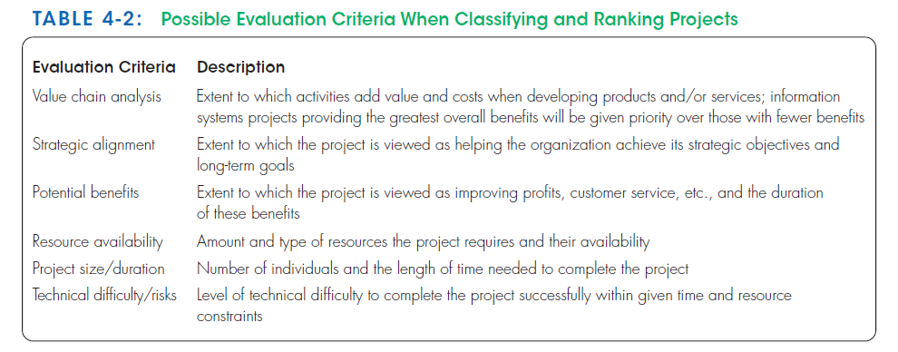
2- Classifying and ranking IS development projects
Assessing the merit of potential projects
can be performed by top managers, a steering committee, business units, or the IS development group.
the merit of a given project can vary based on the size of the organization.

Slide 16
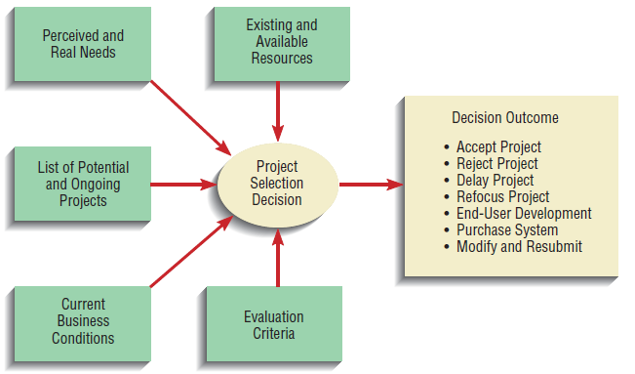
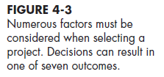
3- Selecting IS development projects
The short- and long-term projects most likely to achieve business objectives are considered.
Factors to be considered in a project selection:
Perceived needs of the organization
Existing systems and ongoing projects
Resource availability
Evaluation criteria
Current business conditions
Perspectives of the decision makers
This decision-making process can lead to numerous outcomes :
Project is accepted : funding to conduct the next SDLC activity has been approved
Project is rejected : the project will no longer be considered for development
Project is conditionally accepted: accepted pending the approval or availability of needed resources or the demonstration that a particularly difficult aspect of the system can be developed.
Project is returned to the original requesters who are told to develop or purchase the requested system themselves.
Resubmit: modify and resubmit after making suggested changes or clarifications.

Slide 17
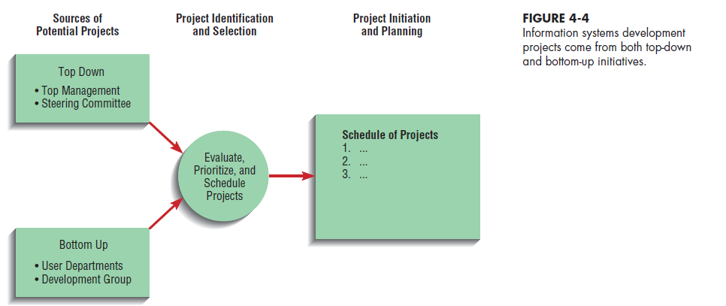
Deliverables and Outcomes
The primary deliverable, or end product, from this phase is a schedule of specific IS development projects.
The principle of incremental commitment : after each subsequent SDLC activity, the project is reassessed to determine whether the business conditions have changed or whether a more detailed understanding of a system’s costs, benefits, and risks would suggest that the project is not as worthy as previously thought, thus a selected project does not necessarily result in a working system.
SDLC – Phase 1

Slide 18
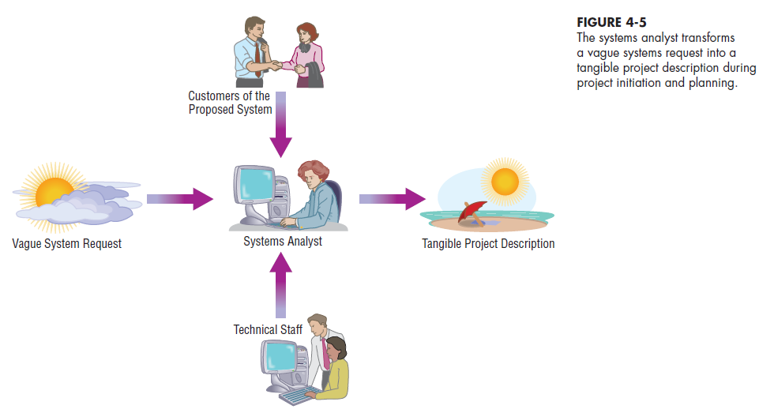
2- Initiating and Planning Systems Development Projects
Between 10 and 20 percent of the entire development effort should be expended on initiation and planning.
Done during planning phase of SDLC, some activities could be done during analysis phase of SDLC.
The objective is to transform a vague system request document into a tangible project description.

Slide 19
The Process of Initiating and Planning Systems Development Projects
Project initiation : activities that will help organize a team to conduct project planning. During initiation, one or more analysts are assigned to work with a customer to establish work standards and communication procedures.
Project planning : focuses on defining clear, discrete tasks and the work needed to complete each task.
The objective of the project planning process is to set the project objectives and produce two documents:
Baseline Project Plan (BPP)
Project Scope Statement (PSS)
Further, numerous assumptions about resource availability and potential problems will have to be made. Analysis of these assumptions and system costs and benefits forms a business case.
Business case : A written report that outlines the justification for an information system. The report highlights economic benefits and costs and the technical and organizational feasibility of the proposed system.

Slide 20
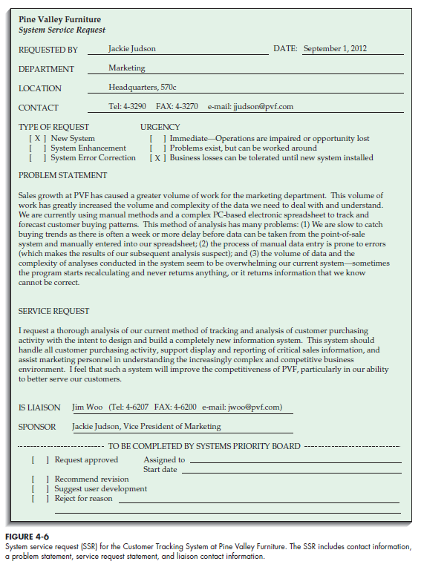
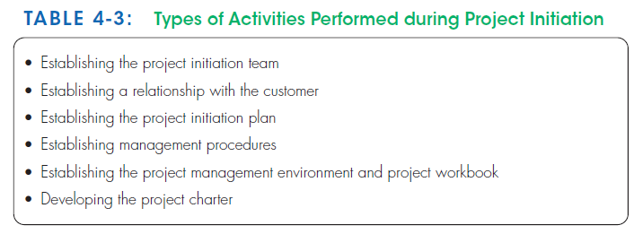
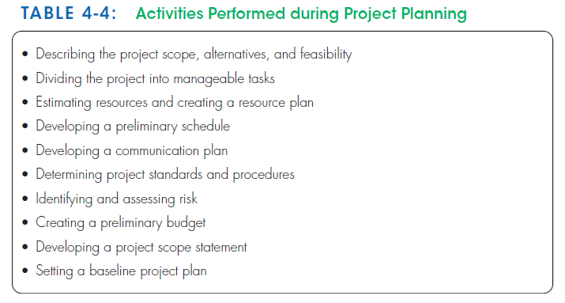

Slide 21
Deliverables and Outcomes
1- The baseline project plan (BPP)
It is an internal document that contains the best estimate of the project’s scope, benefits, costs, risks, and resource requirements.
contains all information collected and analyzed during the project initiation and planning activity.
The BPP specifies detailed project activities for the next life cycle phase (systems analysis) and provides less detail for subsequent project phases .
The project selection committee uses the BPP to help decide whether to continue, redirect, or cancel a project.
If the project is selected, the BPP becomes the foundation document for all subsequent SDLC activities
2- Project scope statement :
Prepared for external and internal stakeholders, and outlines the objectives of the project for the customer (high-level Overview) .

Slide 22
3- Assessing Project Feasibility
Economic : cost-benefit analysis
Operational : Assessment of how a proposed system solves business problems or takes advantage of opportunities
Technical : Assessment of the development organization’s ability to construct a proposed system (hardware, software, and operating environments to be used, as well as, system size, complexity, and the group’s experience
Schedule : Assessment of time-frame and project completion dates with respect to organization constraints for affecting change
Legal and contractual : Assessment of legal and contractual ramifications of new system (copyright or nondisclosure infringements, labor laws, antitrust legislation)
Political : Assessment of key stakeholders’ view in organization toward proposed system (may take steps to block, disrupt, or change the project’s intended focus)
The analysis of these six factors forms the business case that justifies the expenditure of resources on the project.

Slide 23
i - Assessing Economic Feasibility
The purpose for assessing economic feasibility is to identify the financial benefits and costs associated with the development project.
Economic feasibility is often referred to as cost-benefit analysis.
During this stage (project initiation and planning) benefits and costs are not defines precisely, they can be just quantified.
worksheets and techniques can be used to record costs and benefits and make the related calculations respectively,
These worksheets and techniques are used after each SDLC phase to decide whether to continue, redirect, or kill a project.
Worksheets Data are collected from users of the current system.

Slide 24
A- Determining Project Benefits
Examples of the benefits of a new or renovated IS :
automate monotonous jobs,
reduce errors,
provide innovative services to customers and suppliers,
improve organizational efficiency, speed, flexibility, and morale.
Type of benefits | Tangible benefits | Intangible benefits
Definition | can be measured in dollars and with certainty | cannot be easily measured in dollars or with certainty
Examples | reduced personnel expenses lower transaction costs higher profit margins. | direct organizational benefits the improvement of employee morale broader societal implications reduction of waste creation or resource consumption.
Ease | Most often (but not always) easy to quantify in terms of hard dollar savings | Can be described in the final BPP
Categories | Cost reduction and avoidance Error reduction Increased flexibility Increased speed of activity Improvement of management planning and control Opening new markets and increasing sales opportunities | Competitive necessity Increased organizational flexibility Increased employee morale Promotion of organizational learning and understanding More timely information
Potential tangible benefits may have to be considered intangible during project initiation and planning because they could not be quantified in dollars or with certainty. During later stages, they can become tangible benefits

Slide 25
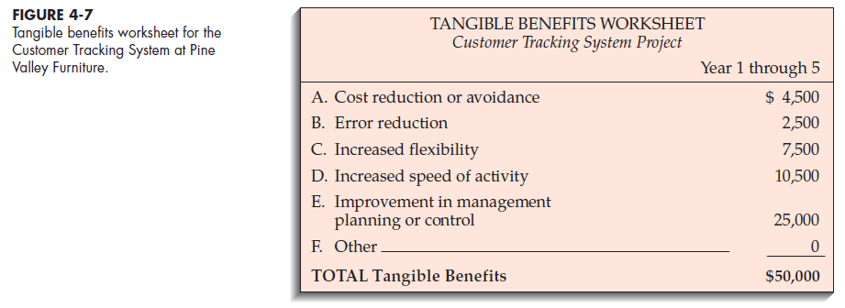
Example of tangible benefits worksheet ( PVF company – CTS project)
The person responsible for collecting, entering, and analyzing the correctness of the current customer tracking data estimated that he spent 10 percent of his time correcting data-entry errors. This person’s salary is $25,000, then the estimated error reduction benefit is $2,500 (10 percent of $25,000).
Managers assumed that cost reduction or avoidance benefits could be gained with better inventory management. (4500 dollars)
increased flexibility would likely occur from a reduction in the time normally taken to reorganize data manually for different purposes. (7500 dollars + 10500 dollars)
improvements in management planning or control should result from a broader range of analyses in the new system. (25000 dollars)

Slide 26
B- Determining Project Costs
Type | Tangible cost | Intangible cost | One-time cost | Recurring cost
Definition | an item that you can easily measure in dollars and with certainty | Cannot be easily measured in terms of dollars or with certainty. | associated with project initiation and development, or system start-up. May be staged over one or more years (One worksheet for each year) | resulting from the ongoing evolution and use of the system.
Examples | hardware costs labor costs operational costs employee training building renovations | Loss of customer goodwill Loss of employee morale operational inefficiency | System development New hardware and software purchases User training Site preparation Data or system conversion | Application software maintenance Incremental data storage expense Incremental communications New software and hardware leases Consumable supplies and other expenses (paper, forms, datacenter personnel)
 |  |  | consist of items that are fixed or variable in nature. Fixed costs refer to costs that are billed or incurred at a regular interval and usually at a fixed rate (facility lease payment) Variable costs refer to items that vary in relation to usage (Long distance phone charges)

Slide 27
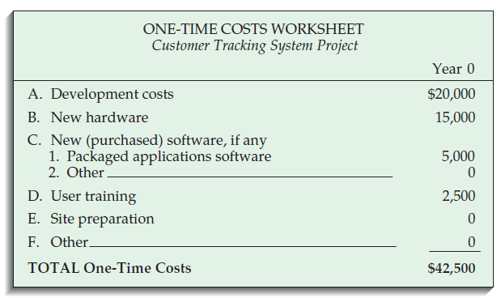

Example of One-time costs worksheet ( PVF company – CTS project)
One-time costs were established by discussing the system with the boss, who felt that the system would require :
approximately four months to develop (at $5,000 per month).
To run the new system effectively, the marketing department would need to upgrade at least five of its current workstations (at $3,000 each).
software licenses for each workstation (at $1,000 each)
user training fees (10 users at $250 each) .

Slide 28
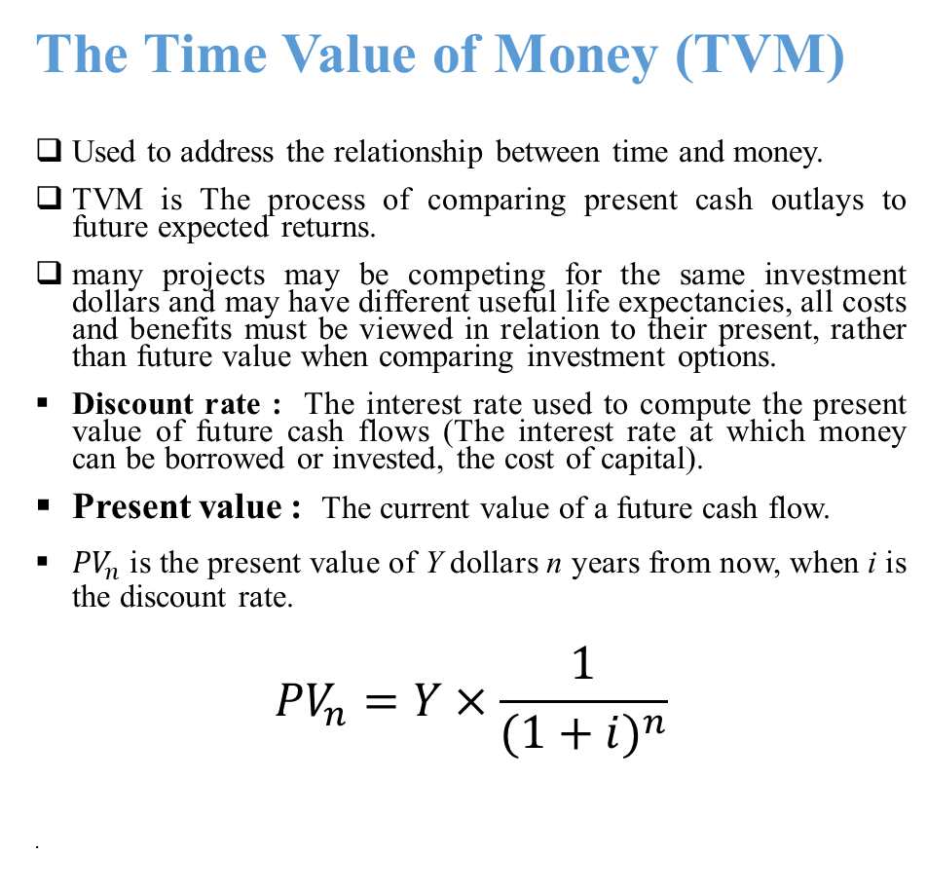
The Time Value of Money (TVM)
Used to address the relationship between time and money.
TVM is The process of comparing present cash outlays to future expected returns.
many projects may be competing for the same investment dollars and may have different useful life expectancies, all costs and benefits must be viewed in relation to their present, rather than future value when comparing investment options.
Discount rate : The interest rate used to compute the present value of future cash flows (The interest rate at which money can be borrowed or invested, the cost of capital).
Present value : The current value of a future cash flow.
${PV}_{n}$ is the present value of Y dollars n years from now, when i is the discount rate.
$${PV}_{n}=Y×\frac{1}{{(1+i)}^{n}}$$
Example :
You want to buy a used car and you make three payments of $1,500 for three years, beginning next year, for a total of $4,500.
If you want to pay all the amount once at the beginning, what amount should you pay ? Should the single payment be $4,500? Should it be more or less?
years
Present
Future
interest

Slide 29
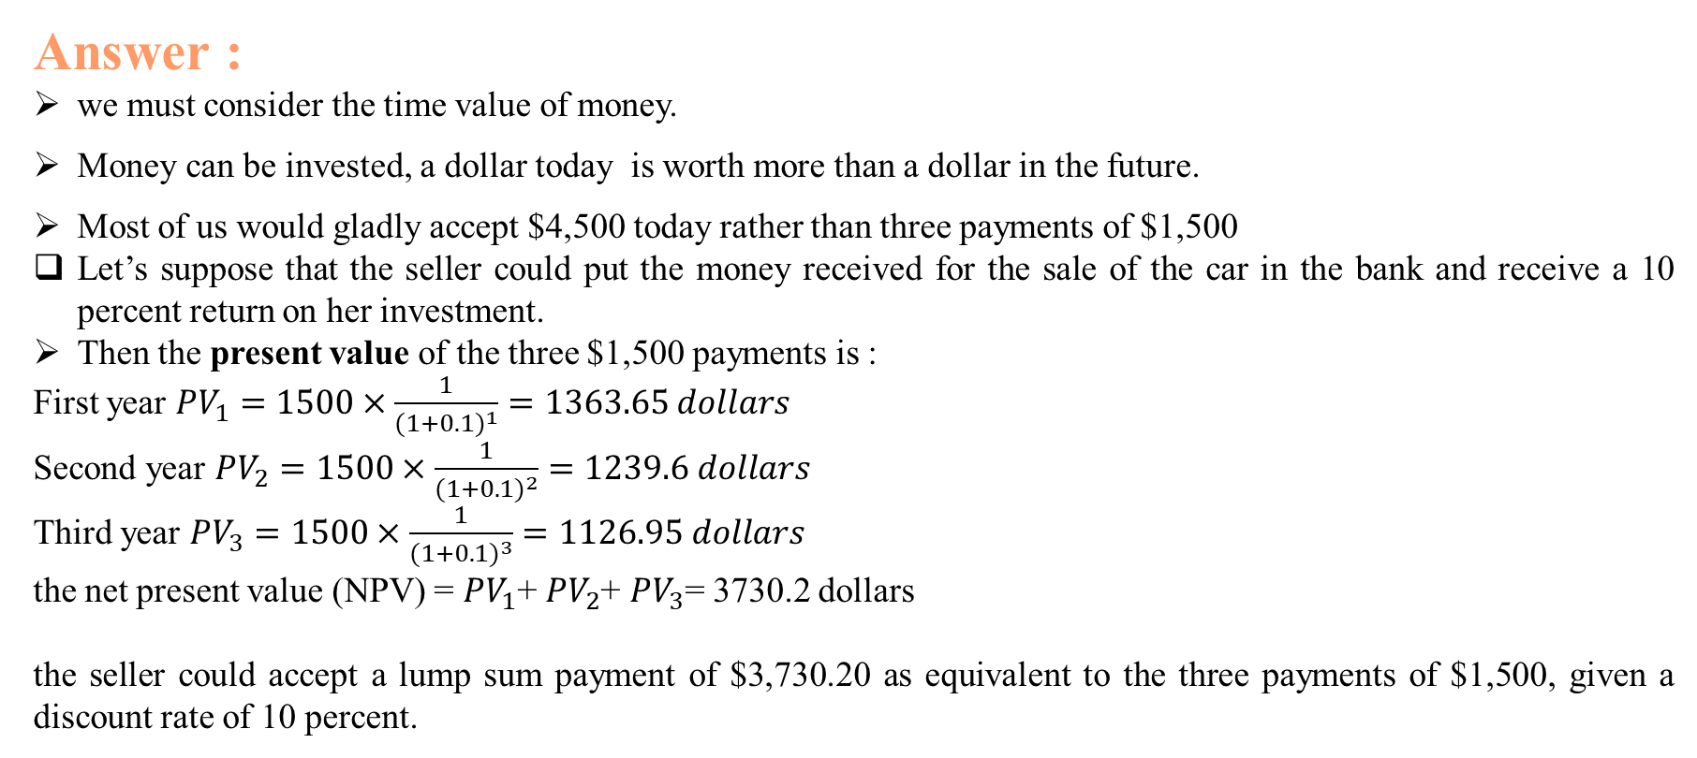
Answer :
we must consider the time value of money.
Money can be invested, a dollar today is worth more than a dollar in the future.
Most of us would gladly accept $4,500 today rather than three payments of $1,500
Let’s suppose that the seller could put the money received for the sale of the car in the bank and receive a 10 percent return on her investment.
Then the present value of the three $1,500 payments is :
First year ${PV}_{1}=1500×\frac{1}{{(1+0.1)}^{1}}=1363.65 dollars$
Second year ${PV}_{2}=1500×\frac{1}{{(1+0.1)}^{2}}=1239.6 dollars$
Third year ${PV}_{3}=1500×\frac{1}{{(1+0.1)}^{3}}=1126.95 dollars$
the net present value (NPV) = ${PV}_{1}$+ ${PV}_{2}$+ ${PV}_{3}$= 3730.2 dollars
the seller could accept a lump sum payment of $3,730.20 as equivalent to the three payments of $1,500, given a discount rate of 10 percent.

Slide 30
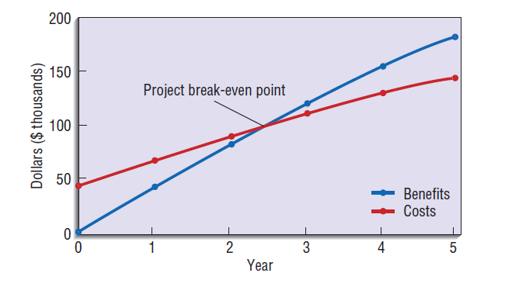

Summary Worksheet
A summary worksheet reflects the present values of all benefits and costs
The overall ROI value is useful for making project comparisons on an economic basis. An ROI analysis can be calculated for each year of the project.
Break-even analysis : A type of cost-benefit analysis to identify at what point (if ever) benefits equal costs.
To conduct this analysis, the NPV of the yearly cash flows is determined.
The yearly NPV cash flows = PV of the yearly benefits - ( the one-time cost + PV of the recurring costs).
The overall NPV of the cash flows reflect the total cash flows for all preceding years.
Overall NPV cash flows = NVP of benefits – NVP of costs
break-even occurs between the first year in which the overall NPV cash flows figure is non-negative the year before it.
Identifying the point when Break even occurs can be derived as follows:

Slide 31
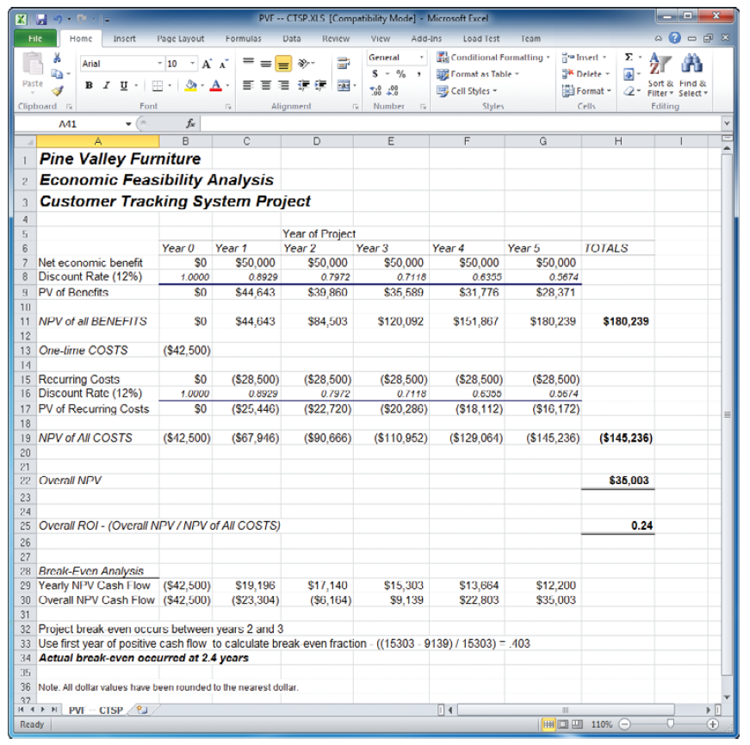
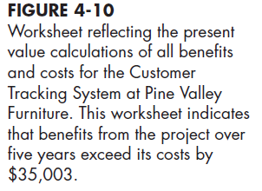

$${PV}_{n}=Y×\frac{1}{{(1+i)}^{n}}$$
Total yearly tangible benefits from the worksheet
Time Horizon
years | 1 | 2 | 3 | 4 | 5
Y | 50000 | 50000 | 50000 | 50000 | 50000
i | 0,12 | 0,12 | 0,12 | 0,12 | 0,12
PV | 44642,86 | 39859,69 | 35589,01 | 31775,9 | 28371,34
cost of capital (discount rate)
NPV of the total tangible benefits
NPV of the total costs
The NPV for the project
(benefits > costs).
The overall return on investment
First positive
break-even analysis
2 years and 4 months and 24 days

Slide 32
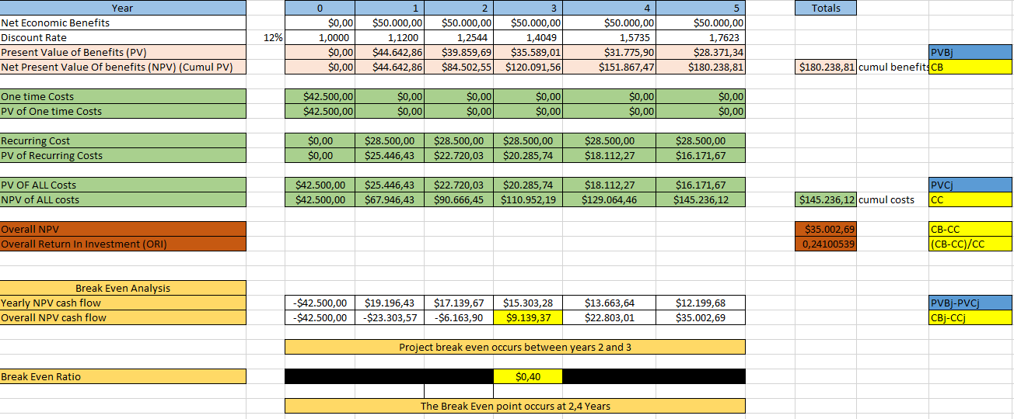

Slide 33
Chapter 4 - PART2

Slide 34
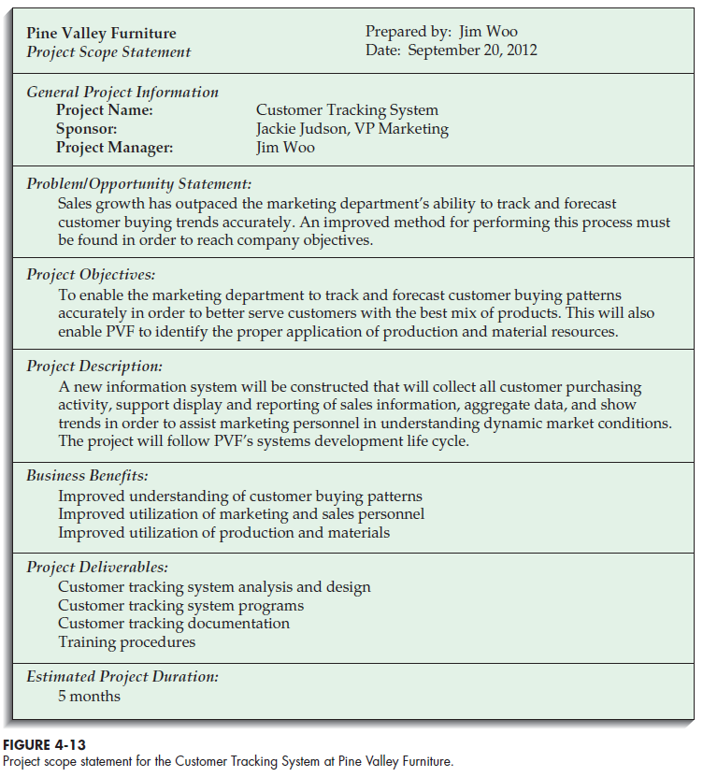
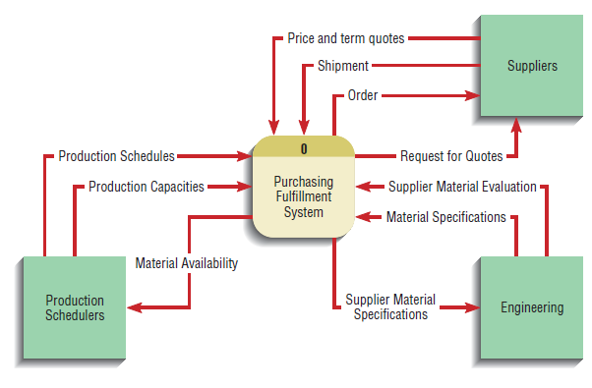

4- Building the Baseline Project Plan & Project Scope Statement
A- Project Scope Statement
A project scope statement provides a detailed description of the work that must be done to deliver the output of a project on time and within the allotted budget.
The document also places the objectives of the project and its output—which could be a product that a company is releasing to the marketplace or analysis that leadership will use to make an informed business decision—within the larger context of the organization’s goals and objectives.

Slide 35
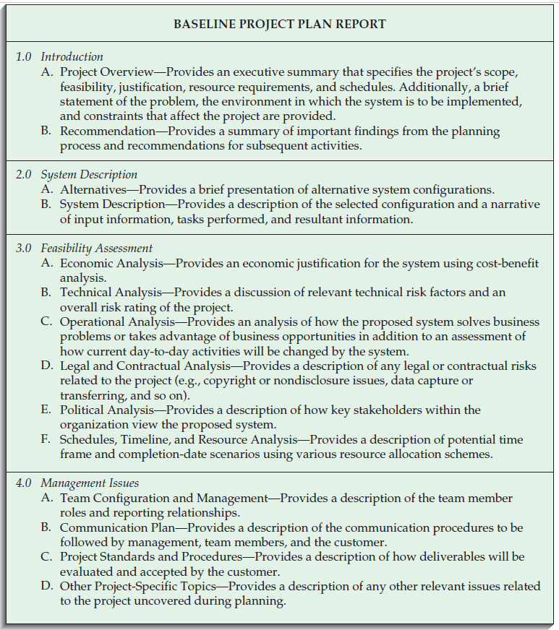
B- The Baseline Project Plan
Objectives
Assures that customer and development group have a complete understanding of the proposed system and requirements
Provides sponsoring organization with a clear idea of scope, benefits and duration of project
Four Sections of a Baseline Project Plan:
Introduction
System description
Feasibility assessment
Management issues

Slide 36
I- Introduction:
It is limited to only a few pages
It is the final section to be written
Brief overview
Recommended course of action
Definition of the project scope:
Units affected (business functions and divisions) by or use the proposed system
Who is interested by the system
Interaction with other systems
Range of system capabilities
II- System Description :
Narrative format
Outline of possible alternative solutions
how the system would be acquired : (1) purchase , (2) outsource or (3) build the system in-home.
Defining the comprehensiveness of the system’s functionality ( tasks that would be accomplished when using the CTS-Common Type System).
Alternatives may be stated as simply as this:
1. Web-based online system
2. Mainframe with central database
3. Local area network with decentralized databases
4. Batch data input with online retrieval
5. Purchasing of a prewritten package

Slide 37
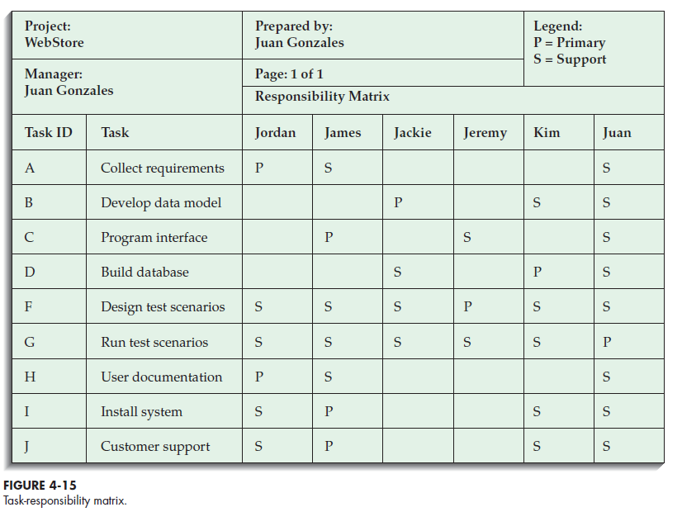
III- Feasibility Assessment :
outlines project costs and benefits
technical difficulties.
This section is where high-level project schedules are specified using Network diagrams and Gantt charts (this process is referred to as a work breakdown structure).
VI- Management Issues :
outlines the concerns that management has about the project
the team configuration and management ( who will do what? and how work will be supervised and reviewed )
the communication plan (Customer - review meetings, newsletter; team- computer-based conference facility)
the project standards and procedures ( procedures for submitting and approving project change requests and any other issues deemed important for the project’s success) .

Slide 38
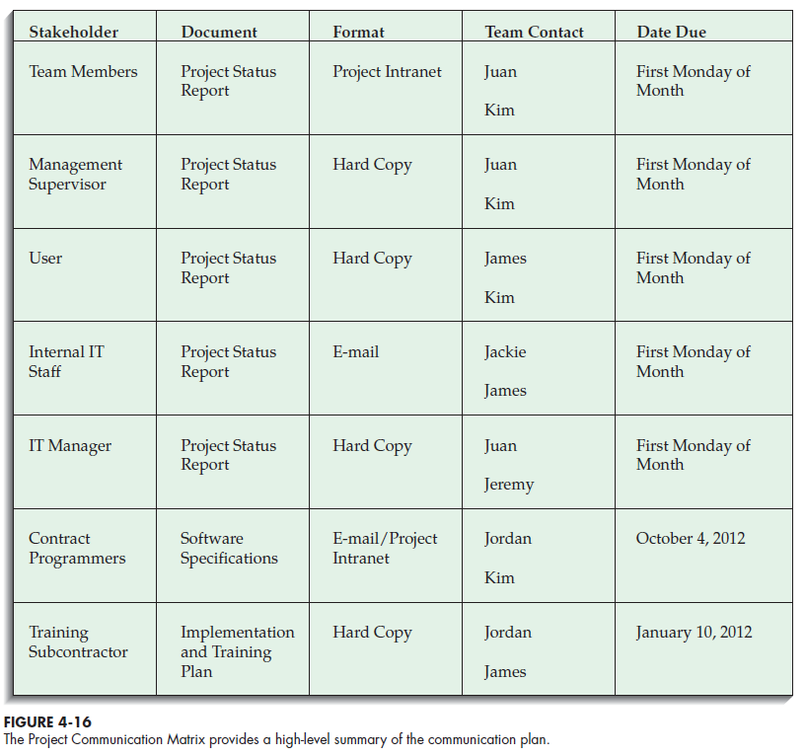

Slide 39
5- Reviewing the Baseline Project Plan
Objectives
Assure conformity to organizational standards
All parties agree to continue with project
Method for Reviewing:
Walkthrough : A peer group review of any product created during the systems development process; also called a structured walkthrough. They have a specific agenda and shown on the project schedule.
Advantage: to ensure that formal review points occur during the project
Activities
Walkthrough review form
Individuals polled
Walkthrough action list
Participants
Coordinator : plans the meeting and facilitates discussions.
Presenter : describes the work product to the group
User : makes sure that the product meets the needs of the customers
Secretary : takes notes and records decisions or recommendations
Standard Bearer : ensures that the work product adheres to organizational technical standards
Maintenance Oracle : make the system and its documentation easy to maintain.
In addition to reviewing the BPP, the walkthrough meetings can be used for System specifications, Logical and physical designs, Code or program segments, Test procedures and results, Manuals and documentation.

Slide 40
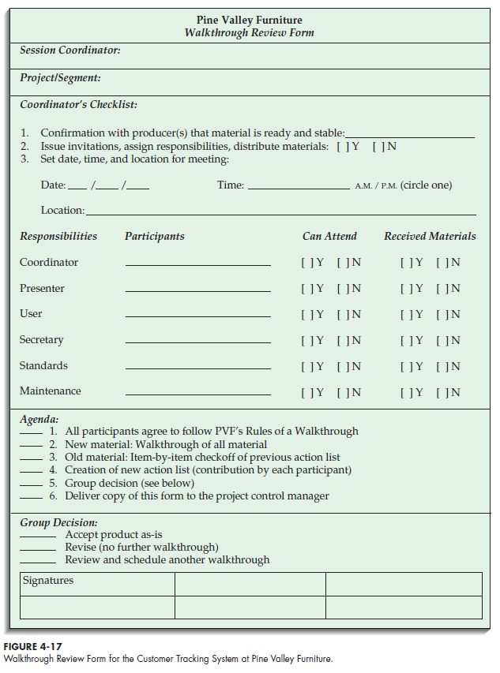
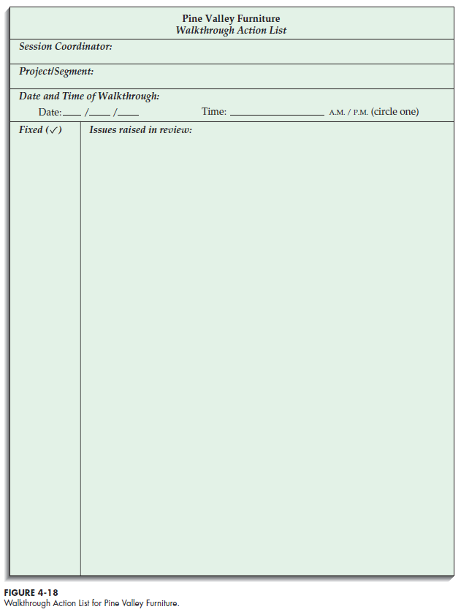

Slide 41
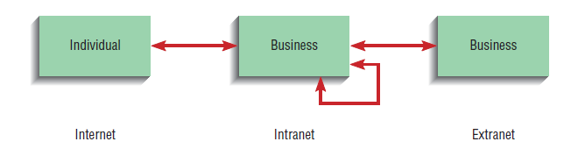
6 – PVF WebStore: Systems Planning and Selection
Internet-based electronic commerce application
Development process for Internet projects is no different than other projects
Special issues need to be taken into account
Electronic commerce (EC)
Internet-based communication and other technologies that support day-to-day business activities (communicating with customers and selling goods and services online) .
EC can also refer to the use of non-Internet technologies such as telephone voice-messaging systems.
The three classes of Internet EC applications are Internet, intranet, and extranet
A. Internet
A network of interconnected individual networks that use a common protocol to communicate with each other (TCP/IP – transmission control protocol/Internet protocol); a global computing network to support business-to-consumer electronic commerce.
B. Intranet
Internet-based communication to support business activities within a single organization.
C. Extranet
Internet-based communication to support business-to-business activities.
Electronic data interchange (EDI)
The use of telecommunication technologies to transfer business documents directly between organizations.

Slide 42
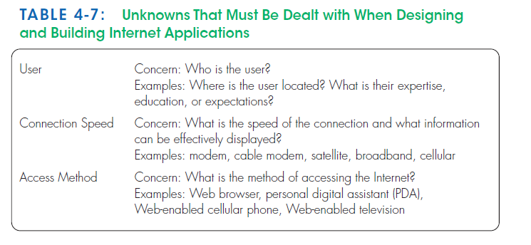
Internet vs. Intranet/Extranet Apps
Intranet/Extranet: Developer knows how application will be run and used
Internet: Developer faces various unknowns

Slide 43
Pine Valley Furniture WebStore
The board wants to incorporate all three target markets into its long-term EC plan :
Corporate furniture buying
Home-office furniture purchasing
Student furniture purchasing
Initially focus on the corporate furniture buying system
building block for moving into the customer-based markets.
The new EC system should integrate with two currently existing systems, Purchasing Fulfillment and Customer Tracking.
Initiating and Planning PVF’s E-Commerce System
1- Agreement about the proposed system project name “WebStore”.
2- Identifying potential benefits, costs, and feasibility concerns.
WebStore Project Walkthrough
1- An initial list of benefits and costs
2- several feasibility concerns
3- An initial project schedule.
4- presentation of the initial project plans in a walkthrough to PVF’s board of directors and senior management.
5- Approval was given to move the WebStore project on to the analysis phase.

Slide 44
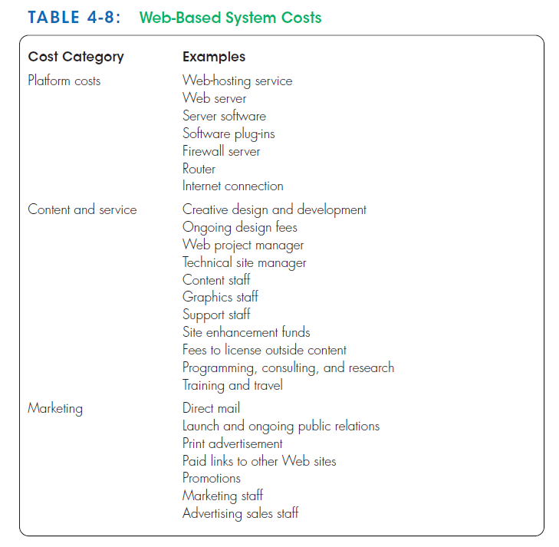
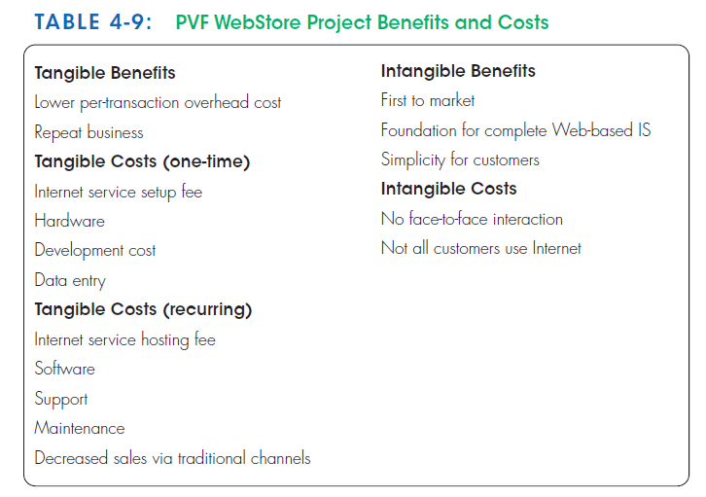

Slide 45
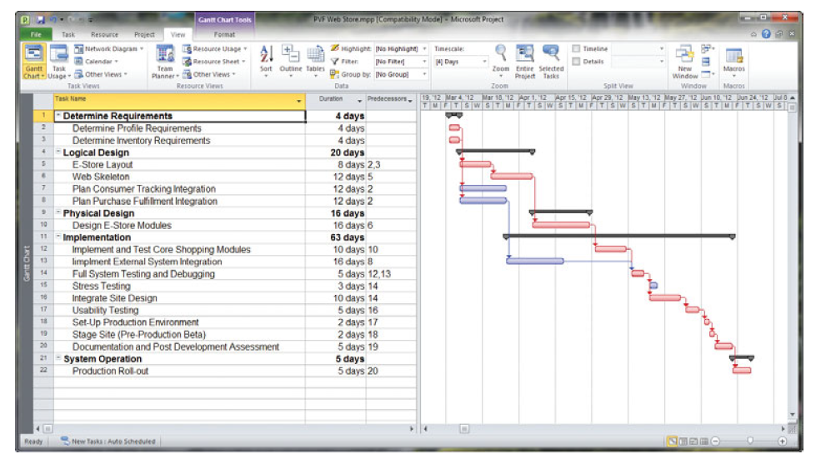
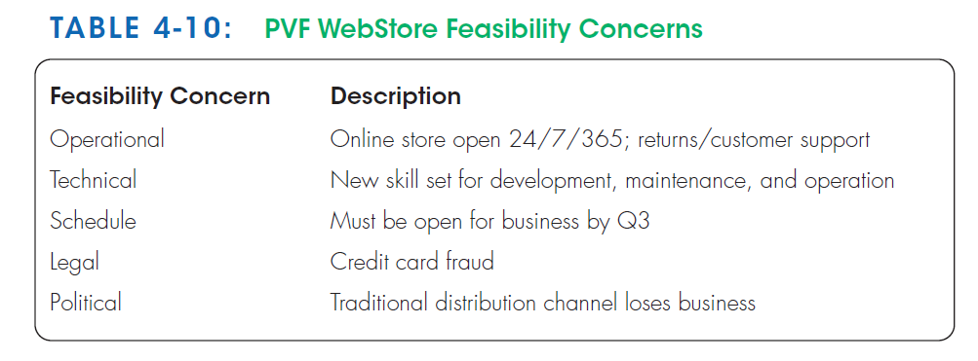
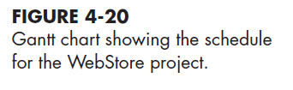

Slide 46
Summary
Project Identification and Selection involves:
Identifying potential projects
Classifying and ranking of projects
Selecting projects
Project initiation and planning
Baseline Project Plan (BPP) contains :
Introduction
High-level description of system
Outline of feasibility
Overview of management issues
Project Scope Statement
Describes what project will deliver
Feasibility
Economic
Operational
Technical
Schedule
Legal
Contractual
Political
Benefits
Tangible vs. Intangible
Costs
Tangible vs. Intangible
One-time vs. Recurring
Internet Applications
Internet
Intranet
Extranet

Slide 47
Thank you for your attention
Any Questions
???

