Slide 1
Ethics in Research and Courses

Slide 2
■ Ethics
– moral principles of right and wrong
– not absolute; may vary by person, by time, by
place
– and may be in competition with each other
■ Research ethics
– incorporating ethical principles into research
practice
– may involve a balance between and within
principles and practices
– all stages, all those involved, from inception of
research through to completion and
publication of results and beyond

Slide 3
1947- Nuremberg Code : (German: Nürnberger Kodex) is a set of research ethics principles for human experimentation set as a result of the subsequent Nurembergtrials at the end of the Second World War.
1968- Declaration of Helsinki (DoH) is a set of ethical principles regarding human experimentation developed for the medical community by the World Medical Association (WMA). It is widely regarded as the cornerstone document on human research ethics
1979-Belmont Report is a report created by the National Commission for the Protection of Human Subjects of Biomedical and Behavioral Research. ... The Belmont Report summarizes ethical principles and guidelines for research involving human subjects
1993-Council for International Organizations of Medical Sciences (CIOMS) serves the scientific interests of the international biomedical community in general and has been active in promulgating guidelines for the ethical conduct of research, among other activities. CIOMS promulgated guidelines in 1993 entitled International Ethical Guidelines for Biomedical Research Involving Human Subjects. These 15 guidelines address issues including informed consent, standards for external review, recruitment of participants, and more. The Guidelines are general instructions and principles of ethical biomedical research.
2005- Universal Declaration on Bioethics and Human Rights adopted by the United Nations Educational, Scientific, and Cultural Organisation (UNESCO) on 19 October 2005 is an important step in the search for global minimum standards in biomedical research and clinical practice.

Slide 4
Research Misconduct
Public concern over research misconduct initially arose in the early 1980’s.
At the time, research institutions sometimes ignored or covered up potential misconduct problems rather than investigate them.

Slide 5
Purpose of Research Misconduct Policies
Establish definitions for research misconduct
Outline procedures for reporting and investigating misconduct
Provide protection for whistleblowers and persons accused of misconduct

Slide 6
Research Misconduct
What is it?:
The Department of Health and Human Services defines research misconduct as:
Fabrication, falsification, or plagiarism in proposing, performing, or reviewing research results.
Fabrication: making up results and recording or reporting them
Falsification: manipulation of research materials, equipment, or processes, or changing or omitting results such that the research is not accurately represented in the record.
Plagiarism: the appropriation of another’s ideas, processes, results, or words without giving proper credit.
What is it not:
Honest error or differences of opinion

Slide 7
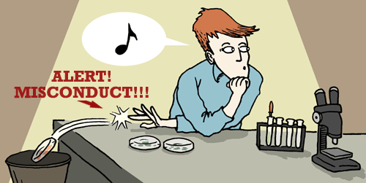
Criteria for Research Misconduct
Represents a significant departure from accepted practices
Has been committed intentionally, or knowingly, or recklessly; and
Can be proven by a preponderance of evidence
What is NOT MISCONDUCT: honest, unintentional error

Slide 8
Recommendations
Adopt zero tolerance
Protect whistleblowers
Clarify how to report
Train the mentors
Model ethical behavior

Slide 9
Top ten “POOR” behaviors
Falsifying or ‘cooking’ research data
Ignoring major aspects of human-subject requirements
Not properly disclosing involvement in firms whose products are based on one‘s own research
Relationships with students, research subjects or clients that may be interpreted as questionable
Using another’s ideas without obtaining permission or giving due credit (plagiarism)
Unauthorized use of confidential information in connection with one’s own research
Failing to present data that contradict one’s own previous research ????
Circumventing certain minor aspects of human-subject requirements
Overlooking others' use of flawed data or questionable interpretation of data
Changing the design, methodology or results of a study in response to pressure from a funding source (falsification)

Slide 10
Other Poor behaviors
Publishing the same data or results in two or more publications
Inappropriately assigning authorship credit
Withholding details of methodology or results in papers or proposals
Using inadequate or inappropriate research designs
Dropping observations or data points from analyses based on a gut feeling that they were inaccurate
Inadequate record keeping related to research projects

Slide 11
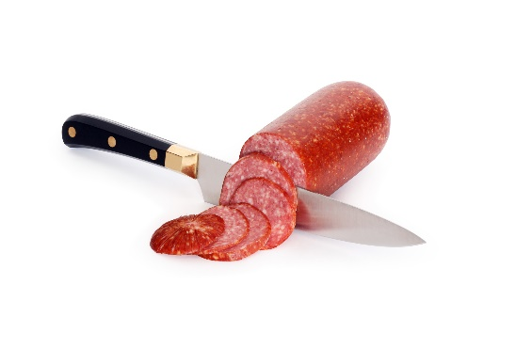
What do these terms mean?
Salami Slicing
Publishing the same study in multiple journals
Multiple submissions
Submitting the same manuscript to multiple journals
Breaking up a large study into two or more smaller published articles
Duplicate submission
These practices are unethical and are categorized under “author misconduct”.
Duplicate Submission and Multiple Submission are brought to the notice of all editors within the field.
Authors stand to lose credibility.
Some journals ban the author for as many as five years.

Slide 12
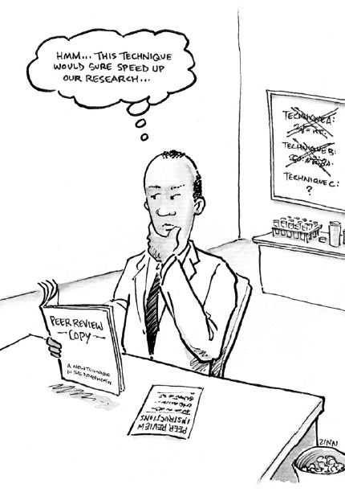
Why does misconduct happen?
Publish or Perish Pressure
Desire to “get ahead”
Personal problems
Character issues
Cultural Differences
???

Slide 13
How is misconduct identified
Suspected and reported by a colleague
Failure to confirm research results
by own lab or others

Slide 14
Consequences (if misconduct is substantiated)
Withdrawal or correction of all pending and published papers and abstracts affected by the misconduct
Reprimand, removal from project, rank and salary reduction, dismissal
Restitution of funds to the granting agency
Ineligibility to apply for grants for years
I.E. the end of your research career!

Slide 15
Who is investigated and who is held accountable?
Investigated
All authors that are involved in the specific data in question
Held accountable
Primary author
Other authors whose results are found culpable

Slide 16
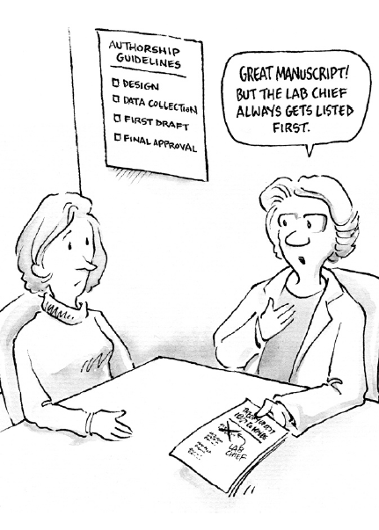
Mentor Responsibilities
Mentors have the responsibility to ensure that all trainees (post-docs, grad students, undergrads) are aware of the responsible conduct of research
Define the Relationship
Role of Trainee
Publication/Authorship
Obligation to report
Good faith report

Slide 17
http://turnitin.com/assets/en_us/media/plagiarism_spectrum.php

Slide 18
Definition of plagiarize
plagiarized; plagiarizing
transitive verb
: to steal and pass off (the ideas or words of another) as one's own
: use (another's production) without crediting the source
intransitive verb
: to commit literary theft : present as new and original an idea or product derived from an existing source

Slide 19
Is the work the author’s own creation and written in the author’s own words?
If not, does the writing provide appropriate credit to previous work?

Slide 20
10 TYPES OF PLAGIARISM ORDERED FROM MOST TO LEAST SEVERE
CLONE: An act of submitting another’s work, word-for-word, as one’s own.
CTRL-C: A written piece that contains significant portions of text from a single source without alterations.
FIND–REPLACE: The act of changing key words and phrases but retaining the essential content of the source in a paper.
REMIX: An act of paraphrasing from other sources and making the content fit together seamlessly.
RECYCLE: The act of borrowing generously from one’s own previous work without citation; To self plagiarize.
HYBRID: The act of combining perfectly cited sources with copied passages—without citation—in one paper.
MASHUP: A paper that represents a mix of copied material from several different sources without proper citation.
404 ERROR: A written piece that includes citations to non-existent or inaccurate information about sources
AGGREGATOR: The “Aggregator” includes proper citation, but the paper contains almost no original work.
RE-TWEET: This paper includes proper citation, but relies too closely on the text’s original wording and/or structure.

Slide 21
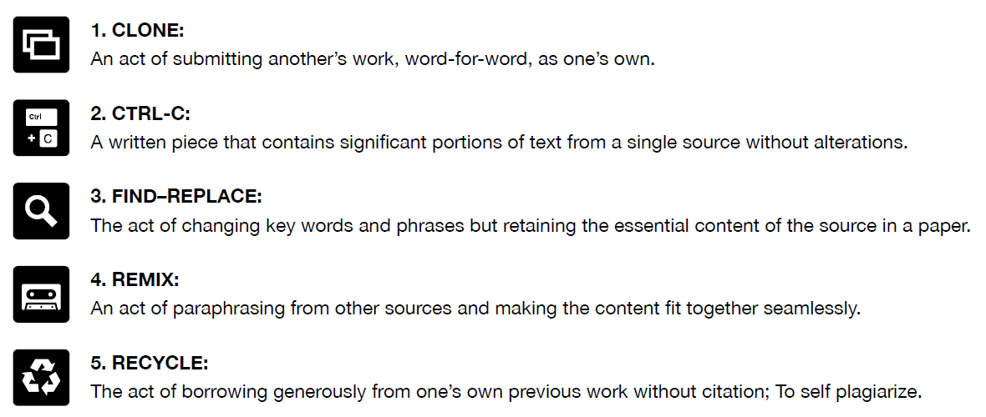
10 TYPES OF PLAGIARISM ORDERED FROM MOST TO LEAST SEVERE

Slide 22
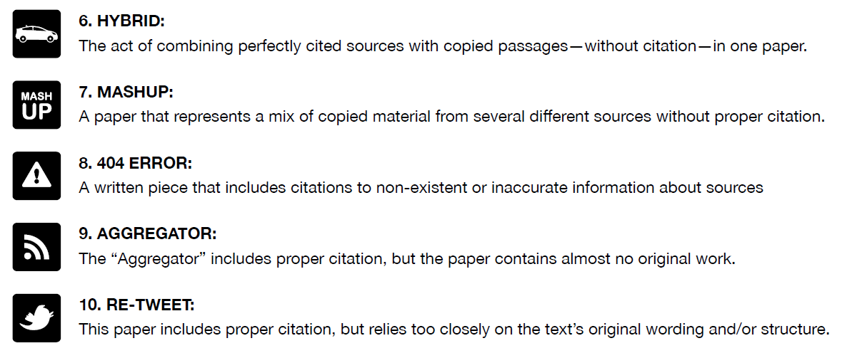
10 TYPES OF PLAGIARISM ORDERED FROM MOST TO LEAST SEVERE

Slide 23
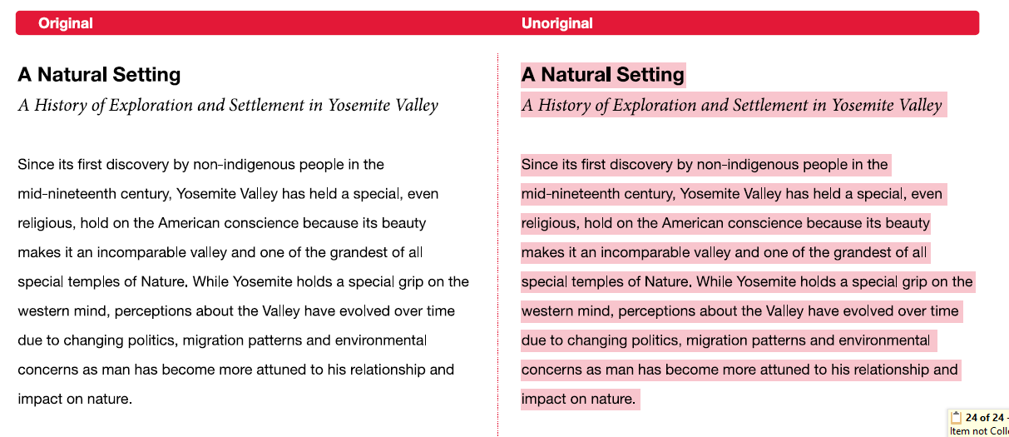
1. CLONE

Slide 24
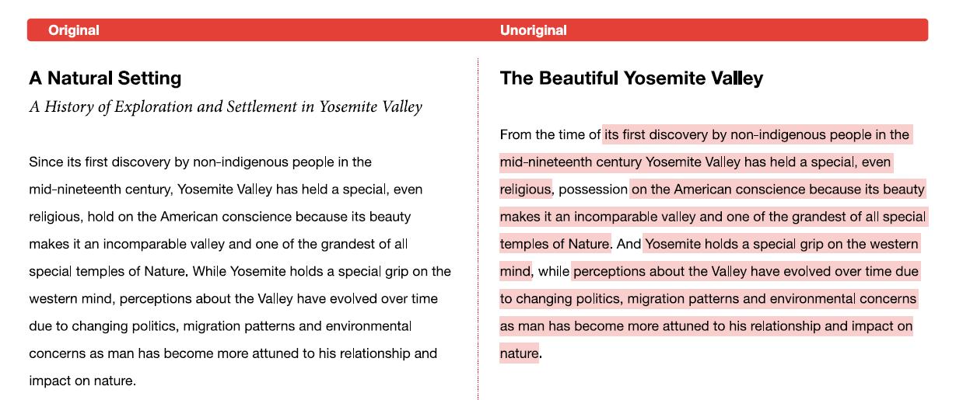
2. CTRL-C

Slide 25
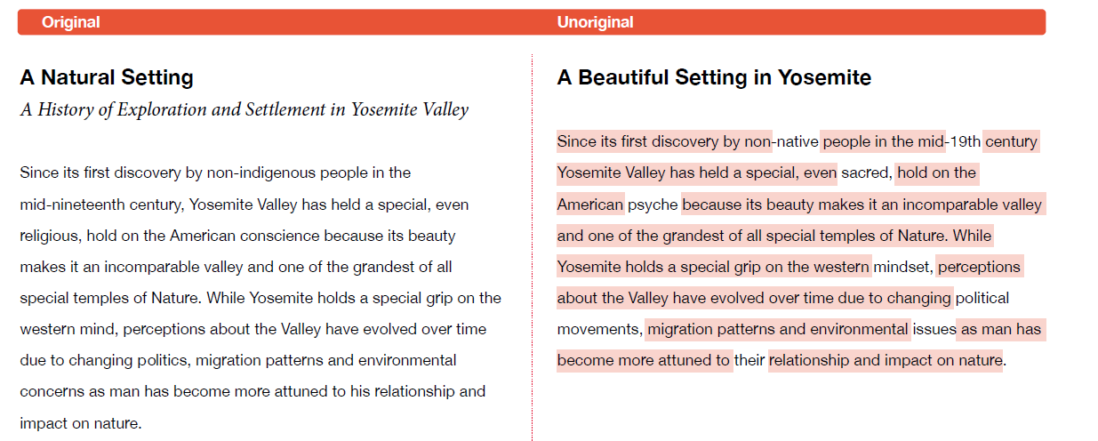
3. FIND-REPLACE

Slide 26
4. REMIX

Slide 27
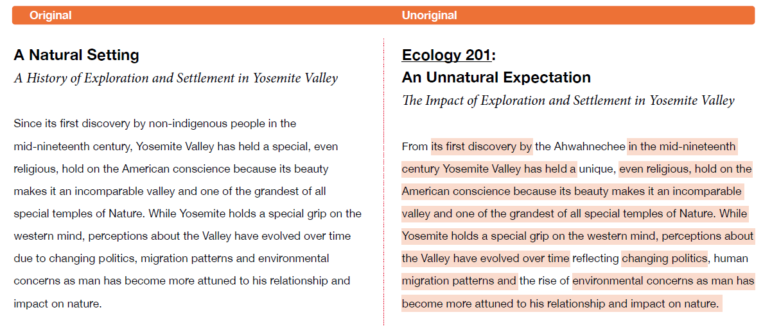
5. RECYCLE

Slide 28
6. HYBRID

Slide 29
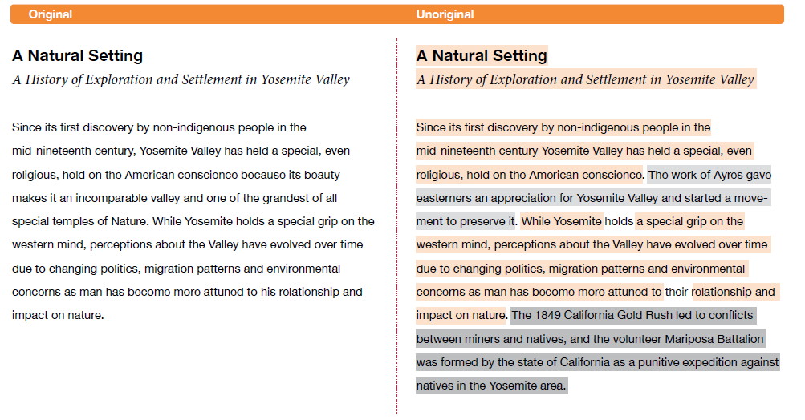
7. MASHUP

Slide 30
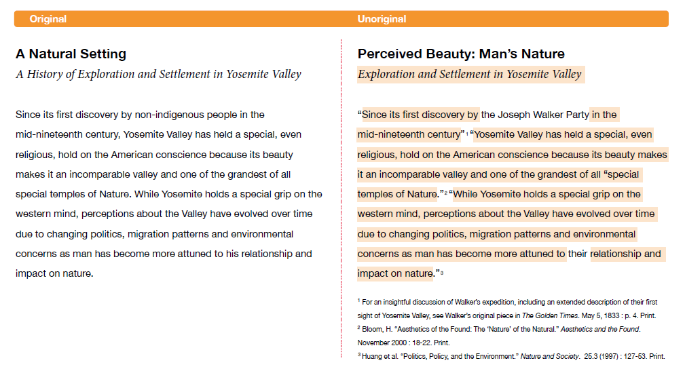
8. 404 ERROR

Slide 31
9. AGGREGATOR

Slide 32
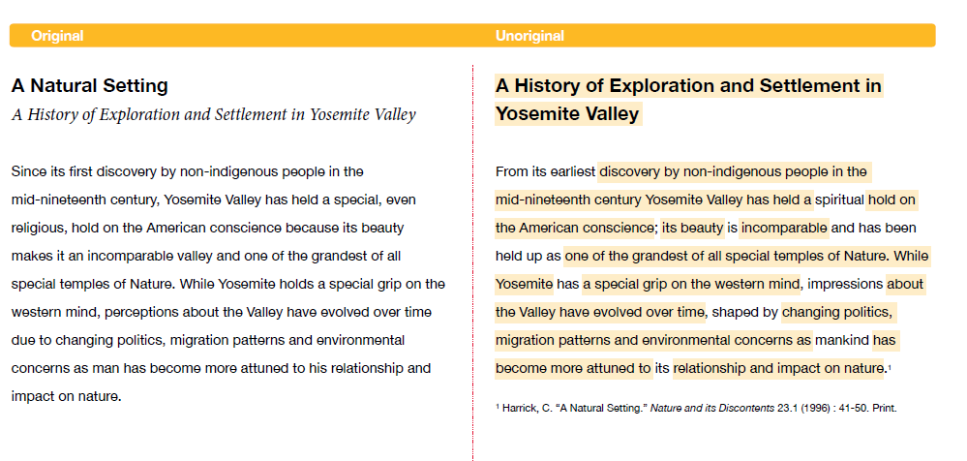
10. RE-TWEET

Slide 33
Plagiarism what it is and how to avoid it
Presented by:
Megan Lowe
Reference Librarian

Slide 34
Session Overview
What It Is
Terminology
Legal Implications
Four Types of Plagiarism
How to Avoid It
Methods
Proper Quotations
Proper Citations
Q & A Time!

Slide 35
Terminology: Copyright
Copyright is "a form of protection provided by the laws of the United States (title 17, U.S. Code) to the authors of 'original works of authorship,' including literary, dramatic, musical, artistic, and certain other intellectual works. This protection is available to both published and unpublished works." (U.S. Copyright Office)

Slide 36
Terminology: Fair Use
Fair Use is a statute under copyright law that allows for the use of limited portions of a work that has copyright without having to have permission from the original author.
It was created for the purposes of education and research.
It’s a little harder to pin down than plagiarism or copyright.
What qualifies as a "limited portion"?
The Copyright Office only states that "there is no specific number of words, lines, or notes that may safely be taken without permission."
When using someone else's work, it's best to always give credit where credit's due, even if using only a small part.
If you're unsure, then ask for permission.

Slide 37
Types of Plagiarism: Copying
The most well-known and, sadly, the most common type of plagiarism is the simplest: copying. If you copy someone else's work and put your name on it, you have plagiarized.

Slide 38
Copying: An Example
"Children are totally insensitive to their parents' shyness; it is the rare child who labels a parent shy [...] This is understandable, since parents are in positions of control and authority in their homes and may not reveal their shy side to their children. Also, since shyness is viewed as undesirable by many children, it may be threatening to think of parents in these terms. At this young age, the parent is still idealized as all-knowing and all-powerful - - not dumb, ugly, or weak." Zimbardo, Philip G. (1977). Shyness: What it is, what to do about it. Cambridge, Mass.: Perseus Books.

Slide 39
Copying: An Example
This one is pretty straightforward. If a writer copies, word for word, the text from Dr. Zimbardo's book and does not acknowledge in any way that it was Dr. Zimbardo's work, the writer has committed plagiarism.

Slide 40
Types: Patchwork Plagiarism
The second kind of plagiarism is similar to copying and is perhaps the second most common type of plagiarism: patchwork plagiarism. This occurs when the plagiarizer borrows the "phrases and clauses from the original source and weaves them into his own writing" (McConnell Library, Radford University) without putting the phrases in quotation marks or citing the author.

Slide 41
Patchwork: An Example
With regard to children, “they are totally insensitive to their parents' shyness” [1]. Rare is the child who labels a parent shy. It is easy to understand this, since the parents are in positions of control and authority in their own homes and may not necessarily show their shy side to their children. Moreover, since shyness is viewed as unfavorable by most children, it may be threatening for them to think of their parents in that light. During the formative years, the parent is idealized as all-knowing and all-powerful -- not dumb, ugly, or weak.

Slide 42
Patchwork: An Example
Now, had the "author" of this passage put the colored phrases in quotation marks and added a citation after the quotation, like (Zimbardo 62), the "author" would have been safe. Without the quotation marks and the proper citation, the "author" has committed plagiarism.

Slide 43
Types: Paraphrasing Plagiarism
The third type of plagiarism is called paraphrasing plagiarism. This occurs when the plagiarizer paraphrases or summarizes another's work without citing the source. Even changing the words a little or using synonyms but retaining the author's essential thoughts, sentence structure, and/or style without citing the source is still considered plagiarism.

Slide 44
Paraphrasing: An Example
Children are completely insensitive to their parents' shyness and rarely label their parents as shy. Because the parents are the authority and controlling figures in the home, they may not feel shy and therefore not show their shy side. Moreover, during the formative years, parents are seen as omnipotent and omniscient and not stupid, unattractive, or pathetic; it may be frightening for children to view their parents in terms of shyness.

Slide 45
Paraphrasing: An Example
Now, had the "author" of this paragraph used footnotes or parenthetical citations to acknowledge Dr. Zimbardo's work, he or she would have been in the clear. However, since the "author" acts like these ideas are his or her own, and does not acknowledge Dr. Zimbardo, it's plagiarism.

Slide 46
Types: Unintentional
The fourth type of plagiarism is called unintentional plagiarism
it occurs when the writer incorrectly quotes and/or incorrectly cites a source they are using.
How is this plagiarism, if the author didn't mean to do it?
The dishonest usage of another's work is most often considered plagiarism.
People cannot read minds!

Slide 47
Avoiding Plagiarism
Be honest; when you've used a source in your paper, give credit where it's due.
Acknowledge the author of the original work you've used.
Use your own work as often as possible.
Quoting and citing sources is usually required and inevitable when doing research -- that's how you "back up" your own work.
But using someone else's work excessively can be construed as plagiarism.
Another way to it is to quote and/or cite your sources properly.

Slide 48
Proper Quotations
In order to properly quote your sources, you should consult the style manual that would be appropriate for the research. In most cases, your professor will tell you which style manual would be preferred. If your professor doesn't indicate which manual to use, be sure to ask.
The following examples are formatted in MLA, APA, and Chicago (Turabian is similar to Chicago) formats. The text is taken from the passage from Zimbardo.

Slide 49
MLA Quotations
Indirect: Some researchers note that "children are totally insensitive to their parents' shyness" (Zimbardo 62).
Direct: Zimbardo notes that “children are totally insensitive to their parents’ shyness” (62).
Paraphrasing: Some researchers have observed that children seem unaware that their parents are considered bashful (Zimbardo 62).

Slide 50
APA or Chicago Quotations
Indirect: Some researchers note that "children are totally insensitive to their parents' shyness" (Zimbardo, 1977, p.62).
Direct: Zimbardo (1977) notes that “Children are totally insensitive to their parents’ shyness” (p. 62).
Paraphrasing: Some researchers have observed that children seem oblivious to their parents’ bashfulness (Zimbardo, 1977).

Slide 51
Proper Citations
In order to properly cite your sources, you should also consult the style manual that would be appropriate for the research. The following examples are formatted in MLA, APA, and Chicago (Turabian is similar to Chicago) formats. The citation is related to the passage we saw earlier from Zimbardo.

Slide 52
MLA Citations
Book
Zimbardo, Philip G. Shyness: What It Is, What To Do About It. Cambridge, Mass.: Perseus Books, 1977. Print.
Essay/Chapter in a Book
Swanson, Gunnar. "Graphic Design Education as a Liberal Art: Design and Knowledge in the University and The 'Real World.'" The Education of a Graphic Designer. Ed. Steven Heller. New York: Allworth Press, 1998. 13-24. Print.

Slide 53
MLA Citations
Article
Bagchi, Alaknanda. "Conflicting Nationalisms: The Voice of the Subaltern in Mahasweta Devi's Bashai Tudu." Tulsa Studies in Women's Literature 15.1 (1996): 41-50. Print.
Article from a Database
Langhamer, Claire. “Love and Courtship in Mid-Twentieth-Century England.” Historical Journal 50.1 (2007): 173-96. ProQuest. Web. 27 May 2009.

Slide 54
MLA Citations
Entire Website
The Purdue OWL Family of Sites. The Writing Lab and OWL at Purdue and Purdue U, 2008. Web. 6 September 2012.
Page on a Website
"How to Make Vegetarian Chili." eHow.com. eHow, n.d. Web. 24 Feb. 2012.

Slide 55
APA Citations
Book
Zimbardo, P.G. (1977). Shyness: What it is, what to do about it. Cambridge, Mass.: Perseus Books.
Essay/Chapter in a Book
O'Neil, J. M., & Egan, J. (1992). Men's and women's gender role journeys: Metaphor for healing, transition, and transformation. In B. R. Wainrib (Ed.), Gender issues across the life cycle (pp. 107-123). New York: Springer.

Slide 56
APA Citations
Article
Scruton, R. (1996). The eclipse of listening. The New Criterion, 15(30), 5-13.
Article from a Database
APA does not require that a citation for an article in a database document that fact. You can cite an article you find in a database the same way you’d cite a regular print article, as in the example above.

Slide 57
APA Citations
Website
Lowe, M. (2012). Megan Lowe @ ULM. January 29, 2012, from http://www.ulm./edu/~lowe.
Item Without Author
Merriam-Webster's collegiate dictionary (10th ed.).(1993). Springfield, MA: Merriam-Webster.

