Slide 1
Then we will need to use variables which their value can be 1(yes) or 0(no).
The special kinds of integer variables are variables which can take just 0 or 1 as their values, such variables are called binary variables (0-1 variables). IP problems that contain only binary variables sometimes called binary integer programming (BIP) problems.

Slide 2
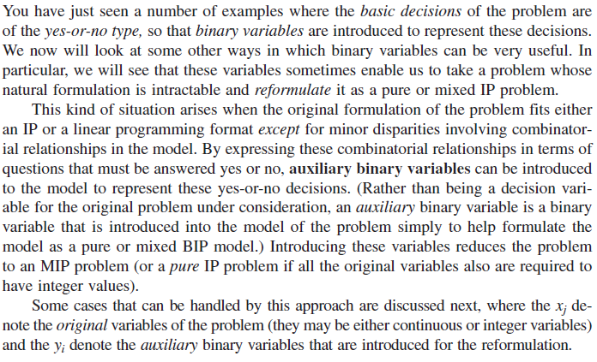

Slide 3
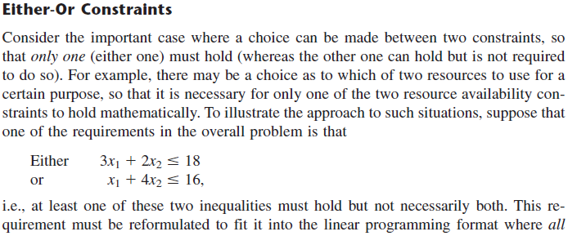
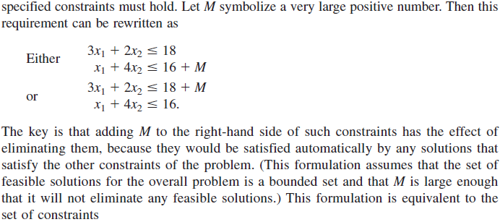

Slide 6
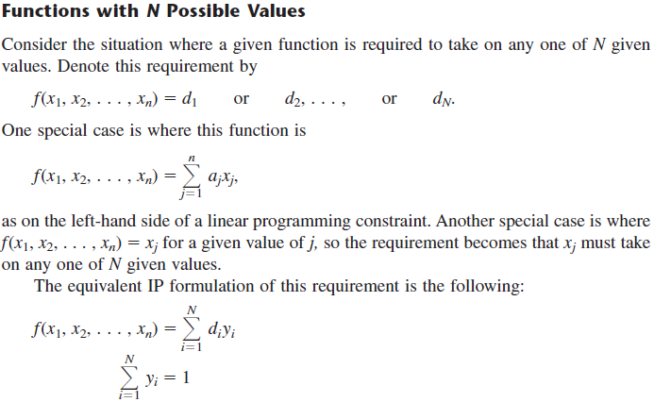

Slide 7
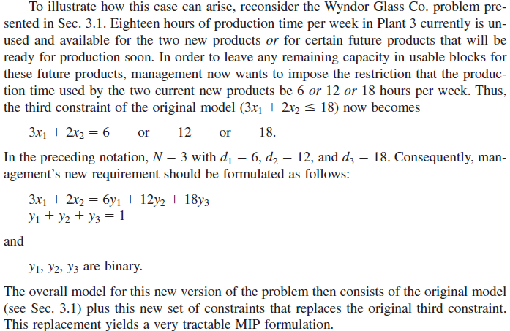
Assume that
is one of constraints in our problem

Slide 8
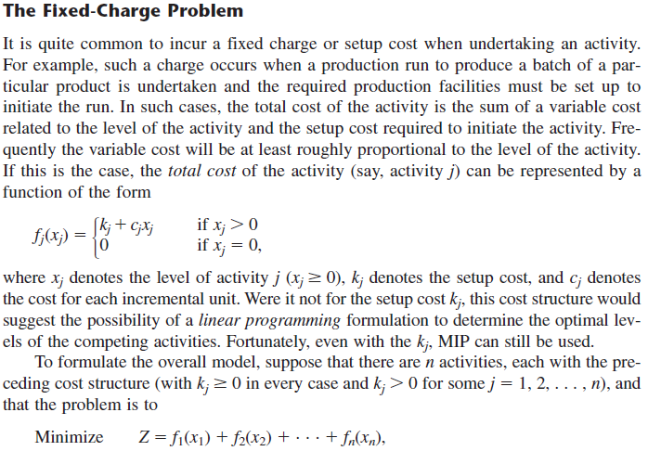

Slide 9
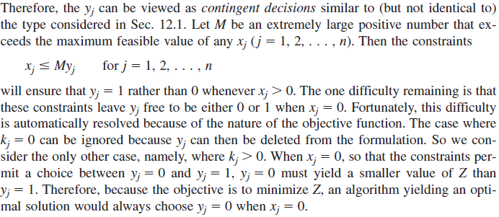

Slide 10
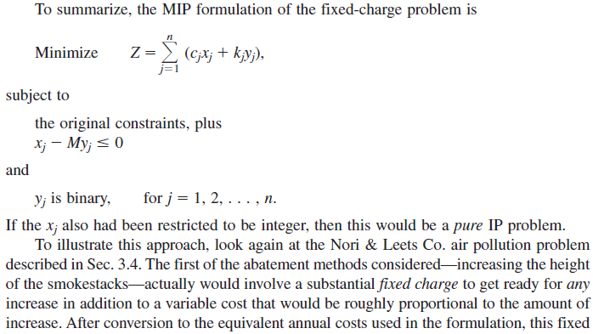
Suppose that there is a variable say x_{j} which it’s cost coefficient defined as
Based on the above mentioned modifications in the objective
function we should use the following replacement:
And should add to the constraints.

Slide 11
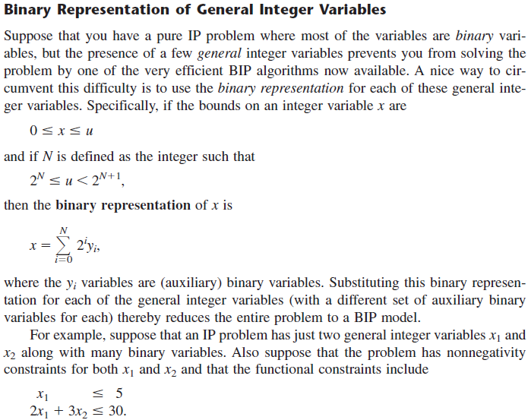

Slide 12
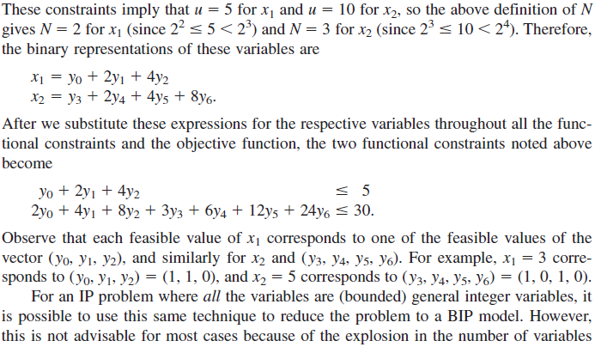
Write as a linear constraint using binary variables. What is your suggestion for writing by binary variables?

Slide 14
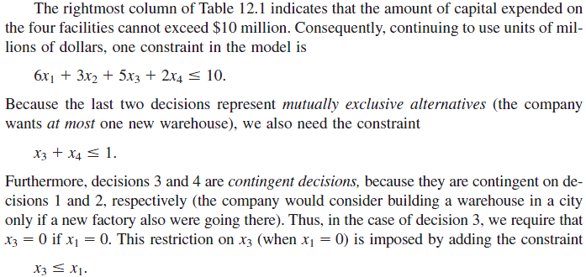

Slide 15
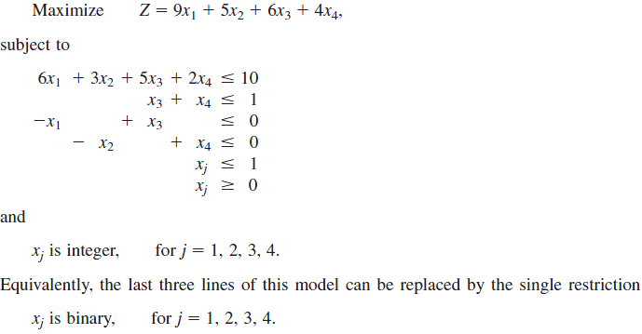
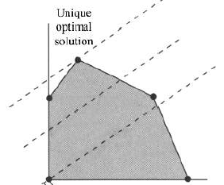
Redundant Constrient

Slide 16
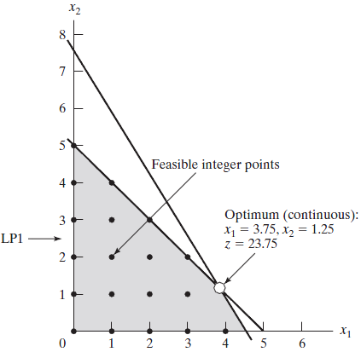
Lets see In two dimensional system what is change when we consider our variable as the integer variables. Assume that we asked to solve the following integer problem:
x₂
x₁
Optimum (integer)
x₁=3, x₂=2 z=23

Slide 17
