Slide 1
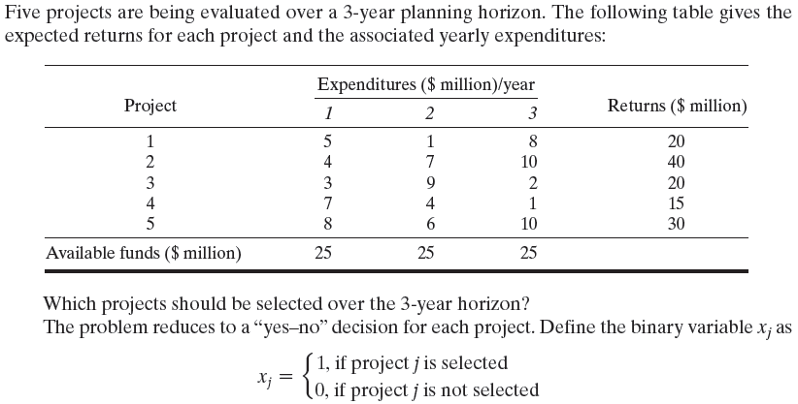

Slide 2
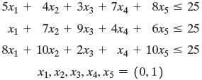
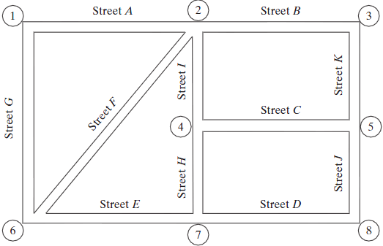
Example 2

Slide 3
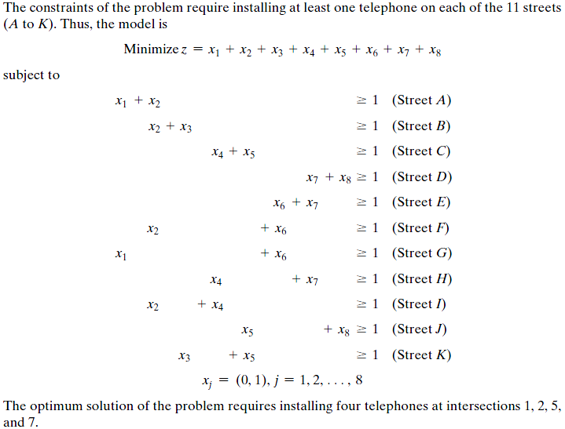

Slide 4
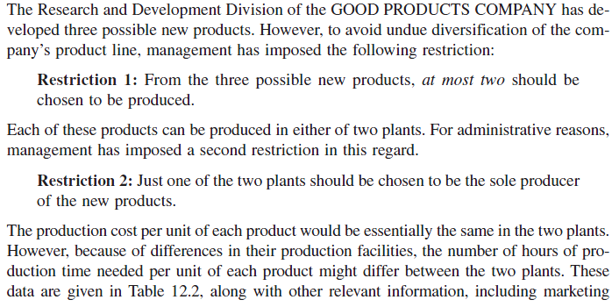
Example 3

Slide 5
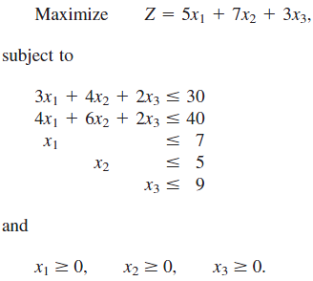
the

Slide 6
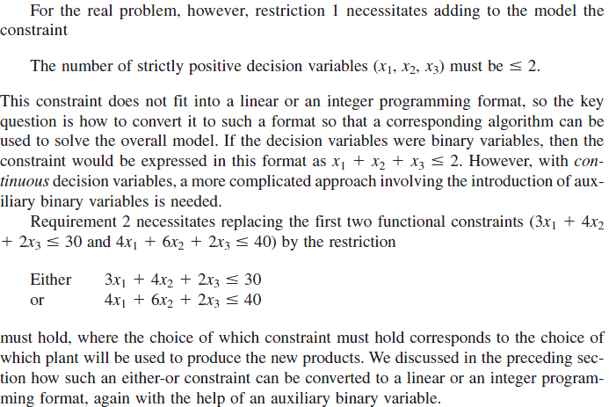

Slide 7
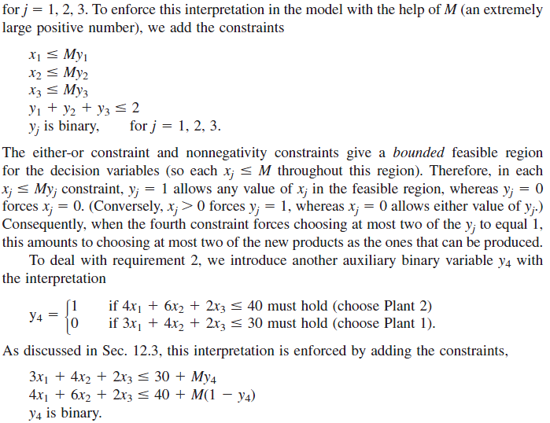

Slide 8
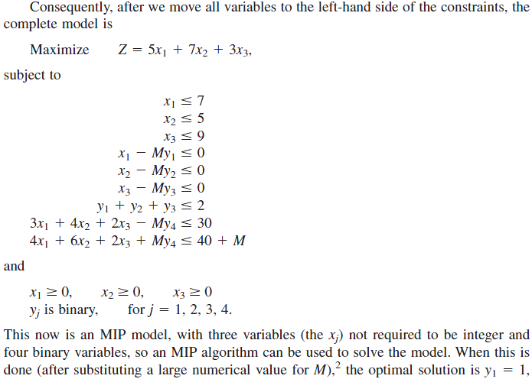

Slide 9
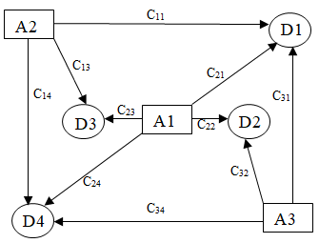
Example 4
A company decided to develop its activities by creating two new stores. Three places are considered for this aim. The following figure shows the possible transportation relations between mentioned places and four new customers, for example first place can support just first, third and fourth customers. Also this figure contains the capacity of each store (if it is built), demand of each customer and transportation cost of one unit between the places and the customers. The initial investment cost for constructing the store at each place and its inventory cost is summarized in the following table. Formulate an integer linear programming problem to choose the best places for creating these stores and minimize the total investment, transportation and inventory cost.
A1
Place | Initial investment | Inventory cost (per unit)
1 | K₁ | P₁
2 | K₂ | P₂
3 | K₃ | P₃
A2
A3

Slide 10
Lets x_{ij} be the number of the products which will be sent from ith store (if its construct) to the jth customer. Then two of the following three constraints should be hold for the problem. These constraints said that the number of the products which will be send from each of the stores should be less than the capacity of them.
As you seen before we can manage this situation by using the auxiliary binary variables say y_{i} for i=1,2,3.
Then we can rewrite the above (either/or) constraint as follow
For example in the optimal solution if y₁ and y₃ take 1 as their value then y₂ should be equal to zero. Then the right hand of the second constraint is zero so the value of x₂₁, x₂₂, x₂₃ and x₂₄ are equal to zero. ( The summation of four non-negative variables is zero then they should be equal to zero.)
The next types of the constraint are related to the customers obviously the demand of the customers should meet.

Slide 11
To write the objective function based on the aim of the company the total cost should be minimized. The total cost contains initial construction cost to build each of the storages, the transportation cost between the storages (if its construct ) and customers and inventory cost, for example for the first place
Initial construction cost Transportation cost Inventory cost
If we consider the same logic for second and third place, then the related IP is as follows

Slide 12
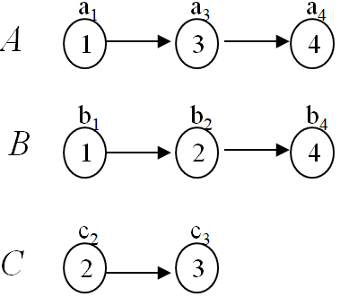
Example 5
Three products A, B and C produce by four machines. The technological order and time scheduling for each of machines are pointed in the following figure. The product B must delivered at t o’clock and product C must be delivered two hours after B. Formulated the problem in a manner that products are complete in minimum time respect to above restrictions. Note that a machine can not work on the two products at the same time
From the figure we can conclude that for example product A is produced by first, third and forth machines and if we start to use the first machine to produce A at k o’clock the machine should spend a₁ hours to work on A and the third machine may start to work on this product after k+ a₁ o’clock. Then lets define the variables as follow:
x_{Ai} the time which ith machine start to work on product A where i=1,3,4
x_{Bi} the time which ith machine start to work on product B where i=1,2,4
x_{Ci} the time which ith machine start to work on product C where i=2,3
Now Assume that the last operation of the machines on the mentioned products will finish at W o’clock then because the aim is minimizing the production duration then W should minimized. Then the time of last operation on each product should be less than W this means that

Slide 13
From the given information the last operation on product B should done before t o’clock and the last operation on product C should finish until t+2 o’clock. Then we have the following constraints.
Now technological order for producing each one of the products implies the following constraints. For example for product B the second machine can start to work on B after x_{B1}+b₁ o’clock and x_{B4} which is the starting time for machine four to work on product B should be after x_{B2}+b₂ the time which the second machine complete its operation on product B.
Beside of the above mentioned constraints there are some either/or constraint because of starting time of using each one of the machines to produce the products. For example the first machine is used to produce both of A and B but if one of them start to use this machine other one should wait to finish the production of first product and after that it can start to use the first machine. Then we have the following either/or constraints:

Slide 14
For each pair of these constraint we should use a auxiliary binary variable say y_{i} for i=1,2,3,4. Then we have these constraints
Here for example for machine 4 in optimal solution if auxiliary binary variable y₄ is equal to 0, product A will be used machine 4 earlier than product B and product B should wait machine 4 to complete its work on A and then it can use this machine. But when y₄ =1 then product B start to use machine 4 earlier than product A, and A should wait.

Slide 15
The IP related to Example 5 is as follow:
S.t

Slide 16
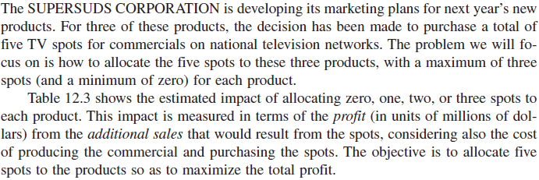
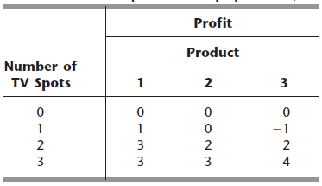
Example 6
Let

Slide 17
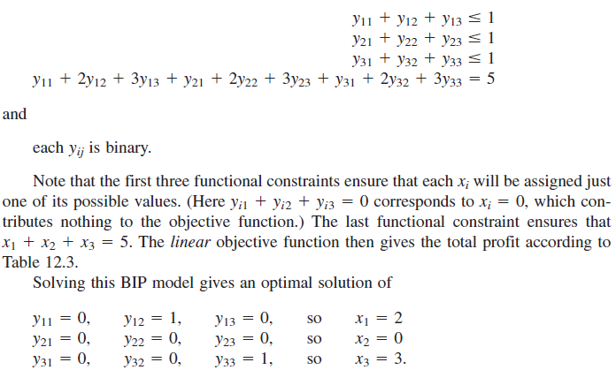

Slide 18
Example 7 (Knapsack Problem)
Assume that Jone should take bread, catchup, sausage and soft drink for school picnic. He has a knapsack with capacity 6kg. The weight and value (degree of importance) for each unit of mentioned items are summarized in the following table. Formulate the problem in a manner that respect to the capacity of his knapsack the value of the knapsack be maximized. The fraction values are not acceptable.
 | Bread | Catchup | sausage | soft drink
Weight | 250 gr | 400 gr | 500 gr | 1200 gr
Value | 50 | 10 | 30 | 35
Lets x_{j} be the number of the units for ith item which Jone will put in his Knapsack. Then IP related to this problem is as follows

