Slide 1
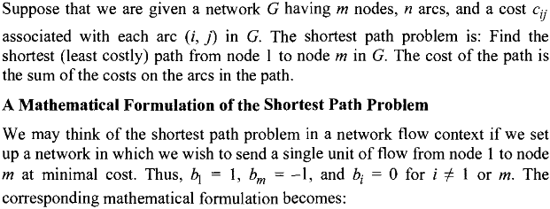
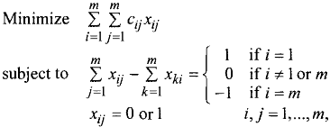
b₁=1
1
b₂=0
2
b_{j}=0
3
b_{i}=0
b₃=0
i
j
k
s
b_{k}=0
b_{s}=0
m
b_{m}=-1

Slide 2
k
d_{ij}
j
1
i
[u_{j},i]
[0,-]
[u_{i},k]

Slide 3
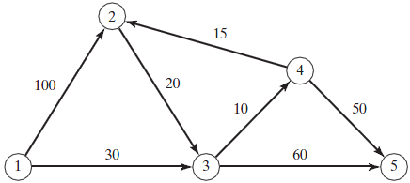

Slide 4
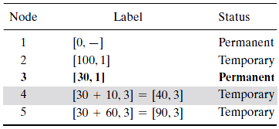

Slide 5
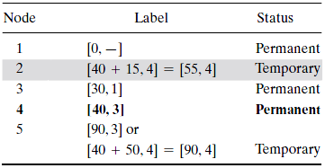

Slide 6
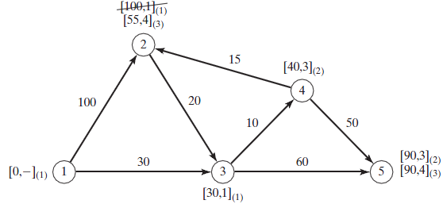

Slide 7
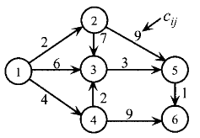
Find the shortest path from node 1 to node 6.
Iteration 1. Nodes 2, 3 and 4 are reached from node1 then we can
consider temporary labels for these nodes as follows
Nodes | Labels | Status
1 | [0,-] | Permanent
2 | [2,1] | Temporary
3 | [6,1] | Temporary
4 | [4,1] | Temporary
Iteration 2. Nodes 3, 4 and 5 are reached from node1 and2 then we can consider temporary labels or refresh them for these nodes as follows
Nodes | Labels | Status
1 | [0,-] | Permanent
2 | [2,1] | Permanent
3 | [6,1] is better then [2+7,2]= [9,2] | Temporary
4 | [4,1] | Temporary
5 | [2+9,2]=[11,2] | Temporary

Slide 8
Iteration 3. Nodes 3, 5 and 6 are reached from node1, 2 and 4, then we can consider temporary labels or refresh them for these nodes as follows
Nodes | Labels | Status
1 | [0,-] | Permanent
2 | [2,1] | Permanent
3 | [6,1] and [4+2,4]=[6,4] are same | Temporary
4 | [4,1] | Permanent
5 | [11,2] | Temporary
6 | [4+9,4]=[13,4] | Temporary
Iteration 4. Nodes 5 and 6 are reached from node1, 2, 4, and 3 then we can refresh their temporary labels as follows
Nodes | Labels | Status
1 | [0,-] | Permanent
2 | [2,1] | Permanent
3 | [6,1] | permanent
4 | [4,1] | Permanent
5 | [3+6,3]=[9,3] is better than [11,2] | Temporary
6 | [13,4] | Temporary

Slide 9
Iteration 5. the labels for nodes1, 2, 4, 3 and 5 are permanent and for node 6 then we can refresh their temporary labels as follows
Nodes | Labels | Status
1 | [0,-] | Permanent
2 | [2,1] | Permanent
3 | [6,1] | permanent
4 | [4,1] | Permanent
5 | [9,3] | Permanent
6 | [9+1,5]=[10,5] is better than [13,4] | Permanent

