Slide 1
Types of Stochastic Processes
There are two kinds of random variables: Discrete and Continues also the time can separate by the same category then we may have the following types of the stochastic processes:
Discrete time-Discrete random variable
The number of the dots appear on a throwing die.
Discrete time- Continues random variable
The call duration on each calling of a secretary.
Continues time-Discrete random variable
The number of the calls which received to a secretary in any time duration.
Continues time-Continues random variable
The temperature of a room in any time duration.
A Markov chain is a discrete time-discrete random variable which satisfy in some properties which will discussed in next steps.

Slide 2
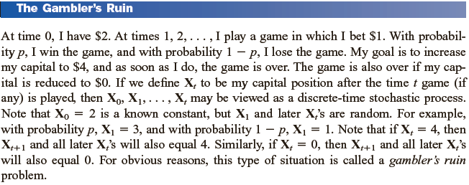
123...
i...s
123...
i...s
123...
i...s
123...
i...s
123...
j..s
123..l
...s
0 1 2 … t t+1 … n …
X₀=3 X₁=1 X₂=3 … X_{t}=i X_{t+1}=j … X_{n}=l …

Slide 3
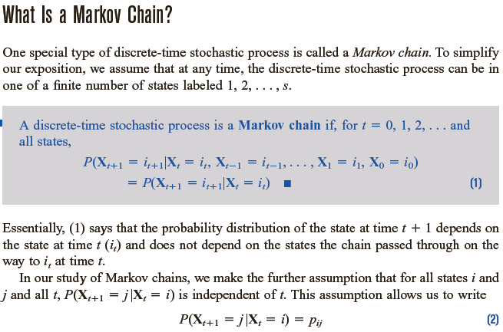
12 . i
.
s
12 . i
.
s
12 . i
.
s
12 . j
.
s
=
12 . i
.
s
12 . j
.
s
p_{ij}
p_{ij}
0 1 t t+1
t+n t+n+1

Slide 4
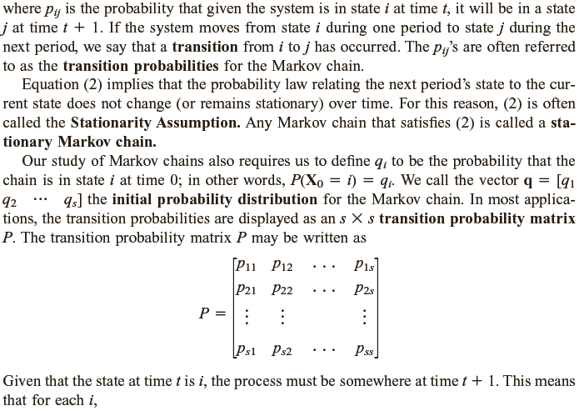
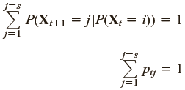

Slide 5
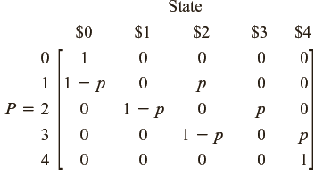
0
1
2
3
4
1-p
0
1
2
3
4
0
1
2
3
4
0
1
2
3
4
1-p
p
1-p
p
p

Slide 7
