Slide 1
Optimization Theory - IENG511 Two phases and big-M methods
By : Khaoula Chnina

Slide 2
CHAPTER FOUR STARTING SOLUTION AND CONVERGENCE

Slide 3
Previously, we saw that given a basic feasible solution BFS, we can use the simplex method to obtain better basic feasible solution BFS until we reach the optimal one ( or else unboundeness ) .
Recall that a basic feasible solution has the following characteristics :
 | Z | $$X_{B}$$ | $$X_{N}$$ | RHS
Z | 1 | 0 | $C_{B}B^{−1}N−C_{N}$ | $C_{B}B^{−1}b$
$$X_{B}$$ | 0 | I | $$B^{−1}N$$ | $B^{−1}b$
≥ 0

Slide 4


The optimal solution OS has the following characteristics :
For minimization problem
For maximization problem
${\overline{B}}_{i}≥0$, i = 1,2,…,m
$max \{ {Z_{j} − C}_{j} :$j Є R } = ${Z_{k} − C}_{k}$ ${Z_{k} − C}_{k}$ $≤0$
( Ie : ${Z_{j} − C}_{j} ≤0$ , $∀$j Є R )
${\overline{B}}_{i}≥0$, i = 1,2,…,m
$min \{ {Z_{j} − C}_{j} :$j Є R } = ${Z_{k} − C}_{k}$ ${Z_{k} − C}_{k} ≥0$
(Ie: ${Z_{j} − C}_{j} ≥0 ,∀ j Є R$)
 | Z | $$X_{B}$$ | $$X_{N}$$ | RHS
Z | 1 | 0 | $C_{B}B^{−1}N−C_{N}$ = ${Z_{j} − C}_{j}$ | $C_{B}B^{−1}b$ =${ C}_{B}{\overline{B}}_{i}$
$$X_{B}$$ | 0 | I | $B^{−1}N$= $Y_{ij}$ | $B^{−1}b$ = ${\overline{B}}_{i}$

Slide 5


The initial BFS
The simplex method can always be initiated with a very simple basis, namely, the identity.
Case 1 : easy case
Original form :
Max/ min z = CX
AX ≤ b
X ≥ 0
Where $A_{m×n}$
$X=\left(x_{1},…,x_{i}…,x_{n}\right)≥0$
${b= (b_{1},…,b_{i}…,b_{m}) }^{t}$ $≥0$
Standard form :
Max/ min z = CX
$AX +X_{s}= b$
X ≥ 0 ,$X_{s} ≥0$
Where $A_{m×n}$
$X_{s}={\left(x_{s1},…,x_{si}…,x_{sm}\right)}^{t}≥0$
${b= (b_{1},…,b_{i}…,b_{m}) }^{t}$ $≥0$
New constraint matrix A’
Max/ min z = CX
$A′X′ = b$
X’ ≥ 0
Where ${A′}_{m×(n+m)}=(A,I)$
$$X^{′}=\left(x_{1},…,x_{n},x_{s1},…,x_{sm}\right) ≥0$$
${b= (b_{1},…,b_{i}…,b_{m}) }^{t}$ $≥0$
Slack
vector
Initial BFS in hand by letting :
$$X_{B}= X_{s}=b$$
$$X_{N}= X=0$$

Slide 6

Case 2 : Some Bad Cases
a- the vector b is not nonegative :
Original form :
Max/ min z = CX
AX ≤ b
X ≥ 0
Where $A_{m×n}$
$X=\left(x_{1},…,x_{i}…,x_{n}\right)≥0$
${b= (b_{1},…,b_{i}…,b_{m}) }^{t}$ ≱ 0
Standard form :
Max/ min z = CX
$$AX +X_{s}= b$$
X ≥ 0 ,$X_{s} ≥0$
Where $A_{m×n}$
$X_{s}={\left(x_{s1},…,x_{si}…,x_{sm}\right)}^{t}≥0$
$${b= (b_{1},…,b_{i}…,b_{m}) }^{t}\text{≱} 0$$
IMPOSSIBLE to let :
$X_{B}= X_{s}=b ≱0$
$$X_{N}= X=0$$
NON-negativity requirement violated

Slide 7


b)
Original form :
Max/ min z = CX
AX ≥ b
X ≥ 0
Where $A_{m×n}$
$X=\left(x_{1},…,x_{i}…,x_{n}\right)≥0$
${b= (b_{1},…,b_{i}…,b_{m}) }^{t}$ ≥ 0
Standard form :
Max/ min z = CX
$$AX−X_{s}= b$$
X ≥ 0 ,$X_{s} ≥0$
Where $A_{m×n}$
$X_{s}={\left(x_{s1},…,x_{si}…,x_{sm}\right)}^{t}≥0$
${b= (b_{1},…,b_{i}…,b_{m}) }^{t}$ ≥ 0
New constraint matrix A’
Max/ min z = CX
$A′X′ = b$
X’ ≥ 0
Where ${A′}_{m×(n+m)}=(A,−I)$
$$X^{′}=\left(x_{1},…,x_{n},x_{s1},…,x_{sm}\right) ≥0$$
${b= (b_{1},…,b_{i}…,b_{m}) }^{t}$ $≥0$
Surplus
vector
The matrix A’ has no identity submatrix
There is no obvious way of picking a basis B
from the matrix (A, -I)
with $\overline{b}{=B}^{−1}b ≥0$

Slide 8


Generally ,any linear programming problem can be transformed into a problem of the following form:
Max/ min z = CX
AX = b
X ≥ 0
Where $A_{m×n}$
$X=\left(x_{1},…,x_{i}…,x_{n}\right)≥0$
${b= (b_{1},…,b_{i}…,b_{m}) }^{t}$ $≥0$
If A contains an identity matrix, then an immediate BFS at hand, by simply letting B = I, and since b > 0, then$\overline{b}{=B}^{−1}b ≥0$.
But I f A has no identity submatrix, What to do ?
Resort to artificial variables to get a starting BFS, and then use the simplex method itself and get rid of these artificial variables.
SOLUTION

Slide 9
The difference between slack and artificial variables
A slack variable is introduced to put the problem in equality form, and the slack variable can be positive.
Artificial variables are not legitimate variables, and they are merely introduced to facilitate the initiation of the simplex method. These artificial variables must eventually drop to zero in order to attain feasibility in the original problem .

Slide 10

Summary of results :
Given an original model ,in order to have an initial BFS and use the simplex method , we should put it in the standard form SF or artificial standard form ASF (when we add artificial variables ), using the following transformations :
««««««««««
$b_{i}≤0$ → ${ Row }_{i}={Row }_{i} ×(−1)$
Constraint type ‘’ ≤ ‘’ → we add slack variable (${+x}_{si}$ )
Constraint type ‘’ ≥ ‘’ → we add surplus variable (${−x}_{si}$ ) and artificial variable (${+x}_{ai}$ )
Constraint type ‘’ = ‘’ → we add artificial variable (${+x}_{ai}$ )
If $x_{i}≤0$ → replace it by $x_{j}=− x_{i} ≥0$
If ${ x}_{i}is unristrected$ → replace it by $x_{j}−x_{k}$ , $x_{j},x_{k}≥0$
If $x_{i}≤u$ → replace it by $x_{j}=u− x_{i} , x_{j}≥0$
If ${ x}_{i}≥l$ → replace it by $x_{j}=−l+ x_{i} , x_{j}≥0$
««««««««««
Always , the slack and artificial variables are the initial basic variables for the simplex method.
Note that the basic decision variables must be ordered according to the their constraint numbers ,to avoid cycle in case of degeneracy.

Slide 11

Now , we have a linear programming model in its artificial standard form ASF :
Max/ min z = CX
Subject to :
$$AX +X_{a}= b$$
X ≥ 0 ,$X_{a} ≥0$
How to get rid of the artificial variables $X_{a}$ ?
THE TWO-PHASE METHOD
SOLUTIONS
THE big-M METHOD

Slide 12



THE TWO-PHASE METHOD
‘’ minimize the sum of the artificial variables ‘’
ASF of the model :
Max/ min z = CX
Subject to :
$$AX +X_{a}= b$$
X ≥ 0 ,$X_{a} ≥0$
Phase 1 :
min w = ${1X}_{a}$
Subject to :
$$AX +X_{a}= b$$
X ≥ 0 ,$X_{a} ≥0$
At the optimality, if $X_{a}≠0$ then we have infeasible solution for the original model >>> STOP
Otherwise pass to the Phase 2.
Phase 2: Change the objective row of the last Simplex Table in the Phase 1. Clean the W row and enter the Z row. If there are basic variables with ZCi ≠ 0 coefficients make them zero by the row operations. Then apply the Simplex algorithm and search the OS
Phase 2 :
Max/ min z = $C_{B}X_{B}+C_{N}X_{N}$
Subject to :
$$X_{B}+B^{−1}NX_{N} =B^{−1} b$$
$X_{B}$ ≥ 0 ,$X_{N} ≥0$

Slide 13



Example 4.3 page 142 (feasible solution)
Original form :
min z = $x_{1}−2x_{2}$
S.to :
$$x_{1}+x_{2}≥2$$
$$−x_{1}+x_{2}≥1$$
$x_{2}≤3$
$$x_{1},x_{2}≥0$$
ASF :
min z = $x_{1}−2x_{2}$
S.to :
${ x}_{1}+x_{2}−x_{3} +x_{6 } =2$ ($x_{3},x_{4} surplus)$
$−x_{1}+x_{2} −x_{4} +x_{7} =1$ ($x_{6},x_{7} artificials)$
$x_{2} +x_{5} =3$ ($x_{5} slack)$
$$x_{i}≥0, i=1,2,3,4,5,6,7$$
Phase 1 :
min w = $x_{0}$ = $x_{6}+x_{7}$
S.to :
${ x}_{1}+x_{2}−x_{3} +x_{6 } =2$ ($x_{3},x_{4} surplus)$
$−x_{1}+x_{2} −x_{4} +x_{7} =1$ ($x_{6},x_{7} artificials)$
$x_{2} +x_{5} =3$ ($x_{5} slack)$
$$x_{i}≥0, i=1,2,3,4,5,6,7$$

Slide 14
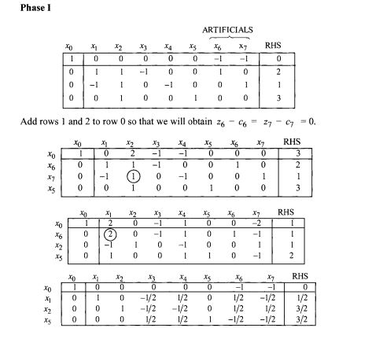
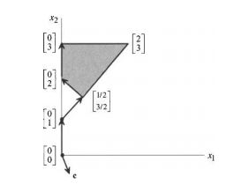

Slide 15
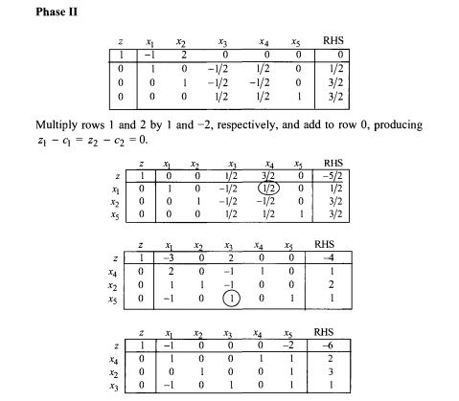
the optimal solution (0, 3)

Slide 16


THE big-M METHOD
‘’ Punishement of artificals :Assign coefficients for the artificial variables in the original objective function in such away as to make their presence in the basis at a positive level very unattractive from the objective function point of view ‘’
ASF of the model :
Min z = CX
Subject to :
$$AX +X_{a}= b$$
X ≥ 0 ,$X_{a} ≥0$
Big-M model :
Min z = CX ${+M1X}_{a}$
Subject to :
$$AX +X_{a}= b$$
X ≥ 0 ,$X_{a} ≥0$
ASF of the model :
Max z = CX
Subject to :
$$AX +X_{a}= b$$
X ≥ 0 ,$X_{a} ≥0$
Big-M model :
Max z = CX ${−M1X}_{a}$
Subject to :
$$AX +X_{a}= b$$
X ≥ 0 ,$X_{a} ≥0$
- If at the OS, some artificials remain in the basic variables , then the original problem is infeasible.
- If at a BFS all the artificials are nonbasic, but there is an entering variable, and no leaving variable is available , so the original problem is unbounded.

Slide 17

Example 4.6 page 153
Original form :
min z = $x_{1}−2x_{2}$
S.to :
$$x_{1}+x_{2}≥2$$
$$−x_{1}+x_{2}≥1$$
$x_{2}≤3$
$$x_{1},x_{2}≥0$$
ASF :
min z = $x_{1}−2x_{2}$
S.to :
${ x}_{1}+x_{2}−x_{3} +x_{6 } =2$ ($x_{3},x_{4} surplus)$
$−x_{1}+x_{2} −x_{4} +x_{7} =1$ ($x_{6},x_{7} artificials)$
$x_{2} +x_{5} =3$ ($x_{5} slack)$
$$x_{i}≥0, i=1,2,3,4,5,6,7$$
Big-M model :
min z = $x_{1}−2x_{2}$ + ${Mx}_{6}+Mx_{7}$
S.to :
${ x}_{1}+x_{2}−x_{3} +x_{6 } =2$ ($x_{3},x_{4} surplus)$
$−x_{1}+x_{2} −x_{4} +x_{7} =1$ ($x_{6},x_{7} artificials)$
$x_{2} +x_{5} =3$ ($x_{5} slack)$
$$x_{i}≥0, i=1,2,3,4,5,6,7$$

Slide 18
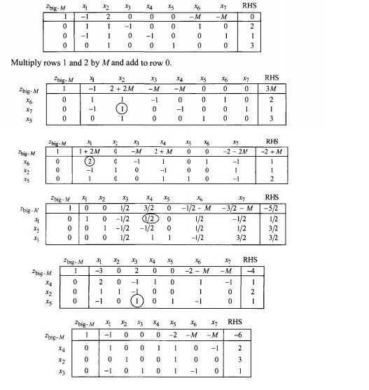
the optimal solution (0, 3)

Slide 19
THE big-M and Two-phases
the objective function of the big-M method is simply the sum of the Phase II objective and M times the Phase I objective of the two-phase method.
$$Z_{big−M}=z+Mx_{0}$$
Consequently, the two-phase method avoids possible round-off computational error problems associated with a large value of M by carrying the coefficients of M in the big-M method separately as Phase I objective coefficients, and by carrying the other coefficients as Phase II objective coefficients.

