Slide 1
NAME: OLUWATOSIN UTHMAN ZUBAIR (145919) COURSE: NETWORK FLOW

Slide 2
OUTLINE
Introduction
Different methods of assignment problem
MOA (Matrix one’s assıgnment) method
Steps for solving MOA
Numerıcal example using MOA method
Conclusion

Slide 3
INTRODUCTION
We already know about transportation problem, and also assignment problem; which is a variation of transportation problem, with two characteristics
The cost matrix is a square matrix.
At the optimum solution there will be only one assignment in a given row or column of the cost matrix.

Slide 4
DIFFERENT METHODS OF ASSINGMENT PROBLEM
Different methods of assignment problem
Complete Enumeration
Simplex Method
Transportation problem
Hungarian Method

Slide 5
MOA(MATRIX ONE’S ASSIGNMENT) METHOD
We are familiar with solving the assignment problem with the simplex method, transportation method, and with the Hungarian method, lets focus on a new method for solving it, called the MOA(Matrix One’s assignment) method.

Slide 6
STEPS FOR SOLVING MOA
Step1. In a minimization (Maximization) case, find the minimum (maximum) element of each row in the assignment matrix (say ai) and write it on the right hand side of the matrix.
Step 2. Find the minimum(maximum) element of each column in assignment matrix (say bj) and write it below jth column. Then divide each element of jth column of the matrix by bj. These operations create at least one ones in each columns. Make assignment in terms of ones. If no feasible assignment can be achieved from step (1) and (2) then go to step 3.
Note : In a maximization case, the end of step 2 we have a fuzzy matrix which all elements are belong to [0,1]and the greatest element is one.

Slide 7
Step 3.Draw the minimum number of lines to cover all the once of the matrix. If the number of drawn lines less than n, then the complete assignment is not possible, which if the number of lines is exactly equal to n, then the complete assignment is obtained.
Step 4. If a complete assignment program is not possible in step 3, then select the smallest (largest) element (say dij) out of those which do not lie on any of the lines in the above matrix. Then divide by dij each element of the uncovered rows or columns, which dij lies on it. This operation create some new ones to this row or column. If still a complete optimal assignment is not achieved in this new matrix, then use step 4 and 3 iteratively. By repeating the same procedure the optimal assignment will be obtained. Priority, plays an important role in this method, when we want to assign the ones.

Slide 8
Prıorıty rule
For maximization(minimization) assignment problem assign the ones on the rows which have highest(smallest) element on the right hand side, respectively.
If we have a non squre matrix, we have to make it a squre matrix, by adding artificial row or column which all elements are one.

Slide 9
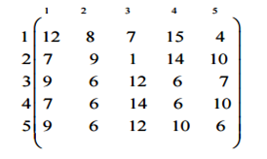
NUMERICAL EXAMPLE USING MOA METHOD
Let us consider the following assignment problem.

Slide 10
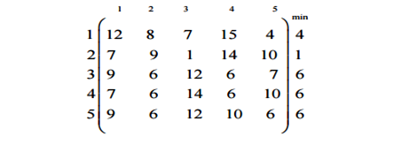
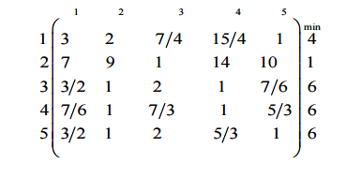
Find the minimum element of each row in the assignment matrix (say ai) and write it on the right hand side of the matrix, as follows. Then divide each element of ith row of the matrix by ai . These operations create ones to each rows, and the matrix reduces to following matrix.

Slide 11
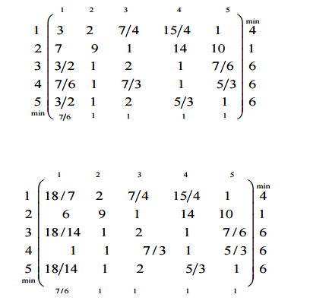
2. Now find the minimum element of each column in assignment matrix (say bj) and write it below column. Then divide each element of jth column of the matrix by bj .

Slide 12
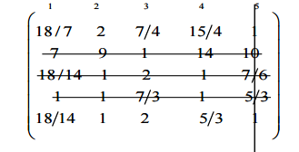
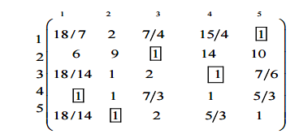
3. The minimum number of lines required to pass through all the ones of the matrix is 5. So the complete assignment is possible.

Slide 13
and we can assign the ones and the solution is (1,5), (2,3), (3,4), (4,1), (5,2) and minimum cost is 24. If we solve the same problem using the hungarian method the minimum cost is also 24.

Slide 14
CONCLUSION
In this paper, a new and simple method was introduced for solving assignment problems. The MOA method can be used for all kinds of assignment problems, whether maximize or minimize objective. The new method is based on creating some ones in the assignment matrix and find an assignment in terms of the ones. As considerable number of methods has been so far presented for assignment problem in which the Hungarian Method is more convenient method among them. This paper attempts to propose a method for solving assignment problem which is different from the preceding methods.

