Slide 1
EASTERN MEDITERRANEAN UNIVERSITY
DEPARTMENT OF INDUSTRIAL ENGINEERING
IENG584 Advanced Quality Engineering
COURSE CODE | IENG584 |  | SEMESTER / ACADEMIC YEAR | Spring 2018-19
COURSE TITLE | Advanced Quality Engineering
CREDIT VALUE | (3, 0, 0) 3
LECTURER(S) | Asst. Prof. Dr. Sahand DANESHVAR | sahand.daneshvar@emu.edu.tr |  | IE-C109 | +90 392 630 2773
COURSE TYPE | Elective
PRE-REQUISITE(S) | Consent of the instructor
DURATION OFCOURSE | 15 Weeks
COURSE SCHEDULE | Thursday 08:30-11:20 IE-E201
COURSE WEB LINK | http://ie.emu.edu.tr/lec/ann.php?lec=Sahand+DANESHVAR

Slide 2
Quizzes 5%+7%+10%=22 % Homework 6*3% =18 % Mid-term Exam 25% Final Exam 35% TOTAL 100 points
TEXTBOOK/S Students must refer the following textbooks: Text Book: John Oakland, Statistical Process Control, 6th ed., Elsevier, 2008. Reference Books: Montgomery, D. C., Introduction to Statistical Quality Control, 6th ed., Wiley, 2009. Richard E. Devor, Tsong-how Chang, John W. Sutherland, Statistical Quality Design and Control, Prentice-Hall, 1992.

Slide 3
Week | Topics
1 | Review and preliminary subjects
2 | Control charts for $\overline{X}$ , R
3 | Control charts for $\overline{X}$, S
4 | Control charts for fraction nonconforming
5 | p, np, c and u charts
6 | CUSUM charts and average run length
7 | Economic design of $\overline{X}$ Charts
8 | Midterm Exam
9 | Quality improvement and total quality control
10 | Experimental and fractional factorial design
11 | The Taguchi method, off-line and on-line quality control, Parameter design
12 | Acceptance sampling, Producer’s and Consumer’s risks
13 | AQL, LTPO and AOQL systems
14 | Dodge-Romig System, Economic analysis of acceptance sampling
15 | Demonstration of software (SPSS, Minitab)
16 | Final Exam

Slide 4
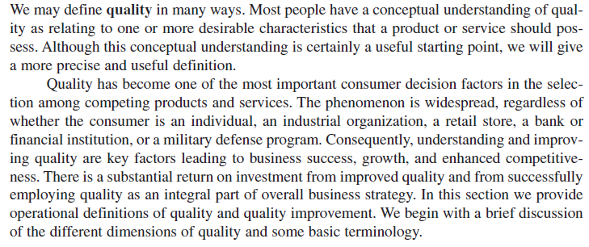

Slide 5
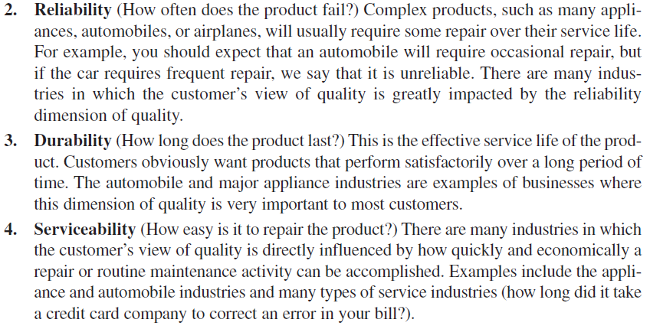

Slide 6
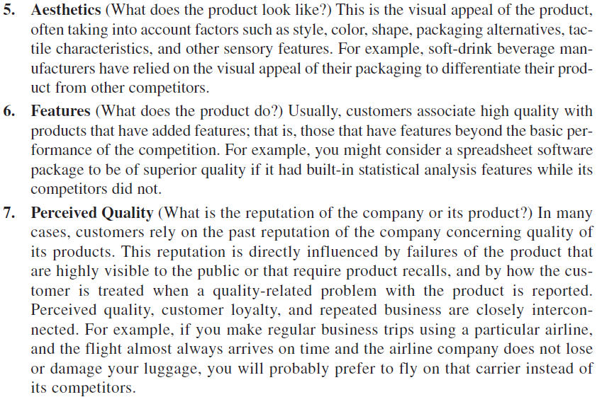

Slide 7
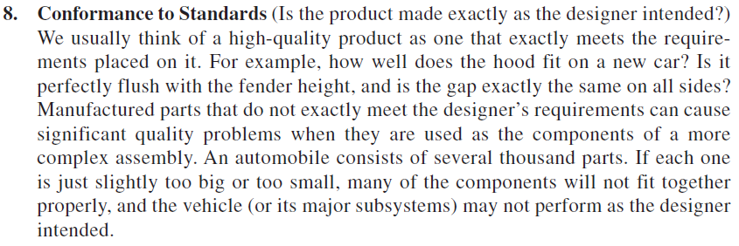

Slide 8
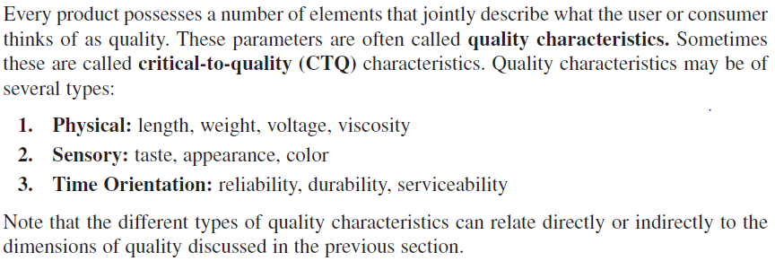

Slide 11
We focus on three major area:
Statistical Process Control
Control Charts
Process Monitoring Technique
Design of Experiment
A designed experiment is an approach to systematically varying the controllable input factors in the process and determining the effect these factors have on the output product parameters. Statistically designed experiments are invaluable in reducing the variability in the quality characteristics and in determining the levels of the controllable variables that optimize process performance. One major type of designed experiment is factorial design.
Acceptance Sampling
Acceptance sampling, defined as the inspection and classification of a sample of units selected at random from a larger batch or lot and the ultimate decision about disposition of the lot, usually occurs at two points: incoming raw materials or components, or final production.

Slide 12
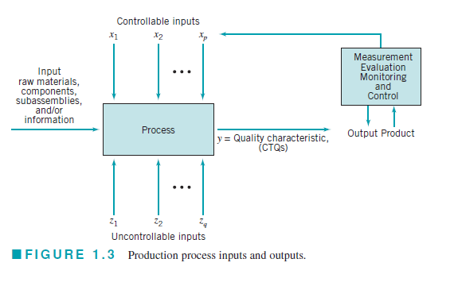

Slide 13
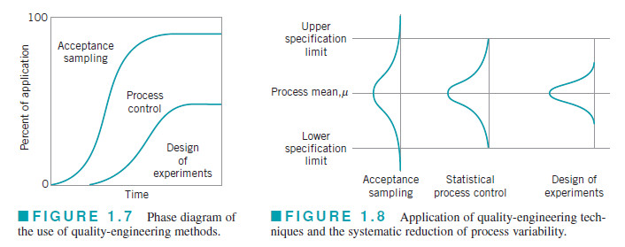

Slide 14
The effective management of quality involves successful execution of three activities: quality planning, quality assurance, and quality control and improvement.
Quality planning is a strategic activity, and it is just as vital to an organization’s longterm business success as the product development plan, the financial plan, the marketing plan, and plans for the utilization of human resources.
Quality assurance is the set of activities that ensures the quality levels of products and services are properly maintained and that supplier and customer quality issues are properly resolved.
Quality control and improvement involve the set of activities used to ensure that the
products and services meet requirements and are improved on a continuous basis.

Slide 15
