Slide 1
Lecture II
Introduction to Optimization

Slide 2
Optimization
… is a branch of mathematics and computational science that studies methods and techniques specially designed for finding the “best” solution of a given “optimization” problem.
Such problems aim to minimize or maximize one or more objective functions based on one or more dependent variables, which can take integer or real values, and subject to a set of equality or inequality constraints.

Slide 4
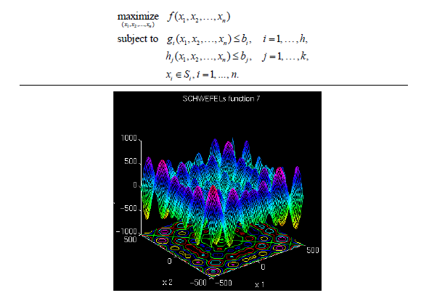
Definitions
Objective Function
Max (Min) some function of decision variables
Subject to (s.t.)
equality (=) constraints
inequality ( ) constraints
Search Space
Range or values of decisions variables that will be searched during optimization. Often a calculable size in combinatorial optimization

Slide 5

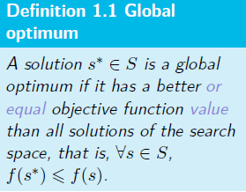
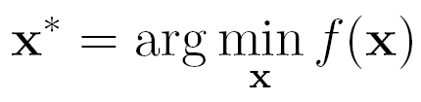


Suppose we have a cost function (or objective function)
Our aim is to find values of the parameters (decision variables) x that minimize this function
Subject to the following constraints:
    equality:
    inequality:
If we seek a maximum of f(x) (profit function) it is equivalent to seeking a minimum of –f(x)

Slide 6
Types of Solutions
A solution to an optimization problem specifies the values of the decision variables, and therefore also the value of the objective function.
A feasible solution satisfies all constraints.
An optimal solution is feasible and provides the best objective function value.
A near-optimal solution is feasible and provides a superior objective function value, but not necessarily the best.

Slide 7
Continuous vs Combinatorial
Optimization problems can be continuous (an infinite number of feasible solutions) or combinatorial (a finite number of feasible solutions).
Continuous problem generally maximize or minimize a function of continuous variables such as min 4x + 5y where x and y are real numbers
Combinatorial problems generally maximize or minimize a function of discrete variables such as min 4x + 5y where x and y are countable items (e.g. integer only).

Slide 8
Definition of Combinatorial Optimization
Combinatorial optimization is the mathematical study of finding an optimal arrangement, grouping, ordering, or selection of discrete objects usually finite in numbers.
- Lawler, 1976
In practice, combinatorial problems are often more difficult because there is no derivative information and the surfaces are not smooth.

Slide 9
Constraints
Constraints can be hard (must be satisfied) or soft (is desirable to satisfy).
Example: In your course schedule a hard constraint is that no classes overlap. A soft constraint is that no class be before 10 AM.
Constraints can be explicit (stated in the problem) or implicit (obvious to the problem).

Slide 10
TSP (Traveling Salesman Problem)
Given the coordinates of n cities, find the shortest closed tour which visits each once and only once (i.e. exactly once).
Example: In the TSP, an implicit constraint is that all cities be visited once and only once.

Slide 11
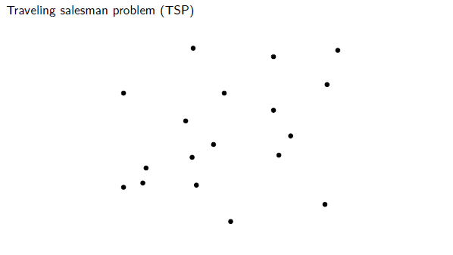
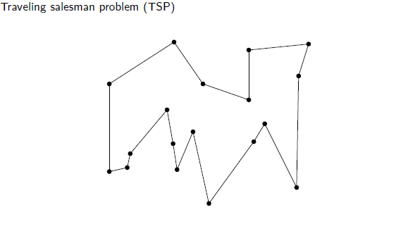

Slide 12
Aspects of an Optimization Problem
Continuous or Combinatorial
Size – number of decision variables, range/count of possible values of decision variables, search space size
Degree of constraints – number of constraints, difficulty of satisfying constraints, proportion of feasible solutions to search space
Single or Multiple objectives

Slide 13
Aspects of an Optimization Problem
Deterministic (all variables are deterministic) or Stochastic (the objective function and/or some decision variables and/or some constraints are random variables)
Decomposition – decomposite a problem into series problems, and then solve them independently
Relaxation – solve problem beyond relaxation, and then can solve it back easier

Slide 14
Simple
Few decision variables
Differentiable
Single modal
Objective easy to calculate
No or light constraints
Feasibility easy to determine
Single objective
deterministic
Hard
Many decision variables
Discontinuous, combinatorial
Multi modal
Objective difficult to calculate
Severely constraints
Feasibility difficult to determine
Multiple objective
Stochastic

Slide 15
For Simple problems, enumeration or exact methods such as differentiation or mathematical programming or branch and bound will work best.
For Hard problems, differentiation is not possible and enumeration and other exact methods such as math programming are not computationally practical. For these, heuristics are used.

Slide 16
Search Basics
Search is the term used for constructing/improving solutions to obtain the optimum or near-optimum.
Solution Encoding (representing the solution)
Neighborhood Nearby solutions (in the encoding or solution space)
Move Transforming current solution to another (usually neighboring) solution
Evaluation The solutions’ feasibility and objective function value

Slide 17
Constructive search techniques work by constructing a solution step by step, evaluating that solution for (a) feasibility and (b) objective function.
Improvement search techniques work by constructing a solution, moving to a neighboring solution, evaluating that solution for (a) feasibility and (b) objective function.

Slide 18
Search techniques may be deterministic (always arrive at the same final solution through the same sequence of solutions, although they may depend on the initial solution). Examples are LP (simplex method), tabu search, simple heuristics like FIFO, LIFO, and greedy heuristics.
Search techniques may be stochastic where the solutions considered and their order are different depending on random variables. Examples are simulated annealing, ant colony optimization and genetic algorithms.

Slide 19
Search techniques may be local, that is, they find the nearest optimum which may not be the real optimum. Example: greedy heuristic (local optimizers).
  Instead of looking in the whole feasible region for the best solution, we may search for the best solution in a local region of a given starting solution. And repeat for a number of steps, or until we find a local optimal solution.
Search techniques may be global, that is, they find the true optimum even if it involves moving to worst solutions during search (non-greedy).

Slide 20
Heuristics
Heuristics are rules to search to find optimal or near-optimal solutions.
". . . the art of discovering new strategies (rules) to solve problems."
Examples are FIFO, LIFO, earliest due date first, largest processing time first, shortest distance first, etc.
Heuristics can be constructive (build a solution piece by piece) or improvement (take a solution and alter it to find a better solution).

Slide 21
Many constructive heuristics are greedy or myopic, that is, they take the best thing next without regard for the rest of the solution.
Example: A constructive heuristic for TSP is to take the nearest city next. An improvement heuristic for TSP is to take a tour and swap the order of two cities.

Slide 22
Metaheuristics
Meta- Greek word for upper level methods
Heuristics – Greek word heuriskein – art of discovering new strategies to solve problems.
Exact and Approximate methods
Exact
  Math programming LP, IP, NLP, DP
Approximate
  Heuristics
Metaheuristics used for
  Combinatorial Optimization problems – a general class of IP problems with discrete decision variables and finite solution space. Objective function and constraints could be non-linear too. Uses relaxation techniques to prune the search space.
  Constraint Programming problems – used for timetabling and scheduling problems. Uses constraint propagation techniques that reduces the variable domain. Declaration of variables is a lot more compact

Slide 23
Need for Metaheuristics
What if the objective function can only be simulated and there is no (or an inaccurate) mathematical model that connect the variables
  Math and constraint programming need exact math formulations, therefore cannot be applied to the above
Large solution space- Ex: TSP, 5 cities have 120 solutions (5!), 10 cities have 10! ~ 3.6 million, 75 cities have 2.5X10¹⁰⁹ solutions
Ex: Parallel machine job scheduling: process n jobs on m identical machines. There are m^{n} solutions
  Complexity - time and space complexity
  Time is the number of steps required to solve a problem of size n. We are looking for the worst-case asymptotic bound on the step count (not an exact count). Asymptotic behavior is the limiting behavior as n tends to a large number.

Slide 24
Metaheuristics
The idea: search the solution space directly. No math models, only a set of algorithmic steps, iterative method.
Trajectory based methods (single solution based methods)
  search process is characterized by a trajectory in the search space
  It can be viewed as an evolution of a solution in (discrete) time of a dynamical system
    Tabu Search, Simulated Annealing, Iterated Local search, variable neighborhood search, guided local search
Population based methods
  Every step of the search process has a population – a set of- solutions
  It can be viewed as an evolution of a set of solutions in (discrete) time of a dynamical system
    Genetic algorithms, swarm intelligence - ant colony optimization, bee colony optimization, scatter search
Hybrid methods
Parallel metaheuristics: parallel and distributed computing- independent and cooperative search
You will learn these techniques through several examples

Slide 25
History of Metaheuristics
1965: first Evolution Strategy
1975: first Genetic Algorithms
1983: Simulated Annealing
1986: Tabu Search
1991: Ant Colony Optimization
1997: Variable Neighborhood Search
2000+: parallel and distributed computing in metaheuristics

Slide 26
Metaheuristics
The idea: search the solution space directly. No math models, only a set of algorithmic steps, iterative method. Find a feasible solution and improve it. A greedy solution may be a good starting point.
Goal: Find a near optimal solution in a given bounded time.
Applied to combinatorial and constraint optimization problems
Diversification and intensification of the search are the two strategies for search in Metaheuristics. One must strike a balance between them. Too much of either one will yield poor solutions. Remember that you have only a limited amount of time to search and you are also looking for a good quality solution. Quality vs Time tradeoff.
  For applications such as design decisions focus on high quality solutions (take more time) Ex. high cost of investment, and for control/operational decisions where quick and frequent decisions are taken look for good enough solutions (in very limited time) Ex: scheduling
  Trajectory based methods are heavy on intensification, while population based methods are heavy on diversification.
Diversification means to generate diverse solutions so as to explore the search space on the global scale, while intensification means to focus on the search in a local region by exploiting the information that a current good solution is found in this region.

Slide 27
Classifications in Metaheuristics
Nature inspired (swarm intelligence from biology) vs nonnature inspired (simulated annealing from physics)
Memory usage (tabu search) vs memoryless methods (local search, simulated annealing SA)
Deterministic (tabu, local search) vs stochastic (GA, SA) metaheuristics
  Deterministic – same initial solution will lead to same final solution after several search steps
  Stochastic – same initial solution will lead to different final solutions due to some random rules in the algorithm
Population based (manipulates a whole population of solutions – exploration/diversification) vs single solution based search (manipulates a single solution – exploitation/intensification).
Iterative vs greedy. Iterative – start with a complete solution(s) and transform at each iteration. Greedy- start with an empty solution and add decision variables till a complete solution is obtained.

Slide 28
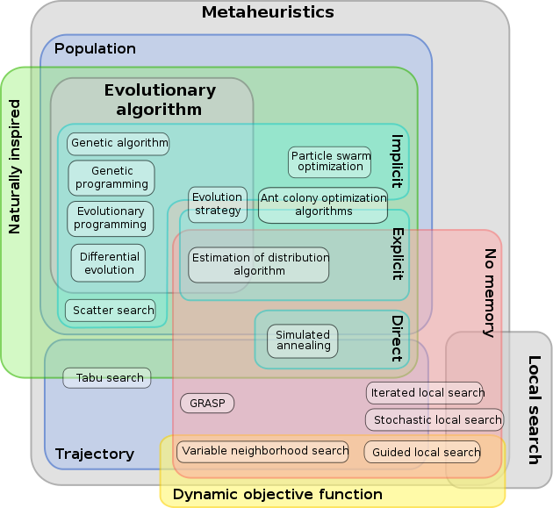

Slide 29
When to use Metaheuristics
If one can use exact methods then do not use Metaheuristics.
P class problem with large number of solutions. P-time algorithms are known but too expensive to implement
Dynamic optimization- real-time optimization- Metaheuristics can reduce search time and we are looking for good enough solutions.
A difficult NP-hard problem - even a moderate size problem.
Problems where objective function is a black box, i.e. often simulated and has no/inaccurate math formulation for the objective function
x
f(x)
Metaheuristic
Black box objective function
Assess quality of f(x)
Quality metric

Slide 30
Evaluation of Results
Best Metaheuristic approach- does not exist for any problem. No proof of optimality exists and you don’t care for one either.
A heuristic approach designed for problem A does not always apply to problem B. It is context-dependent.
Questions: Is the metaheuristic algorithm well designed and does it behave well? No common agreement exist in the literature.
What do we look for during implementation
  Easy to apply for hard problems
  Intensify: should be able to find a local optima
  Diversify: should be able to widely explore the solution space
  A greedy solution is a good starting point for an iterative search

Slide 31
Evaluation of Results
Evaluation criteria include:
  Ability to find good/optimal solutions. No way to prove optimality unless all solutions are exhaustively enumerated, which is infeasible.
  Comparison with optimal solutions (if available). Test the heuristics on small problems before scaling it up.
  Comparison with Lower/Upper bounds if already known (may be a target was already set)
  Comparison with other metaheuristics methods
Reliability and stability over several runs
  Average gap between solution while approaching the (local) optimum
  statistical tools (standard deviation of solutions, Confidence intervals, ANOVA )
Reasonable computational time Usually: between a few seconds upto a few hours

Slide 32
Main concepts to implement a Metaheuristic algorithm
Representation of solutions
  Vector of Binary values – 0/1 Knapsack, 0/1 IP problems
  Vector of discrete values- Location , and assignment problems
  Vector of continuous values on a real line – continuous, parameter optimization
  Permutation – sequencing, scheduling, TSP
Objective function
Constraint handling
  Reject strategies- keep only feasible solution and reject infeasible ones automatically.
  Penalizing strategy - infeasible solutions are considered and a penalty function is added to the objective function for including a infeasible solution during the search. s_{t}, s_{t+1}, s_{t+2} are the search sequence where s_{t+2} and s_{t} are feasible but s_{t+1} is infeasible and f(s_{t+2}) is better than f(s_{t}). The penalized obj function is f’(s) = f(s)+ λ c(s) where c(s) is the cost of infeasible s and λ is a weight.

Slide 33
Advantages of Meta-Heuristics
Very flexible
Often global optimizers
Often robust to problem size, problem instance and random variables
May be only practical alternative

Slide 34
Disadvantages of Meta-Heuristics
Often need problem specific information / techniques
Optimality (convergence) may not be guaranteed
Lack of theoretic basis
Different searches may yield different solutions to the same problem (stochastic)
Stopping criteria
Multiple search parameters

Slide 35
Summarizing, outline fundamental properties which characterize metaheuristics:
Metaheuristics are strategies that “guide” the search process.
The goal is to efficiently explore the search space in order to find (near–)optimal solutions.
Techniques which constitute metaheuristic algorithms range from simple local search procedures to complex learning processes.
Metaheuristic algorithms are approximate and usually non-deterministic.
They may incorporate mechanisms to avoid getting trapped in confined areas of the search space.
The basic concepts of metaheuristics permit an abstract level description.
Metaheuristics are not problem-specific.
Metaheuristics may make use of domain-specific knowledge in the form of heuristics that are controlled by the upper level strategy.
Todays more advanced metaheuristics use search experience (embodied in some form of memory) to guide the search.

Slide 36
Algorithm Design & Analysis
Steps:
Design the algorithm
Encode the algorithm
Steps of algorithm
Data structures
Apply the algorithm

Slide 37
Algorithm Efficiency
Run-time
Memory requirements
Number of elementary computer operations to solve the problem in the worst case
Study increased in the 70’s

Slide 38
Complexity Analysis
Seeks to classify problems in terms of the mathematical order of the computational resources required to solve the problems via computer algorithms

Slide 39
Problem is a collection of instances that share a mathematical form but differ in size and in the values of numerical constants in the problem form (i.e. generic model) Example: shortest path.
Instance is a special case of problem with specified data and parameters.
An algorithm solves a problem if the algorithm is guaranteed to find the optimal solution for any instance.

Slide 40
Complexity Measures
Empirical Analysis
- see how algorithms perform in practice
- write program, test on classes of problem instances
Average Case Analysis
- determine expected number of steps
- choose probability distribution for problem instances, use statistical analysis to derive asymptotic expected run times

Slide 41
Complexity Measures
Worst Case Analysis
- provides upper bound (UB) on the number of steps an algorithm can take on any instance
- count largest possible number of steps
- provides a “guarantee” on number of steps the algorithm will need

Slide 42
Complexity Measures
CONs of Empirical Analysis
- algorithm performance depends on computer language, compiler, hardware, programmer’s skills
- costly and time consuming to do
- algorithm comparison can be inconclusive

Slide 43
Complexity Measures
CONs of Average Case Analysis
- depends heavily on choice of probability distribution
- hard to pick the probability distribution of realistic problems
- analysis often very complex
- assumes analyst solving multiple problem instances

Slide 44
Complexity Measures
Worst Case Analysis
PROs
- independent of computing environment
- relatively easy
- guarantee on steps (time)
- definitive
CONs
- simplex method exception
- algorithm comparisons can be inconclusive

Slide 45

Complexity of Algorithms
An algorithm needs two important resources to solve a problem: time and space.
The time complexity is the number of steps to solve a problem of size n. (generally defined as a worst case analysis)

Slide 46
Big “O” Notation
Usually interested in performance on large instances
Only consider the dominant term
Example:
→

Slide 47
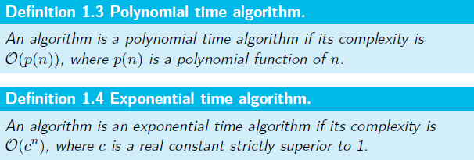
Polynomial vs Exponential-Time Algorithms

Slide 48
The complexity of a problem is equivalent to the complexity of the best algorithm solving that problem.
A problem is tractable (or "easy") if there exists a polynomial time algorithm to solve it, or intractable otherwise.

Slide 49
Optimization vs Decision Problems
Optimization Problem
A computational problem in which the object is to find the best of all possible solutions. (i.e. find a solution in the feasible region which has the minimum or maximum value of the objective function.)
Decision Problem
A problem with a “yes” or “no” answer.

Slide 50
Convert Optimization Problems into equivalent Decision Problems
What is the optimal value?
→Is there a feasible solution to the problem with an objective function value equal to or superior to a specified threshold?

Slide 51

Complexity Classes of Problems
The class of decision problems for which we can find a solution in polynomial time.
i.e. P includes all decision problems for which there is an algorithm that halts with the correct yes/no answer in a number of steps bounded by a polynomial in the problem size n.
The Class P in general is thought of as being composed of relatively “easy” problems for which efficient algorithms exist.
A (decision) problem of class P can be solved by a deterministic machine in polynomial time.

Slide 52
Examples of Class P Problems
Shortest path
Minimum spanning tree
Network flow
Transportation, assignment and transshipment
Some single machine scheduling problems

Slide 53
Class NP
NP = Nondeterministic Polynomial
NP is the class of decision problems for which we can check solutions in polynomial time.
i.e. easy to verify but not necessarily easy to solve
A (decision) problem of class NP can be solved by a non deterministic machine in polynomial time.

Slide 54
Class NP
Formally, it is the set of decision problems such that if x is a “yes” instance then this could be verified in polynomial time if a clue or certificate whose size is polynomial in the size of x is appended to the problem input.
NP includes all those decision problems that could be polynomial-time solved if the right (polynomial-length) clue is appended to the problem input.

Slide 55
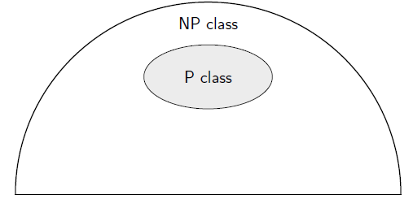
Class P vs Class NP
Class P contains all those that have been conquered with well-bounded, constructive algorithms.
Class NP includes the decision problem versions of virtually all the widely studied combinatorial optimization problems.
P is a subset of NP.

Slide 56
NP Hard vs NP Complete
A problem P is said to be NP-Hard if all members of NP polynomially reduce to this problem.
A problem P is said to be NP-Complete if (a) P ∈ NP, and (b) P is NP-Hard.
NP
NP-Hard
P
NP Complete

Slide 57
If there is an efficient (i.e. polynomial) algorithm for some NP-Complete problem, then there is a polynomial algorithm existing for all problems in NP.→ P = NP
P–problems
Minimum spanning tree
Shortest path problems
Maximum flow network
Maximum bipartite matching
Linear programming continuous models
NP–hard problems
Sequencing and scheduling problems
Assignment and location problems
Grouping problems
Routing and covering problems
Knapsack and packing/cutting problems

Slide 58
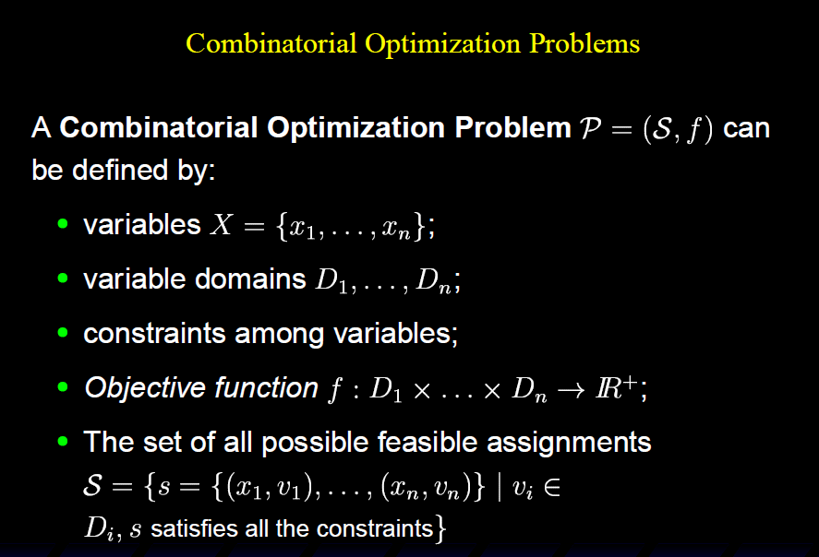

Slide 59
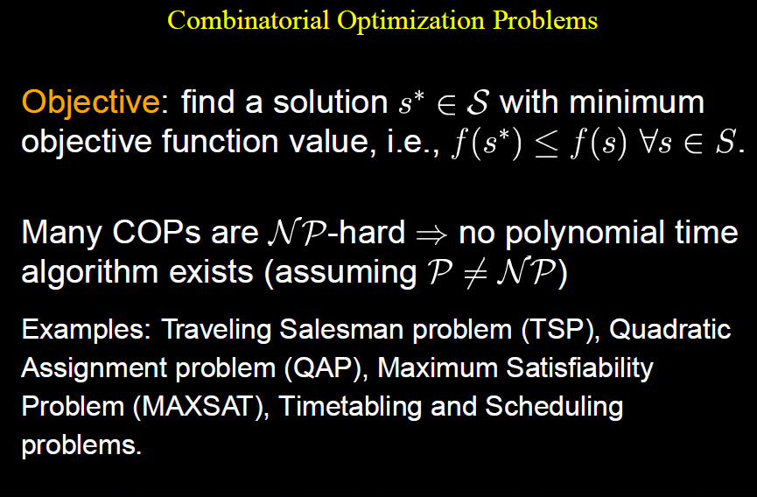

Slide 60
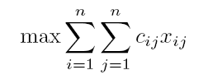
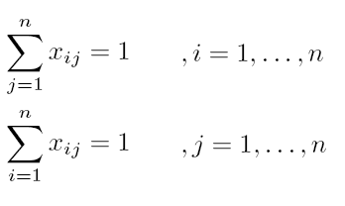
COP Example: The Assignment Problem
n persons (i) and n tasks (j)
It costs to let person i do task j
We introduce decision variables:
Find the minimal cost assignment:
If person i does task j
Otherwise

Slide 61
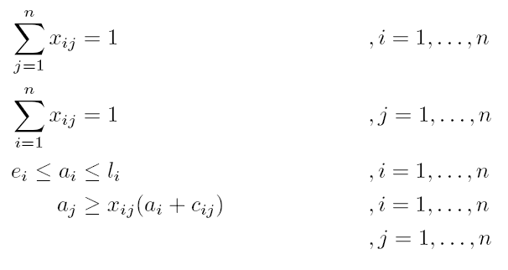
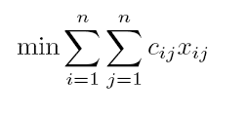

COP Example: TSPTW
If city j follows right after city i
otherwise
Arrival time at city i

Slide 62
COP Example: The Knapsack Problem
n items {1,...,n} available, weight a_{i} , profit c_{i}
A selection shall be packed in a knapsack with capacity b
Find the selection of items that maximizes the profit
If the item i is in the knapsack
otherwise

Slide 63
Example: TSP
Earlier solution:
1 2 7 3 4 5 6 1 (184)
Trivial solution:
1 2 3 4 5 6 7 1 (288)
Greedy construction:
1 3 5 7 6 4 2 1 (160)
 | 1 | 2 | 3 | 4 | 5 | 6 | 7
1 | 0 | 18 | 17 | 23 | 23 | 23 | 23
2 | 2 | 0 | 88 | 23 | 8 | 17 | 32
3 | 17 | 33 | 0 | 23 | 7 | 43 | 23
4 | 33 | 73 | 4 | 0 | 9 | 23 | 19
5 | 9 | 65 | 6 | 65 | 0 | 54 | 23
6 | 25 | 99 | 2 | 15 | 23 | 0 | 13
7 | 83 | 40 | 23 | 43 | 77 | 23 | 0

Slide 64
Example: Knapsack Problem
 | 1 | 2 | 3 | 4 | 5 | 6 | 7 | 8 | 9 | 10
Value | 79 | 32 | 47 | 18 | 26 | 85 | 33 | 40 | 45 | 59
Size | 85 | 26 | 48 | 21 | 22 | 95 | 43 | 45 | 55 | 52
Knapsack with capacity 101
10 ”items” (e.g. projects, ...) 1,...,10
Trivial solution: empty backpack, value 0
Greedy solution, assign the items after value:
  (0000010000), value 85
  Better suggestions?

Slide 65
Given a Solution: How to Find a Better One
Modification of a given solution gives a ”neighbor solution”
A certain set of operations on a solution gives a set of neighbor solutions, a neighborhood
Evaluations of neighbors
  Objective function value
  Feasibility ?

Slide 66
Example: TSP
Operator: 2-opt
How many neighbors?

Slide 67
Example: Knapsack Instance
 | 1 | 2 | 3 | 4 | 5 | 6 | 7 | 8 | 9 | 10
Value | 79 | 32 | 47 | 18 | 26 | 85 | 33 | 40 | 45 | 59
Size | 85 | 26 | 48 | 21 | 22 | 95 | 43 | 45 | 55 | 52
 | 0 | 0 | 1 | 0 | 1 | 0 | 0 | 0 | 0 | 0
Given solution 0010100000 value 73
Natural operator: ”Flip” a bit, i.e.
  If the item is in the knapsack, take it out
  If the item is not in the knapsack, include it
Some Neighbors:
  0110100000 value 105
  1010100000 value 152, not feasible
  0010000000 value 47

Slide 68
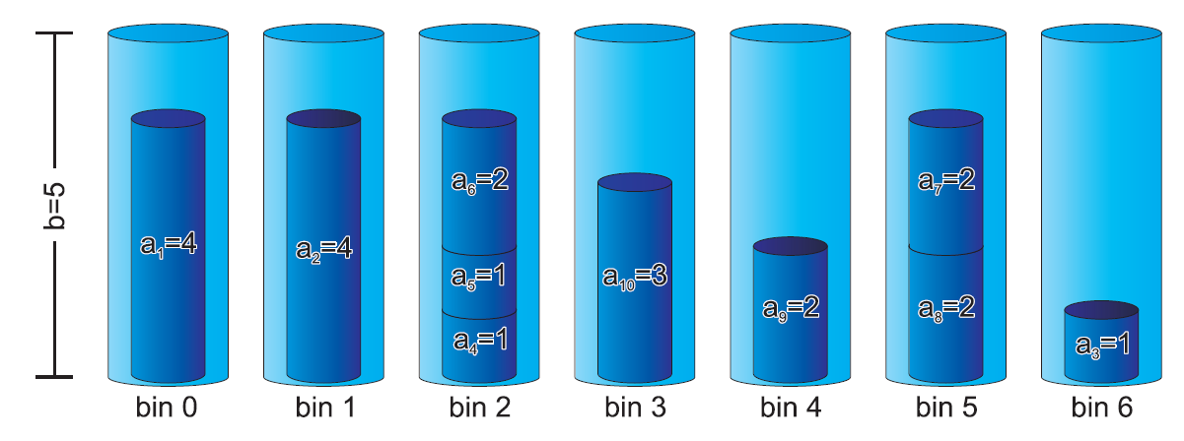
More Examples for Optimization Problems

Slide 70
