Slide 1
TOPIC-5
SOFTWARE PROJECT PLANNING

Slide 2
Software Project Planning
The first step of software projects management process is the project planning step.
Project planning, in turn, start with Estimation.
Estimation is both an ‘art’ and ‘science’ (There are techniques for time and human-effort estimation)
We have got to estimate:
resources, cost and schedule required for a Project.
Estimation requires experience access to info on previous projects.
Estimation carries a risk.
If we are familiar with the type of projects, we are going to handle, estimation becomes easier.

Slide 3
Project Cost Management Processes
Process Group | Cost Management Process | Major Output
Planning | CP1: Planning Cost Mgmt | Cost Management Plan
 | CP2: Estimating Costs | Activity Cost Estimates
 | CP3: Determining the Budget | Cost Performance Baseline
Monitoring and Controlling | MC1: Controlling Costs | Work Perf. Measurements Budget Forecasts

Slide 4
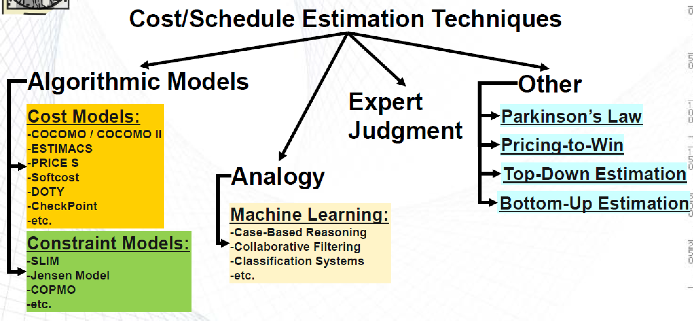
Estimation techniques
Organizations need to estimate the software EFFORT and COST of a SW Project.

Slide 5
Estimation techniques
Concentrate two types of technique that can be used to do this:
  Experience-based techniques: is based on the manager’s experience of past projects and the application domain.
  Algorithmic cost modeling: a formulaic approach is used to compute the project effort.
The PROJECT EFFORT based on estimates of product size, and process characteristics such as experience of staff involved.

Slide 6
Experience-based approaches
Experience-based techniques rely on:
  judgments based on experience of past projects
  the effort used in these projects on software development activities.
Typically, you identify the deliverables to be produced in a project and the different software components or systems that are to be developed.
You document these in a spreadsheet, estimate them individually and compute the total effort required.
It usually helps to get a group of people involved in the effort estimation and to ask each member of the group to explain their estimate.

Slide 7
Algorithmic cost modelling
Cost is estimated as a mathematical function of
product, project and process attributes whose
values are estimated by project managers:
  Effort = A × Size^{B} × M
  A is an organisation-dependent constant,
  B reflects the disproportionate(unbalanced) effort for large projects
  M is a multiplier reflecting product, process and people attributes.
The most commonly used product attribute for cost
estimation is code size.
Most models are similar but they use different values for A, B and M.

Slide 8
Estimation accuracy (Size of System?)
The size of a system can only be known accurately when it is finished.
Several factors influence the final size:
  Use of components;
  Programming language;
  Distribution of system.
As the development process progresses then the size estimate becomes more accurate.
The estimates of the factors contributing to B and M are subjective and vary according to the judgment of the estimator.

Slide 9
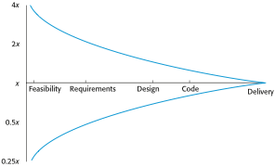
Estimate uncertainty

Slide 10
COCOMO
Reading Overview of COCOMO
http://www.softstarsystems.com/overview.htm
Copyright © 1986-2015 Softstar Systems. All rights reserved. SystemStar®, Costar™, and Calico™ are trademarks of Softstar Systems.

Slide 11
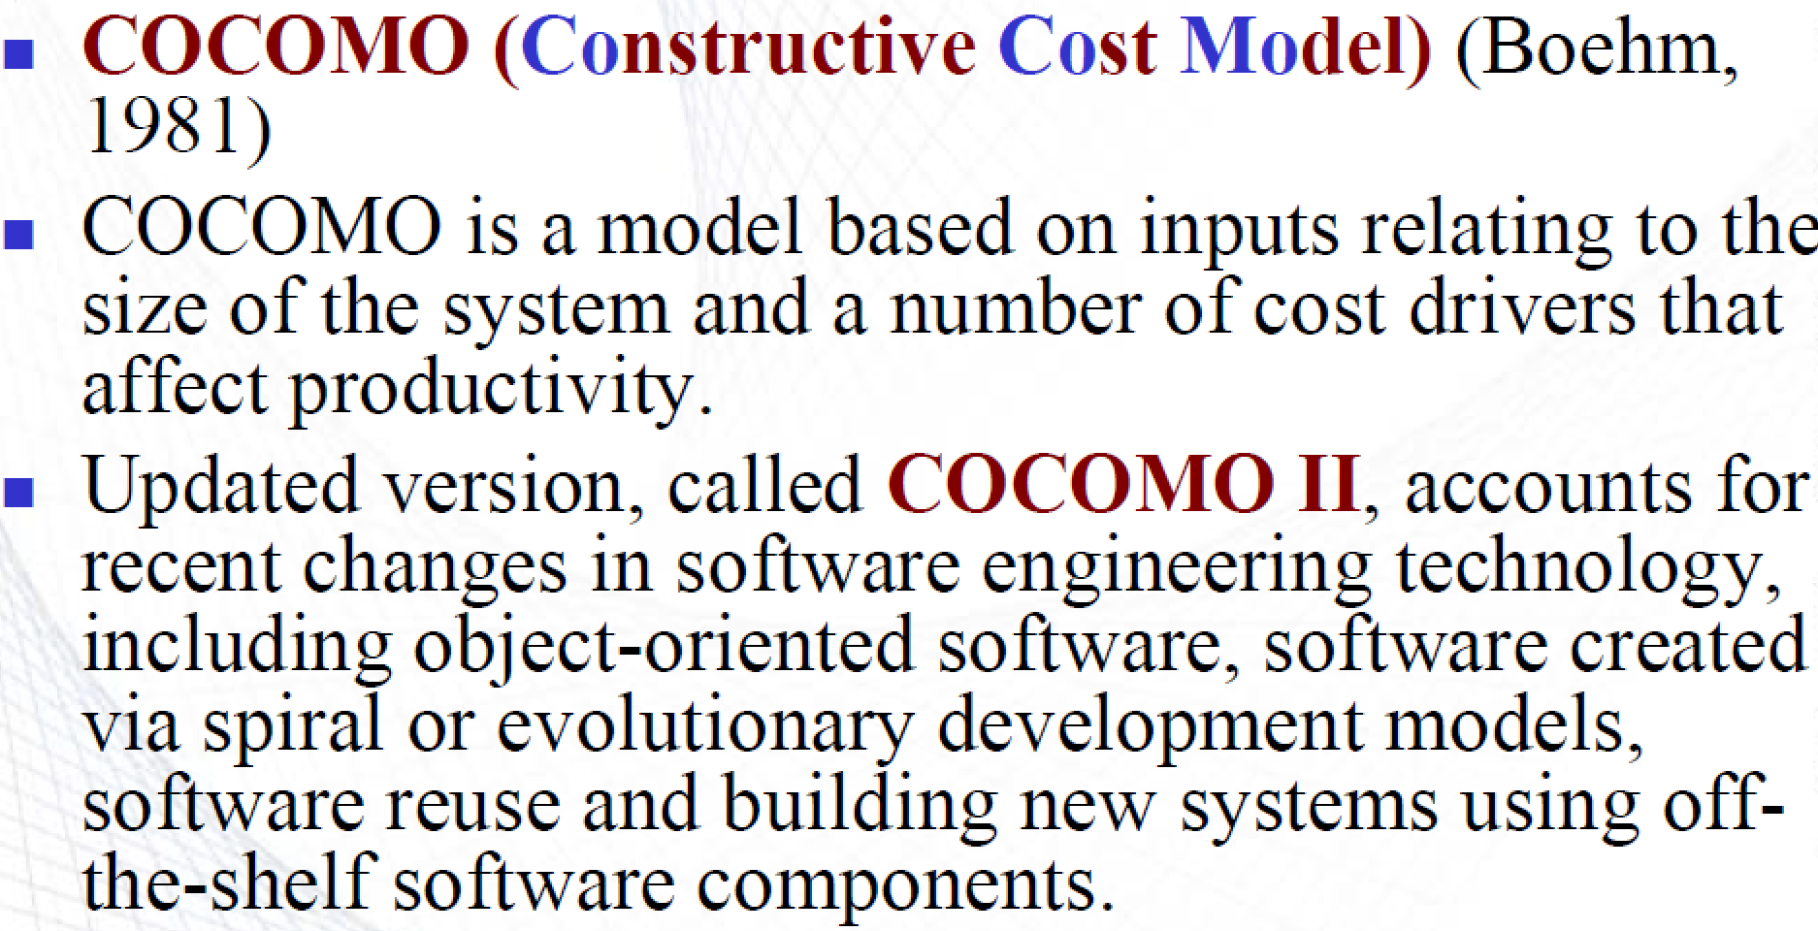
COCOMO MODEL

Slide 12
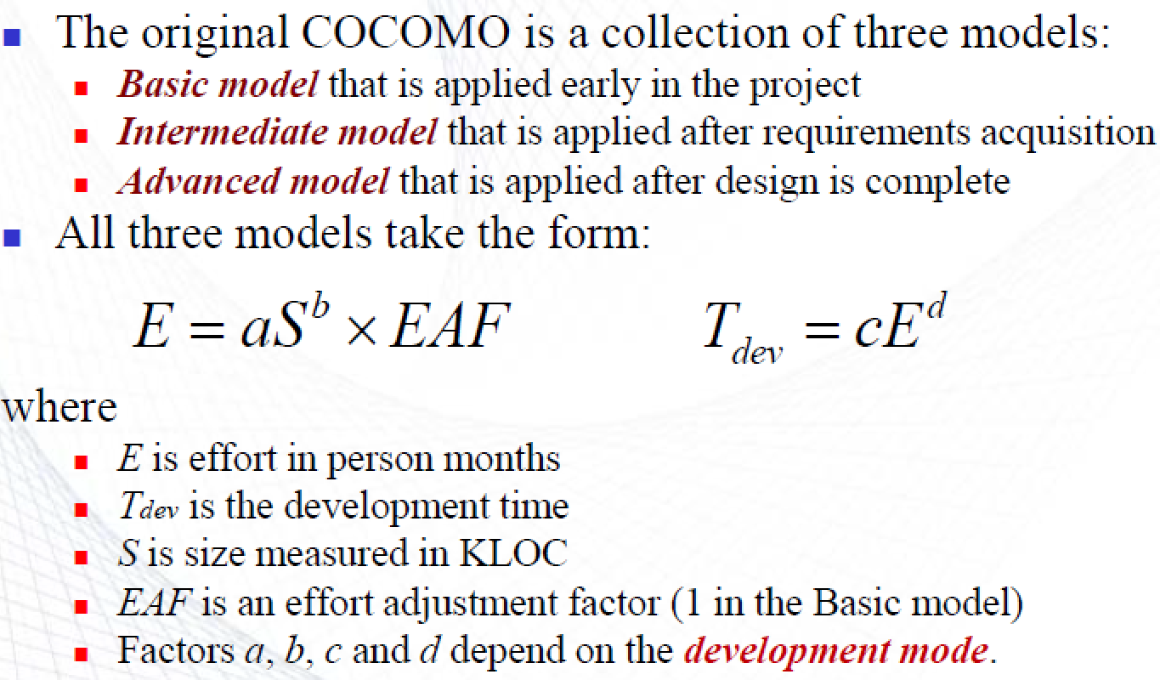
COCOMO MODEL

Slide 13
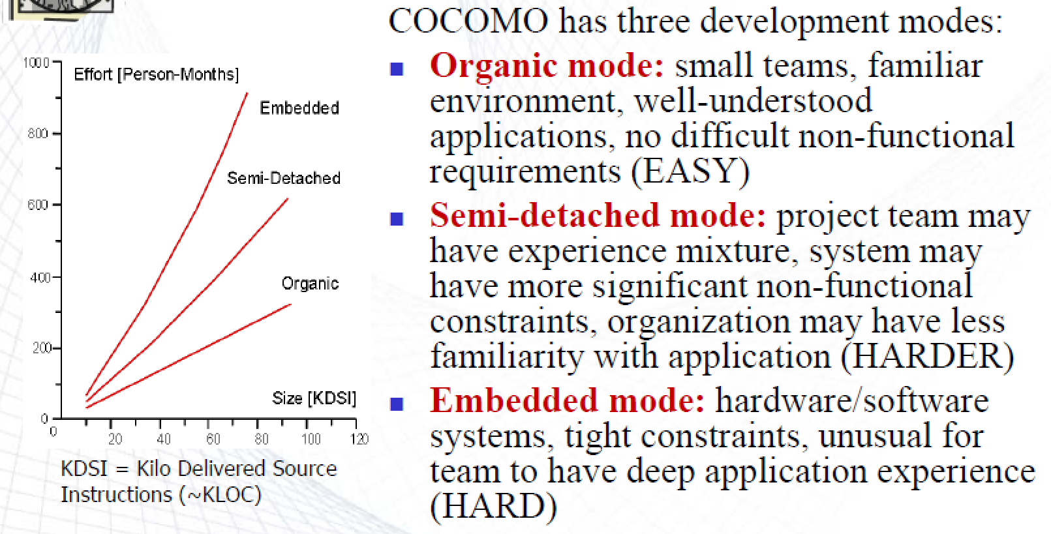
COCOMO MODEL

Slide 14
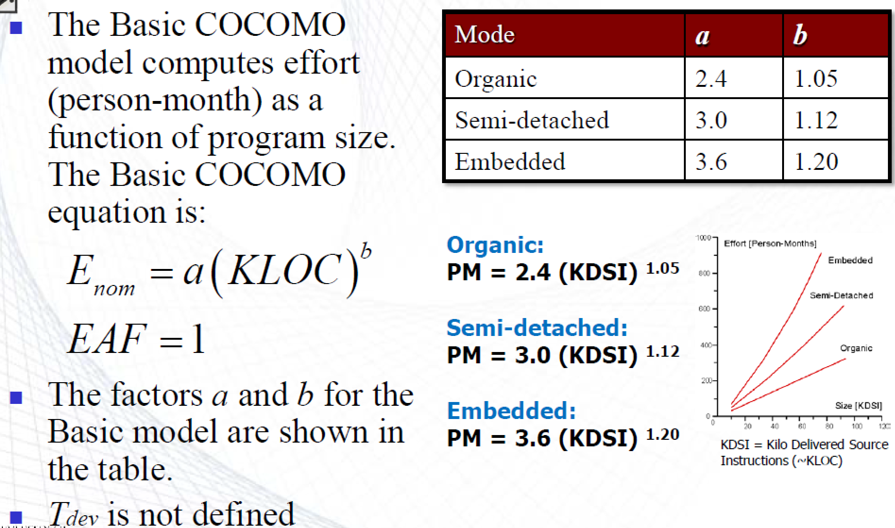
COCOMO BASIC MODEL

Slide 15
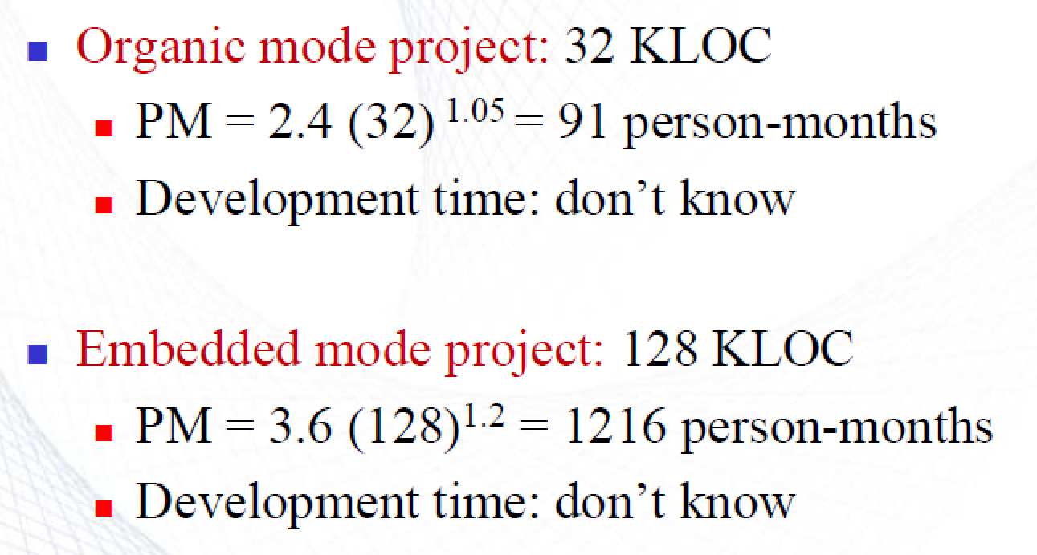
COCOMO BASIC MODEL

Slide 16
COCOMO BASIC MODEL

Slide 17
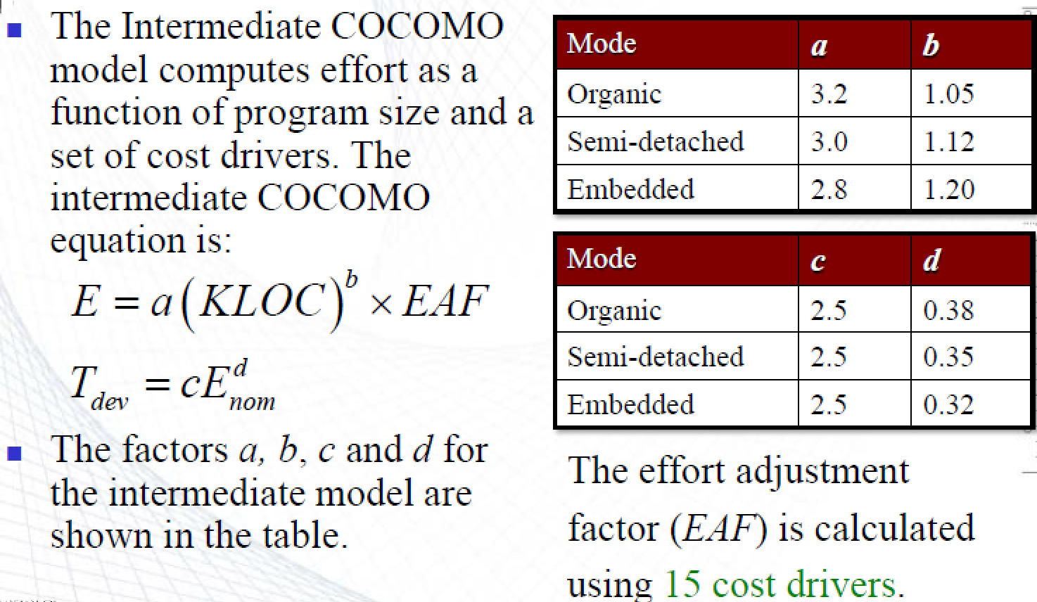
COCOMO INTERMEDIATE MODEL

Slide 18
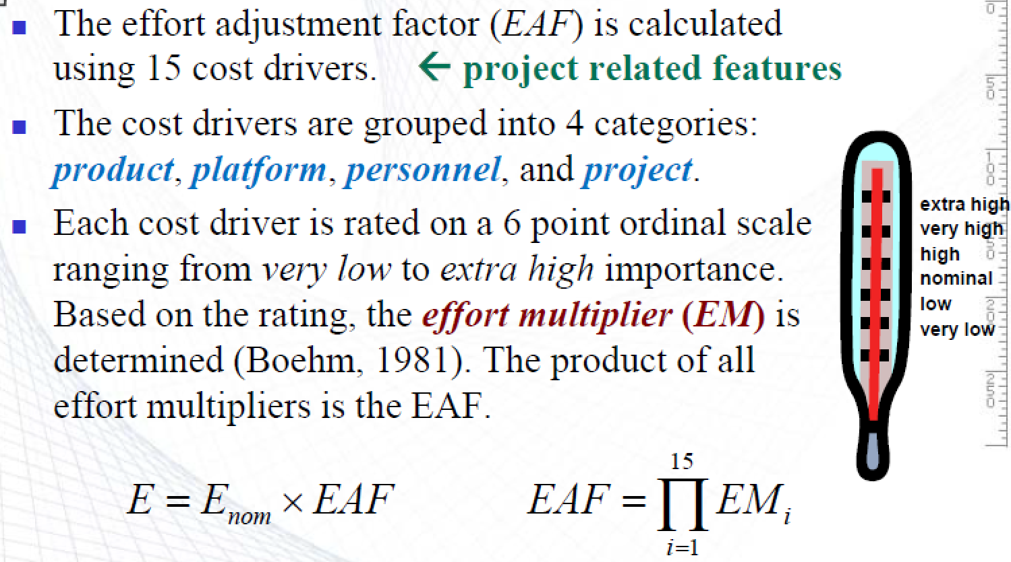
COCOMO INTERMEDIATE MODEL

Slide 19
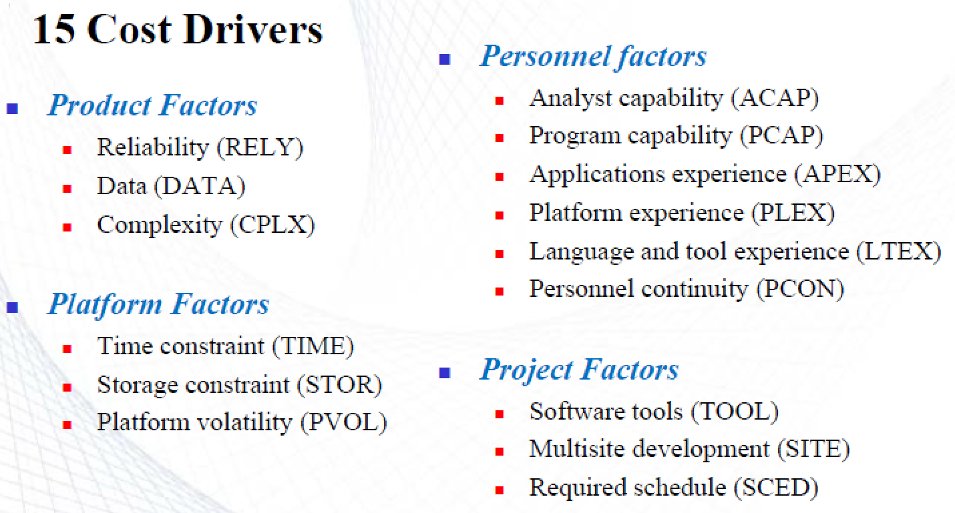
COCOMO INTERMEDIATE MODEL

Slide 20
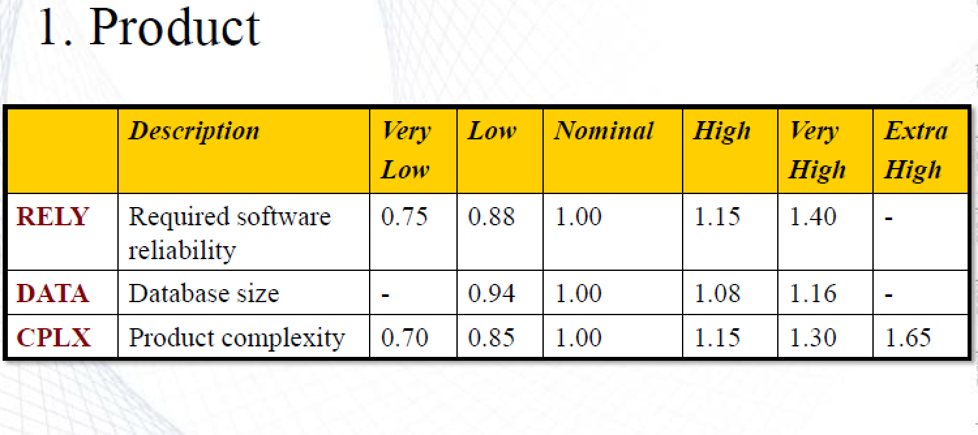
COST DRIVER RATING

Slide 21
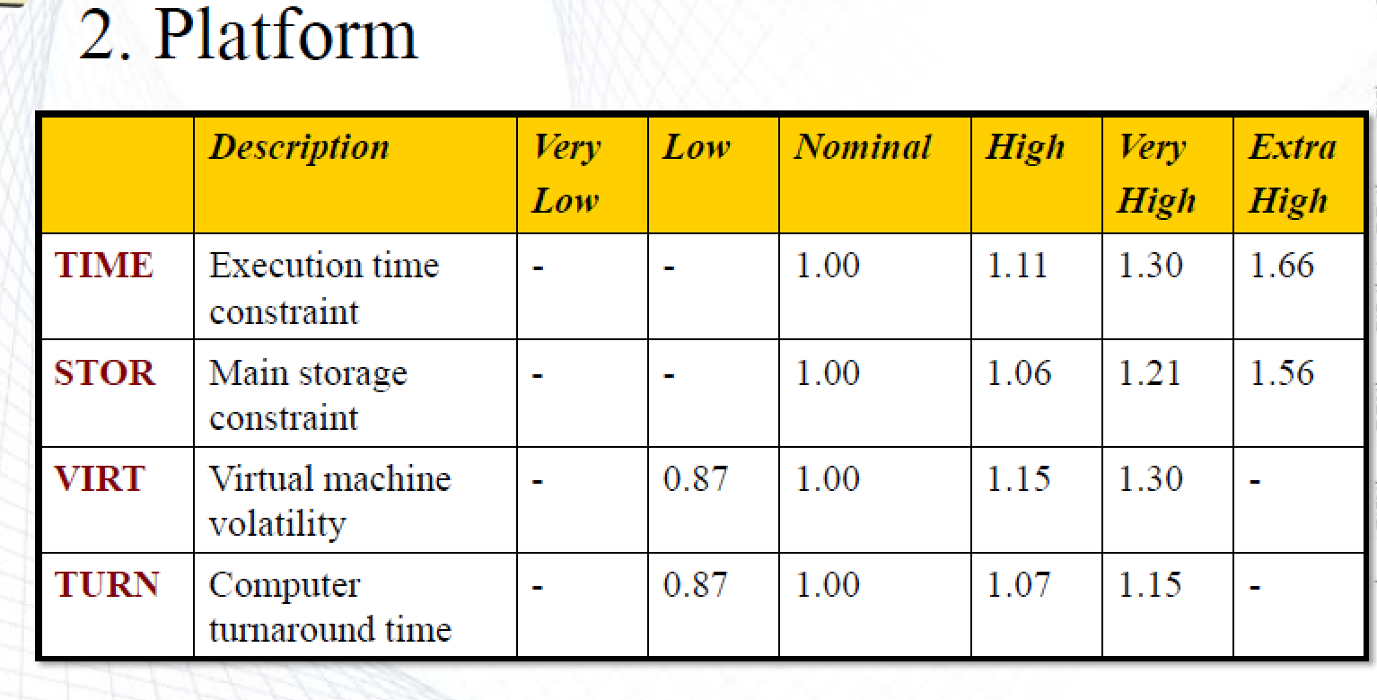
COST DRIVER RATING

Slide 22
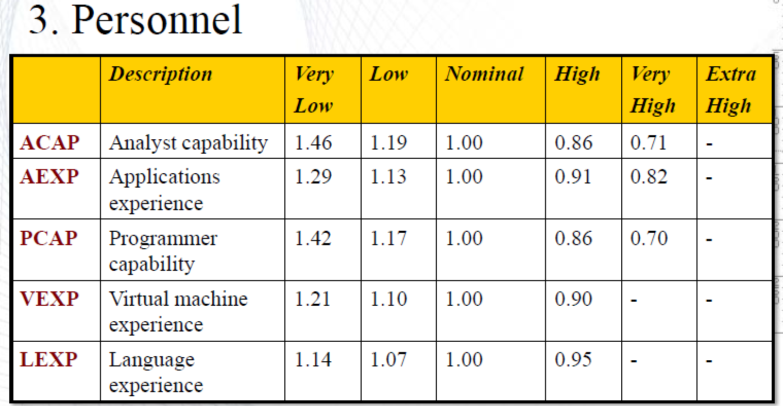
COST DRIVER RATING

Slide 23
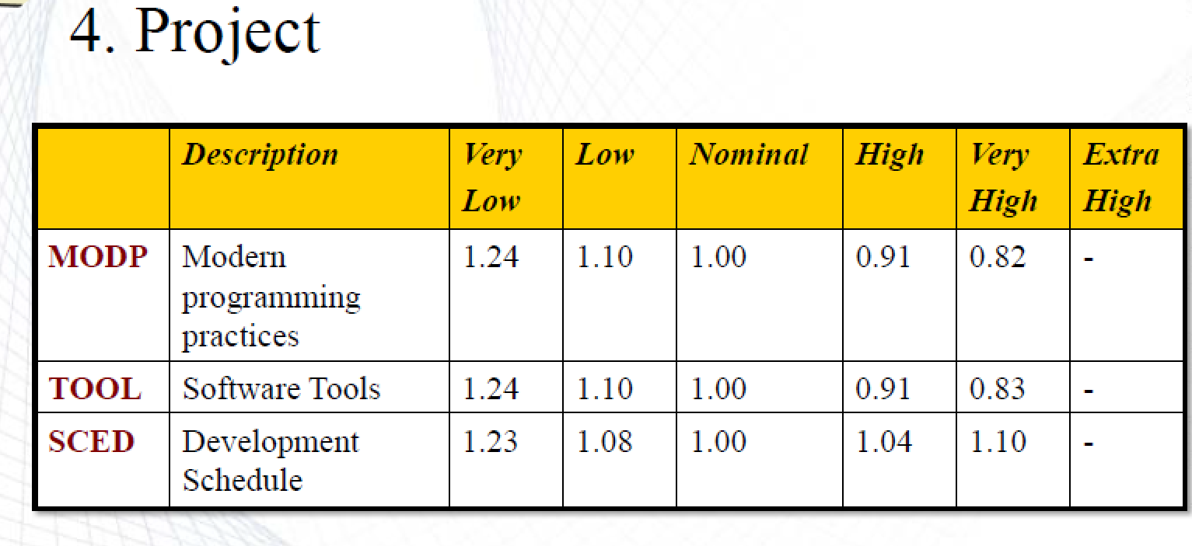
COST DRIVER RATING

Slide 24
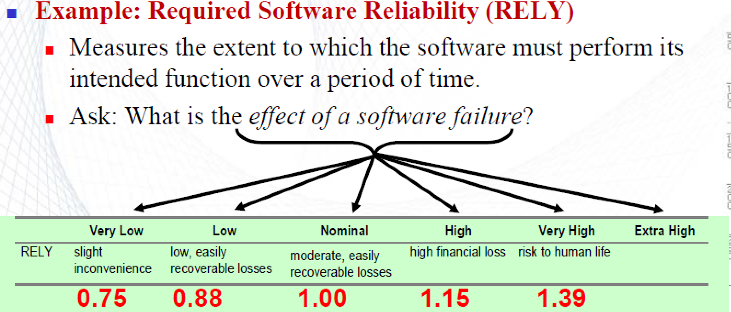
COST DRIVER RATING EXAMPLE
i.e. A PATIENT MONITORING SYSTEM→1.39

Slide 25
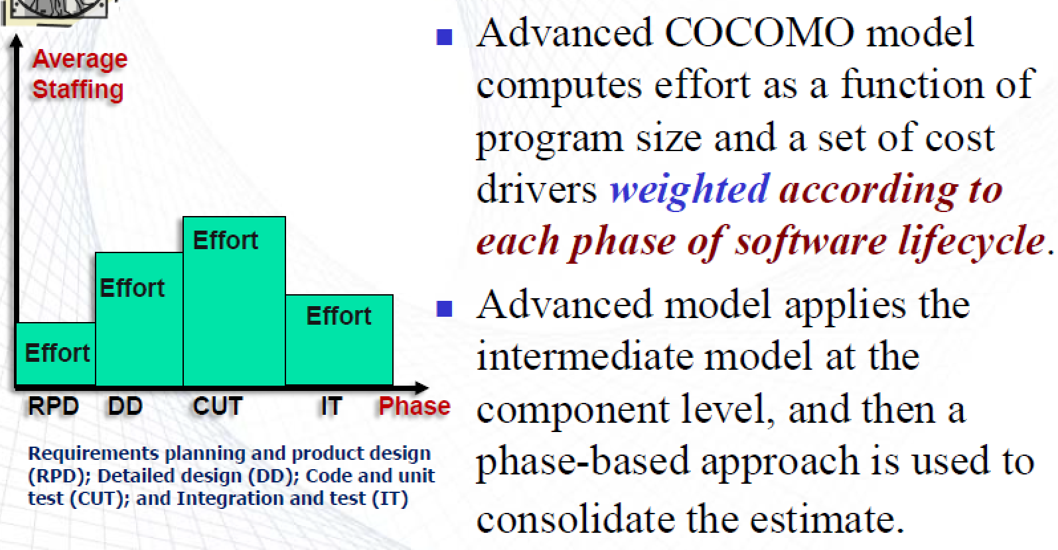
COCOMO ADVANCE MODEL

Slide 26
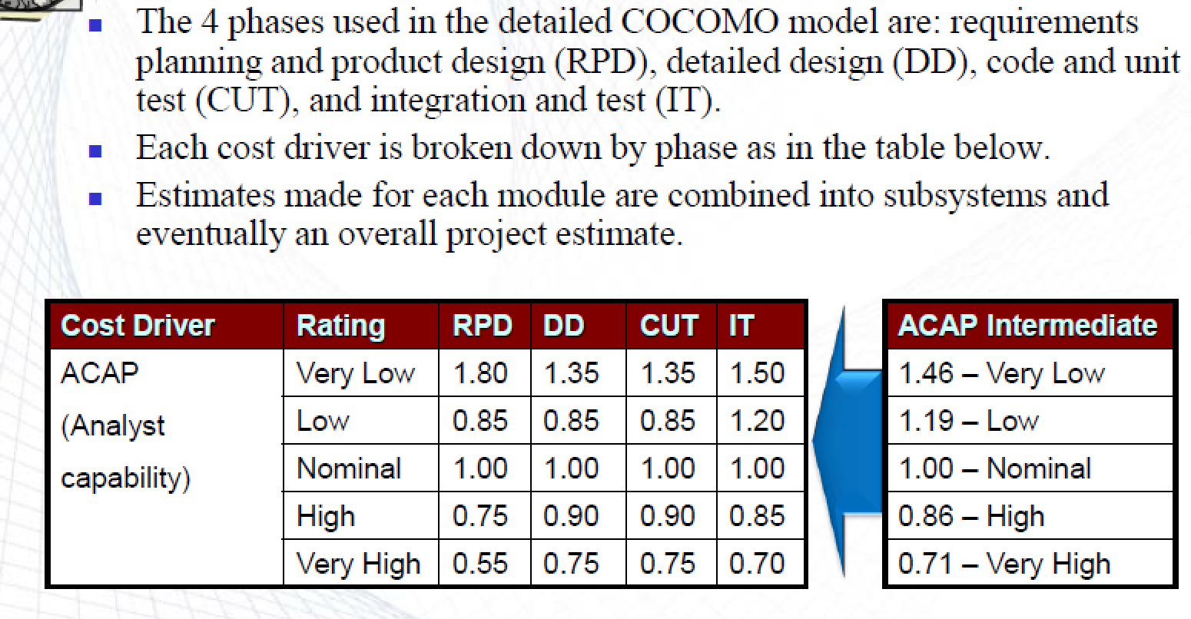
COCOMO ADVANCE MODEL

Slide 27
COCOMO II

Slide 28
COCOMO II

Slide 29
The COCOMO 2 model
Extendend version of (COCOMO-81) →COCOMO 2.
COCOMO 2 recognizes different approaches to software development such as prototyping, development by component composition and use of database programming.
COCOMO II supports a spiral model of development and embeds several sub-models that produce increasingly detailed estimates.
These can be used in successive rounds of the development spiral.

Slide 30
COCOMO 2 models
COCOMO 2 includes a range of sub-models. These sub-models produce increasingly detailed software estimates. The sub-models in COCOMO 2 are:
  Application composition model. This assumes that systems are created from reusable components, scripting or database programming. It is designed to make estimates of prototype development. Software size estimates are based on application points, and a simple size/productivity formula is used to estimate the effort required.
  Early design model. This model is used during early stages of the system design after the requirements. Estimates are based on function points, which are then converted to number of lines of source code.The formula considers set of seven multipliers.
  Reuse model. This model is used to compute the effort required to integrate reusable components and/or program code that is automatically generated by design or program translation tools. It is usually used in conjunction with the post-architecture model.
  Post-architecture model. Once the system architecture has been designed, a more accurate estimate of the software size can be made. However, it includes a more extensive set of 17 multipliers reflecting personnel capability and product and project characteristics.

Slide 31
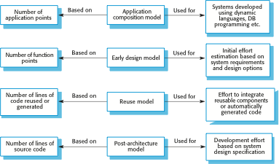
COCOMO estimation models

Slide 32
1. Application composition model
Suitable for software built around graphical user interface (GUI) and modern GUI-builder tools.
Supports prototyping projects and for projects where the software is developed by composing existing components.
Uses object points as a size metric extension of function points
Count of the screens, reports, and modules, weighted by a three-level factor (simple, medium, difficult).
Programmer productivity also depends on the developer’s experience and capability as well as the capabilities of the CASE tools used to support development.
Formula is
  PM = ( NAP * (1 - %reuse/100 ) ) / PROD
  PM is the effort in person*months,
  NAP is the number of application points and
  PROD is the productivity.

Slide 33
Application composition model
EXAMPLE-1
An Application will have 3 screens and will produce 1 report:
  A booking screen: records a new sale booking
  A pricing screen: shows the rate for each day and each flight
  An availability screen: shows available flights
  A sales report: shows total sale figures for the month and year, and compares figures with previous months and years
  PM = ( NAP * (1 - %reuse/100 ) ) / PROD

Slide 34
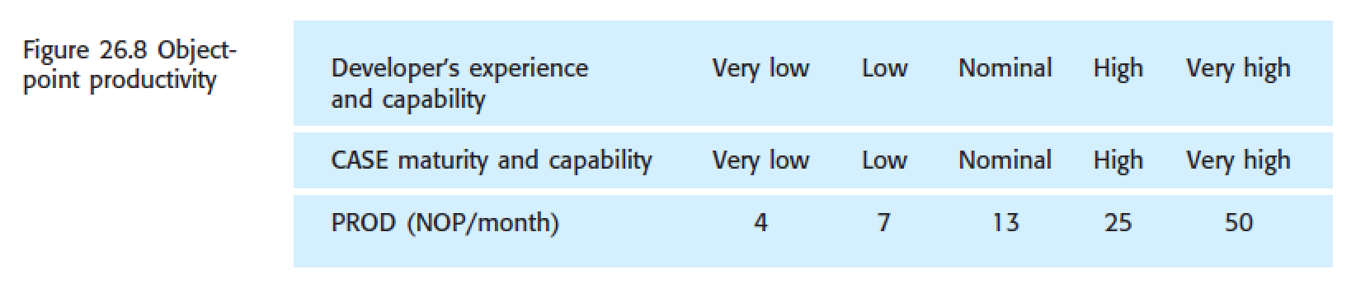
PRODUCTIVITY
EXAMPLE-1 CONTINUE: Calculating the PROD:
Assessment of the developers and the environment shows:
– The developers’ experience is very low (4)
– The CASE tool is low (7).
– So, we have a productivity rate of 5.5=(4+7)/2 object_points/(person*month).

Slide 35
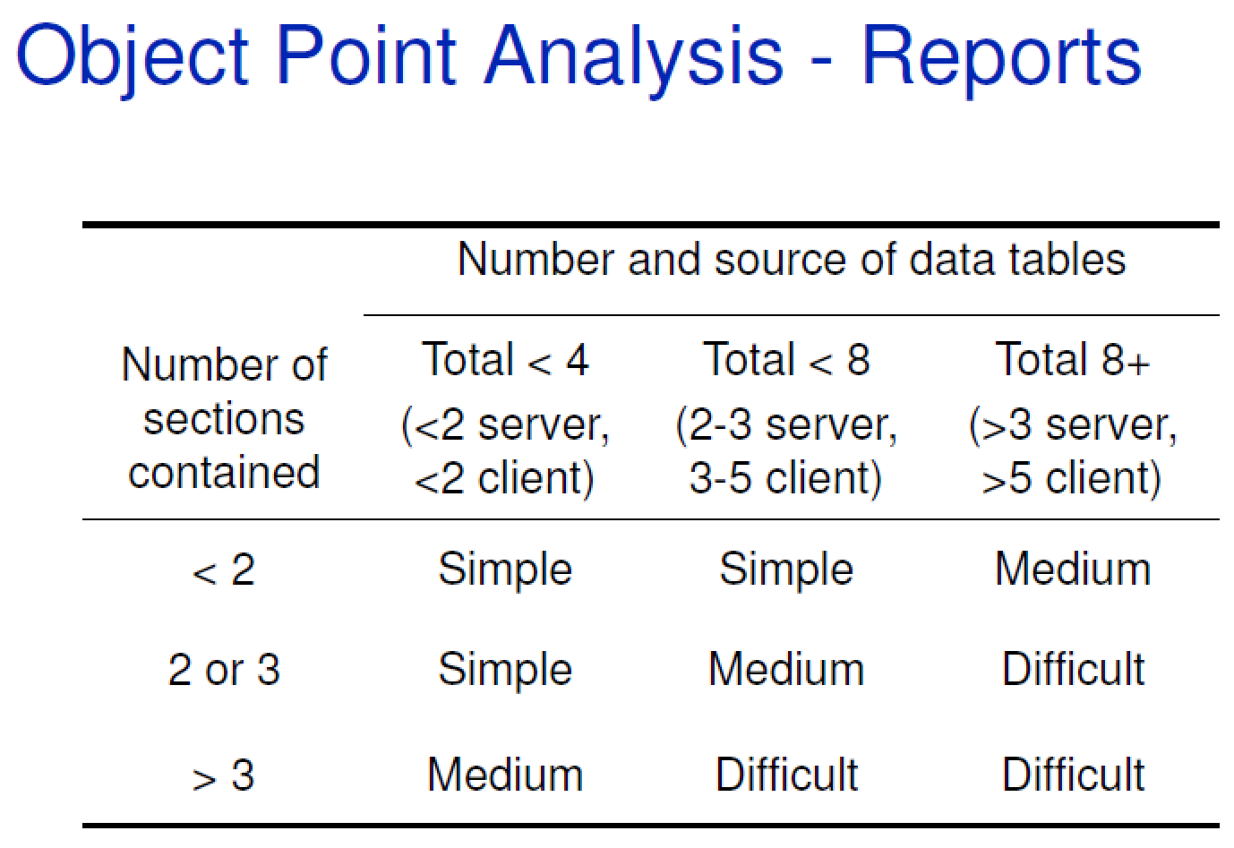
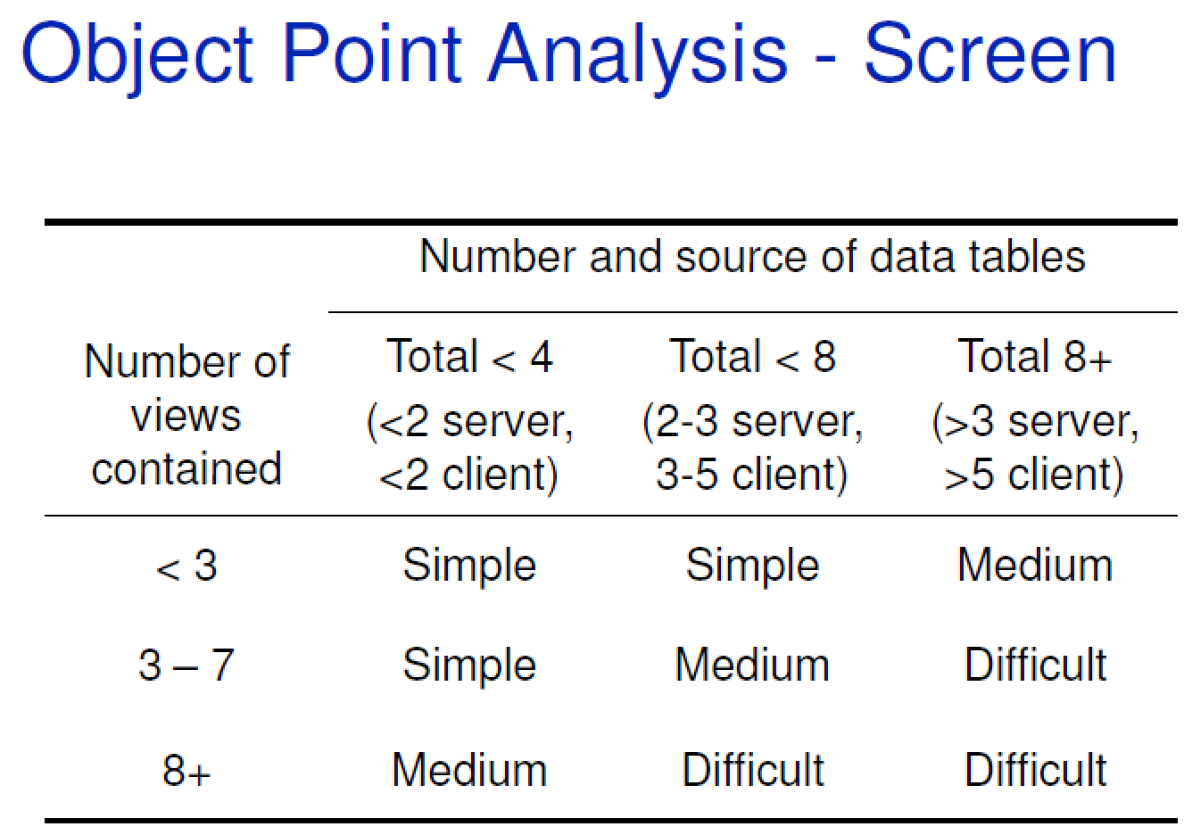

Slide 36
EXAMPLE-1(Cont.): Rating of system
Booking screen: Needs 3 data tables (customer info, customer history table, available seats)
Only 1 view of the screen is enough. So, the booking screen is classified as simple. A DATA VIEW can be thought of as a logical data record.
Similarly, the levels of difficulty of the pricing screen, the availability screen and the sales report are classified as simple, medium and medium, respectively.
There is no 3GL component. 3GL – 3rd Generation Language – high-level language, e.g., C, Pascal

Slide 37
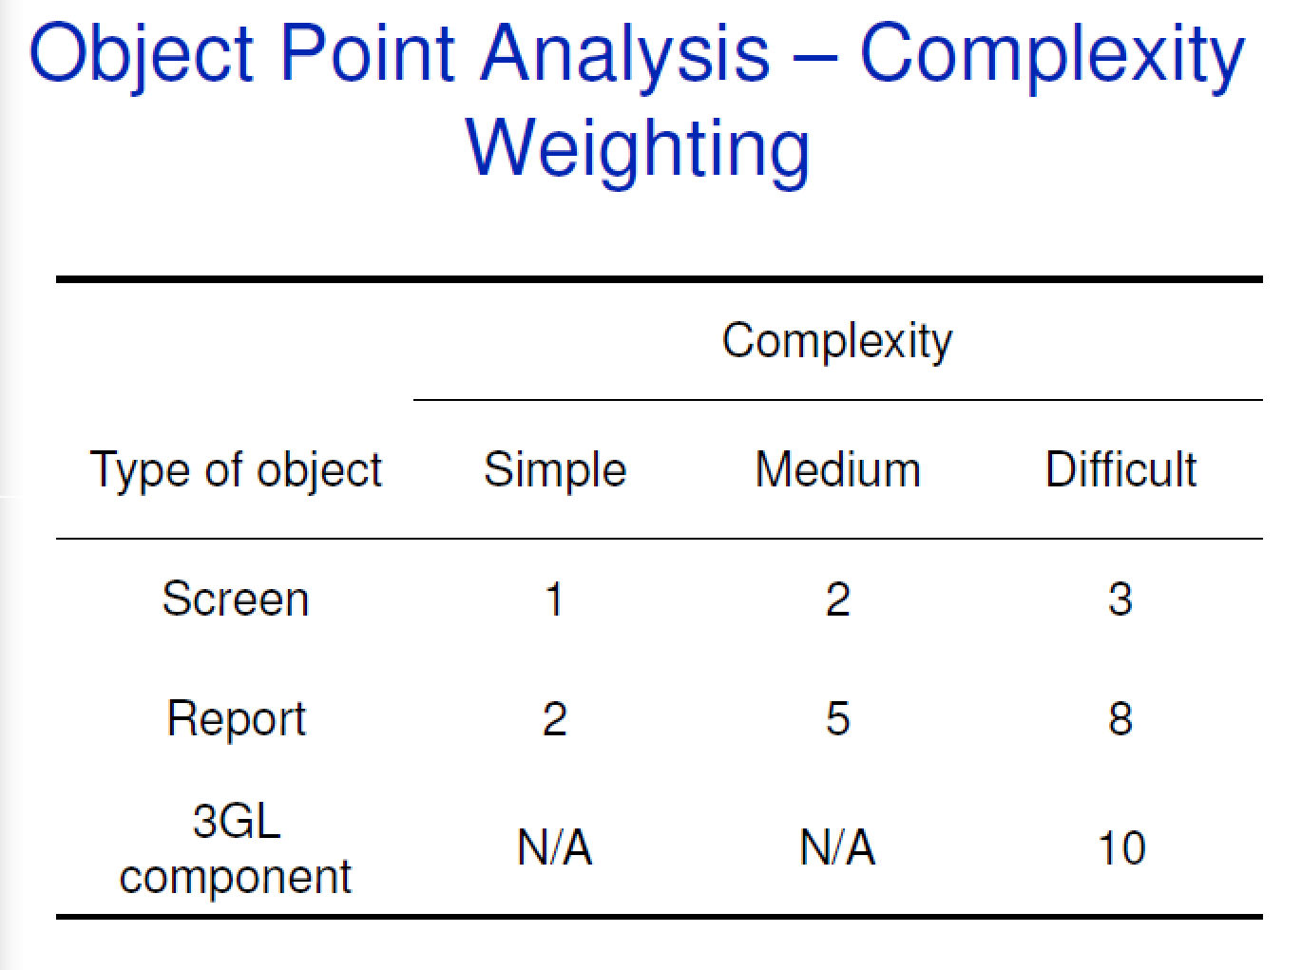

Slide 38
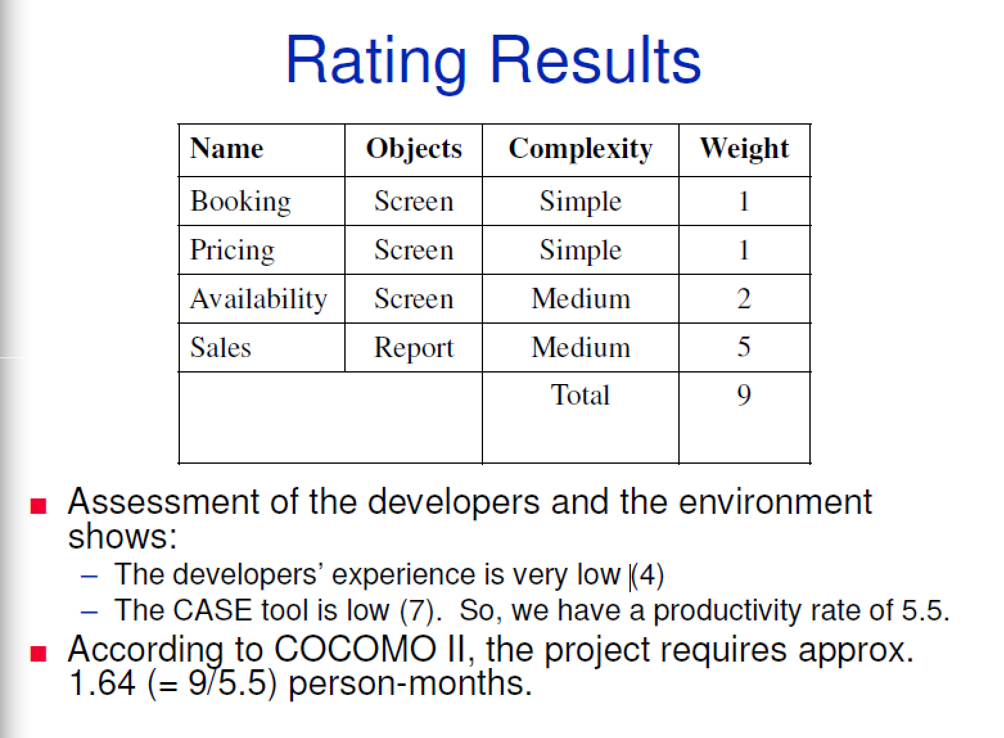
EXAMPLE-1(Cont.):Rating

Slide 39
CONVERT
OBJECT POINTS
TO
FUNCTIONAL POINTS

Slide 40
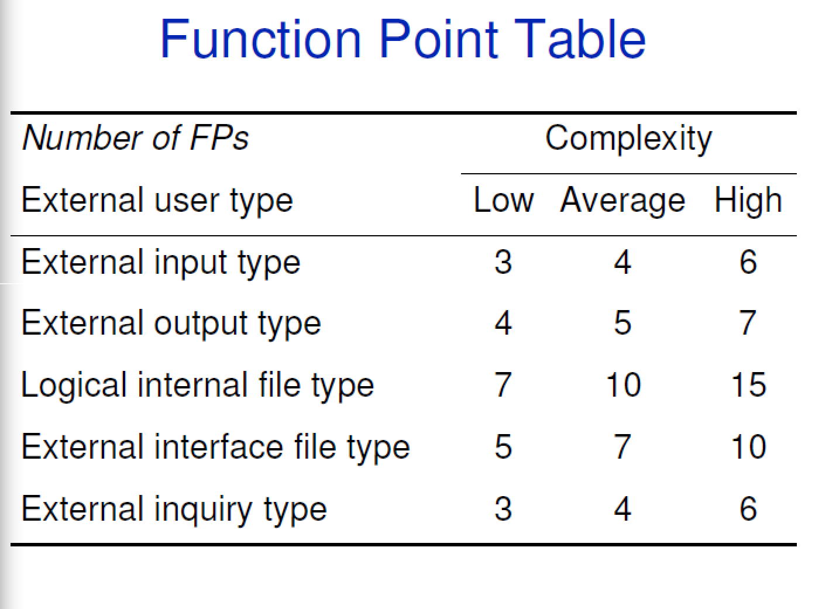

Slide 41
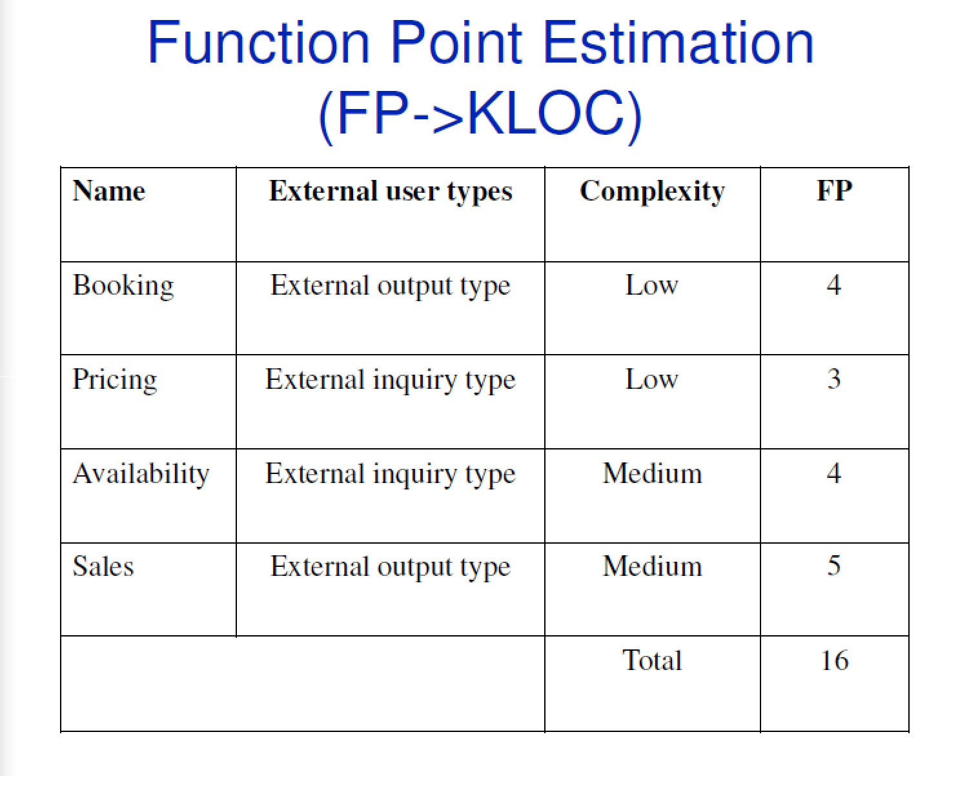
EXAMPLE-1(Cont.): Function Point Estimation
OBJECTS

Slide 42
2. Early design model
This model is used once user requirements have been agreed and initial stages of the system design process are underway.
However, you don’t need a detailed architectural design to make these initial estimates.
Your goal at this stage should be to make an approximate estimate.
It uses a small set of new Cost Drivers, and new estimating equations.
The standard formula for algorithmic models:
PM = A ∗ Size^{B} ∗EAF where
The size of the system is expressed in KSLOC, which is the number of thousands of lines of source code.
You calculate KSLOC by estimating the number of function points in the software.

Slide 43
CONVERT
FUNCTIONAL POINTS
TO
LOC

Slide 44
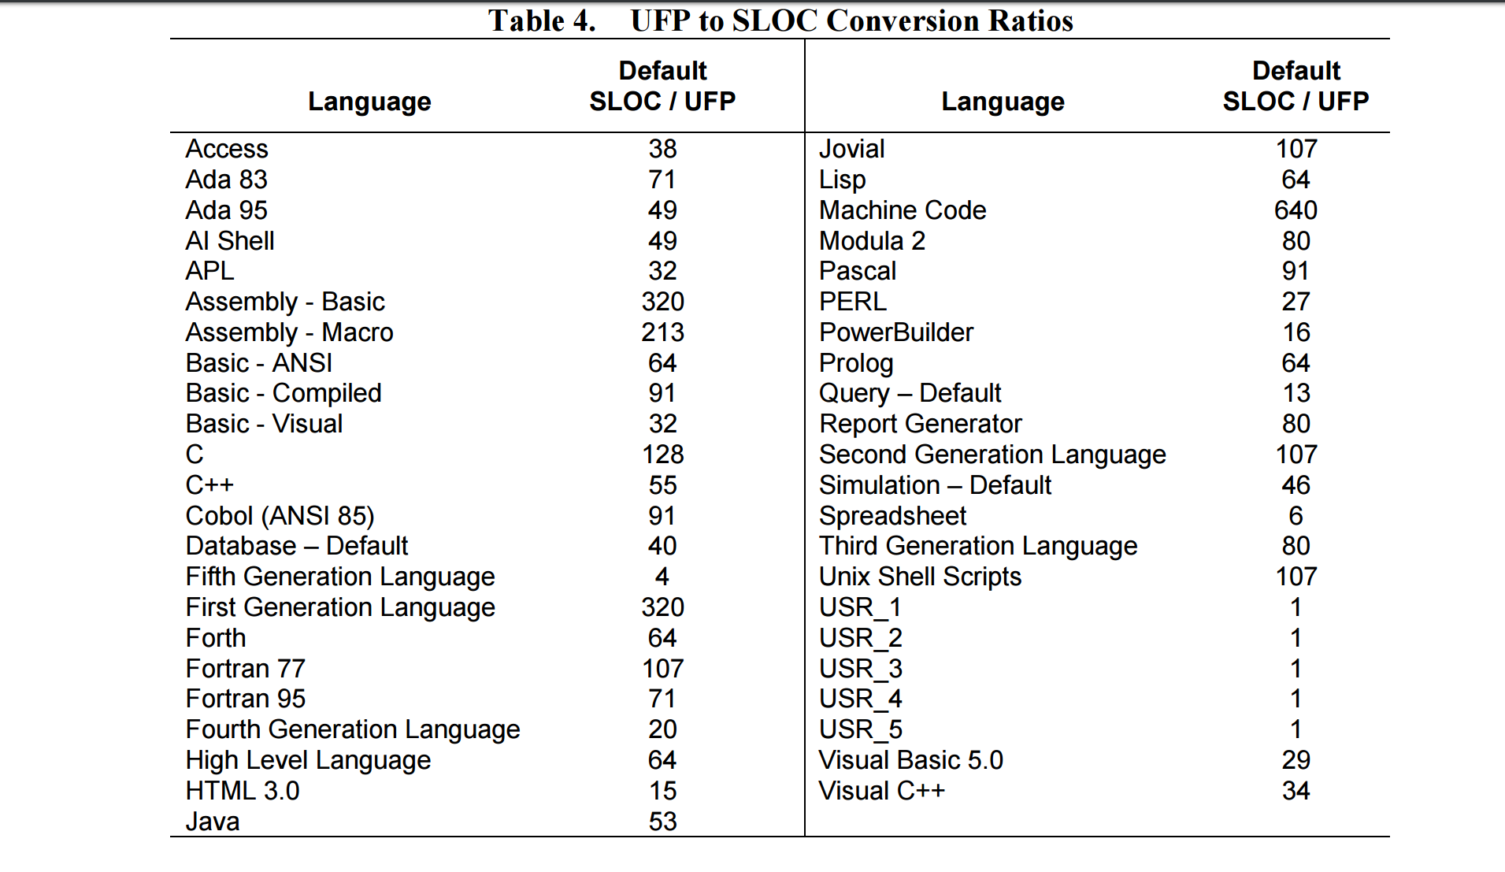
FP to LOC conversion table
a

Slide 45
EXAMPLE-1(Cont.):
Size: FP->LOC
Total function points = 16
Published figures for C show that:
  1 FP = 128 LOC in C
Estimated Size:
  16 FP * 128 LOC/FP = 2048 LOC = 2 KLOC

Slide 46
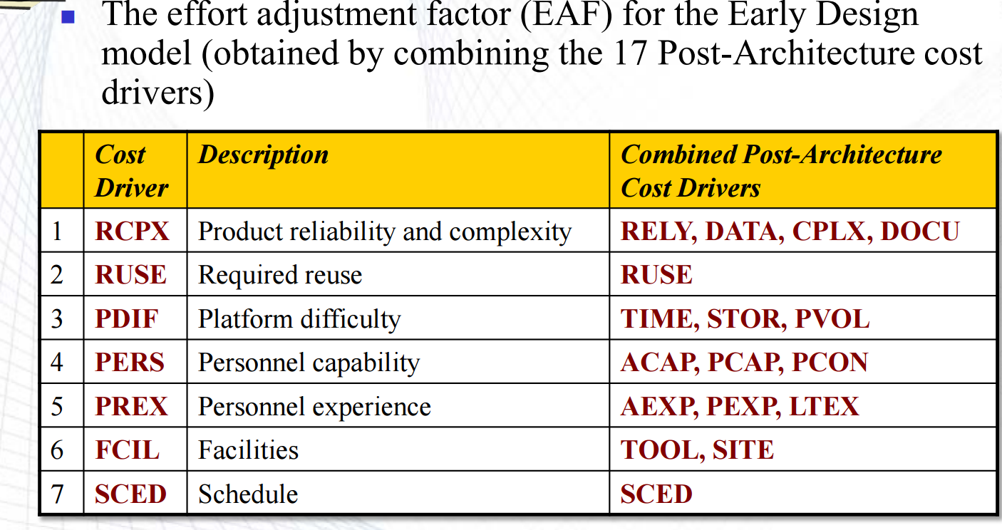
Early design model- EAF Multipliers
Multipliers reflect the capability of the developers, the non-functional requirements, the familiarity with the development platform, etc.

Slide 47
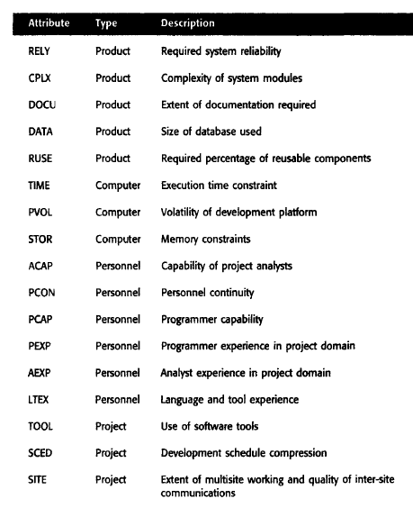

Slide 48
Early design model
Based on his own large data set, Boehm proposes that the coefficient A should be 2.94 (sometimes A = 2.45 in initial calibration).
B reflects the increased effort required as the size of the Project varies from 1.1 to 1.24 depending on :
      novelty of the project,
      development flexibility,
      risk management approaches and
      the process maturity.
The multiplier EAF in COCOMO II is based on a simplified set of seven Project and process characteristics that influence the estimate.
EAF = PERS * RCPX * RUSE * PDIF * PREX * FCIL * SCED;
These can increase or decrease the effort required.

Slide 49
3. The reuse model
Software reuse is now common, and most large systems include a significant percentage of code that is reused from previous developments.
The reuse model is used to estimate the effort required to integrate reusable or generated code.

Slide 50
3. The reuse model
COCOMO II considers reused code to be of two types.
Black-box reuse: where code is not modified. Black-box code is code that can be reused without understanding the code or making changes to it. The development effort for black-box code is taken to be zero.
White-box reuse: where code is modified. Code that has to be adapted to integrate it with new code or other reused components is called white-box code. Some development effort is required to reuse this because it has to be understood and modified before it can work correctly in the system.

Slide 51
Reuse model estimates 1
For code that is automatically generated, the reuse model estimates the number of person months required to integrate this code.
The formula for effort estimation is:
PMAuto = (ASLOC x AT/100) / ATPROD // Estimate for generated code
  ASLOC is Adopted Source Lines of Code, AT is the percentage of adopted code that is automatically generated and
  ATPROD is the productivity of engineers in integrating such code.
  Boehm et al. (Boehm, et al., 2000) have measured ATPROD to be about 2,400 source statements per month.

Slide 52
Reuse model estimates
EXAMPLE-1
Boehm et al. (Boehm, et al., 2000) have measured ATPROD to be about 2,400 source statements per month.
Therefore, if there is a total of 20,000 lines of white-box reused code in a system and
30% of this is automatically generated, then the effort required to integrate this generated code is:
(20,000 x 30/100) / 2400 = 2.5 person months //Generated code example

Slide 53
Reuse model estimates 2
When code has to be understood and integrated:
  ESLOC = ASLOC * (1-AT/100) * AAM.
  ASLOC and AT as before, ESLOC is Equivalent Source Lines of Code
  AAM is the Adaptation Adjustment Multiplier computed from:
    the costs of changing the reused code,
    the costs of understanding how to integrate the code and
    the costs of reuse decision making.

Slide 54
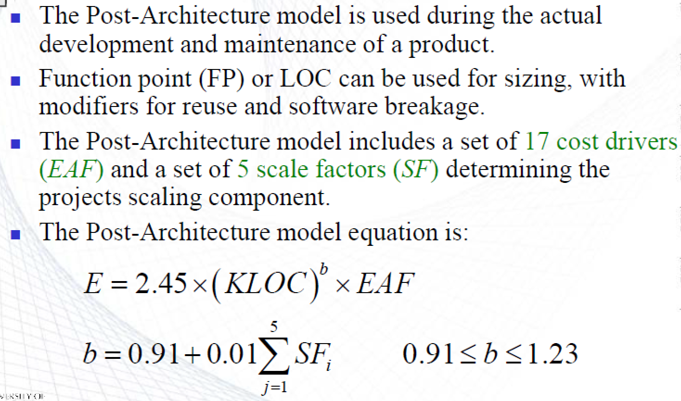
Post-architecture level

Slide 55
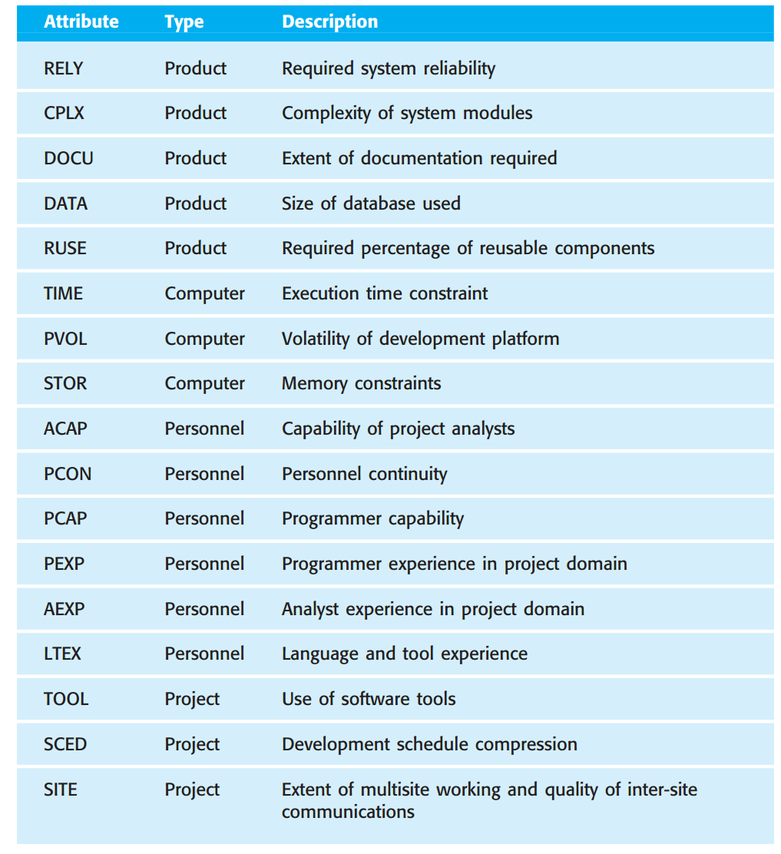
Calculating Project cost drivers , EAF

Slide 56
Scale Factors (SF)
Scale factor | Explanation
Precedentedness | Reflects the previous experience of the organization with this type of project. Very low means no previous experience; extra-high means that the organization is completely familiar with this application domain.
Development flexibility | Reflects the degree of flexibility in the development process (free for development). Very low means an agreed process is used; extra-high means that the client sets only general goals.
Architecture/risk resolution | Reflects the extent of risk analysis carried out. Very low means little analysis; extra-high means a complete and full risk analysis.
Team cohesion | Reflects how well the development team knows each other and work together. Very low means very difficult interactions; extra-high means an integrated and effective team with no communication problems.
Process maturity | Reflects the process maturity of the organization. The computation of this value depends on the CMM Maturity Questionnaire, but an estimate can be achieved by subtracting the CMM process maturity level from 5.

Slide 57
The exponent term
This depends on 5 scale factors (SF) (see next slide).
Their Sum_Of_SF/100 is added to 1.01 (COCOMO 2) OR
Their Sum_Of_SF/100 is added to 0.91 (COCOMO).

Slide 58
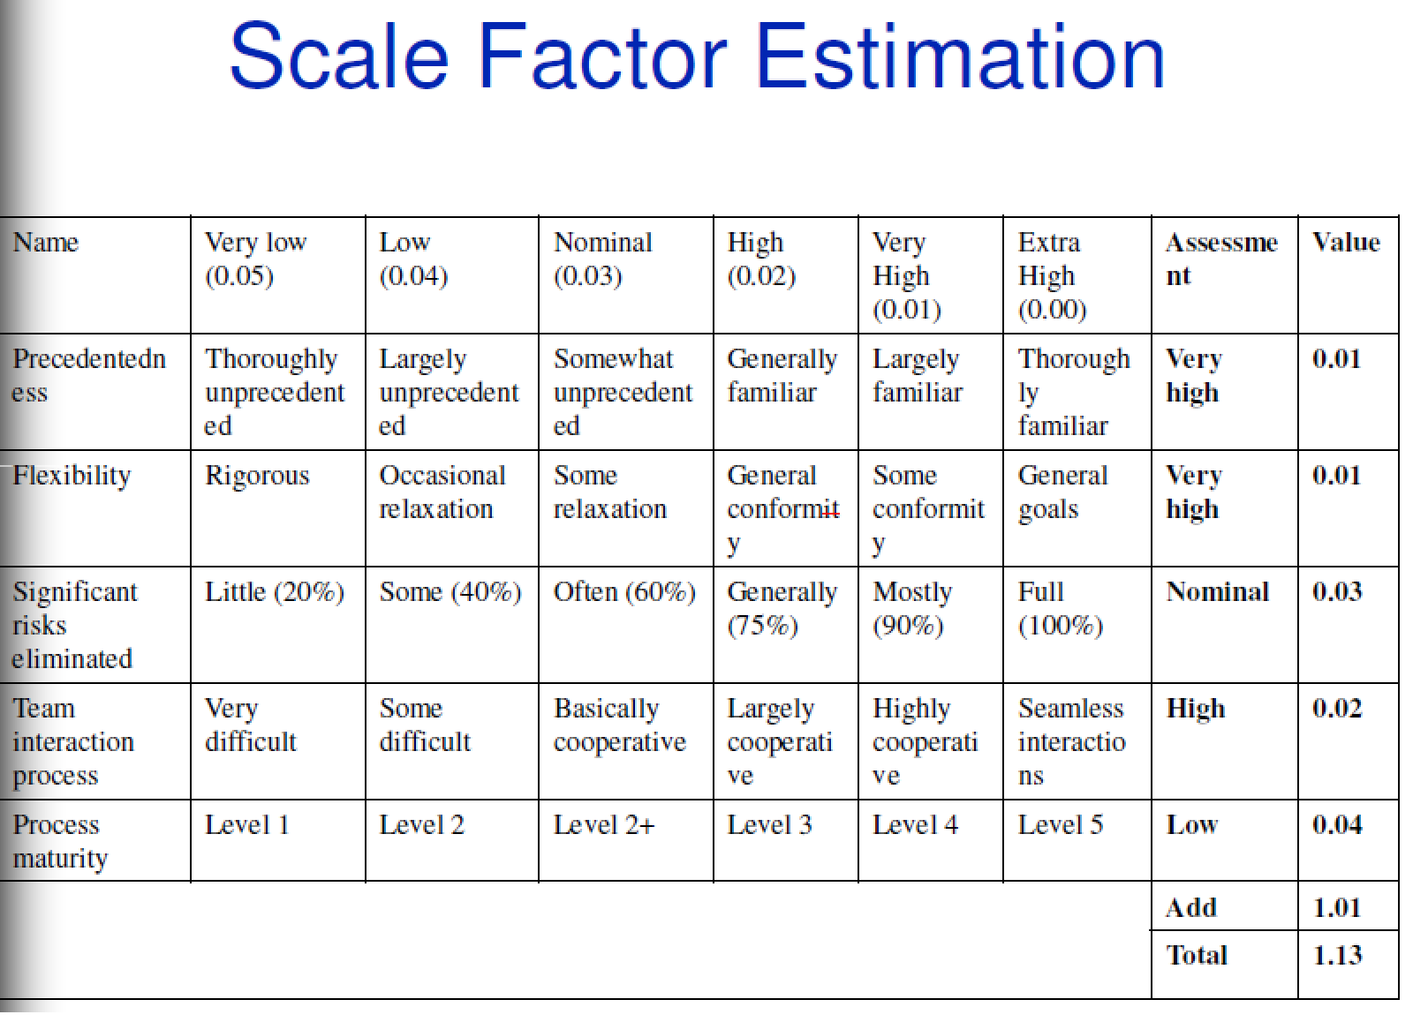
EXAMPLE-1 (Cont.)

Slide 59
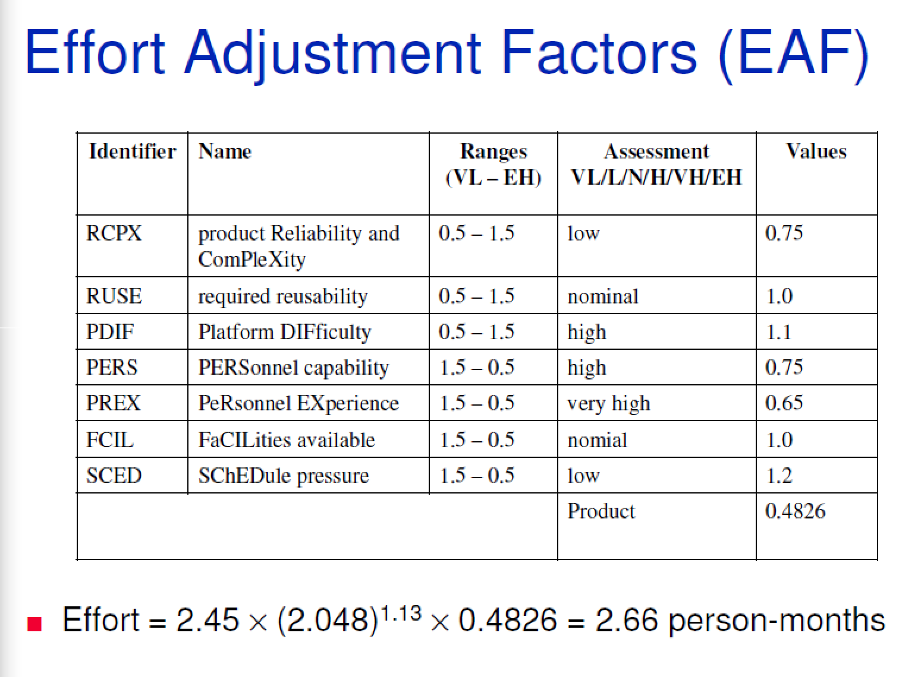
EXAMPLE-1(Cont.):
SCED is the only cost driver that is used to describe the effect of schedule compression /
expansion for the whole project.

Slide 60
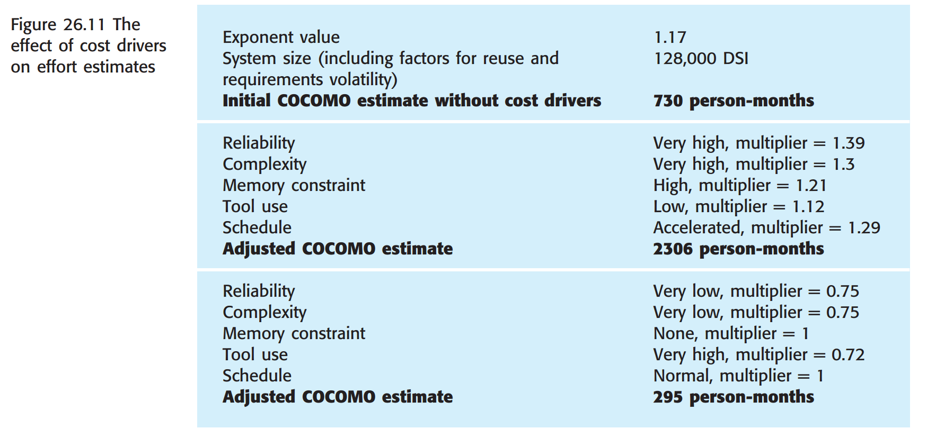
The effect of cost drivers on effort estimates

Slide 61
Project duration and staffing
As well as effort estimation, managers must estimate the calendar time required to complete a project and when staff will be required.
Calendar time (months) can be estimated using a COCOMO 2 formula
  TDEV = 3 ∗ (PM)^{(0.33+0.2*(B-1.01))}
  PM is the effort computation and
  B is the exponent computed as discussed above (B is 1 for the early prototyping model).
  This computation predicts the nominal (minimal) schedule for the project.
The required time is independent of the number of people working on the project.
TDEV = 3 × (PM)^{(0.33+0.2*(B-1.01))}
= 3* (295)^(0.33+0.2*(1.17-1.01)) = 24 months

Slide 62
Staffing requirements
required staff can’t be computed by dividing the development time by the required schedule.
The number of people working on a project varies depending on the phase of the project.
The more people who work on the project, the more total effort is usually required.
A very rapid build-up of people often correlates with schedule slippage.

Slide 63
Key points
Estimation techniques for software may be experience-based, where managers judge the effort required, or algorithmic, where the effort required is computed from other estimated project parameters.
The COCOMO II costing model is an algorithmic cost model that uses project, product, hardware and personnel attributes as well as product size and complexity attributes to derive a cost estimate.

Slide 64
Cocomo II-Tool Usage-
Example Screens
Homework: Use it for your Project Estimation!

Slide 65
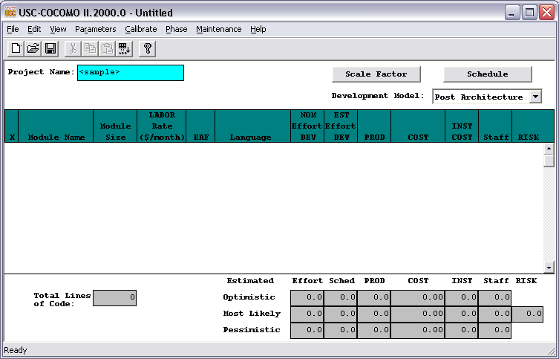
What the Cocomo II screen looks like upon starting a new Project.
Note you start out in the Post Architecture model, and there is no Application Composition model available.

Slide 66
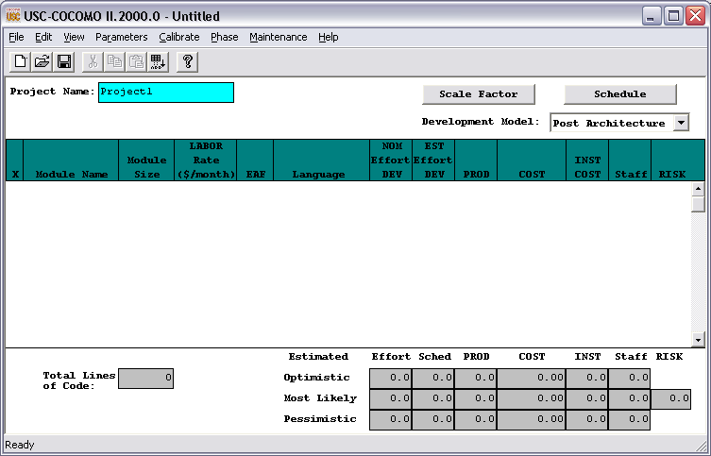
Enter a Project Name

Slide 67
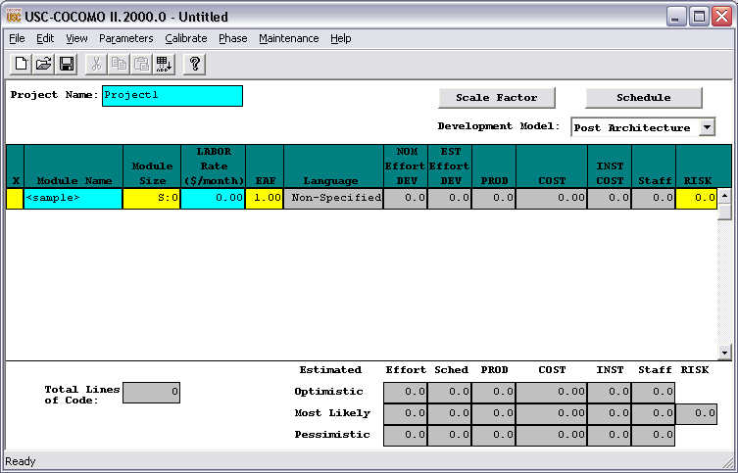
Can’t really do much unless we add a Module, so choose Edit → Add Module. A new line shows up in the screen with a default module name.

Slide 68

1. Change the module name to whatever you want.
2. Now double click on the yellow rectangle under Module Size…

Slide 69
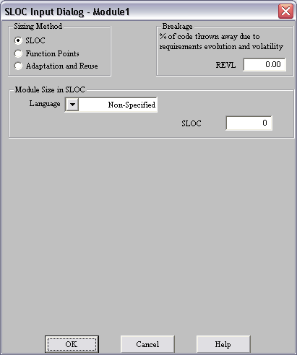
This screen will pop up allowing us to choose between Source Lines Of Code (SLOC), Function Points, or Adaptation and Re-Use. Let’s stick with SLOC for this module.

Slide 70
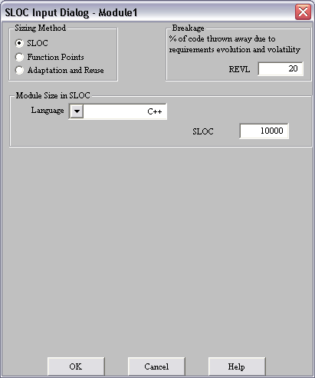
I have indicated my program language is C++ (this is really important to know for Function Points), there is an estimated 10,000 lines of code, and 20% of the code will be discarded due to requirements evolution and volatility.
Hit OK…

Slide 71

The main screen is updated with the SLOC and programming language as well as some calculated values we will decipher later. Note that the SLOC is 12,000. Why? ☺
{Pertinent portion of calculation on next slide in red boxes}
Now add another module and choose Function Points.

Slide 72
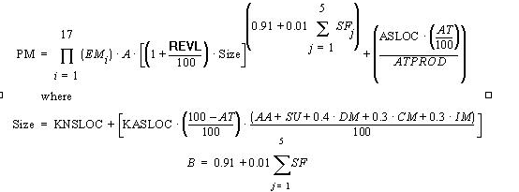
Cocomo II basic calcs:
Effort Equation for Post Architecture Model

Slide 73
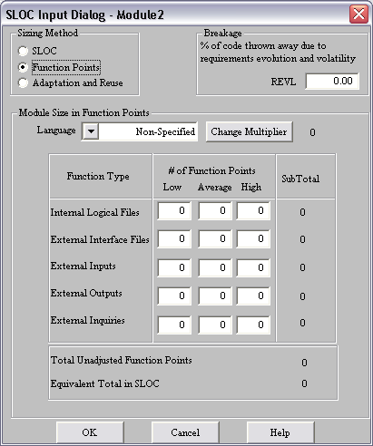
This is the default screen for Function Points.
Let’s look deeper at the Function Type descriptions…

Slide 74
External Input (Inputs)
Count each unique user data or user control input type that (i) enters the external boundary of the software system being measured and (ii) adds or changes data in a logical internal file.
External Output (Outputs)
Count each unique user data or control output type that leaves the external boundary of the software system being measured.
Internal Logical File (Files)
Count each major logical group of user data or control information in the software system as a logical internal file type. Include each logical file (e.g., each logical group of data) that is generated, used, or maintained by the software system.
External Interface Files (Interfaces)
Files passed or shared between software systems should be counted as external interface file types within each system.
External Inquiry (Queries)
Count each unique input-output combination, where an input causes and generates an immediate output, as an external inquiry type.
From Cocomo II User Manual via software

Slide 75

So let’s go back into this screen and add some entries in the grid.
Notice, there are some kind of subtotals per line, but the Equivalent SLOC = 0.
Let’s change the Language and see what happens.

Slide 76
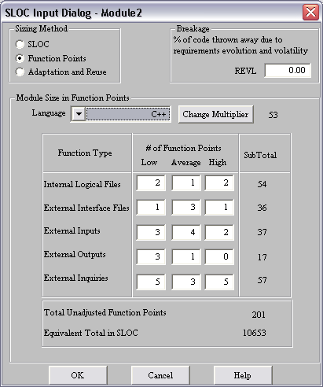
By changing the language to C++, we now have an Equivalent Total in SLOC.
Also, we can see a value next to the Change Multiplier button.
Let’s change the language to Machine Code! ☺

Slide 77
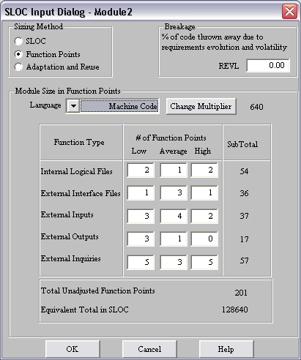
Quite a difference jumping from 10,653 SLOC to 128,640 SLOC.
Note the multiplier changed from 53 to 640.
Change the language once more to 5’th Generation.

Slide 78
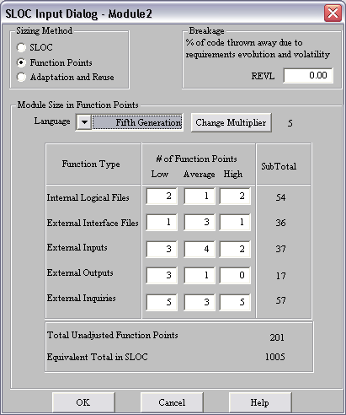
So using a 5’th generation level language would cut our code base by a factor of 285 times according to Cocomo II’s default estimation (not calibrated for your environment, not taking into account other factors).
Change the language to C++ and change REVL to 20%…

Slide 79
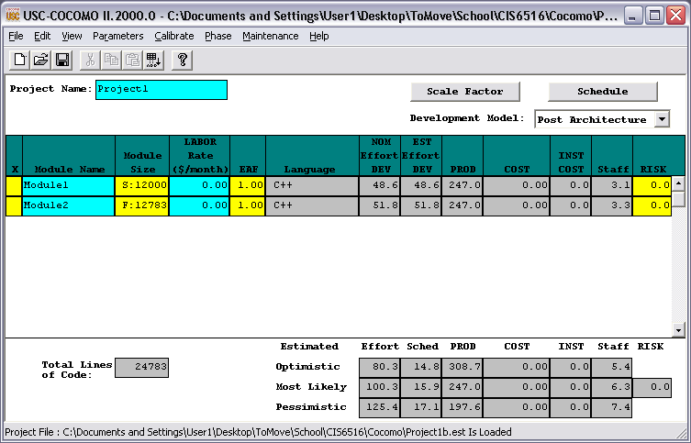
So now Module2 has F:12783 or, in other words, it’s based on Function points (the F:) and it has an equivalent 12,783 lines of code (10,653 + 20% for volatility or unpredictability).
So how did the 12,783 (or even the 10,653) get calc’d?
Part 1 of the answer is to click on Parameters→ Function Points. You will see the following screen…

Slide 80
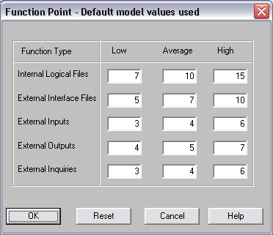
These are the default values used as weighting factors against the entries you put in. So if you entered 2,3,4 when enter in Function Point information for the first row, the end result would be 2*7 + 3*10 + 4*15. This is then multiplied by The Multiplier…

Slide 81
Default Multiplier values per Language

Slide 82
So let’s see what part of the calculation we just affected…

Slide 83
Cocomo II basic calcs:
Effort Equation for Post Architecture Model
Again, we have affected the same portion of the effort calculation as when we entered source lines directly.

Slide 84
So now let’s add a module and use Adaptation and Reuse…

Slide 85
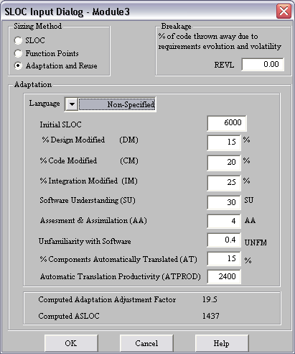
All of these items are associated with a non-linear re-use model.
Why non-linear?
NASA study of 3000 re-used modules found:
There is a cost of about 5% just to assess, select, and assimilate a project.
Small mods generate excessively large costs.

Slide 86
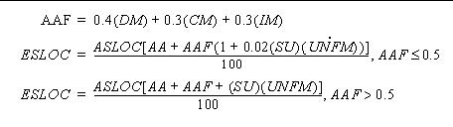
Cocomo II’s non-linear estimation model,
according to the Model Manual:

Slide 87
What % of the adapted
software’s design will
change?
… % of code that will change?
% of effort required to integrate the adapted
software into an overall product and to test the resulting product as compared to the normal amount of integration and test
effort for software of comparable size.

Slide 88
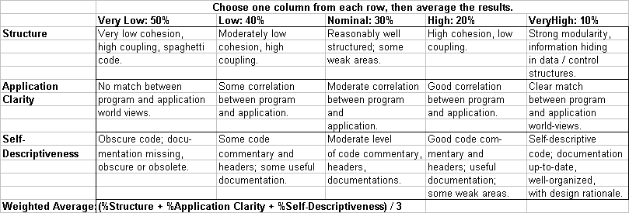
Software Understanding (SU): Use the table below to help you come up with a weighted average based on three key areas…

Slide 89
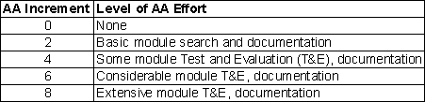
Assessment & Assimilation (AA): 0 to 8. Effort to determine whether
a fully-reused software module is appropriate to the application, and to integrate its description into the overall product
description

Slide 90
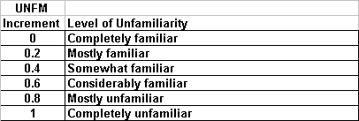

Slide 91
These last two areas have
to deal with automatically translating code.
The ATPROD figure is in source statements / person month.
The Model manual goes into more detail.

Slide 92
Cocomo II basic calcs:
Effort Equation for Post Architecture Model
So via Adaptation and Reuse we have now addressed the areas of the calculation in this blue color…
So now let’s talk about Effort Adjustment Factors (EAF)

Slide 93

Double click on the yellow rectangle under EAF for Module1

Slide 94

This screen will pop-up. As you click on any given button top row button, the button’s title will change (Nom, High,Very High, Very Low, Low, etc) AND you will see the EAF at the bottom of the screen change.

Slide 95

I have changed ONLY the button for RELY to VHI and by doing so, the EAF has changed to 1.26.
So we just increased the Effort equation by 26%!!!
Click OK to see the result.

Slide 96

So the EAF for Module1 has changed. We also see changes on the results to the right… NOM DEV has stayed the same; EST DEV has gone from 48.6 to 61.6; PROD from 245.6 to 194.9; Staff from 3 to 3.7; and risk from 0.0 to 1.7. What does this all mean?

Slide 97
NOM DEV: Nominal Person Man Months exclusive of EAF.
EST DEV: Median Person Months inclusive of EAF.
PROD: SLOC / EST DEV Effort. So the unit is Source Lines Of Code per Man Month.
Cost: If we had entered a Labor Rate, the cost would be calc’d.

Slide 98
INST COST: calculated most likely cost per instruction. This number is calculated from Cost/SLOC in each module.
Staff: most likely estimate for the number of full-time developers that would be needed to complete a module in the estimated development time.
RISK: total_risk = schedule_risk + product_risk + personnel_risk + process_risk + platform_risk + reuse_risk. Then total risk of a module=total_risk/373.*100.

Slide 99

Let’s re-visit the EAF screen. What did it mean when we chose “VHI” (Very High)? Qualitatively, that’s a nice phrase. But what did it mean quantitatively?
Email received from USC after the presentation: the Incr% toggles are just a further refinement of the “base” in increments of 25% of the range…

Slide 100

To answer that question we need to click on the above menu choices Parameters→Post Architecture→Product.
Note: There are other parameter menus just like the Post-Arch / Product choices. You can see a list of those above. You can adjust Function Point weights, EAF factors for Early Architecture, Scale Factors, the number of hours in a Person Month, etc.

Slide 101

This is where you set the quantitative measures associated with your qualitative choices. This is how you calibrate Cocomo II to fit your environment. You can also save your calibrations as a separate loadable module.

Slide 102

“Very High”, “Very Low”, etc are ok, but what are the details behind them? To get this answer, you actually have to visit the Model Manual, which is a weakness in Cocomo II. So for RELY, here is what the Model Manual says:
So selecting “Very High” really meant “Risk to human life” and, through the Parameters→Post Architecture→Product menu choice for RELY changed the EAF contribution by a factor of 1.26.

Slide 103
Cocomo II basic calcs:
Effort Equation for Post Architecture Model
When we adjust the Effort Adjustment Factors, we are impacing the part of the Effort equation in green above…
Lastly in the Effort equation is the Scale Factors.

Slide 104

If we go back to the main screen and click on Scale Factor, we see the above Popup screen.
Important Note: Scale Factor and Schedule are Project-wide, not module specific!!!

Slide 105

Change Precedentedness to VHI. Notice that the number to the right of the button changes to 1.24. Click OK.

Slide 106

Notice that some of the costs have changed. In particular, they have gone down. By decreasing the exponent in the effort equation, we have decreased the effort expenditure required.
Let’s see what area of the calculation we are talking about…

Slide 107
Cocomo II basic calcs:
Effort Equation for Post Architecture Model
Note; this IS B shown below!
So the Scale Factor portion of the Effort Equation is now highlighted in purple!

Slide 108

Again, what does “VHI” mean quantitatively for “Precedentedness”, and what are the details?
From Parameters→Scale Factors, we can find the quantitative measures shown above in the pop-up…

Slide 109

… and again, from the Model Manual some help on determining how to choose Very Low, Nominal, Very High, etc.

Slide 110

Let’s talk about the SCED factor, which applies project-wide. The calculation for Schedule is:

Slide 111

One more input area to address on this first screen: Schedule.
If we click on the Schedule button in the upper right hand corner, we can adjust the Schedule compression / elongation via the pop-up we see on the screen.

Slide 112


Again, from the Model Manual and from the Parameters→Post Architecture→Project menu we can put more quantitative values to our selection.

Slide 113

It should be noted we have been dealing with the Post Architecture model. An Early Design model is available as well with only 7 Effort Adjustment Factors, no RISK assessment (that I know of), and the same project-wide Scale Factors and Schedule. BUT… in Cocomo II there is a separate Schedule weight adjustment in each model.

Slide 114

What other information can be obtained from the calculations? Well, for one, we know the total lines of code estimated…

Slide 115
We are also given a range of estimates, + / - one standard deviation from the mean.

Slide 116

We can also see some reports with effort distribution, either as a Waterfall lifecycle or “MBASE” (a spiral model), and across all phases or for a specific phase.
So, from the above choices, let’s choose “Overall Phase”

Slide 117

Notice the percentages for Elaboration and Construction add up to 100%!!! Inception and Transition are statically configured as a percent of Elaboration and Construction, in this case at 6% and 12% respectively.

Slide 118

Let’s take a look at the Inception phase in MBASE…

Slide 119

Totals up to 100%…

Slide 120

File menu options. The intriguing ones are the ability to change the weighting factors for Effort Adjustment Factors, Scale Factors, Person Man-Months, and Function Points… and then save those as your own Model for future projects.
Also, if you choose the Export option, you can then load up additional reports via an Excel interface (you can find the Excel file by navigating via the Start→Programs→USC Cocomo II).

Slide 121
Parting thoughts…
1. There are limited online calculator versions of Cocomo 81 and Cocomo II:
http://sunset.usc.edu/research/COCOMOII/cocomo81_pgm/cocomo81.html
http://sunset.usc.edu/research/COCOMOII/expert_cocomo/expert_cocomo2000.html
2. SoftStarSystems.com sells CoStar, a Cocomo II on steroids. A trial version limited to 5,000 lines of code is available. Single user license starts at $2,000!!!
3. It’s really hard getting a good handle on all the current algorithms for Cocomo II. It varies over time, administered by fluctuating grad students, etc.
4. Home website for Cocomo: http://sunset.usc.edu/csse/research/COCOMOII/cocomo_main.html
5. Email from USC student: There is no source code available for COCOMO II.
This would be an interesting open source/thesis project if you could get their data!

