Slide 1
Chapter 10:
Project Quality Management

Slide 2
What Is Quality?
The International Organization for Standardization (ISO) defines quality as the totality of characteristics of an entity that bear on its ability to satisfy stated or implied needs
Other experts define «the quality» based on
  conformance to requirements: meeting written specifications…
  appropriateness for use: ensuring a product can be used as it was intended…

Slide 3
Project Quality Management Processes
Quality planning: identify/find which quality standards are relevant to the project (scope) and how to satisfy them
Quality assurance: evaluating total project performance to ensure the project will satisfy the relevant quality standards
Quality control: monitoring specific project results to ensure that they comply with the relevant quality standards while identifying ways to improve overall (the Project’s) quality

Slide 4
Quality Planning
Design of experiments helps to identify which variables have the most influence on the overall outcome of a process
Many aspects of IT projects affect the quality: performance, reliability, maintainability…

Slide 5
Quality Assurance
Quality assurance process includes all the activities related to satisfying the relevant quality standards for a project
Another goal of quality assurance is continuous quality improvement
Benchmarking can be used to generate ideas for quality improvements
Quality audits (checks) help to identify lessons learned that can improve performance on current or future projects

Slide 6
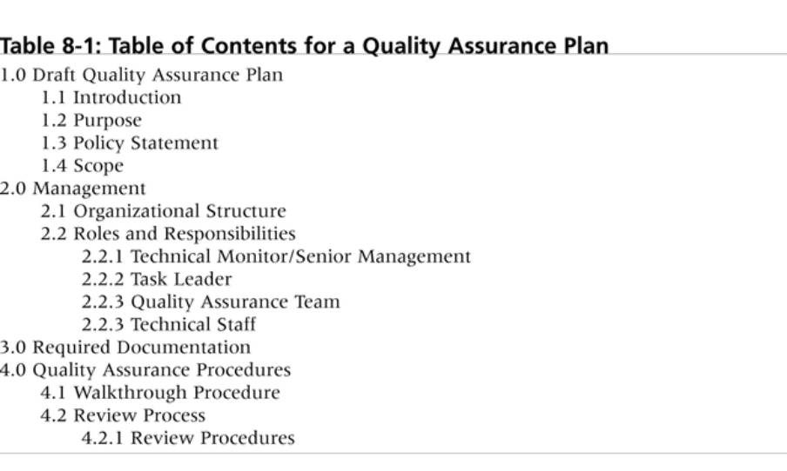
Quality Assurance Plan

Slide 7
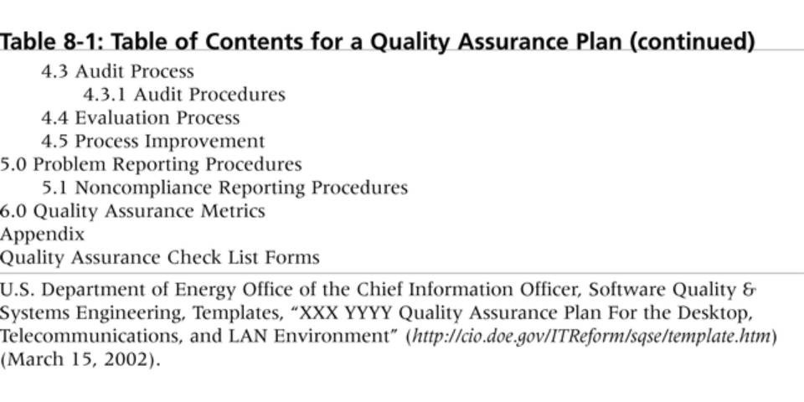
Quality Assurance Plan

Slide 8
Quality Control
The main outputs of quality control are
  acceptance decisions
  rework
  process adjustments
Some tools and techniques used:
  Pareto analysis
  statistical sampling
  Six Sigma
  quality control charts
  testing

Slide 9
1-Pareto Analysis
Pareto analysis involves finding the vital few contributors that give explanation for the most quality problems in a system
Also called the 80-20 rule→meaning that 80% of problems are often because of 20% of the causes…
Pareto diagrams are histograms that help to identify and prioritize problem areas

Slide 10
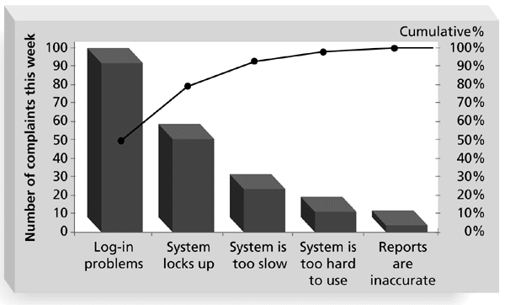
Figure 8-1. Sample Pareto Diagram

Slide 11
MINICASE
You are a part of a team analyzing quality problems that you have with your call center/customer service area.
After studying customer complaints, you have categorized and logged them for a week as follows:
Part 1: Create a Pareto diagram based on the information in the table below

Slide 12
MINICASE (Cont)
Complaint Category | Frequency/week
Customer is on hold too long | 90
Customer gets transferred to wrong area or cut off | 20
Service rep cannot answer customer’s questions | 120
Service rep does not follow through as promised | 40

Slide 13
MINICASE (Cont)
Part 2: Your team has decided to add some customer service features to your Web site.
You believe that having “Frequently Asked Questions” and answers will help reduce the complaints about service reps not being able to answer customers’ questions and will lower the volume of calls.
Customers and service reps could access information through this new Web page.
However, you know that while people complain about call centers, they also complain about Web sites.
Develop a list of at least four potential complaints that your customers and service reps might have about this new Web page, and then describe your plans for preventing those problems.
Describe also how this new Web page could continuously help to improve the quality of service provided by your call center/customer service area.

Slide 14
2-Statistical Sampling and Standard Deviation
Statistical sampling involves choosing part of a population of interest for inspection
The size of a sample depends on how representative you want the sample to be
Sample size formula:
Sample size = .25 X (certainty Factor/acceptable error)²

Slide 15
Table 8-2. Commonly Used Certainty Factors
Desired Certainty
Certainty Factor
95%
1.960
90%
1.645
80%
1.281
95% certainty: Sample size = 0.25 X (1.960/.05) ² = 384
90% certainty: Sample size = 0.25 X (1.645/.10)² = 68
80% certainty: Sample size = 0.25 X (1.281/.20)² = 10

Slide 16
3 - Six Sigma Defined
Six Sigma is “a comprehensive and flexible system for achieving, sustaining and maximizing business success.
Six Sigma is uniquely driven by well understanding of customer needs, disciplined use of facts, data, and statistical analysis, and diligent attention to managing, improving, and reinventing business processes.”*
*Pande, Peter S., Robert P. Neuman, and Roland R. Cavanagh, The
Six Sigma Way. New York: McGraw-Hill, 2000, p. xi

Slide 17
Basic Information on Six Sigma
The target for perfection is the achievement of no more than 3.4 defects per million opportunities
The principles can apply to a wide variety of processes
Six Sigma projects normally follow a five-phase improvement process called DMAIC

Slide 18
DMAIC
Define: Define the problem/opportunity, process, and customer requirements
Measure: Define measures, collect, compile, and display data
Analyze: Examine process details to find improvement opportunities
Improve: Generate solutions and ideas for improving the problem
Control: Track and verify the stability of the improvements and the predictability of the solution

Slide 19
How is Six Sigma Quality Control Unique?
It requires an organization-wide commitment
Six Sigma organizations have the ability and willingness to adopt contradictory objectives, like reducing errors and getting things done faster
It is an operating philosophy that is customer-focused and attempts to drive out waste, raise levels of quality, and improve financial performance at advance levels

Slide 20
Examples of Six Sigma Organizations
Motorola, Inc. pioneered the adoption of Six Sigma in the 1980s and saved about $14 billion
Allied Signal/Honeywell saved more than $600 million a year by reducing the costs of reworking (adaptation-change) defects and improving aircraft engine design processes
General Electric uses Six Sigma to focus on achieving customer satisfaction.

Slide 21
Six Sigma and Statistics
The term sigma means standard deviation
Standard deviation measures how much variation exists in a distribution of data
Standard deviation is a key factor in determining the acceptable number of defective units found in a population
Six Sigma projects struggle for no more than 3.4 defects per million opportunities yet this number is confusing to many statisticians

Slide 22
Standard Deviation
A small standard deviation means that data cluster closely around the middle of a distribution and there is little variability among the data …
A normal distribution is a bell-shaped curve that is symmetrical about the mean or average value of a population

Slide 23
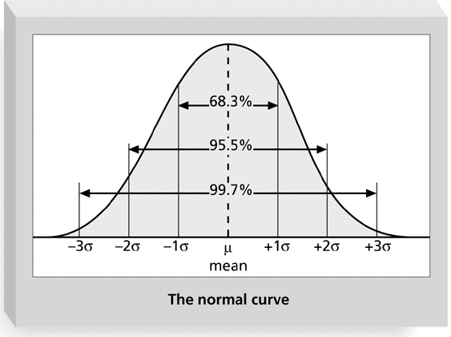
Figure 8-2. Normal Distribution and Standard Deviation

Slide 24
Table 8-3. Six Sigma and Defective Units

Slide 25
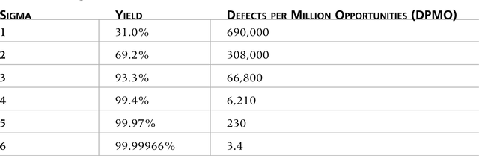
Table 8-4: Six Sigma Conversion Table https://en.wikipedia.org/wiki/Six_Sigma
The Six Sigma convention for determining defects is based on the
above conversion table. It accounts for a 1.5 sigma shift to account for
time and measures defects per million opportunities, not defects
per unit.

Slide 26
4 - Quality Control Charts and the Seven Run Rule
A control chart is a graphic display of data that illustrates the results of a process over time.
It helps prevent defects and allows you to determine whether a process is under control or out of control…
The seven run rule states that if seven data points in a row are all below the mean, above the mean, or increasing or decreasing, then the process needs to be examined for non-random problems

Slide 27
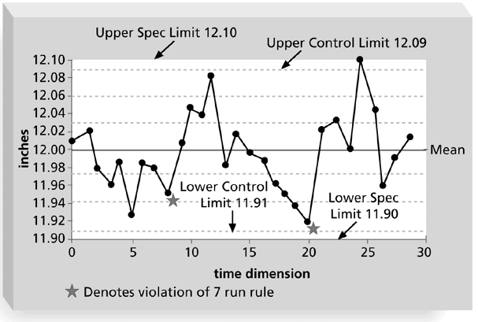
Figure 8-3. Sample Quality Control Chart

Slide 28
5- Testing
Many IT professionals think of testing as a stage that comes near the end of IT product development
Testing should be done during almost every phase of the IT product development life cycle

Slide 29
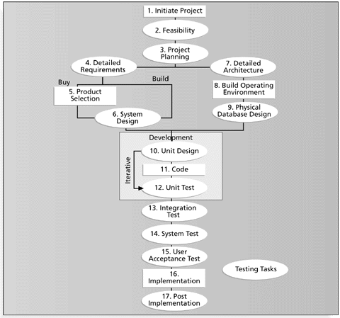
Figure 8-4. Testing Tasks in the Software Development Life Cycle

Slide 30
Types of Tests
A unit test is done to test each individual component (often a program) to ensure it is as defect free as possible
Integration testing occurs between unit and system testing to test functionally grouped components
System testing tests the entire system as one entity
User acceptance testing is an independent test performed by the end user prior to accepting the delivered system

Slide 31
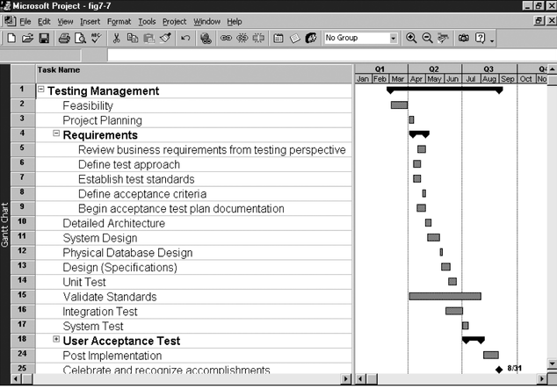
Figure 8-5. Gantt Chart for Building Testing into a Systems Development Project Plan

Slide 32
Software Quality Assurance

Slide 33
Software Quality Assurance
Covers
A quality management approach,
Effective SE methods and tools,
Formal technical reviews (FTR’s)
A good testing strategy
Control of software documentation
Software configuration management (Keeping Track Changes)
Assuming compliance with software development standards
Reporting and measurement of progress mechanisms

Slide 34
Elements of Quality include:
Quality of Design: refers to the characteristics that designers specify for an item
Quality of Conformance: is the degree to which the design specifications are followed during manufacturing. Again, the greater the degree of conformance, the higher is the level of quality of conformance. In software development, quality of design encompasses requirements, specifications, and the design of the system. Quality of conformance is an issue focused primarily on implementation. If the implementation follows the design and the resulting system meets its requirements and performance goals, conformance quality is high.
Quality Control: is a series of inspections, reviews and tests used throughout the development cycle, to ensure that each work product meets the requirements placed on it.
Measure and feedback allows process tuning to meet specifications

Slide 35
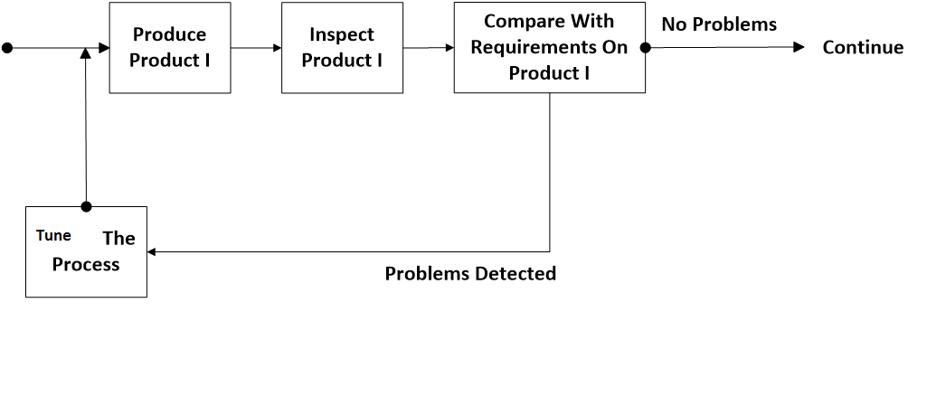
Feedback Loop For Work Product I:

Slide 36
Cost Of Quality Control
Cost of Control (Also known as Cost of Conformance)
  Prevention Cost
    The cost rises from efforts to prevent defects.
    Example: Quality Assurance costs
  Appraisal Cost
    The cost rises from efforts to detect defects.
    Example: Quality Control costs
Cost of Failure of Control (Also known as Cost of Non-Conformance)
  Internal Failure Cost
    The cost rises from defects identified internally and efforts to correct them.
    Example: Cost of Rework (Fixing of internal defects and re-testing)
  External Failure Cost
    The cost rises from defects identified by the client or end-users and efforts to correct them.
    Example: Cost of Rework (Fixing of external defects and re-testing) and any other costs due to external defects (Product service/liability/recall, etc)

Slide 37
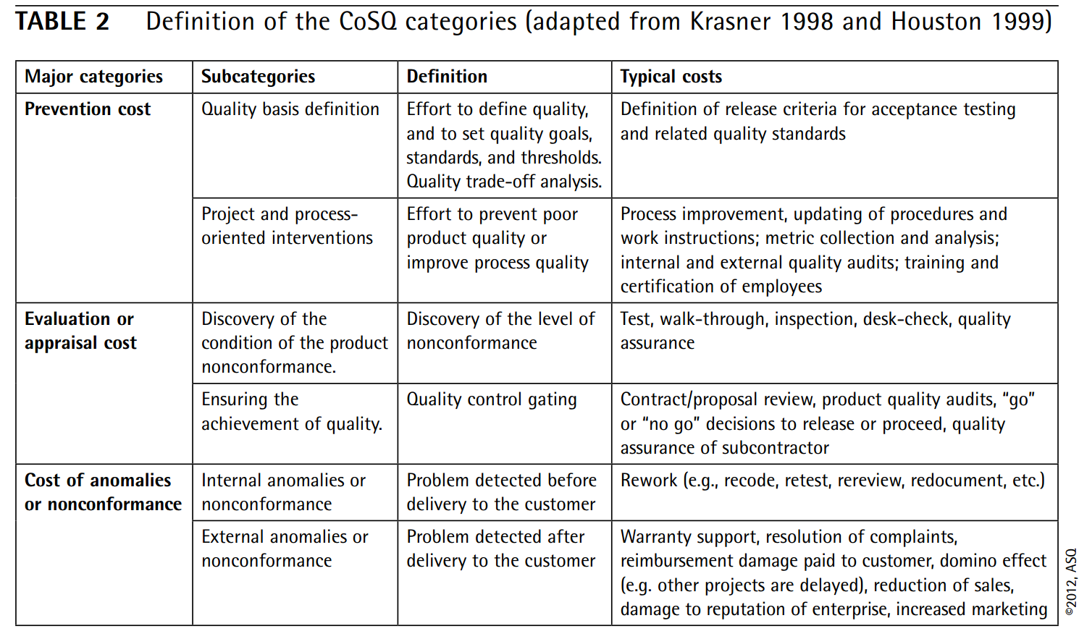
https://www.etsmtl.ca/Professeurs/claporte/documents/publications/Project-at-bombardier-transportation_SQP_June-2012.pdf

Slide 38
Cost Of Quality Control
  Prevention (Prevent Defects) Costs:
  Appraisal (Control Defects) Costs:

Slide 39
Failure Costs:
    Internal (we detect an error before shipment of product)
    External (we detect an error after the shipment)
  The relative costs to find and repair a defect increases considerably as we go:
  *from prevention to failure and
  *from internal to external failure. See Fig.8.1 on p.183

Slide 41
FORMULA / CALCULATION
Cost of Quality (COQ) = Cost of Control + Cost of Failure of Control
where
Cost of Control = Prevention Cost + Appraisal Cost
and
Cost of Failure of Control = Internal Failure Cost + External Failure Cost

Slide 42
NOTES
In its simplest form, COQ can be calculated in terms of effort (hours/days).
A better approach will be to calculate COQ in terms of money (converting the effort into money and adding any other tangible costs like test environment setup).
The best approach will be to calculate COQ as a percentage of total cost. This allows for comparison of COQ across projects or companies.
Cost of Quality of a project/product be calculated and reported by a person external to the core project/product team (Say, someone from the Accounts Department).
It is desirable to keep the Cost of Quality as low as possible.
However, this requires a fine balancing of costs between Cost of Control and Cost of Failure of Control.
In general, a higher Cost of Control causes a lower Cost of Failure of Control.

Slide 43
SQA Activities
Application of Technical Methods (Employing proper methods and tools for developing software)
Conduct of Formal Technical Review (FTR)
Testing of Software
Enforcement of Standards (Customer imposed standards or management imposed standards, internal / external (e.g. ISO 9001))
Control of Change (Assess the need for change, document the change)
Measurement (Software Metrics to measure the quality, quantifiable)
Records Keeping and Recording (Documentation, reviews, change control etc., documents to be produced by the SQA group).

Slide 44
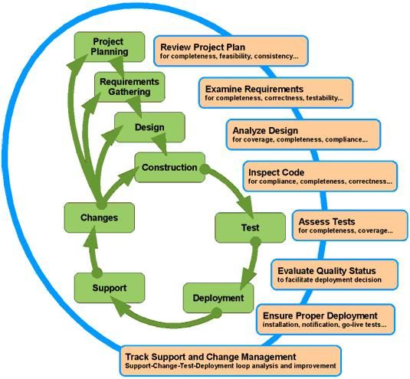
Quality Assurance activities should follow every stage in the Software Life Cycle.
For each activity in the Software Life Cycle, there is one or more QA support activities focusing on ensuring the Quality of the process and of the resulting product.

Slide 45
Software Review tasks
  Discuss the needed improvements
  Confirm connections of already finished parts
  review can be informal or formal (Presentation to audience/target end users)
We shall focus on: Formal Technical Reviews !

Slide 46
FORMAL TECHNICAL REVIEW
A formal technical review is a software quality assurance activity performed by software engineers (and others). The objectives of the FTR are:
(1) to uncover errors in function, logic, or implementation for any representation of the software;
(2) to verify that the software under review meets its requirements;
(3) to ensure that the software has been represented according to predefined standards;
(4) to achieve software that is developed in a uniform manner, and
(5) to make projects more manageable.

Slide 47
Software Defects
(IEEE standard 610-12-1990 (Standard Dictionary of EE terms) defines a defect as follows for software:
An incorrect step, process or data definition in a computer program.
Before the software is delivered to the customer: error
After delivery: defect or fault.
In Formal Technical Reviews (FTR), we try to find errors.
Some studies in SE industry have shown that:
  Design activities introduce 50->65% of all errors
  Formal Technical Reviews can find 75% of the design errors.
  So, we can reduce the cost. (Remember correction of ‘defects’ will be much more costly after delivery!!! )

Slide 48
IBM’s Defect Amplification Model (1981)
Software Development Step-i
Defects
Detection
Sometimes errors coming from previous steps may be amplified by the current step

Slide 49
Example 1: (assume FTR’s)

Slide 50
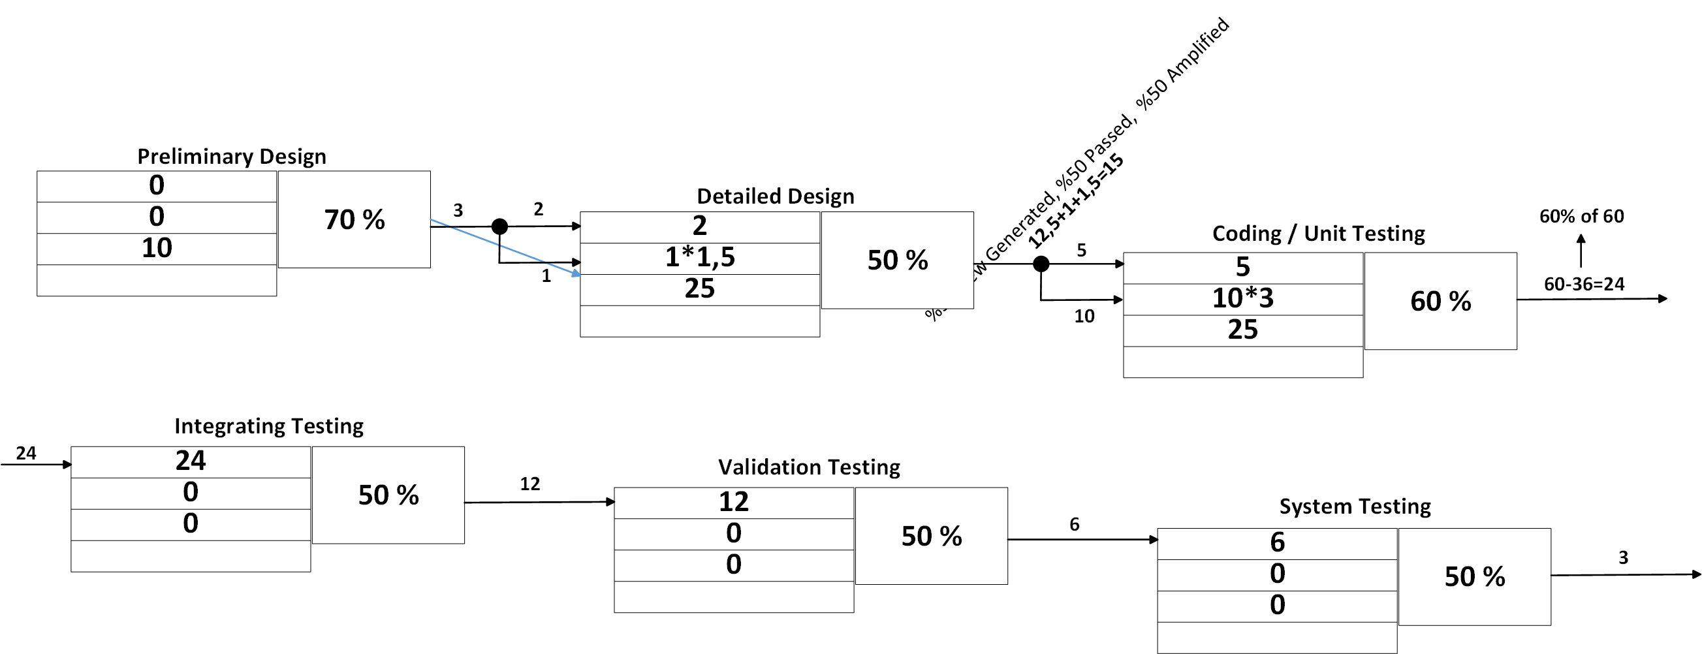
Example 1: (assume FTR-Formal Technical Reviews )
Passed err
Amplified
New err

Slide 51
Example 2: (assume NO FTR’s)
*** See Table 8.1 on P.191 for a comparison of development costs of Example 1-2.
* Don’t forget that FTR’s also have some cost for the Project.

Slide 52
Formal Technical Reviews
Objectives:
    Discover software errors.
    Verify that software being reviewed meets the requirements.
    Ensure that software is represented according to predefined standards.
    Help project management.
Every Review Meeting Should Satisfy The Following Criteria:
    3- 5 people in the meeting.
    Preparation for the meeting should not require more than 2 hours of work for each person.
    Duration of the meeting should be at most 2 hours.
    So, an FTR focuses an a specific and small part of the software. (a module)

Slide 53
The Players of the Review Meeting
Producer—The team member who finished a work product:
  informs the project leader that the work product is complete and that a review is required
Review leader—evaluates the product for readiness, generates copies of product materials, and distributes them to two or three reviewers for advance preparation.
Reviewer(s)—expected to spend between one and two hours reviewing the product, making notes, and otherwise becoming familiar with the work.
Recorder—reviewer who records (in writing) all important issues raised during the review.

Slide 54
At the end of the review meeting, all attended must decide whether to:
  Accept the work product with modifications
  Reject it due to severe errors (reds, review again !)
  Accept the work product with minor errors (no need for a new FTR after corrections)
A review summary report (one page document) is produced, which answers four questions:
  What was reviewed ?
  Who reviewed it ?
  What were the findings ?
  What is the decision ? (accept / reject)
This report becomes a part of the Project historical record.
It is distributed to the Project leader and other interested persons.
The follow up responsibility may be given to the review leader he makes it sure that errors / problems mentioned in the review summary report are corrected / handled properly.

Slide 55
A Minimum Set Of Guidelines for FTR’s:
Review the product, not the producer.
  Errors should be pointed out gently,
  The meeting should be constructive,
  The ‘producer’ should not be uncomfortable.
Set an agenda and follow it.
Limit date
  Do not spend too much time on one single issue
Find out the problems, but do not attempt to solve every problem.
  An FTR is not a problem solving session.
  Solution of a problem can often be accomplished by the producer later.
Take down written notes
  Notes can be made on a White board, corrected / modified , and then recorded.

Slide 56
Limit the no. of participants
Insist upon advance preparation
  All review team members must prepare well in advance, and they should come to the meeting with written comments on the work product
Develop a checklist for each work product
Allocate necessary resources and time schedule
Provide training for all reviewers before hand
Review your reviews
  To uncover problems with the review process itself.

Slide 57
Statistical Quality Assurance
Collect and categorize information about the defects in your software project.
Trace each defect to its underlying cause (nonconformance to specification, design error, violation of standards, poor communication with customer, etc …)
Isolate the vital few causes:
Pareto Principle says: 80% of the defects can be traced to
20% of all possible causes .
After defining the vital few causes, correct the problems that have caused the defects.

Slide 58
Common Causes Of Defects:
IES: Incomplete or Erroneous Specification
MCC: Misinterpretation of Customer Communication
IDS: Intentional Deviation From Specifications
VPS: Violation Of Programming Standards
EDR: Error In Data Representation
IMI: Inconsistent Module Interface
EDL: Error In Design Logic
IET: Incomplete Or Erroneous Testing
IID: Inaccurate Or Incomplete Documentation
PLT: Error In Programming Language Translation Of Design
HCI: Ambiguous Or Inconsistent Human Computer Interface
MIS: Miscellaneous

Slide 59
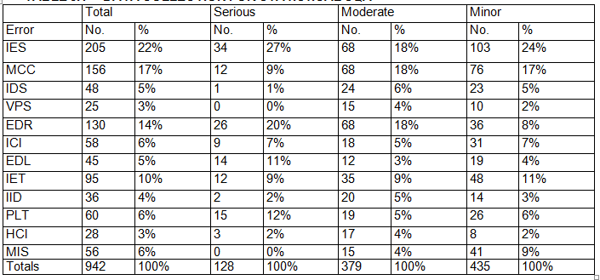
A table like Table 8.2 on P.196 is built to apply Statistical QA.
Shows the data collection for statistical SQA.
In this manner, we can find out the more ‘vital’ causes of errors.
Loading at table 8.2, we see that IES, MCC, EDR, and IET account for 63% (almost 2/3) of all errors.

Slide 60
*Accordingly, we have to take appropriate actions within the organization to correct related process and design steps.
*We can also calculate an error index for each major step in the SE process. We collect the following data first:
1. E_{i}: Total no. of errors discovered during the i ’th design step.
S_{i}: The no. of serious errors
M_{i}: The no. of moderate errors
T_{i}: The no. of minor errors
2. PS: the size of product (LOC, FP, pages of doc …)
We use weighting factors for error types: W_{s}, W_{m}, W_{t}.
Recommended by Pressman : W_{s}:10, W_{m}:3, W_{t}:1 at each design step, we compute a phase index (Pɪ_{i})

Slide 61
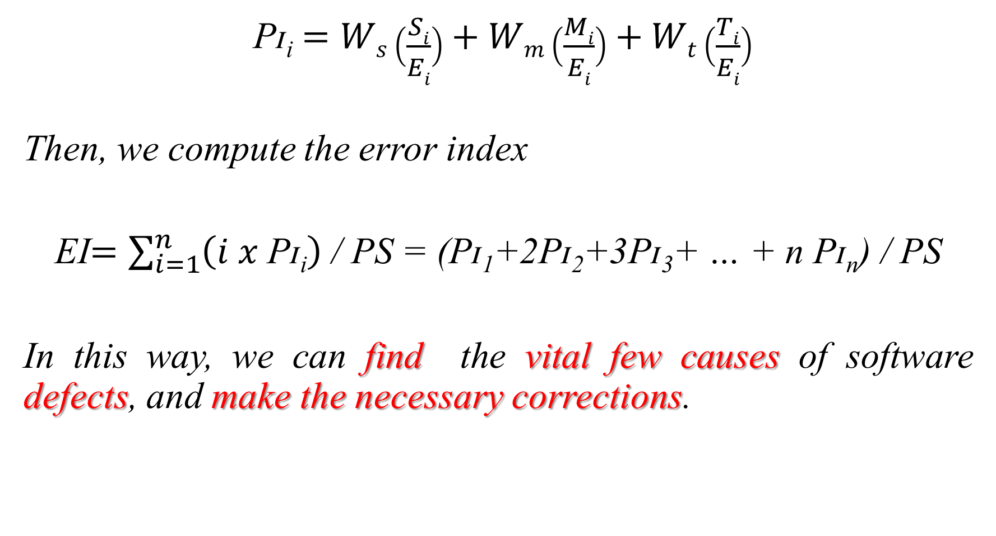
Pɪ_{i} $=Ws\left(\frac{Si}{Ei}\right)+Wm\left(\frac{Mi}{Ei}\right)+Wt\left(\frac{Ti}{Ei}\right)$
Then, we compute the error index
EI$=\sum_{i=1}^{n}{\left(i x \text{P}\text{ɪ}\text{i}\right)}$ / PS = ($\text{P}\text{ɪ}$₁+2$\text{P}\text{ɪ}$₂+3$\text{P}\text{ɪ}$₃+ … + n $\text{P}\text{ɪ}$_{n}) / PS
In this way, we can find the vital few causes of software defects, and make the necessary corrections.

Slide 62
Software Quality Assurance Plan
(ANSI / IEEE standard 730-1984 and 983-1986)
*See Fig. 8.5 on P.201
In the documentation section, the following SE documents should be considered:
The project plan and timing
The requirements document
The entity relationship diagrams and data structure definitions
Testing plans, test results
User documentation

Slide 63
In the standards, Practices and Conventions section, all applicable internal / external standards (coding standards, documentation standards, review guidelines) are listed and product metrics are outlined. The reviews and audits section provides an overview of each review / audit to be conducted.
The ISO 9001 Quality Assurance Standard
ISO 9001, Developed for all engineering disciplines, also applies to SE.
It contains 20 requirements that must be present for an effective Quality Assurance System, ISO_9000_3 is a special set of ISO guidelines that have been developed to help the use of ISO_9001 in the SE process.
The 20 Requirements of ISO_9001 are:
Management responsibility
Quality system
Contract review
Design control

Slide 64
Document and data control
Purchasing
Control of customer supplied product
Product identification and traceability
Process control
Inspection and testing
Control of inspection, measurement, and testing equipment
Inspection and testing status
Control of non conforming product
Corrective and preventive action
Handling, storage, packaging, preservation, and delivery
Control of quality records
Internal quality audits
Training
Servicing
Statistical techniques

Slide 65
NOTE: A software company/organization must establish policies and procedures to address each of the 20 requirements, and then demonstrate to external auditors/examiners that these policies and procedures are being followed. Only then it can get an ISO_9000 certificate.

Slide 66
The SQA Plan
The SQA plan provides a road map for introducing software quality assurance.
Basic items:
- purpose of plan and its scope
- management
- organization structure, SQA tasks, their placement in the process
- roles and responsibilities related to product quality
- documentation
- project documents, models, technical documents, user documents.
- standards, practices, and agreements
- reviews and audits
- test - test plan and procedure
- problem reporting, and correction actions
- tools
- code control
- media control
- supplier control
- records collection, maintenance, and retention
- training
- risk management

