Slide 1
TOPIC-6
SOFTWARE REQUIREMENTS MODELING PRINCIPLES

Slide 2
SE Requirements Modeling Principles:
The information domain of the problem must be represented (properly) and understood (well).
Data in
Data out
Data store
e.g.Sensors

Slide 3
Define the functions that the software performs.
  Some functions transform data, some others help control the system.
  Functions can be described at many levels of abstraction.
    Start with (a general statement of purpose) → translate → (detailed description)
Represent the behavior of the software as a consequence of external events {such as monitoring data, input from user, data from external systems}
  Sometimes, we use scenarios for each case.
Divide and conquer in a layered fashion (bcz, easier to understand)
  Divide a complex problem into sub problems and analyze each sub problem separately → ‘partitioning’ or ‘separation of concerns’
Transformation from essential information to implementation details…
Ex: gathering initial requirements (elicitation)
(a communication activity, but also planning)

Slide 4
  For Simple Projects:
    Make a list of stakeholders.
    Conduct informal meetings with stakeholders.
    Stakeholders will list/arrange the features and functions they require.
    Discuss the proposed features/functions and decide on the final list of requirements.
    Prioritize the requirements (essential, should do, can do, …)
    Take note the areas of uncertainty/doubts and discuss constraints.
  b) For larger & complex projects:
    Make a list of stakeholders.
    Interview stakeholders to find out their needs.
    Build a preliminary list of functions / features to consider.
    Conduct meetings with stakeholders to go over the preliminary list of requirements.
    Produce informal user scenarios in these interactive meetings.
    Build a revised list of requirements.

Slide 5
    Prioritize the requirements.
    If prototyping (incremental) development is to be employed, decide which requirements must be included in each prototype.
    Take note the areas of uncertainty/doubts and discuss constraints.
    Discuss how the system will be tested / validated.
(For process assessment and improvement: Use CMMI approach…)
Capability Maturity Model Integration (CMMI) is a process level improvement training and appraisal program.
CMMI was developed by a group of experts from industry, government, and the Software Engineering Institute (SEI) at CMU.

Slide 6
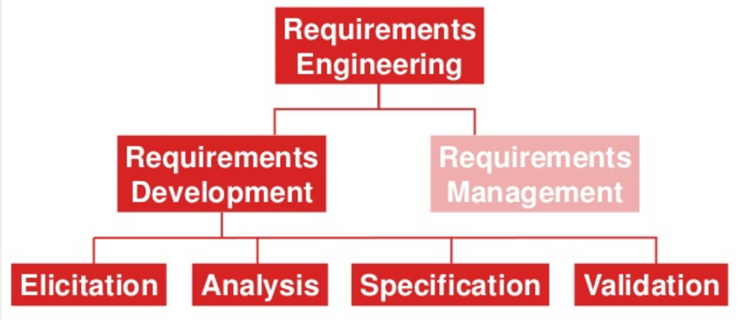
Requirements Analysis and Specification

Slide 7
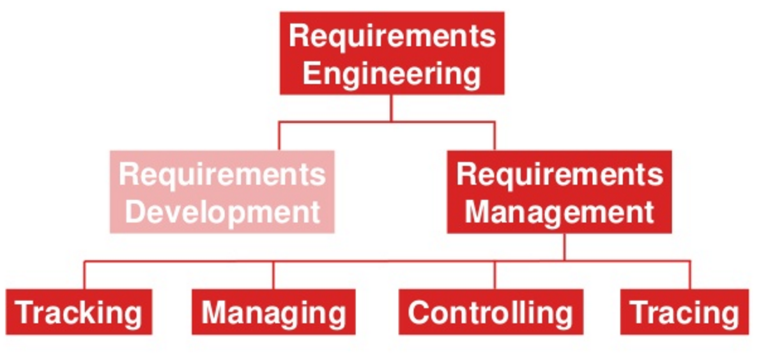
Requirements Analysis And Specification

Slide 8
Requirements Analysis and Specification
Difficult Task: (Clear understanding of requirements, features and functionality to implement )
There may be changes through the Project…
Steps:
  Inception (başlangıç): Define the scope and the nature of the problem solved.
  Elicitation (finding): Together with stakeholders, define which features/ functionally is required.
  Elaboration (classifying): Go over the initial list of requirements, decide on the final list and classify requirements.
  Negotiation: Negotiation is needed with stakeholders.
  Specification: Requirements specification document is produced.

Slide 9
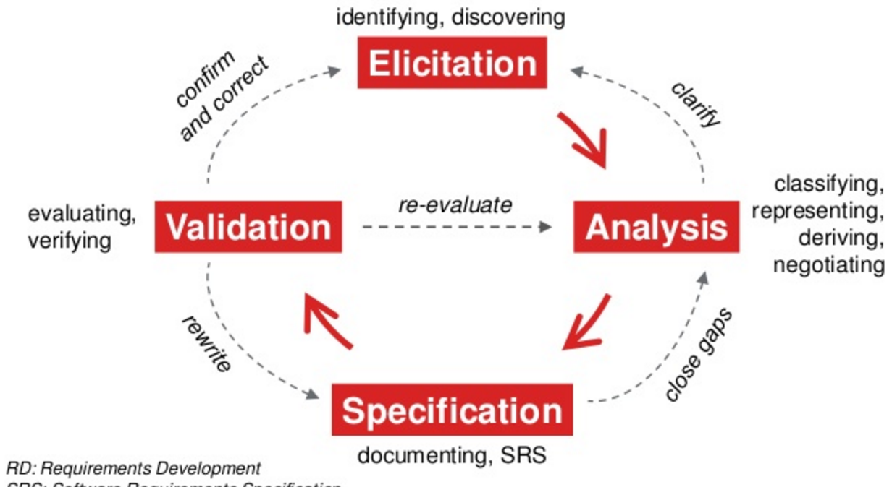

Slide 10
Requirements Analysis and Specification stage:
Business needs are defined,
User scenarios are described,
Functions and features are sketched out (kabaca belli olur), and
Project constraints are identified.
Important: Get stakeholder inputs on time

Slide 11
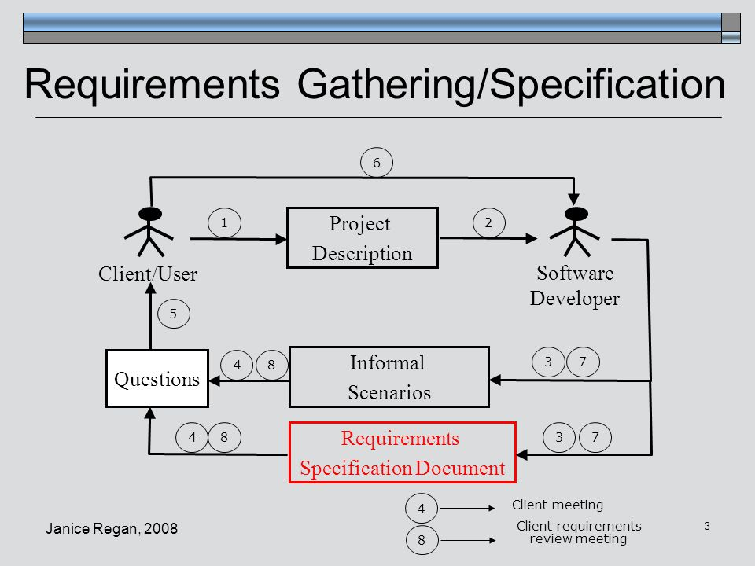

Slide 12
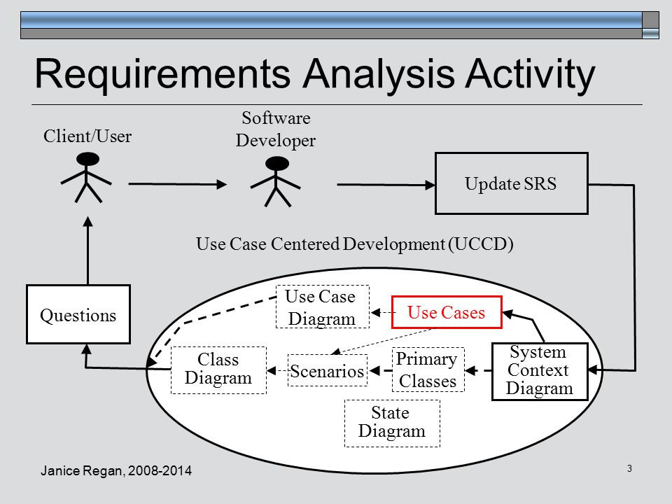

Slide 13
I. Inception
In general, most projects begin:
  when a business need is identified, or
  a potential new market or
  service is discovered.
Stakeholders from the ‘customer’ company (such as. business managers, product managers, marketing people)
  define a business case for idea,
  do a market study,
  a rough feasibility analysis, and
  identify a description of the project’s scope.
Then, the software company (Project manager) founds a basic understanding of the problem, the nature of the designed solution.
Vendor
Bid 1
Bid 2
Bid 3…

Slide 14
II. Elicitation
Software organizations ask the customers (users):
  what will be objectives for the product,
  what is to be accomplished,
  how the product fits needs of the business, and
  how the product is going to be used on a day-to-day basis.
Establish (specify) business goals- it requires effective communication with stakeholders. Goals may be associated with
  Functional, or
  Nonfunctional requirements (reliability, usability, security, …)
Then, prioritize all goals.
Create a design rationale for a potential system architecture.

Slide 15
Possible Dangers:
  Problems of scope – boundary of the system is ill-defined, or there is confusion on system objectives.
  Problems of understanding – customers are not sure of what is needed, have not a full understanding of the problem domain, have communication problems, omit information, specify requirements that conflict with the needs of other users, specify requirements that are ambiguous.
  Problems of volatility – requirements may change over time.

Slide 16
III. Elaboration:
The info gathered from the customer during inception and elicitation steps is expanded and refined.
Developed a requirements model that identifies various aspects of the functionally, behavior and information of the software.
User scenarios are created and refined (e.g. How does the end user interact with the system)
If OO model is preferred, OO-analysis defines:
  the attributes for each class,
  the services required by each class,
  the relationships and collaboration between classes and supplementary diagrams.

Slide 17
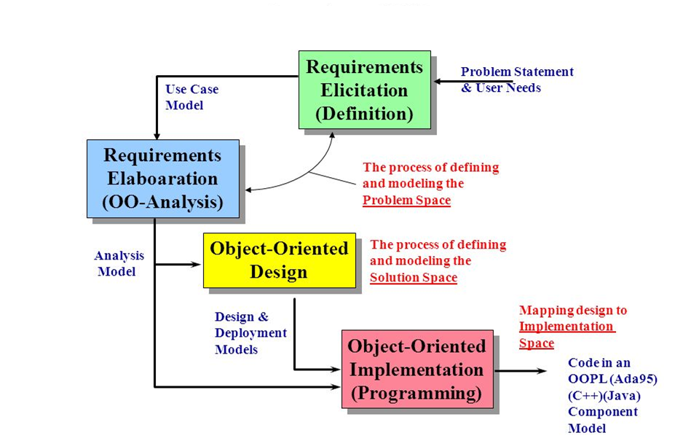

Slide 18
IV. Negotiation
Asking customers & other stakeholders to rank the requirements (by considering priorities of each requirements).
Using an iterative approach:
    requirements are prioritized,
    their costs/risks are assessed,
    internal conflicts are addressed, then
    requirements are eliminated / combined / modified.

Slide 19
V. Specification
Requirements are described by using:
  Written document + graphical models + mathematical models + created scenarios (in natural language)
For small systems, user scenarios may be sufficient for requirements specification

Slide 20
Requirements vs. Design
Requirements | Design
Describe what will be delivered | Describe how it will be done
Primary goal of analysis: UNDERSTANDING | Primary goal of design: OPTIMIZATION
There is more than one solution | There is only one (final) solution
Customer is interested | Customer is not interested (Most of the time)

Slide 21
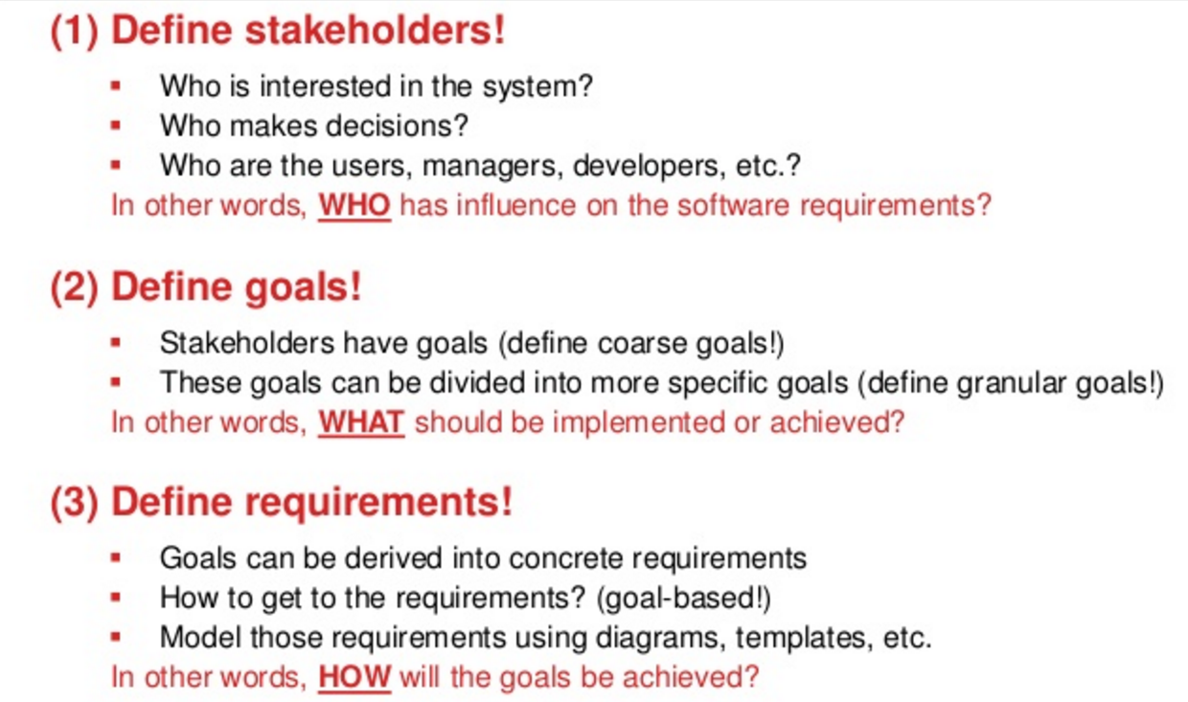

Slide 22
A Software Requirements Specification Template
Cover Page Table Of Contents Revision History Introduction 1.1 Purpose 1.2 Document Conventions 1.3 Intended Audience 1.4 Project Scope 1.5 References Overall Description 2.1 Product Perspective 2.2 Product Features 2.3 User Classes & Characteristics 2.4 Operating Environment 2.5 Design & Implementation Constraints 2.6 User Documentation 2.7 Assumptions & Dependencies | System Features 3.1 System Feature 1 3.2 System Feature 2 (and so on) External Interface Req’s 4.1 User Interfaces 4.2 Hardware Interfaces 4.3 Software Interfaces 4.4 Communications Interfaces Other Nonfunctional Req’s 5.1 Performance Req’s 5.2 Safety Req’s 5.3 Security Req’s 5.4 Software Quality Attributes 5.5 Business Rules Other Req’s Appendix Glossary, Analysis Models, To Be Determined List

Slide 23
Nonfunctional Requirements:
What are the NF Reqs:
  A quality attribute (usability, testability, maintainability)
  A performance attribute,
  A security attribute,
  Or a general constraint on the system
Without those, the system may not be usable or useful.
Often listed separately in the SRS document.

Slide 24
Service-oriented Approach
Requirements elicitation (finding) in service–oriented development approach → focuses on the definition of services to be rendered by an application.
Ex: a guest comes to hotel:
  A door person greets the guest
  A valet parks his car
  A receptionist checks the guest in
  A bellboy carries his baggage to his room
  The bellboy gives information about facilities in the room.
Each ‘touch-point’ between a quest and a hotel employee represents a ‘service’ offered.

Slide 25
Requirements Analysis Models:
We can use some technique:
Scenario-based models (e.g., UML use case)
Class models (OO approach: class diagrams)
Flow models (e.g., Dataflow diagrams)
Behavioral models (e.g., State-transition diagrams)

Slide 26
1.Scenario-Based Models
Use Cases (Scenarios)
use case is a description of a system’s behavior as it responds to a request that originates from outside of the system
it describes "who" can do "what" with the system in question
Particularly important for parts of the software interacting with users (interfaces)

Slide 27
1.Scenario-Based Models
Example: Safe Home System: (Home surveillance/watching part)
  Consider ‘Home owner’ actor; the following functions are performed by the home owner:
    Select a camera to view
    Request thumbnails (small pictures) from all cameras
    Display camera views in a PC window
    Control pan and zoom for a specific camera
    Selectively record camera output
    Replay camera output
    Access camera surveillance via internet
  So, the development team is expected to develope use cases for each of those functions.
  if there is need, we mostly write an informal (narrative) use case first,
  We later rewrite it in a structured format.

Slide 28
Ex: Use case: Access camera surveillance via Internet-display camera views (ACS-DCV)
  Actor: homeowner
  Homeowner logs on to the Safe Home company website.
  Homeowner enters USER_ID
  Homeowner enter 2 levels of passwords (each >=|8 chars|)
  System displays all major function buttons
  Homeowner selects ‘surveillance’ button
  Homeowner selects ‘pick a camera’ button
  System displays house floor plan. (System shows camera icons)
  Homeowner selects a camera from floor plan
  Homeowner selects the ‘view’ button
  System displays a viewing window for the selected camera
  System displays video output from selected camera at a rate of 1 frame per second.

Slide 29
Alternatives: for each step, ask the following questions;
  - Can the actor take some other action at this point ?
  Ex 1.
  Step 6: Homeowner selects ‘pick a camera’
  Alternative: Homeowner selects ‘view thumbnails from all cameras’
  Is it possible that the actor will encounter some error condition at this point
  If yes, what might it be ?
  Ex 2.
  Step 8: Homeowner selects a camera from the floor plan error condition: that camera is out of order!
  Error Condition: that camera is out of order!
  Is it possible that the actor will encounter some other behavior at this point ?
  Ex 3. While going over steps 6 and 7, an alarm condition may be raised, which has higher priority and the system will display the alarm notification (type location, system action for this alarm ) instead of floor plan.
*these are called ‘use-case exceptions’

Slide 30
Preliminary use-case diagrams for the safe home system:
-graphical representation is not a ‘must’ for use case scenarios,
-but it may facilitate understanding when the scenario is complex.

Slide 31
EXAMPLE
INFO 1. Assume such a software project you need to develop acording to the given scenario:
Most of working people have to travel to different countries as part of their job.
If they were to take care of their health and thus keep a record of their check-ups, they would have to carry a paper diary everywhere.
This will not only be cumbersome but also a very approximate way of keeping records.
As software organization, you want to develop such a project that will provide the customers with a 24x7 access to their medical records from wherever they need it, whenever they need it.
The software organization plans to build an online system that will store, process and diagnose a person’s heart rate and calories burned reading from a heart rate sensor and pedometer device.
A pedometer is a device, usually portable and electronic or electromechanical, that counts each step a person takes by detecting the motion of the person's hands or hips.
Providing a web-based system will permit users to access their data from any location.
The system scheme is given:

Slide 32
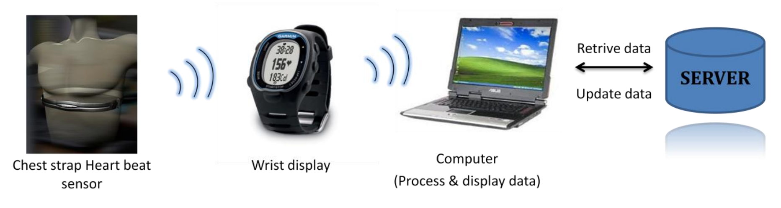
EXAMPLE
The system will comprise of two parts: the health monitoring device, a Garmin FR 70 wrist display with a heart rate sensor and the other part would be an online software system that is connected to a server to store and retrieve customer records.
While using system, the user has to fix the chest strap with the mounted sensor on their ribcage. Next wear their wrist display which accepts continuous heart rate readings transmitted by the chest strap. The user can look at instantaneous heart ratings on the wrist display.

Slide 33
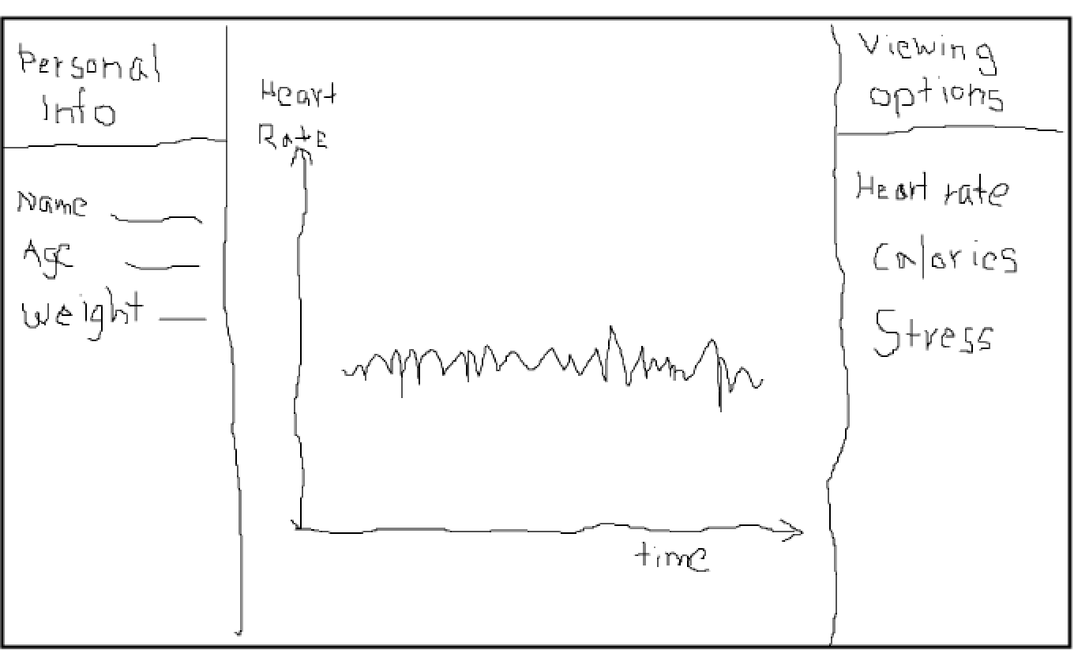
INFO 2. Sketch provided by customer.

Slide 34
INFO 3. List of the Enumerated Functional Requirements that provided by customer:
Requirements | Description
REQ - 1 | The system shall allow the user to register using a unique user id and password.
REQ – 2 | The system shall allow any user to load their data from any computer having the data file.
REQ – 3 | The system shall allow any user to modify their personal profile.
REQ – 4 | The system shall prompt for security questions if the user forgets their password.
REQ – 5 | The system shall allow the user to see their daily and monthly heart rate, calories burnt and stress level.
REQ – 6 | The system shall display the heart condition as text, which represent the condition of the heart for the selected entry which is in the range of 60-70 seconds.
REQ – 7 | The system should allow the administrator to retrieve a user password.

Slide 35
INFO 4. List of Extended Functional Requirements that is provided by a customer:
REQ – 2a | The system shall allow the user to upload only .csv file produced by the Garmin FR70. This file will contain heart rate reading and calories burnt.
REQ – 2b | The system will allow user to upload a file either as an exercise entry or a resting heart entry.
REQ – 4a | The system shall allow only the user with correct login Id and password to access their profile.
REQ – 4b | The system shall logout from a session if there is inactivity for more than ten minutes.
REQ – 4c | The system shall lock the profile if the user enters wrong password more than 3 times in a row. The user will need to send a mail to the administrator to ask him to unlock his profile.
REQ – 4d | The system shall give a security question option to the user if they forget their password. If the user gives the correct answer he will be able to see his password.
REQ – 4e | The system shall allow the user to delete his profile.
REQ – 5a | The system shall allow the user to view all entries for a day and individual graphs will be shown for calories burnt, heart rate and stress level.
REQ – 5b | If there is more than one entry for a day, the system shall display graphs of all entries.
REQ – 5c | When requested, the system shall display the monthly graph for any of the parameters mentioned above (i.e. calories burnt, heart rate and stress level.)
REQ – 5d | The system shall display the yearly timeline.

Slide 36
INFO 5. List of THREE ACTORS interacting in the system:
Actor | Goals
User | The user’s goal is to access the personal health monitoring system to keep track of health condition. Includes all the people especially patients, athletes who require regular health check-ups.
Administrator | The goal of administrator is to retrieve the password for the user.
Database | The goal of a database is to store all the readings of each user separately. All the data collected is stored in the database and the user interface has to access the database to retrieve the required information.

Slide 37
INFO 6. Use Case diagram of the system.

Slide 38
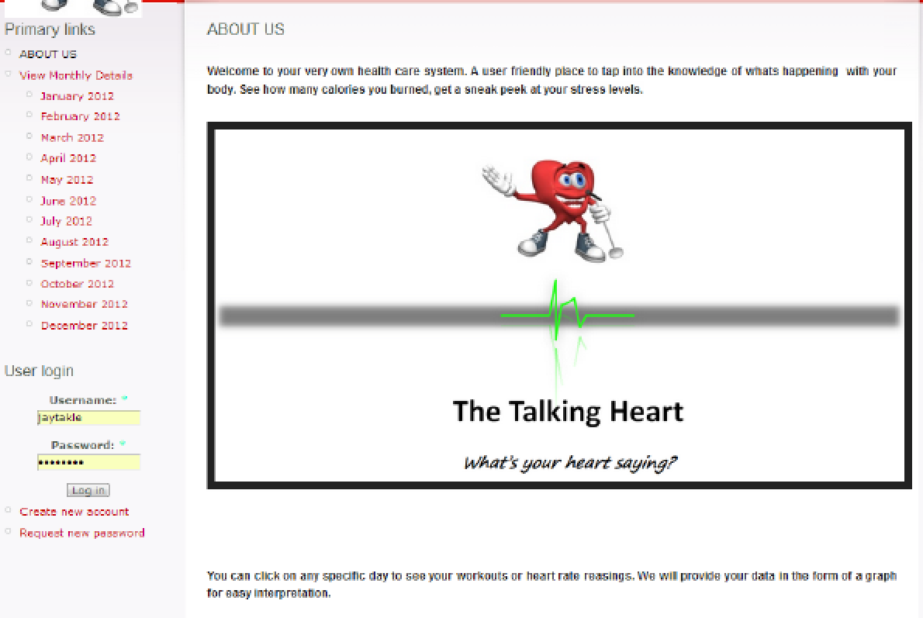
Sketch of the planned software product or required system.

Slide 39
Final screen for daily view of heart rate graph.

Slide 40
Final screen for daily view of heart rate comparison and stress.

Slide 41
Use cases of Functional Requirement
Use Case | Name | Description
UC1 | CreateProfile | Allows a user to create a new profile
UC2 | Login | Allows the user to access the system.
UC 3 | UploadFile | Allows the user to upload a data file to system from a computer.
UC 4 | ChangeProfile | Allows the user to modify their personal information.
UC 5 | ViewDailyHeartRate | Allows the user to view the heart rate readings for a day in the form of a line graph.
UC6 | ViewDailyCaloriesBurnt | Allows the user to view the calories burnt in a day in the form of a bar graph.
UC7 | ViewDailyStressLevel | Allows the user to view the stress levels for a day in the form of a line graph.
UC8 | ViewMonthlyHeartRate | Allows the user to view the heart rate readings for a month in the form of a line graph.
UC9 | ViewMonthlyCaloriesBurnt | Allows the user to view the calories burnt in a month in the form of a bar graph.
UC10 | ViewMonthlyStressLevel | Allows the user to view the stress levels for a month in the form of a line graph.
UC11 | ViewHeartCondition | Allows the user to view whether their heart condition is normal, Tachycardia, Bradycardia or cardiac mortality in the form of text.
UC12 | CalculateDailyAverageHeartRate | Allows the user to view the average values of heart rate for a day in the form of text.
UC13 | DeleteProfile | Allow the user to delete his profile.
UC14 | RetrievePassword | Allow the user to send a mail to the administrator to retrieve his password when he fails to enter correct password three times in a row.
UC15 | ViewYearlyGraph | Allow the user to view the yearly heart rate.

Slide 42
Create two Functional Requirements?
REQUIREMENTS | DESCRIPTION

Slide 43
Design the “ViewDailyHeartRate” use case in terms of Flow of Events for “Main Success Scenario” and for “Alternate Scenario: could not retrieve required data from DB search”?
Initiating Actor: User
Actor’s Goal: To view the heart rate readings for a day in the form of a line graph.
Participating Actor: Database
Pre-conditions: System displays the user’s current month home screen.
Post-conditions: System displays the heart rate data for a day in form of a line graph.
Flow of Events for Main Success Scenario:
-> 1. User clicks on a day and then clicks on “View Daily Heart Graph”.
<- 2. System sends request to database for the data.
->3. Database searches for user’s data for the day and sends data to system.
<-4. System converts data to line graph and displays on the screen.
Flow of Events for Extension (Alternate Scenario):
-> 1. User clicks on a day and then clicks on “View Daily Heart Graph”.
<- 2. System sends request to database for the data.
->3. Database searches for user’s data for the day but does not find data.
<-4. System displays message “No data uploaded”.

Slide 44
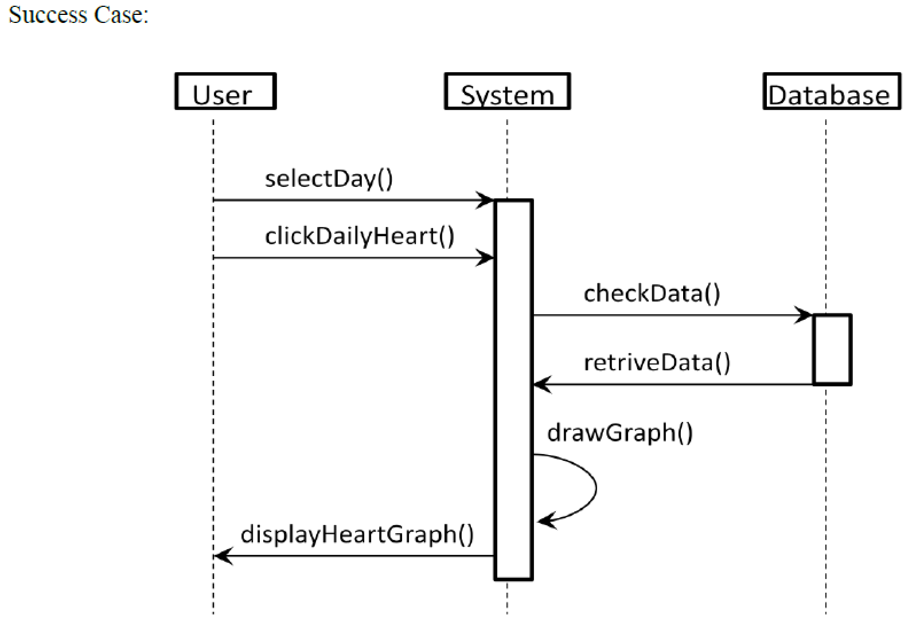
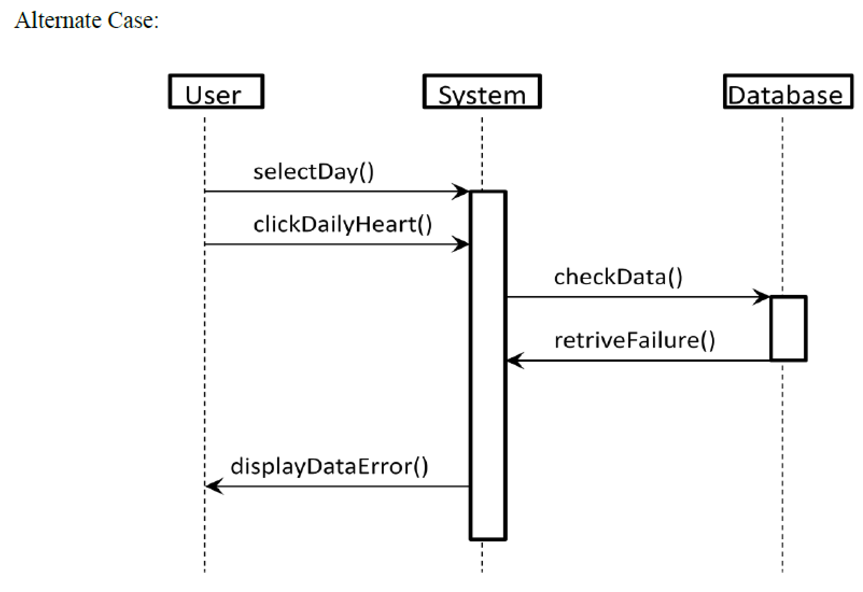
Draw a System Sequence Diagram for the use case of ViewDailyHeartRate? User will select the day and then retrieve DailyHeartRate data from DB by the system. There two possible cases: Success Case and Alternate/Fail Case when showing the daily heart rate to the user

Slide 45
Create a test plan for the use case of ViewDailyHeartRate?
Input | Requirement | Expected Output | Pass/Fail Comments
the user clicks on the day to see the uploaded data | the user is taken to the day screen and graphs are displayed with proper markings on x-axis and y-axis | Pass if the user is able to see his daily heart rate graph, daily minimum maximum heart rate and stress level. | This test is to determine that the user is able to see his heart graphs properly.
the user clicks on the day where no data is uploaded | Display message "no data uploaded" | Pass if the user is unable to see any graph | This test is to determine that the system does not display graph for day when no data is uploaded.

