Slide 1
Project Scheduling and Tracking
Asst. Prof. Dr. Duygu Çelik Ertuğrul

Slide 2
Project Scheduling and Tracking
Why is software delivered late in many projects ?
  Unrealistic deadline estimates (Deadline estimated by someone who is not familiar with software engineering, and forced on the Project manager)
  Changing customer requirements
  Underestimation of the human effort and for resources.
  Risks that were not considered when the Project started
  Technical difficulties that were not foreseen in advance.
  Human problems that were not foreseen. (illness, low performance because of personal problems)
  Communication problems between teams and for team members.
  Failure by the Project manager to recognize that the Project is falling behind the Schedule, and a lack of action to correct this.
What to do as a Project manager, if unrealistic deadline is imposed.

Slide 3
Ex: Assume the sales/marketing department asks for a new real-time system program to be built in 9 months. Also, assume you apply the estimation techniques we discussed before, and you estimate that it will take 14 months to write this software package with the team members available. so, what to do ?
  Go to the customer’s office (sales/marketing dept.) and ask for the delivery date be changed. This will probably not work, because external market pressures might have dictated the 9 months deadline.
  Refuse to undertake the project, saying that your team can’t finish it in 9 months not good for your career!
  Ask for more budget and additional resources to finish the Project in 9 months. The company management may reject additional budget and resources. Even if you get it, the risk of poor quality due to tight timeline will be high. Also, there will be training problems for the newcomers.
  What you can do???
  Consider the incremental development strategy as an alternative….
    Perform a detailed estimate using historical data obtained from past projects.
    Develope a strategy that will deliver ‘critical functionality’ in 9 months, delay other functionality until later.
    Explain to the customer that the imposed deadline is unrealistic.

Slide 4
CRITICAL PATH
A software project is composed of many small tasks.
Some of these tasks do not have an impact on the project completion date.
But some others lay on the ‘critical path’ if these tasks fall behind the schedule, we will not be able to finish on time (discussed later).
So, the project manager must define all the project tasks, identify the critical tasks, and track the progress of the critical tasks.

Slide 5
-> He needs a ‘time schedule’ for the project, to monitor the progress, and to control the project.
-> Software Project scheduling is an acitivity that distributes the estimated human effort across the project duration by allocating it to specific tasks.
During the early stages:
A Macroscopic Project Schedule is developed. It identifies the major SE activities and the product functions to which they are applied.
As the Project goes underway, entries of the macroscopic project schedule are refined, to produce the detailed project schedule.
Human effort is distributed to make the best use of available human and technical resources.
Actually, we first have to analyze the SE activity, decide on the tasks, see how they can fit to the Project Schedule, and then decide on the date of delivery.
Unfortunately, most of the time, the deadline will be forced/imposed on us.

Slide 7
Basic Principles of Software Project Scheduling:
Compartmentalization: Divide the project into manageable activities and tasks.
Interdependency: Determine the interdependencies of activities and tasks. Some tasks must occur one after the other, some can occur in parallel (fully independent of each other).
Time allocation: Allocate work units (like person days) to each task. Assign the start/end dates of activities, taking into consideration their interdependencies on other tasks.
Effort validation: Ensure that no more than the allocated number of people are considered for tasks. Control staff numbers, keep balance!!!

Slide 8
Defined responsibilities: Every defined task should be assigned to a specific team member.
Defined outcomes: Every defined task should have a defined outcome (or deliverable) (e.g., design document, report, code, ...)
Defined milestones: Every defined task should be associated with a milestone (e.g., approval of a work product)

Slide 9
Total Human Effort Required vs. No. Of People
We said that in small projects, one SE can analyze the system, perform the design, prepare the requirements, write the code and test the program.
As the project size increases, we’ll need more people. Consider the CAD Project. We can’t wait for a single person to do everything for 58 months ! (Almost 5 years)
More people means more communication paths.
Also, we can’t add people easily in later stages of the project, so we’d rather form the whole group at the beginning.

Slide 10
Example: Consider four programmers.
Each is capable of producing 5000 LOC per year*person.
When they are placed on a team for a Project,

Slide 11
Consider Productivity Factor According to
Number of People in Team!!!
Example: Assume that the team productivity is reduced by 250 LOC/year*com for every communication path. So, the total team productivity will be :
People*productivity-communications*productivity_reduction,
Where communications=0.5*people(people-1):
(4 people*5,000 LOC/year*person)-(6 com*250 LOC/year*com)=20,000-1,500=18,500 LOC/year
1500 LOC/20.000 LOC= 0.075
This is 7,5% less than the ‘blind’ expectation of 20,000 LOC/year.
It can be shown by extending the project time, we can tolerate to work with fewer people.
However, in general the converse is not true.
That is, we cannot decrease the project time by adding more people (more communication!).
There will be some normal limit to the minimum time for finishing a project.

Slide 12
Effort Distribution for a Project:
Project Planning: | 2-3%
Requirements Analysis: | 10-25%
Software Design: | 20-25% (depends on the Project size and complexity)
Coding: | 15-20%
Testing / Debugging: | 30-40%
These are Pressman’s suggestions!!!

Slide 13
Defining a Task Set for The Software Project
There is no single set of tasks that is appropriate for all projects.
Therefore, it is better to define a collection of task sets, each designed to meet the needs of different types of projects.
A task set is a collection of SE work tasks, milestones, and deliverables,
that must be accomplished to complete a particular Project.

Slide 14
Pressman’s Project Types:
Concept Development Projects: initiated to explore some new business concept, or application of some new technology.
New Application Development Projects: initiated by a specific customer request.
Application Enhancement Projects: existing software is to undergo major modifications.
Application Maintenance Projects: existing software is to be connected, adapted, or extended.
Reengineering Projects: to rebuild an existing system in whole or in part.
Classifying projects into ‘types’ is not sufficient.
We also have to consider the ‘DEGREE OF RIGOR’ (difficulty)
The degree of rigor is a function of many project characteristics.
For example:
Small, non business-critical projects can be addressed with less rigor.
Large, complex, business-critical projects require more rigor.

Slide 15
Pressman’s Degrees Of Rigor:
*To determine the recommend degree of rigor for a software Project, we use ‘Adaptation Criteria’ :
  Size of the Project
  No. of potential users
  Mission criticality
  Application longevity (life long)
  Stability of requirements
  Case of customer / developer communication
  Maturity of applicable technology
  Performance constraints
  Embedded / Non embedded characteristics
  Project staffing
  Reengineering factors
  http://www.rspa.com/apm/apm03.html

Slide 16
Size of project. This criterion can be estimated in work units (e.g., person-months) or product units (e.g., number of lines of code to be generated).
1 less than 3 person-months and/or 3,000 LOC or 30 function points
2 between 3 and 9 person months and/or 3,000 and 6,000 LOC (30 to 60 function points)
3 a moderate-size project, between 6 and 12 person-months and/or 5,000 and 20,000 LOC (50 to 200 function points)
4 between 9 and 24 person-months and/or 10,000 and 30,000 LOC (100 and 300 function points)
5 between 18 and 48+ person-months and over 25,000 LOC (250 function points)
Number of potential users. This criterion provides information on the potential market and by inference, the amount of support required.
1 to be used by local staff only, no immediate outside use
2 a product with a limited internal customer base
3 a product with over 1-9 geographically separate customers
4 a product with over 10 - 99 geographically separate customers
5 a product with over 100 geographically separate customers

Slide 17
Mission criticality. This criterion provides an indication of the relative business/mission impact of the project.
1 R&D project, no immediate business impact
2 supports minor business/technical function, not critical
3 supports major mission objective; critical, but workaround exists
4 lack of application will cause severe mission related problems
5 no workaround exists; absolutely critical
Application longevity. This criterion estimates the number of years that the product/application to be built/maintained will be in active use.
1 use projected at less than 1 year
2 use projected between 1 and 3 years
3 use projected between 2 and 5 years
4 use projected between 4 and 7 years
5 use projected to be over 7 years

Slide 18
Stability of requirements from external customer. This criterion indicates the degree to which software requirements are understood and will remain stable throughout the project.
1 scope is documented and well understood
2 scope is understood, but not documented by customer
3 complex requirements that are fully understood by customer and developer
4 moderately complex requirements that must be negotiated with customer
5 complex requirements that are not fully understood by customer and developer
Ease of customer-developer communication. This criterion provides an indication of the ease with which communication can be conducted between customer and developer. It is often affected by the location of developer and customer.
1 customer is the developer
2 customer and developer work in the same group or organization
3 customer and developer are geographically separated or organizationally separated
4 customer and developer are separated by service and/or international boundaries
5 poor communication has been exhibited in past endeavors

Slide 19
Maturity of technology. This criterion provides a relative indication of the risk associated with the technology to be implemented.
1 technology is well understood and mature
2 technology is well understood but there is little local experience with it
3 technology is less well understood (or has high risk)
4 technology is less well understood (or has high risk) and there is little local experience with it
5 technology is not well understood and is high risk
Performance constraints. This criterion provides a relative indication of the overall performance demanded of the product and the risk associated with achieving it.
1 run-time performance and/or data capacity are not issues
2 run-time performance and/or data capacity are important
3 run-time performance and/or data capacity are critical
4 specialized performance requirements must be accommodated
5 software is coupled intimately with hardware

Slide 20
Embedded/non-embedded characteristics. This criterion identifies whether the software is a support application or whether it is to be embedded directly into the product.
1 stand-alone application software in a conventional computing environment
2 application software residing in computing environment that services/controls a product
3 embedded software to be developed in a high-order programming language
4 embedded software to be developed in assembly language
5 embedded software with special high performance or design constraints
Project staffing. This criterion defines the type of staffing to be used for this project.
1 internal staff, high competency and experience
2 external contractor, past experience has been positive
3 internal staff, lower competency and experience
4 internal staff, little experience
5. external contractor, first encounter

Slide 21
Interoperability. This criterion indicates the degree to which the application interacts with other applications.
1 the application is standalone
2 the application is standalone but does access an external file structure or database
3 the application communicates with less than 3 other applications and/or access less than 3 external file structures or databases
4 the application communicates with between than 3 and 10 other applications and/or accesses more than 3 external file structures or databases
5. the application communicates with more than 8 other applications and/or accesses more than 3 external file structures or databases
Reengineering factors. This criterion describes technical characteristics of the application to be reengineered:
1 the system is to be reengineered with little or no change to requirements; good descriptive information already exists;
2 the system is to be reengineered with minor changes to requirements; descriptive information must be reworked;
3 the system is to be reengineered with major changes to requirements; descriptive information must be reworked;
4 the system is to be reengineered with major changes to requirements; no descriptive information exists;
5 the system is to be reengineered with major changes to requirements; no descriptive information exists; major changes are also expected in the technical infrastructure that supports the application

Slide 22
Computing a Task Set Selector Value
Assign Grades to each of the Adaptation Criteria (1 to 5) based on the characteristics of the project.
Decide on the Weighting Factors assigned to each Adaptation Criteria (0.8 to 1.2).
  These assigned factors show the relative importance of that criterion to the type of software being developed (We can make modifications in time, if needed)
Decide on the Entry Point Multipliers for the type of Project to be undertaken. (0 or 1) that indicates the relevance of the adaptation criterion to the project type.
Compute product = Grade * Weighting Factor * Entry Point Multiplier
for each adaptation criterion.
(See Table 7.1) (P.163)
WEB ENGINE: http://groups.engin.umd.umich.edu/CIS/tinytools/cis375/f00/tss/Main_11291.html

Slide 23
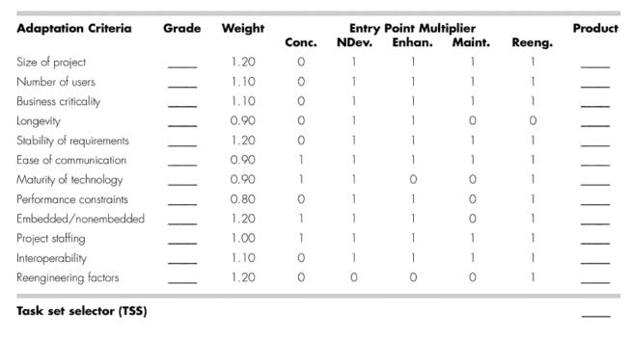
Task Set Selector- TSS table

Slide 24
Find the average of all multiplications that gives -> Task Set Selector (TSS) value
Then, once the TSS value is computed, we can decide on the degree of rigor for the project as follows.
TSS | Degree Of Rigor
TSS<1.2 | Casual
1.0<TSS<3.0 | Structured | Note: (there are some overlapping's!)
TSS>2.4 | Strict

Slide 25
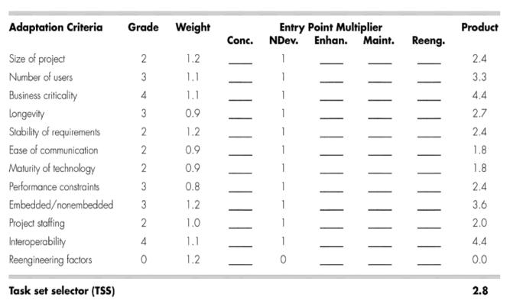
EXAMPLE:
Table illustrates how TSS might be computed for a project.
Project manager selects the grades shown in the Grade column.
Project type is new application development.
Therefore, entry point multipliers are selected from the NDev column.
The entry in the Product column is computed using → Grade x Weight x NewDev Entry Point Multiplier
Value of TSS (computed as the average of all entries in the product column) is 2.8.
The manager has the option of using either the structured or the strict task set
An example is given in Table 7.2 on p.164.

Slide 26
Selecting SE Tasks
Ex: Consider ‘Concept development projects’. Those projects are divided into the following tasks:
Concept scoping determines the overall scope of the project.
Preliminary concept planning establishes the organization’s ability to undertake the work implied by the project scope.
Technology risk assessment evaluates the risk associated with the technology to be implemented as part of project scope.
Proof of concept demonstrates the viability of a new technology in the software context.
Concept implementation implements the concept representation in a manner that can be reviewed by a customer and is used for “marketing” purposes when a concept must be sold to other customers or management.
Customer reaction to the concept solicits feedback on a new technology concept and targets specific customer applications

Slide 27
Assume we are using a linear, sequential model: ‘Concept development projects’
Selecting SE Tasks

Slide 28
Refinement of Major Tasks
From the Macroscopic Schedule, we must create a Detailed Project Schedule.
This can be done by the refinement of major tasks.
We take each task one by one, and we decompose tasks into ‘Subtasks’.
For Example: consider the ‘Concept Scoping’ task:

Slide 31
Defining a Task Network
Individual tasks and subtasks have interdependencies based on their sequence.
Also, when a number of employees are involved in a SE Project, some tasks will be performed in parallel.
So, we must prepare a task flow:
Task network, to guarantee that tasks are sequenced correctly, and parallel tasks are coordinated properly.
We may use automated Project scheduling tools, into which task sequences, dependencies are input.

Slide 32
Ex: (For a concept development project) (Macroscopic Schedule)
(Here, three TRA tasks applied in parallel to 3 different concept functions)

Slide 33
Since parallel tasks occur asynchronously, the Project manager must find out all inter-task dependencies, and take them into consideration in planning.
Also, the Project manager must find those tasks which are on the critical path.
We can develop a detailed task network for the above project by expanding/detail the major activities shown.

Slide 34
Project Scheduling
Engineering Project scheduling techniques:
PERT (Program Evaluation and Review Technique)
CPM (Critical Path Method)
Information Needed For Scheduling:
Human effort estimates
Selection of the appropriate process model
Selection of the ‘Project type’ and ‘task set’
A decomposition of product function
Interdependencies among tasks may be defined using a task network.

Slide 35
PERT and CPM provide quantitative tools that allow the software planner to:
  Determine the critical path (the chain of tasks that determines the Project duration)
  Establish ‘most likely’ time estimates for tasks
  Calculate ‘boundary times’ that define ‘time windows’ for particular tasks.
Boundary Times:
The earliest time a task can begin when all proceeding tasks are completed in the shortest possible time. (t_{eb}) →earliest begin
The latest time a task can begin without delaying the minimum Project completion time. (t_{lb}) →latest begin
The earliest time a task can finish. (t_{ef} = t_{eb} + t_{task min} ) → earliest finish
The latest time a task can finish without delaying the minimum Project completion time. (t_{lf} = t_{lb} + t_{task max} ) →latest finish
The total float: the amount of surplus time or leeway allowed in scheduling tasks so that the network critical path is maintained on schedule

Slide 36
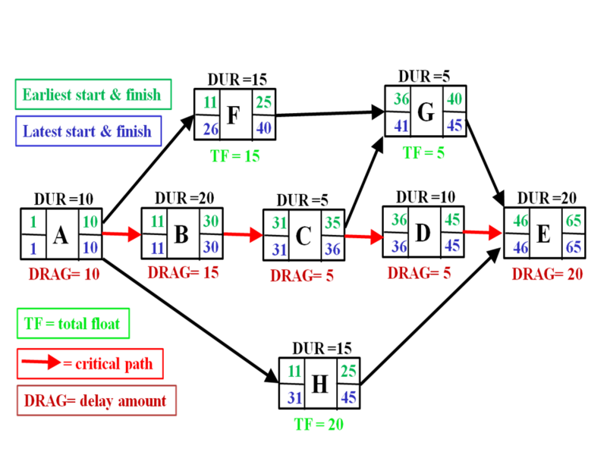
https://en.wikipedia.org/wiki/Critical_path_method, https://en.wikipedia.org/wiki/Critical_path_drag

Slide 37
In this diagram, Activities A, B, C, D, and E comprise the critical or longest path, while Activities F, G, and H are off the critical path with floats of 15 days, 5 days, and 20 days respectively. Whereas activities that are off the critical path have float and are therefore not delaying completion of the project, those on the critical path will usually have critical path drag, i.e., they delay project completion. The drag of a critical path activity can be computed using the following formula:
If a critical path activity has nothing in parallel, its drag is equal to its duration. Thus A and E have drags of 10 days and 20 days respectively.
If a critical path activity has another activity in parallel, its drag is equal to whichever is less: its duration or the total float of the parallel activity with the least total float. Thus since B and C are both parallel to F (float of 15) and H (float of 20), B has a duration of 20 and drag of 15 (equal to F's float), while C has a duration of only 5 days and thus drag of only 5. Activity D, with a duration of 10 days, is parallel to G (float of 5) and H (float of 20) and therefore its drag is equal to 5, the float of G.

Slide 38
So, when creating a Project Schedule:
We begin with a set of tasks, (this can be input as a task network or task outline if we are using automated tools like PERT or CPM)
  Human Effort
  We input: Task Duration for each task
  Task Start Date
We can assign specific tasks to specific individuals.
We decide on the milestones
This results in : a timeline chart (or, a Gantt Chart)
  A timeline chart can be developed for the whole project, showing all the tasks,
  and / or separate charts for each Project functions
  for each individual

Slide 41
Tracking The Schedule:
Conduct periodic ‘Project status meetings’ in which each team member reports progress and problems.
Evaluate the results of all reviews conducted throughout the SE process.
Check whether Project milestones have been accomplished by the Schedule date.
Compare actual start dates with planned start dates of tasks.
Conduct informal meetings with team members to obtain their subjective assessment of Project progress.

Slide 42
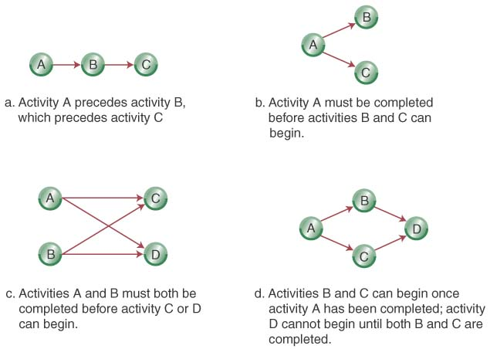
Network Diagrams: from Operations Management . An Integrated Approach. 4th. Ed. R. Dan Reid, Nada R. Sanders, John Wiley and Sons, Inc., 2011, ISBN 13: 978-0-470-32504-9, ISBN 10: 0-470-32504-6 http://www.mediafire.com/file/9yt835pi3j96vvb/Operations_Management%28Sanders+%26+Reid.pdf
Activity-on-Node (AON):
  Uses nodes to represent the activity
  Uses arrows to represent precedence relationships

Slide 43
EXAMPLE
Step 1-Define the Project: A new product’s production involves 11 activities and their precedence relationships. Develop an AON for the prj.

Slide 44
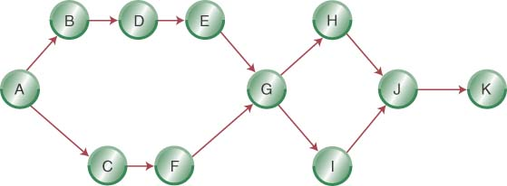
Step 2- Diagram the Network for the project

Slide 45
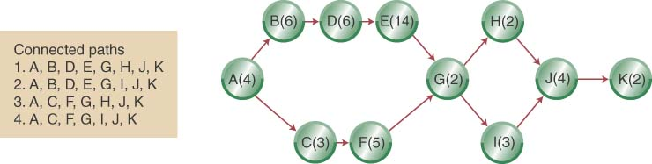
Step 3 (a)- Add Deterministic Time Estimates & Connected Paths

Slide 46
Step 3 (a) (Con’t): Calculate the Project Completion Times
The longest path (ABDEGIJK) limits the project’s duration (project cannot finish in less time than its longest path)
ABDEGIJK is the project’s critical path

Slide 47
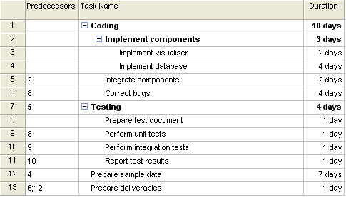
An Example Network Diagram
(Sample: Summary & Leaf Tasks)

Slide 48
Network Diagrams (Sample: Leaf Tasks)
With the information below,
  You can be able to draw a network diagram.
ID | Task Name | Duration | Predecessors
3 | Implement visualiser | 2 | -
4 | Implement database | 4 | -
5 | Integrate components | 2 | 3, 4
6 | Correct bugs | 4 | 8
8 | Prepare test document | 1 | 5
9 | Perform unit tests | 1 | 5, 8
10 | Perform integration tests | 1 | 5, 9
11 | Report test results | 1 | 5, 10
12 | Prepare sample data | 7 | 4
13 | Prepare deliverables | 1 | 6, 12

Slide 49
Network Diagrams
(Sample: Network Diagram)
ID | Task Name | Duration | Predecessors
3 | Implement visualiser | 2 | -
4 | Implement database | 4 | -
5 | Integrate components | 2 | 3, 4
6 | Correct bugs | 4 | 8
8 | Prepare test document | 1 | 5
9 | Perform unit tests | 1 | 5, 8
10 | Perform integration tests | 1 | 5, 9
11 | Report test results | 1 | 5, 10
12 | Prepare sample data | 7 | 4
13 | Prepare deliverables | 1 | 6, 12
3
5
8
6
9
10
11
13
4
12

Slide 50
Network Diagrams
(Sample: Network Diagram)
ID | Task Name | Duration | Predecessors
3 | Implement visualiser | 2 | -
4 | Implement database | 4 | -
5 | Integrate components | 2 | 3, 4
6 | Correct bugs | 4 | 8
8 | Prepare test document | 1 | 5
9 | Perform unit tests | 1 | 5, 8
10 | Perform integration tests | 1 | 5, 9
11 | Report test results | 1 | 5, 10
12 | Prepare sample data | 7 | 4
13 | Prepare deliverables | 1 | 6, 12
D = 2
D = 2
D = 1
D = 4
3
5
8
6
D = 1
D = 4
9
10
11
13
4
D = 7
D = 1
D = 1
D = 1
12

Slide 51
Network Diagrams
(Sample: Network Diagram)
ID | Task Name | Duration | Predecessors
3 | Implement visualiser | 2 | -
4 | Implement database | 4 | -
5 | Integrate components | 2 | 3, 4
6 | Correct bugs | 4 | 8
8 | Prepare test document | 1 | 5
9 | Perform unit tests | 1 | 5, 8
10 | Perform integration tests | 1 | 5, 9
11 | Report test results | 1 | 5, 10
12 | Prepare sample data | 7 | 4
13 | Prepare deliverables | 1 | 6, 12
ET = Earliest completion time
Compute ET of left mosts first.
Compute ET of each forward task
by summing ET for each task from left to right.
LT = Latest completion time
Compute LT of right mosts first.
Compute LT of each backward task
by subtracting duration for each task from right to left.
D = 2
D = 2
D = 1
D = 4
3
5
8
6
D = 1
D = 4
9
10
11
13
4
D = 7
D = 1
D = 1
D = 1
12

Slide 52
Network Diagrams
(Sample: Network Diagram)
ID | Task Name | Duration | Predecessors
3 | Implement visualiser | 2 | -
4 | Implement database | 4 | -
5 | Integrate components | 2 | 3, 4
6 | Correct bugs | 4 | 8
8 | Prepare test document | 1 | 5
9 | Perform unit tests | 1 | 5, 8
10 | Perform integration tests | 1 | 5, 9
11 | Report test results | 1 | 5, 10
12 | Prepare sample data | 7 | 4
13 | Prepare deliverables | 1 | 6, 12
ET = Earliest completion time
Compute ET of left mosts first.
Compute ET of each forward task
by summing ET for each task from left to right.
LT = Latest completion time
Compute LT of right mosts first.
Compute LT of each backward task
by subtracting duration for each task from right to left.
D = 2
D = 2
D = 1
D = 4
3
5
8
6
ET = 2
D = 1
D = 4
9
10
11
13
4
D = 7
D = 1
D = 1
D = 1
ET = 4
12

Slide 53
Network Diagrams
(Sample: Network Diagram)
ID | Task Name | Duration | Predecessors
3 | Implement visualiser | 2 | -
4 | Implement database | 4 | -
5 | Integrate components | 2 | 3, 4
6 | Correct bugs | 4 | 8
8 | Prepare test document | 1 | 5
9 | Perform unit tests | 1 | 5, 8
10 | Perform integration tests | 1 | 5, 9
11 | Report test results | 1 | 5, 10
12 | Prepare sample data | 7 | 4
13 | Prepare deliverables | 1 | 6, 12
ET = Earliest completion time
Compute ET of left mosts first.
Compute ET of each forward task
by summing ET for each task from left to right.
LT = Latest completion time
Compute LT of right mosts first.
Compute LT of each backward task
by subtracting duration for each task from right to left.
D = 2
D = 2
D = 1
D = 4
3
5
8
6
ET = 2
ET = max(2,4)+2
D = 1
D = 4
9
10
11
13
4
D = 7
D = 1
D = 1
D = 1
ET = 4
12
ET = 4+7

Slide 54
Network Diagrams
(Sample: Network Diagram)
ID | Task Name | Duration | Predecessors
3 | Implement visualiser | 2 | -
4 | Implement database | 4 | -
5 | Integrate components | 2 | 3, 4
6 | Correct bugs | 4 | 8
8 | Prepare test document | 1 | 5
9 | Perform unit tests | 1 | 5, 8
10 | Perform integration tests | 1 | 5, 9
11 | Report test results | 1 | 5, 10
12 | Prepare sample data | 7 | 4
13 | Prepare deliverables | 1 | 6, 12
ET = Earliest completion time
Compute ET of left mosts first.
Compute ET of each forward task
by summing ET for each task from left to right.
LT = Latest completion time
Compute LT of right mosts first.
Compute LT of each backward task
by subtracting duration for each task from right to left.
D = 2
D = 2
D = 1
D = 4
3
5
8
6
ET = 2
ET = 6
ET = 6+1
D = 1
D = 4
9
10
11
13
4
D = 7
D = 1
D = 1
D = 1
ET = 4
12
ET = 11

Slide 55
Network Diagrams
(Sample: Network Diagram)
ID | Task Name | Duration | Predecessors
3 | Implement visualiser | 2 | -
4 | Implement database | 4 | -
5 | Integrate components | 2 | 3, 4
6 | Correct bugs | 4 | 8
8 | Prepare test document | 1 | 5
9 | Perform unit tests | 1 | 5, 8
10 | Perform integration tests | 1 | 5, 9
11 | Report test results | 1 | 5, 10
12 | Prepare sample data | 7 | 4
13 | Prepare deliverables | 1 | 6, 12
ET = Earliest completion time
Compute ET of left mosts first.
Compute ET of each forward task
by summing ET for each task from left to right.
LT = Latest completion time
Compute LT of right mosts first.
Compute LT of each backward task
by subtracting duration for each task from right to left.
D = 2
D = 2
D = 1
D = 4
3
5
8
6
ET = 2
ET = 6
ET = 7
ET = 7+4
D = 1
D = 4
9
10
11
13
4
D = 7
D = 1
D = 1
D = 1
ET = 4
12
ET = 7+1
ET = 11

Slide 56
Network Diagrams
(Sample: Network Diagram)
ID | Task Name | Duration | Predecessors
3 | Implement visualiser | 2 | -
4 | Implement database | 4 | -
5 | Integrate components | 2 | 3, 4
6 | Correct bugs | 4 | 8
8 | Prepare test document | 1 | 5
9 | Perform unit tests | 1 | 5, 8
10 | Perform integration tests | 1 | 5, 9
11 | Report test results | 1 | 5, 10
12 | Prepare sample data | 7 | 4
13 | Prepare deliverables | 1 | 6, 12
ET = Earliest completion time
Compute ET of left mosts first.
Compute ET of each forward task
by summing ET for each task from left to right.
LT = Latest completion time
Compute LT of right mosts first.
Compute LT of each backward task
by subtracting duration for each task from right to left.
D = 2
D = 2
D = 1
D = 4
3
5
8
6
ET = 2
ET = 6
ET = 7
ET = 11
D = 1
D = 4
9
10
11
13
4
D = 7
D = 1
D = 1
D = 1
ET = max(11,11)+1
ET = 4
12
ET = 8
ET = 8+1
ET = 11

Slide 57
Network Diagrams
(Sample: Network Diagram)
ID | Task Name | Duration | Predecessors
3 | Implement visualiser | 2 | -
4 | Implement database | 4 | -
5 | Integrate components | 2 | 3, 4
6 | Correct bugs | 4 | 8
8 | Prepare test document | 1 | 5
9 | Perform unit tests | 1 | 5, 8
10 | Perform integration tests | 1 | 5, 9
11 | Report test results | 1 | 5, 10
12 | Prepare sample data | 7 | 4
13 | Prepare deliverables | 1 | 6, 12
ET = Earliest completion time
Compute ET of left mosts first.
Compute ET of each forward task
by summing ET for each task from left to right.
LT = Latest completion time
Compute LT of right mosts first.
Compute LT of each backward task
by subtracting duration for each task from right to left.
D = 2
D = 2
D = 1
D = 4
3
5
8
6
ET = 2
ET = 6
ET = 7
ET = 11
D = 1
D = 4
9
10
11
13
4
D = 7
D = 1
D = 1
D = 1
ET = 12
ET = 4
12
ET = 8
ET = 9
ET = 9+1
ET = 11

Slide 58
Network Diagrams
(Sample: Network Diagram)
ID | Task Name | Duration | Predecessors
3 | Implement visualiser | 2 | -
4 | Implement database | 4 | -
5 | Integrate components | 2 | 3, 4
6 | Correct bugs | 4 | 8
8 | Prepare test document | 1 | 5
9 | Perform unit tests | 1 | 5, 8
10 | Perform integration tests | 1 | 5, 9
11 | Report test results | 1 | 5, 10
12 | Prepare sample data | 7 | 4
13 | Prepare deliverables | 1 | 6, 12
ET = Earliest completion time
Compute ET of left mosts first.
Compute ET of each forward task
by summing ET for each task from left to right.
LT = Latest completion time
Compute LT of right mosts first.
Compute LT of each backward task
by subtracting duration for each task from right to left.
D = 2
D = 2
D = 1
D = 4
3
5
8
6
ET = 2
ET = 6
ET = 7
ET = 11
D = 1
D = 4
9
10
11
13
4
D = 7
D = 1
D = 1
D = 1
ET = 12
ET = 4
12
ET = 8
ET = 9
ET = 10
ET = 11

Slide 59
Network Diagrams
(Sample: Network Diagram)
ID | Task Name | Duration | Predecessors
3 | Implement visualiser | 2 | -
4 | Implement database | 4 | -
5 | Integrate components | 2 | 3, 4
6 | Correct bugs | 4 | 8
8 | Prepare test document | 1 | 5
9 | Perform unit tests | 1 | 5, 8
10 | Perform integration tests | 1 | 5, 9
11 | Report test results | 1 | 5, 10
12 | Prepare sample data | 7 | 4
13 | Prepare deliverables | 1 | 6, 12
ET = Earliest completion time
Compute ET of left mosts first.
Compute ET of each forward task
by summing ET for each task from left to right.
LT = Latest completion time
Compute LT of right mosts first.
Compute LT of each backward task
by subtracting duration for each task from right to left.
D = 2
D = 2
D = 1
D = 4
3
5
8
6
ET = 2
ET = 6
ET = 7
ET = 11
ET = 11
D = 1
D = 4
9
10
11
13
4
D = 7
D = 1
D = 1
D = 1
ET = 12
ET = 8
ET = 9
ET = 10
ET = 11
LT = 12
ET = 4
12
LT = 12
ET = 11
Assign project end date, max(ET)

Slide 60
Network Diagrams
(Sample: Network Diagram)
ID | Task Name | Duration | Predecessors
3 | Implement visualiser | 2 | -
4 | Implement database | 4 | -
5 | Integrate components | 2 | 3, 4
6 | Correct bugs | 4 | 8
8 | Prepare test document | 1 | 5
9 | Perform unit tests | 1 | 5, 8
10 | Perform integration tests | 1 | 5, 9
11 | Report test results | 1 | 5, 10
12 | Prepare sample data | 7 | 4
13 | Prepare deliverables | 1 | 6, 12
ET = Earliest completion time
Compute ET of left mosts first.
Compute ET of each forward task
by summing ET for each task from left to right.
LT = Latest completion time
Compute LT of right mosts first.
Compute LT of each backward task
by subtracting duration for each task from right to left.
D = 2
D = 2
D = 1
D = 4
3
5
8
6
ET = 2
ET = 6
ET = 7
ET = 11
D = 1
LT = 12-1
D = 4
9
10
11
13
4
D = 7
D = 1
D = 1
D = 1
ET = 12
ET = 8
ET = 9
ET = 10
LT = 12
ET = 4
12
LT = 12-1
LT = 12
ET = 11
LT = 12-1

Slide 61
Network Diagrams
(Sample: Network Diagram)
ID | Task Name | Duration | Predecessors
3 | Implement visualiser | 2 | -
4 | Implement database | 4 | -
5 | Integrate components | 2 | 3, 4
6 | Correct bugs | 4 | 8
8 | Prepare test document | 1 | 5
9 | Perform unit tests | 1 | 5, 8
10 | Perform integration tests | 1 | 5, 9
11 | Report test results | 1 | 5, 10
12 | Prepare sample data | 7 | 4
13 | Prepare deliverables | 1 | 6, 12
ET = Earliest completion time
Compute ET of left mosts first.
Compute ET of each forward task
by summing ET for each task from left to right.
LT = Latest completion time
Compute LT of right mosts first.
Compute LT of each backward task
by subtracting duration for each task from right to left.
D = 2
D = 2
D = 1
D = 4
3
5
8
6
ET = 2
ET = 6
ET = 7
ET = 11
D = 1
LT = 11
D = 4
9
10
11
13
4
D = 7
D = 1
D = 1
D = 1
ET = 12
ET = 8
ET = 9
ET = 10
LT = 12
ET = 4
12
LT = 11-1
LT = 11
LT = 12
ET = 11
LT = 11

Slide 62
Network Diagrams
(Sample: Network Diagram)
ID | Task Name | Duration | Predecessors
3 | Implement visualiser | 2 | -
4 | Implement database | 4 | -
5 | Integrate components | 2 | 3, 4
6 | Correct bugs | 4 | 8
8 | Prepare test document | 1 | 5
9 | Perform unit tests | 1 | 5, 8
10 | Perform integration tests | 1 | 5, 9
11 | Report test results | 1 | 5, 10
12 | Prepare sample data | 7 | 4
13 | Prepare deliverables | 1 | 6, 12
ET = Earliest completion time
Compute ET of left mosts first.
Compute ET of each forward task
by summing ET for each task from left to right.
LT = Latest completion time
Compute LT of right mosts first.
Compute LT of each backward task
by subtracting duration for each task from right to left.
D = 2
D = 2
D = 1
D = 4
3
5
8
6
ET = 2
ET = 6
ET = 7
ET = 11
D = 1
LT = min ( 11-4 ,
10-1 )
LT = 11
D = 4
9
10
11
13
4
D = 7
D = 1
D = 1
D = 1
ET = 12
ET = 8
ET = 9
ET = 10
LT = 12
ET = 4
12
LT = 10
LT = 11
LT = 12
ET = 11
LT = 11

Slide 63
Network Diagrams
(Sample: Network Diagram)
ID | Task Name | Duration | Predecessors
3 | Implement visualiser | 2 | -
4 | Implement database | 4 | -
5 | Integrate components | 2 | 3, 4
6 | Correct bugs | 4 | 8
8 | Prepare test document | 1 | 5
9 | Perform unit tests | 1 | 5, 8
10 | Perform integration tests | 1 | 5, 9
11 | Report test results | 1 | 5, 10
12 | Prepare sample data | 7 | 4
13 | Prepare deliverables | 1 | 6, 12
ET = Earliest completion time
Compute ET of left mosts first.
Compute ET of each forward task
by summing ET for each task from left to right.
LT = Latest completion time
Compute LT of right mosts first.
Compute LT of each backward task
by subtracting duration for each task from right to left.
D = 2
D = 2
D = 1
D = 4
3
5
8
6
ET = 2
ET = 6
ET = 7
ET = 11
D = 1
LT = min(7,9)
LT = 11
D = 4
9
10
11
13
4
D = 7
D = 1
D = 1
D = 1
ET = 12
ET = 8
ET = 9
ET = 10
LT = 12
ET = 4
12
LT = 10
LT = 11
LT = 12
ET = 11
LT = 11

Slide 64
Network Diagrams
(Sample: Network Diagram)
ID | Task Name | Duration | Predecessors
3 | Implement visualiser | 2 | -
4 | Implement database | 4 | -
5 | Integrate components | 2 | 3, 4
6 | Correct bugs | 4 | 8
8 | Prepare test document | 1 | 5
9 | Perform unit tests | 1 | 5, 8
10 | Perform integration tests | 1 | 5, 9
11 | Report test results | 1 | 5, 10
12 | Prepare sample data | 7 | 4
13 | Prepare deliverables | 1 | 6, 12
ET = Earliest completion time
Compute ET of left mosts first.
Compute ET of each forward task
by summing ET for each task from left to right.
LT = Latest completion time
Compute LT of right mosts first.
Compute LT of each backward task
by subtracting duration for each task from right to left.
D = 2
D = 2
D = 1
D = 4
3
5
8
6
ET = 2
ET = 6
ET = 7
ET = 11
D = 1
LT = 7-1
LT = 7
LT = 11
D = 4
9
10
11
13
4
D = 7
D = 1
D = 1
D = 1
ET = 12
ET = 8
ET = 9
ET = 10
LT = 12
ET = 4
12
LT = 10
LT = 11
LT = 12
ET = 11
LT = 11

Slide 65
Network Diagrams
(Sample: Network Diagram)
ID | Task Name | Duration | Predecessors
3 | Implement visualiser | 2 | -
4 | Implement database | 4 | -
5 | Integrate components | 2 | 3, 4
6 | Correct bugs | 4 | 8
8 | Prepare test document | 1 | 5
9 | Perform unit tests | 1 | 5, 8
10 | Perform integration tests | 1 | 5, 9
11 | Report test results | 1 | 5, 10
12 | Prepare sample data | 7 | 4
13 | Prepare deliverables | 1 | 6, 12
ET = Earliest completion time
Compute ET of left mosts first.
Compute ET of each forward task
by summing ET for each task from left to right.
LT = Latest completion time
Compute LT of right mosts first.
Compute LT of each backward task
by subtracting duration for each task from right to left.
D = 2
D = 2
D = 1
D = 4
3
5
8
6
ET = 2
ET = 6
ET = 7
ET = 11
D = 1
LT = 6-2
LT = 6
LT = 7
LT = 11
D = 4
9
10
11
13
4
D = 7
D = 1
D = 1
D = 1
ET = 12
ET = 8
ET = 9
ET = 10
LT = 12
ET = 4
12
LT = 10
LT = 11
LT = 12
LT = min ( 6-2 ,
11-7 )
ET = 11
LT = 11

Slide 66
Network Diagrams
(Sample: Network Diagram)
ID | Task Name | Duration | Predecessors
3 | Implement visualiser | 2 | -
4 | Implement database | 4 | -
5 | Integrate components | 2 | 3, 4
6 | Correct bugs | 4 | 8
8 | Prepare test document | 1 | 5
9 | Perform unit tests | 1 | 5, 8
10 | Perform integration tests | 1 | 5, 9
11 | Report test results | 1 | 5, 10
12 | Prepare sample data | 7 | 4
13 | Prepare deliverables | 1 | 6, 12
ET = Earliest completion time
Compute ET of left mosts first.
Compute ET of each forward task
by summing ET for each task from left to right.
LT = Latest completion time
Compute LT of right mosts first.
Compute LT of each backward task
by subtracting duration for each task from right to left.
D = 2
D = 2
D = 1
D = 4
3
5
8
6
ET = 2
ET = 6
ET = 7
ET = 11
D = 1
LT = 4
LT = 6
LT = 7
LT = 11
D = 4
9
10
11
13
4
D = 7
D = 1
D = 1
D = 1
ET = 12
ET = 8
ET = 9
ET = 10
LT = 12
ET = 4
12
LT = 10
LT = 11
LT = 12
LT = min(4,4)
ET = 11
LT = 11

Slide 67
Network Diagrams
(Sample: Network Diagram)
ID | Task Name | Duration | Predecessors
3 | Implement visualiser | 2 | -
4 | Implement database | 4 | -
5 | Integrate components | 2 | 3, 4
6 | Correct bugs | 4 | 8
8 | Prepare test document | 1 | 5
9 | Perform unit tests | 1 | 5, 8
10 | Perform integration tests | 1 | 5, 9
11 | Report test results | 1 | 5, 10
12 | Prepare sample data | 7 | 4
13 | Prepare deliverables | 1 | 6, 12
ET = Earliest completion time
Compute ET of left mosts first.
Compute ET of each forward task
by summing ET for each task from left to right.
LT = Latest completion time
Compute LT of right mosts first.
Compute LT of each backward task
by subtracting duration for each task from right to left.
D = 2
D = 2
D = 1
D = 4
3
5
8
6
ET = 2
ET = 6
ET = 7
ET = 11
D = 1
LT = 4
LT = 6
LT = 7
LT = 11
D = 4
9
10
11
13
4
D = 7
D = 1
D = 1
D = 1
ET = 12
ET = 8
ET = 9
ET = 10
LT = 12
ET = 4
12
LT = 10
LT = 11
LT = 12
LT = 4
ET = 11
LT = 11

Slide 68
Network Diagrams
(Sample: Network Diagram)
ID | Task Name | Duration | Predecessors
3 | Implement visualiser | 2 | -
4 | Implement database | 4 | -
5 | Integrate components | 2 | 3, 4
6 | Correct bugs | 4 | 8
8 | Prepare test document | 1 | 5
9 | Perform unit tests | 1 | 5, 8
10 | Perform integration tests | 1 | 5, 9
11 | Report test results | 1 | 5, 10
12 | Prepare sample data | 7 | 4
13 | Prepare deliverables | 1 | 6, 12
ET = Earliest completion time
Compute ET of left mosts first.
Compute ET of each forward task
by summing ET for each task from left to right.
LT = Latest completion time
Compute LT of right mosts first.
Compute LT of each backward task
by subtracting duration for each task from right to left.
D = 2
D = 2
D = 1
D = 4
3
5
8
6
ET = 2
ET = 6
ET = 7
ET = 11
D = 1
LT = 4
LT = 6
LT = 7
LT = 11
D = 4
9
10
11
13
4
D = 7
D = 1
D = 1
D = 1
ET = 12
ET = 8
ET = 9
ET = 10
LT = 12
ET = 4
12
LT = 10
LT = 11
LT = 12
LT = 4
ET = 11
Red tasks are on critical path, so should not be delayed.
LT = 11

Slide 69
Network Diagrams
(Sample: Network Diagram)
ID | Task Name | Duration | Predecessors
3 | Implement visualiser | 2 | -
4 | Implement database | 4 | -
5 | Integrate components | 2 | 3, 4
6 | Correct bugs | 4 | 8
8 | Prepare test document | 1 | 5
9 | Perform unit tests | 1 | 5, 8
10 | Perform integration tests | 1 | 5, 9
11 | Report test results | 1 | 5, 10
12 | Prepare sample data | 7 | 4
13 | Prepare deliverables | 1 | 6, 12
ET = Earliest completion time
Compute ET of left mosts first.
Compute ET of each forward task
by summing ET for each task from left to right.
LT = Latest completion time
Compute LT of right mosts first.
Compute LT of each backward task
by subtracting duration for each task from right to left.
D = 2
D = 2
D = 1
D = 4
3
5
8
6
ET = 2
ET = 6
ET = 7
ET = 11
D = 1
LT = 4
LT = 6
LT = 7
LT = 11
D = 4
9
10
11
13
4
D = 7
D = 1
D = 1
D = 1
ET = 12
ET = 8
ET = 9
ET = 10
LT = 12
ET = 4
12
LT = 10
LT = 11
LT = 12
LT = 4
ET = 11
Orange tasks are not on critical path, so can be delayed up to some point.
LT = 11

Slide 70
Network Diagrams
(Sample: Network Diagram)
ID | Task Name | Duration | Predecessors
3 | Implement visualiser | 2 | -
4 | Implement database | 4 | -
5 | Integrate components | 2 | 3, 4
6 | Correct bugs | 4 | 8
8 | Prepare test document | 1 | 5
9 | Perform unit tests | 1 | 5, 8
10 | Perform integration tests | 1 | 5, 9
11 | Report test results | 1 | 5, 10
12 | Prepare sample data | 7 | 4
13 | Prepare deliverables | 1 | 6, 12
Slack time is the amount of time
a task can be delayed
without delaying the project.
Slack-time = LT-ET
D = 2
D = 2
D = 1
D = 4
3
5
8
6
ET = 2
st = 2
ET = 6
ET = 7
ET = 11
D = 1
LT = 4
LT = 6
LT = 7
LT = 11
D = 4
9
10
11
13
4
D = 7
D = 1
D = 1
D = 1
ET = 12
ET = 8
ET = 9
ET = 10
LT = 12
ET = 4
12
LT = 10
st = 2
LT = 11
st = 2
LT = 12
st = 2
LT = 4
ET = 11
Tasks not on the critical path contain some slack time (st).
LT = 11

Slide 71
Program Evaluation Review Technique (PERT)
A technique used for determining the duration of tasks in work breakdown structures.
It is difficult to estimate a tasks duration
  When it involves a high degree of complexity and uncertainty.
PERT uses;
  Optimistic,
  Most likely, and
  Pessimistic time estimates
    To calculate expected time.

Slide 72
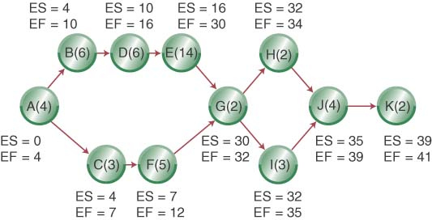
ES, EF Network

Slide 73
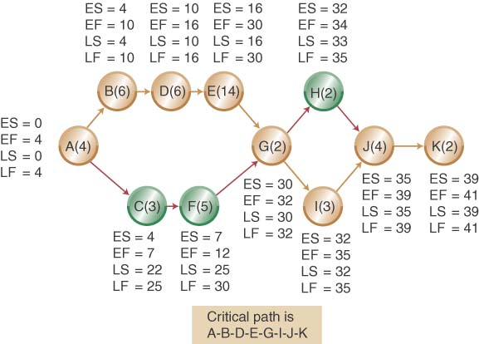
LS, LF Network

Slide 74
Calculating Slack
Slack-time = LT-ET or LF-EF

Slide 75
Using Probabilistic Time Estimates

Slide 76
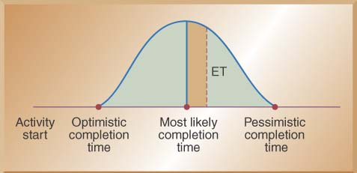
Using Beta Probability Distribution to Calculate Expected Time Durations
A typical beta distribution is shown below, note that it has definite end points
The expected time for finishing each activity is a weighted average

Slide 77
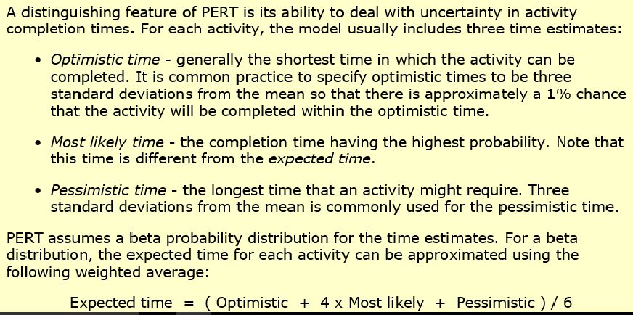
http://www.netmba.com/operations/project/pert/

Slide 78
Calculating Expected Task Times

Slide 79
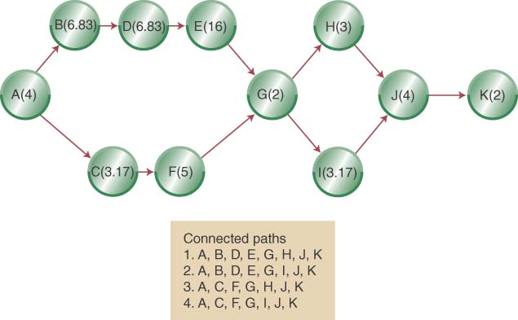
Network Diagram with Expected Activity Times

Slide 80
Estimated Path Durations through the Network
ABDEGIJK is the expected critical path & the project has an expected duration of 44.83 weeks

Slide 81
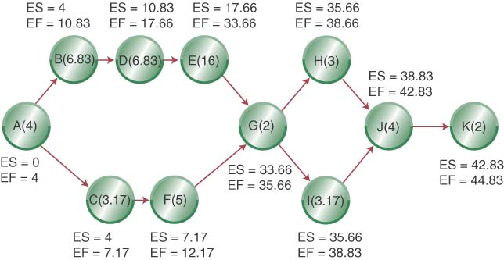
Adding ES and EF to Network

Slide 82
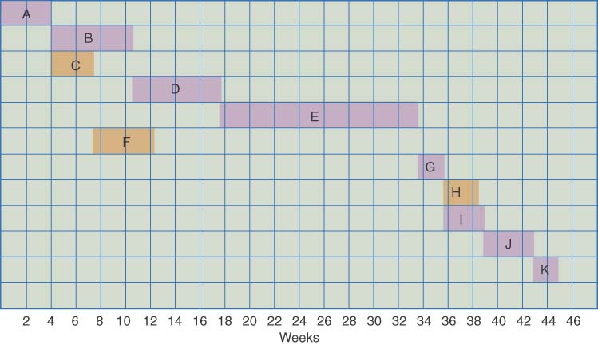
Gantt Chart Showing Each Activity Finished at the Earliest Possible Start Date

Slide 83
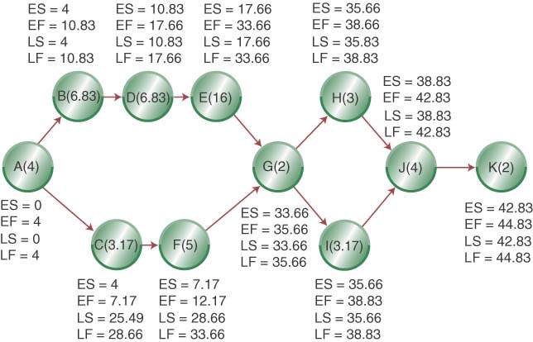
Adding LS and LF to Network

Slide 84
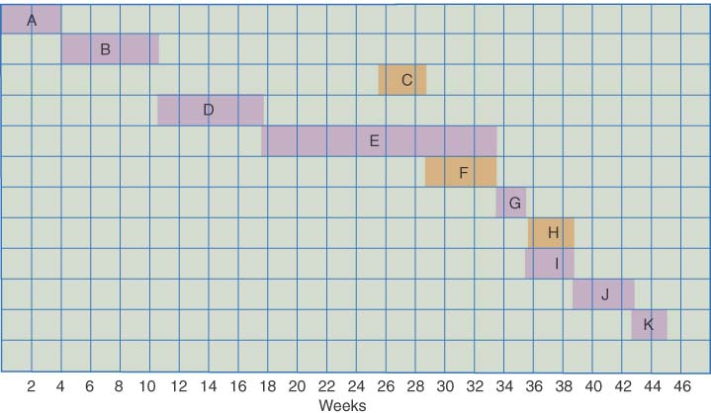
Gantt Chart Showing the Latest Possible Start Times if the Project Is to Be Completed in 44.83 Weeks

Slide 85
Estimating the Probability of Completion Dates
Using probabilistic time estimates offers the advantage of predicting the probability of project completion dates
We have already calculated the expected time for each activity by making three time estimates
How ?

Slide 86
Calculating Expected Task Times

Slide 87
Network Diagram with Expected Activity Times

Slide 88
Adding LS and LF to Network

Slide 89
Estimated Path Expected Times
ABDEGIJK is the expected critical path & the project has an expected duration of 44.83 weeks

Slide 90
Estimating the Probability of Completion Dates
Using probabilistic time estimates offers the advantage of predicting the probability of project completion dates
We have already calculated the expected time for each activity by making three time estimates
Now we need to calculate the variance for each activity
The variance of the beta probability distribution is:
  where p=pessimistic activity time estimate
o=optimistic activity time estimate

Slide 91
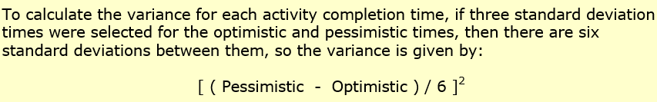

Slide 92
Project Activity Variance
Activity | Optimistic | Most Likely | Pessimistic | Variance
A | 2 | 4 | 6 | 0.44
B | 3 | 7 | 10 | 1.36
C | 2 | 3 | 5 | 0.25
D | 4 | 7 | 9 | 0.69
E | 12 | 16 | 20 | 1.78
F | 2 | 5 | 8 | 1.00
G | 2 | 2 | 2 | 0.00
H | 2 | 3 | 4 | 0.11
I | 2 | 3 | 5 | 0.25
J | 2 | 4 | 6 | 0.44
K | 2 | 2 | 2 | 0.00

Slide 93
Variances of Each Path through the Network
Path Number | Activities on Path | Path Variance (weeks)
1 | A,B,D,E,G,H,J,K | 4.82
2 | A,B,D,E,G,I,J,K | 4.96
3 | A,C,F,G,H,J,K | 2.24
4 | A,C,F,G,I,J,K | 2.38

Slide 94
Calculating the Probability of Completing the Project in Less Than a Specified Time
When you know:
  The expected completion time
  Its variance
You can calculate the probability of completing the project in “X” weeks with the following formula:
Where D_{T} = the specified completion date
EFPath = the expected completion time of the path

Slide 95
Question: Calculating the probability of finishing the project in 48 weeks?
Use the z values in Table A (next slide) to determine probabilities
https://en.wikipedia.org/wiki/Standard_normal_table
e.g. probability for path 1 is
Path Number | Activities on Path | Path Variance (weeks) | z-value | Probability of Completion
1 | A,B,D,E,G,H,J,k | 4.82 | 1.5216 | 0.9357
2 | A,B,D,E,G,I,J,K | 4.96 | 1.4215 | 0.9222
3 | A,C,F,G,H,J,K | 2.24 | 16.5898 | 1.000
4 | A,C,F,G,I,J,K | 2.38 | 15.9847 | 1.000

Slide 96
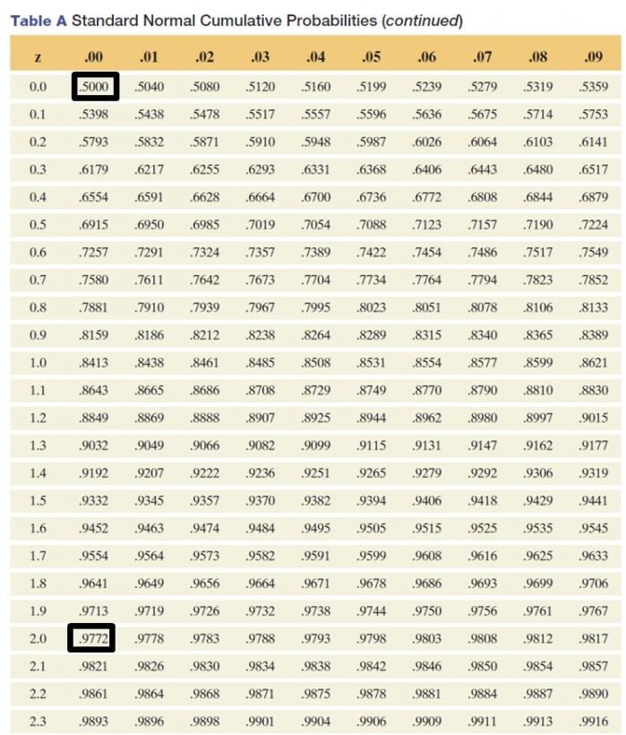

Slide 97
Crashing Technique

Slide 98
Crashing Example: Suppose the project manager wants to reduce the new product project 5 weeks.
Crashing Costs are considered to be linear
Look to crash activities on the critical path
Find least expensive activities on the critical path first (according to reduced cost per week, see Table
Then look 5 possible weeks to reduces according to Critical Path: ABDEGIJK
  Crash activity I from 3 weeks to 2 weeks (1 week reduced) $1000
  Crash activity J from 4 weeks to 2 weeks (2 week reduced) $2400
  Crash activity D from 6 weeks to 4 weeks (2 week reduced) $4000
  Recommend Crash Cost $7400

Slide 99
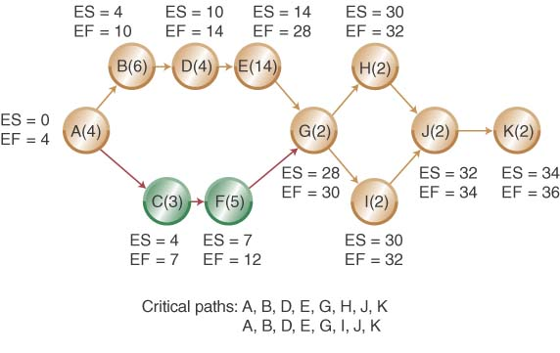
Crashed Network Diagram
Question: Will crashing 5 weeks return more in benefits than it costs?

Slide 100
Activity | Normal Time (wk) | Normal Cost ($) | Crash Time | Crash Cost ($) | Max. weeks of reduction | Reduce cost per week
A | 4 | 8,000 | 3 | 11,000 | 1 | 3,000
B | 6 | 30,000 | 5 | 35,000 | 1 | 5,000
C | 3 | 6,000 | 3 | 6,000 | 0 | 0
D | 6 | 24,000 | 4 | 28,000 | 2 | 2,000
E | 14 | 60,000 | 12 | 72,000 | 2 | 6,000
F | 5 | 5,000 | 4 | 6,500 | 1 | 1500
G | 2 | 6,000 | 2 | 6,000 | 0 | 0
H | 2 | 4,000 | 2 | 4,000 | 0 | 0
I | 3 | 4,000 | 2 | 5,000 | 1 | 1,000
J | 4 | 4,000 | 2 | 6,400 | 2 | 1,200
K | 2 | 5,000 | 2 | 5,000 | 0 | 0
TOTALS | 51 | 156,000 | 41 | 184.900 | 10 weeks
Project Normal Cost= $ 156,000 (normal cost)
Reduce 5 weeks from D(2 weeks), J(2 weeks), I(1 week)) 5 WEEKS
Project Reduced Time – New Cost= $8,000+ $30,000+$6,000+$ 28,000+$ 60,000+ $5,000+ $6,000+ $4,000+$5,000+$6,400+$5,000= $163.400 (crash cost DIJ)

Slide 101
Study & Watch This Video
https://www.youtube.com/watch?v=BjOLdukjAck

Slide 102
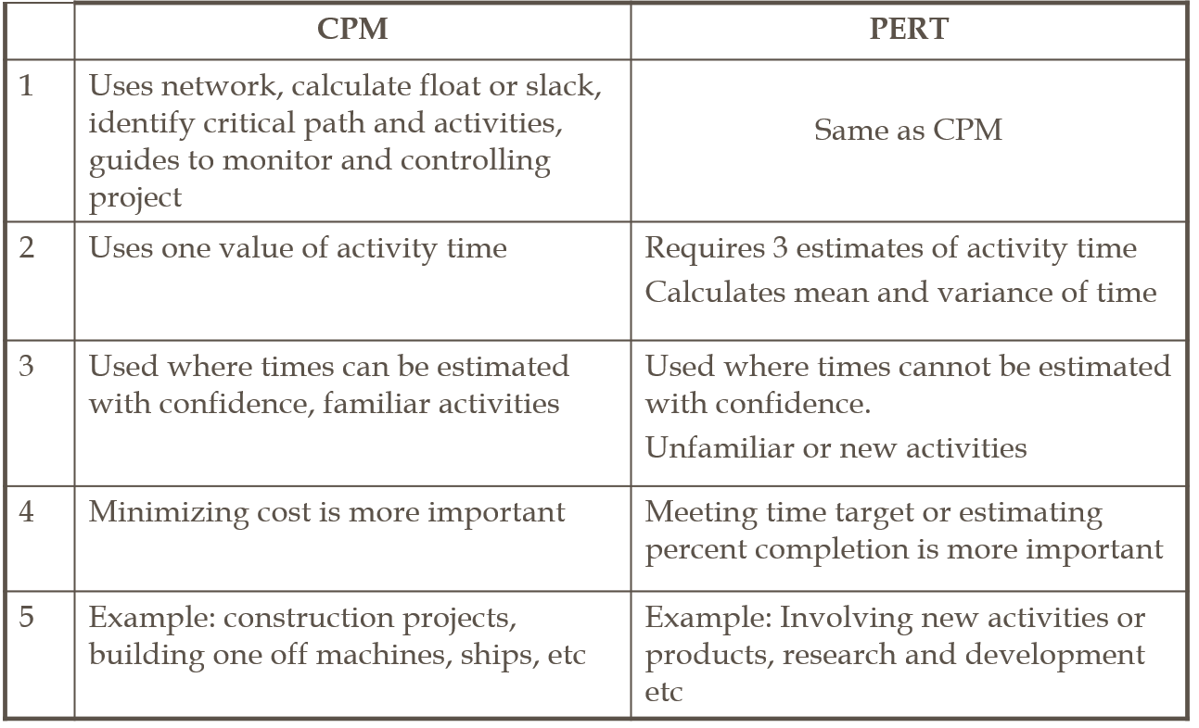
Comparison Between CPM and PERT

