Slide 1
Software Development Processes
Software Development Life Cycle Models

Slide 2
Topics covered
Software process models (Ch 2)
Process activities (Ch 2.1)
Coping with change (Ch 2.1)
Process improvement (Ch 2.1)

Slide 3
The software process
A structured set of activities required to develop a software system.
SOFTWARE ENGINEERS’ Activities:
Specification – defining what the system should do;
Design and implementation – defining the organization of the system and implementing the system;
Validation – checking that it does what the customer wants;
Evolution – changing the system in response to changing customer needs.
A software process model is an abstract representation of a process.
Note: It presents a description of a process from some particular perspective.

Slide 4
Software process descriptions
When we describe processes;
  we usually talk about the activities in these processes such as specifying a data model, designing a user interface, etc. and also the ordering of these activities.
Process descriptions may also include:
  Products: which are the outcomes of a process activity;
  Roles: which reflect the responsibilities of the people involved in the process;
  Pre- and post-conditions: which are statements that are true before and after a process activity has been passed or a product produced.
Process
Pre/post
conditions
products
roles
activities

Slide 5
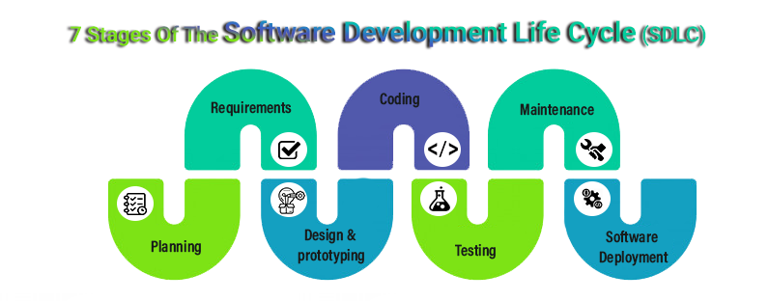
SDLC STAGES
Specification
Implementation
Evolution
2
4
6
1
3
5
7
Design
Validation

Slide 6
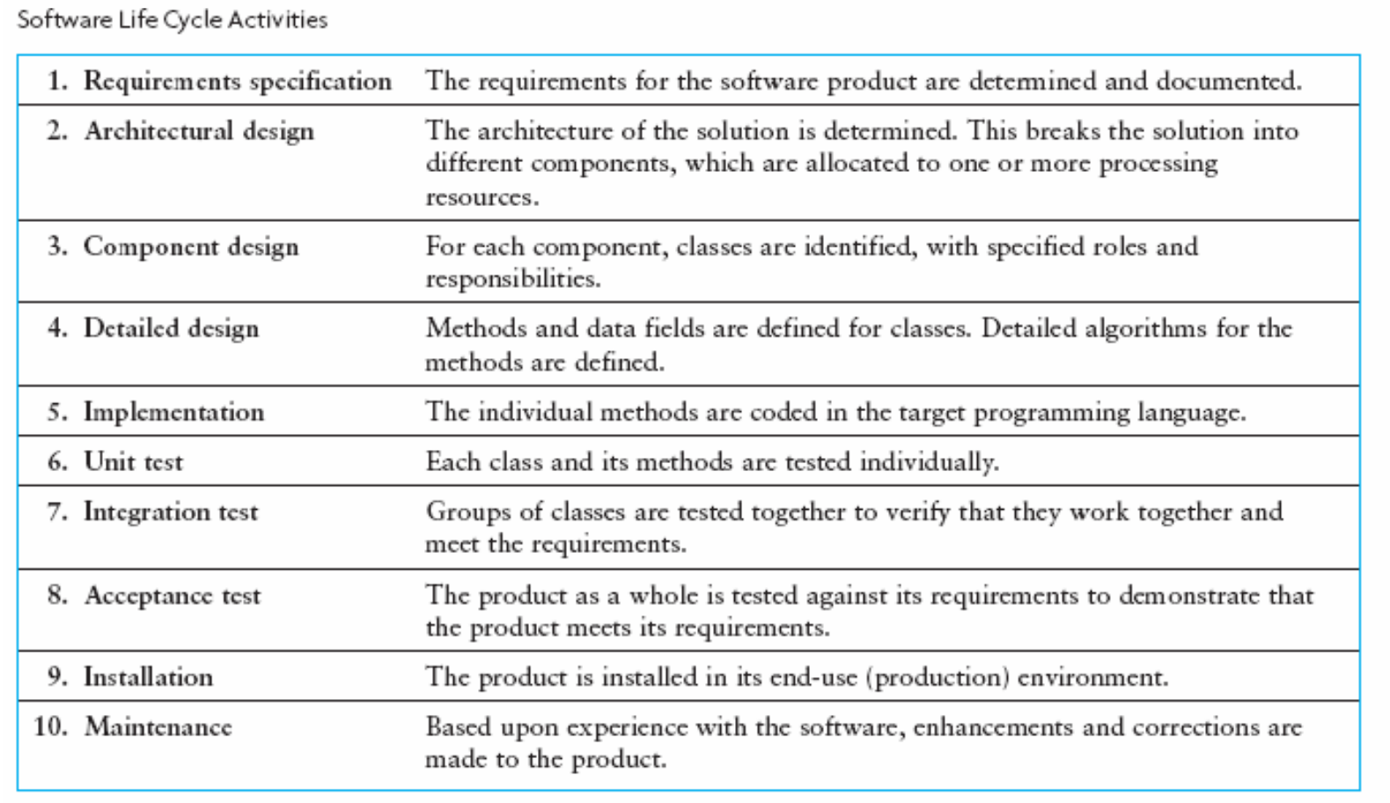
SDLC: is a framework that describes the activities performed at each stage of a software development.
Requirements
All Modules
Classes of each Module
All Methods & Obj
Coding
Test Classes & Methods
Test Modules
Test Product for Requirements
Installation
Corrections /Improvements

Slide 7
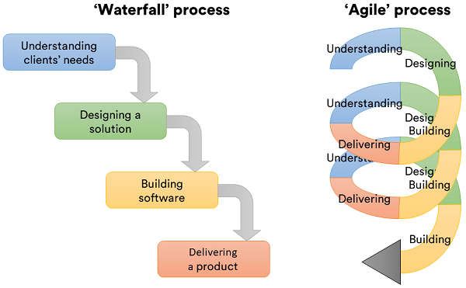
Plan-driven and agile processes
Plan-driven processes (WATERFALL)→ all of the process activities are planned in advance and progress is measured against this plan.
In Agile processes (INCREMENTAL), planning is incremental and it is easier to change the process to reflect changing customer requirements.
In practice, most practical processes include elements of both plan-driven and agile approaches.
There are no right or wrong software process model.

Slide 8
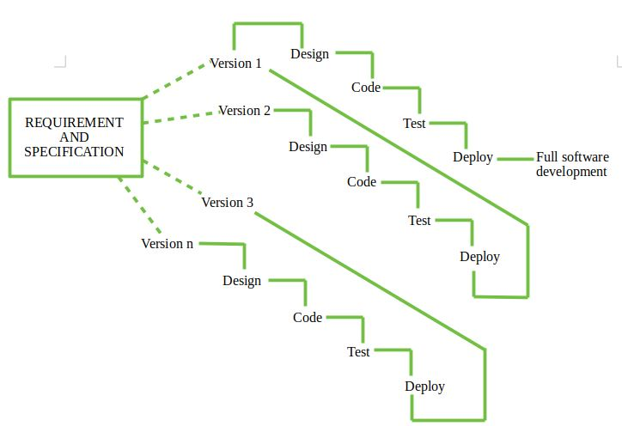
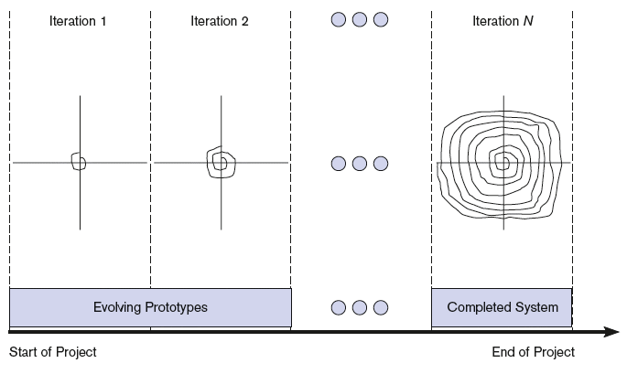
INCREMENTAL DEVELOPMENT: Each iteration will involve a combination of analysis, design, coding, and testing.
Ver 1
Ver 2
Ver N
FIGURE. The system evolves incrementally over the life of the project.
Notes:
Each iteration will involve a combination of analysis, design, coding, and testing.

Slide 9
Software process models
1-Planning, 2- Analysing, 3- Design, 4-Imp&Test,5-Maintanance
The Plan-driven model
  Plan-driven model. Separate and distinct phases of specification and development.
Incremental development
  Specification, development and validation are interleaved/work together.
  May be plan-driven or agile.
Integration and configuration (birleştir ve yapılandır)
  The system is collected from existing configurable components. May be plan-driven or agile.
In practice, most large systems are developed using a SDLC model that includes elements from all of these models.

Slide 10
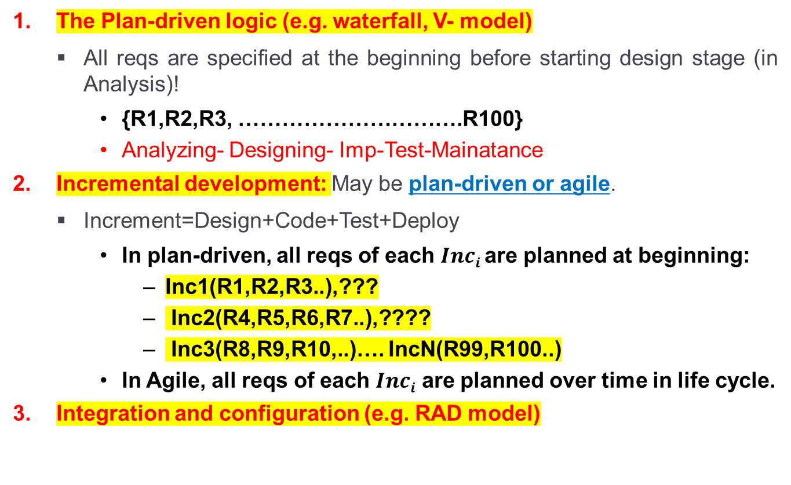
EXAMPLES
The Plan-driven logic (e.g. waterfall, V- model)
  All reqs are specified at the beginning before starting design stage (in Analysis)!
    {R1,R2,R3, ………………………….R100}
    Analyzing- Designing- Imp-Test-Mainatance
Incremental development: May be plan-driven or agile.
  Increment=Design+Code+Test+Deploy
    In plan-driven, all reqs of each $Inci$ are planned at beginning:
      Inc1(R1,R2,R3..),???
      Inc2(R4,R5,R6,R7..),????
      Inc3(R8,R9,R10,..)…. IncN(R99,R100..)
    In Agile, all reqs of each $Inci$ are planned over time in life cycle.
Integration and configuration (e.g. RAD model)

Slide 11
SDLC Models

Slide 12
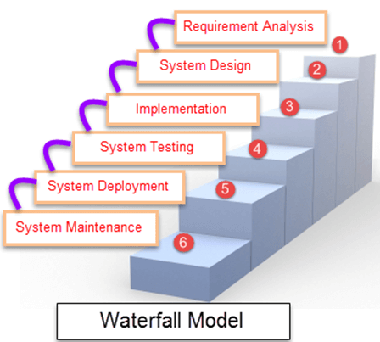
1. Waterfall Model (is a Plan-driven model)
There are separated identified phases in the waterfall model:
  Requirements analysis and definition
  System and software design
  Implementation and unit testing
  Integration and system testing
  System Operation /Deployment
  Maintenance
https://www.youtube.com/watch?v=5A5XCuWMG4o

Slide 13
Waterfall model phases
There phases in the waterfall model:
  Requirements analysis and definition
  System and software design
  Implementation and unit testing
  Integration and system testing
  System Operation /Deployment
  Maintenance
In principle, the activities of a phase to be completed then you can initiate the next phase.
So, the main drawback of the waterfall model is the difficulty of accepting changes after the process is underway.

Slide 14
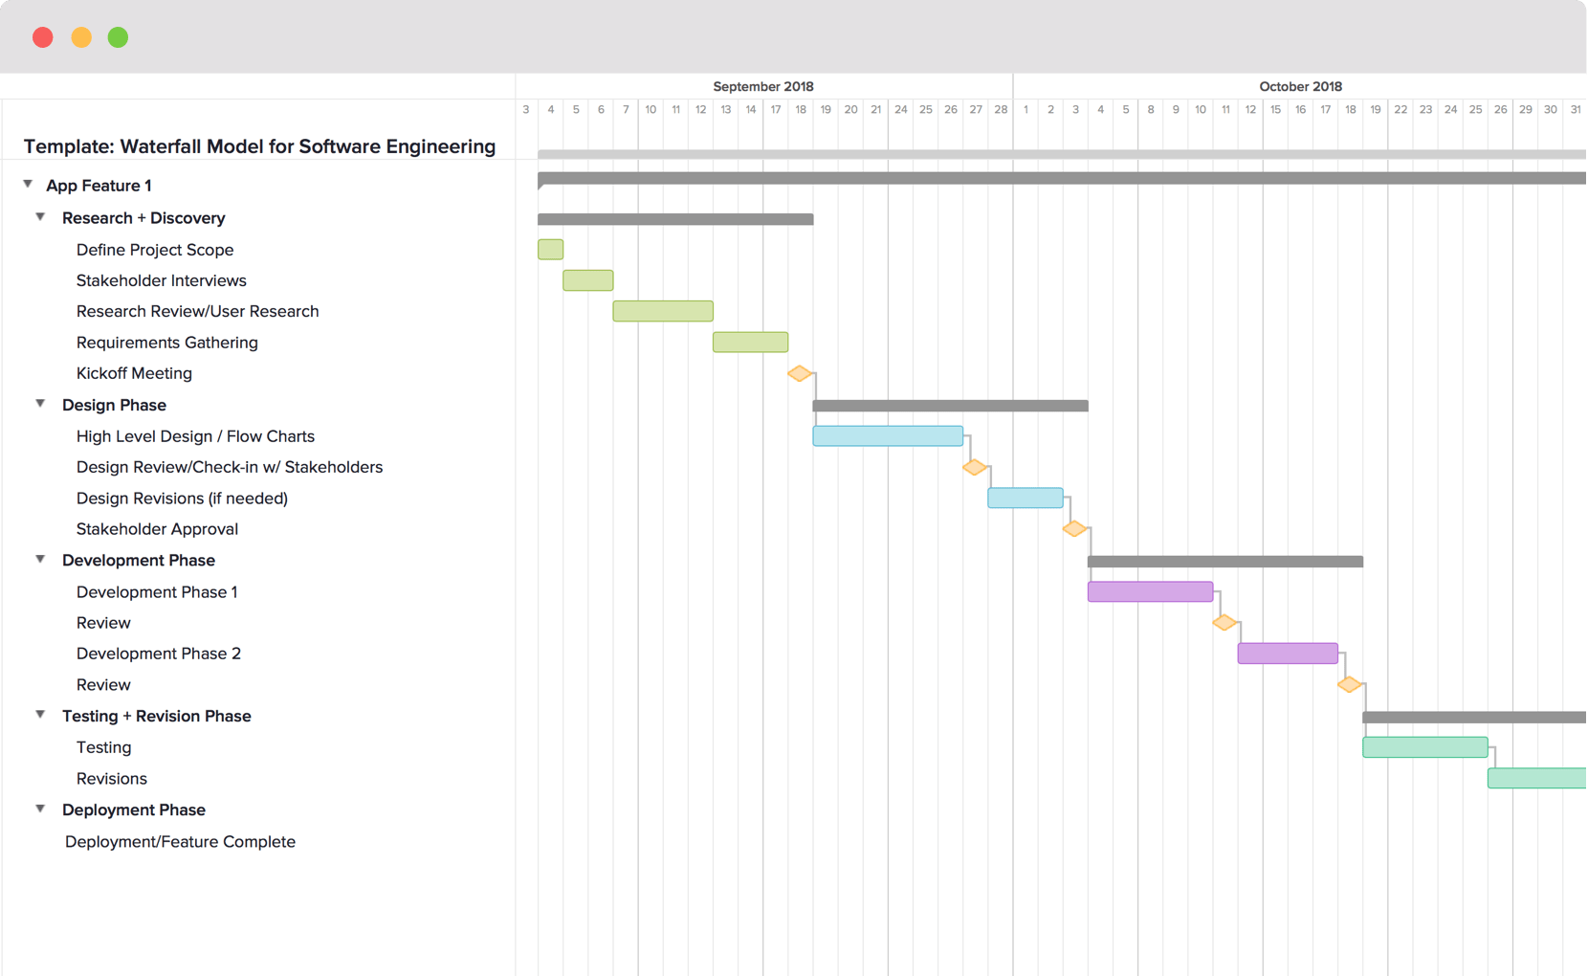
Processes on Phases
Activities

Slide 15
Advantages/ Dis-Advantages
Advantages | Dis-Advantages
Easy to understand, easy to use. Good for management control (plan, staff, track).
Before the next phase of development, each phase must be completed | Error can be fixed only during the phase
Suited for smaller projects where requirements are well defined | It is not desirable for complex project where requirement changes frequently
Team should perform quality assurance test (Verification and Validation) before completing each stage | Testing period comes quite late in the developmental process
Detailed documentation is done at every phase | Documentation occupies a lot of time of developers and testers
Project is completely dependent on project team with minimum customer involvement | Customers’ feedbacks cannot be included during ongoing development phase
Any changes needed are made in development | Small changes or errors that arise in the completed software may cause a lot of problems
Milestones are well understood (in plan) | It is difficult to measure progress in stages. Can give a false impression about progress
Provides structure to inexperienced staff

Slide 16
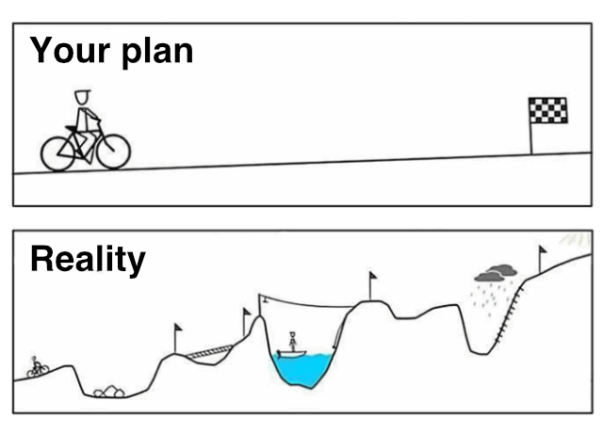
Major disadvantages of Waterfall model
Integration is done as a "big-bang. Little opportunity for customers to see their system before completion of it (may be too late to notice mistakes)
All requirements must be known clearly at beginning.

Slide 17
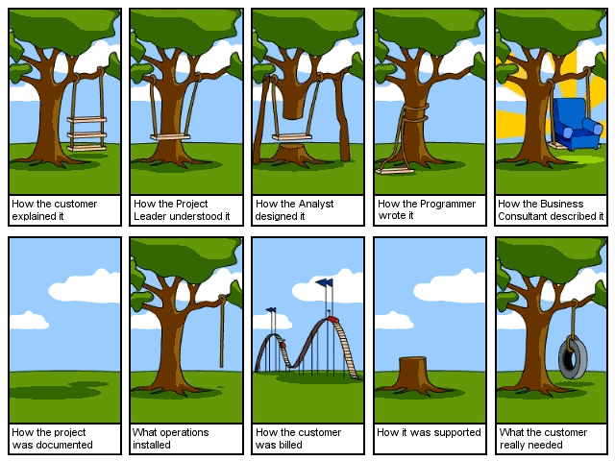
A swing design
Integration is one big bang at the end ☺

Slide 18
When to use the Waterfall Model
If your requirements are clear and fixed that may not change…not changing frequently.
If there are no unclear requirements (no confusion).
If application is not complicated and not big.
If the technology preffered/needed is well understood. Technology used are not dynamic and stable (e.g BLE 6.0).
If the project is short and you have small team.
If risk is zero or minimum.

Slide 19
2. Incremental development

Slide 20
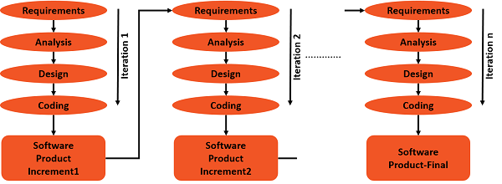
Incremental development structure
https://www.youtube.com/watch?v=gcpOZi6Hz38

Slide 21
Incremental development benefits
Changing of customer requirements is possible!
The cost of the requirement changes is reduced.
The amount of analysis and documentation for this model is much less than the waterfall model.
It is easier to get customer feedbacks during the development work.
  Customers can comment on demonstrations of the software and can see how much has been implemented. (that increases customer's trust to our company.)
More rapid delivery and deployment of useful software to the customer is possible.
  Customers are able to use their SW and gain value of it earlier
  In waterfall, delivery of SW to customers is more late.

Slide 22
Incremental development problems
The development process is not visible.
  Managers need regular deliverables to measure progress.
  If systems are developed quickly, it is not effective to produce documents.
  Because, the documents are need to understand the functionalities of each version of the system.
As the new increments are come up, your system structure may degrade/corrupt!!!
  Continuous changes can cause to corrupt the system’s structure.
  Adding more changes becomes increasingly difficult and costly.

Slide 23
3. Integration and configuration
Based on software reuse where systems are integrated from existing components or application systems (sometimes called COTS -Commercial-off-the-shelf systems).
Code reuse, also called software reuse, is the use of existing software, or software knowledge, to build new software.
Reused elements may be arranged to adapt their behaviour and functionality to satisfy a user’s requirements.
Reuse is now the standard approach for building many types of business system.
Notes:
Commercial Of The Shelve (COTS) software is software that is available from suppliers and distributed to many users.
The opposite of COTS software is customer made software.

Slide 24
Types of reusable software
Stand-alone application systems (sometimes called COTS) that are configured for use in a particular environment.
Collections of objects that are developed as a package to be integrated with a component framework such as .NET or J2EE.
Web services that are developed according to service standards and which are available for remote invocation.

Slide 25
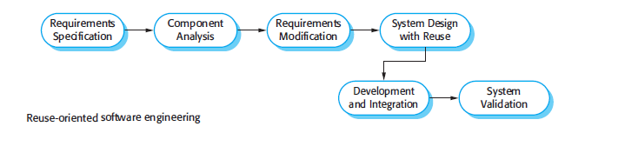
Reuse-oriented software engineering
Stand-alone App.
Suitable
Reusing
Component codes:
objects, services etc.
Code reuse, also called software reuse, is the use of existing software, or software knowledge, to build new software.

Slide 26
Key process stages
Requirements specification
Software (Reusable Application/Components) discovery and evaluation
Customer requirements refinement/modification according to (Reusable Application/Components)
Application system configuration
Component adaptation and integration

Slide 27
Advantages and disadvantages
Reduced costs and risks as less software is developed from scratch
Faster delivery and deployment of system
But give up from some requirements are inevitable
Therefore, the final system may not meet real needs of users
Loss of control over evolution of reused system elements (note: you may not able to modify or change the compnents)

Slide 28
OTHER SDLC MODELS

Slide 29
V-Shaped SDLC Model

Slide 30
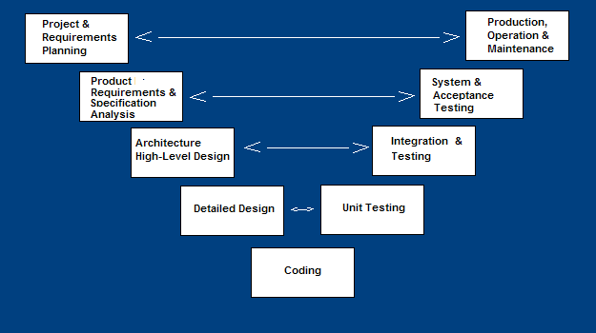
V-Shaped SDLC Model
It is plan-driven
A modified of the Waterfall model
Highly disciplined SDLC model
Highlights the verification and validation of the product.
Testing of the product is planned in parallel with a corresponding phase of development.

Slide 31
V-Shaped Steps
Project and Requirements Planning – allocate resources
Product Requirements and Specification Analysis – complete specification of the software system
Architecture or High-Level Design – defines how software functions fulfill the design
Detailed Design – develop algorithms for each architectural component
Production, operation and maintenance – provide for enhancement and corrections
System and acceptance testing – check the entire software system in its environment (client environment)
Integration and Testing – check that modules interconnect correctly
Unit testing – check that each module acts as expected
Coding – transform algorithms into software

Slide 32
V-Shaped Steps
https://www.youtube.com/watch?v=7no8_bzzaQc
Allocate
resources
Enhancements
&
Corrections
Test Product acc to Cust. Reqs.
SRS
SDLC
STLC
Test Plans/Test Modules
Design All Modules
Test Plans / Test Classes & Methods
All Class & Methods & Obj
Notes:
The left side of the model is Software Development Life Cycle – SDLC
The right side of the model is Software Test Life Cycle – STLC
The entire figure looks like a V, hence the name V – model

Slide 33
Testing phases in a plan-driven software process (V-model/Waterfall)
1
2
3
4
Coding
+
1-2
2-3
3-4
9
8
7
6
5
Seven Testing Principles: https://www.youtube.com/watch?v=rFaWOw8bIMM
How to write a Test Case: https://www.youtube.com/watch?v=BBmA5Qp6Ghk
Unit Testing Example: https://www.youtube.com/watch?v=lj5nnGa_DIw
Integration Testing Example: https://www.youtube.com/watch?v=QYCaaNz8emY
System Testing & Acceptance Testing: https://www.youtube.com/watch?v=N8-qNMHOVyw
Top 5 Software Testing Interview Questions: https://www.youtube.com/watch?v=Vb0_bY1tHfQ

Slide 34
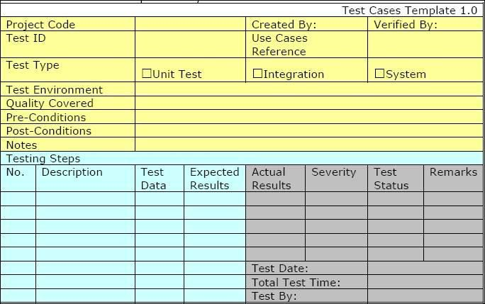
Example-1

Slide 35
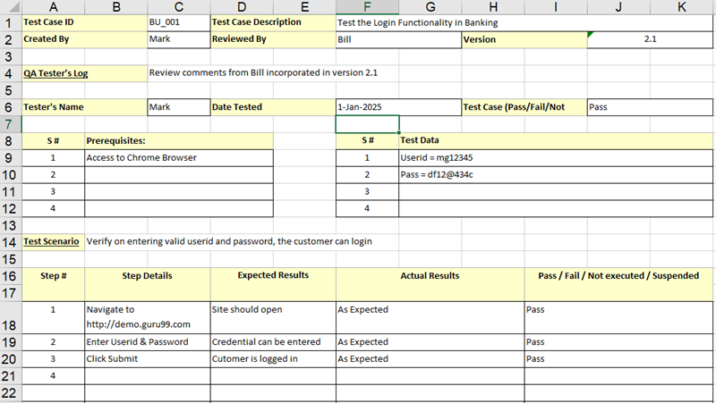
Example-2

Slide 36
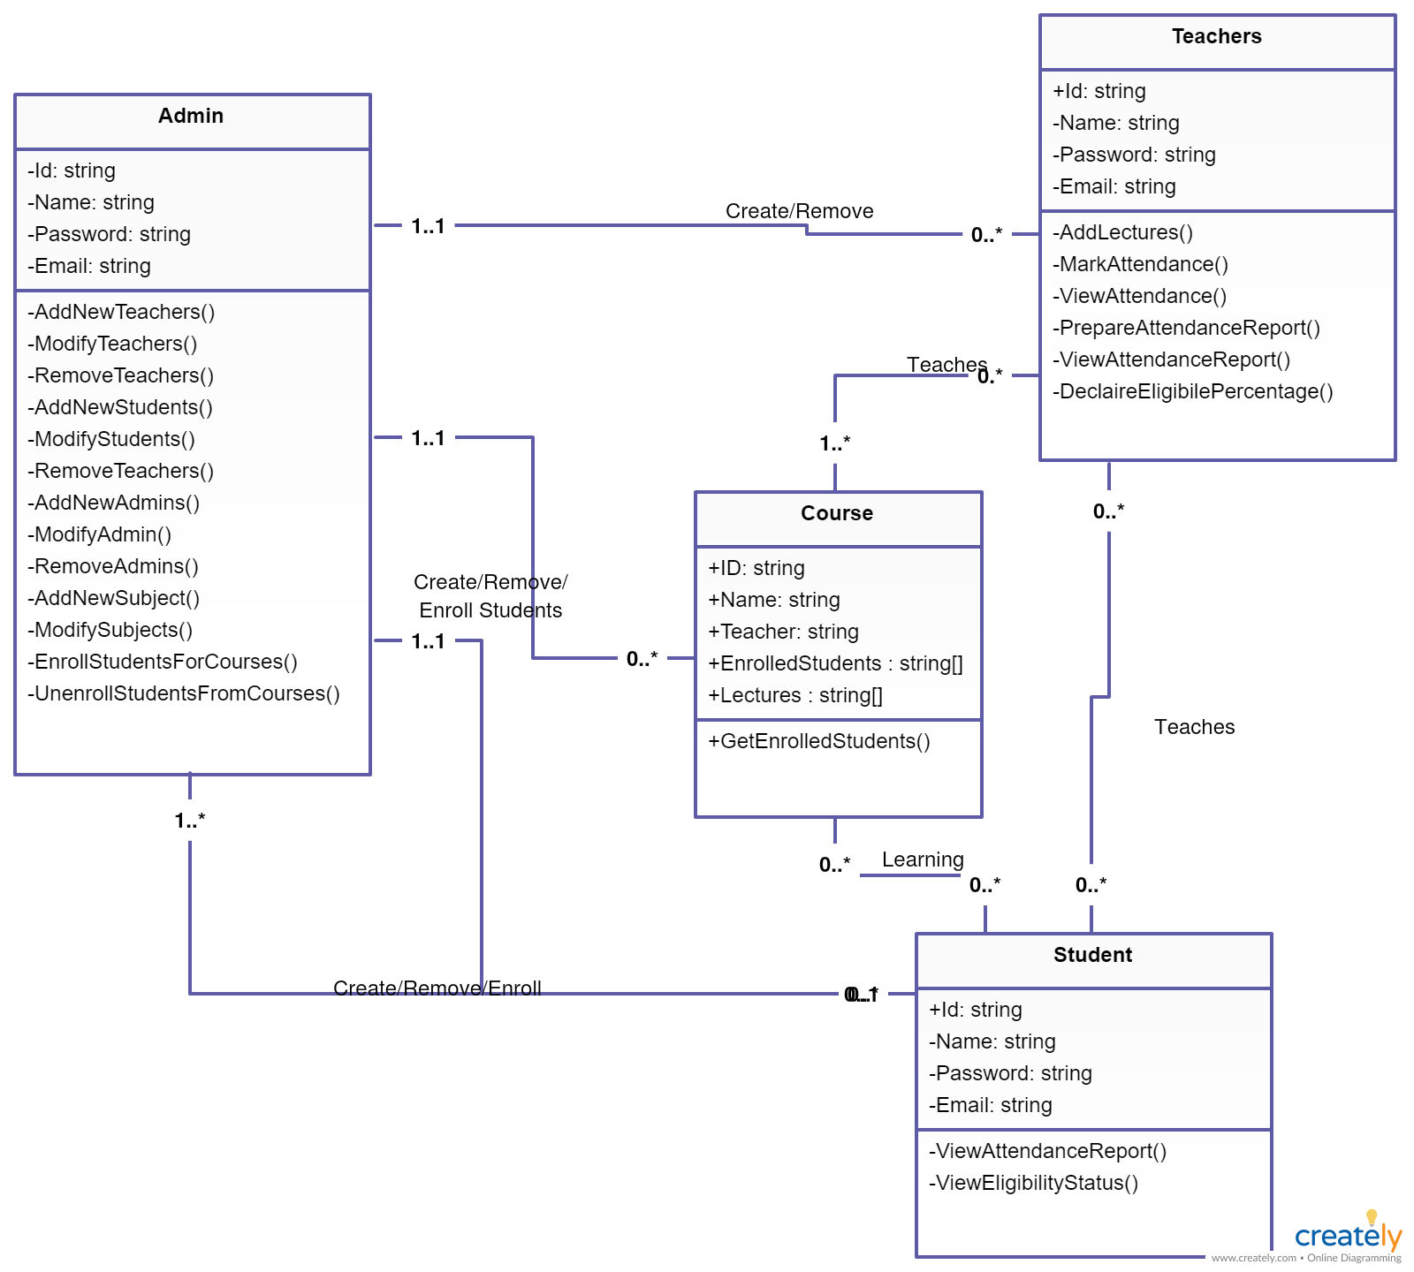
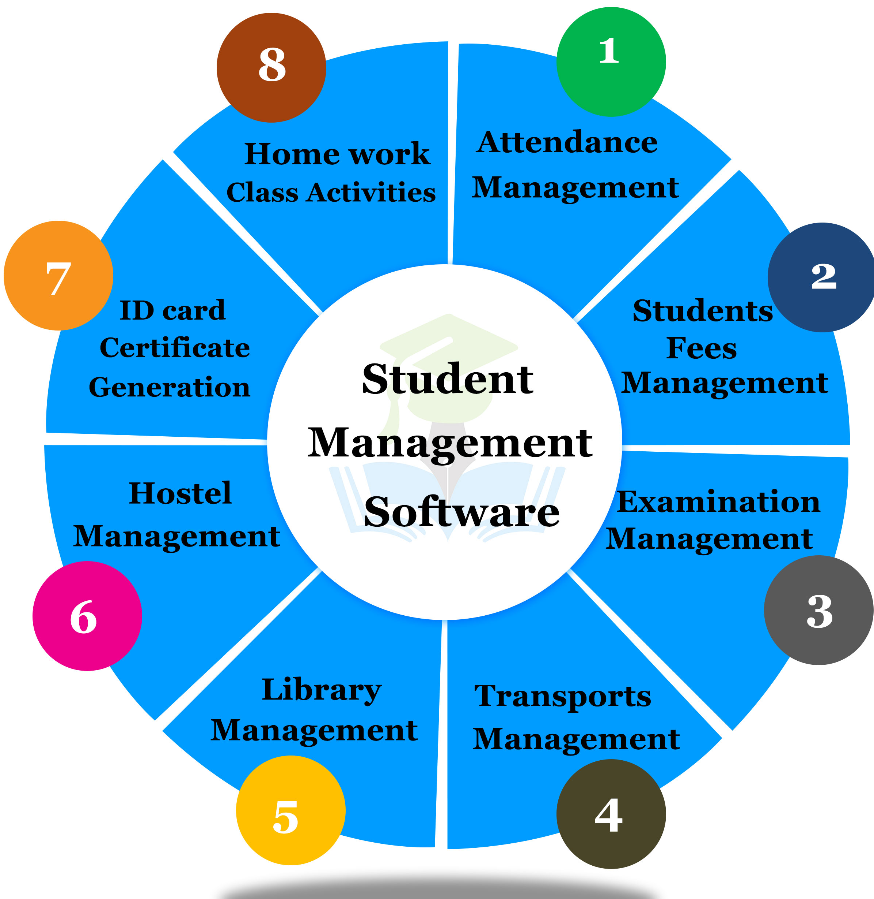
Student Management System:
Modules and their classes
Module 1 Classes

Slide 37
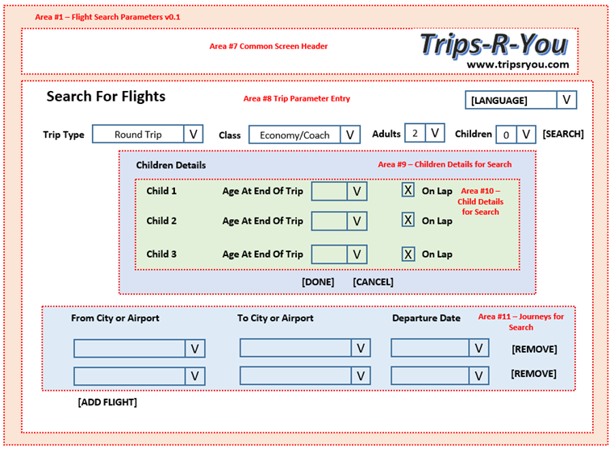
CUSTOMER APPROVAL:
User acceptance test plan is created from our customer requirements on Flight Search process

Slide 38
V-Shaped Strengths
Test planning for verification and validation of the product is done in early stages of product development (for quality control steps)
Why testing is important?
  Each deliverable must be testable→ to increase SW quality
Project manager can monitor progress by milestones…
Easy to use
If high reliability products are needed and expected, this model is good. Because many tests are performed…

Slide 39
V-Shaped Weaknesses
Does not easily handle concurrent events/tasks, because all tasks are created plan-driven for this model…
Does not good for iterations or phases
Does not easily apply when requirement changes needed (diffucult to change plans in any time!!!)
Does not contain risk analysis activities.

Slide 40
When to use the V-Shaped Model
Excellent choice for systems requiring high reliability – i.e. hospital patient control applications
If all requirements are known clearly, it is good.
If solution and technology are known well, it is good.

Slide 41
Rapid Application Development Model (RAD)

Slide 42
Rapid Application Development Model (RAD) https://www.youtube.com/watch?v=Iuuj-GgJtXU&spfreload=10
Requirements planning phase (a workshop is organized for understanding available business problems)
User description phase – automated tools used to collect information from end users
Construction phase – productivity tools, such as code generators, screen generators, etc. inside a time-box. (“Do until done”)
Cutover phase -- involves installation of the system, user acceptance testing and user training
https://www.youtube.com/watch?v=X6QzyHiSPf0
https://www.youtube.com/watch?v=gPgsKLtwJ68&spfreload=10
https://www.youtube.com/watch?v=BoQzy_N7U2w
Notes:
Cutover phase: a rapid transition from one phase of a project to another.

Slide 43
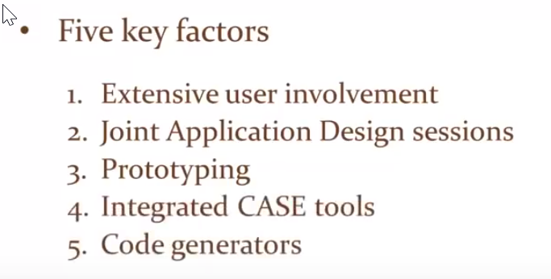
Rapid Application Development Model (RAD) have 5 key factors:

Slide 44
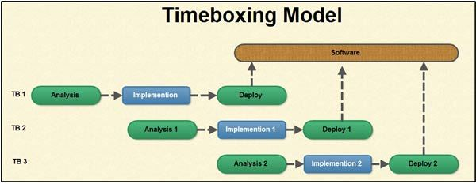
RAD Strengths
In this model, production cycle time is reduced and
productivity improved with fewer people → means lower labor costs!
Time-box approach (2 months time intervals) is used that will be useful for cost and schedule risk of the project.
Customer involved entire the development cycle to minimize the risks of not achieving customer satisfaction and completing business needs.
Focus moves from documentation to code.

Slide 45
RAD Weaknesses
Accelerated development process –We must give quick responses to our customers
There is a risk to reach an end???
Products generated are hard to use with legacy (older/existing) systems
Requires that the planned system can be modularized
Developers and customers must be dedicated to rapid-fire activities in an shortened time frame.

Slide 46
Spiral Model

Slide 47
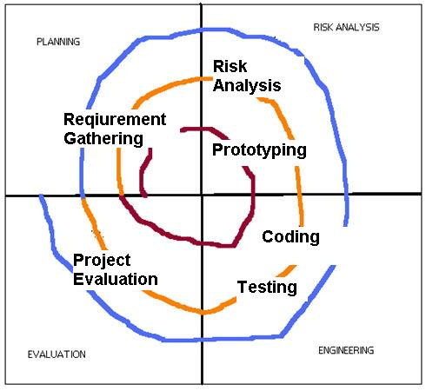
Spiral SDLC Model
Adds risk analysis, and
4GL RAD prototyping
Each cycle involves the same sequence of steps as the waterfall process model.
Planning & Setting Objectives/doing Risk Analysis & Prototyping / SE Steps / Evaluation
https://www.youtube.com/watch?v=mp22SDTnsQQ

Slide 48
Spiral Model Strengths
Provides to see the sign of possible risks early, without much cost
Customer see the product early because of rapid prototyping tools
High-risky or critical functions of customer are developed first
The design does not have to be perfect
Customer can be closely tied to all lifecycle steps
Early and frequent feedbacks from customers (each cycle prototyping)
Cumulative costs can be assessed frequently

Slide 49
Spiral Model Weaknesses
Time spent to evaluate possible risks too large (especially for small or low-risk projects)
Time spent for planning, resetting objectives, doing risk analysis and prototyping may be extreme (may be unnecessary)
The model is complex
Risk assessment expertise is required
Spiral may continue indefinitely (when should we stop??)
Developers must be reassigned/moved during non-development phase activities (idle times for developers!)
May be hard to define objectives & demonstrable milestones that show willingness to continue through the next iteration

Slide 50
When to use Spiral Model
It is suitable for any type of SW project which requires a prototyping
When costs and risk evaluation is important (i.e.medical service program…)
Suitable for medium to high-risky projects
When our customers are not sure of their needs/requirements
If customer requirements are too complex
When new sector product (requirments are unknown yet) is needed
Important and various changes are expected (research and exploration)

Slide 51
Agile Model

Slide 52
Agile SDLC’s
Provides continuous iteration of development and testing throughout SDLC.
Usually, this methodology is less formal.
In the Agile model, both development and testing activities are concurrent, unlike the Waterfall model.
Suitable for “time-critical applications”
Used in organizations who uses disciplined methods
It encourages flexible responses to change.
https://www.youtube.com/watch?v=Z9QbYZh1YXY
https://www.youtube.com/watch?v=7nTxdl29ePY

Slide 53
Agile Development
(Kent Beck, 2001 et al.) → ‘Manifesto for Agile Software Development’
Main items in the Agile methodology:
Individuals and interactions over processes and tools
Working software over comprehensive documentation
Customer collaboration over contract negotiation
Responding to customer changes over following a project plan

Slide 54
Agile Development encourages:
Customer satisfaction…
Early incremental delivery of software (produce as versions of product),
Small, BUT highly motivate project teams,
Informal methods in customer relations,
Minimal SE work products (e.g. less documentation),
Overall development simplicity
Provides active and continues communication between the customer and the developers (design team involves customer representatives)

Slide 55
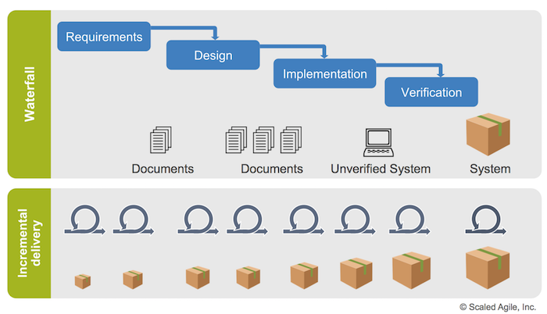

Slide 56
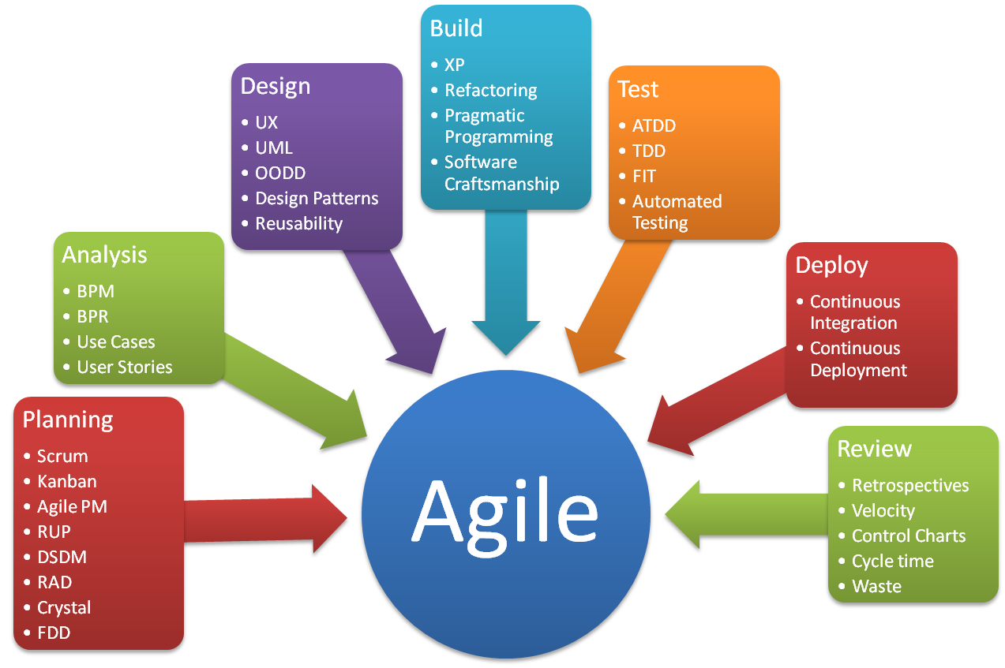

Slide 57
Some Agile Methods/Techniques
Adaptive Software Development (ASD)
Feature Driven Development (FDD)
Crystal Clear
Dynamic Software Development Method (DSDM)
Scrum (home work!)
Extreme Programming (XP) (home work!)
Rational Unify Process (RUP) (home work!)

Slide 58
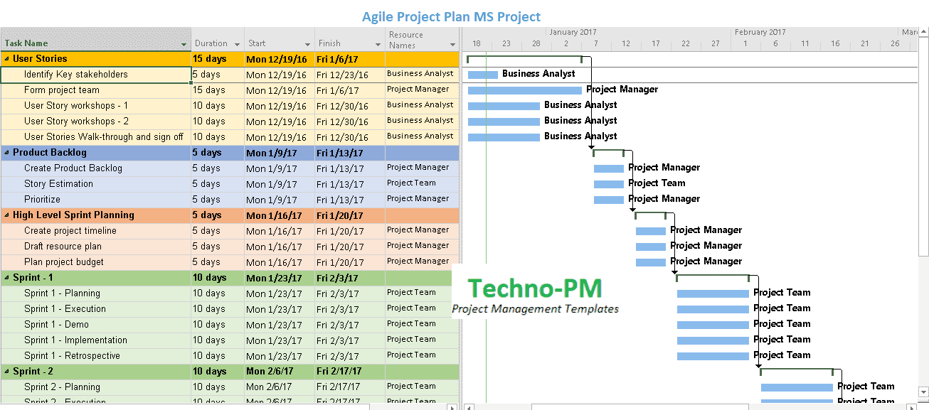
The Agile Project Management Process
Sprints…Shorter Development Cycles. 1 to 3 weeks..
More Frequent Product Releases Than Traditional Waterfall PM.
This shorter time frame enables project teams to react to changes in the client’s needs more effectively.

Slide 59
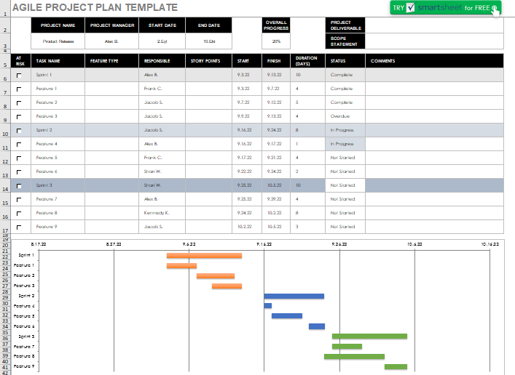
Agile project management with Scrum
Like other Agile methodologies, Scrum relies on sprints.
Sprints can be periods of 1 to 3 weeks in which the team aims to complete a small set of work items.
An agile project plan is based on features…
The plan estimates how long it will take for each feature to be delivered.
You can group similar features into sprints, due to the project plans are focused on features.
An agile project plan is always changing.

Slide 60
Topics covered
Software process models
SW DEVELOPMENT Process activities (Ch 2.1)
Coping with change (Ch 2.1)
Process improvement (Ch 2.1)

Slide 61
Key points
Software processes are the activities involved in producing a software system. Software process models are abstract representations of these processes.
General process models describe the organization of software processes.
  Examples of these general models include the ‘waterfall’ model, incremental development, and reuse-oriented development.
Requirements engineering is the process of developing a software specification.

Slide 62
Key points
Design and implementation processes are concerned with transforming a requirements specification into an executable software system.
Software validation is the process of checking that the system conforms to its specification and that it meets the real needs of the users of the system.
Software evolution takes place when you change existing software systems to meet new requirements. The software must evolve to remain useful.
Processes should include activities such as prototyping and incremental delivery to cope with change.

Slide 63
Key points
Processes may be structured for iterative development and delivery so that changes may be made without disrupting the system as a whole.
The principal approaches to process improvement are agile approaches, geared to reducing process overheads, and maturity-based approaches based on better process management and the use of good software engineering practice.
The SEI process maturity framework identifies maturity levels that essentially correspond to the use of good software engineering practice.

