Slide 1
Chapter 3 – Requirements Engineering

Slide 2
Topics covered
Functional and non-functional requirements
Requirements engineering processes
  Requirements elicitation/discover
  Requirements specification
  Requirements validation
  Requirements change

Slide 3
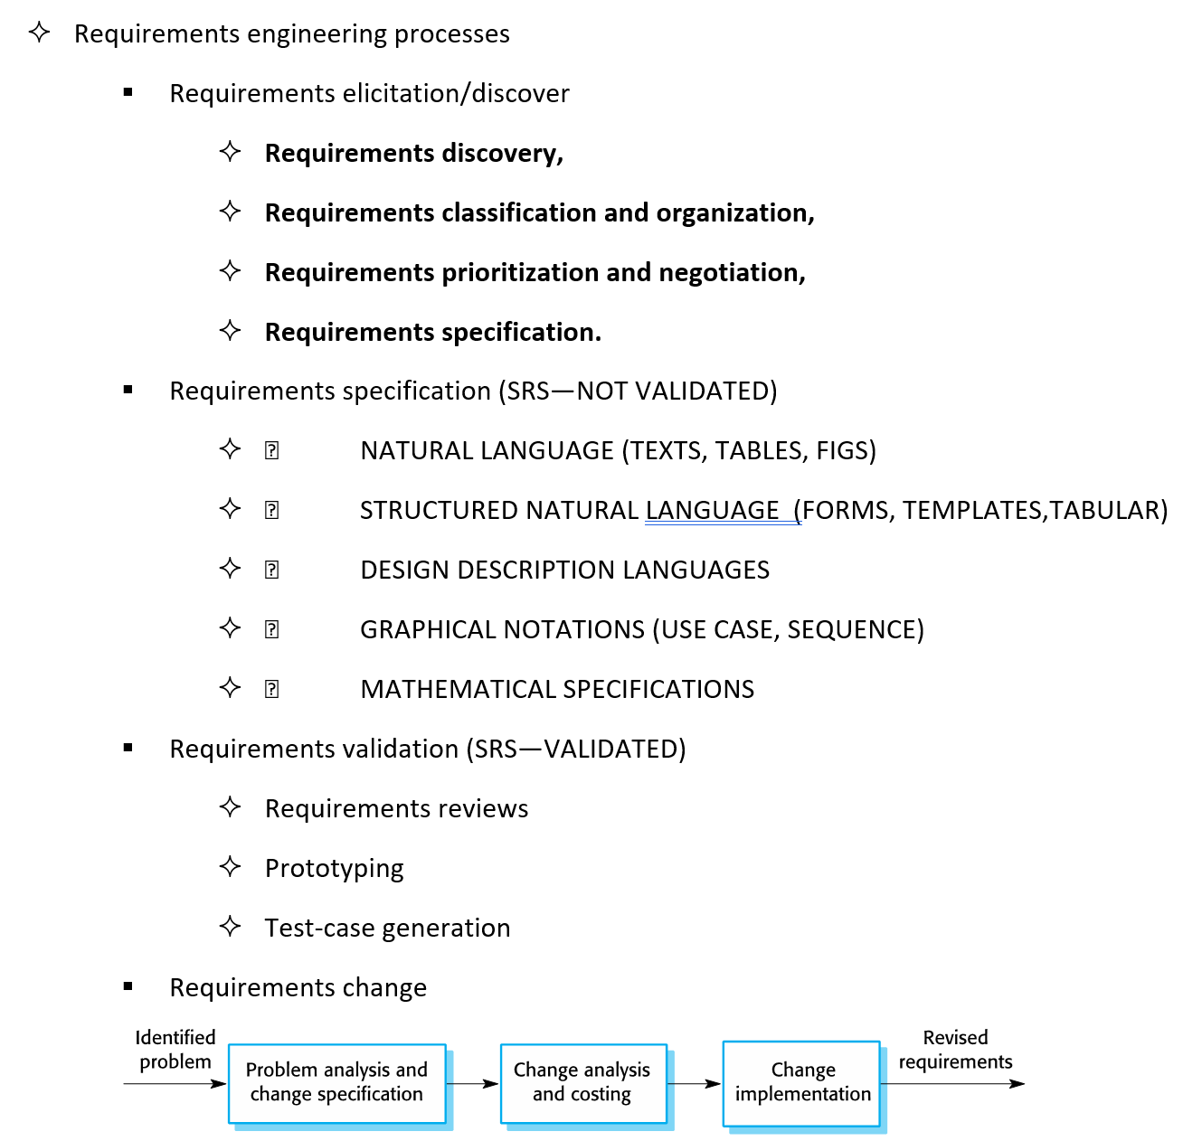
SUMMARY: REQUIREMENTS ENGINEERING PROCESSES

Slide 4
SECTION 1. FUNCTIONAL AND NON-FUNCTIONAL REQUIREMENTS

Slide 5
Requirements engineering
Requirements engineering (RE) discusses to:
  the process of defining, documenting and maintaining customer requirements in the engineering design process.
  It is a common role in systems engineering and software engineering.
The system requirements are → the descriptions of the system services (functions) and constraints that are generated during the RE process.

Slide 6
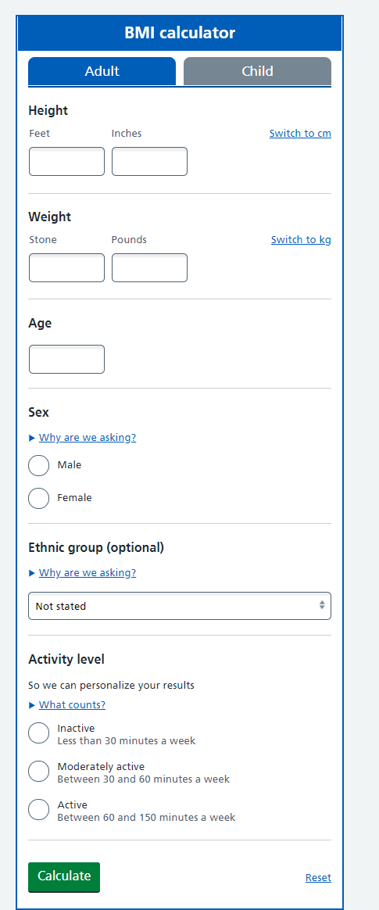
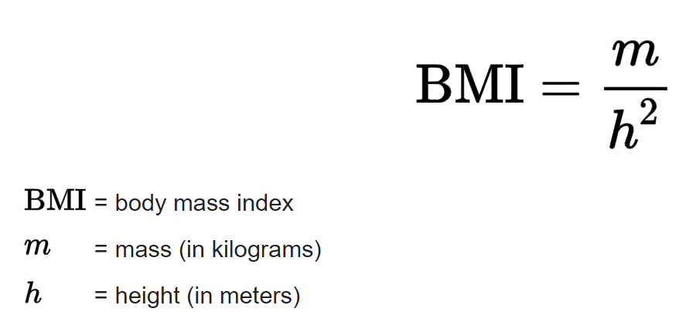
What is a requirement?
It may range from:
  a high-level abstract statement of a service (e.g. renting service) or,
  a high-level abstract statement of a system constraint (e.g. authorized people can see patient records) to,
  a detailed mathematical functional specification (e.g. BMI)
Requirements are basis of your contract.

Slide 7
Requirements abstraction (Davis)
“If a company wishes to let a contract for a big software project, it must define its requirements in an abstract way.
(1) Contracts can be written in different ways/in details for satisfying the customer organization’s requirements.
After a contract is taken by a software development company, the contractor (the soft company) must write a system functional details (system reqs) for their customer in more detail so that the customer understands and can validate what the software will do. → (2) SRS
Both of the documents may be called the requirement documents for the system.”

Slide 8
Types of requirement
User requirements
  Statements in natural language plus diagrams of the planned services and its operational constraints.
  Written for customers.
System requirements →SRS
  A structured document which involves detailed descriptions of the system’s functions, services and operational constraints.
  It defines what should be implemented in detail.
  System requirements document may be basis of the contract between the customer and software companies.
Notes:
• Kullanıcı gereksinimleri – Doğal dil ve diyagramlarla anlatılmış, sistemin ne yapacağını ve kısıtlarını anlatan ifadeler. Müşteriler için hazırlanır.
• Sistem gereksinimleri – Sistemin fonksinoyel detaylarını tanımlayan yapısal bir doküman. Müşteri ile yazılım firması arasındaki sözleşmeye konu olabilir.

Slide 9
Remember from CH 1
Mentcare: A patient information system for mental health care
A patient IS to support mental health care is a Medical Information System that preserves information about patients suffering from mental health problems and the treatments that they have received.
Most mental health patients do not require dedicated hospital treatment but need to attend specialist clinics regularly where they can meet a doctor who has detailed knowledge of their problems.
To make it easier for patients to attend, these clinics are not just run in hospitals.
They may also be held in local medical practices or community centres (toplum merkezleri,sağlık ocağı vb).

Slide 10
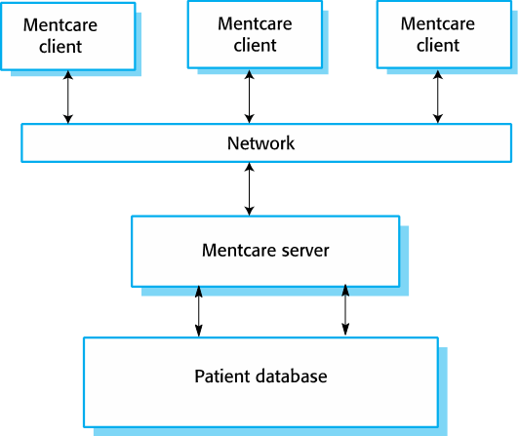
Remember from CH 1: Mentcare
Mentcare is an IS that is intended for use in clinics.
It makes use of a centralized database of patient information but has also been designed to run on a PC, so that it may be accessed and used from sites that do not have secure network connectivity.
When the local systems have secure network access, they use patient information in the database, but they can download and use local copies of patient records when they are disconnected.

Slide 11
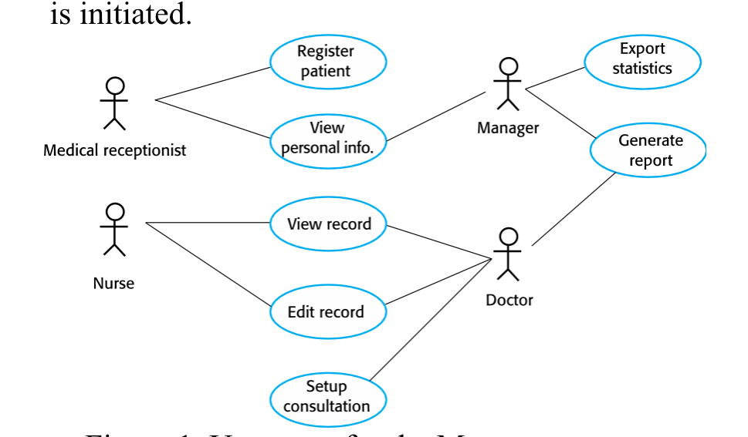
Example-MENTCARE SYSTEM

Slide 12
User and system requirements
1.Bir ay boyunca her klinik için, reçete ettikleri ilaçların toplam fiyatı gösteren raporu aylık üretebilmeli

Slide 13
User and system requirements
Generate Monthly Report
On the last working day of each month
After 17.30 on the last day of the month
Produced for each clinic with→
List of drug names
Total number of prescription
Number of doses
Total cost of the prescribed drugs
Different reports for different drug doses (10 mg,20mg, 30 mg)
Authorized users can access to management control lists
User
System Requirements (SRS)

Slide 14
Readers of different types of requirements specification
General
More Detail

Slide 15
System stakeholders
Stakeholder???
  Any person or organization who is affected by the planned system in some way and so who has a legitimate interest
Stakeholder types
  End users (who will use the produced SW product at the end)
  System managers
  System owners
  External stakeholders

Slide 16
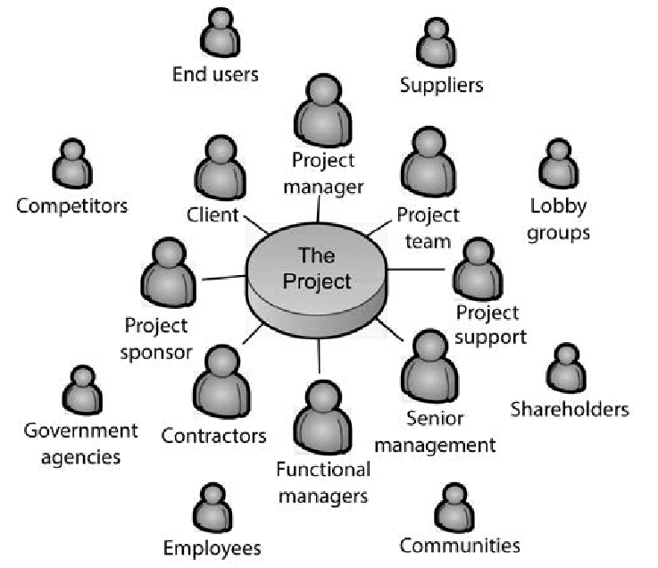
Stakeholders
Internal and External

Slide 17
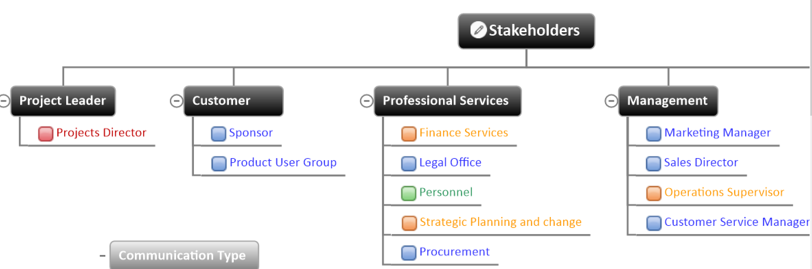
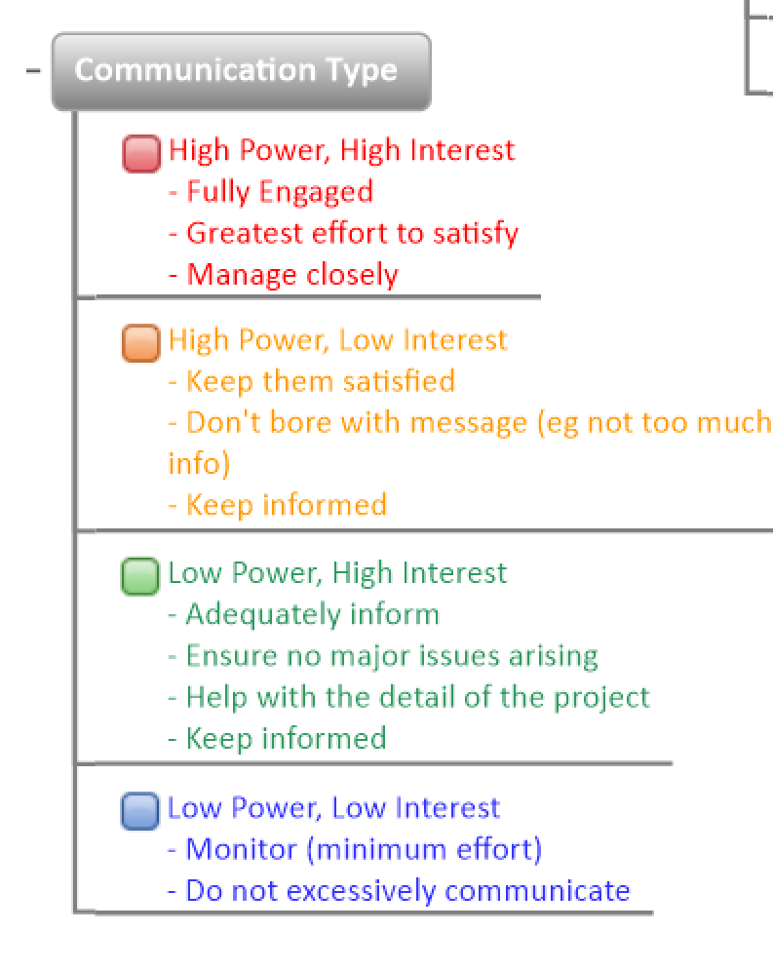
Stakeholders

Slide 18
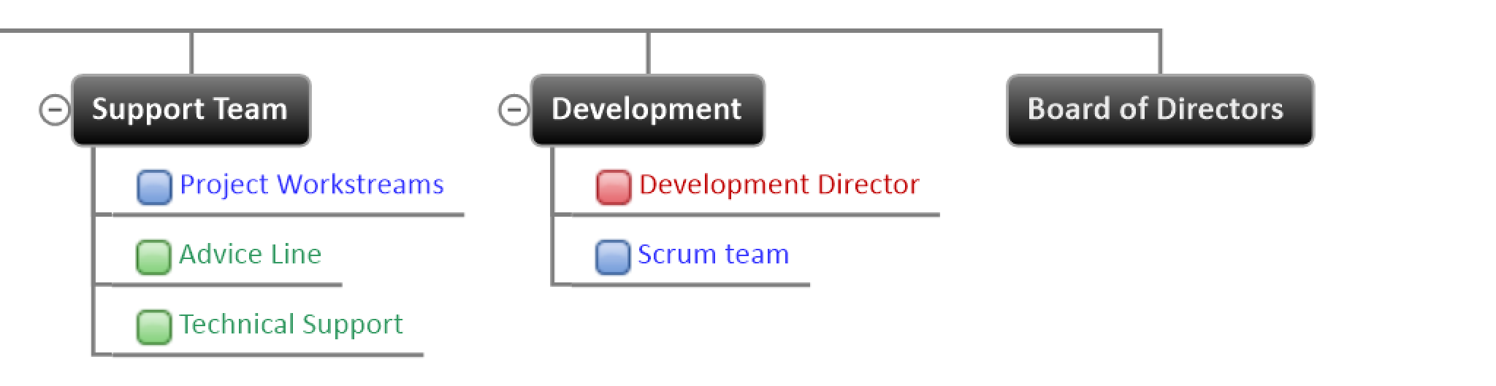
Stakeholders

Slide 19
Example: Stakeholders in the Mentcare system
Patients whose information is recorded in the system.
Doctors who are responsible for assessing and treating patients.
Nurses who coordinate the consultations with doctors and manage some treatments.
Medical receptionists who manage patients’ appointments.
IT staff who are responsible for installing and maintaining the system.
Medical Ethics Manager who must ensure that the system meets current ethical guidelines for patient care.
Health Care Managers who obtain hospital management information from the system (e.g. monthly profit, monthly loss, drugs monthly prescribed etc.)
Medical Records Staff who are responsible for keeping system information and ensuring to apply recording tasks properly.

Slide 20
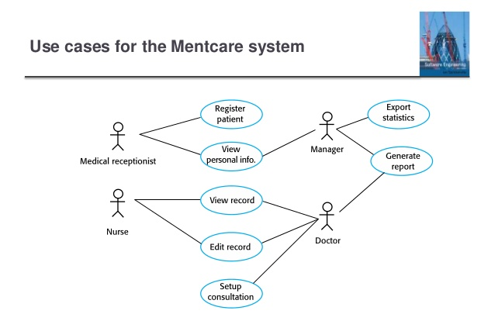

Slide 21
Agile methods and requirements
Many agile methods say that creating detailed system requirements is a waste of time as requirements change so quickly.
Requirements document is therefore always out of date.
Agile methods usually use incremental requirements engineering and may express requirements as ‘user stories’.
This is practical for business systems but problematic for the systems that require pre-delivery analysis (e.g. critical systems) or the systems developed by several teams.

Slide 22
Functional and non-functional requirements

Slide 23
Functional and non-functional requirements
Functional requirements
  FRs are the services expected by the system should provide,
  how the system should react to particular inputs and
  how the system should behave in particular situations.
  FRs may explain what the system should not do.
Non-functional requirements
  Constraints on the services or functions offered by the system such as timing constraints, constraints on the development process, standards, etc.
  NFRs often apply to the system as a whole rather than individual features or services.
Domain requirements (çalışacağı ortam/saha gereksinimleri)
  Constraints on the system from the domain of operation.
  Requirements for the environment in which the system will operate.

Slide 24
Functional requirements
Describe functionality or system services that the system should provide.
FDs depend on the type of software, expected end users and the type of system where the software is used.
Functional USER requirements may be high-level statements about what the system should do.
  These reqs. can be expressed in a more abstract simple language
Functional SYSTEM requirements should describe the system services in detail.
  These reqs. can be expressed in more detail and more technically.

Slide 25
Mentcare system: FRs examples
A user shall be able to search the appointments lists for all clinics.
The system shall generate each day, for each clinic, a list of patients who are expected to attend appointments that day.
Each staff member shall be uniquely identified by his or her 8-digit employee number.
Notes:
Bir kullanıcı bütün klinikler için randevu arayabilmeli
• Sistem, her bir klinik ve her gün için hangi hastanın randevu aldığını gösterebilmeli
• Her bir görevli, 8 basamaklı sicil numaraları ile sisteme giriş yapabilmeli

Slide 26
Requirements imprecision
Problems will arise when FRs are not exactly stated.
Unclear FRs may be understood in different ways by developers and end users.
Consider the term ‘search’ in FR 1→ “A user shall be able to search the appointment lists for all clinics” (Bir kullanıcı tüm klinikler için randevu listelerinde arama yapabilir)
  User intention – search for a particular patient name among all appointments in all clinics.
  Developer interpretation – search for a particular patient name in an individual clinic. User chooses first a clinic then search the name.
Notes:
Gereksinimlerdeki belirsizlik
• Düzgün ifade edilmeyen gereksinimler sorun yaratır
• Açık olmayan ifadeler kullanıcılar ve geliştiriciler tarafından farklı yorumlanabilir
• İlk gereksinimdeki «arama» ifadesi gibi
– Kullanıcı tarafı: bir hasta için bütün kliniklerdeki bütün randevuları ara
– Geliştirici tarafı: bir klinikteki bir hasta ismini ara. Sonra klinikleri seçerek arama yap

Slide 27
Requirements completeness and consistency
In principle, requirements should be both COMPLETE and CONSISTENT.
Complete
  FR descriptions should include ALL (user/system) abilities/facilities required.
Consistent
  There should not be conflicts/contradictions in the descriptions of the system facilities (in all FRs).
In practice, due to system & environmental complexity, it is impossible to produce a complete and consistent FRs document.
Notes:
Gereksinimlerin tamlığı ve tutarlılığı
• Prensipte gereksinimler tam ve tutarlı olmalı
• Tamlık – Gerekli olan herşeyi içermeli
• Tutarlılık – Gereksinimler arasında çelişki veya çatışma olmamalı
• Pratikte, tam ve tutarlı bir gereksinim dokümanı hazırlamak imkansız

Slide 28
Non-functional requirements
NFRs define SYSTEM PROPERTIES and CONSTRAINTS.
e.g.
  RELIABILITY,
  RESPONSE TIME,
  STORAGE REQUIREMENTS,etc.
Constraints are I/O device capability, system representations, etc.
Process requirements may force: a specific IDE, programming language, or development method
NFRs may be more critical than FRs.
If NFRs are not met customer needs, the system (its functional features) may be useless.
Notes:
Fonksiyonel olmayan gereksinimler
• Güvenilirlik, yanıt süresi, depolama alanı ihtiyacı gibi sistem özelliklerini tanımlar
• Süreç gereksinimleri belirli bir IDE, programlama dili veya geliştirme yöntemini zorlayabilir
• Fonksiyonel olmayan gereksinimler, fonksiyonel gereksinimlerden daha kritik olabilir. Karşılanmadıkları taktirde sistem kullanışsız hale gelebilir

Slide 29
Types of nonfunctional requirement

Slide 30
Non-functional requirements classifications
Product requirements
  Requirements which specify that the delivered product must behave in a particular way e.g. execution speed, reliability, etc.
Organisational requirements
  Requirements which are a consequence of organisational policies and procedures e.g. process standards used in the company, implementation requirements acc to customer company directives, etc.
External requirements
  Requirements which arise from factors that are external to the system and its development process e.g. interoperability requirements, legislative requirements, etc.
Notes:
Fonksiyonel olmayan gereksinimlerin sınıflandırılması
• Ürünün gereksinimleri – Hız, güvenilirlik vb.
• Organizasyonel gereksinimler – Standartlar, geliştirme detayları vb.
• Dış kaynaklı gereksinimler – Beraber çalışabilirlik, yasal düzenlemeler vb

Slide 31
Implementation of Non-functional requirements
NFRs may effect the overall architecture of a system rather than the individual components.
  e.g. for getting a good system performance, you may have to organize the system to minimize communications among components.
Notes:
Fonksiyonel olmayan gereksinimleri hayata geçirme
• Fonksiyonel olmayan gereksinimler küçük bileşenlerden ziyade bütün sistem mimarisini etkileyebilir
– Performans için bileşenler arası haberleşmenin en aza indirilmesi gibi
• Güvenlik gibi fonksiyonel olmayan bir gereksinim bir ya da daha fazla fonksiyonel gereksinimi meydana getirebilir

Slide 32
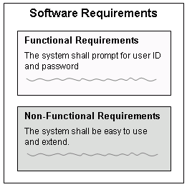
Implementation of Non-functional requirements
A single NFR (such as a SECURITY NFR), may generate a number of related FRs that define system services that are required.
Also it may generate new requirements that restrict existing requirements.

Slide 33
Examples of NFRs in the Mentcare system
Product requirement The Mentcare system shall available to all clinics during normal working hours (Mon–Fri, 08.30–17.30). Idle time within normal working hours shall not exceed 5 seconds in any one day. Organizational requirement Users of the Mentcare system shall authenticate themselves using their health authority identity card. External requirement The system shall implement patient privacy necessities as set out in HStan-03-2006-priv.
Notes:
Ürün gereksinimi
Mentcare sistemi normal çalışma saatlerinde tüm kliniklere açık olacaktır (Pzt-Cum, 0830–17.30).
Normal çalışma saatleri içinde çalışma süresi herhangi bir günde beş saniyeyi geçmemelidir.
Örgütsel gereksinim Mentcare sisteminin kullanıcıları sağlık yetkilileri kimlik kartlarını kullanarak kendilerini doğrulamalıdırlar.
Dış gereklilik Sistem, HStan-03-2006-priv'da belirtilen hasta gizliliği hükümlerini uygulayacaktır.

Slide 34
Goals and requirements relationship
NFRs may be very difficult to state/write exactly and
NFRs may be inexact requirements and difficult to verify.
Goal
  Is a general intention of the user (such as ease of use).
  Goals are helpful to developers as they convey the intentions of the system users.
Verifiable NFRs
  NFR has a statement using some measure which can be objectively tested.
  Examples are given in next slide.

Slide 35
NFR Examples
The system should be easy to use by medical staff and should be organized in such a way that user errors are minimized (Goal).
  Medical staff shall be able to use all the system functions after 4 hours of training (Verifiable&Testable NFRs).
  After this training, the average number of errors made by experienced users shall not exceed TWO per hour of system use. (Verifiable&Testable NFR).
Notes:
Kullanılabilirlik gereksinimleri
• Amaç: Sistem sağlık personeli tarafından kolay kullanılabilir olmalı ve kullanıcı hatalarını en aza indirecek şekilde organize edilmeli
• Test edilebilir fonksiyonel olmayan gereksinim: Sağlık personeli 4 saatlik eğitimden sonra sistemin bütün fonksiyonelliklerini kullanabilecektir. Bu eğitimden sonra kullanıcıların hata oranı 2 hata/saat’i geçmeyecektir.

Slide 36
Metrics for specifying NFRs
Property | Measure
Speed | Processed transactions/second User/event response time Screen refresh time
Size | Mbytes Number of ROM chips
Ease of use | Training time Number of help frames in system
Reliability | Mean time to failure Probability of unavailability Rate of failure occurrence Availability
Robustness (sağlamlık) | Time to restart after failure Percentage of events causing system failure Probability of data corruption on failure
Portability (taşınabilirlik) | Percentage of target dependent statements Number of target systems

Slide 37
1. Requirements elicitation/discover
2. Requirements specification
3. Requirements validation
4. Requirements change
SECTION 2. REQUIREMENTS ENGINEERING PROCESSES

Slide 38
Requirements engineering processes???
The processes used for RE may widely vary depending on:
  the application domain,
  the people involved and
  the organisation
  developing the requirements.
However, there are a number of generic activities common to all processes:
  Requirements elicitation/discovery;
  Requirements analysis/specification;
  Requirements validation;
  Requirements management.
In practice, RE is an iterative activity in which these processes are interleaved.
Notes:
RE için kullanılan işlemler şunlara bağlı olarak geniş ölçüde değişebilir:
uygulama alanı
katılan insanlar ve
gereksinimleri geliştiren kuruluş.

Slide 39
General View of Requirments Enginerring Processes
A spiral view of the RE process
8
5
2
7
1
3
4
6
9
SRS
https://www.youtube.com/watch?v=xb7z2RBxqXE

Slide 40

Four Main Activities Requirements Engineering - Requirements, Stakeholders & Key Activities
https://www.youtube.com/watch?v=UvZVBayVjQY

Slide 41
STEP 1: Requirements elicitation/discover

Slide 42
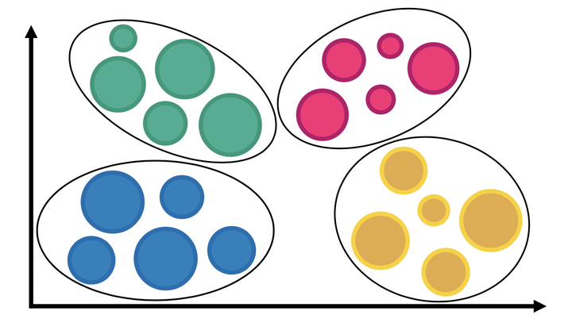
The requirements elicitation and analysis process
1
Find the USER and SYSTEM requirements
2

Slide 43
Requirements elicitation activities
Requirements discovery
  It is a process of :
    gathering information about the required and existing systems and
    extracting the USER and SYSTEM requirements from this information.
  Collaborate with stakeholders: from managers to external regulators.
  Domain requirements are also discovered at this stage.
Requirements classification and organisation
  Create groups of related requirements and put them into coherent clusters.
Prioritisation and negotiation
  Prioritise the requirements and resolving conflicts in requirements.
Requirements specification
  Requirements are documented that will input into the next round of the spiral.

Slide 44
STEP 1: Requirements Elicitation details
Requirements Elicitation stages:
Requirements discovery,
Requirements classification and organization,
Requirements prioritization and negotiation,
Requirements specification.
8
5
2
7
1
3
4
6
9
SRS
https://www.youtube.com/watch?v=xb7z2RBxqXE

Slide 45
STEP 1: Requirements Elicitation
Sometimes called requirements elicitation or requirements discovery.
Technical staff works with customers to discover about (1) Application Domain, (2) The Services that the system should provide and (3) the system’s Operational Constraints.
  System Services (what the system should provide)
  Constraints (e.g. required system performance, hardware constraints, other system constraints)
This step is done by collaborating with stakeholders (e.g. end-users, managers, engineers involved in maintenance, domain experts, trade unions, etc. these are called stakeholders.)

Slide 46
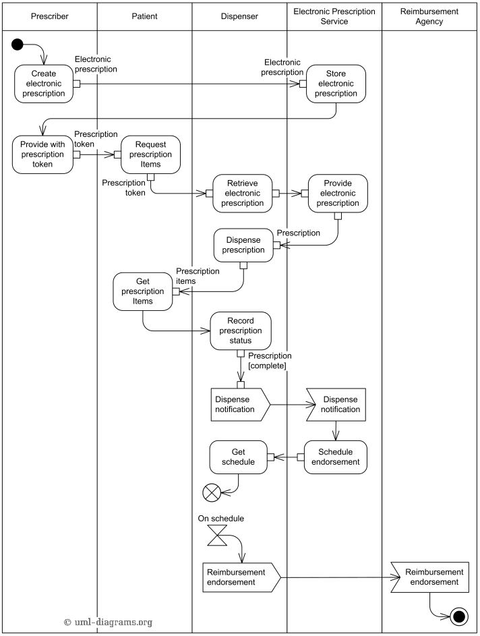
Problems of requirements elicitation
Stakeholders don’t know what they really want.
Stakeholders express requirements in their own terms.
Different stakeholders may cause to conflicting requirements.
Organisational and political factors may affect the system requirements.
The requirements may change during the analysis process.
  DUE TO new stakeholders may appear and
  Business environment may change.
A Complex Business Process
Electronic Drug Prescription
(this figure details not important)

Slide 47
Requirements discovery: Interviewing
Formal or informal interviews with stakeholders are part of most RE processes.
Types of interview
  Closed interviews based on pre-determined list of questions
  Open interviews where various issues are discovered with stakeholders.
For effective interviewing:
  Be open-minded and neutral about the requirements and are willing to listen to stakeholders.
  Perform interviewee to get discussions using;
    a tramplen/springboard question,
    a requirements proposal, or
    by working together on a prototype system.

Slide 48
Interviews in practice
Normally applied as a mix of closed and open-ended interviewing (examples on next slide).
Interviews are good for getting an overall understanding of what stakeholders do and how they might interact with the system.
Interviewers need to be open-minded and neutral about the ideas of what the system should do
Instead of asking what they want, you need to ask them to talk about the system by suggesting possible requirements.

Slide 49
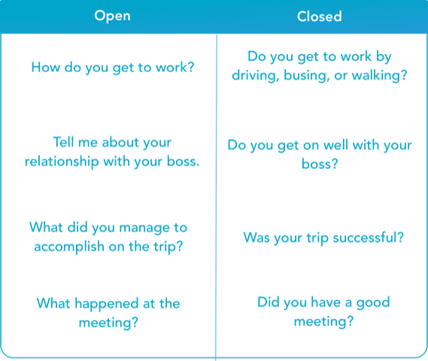

Slide 50
Problems with interviews
Application specialists/end users may use their jargon/ language to describe their work that isn’t easy for the requirements engineer to understand. e.g. medical surgery sector?!!
Sometimes, interviews may not be useful for understanding domain requirements.
Because, requirement engineers can not understand specific domain terminology.

Slide 51
Requirements discovery: Stories and scenarios
SCENARIOS and USER STORIES are real-life examples of how a system can be used.
Stories and scenarios are a description of how a system may be used for a particular task.
Because they are based on a practical situation, stakeholders can relate to them and can comment on their situation with respect to the story.

Slide 52
Scenarios
Scenario is a structured form of user story
Scenarios should include:
  A description of the starting situation/conditions;
  A description of the normal flow of events;
  A description of what can go wrong;
  Information about other concurrent activities;
  A description of the state when the scenario finishes.

Slide 53
Example
Photo sharing in the classroom (iLearn system)

Slide 54
Photo sharing in the classroom (iLearn)
Jack is a primary school teacher in Ullapool (a village in northern Scotland). He has decided that a class project should be focused around the fishing industry in the area, looking at the history, development and economic impact of fishing.
As part of this, students are asked to gather and share memories from relatives, use newspaper archives and collect old photographs related to fishing and fishing communities in the area. Students use an iLearn wiki (integrated to iLearn) to gather together fishing stories and SCRAN (a history resources web site) to access newspaper archives and photographs.
However, Jack also needs a photo sharing site as he wants students to take and comment on each others’ photos and to upload scans of old photographs that they may have in their families.
Jack sends an email to a primary school teachers group, which he is a member of to see if anyone can recommend an appropriate system. Two teachers reply and both suggest that he uses KidsTakePics, a photo sharing site that allows teachers to check and moderate content.
As KidsTakePics is not integrated with the iLearn authentication service, he sets up a teacher and a class account. He uses the iLearn setup service to add KidsTakePics to the services seen by the students in his class so that when they log in, they can immediately use the system to upload photos from their mobile devices and class computers.

Slide 55
Uploading photos iLearn
Initial assumption: A user or a group of users have one or more digital photographs to be uploaded to the picture sharing site. These are saved on either a tablet or laptop computer. They have successfully logged on to KidsTakePics.
Normal: The user chooses upload photos and they are prompted to select the photos to be uploaded on their computer and to select the project name under which the photos will be stored. They should also be given the option of inputting keywords that should be associated with each uploaded photo. Uploaded photos are named by creating a combination of the user name with the filename of the photo on the local computer.
On completion of the upload, the system automatically sends an email to the project moderator asking them to check new content and generates a screen message to the user that this has been done.

Slide 56
Uploading photos
What can go wrong: No moderator is associated with the selected project. An email is automatically generated to the school administrator asking them to propose a project moderator. Users should be informed that there could be a delay in making their photos visible.
Photos with the same name have already been uploaded by the same user. The user should be asked if they wish to re-upload the photos with the same name, rename the photos or cancel the upload. If they chose to re-upload the photos, the originals are overwritten. If they chose to rename the photos, a new name is automatically generated by adding a number to the existing file name.
Other activities: The moderator may be logged on to the system and may approve photos as they are uploaded.
System state on completion: User is logged on. The selected photos have been uploaded and assigned a status ‘awaiting moderation’. Photos are visible to the moderator and to the user who uploaded them.

Slide 57
STEP 2: Requirements specification

Slide 58
A spiral view of the RE process
8
5
2
7
1
3
4
6
9
SRS
https://www.youtube.com/watch?v=xb7z2RBxqXE

Slide 59
Requirements Specification → documentation
The process of writing down the user and system requirements in a requirements document.
User requirements have to be understandable by end-users and customers who do not have a technical background.
System requirements are more detailed requirements and may include more technical information.
The requirements may be part of a contract for the system development.
  It is therefore important that these are as complete as possible.

Slide 60
Ways of writing a system requirements
Notation | Description
NATURAL LANGUAGE (TEXTS, TABLES, FIGS) | The requirements are written using numbered sentences in natural language. Each sentence should express one requirement.
STRUCTURED NATURAL LANGUAGE (FORMS, TEMPLATES,TABULAR) | The requirements are written in natural language on a standard form or template. Each field on the form provides information about an characteristic of the requirement.
DESIGN DESCRIPTION LANGUAGES | This approach uses a language like a programming language, but with more abstract features to specify the requirements by defining an operational model of the system. This approach is now rarely used although it is useful for interface specifications.
GRAPHICAL NOTATIONS (USE CASE, SEQUENCE) | Graphical models, supplemented by text annotations, are used to define the functional requirements for the system; UML use case and sequence diagrams are commonly used.
MATHEMATICAL SPECIFICATIONS | These notations are based on mathematical concepts such as finite-state machines or sets. Although these specifications can reduce the uncertainty in requirements, but most customers don’t understand a formal specification. They cannot check that it represents what they want and are unwilling to accept it as a system contract.

Slide 61
Requirements and design
In principle, requirements should describe what the system should do and the design should describe how it does this.
In practice, requirements and design are inseparable!!!
  Design of system architecture may be designed according to structure the requirements;
  The planned system may inter-operate with other systems that generate design requirements.

Slide 62
1-Natural language specification
Requirements are written as natural language sentences enhanced by diagrams and tables.
Used for writing requirements because it is expressive, intuitive/powerful and universal.
This means that the requirements can be understood by users and customers easily.
  Design diagrams, code etc. may not be understanble by customers.

Slide 63
Guidelines for writing requirements
Formulate a standard format and use it for all requirements.
Use language in a consistent way.
USE;
  “shall” for mandatory requirements (zorunlu),
  “should” for desirable requirements (gerekli).
Use text highlighting to identify key parts of the requirement.
Avoid the use of computer jargon.
Include an explanation of why a requirement is necessary.

Slide 64
Problems with natural language
There is readers and writers of requirements.
Lack of clarity
  Don’t make the document difficult to read.
  Readers may not understand obviously due to unclear expressions.
Requirements confusion
  Functional and non-functional requirements intend to be mixed-up.
Requirements amalgamation (merge)
  Different requirements by writers may be expressed together.

Slide 65
Example requirements for the insulin pump software system
3.2 The system shall measure the blood sugar and deliver insulin, if required, every 10 minutes. (Changes in blood sugar are relatively slow, so more frequent measurement is unnecessary; less frequent measurement could lead to unnecessarily high sugar levels.) →10 dk bir şeker ölçümü gereksizdir, aksine şekerin daha çok yükselmesine sebep olur. 3.6 The system shall run a self-test routine every minute with the conditions to be tested and the associated actions defined in Table 1. (A self-test routine can discover hardware and software problems and alert the user to the fact the normal operation may be impossible.) If the system misleads users! →Bazen HW/SW problemlerinden dolayı normal operasyon işlemi imkansız olabilir, system ya yanıltırsa.
Confused and difficult to understand the requirements!

Slide 66
2-Structured specifications
“Structured specifications” is an approach to writing requirements where the freedom of the writer is limited due to requirements should be written in a standard way.
Structured specifications method works well for some types of requirements.
  e.g. requirements for embedded control system but is sometimes too difficult for writing business system requirements.

Slide 67
a.Form-based specifications
Definition of the function or entity.
Description of inputs and where they come from.
Description of outputs and where they go to.
Information about the information needed for the computation and other entities used.
Description of the action to be taken.
Pre and post conditions (if appropriate).
The side effects (if any) of the function.

Slide 68
A structured specification example of a requirement for an insulin pump
r2
r1
Req (F)
r0
CompDose

Slide 69
A structured specification of a requirement for an insulin pump

Slide 70
b.Tabular specification
Used to support natural language.
Particularly useful when you have to define a number of possible alternative paths of action.
For example, the insulin pump system bases its computations on the rate of change of blood sugar level and the tabular specification explains how to calculate the insulin requirement for different scenarios.
See next.

Slide 71
Tabular specification of computation for an insulin pump
Condition | Action
Sugar level falling (r2 < r1) | CompDose = 0
Sugar level stable (r2 = r1) | CompDose = 0
Sugar level increasing and rate of increase decreasing ((r2 – r1) < (r1 – r0)) | CompDose = 0
Sugar level increasing and rate of increase stable or increasing ((r2 – r1) ≥ (r1 – r0)) | CompDose = round ((r2 – r1)/4) If rounded result = 0 then CompDose = MinimumDose
Input: Current sugar reading (r2); the previous two readings (r0 and r1).

Slide 72
3. GRAPHICAL NOTATIONS: Use cases
Use-cases are a kind of scenario that are included in the UML.
Use cases identify the actors in an interaction and which describe the interaction itself.
A set of use cases should describe all possible interactions with the system.
High-level graphical model enhanced by more detailed tabular description.
UML sequence diagrams may be used to add detail to use-cases by showing the sequence of event processing in the system.

Slide 73
Use cases for the Mentcare system

Slide 74
Output of the Req. Specification step: SRS
The SRS document is the official statement of what is essential for the system developers.
Should include both → a definition of user requirements and a specification of the system requirements.
It is NOT a design document.
It should set WHAT the system should do rather than HOW it should do it.

Slide 75
Users of a requirements document

Slide 76
Requirements document variability
Information in requirements document depends on type of system and the approach to development used.
Incrementally developed systems will have less detail in the requirements document.
Requirements documents standards have been designed e.g. IEEE standard.
  These are mostly applicable to the requirements for large systems engineering projects.

Slide 77
The structure of a requirements SRS document
Chapter | Description
Preface | This should define the expected readership of the document and describe its version history, including a motivation for the creation of a new version and a summary of the changes made in each version.
Introduction | This should describe the need for the system. It should briefly describe the system’s functions and explain how it will work with other systems. It should also describe how the system fits into the overall business or strategic objectives of the organization commissioning the software.
Glossary | This should define the technical terms used in the document. You should not make assumptions about the experience or expertise of the reader.
User requirements definition | Here, you describe the services provided for the user. The nonfunctional system requirements should also be described in this section. This description may use natural language, diagrams, or other notations that are understandable to customers. Product and process standards that must be followed should be specified.
System architecture | This chapter should present a high-level overview of the expected system architecture, showing the distribution of functions across system modules. Architectural components that are reused should be highlighted.

Slide 78
The structure of a requirements document
Chapter | Description
System requirements specification | This should describe the functional and nonfunctional requirements in more detail. If necessary, further detail may also be added to the nonfunctional requirements. Interfaces to other systems may be defined.
System models | This might include graphical system models showing the relationships between the system components and the system and its environment. Examples of possible models are object models, data-flow models, or semantic data models.
System evolution | This should describe the fundamental assumptions on which the system is based, and any expected changes due to hardware evolution, changing user needs, and so on. This section is useful for system designers as it may help them avoid design decisions that would constrain likely future changes to the system.
Appendices | These should provide detailed, specific information that is related to the application being developed; for example, hardware and database descriptions. Hardware requirements define the minimal and optimal configurations for the system. Database requirements define the logical organization of the data used by the system and the relationships between data.
Index | Several indexes to the document may be included. As well as a normal alphabetic index, there may be an index of diagrams, an index of functions, and so on.

Slide 79
STEP 3: Requirements validation

Slide 80
A spiral view of the RE process
https://www.youtube.com/watch?v=xb7z2RBxqXE

Slide 81
Requirements validation
It is about → showing that the requirements define the system the customer really wants.
Requirements error costs are high so validation is very important!!!
  Fixing a requirements error after product delivery may cost up to 100 times the cost of fixing an implementation error.

Slide 82
Requirements checking
Validity. Does the system provide the functions which best support the customer’s requirements?
Consistency. Are there any requirements conflicts?
Completeness. Are all functions required by the customer included?
Realism. Can the requirements be implemented given available budget and technology?
Verifiability. Can the requirements be tested?

Slide 83
Requirements validation techniques
Requirements reviews
  Systematic manual analysis of the requirements.
Prototyping
  Using an executable model of the system to check requirements.
Test-case generation
  Developing tests for requirements to check testability.

Slide 84
Requirements reviews
Regular reviews should be held while the requirements definition is being formulated.
Both customer and contractor staff should be involved in reviews.
Reviews may be formal (with completed documents) or informal.
  Good communications between developers, customers and users can resolve problems at an early stage.

Slide 85
Review checks
Verifiability
  Is the requirement realistically testable?
Comprehensibility
  Is the requirement properly understood?
Traceability
  Is the origin of the requirement clearly stated?
Adaptability
  Can the requirement be changed without a large impact on other requirements?

Slide 86
STEP 4: Requirements change management

Slide 87
Changing requirements
The business and technical environment of the system always changes after installation of the product.
This may cause problems in requirements.
  New hardware may be introduced/hosted, may be necessary to develop an interface the system with other systems, business priorities/preferences may change (with result changes in the system support required), and new legislation and regulations may be introduced that the system must adapt.
The people who pay for a system and end users of the system are rarely the same people.
  Our customers may define some conditions in contract due to organizational and budgetary constraints.
  These may conflict with end-user requirements and, after delivery, new features may have to be added for user support.

Slide 88
Requirements evolution

Slide 89
Requirements management
REQUIREMENTS CHANGE MANAGEMENT is the process of managing changing requirements during the Requirements Engineering Process & System Development.
New requirements may appear, as a system is being developed and after the system use.
You need to keep track of individual requirements and preserve relations between dependent requirements so that you can assess the impact of requirements changes.
You need to create a formal process for making change proposals and linking these changes to system requirements.

Slide 90
Requirements change management

Slide 91
Requirements change management
Deciding if a requirement change should be accepted
  Problem analysis and change specification
    During this stage, the problem or the change proposal is analyzed to check that it is valid.
    This analysis is sent back to the change requestor person who may respond with more specific requirements change proposal, or decide to withdraw the request.
  Change analysis and costing
    The effect of the proposed change is assessed using traceability information and general knowledge of the system requirements.
    Once this analysis is completed, a decision is made whether or not to proceed with the requirements change.
  Change implementation
    SRS document and, where necessary, the system design and implementation, are modified.
    Ideally, the document should be organized so that changes can be easily implemented.

Slide 92
Key points
Requirements for a software system set out what the system should do and define constraints on its operation and implementation.
Functional requirements are statements of the services that the system must provide or are descriptions of how some computations must be carried out.
Non-functional requirements often constrain the system being developed and the development process being used.
They often relate to the emergent properties of the system and therefore apply to the system as a whole.

Slide 93
Key points
The requirements engineering process is an iterative process that includes requirements elicitation, specification and validation.
Requirements elicitation is an iterative process that can be represented as a spiral of activities – requirements discovery, requirements classification and organization, requirements negotiation and requirements documentation.
You can use a range of techniques for requirements elicitation including interviews and ethnography. User stories and scenarios may be used to facilitate discussions.

Slide 94
Key points
Requirements specification is the process of formally documenting the user and system requirements and creating a software requirements document.
The software requirements document is an agreed statement of the system requirements. It should be organized so that both system customers and software developers can use it.

Slide 95
Key points
Requirements validation is the process of checking the requirements for validity, consistency, completeness, realism and verifiability.
Business, organizational and technical changes inevitably lead to changes to the requirements for a software system. Requirements management is the process of managing and controlling these changes.

Slide 96
Requirements management planning
Defines the level of requirements management detail
Requirements management decisions:
  Requirements identification Each requirement must be uniquely identified so that it can be cross-referenced with other requirements.
  A change management process This is the set of activities that assess the impact and cost of changes. I discuss this process in more detail in the following section.
  Traceability policies These policies define the relationships between each requirement and between the requirements and the system design that should be recorded.
  Tool support Tools that may be used range from specialist requirements management systems to spreadsheets and simple database systems.

