Slide 1
COST ESTIMATION
Assoc.Prof.Dr.Duygu Çelik Ertuğrul

Slide 2
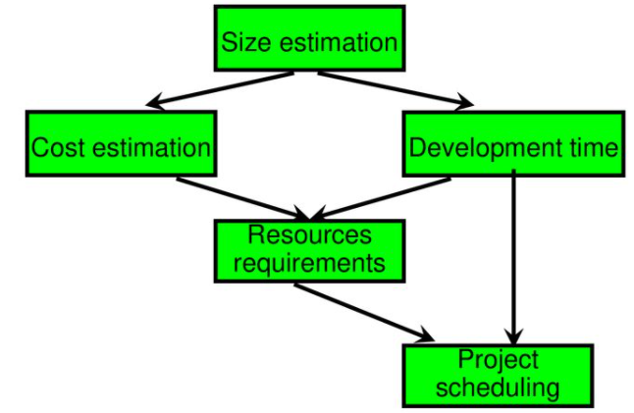
The various steps of a software project planning activities are illustrated shown below :

Slide 3
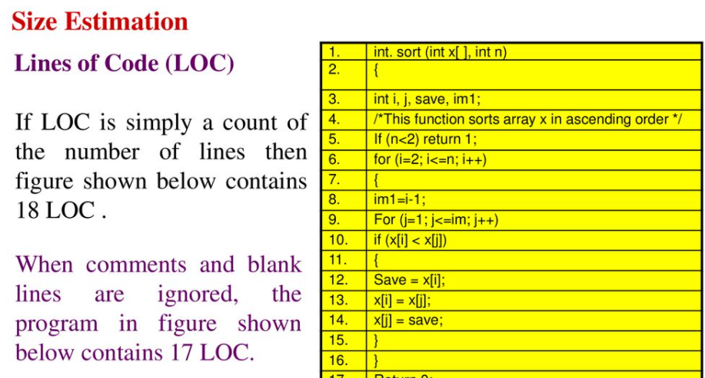

Slide 4
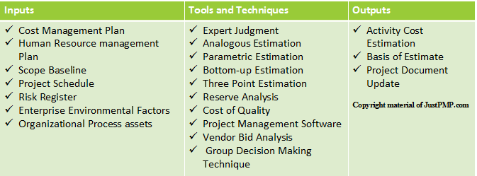
Project Cost Estimation Models
Similar prj
COCOMO
PERT
Vendor Bid Analysis (Vendor analysis) is a technique used to figure out the cost of a project by comparing the bids submitted by many suppliers.

Slide 5
B.W. Boehm introduced COCOMO model in his book “Software Engineering Economics in 1981”
COCOMO is an approach applied for cost estimation of software projects
COCOMO has three sub models: basic , intermediate and detailed
COCOMO 2 considers different approaches to software development, reuse, etc.
COCOMO is an empirical/experimental model based on project experience.
Well-documented, ‘independent’ model which is not tied to a specific software vendor.

Slide 6
COCOMO estimation models
I
I I
I I I
I V

Slide 7
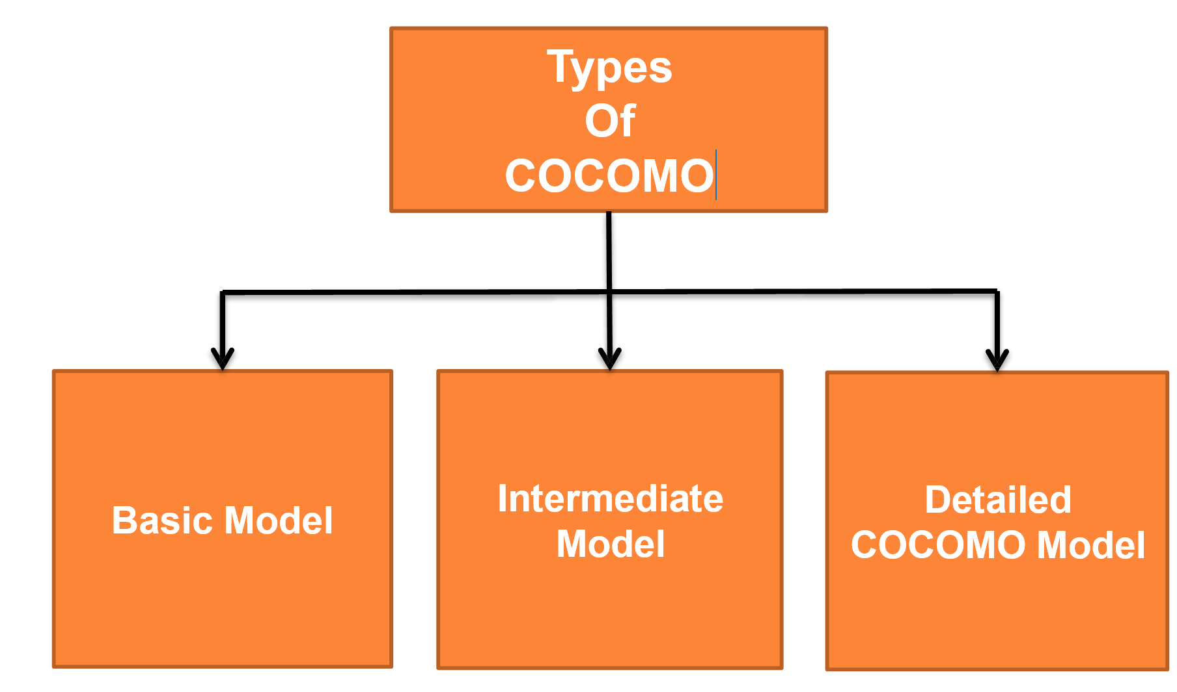

Slide 8
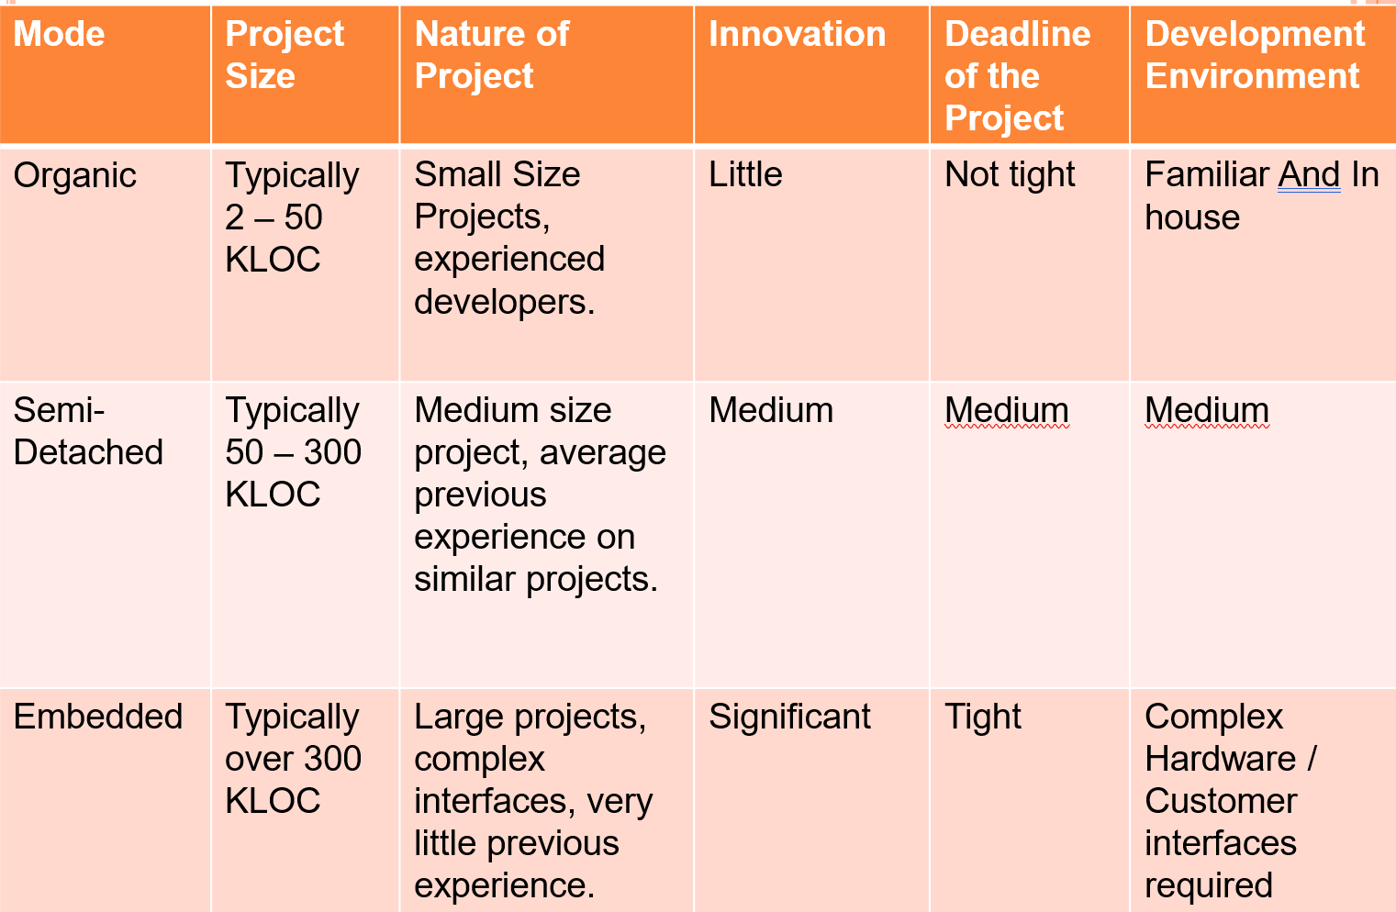
Comparison of three COCOMO modes

Slide 9
Basic Model
The basic model aims at estimating, in a quick and rough fashion, most of the small to medium sized software projects.
Three modes are considered in this model:
  Organic: A small team + experienced developers develop the software in a very familiar environment.
  Semidetached: It is an intermediate mode between the organic model and embedded mode.
  Embedded: The project has hard constraints + large team.
Depending on the problem, the team may include a mixture of experienced and less experienced people.

Slide 10
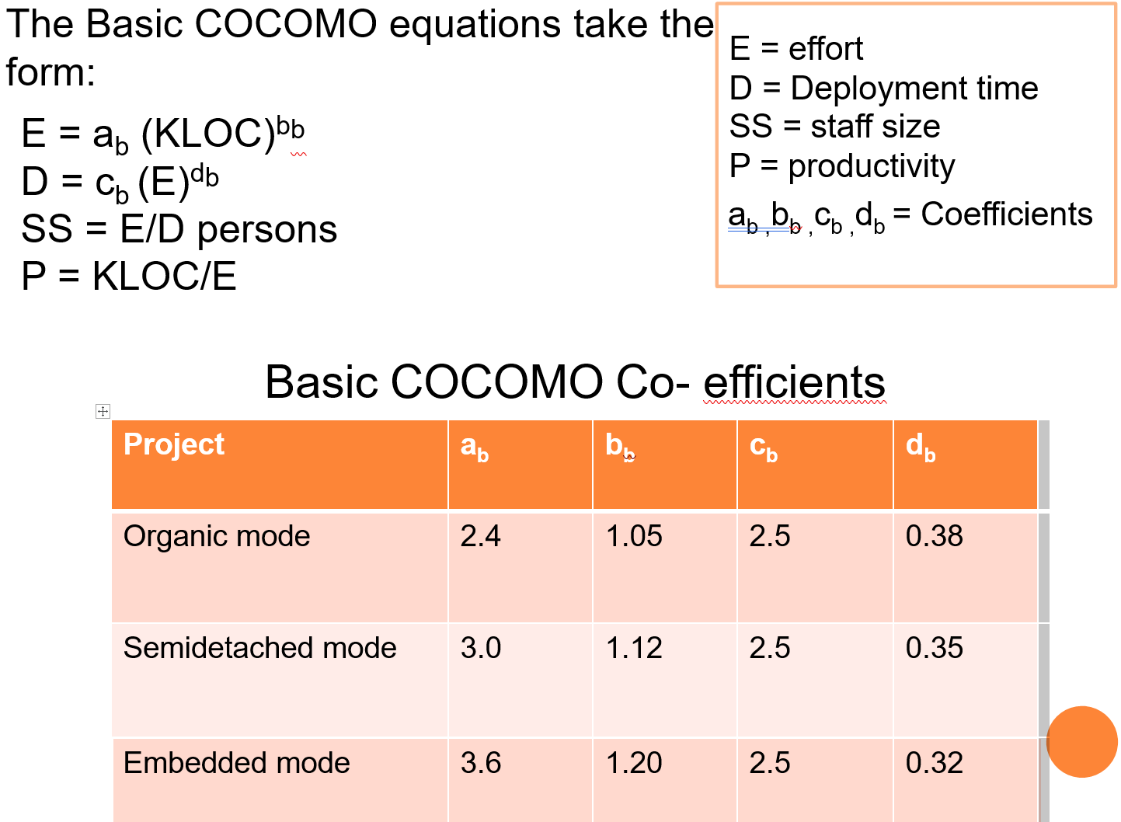
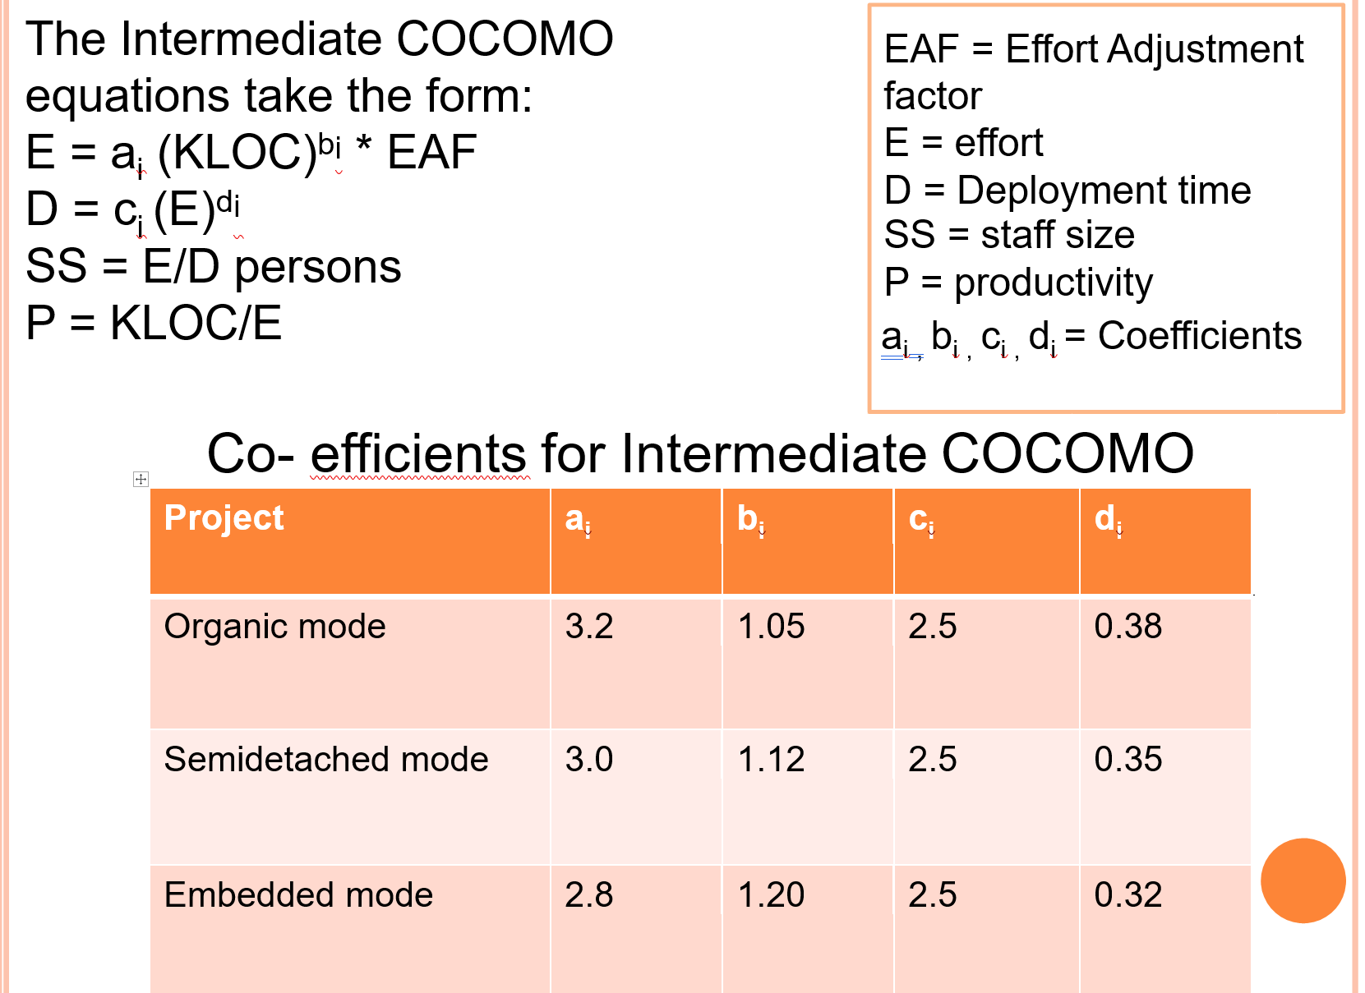
COCOMO
Basic
Organic
Embedded
Intermediate
Embedded
Detailed
Semidetached
Semidetached
Organic
Semidetached
Organic
Embedded

Slide 11
Basic COCOMO
Equations

Slide 12
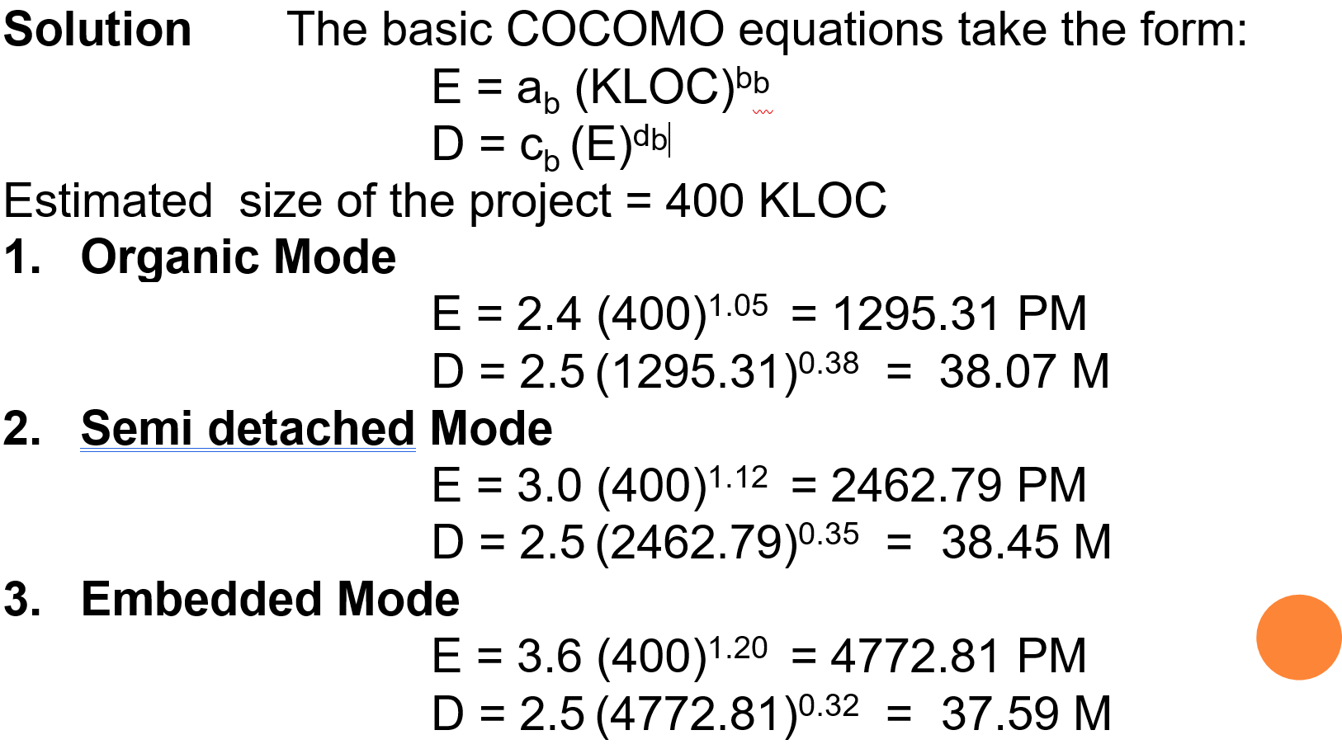
Example
Suppose that a SW project was estimated to be 400 KLOC. Calculate the effort and development time for each of the three modes i.e. organic, semidetached and embedded.

Slide 13
Intermediate Model
In this model, Boehm introduced an additional set of 15 predictors called cost drivers.
The model considers the software development environment.
Cost drivers are used to adjust the cost estimated for a project according to the actual project environment which increase the accuracy of the estimate.

Slide 14
Intermediate Model
Equations

Slide 15
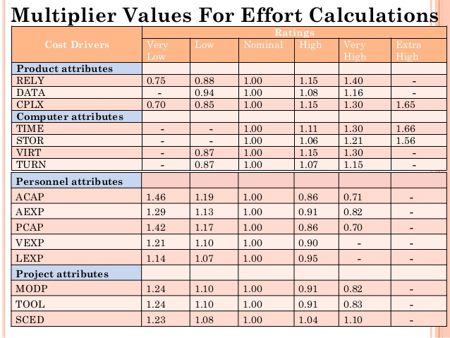
The COST DRIVERS are grouped into 4 categories:
The rating uses a scale; very low, low, nominal, high, very high, extra high
1. Product attributes
  a. Required software reliability (RELY)
  b. Database size (DATA)
  Product complexity (CPLX)
2. Computer attributes
  a. Execution time constraint (TIME)
  b. Main store constraint (STOR)
  c. Virtual machine volatility (VIRT)
  d. Computer turnaround time (TURN)
3. Personnel attributes
  a. System Analyst capability (ACAP)
  b. Application experience (AEXP)
  c. Programmer capability (PCAP)
  d. Virtual machine experience (VEXP)
  e. Programming Language experience (LEXP)
4. Project attributes
  a. Modern programming practices (MODP)
  b. Use of software tool (TOOL)
  c. Required development schedule (SCED)
Notes:
Each cost driver is rated for a given project environment.
The rating uses a scale; very low, low, nominal, high, very high, extra high
which describes to what extent the cost driver applies to the project being estimated.

Slide 16
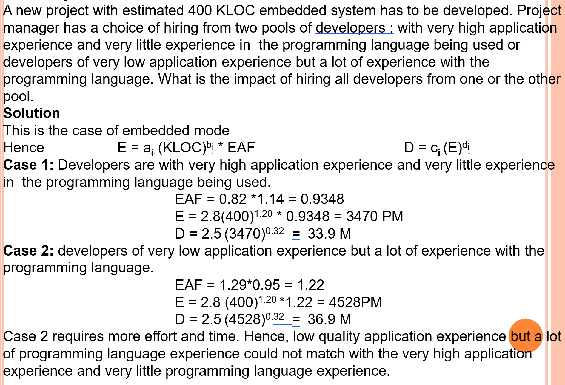
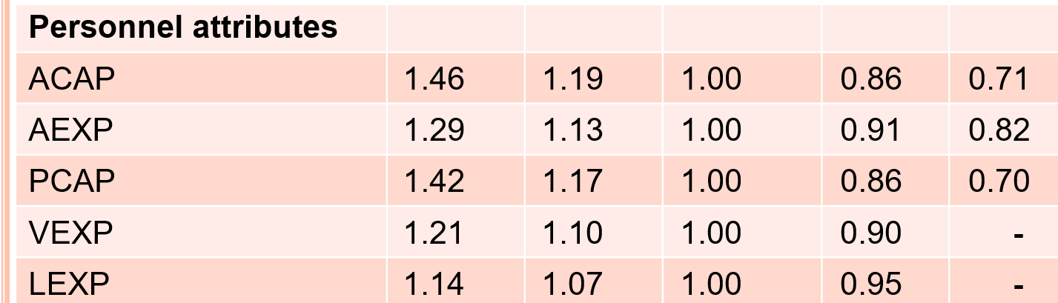
Example of Intermediate
Model
COCOMO

Slide 17
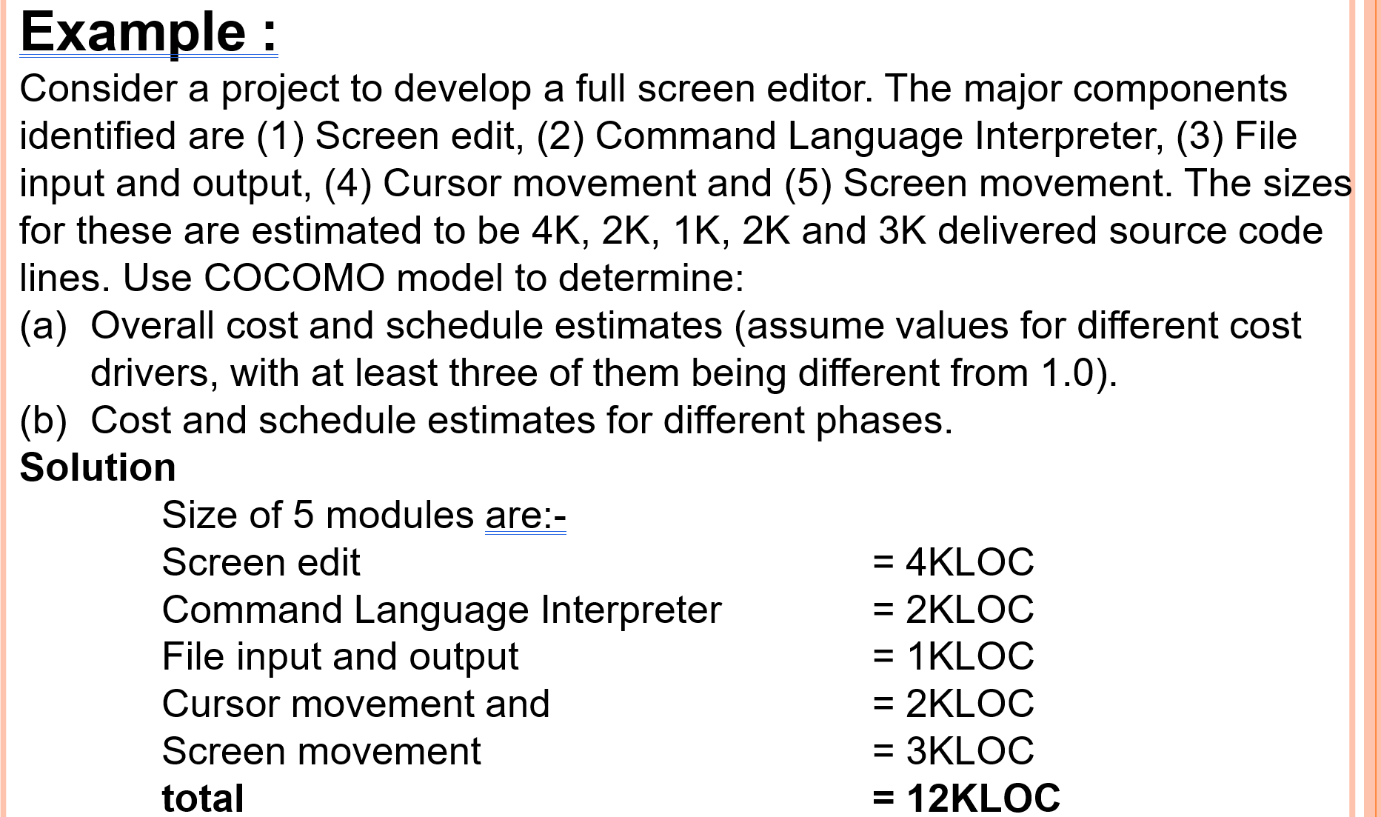

Slide 18
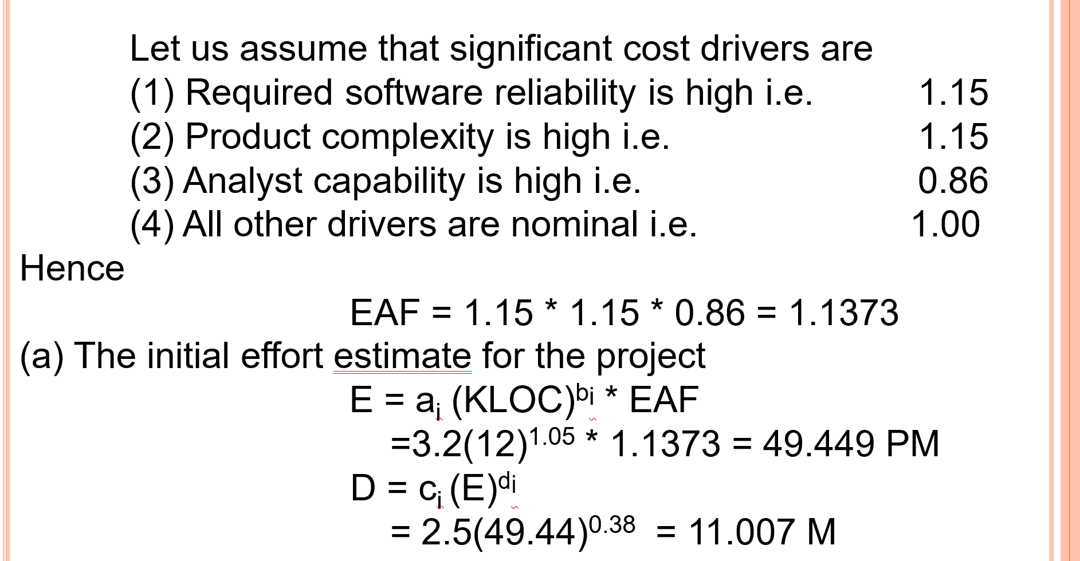
SOLUTION
TOTAL EFFORT
TOTAL DURATION

Slide 19
The COST DRIVERS are grouped into 4 categories:
The rating uses a scale; very low, low, nominal, high, very high, extra high
1. Product attributes
  a. Required software reliability (RELY)
  b. Database size (DATA)
  Product complexity (CPLX)
2. Computer attributes
  a. Execution time constraint (TIME)
  b. Main store constraint (STOR)
  c. Virtual machine volatility (VIRT)
  d. Computer turnaround time (TURN)
3. Personnel attributes
  a. System Analyst capability (ACAP)
  b. Application experience (AEXP)
  c. Programmer capability (PCAP)
  d. Virtual machine experience (VEXP)
  e. Programming Language experience (LEXP)
4. Project attributes
  a. Morden programming practices (MODP)
  b. Use of software tool (TOOL)
  c. Required development schedule (SCED)
Notes:
Each cost driver is rated for a given project environment.
The rating uses a scale; very low, low, nominal, high, very high, extra high
which describes to what extent the cost driver applies to the project being estimated.

Slide 20
If you don’t know KLOC?

Slide 21
Cost Estimation Process based on Functional Point
Effort
Size Table
Lines of Code
Number of Use Case
Function Point
Development Time
Estimation Process
Number of Personnel
Errors

Slide 22
COCOMO estimation models
I
I I
I I I
I V

Slide 23
FUNCTION POINTS (FP) Estimation
FP
KLOC
E, D, #of People
If you can estimate some features about your project at the beginning such as input / output, then you can define a function points (FP) number for the system to be developed.
After that you can convert it to KLOC.
After defining KLOC→ Effort, Duration, Person,Productivty

Slide 24
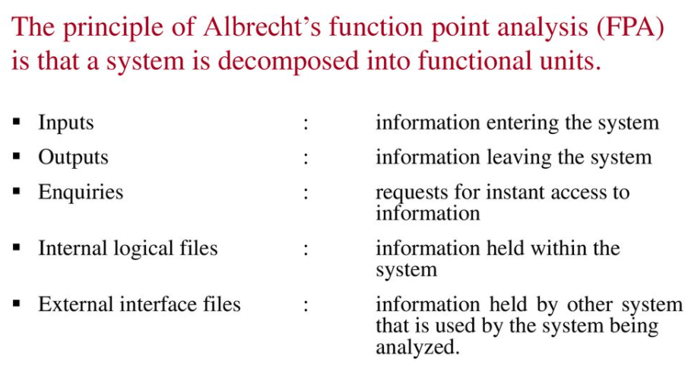
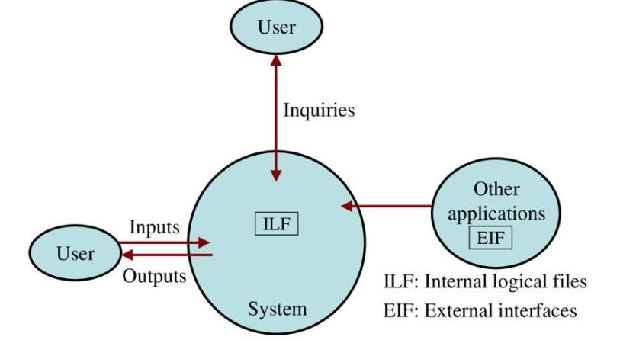
Functional Point Analysis

Slide 25
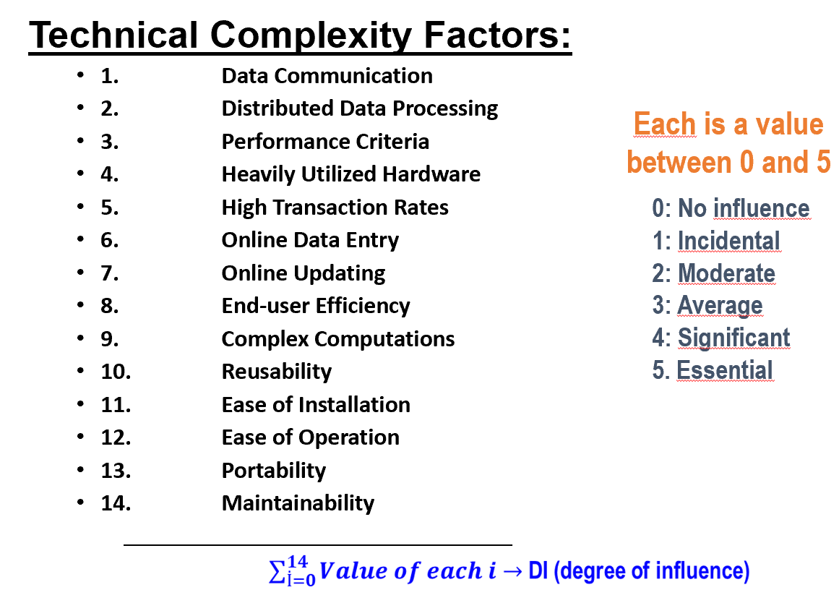
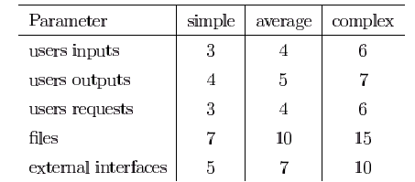
FP=UFP*[0.65+0.01*DI]
1
Unadjusted Function Points (UFP)
3
DI (degree of influence)
2
4
  FP=UFP*[0.65+0.01*DI]

Slide 26
Function Points
STEP 1: measure size in terms of the amount of functionality in a system.
FPs are computed by first calculating an Unadjusted Function Point (UFP).
UFP is calculated from the following categories:
  1-External user inputs – those items provided by the user that describe distinct application-oriented data (such as file names and menu selections, any input required function from user)
  2-External user outputs – those items provided to the user that generate distinct application-oriented data (such as any produced reports and messages to users , any screen outputs for users)
  3- External user inquiries (user requests) – interactive inputs requiring a response (SELECT* queries, just reading data from DB no change like insert,delete, update.)
  4- External files – machine-readable interfaces to other systems. It refers to sharing with another application system.
  5- Internal files – logical master files in the system (user data, stored any data, tables..)

Slide 27
Unadjusted Function Point (UFP)
STEP 2: Multiply each number by a weight factor, according to complexity (simple, average or complex) of the parameter, associated with that number. The value is given by a table:
This table will give you a total Unadjusted Function Points (UFP) value!!

Slide 28
Unadjusted Function Point (UFP)
STEP 3: Calculate the total UFP (Unadjusted Function Points)
STEP 4: Calculate the total TCF (Technical Complexity Factor)
TCF=0.65+0.01*DI
To calculate TCF, you have to calculate DI first from the following points given.

Slide 29
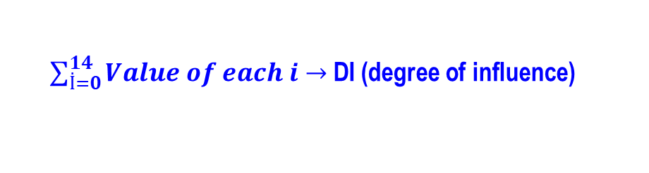
Summarizes the complexity characteristics of the software system – assign grades (0 to 5) to the 14 subjects that significantly affect the effort:
    Technical Complexity Factors:
      1. Data Communication
      2. Distributed Data Processing
      3. Performance Criteria
      4. Heavily Utilized Hardware
      5. High Transaction Rates
      6. Online Data Entry
      7. Online Updating
      8. End-user Efficiency
      9. Complex Computations
      10. Reusability
      11. Ease of Installation
      12. Ease of Operation
      13. Portability
      14. Maintainability
Each is a value
between 0 and 5
  0: No influence
  1: Incidental
  2: Moderate
  3: Average
  4: Significant
  5. Essential
Importance of Factors

Slide 30
Function Points(.....)
STEP 5: Sum the resulting numbers to obtain DI (degree of influence)
STEP 6: TCF (Technical Complexity Factor) by given by the formula
  TCF=0.65+0.01*DI
STEP 7: Function Points are by given by the formula
  FP=UFP*TCF
  or,
  FP=UFP*[0.65+0.01*DI]
TCF

Slide 31
COCOMO EXAMPLE

Slide 32
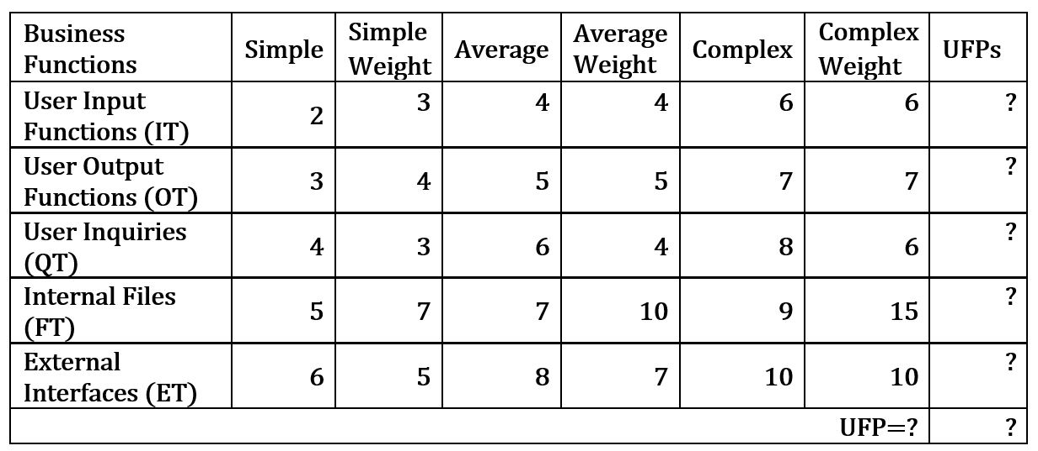
  FP=UFP*[0.65+0.01*DI]
EXAMPLE: Compute the UFP for the SW project with the following information domain characteristics?

Slide 33
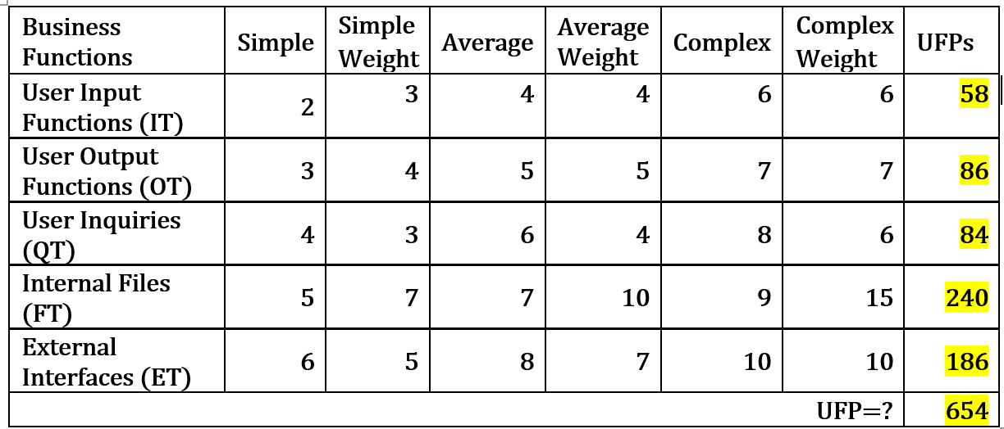
EXAMPLE: Compute the UFP for the SW project with the following information domain characteristics?
  FP=UFP*[0.65+0.01*DI]

Slide 34
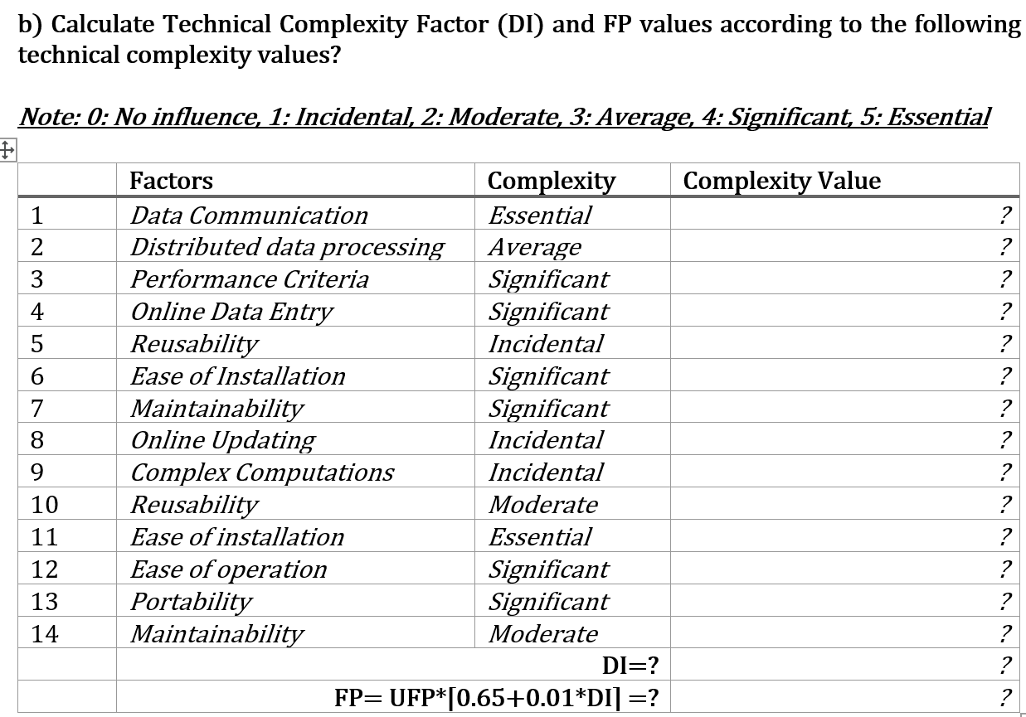
Degree of Influence
Complexity Factors

Slide 35
Complexity Factors
    Technical Complexity Factors:
      1. Data Communication
      2. Distributed Data Processing
      3. Performance Criteria
      4. Heavily Utilized Hardware
      5. High Transaction Rates
      6. Online Data Entry
      7. Online Updating
      8. End-user Efficiency
      9. Complex Computations
      10. Reusability
      11. Ease of Installation
      12. Ease of Operation
      13. Portability
      14. Maintainability
Each is a value between 0 and 5
  0: No influence
  1: Incidental
  2: Moderate
  3: Average
  4: Significant
  5. Essential
Notes:
Dağıtımlı Sistem
Yanıt/Çıktı Performansı Odaklı
Kullanıcı Verimliliği
Karmaşık Dahili İşlem
Yeniden Kullanılabilir Kod
Kurulumu Kolay
Kullanımı Kolay
Taşınabilir
Değiştirilmesi Kolay
Koşut Zamanlı (Concurrent)
Güvenlik İçeren
Diğer Sistemler için Ulaşılabilir
Kullanıcı Eğitimi Gerekliliği

Slide 36
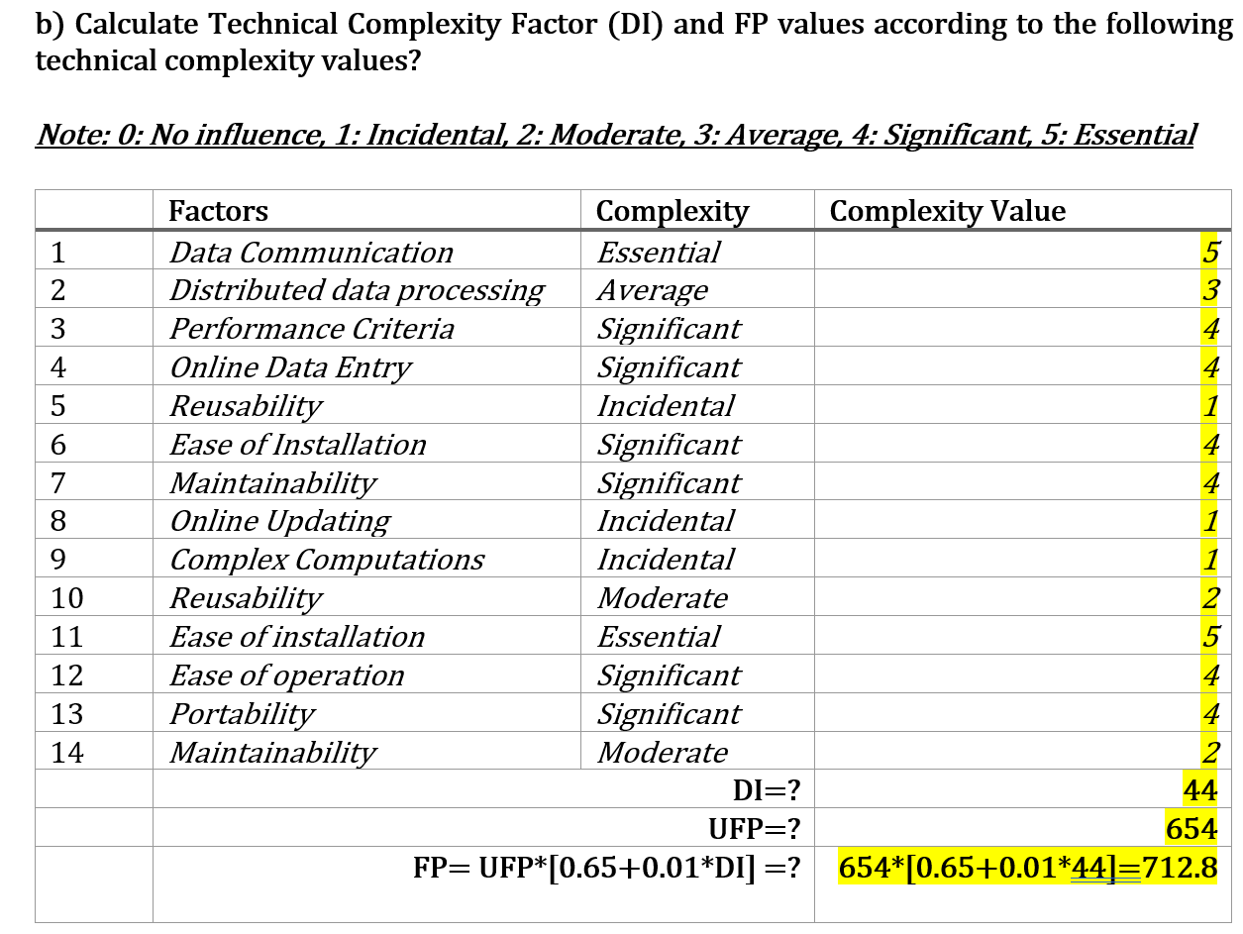
Degree of Influence
Complexity Factors

Slide 37
AFTER FINDING FP
YOU NEED TO CONVERT IT TO KLOC

Slide 38
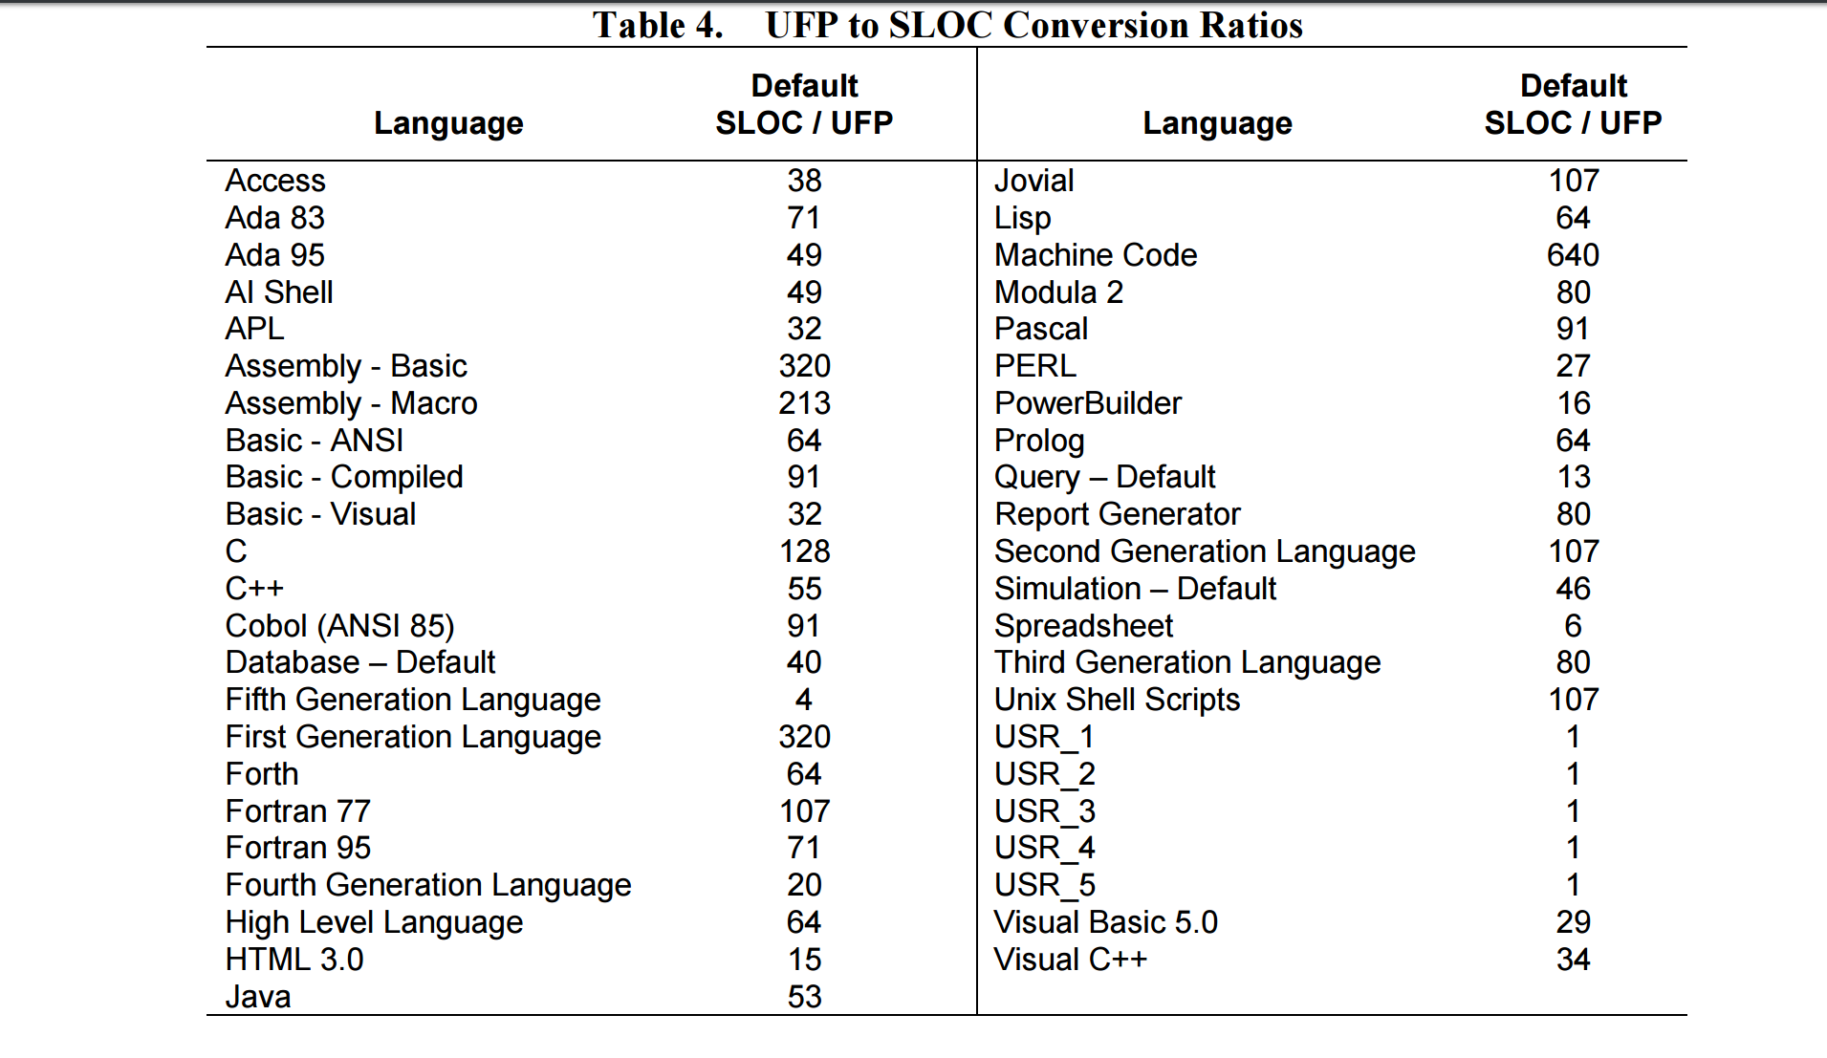
Conversion FP <-> KLOC
KLOC=FP x Language Ratio

Slide 39
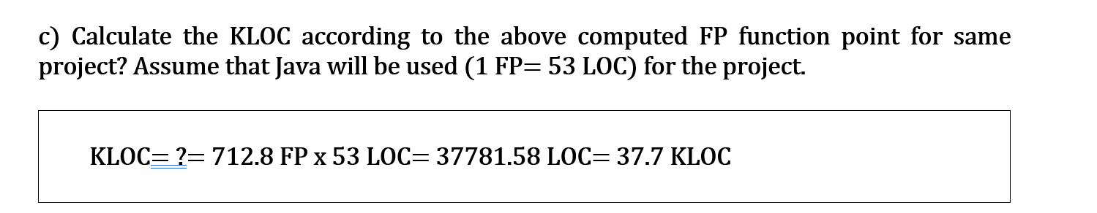


Slide 40
Assume that INTERMEDIATE COCOMO - ORGANIC mode is using…

Slide 41
COCOMO
Basic
Organic
Embedded
Intermediate
Embedded
Detailed
Semidetached
Semidetached
Organic
Semidetached
Organic
Embedded

Slide 42
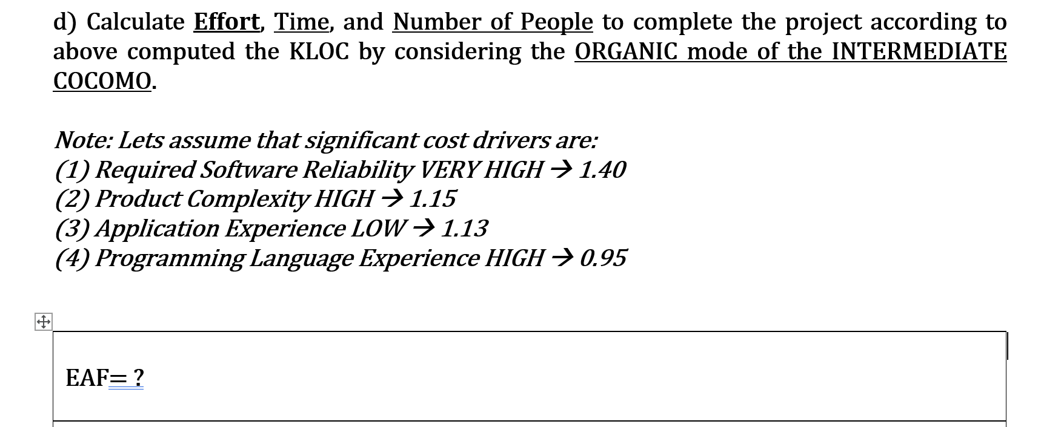
EAF=?
E, D, # of People=?

Slide 43
Calculate the EAF value according to the following cost-drivers:
ATTRIBUTE | RATING
Realiability | V high (1.40)
Complexity | High (1.15)
App Exp | Low(1.13)
Prog Lang Exp | High (0.95)
Cost Driver
Very
Low
Low
Nominal
High
Very
High
Extra
High
Required Reliability
.75
.88
1.00
1.15
1.40
1.40
Database Size
.94
.94
1.00
1.08
1.16
1.16
Product Complexity
.70
.85
1.00
1.15
1.30
1.65
Execution Time Constraint
1.00
1.00
1.00
1.11
1.30
1.66
Main Storage Constraint
1.00
1.00
1.00
1.06
1.21
1.56
Virtual Machine Volatility
.87
.87
1.00
1.15
1.30
1.30
Comp Turn Around Time
.87
.87
1.00
1.07
1.15
1.15
Analyst Capability
1.46
1.19
1.00
.86
.71
.71
Application Experience
1.29
1.13
1.00
.91
.82
.82
Programmers Capability
1.42
1.17
1.00
.86
.70
.70
Virtual machine Experience
1.21
1.10
1.00
.90
.90
.90
Language Experience
1.14
1.07
1.00
.95
.95
.95
Modern Prog Practices
1.24
1.10
1.00
.91
.82
.82
EAF
SW Tools
1.24
1.10
1.00
.91
.83
.83
Required Dev Schedule
1.23
1.08
1.00
1.04
1.10
1,10

Slide 44
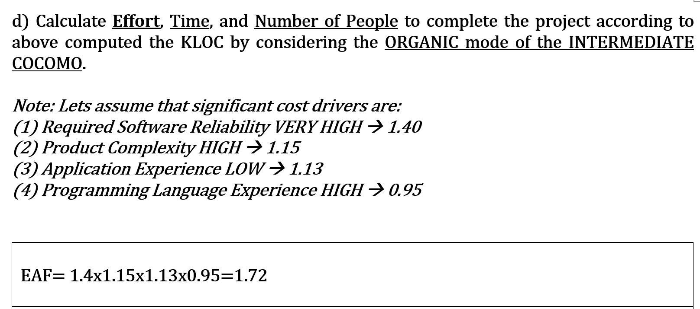
EAF=1.72
E, D, # of People=?

Slide 45
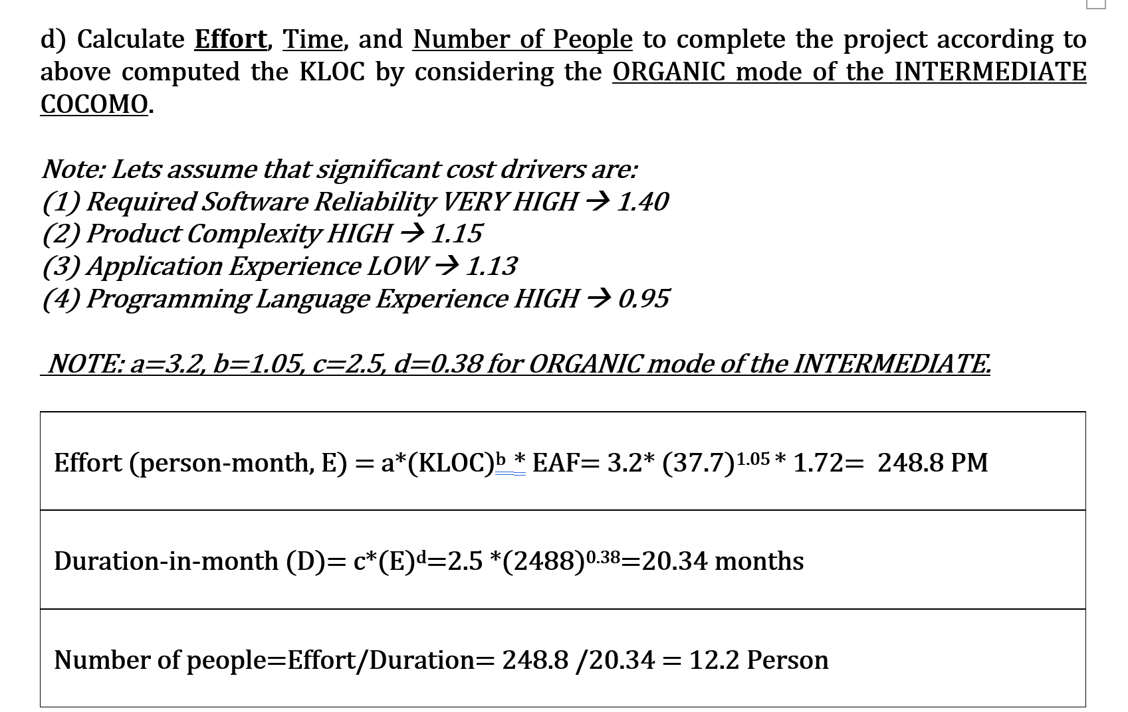
E, D, # of People=?

Slide 46
Problem
You will estimate cost of a SW project acc to the given values below. Use SEMIDETACHED mode of the INTERMEDIATE COCOMO and total Effort, Dur, Num of People, first. Then calculate stage-based Effort and Duration for each stage of SDLC…(JAVA)
 | Factors | Complexity | Complexity Value
1 | Data Communication | Essential | 5
2 | Distributed data processing | Average | 3
3 | Performance Criteria | Significant | ?
4 | Online Data Entry | Significant | ?
5 | Reusability | Essential | ?
6 | Ease of Installation | Significant | ?
7 | Maintainability | Significant | ?
8 | Online Updating | Essential | ?
9 | Complex Computations | Essential | ?
10 | Reusability | Moderate | ?
11 | Ease of installation | Essential | ?
12 | Ease of operation | Significant | ?
13 | Portability | Significant | ?
14 | Maintainability | Moderate | ?
 | DI |  | ?
  0: No influence
  1: Incidental
  2: Moderate
  3: Average
  4: Significant
  5. Essential
Business Functions | Simple | Simple Weight | Average | Average Weight | Complex | Complex Weight | UFPs
User Input Functions (IT) | 5 | 3 | 10 | 4 | 4 | 6 | ?
User Output Functions (OT) | 6 | 4 | 10 | 5 | 4 | 7 | ?
User Inquiries (QT) | 7 | 3 | 10 | 4 | 5 | 6 | ?
Internal Files (FT) | 7 | 7 | 10 | 10 | 5 | 15 | ?
External Interfaces (ET) | 4 | 5 | 10 | 7 | 1 | 10 | ?
TOTAL UFP |  |  |  |  |  |  | ?

Slide 47
Solution
You will estimate cost of a SW project acc to the given values below. Use SEMIDETACHED mode of the INTERMEDIATE COCOMO and total Effort, Duration, Num of People, first. Then calculate stage-based Effort and Duration for each stage of SDLC…(JAVA)
 | Factors | Complexity | Complexity Value
1 | Data Communication | Essential | 5
2 | Distributed data processing | Average | 3
3 | Performance Criteria | Significant | 4
4 | Online Data Entry | Significant | 4
5 | Reusability | Essential | 5
6 | Ease of Installation | Significant | 4
7 | Maintainability | Significant | 4
8 | Online Updating | Essential | 5
9 | Complex Computations | Essential | 5
10 | Reusability | Moderate | 2
11 | Ease of installation | Essential | 5
12 | Ease of operation | Significant | 4
13 | Portability | Significant | 4
14 | Maintainability | Moderate | 2
 | DI |  | 56
  FP=UFP*[0.65+0.01*DI]
Business Functions | Simple | Simple Weight | Average | Average Weight | Complex | Complex Weight | UFPs
User Input Functions (IT) | 5 | 3 | 10 | 4 | 4 | 6 | 79
User Output Functions (OT) | 6 | 4 | 10 | 5 | 4 | 7 | 102
User Inquiries (QT) | 7 | 3 | 10 | 4 | 5 | 6 | 91
Internal Files (FT) | 7 | 7 | 10 | 10 | 5 | 15 | 224
External Interfaces (ET) | 4 | 5 | 10 | 7 | 1 | 10 | 100
TOTAL UFP |  |  |  |  |  |  | 596

Slide 48
Solution
  FP=UFP*[0.65+0.01*DI]=596 *[0.65+0.01*56]= 721.16 FPs
  KLOC=FP*Java Prog Lang= 721.16*53= 38221.48 =38.22
  E=3*(38.22)^1.12*1.72= 305.36 PM
  D=2.5*(305.36)^0.35= 18.51 months
  # of People= E/D= 305.36 / 18.51= 16.5 Person

Slide 49
Factors That Influence Software Productivity
(Basili & Zelkowitz)
People Factors: The size and the expertise of the software company.
Problem Factors: The complexity of the problem to be solved, and the no.of changes in design constraints / requirements.
Process Factors: The analysis and design techniques used, the prog.languages and CASE tools available, the review techniques.
Product Factors: Reliability and performance of the computer-based system used for development.
Resource Factors: Availability of case tools and hardware and software resources.

