Slide 1
System Modeling

Slide 2
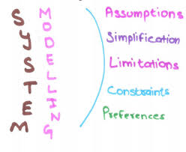
Topics covered
Context models
Interaction models
Structural models
Behavioral models (data-driven & events-driven)
Model-driven engineering

Slide 3
System modeling
System modeling is a process of developing abstract models of a system, with each model presenting a different view or perspective of that system.
  Context models
  Interaction models
  Structural models
  Behavioral models
System modeling has now come to mean representing a system using some kind of graphical notation, which is now almost always based on notations in the Unified Modeling Language (UML).
System modelling helps the analyst to understand the functionality of the system and the models are used to communicate with customers.

Slide 4
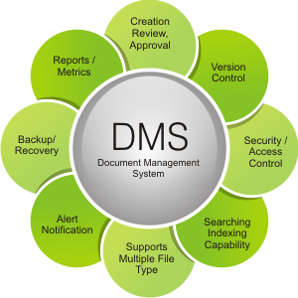
Existing and planned system models
Models of the EXISTING SYSTEM are used during requirements engineering process. They help clarify what the existing system does and can be used as a basis for discussing its strengths and weaknesses. These then lead to define requirements for the NEW SYSTEM.
Models of the system are used during requirements engineering to help explain the requirements (of the new system) to stakeholders.
Engineers use these models to discuss design suggestions and to document the system for implementation.
In a model-driven engineering process, it is possible to generate a complete or partial system implementation from the system model.

Slide 5
System perspectives
System perspective is an external perspective, where you model the context or environment of the system.
  Where should I draw the system boundary?
System perspective is an interaction perspective, where you model the interactions between a system and its environment, or between the components of a system.
System perspective is a structural perspective, where you model the organization of a system or the structure of the data that is processed by the system.
System perspective is a behavioral perspective, where you model the dynamic behavior of the system and how it responds to events.

Slide 6
UML diagram types
Display Patient Profile
Activity diagrams, which show the activities involved in a process or in data processing.
Use case diagrams, which show the interactions between a system and its environment.
Sequence diagrams, which show interactions between actors and the system and between system components.
Class diagrams, which show the object classes in the system and the associations between these classes.
State diagrams, which show how the system reacts to internal and external events.

Slide 7
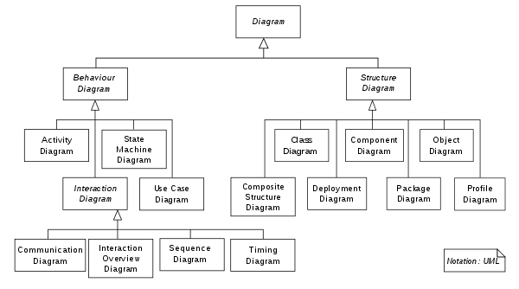
UML diagram types

Slide 8
UML in the SDLC Process
How UML is used in the SDLC
Design
Requirements
Architecture
Domain models
UML sequence diagrams
UML communication diagrams
UML use case diagrams
Scenarios
UML object diagrams
UML component diagrams
UML class diagrams
UML activity diagrams
UML package diagrams
UML deployment diagrams
UML activity diagrams
UML state diagrams

Slide 9
Use of graphical models
It is good to use graphical models to shorten discussions about an existing or new system:
  Incomplete and incorrect models (designs) are OK.
  Because their role is to support the discussions.
It is good to use graphical models to ease documenting of an existing system;
  Models should be an accurate/correct representation of the system but need it is not be complete.
As a detailed system description that can be used to create a system application, the models developed must be both correct and complete.

Slide 10
Topics covered
Context models
Interaction models
Structural models
Behavioral models (data-driven & events-driven)
Model-driven engineering

Slide 11
Context models

Slide 12
Context models
Context models are used to illustrate the operational context of a system - they show what is the outside the system boundaries.
Architectural models show the planned system and its relationship with other systems.
Social and organisational concerns/issues may affect the decision on where to position system boundaries.

Slide 13
System boundaries
System boundaries are established to define what is inside and what is outside the system.
  They show other systems that are used or depend on the planned system.
The position of the system boundary has a deep effect on the system requirements.
Defining a system boundary is a political judgment:
  There may be pressures to develop system boundaries that increase / decrease the influence or workload of different parts of an organization.

Slide 14
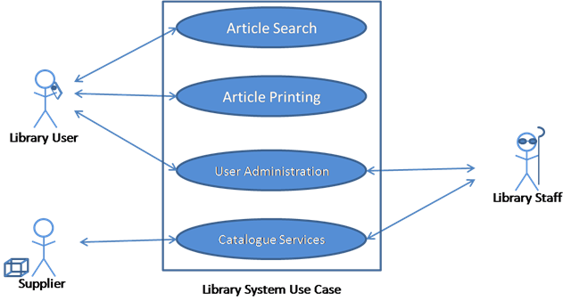
System Boundary

Slide 15
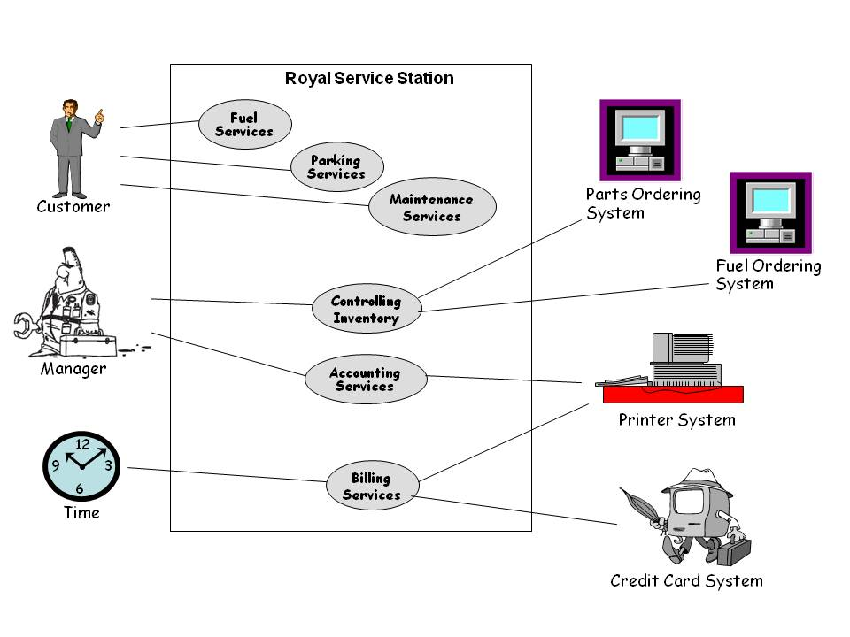
System boundary - a car service station example-

Slide 16
Process perspective
Shotly, “Context Model” shows:
  the other systems in the environment → not how the planned system being developed and used in that environment.
Process models tell how the system being developed (business processes/operations???) is used in broader business processes.
  UML activity diagrams may be used to define business process models.

Slide 17
The context model of the Mentcare system
Defining the system boundaries that increase / decrease the influence or workload of different parts of an organization.

Slide 18
Process model of involuntary detention in hospital
(İstemsiz tutuklama süreci modeli)

Slide 19
Topics covered
Context models
Interaction models (USE CASE,SEQUENCE,..)
Structural models
Behavioral models (data-driven & events-driven)
Model-driven engineering

Slide 20
Interaction models

Slide 21
Interaction models
Modeling USER INTERACTION is important as it helps to identify requirements of user (e.g. doctor account).
Modeling SYSTEM-TO-SYSTEM interactions indicate the communication problems that may arise (e.g. appointment and accounting systems).
Modeling COMPONENT interaction helps us understand;
  if a planned system structure is possible to deliver the required system performance and dependability.
USE CASE DIAGRAMS and SEQUENCE DIAGRAMS may be used for INTERACTION MODELLING.

Slide 22
Use case modeling
Use case diagrams were developed originally to support requirements elicitation (discovering/finding) activity and now considered and added into the UML.
Each use case represents a discrete task that involves external interaction with a system (e.g. assign a homework, create appointment card, etc.)
Actors in a use case may be people or other systems.
Represented diagrammatically to provide an overview of the use case and in a more detailed textual form.

Slide 23
Transfer-data use case
A use case in the Mentcare system
He uses the
Mentcare system
to transfer the patient data

Slide 24
Tabular description of the ‘Transfer data’ use-case
MHC-PMS: Transfer data
Actors | Medical receptionist, patient records system (PRS)
Description | A receptionist may transfer data from the Mentcare system to a general patient record database that is kept by a health authority. The information transferred may either be updated personal information (address, phone number, etc.) or a summary of the patient’s diagnosis and treatment.
Data | Patient’s personal information, treatment summary
Stimulus/input | User command activated by a medical receptionist
Response/output | Confirmation that PRS has been updated
Comments/conditions | Receptionist must have appropriate security permissions to access the patient info and the patient records system (PRS).

Slide 25
Use cases in the Mentcare system involving the role ‘Medical Receptionist’

Slide 26
Use Case Diagram of Royal Car Service Station

Slide 27
Sequence diagrams
Sequence diagrams are part of the UML
SDs are used to model the interactions between THE ACTORS AND THE OBJECTS within a system.
A sequence diagram shows the sequence of interactions that take place during a particular use case or use case instance.
The objects and actors involved are listed along the top of the diagram, with a dotted line drawn vertically from these.
Interactions between objects are indicated by annotated arrows.

Slide 28
Use cases in the Mentcare system involving the role ‘Medical Receptionist’
Search

Slide 29
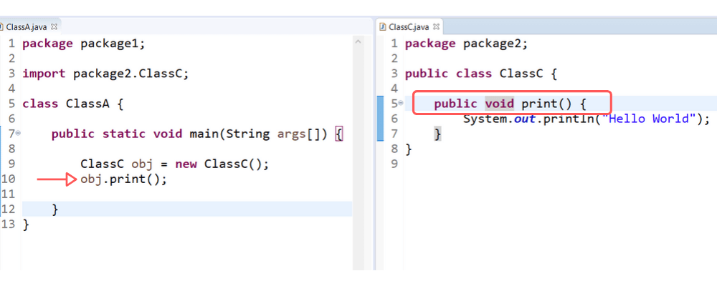
Create and use other class’s object (C)
‘Medical Receptionist’
Patient

Slide 30
Sequence diagram for
VIEW PATIENT INFORMATION USE CASE
OBJECT
ACTOR
OBJECT
ACTOR

Slide 31
Another Example - Sequence Diagram for
Transfer-data use case
A use case in the Mentcare system
Update

Slide 32
Sequence diagram for Transfer Data
NOTE: That information transferred may either be “updated personal information (address, phone number, etc.) or a summary of the patient’s diagnosis and treatment.
.

Slide 33
Another Example – Use Case Diagram for
Royal Car Service Station

Slide 34
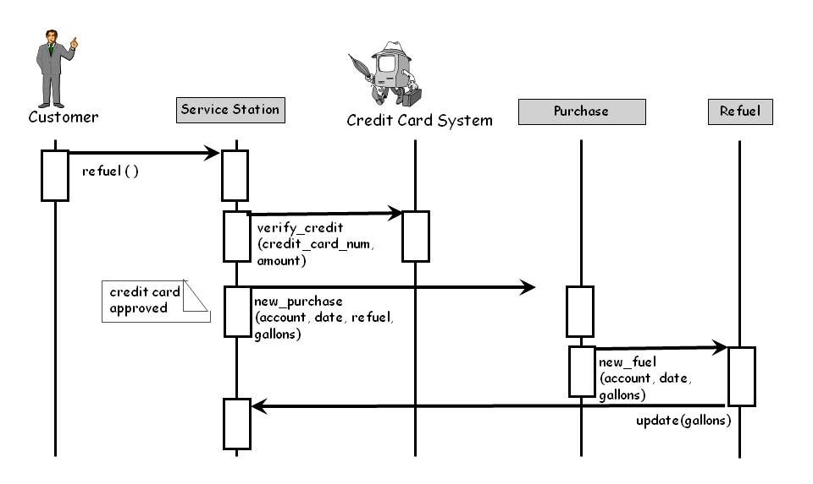
Another Example - Sequence Diagram for Royal Car Service Station
SD describes how operations and behaviors are realized by the objects

Slide 35
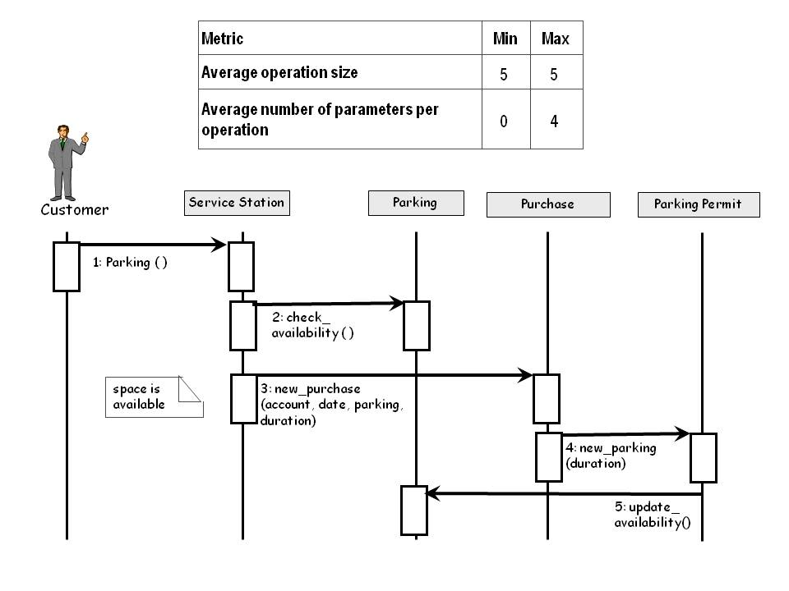
Measuring From a Sequence Diagram

Slide 36
Topics covered
Context models
Interaction models
Structural models
Behavioral models (data-driven & events-driven)
Model-driven engineering

Slide 37
Structural models

Slide 38
Structural models
Structural software models show the organization of a system IN TERMS OF THE COMPONENTS OF THE SYSTEM and THEIR RELATIONSHIPS.
Structural models may be static models, which show the structure of the system design, or dynamic models, which show the organization of the system when it is executing.
You develop structural models of a system when you are discussing and designing the system architecture.

Slide 39
Class diagrams
Class diagrams are used when developing an OBJECT-ORIENTED SYSTEM model to show the classes in a system and the associations between these classes.
An object class can be thought of as a general definition of one kind of system object.
ClassName obj=new ClassName();
An association is a link between classes that indicates that there is some relationship between these classes.
When you are developing models during the early stages of the software engineering process, OBJECTS represent something in the real world, such as a patient, a prescription, doctor, etc.

Slide 40
UML classes and association
2 classes and their association
hasRecord

Slide 41
Classes and associations in the MHC-PMS
pratisyen hekim

Slide 42
The Consultation (muayene) class
Assigning to PRS
değişiliği kayıt sistemine aktarmak

Slide 43
Generalization
Generalization is an everyday technique that we use to manage complexity.
Rather than learn the detailed characteristics of every entity that we experience, we place these entities in more general classes (animals, cars, houses, etc.) and learn the characteristics of these classes.
This allows us to infer that different members of these classes have some common characteristics e.g. squirrels and rats are rodents (sincaplar ve sıçanlar kemirgendir).
E.g. Salaried employee and part-time hourly employee are employee.
Manager and IT staff are employee.

Slide 44
Generalization
In modeling systems, it is often useful to examine the classes in a system to see if there is scope for generalization. If changes are proposed, then you do not have to look at all classes in the system to see if they are affected by the change.
In object-oriented languages, such as Java, generalization is implemented using the class inheritance mechanisms built into the language.
In a generalization, the attributes and operations/methods associated with higher-level classes are also associated with the lower-level classes.
The lower-level classes are subclasses inherit the attributes and operations from their super classes.
These lower-level classes then add more specific attributes and operations.

Slide 45
A generalization hierarchy with added detail
Is_a
çağrı cihazı

Slide 46
A generalization hierarchy
int doctorid;
String name;
CalculateSalary();
int doctorid;
String name;
CalculateSalary();
String addreess;
Date Training-period;
Is a
int doctorid;
String name;
CalculateSalary();
String hospital_meal_card_ID;
Pratisyen/Stajer hekim
int doctorid;
String name;
CalculateSalary();
String hospital_meal_card_ID;
Int Y;
int doctorid;
String name;
CalculateSalary();
String hospital_meal_card_ID;
int X;
int doctorid;
String name;
CalculateSalary();
String hospital_meal_card_ID;
Int Y;
String TraineeDepartment;
int doctorid;
String name;
CalculateSalary();
String hospital_meal_card_ID;
Int Y;
String WorkingDepartment;

Slide 47
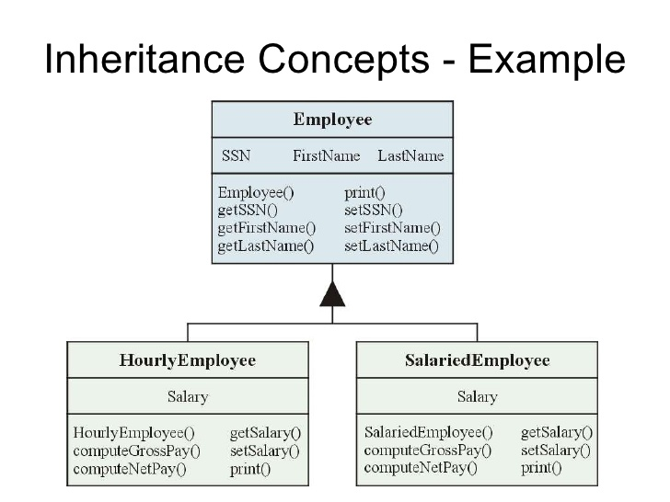
GENERALIZATION- INHERITANCE EXAMPLE

Slide 48
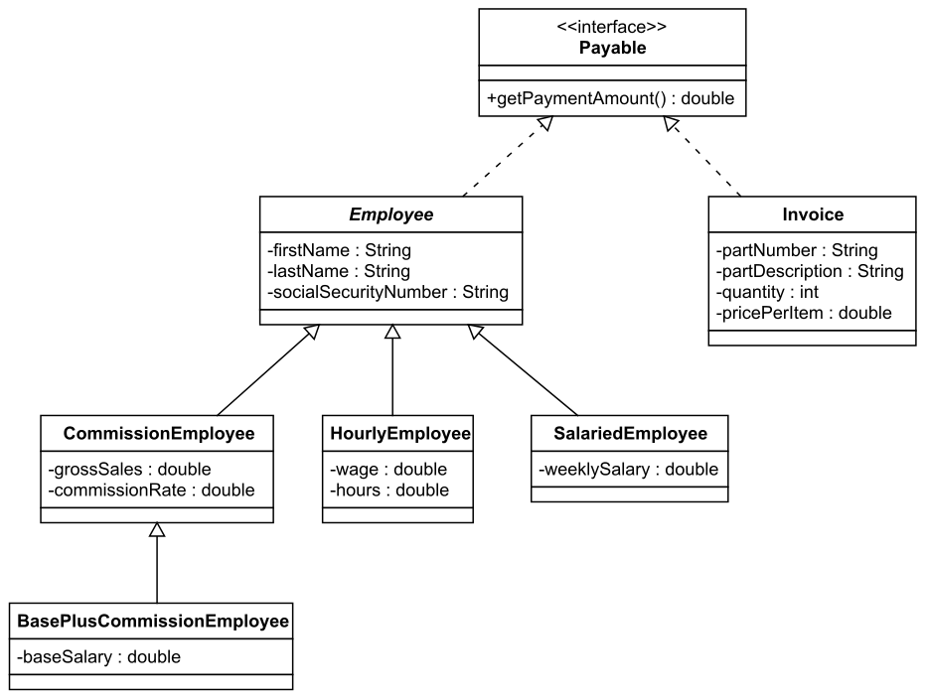
GENERALIZATION- INHERITANCE EXAMPLE

Slide 49
Object class aggregation models
An aggregation model shows how classes that are collections are composed of other classes.
Aggregation models are similar to the part-of relationship in semantic data models.
association
composition
aggregation
generalization
dependency
navigation

Slide 50
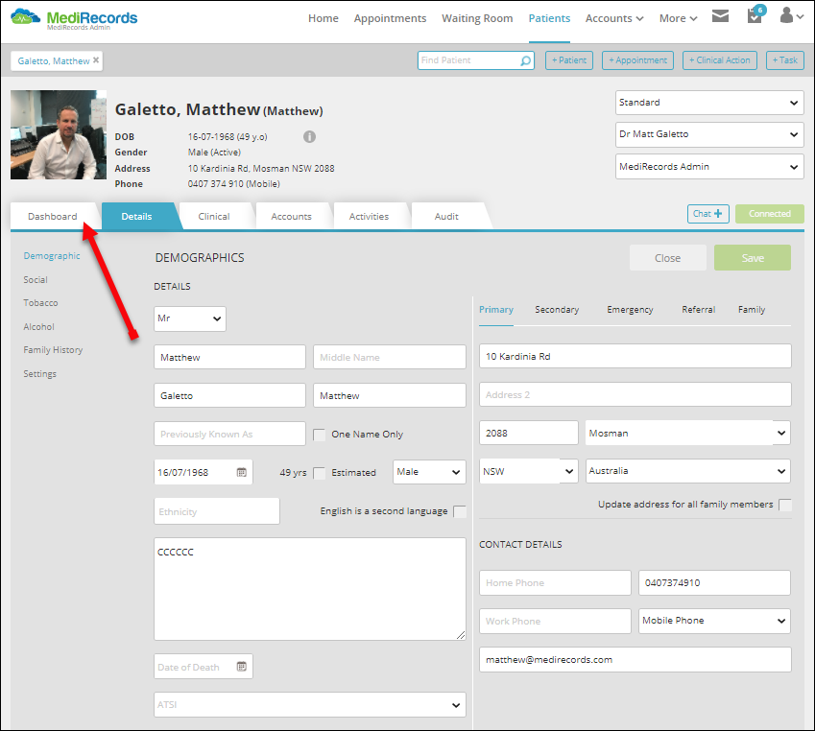
The aggregation association
Patient Record Card
Patient Record= Patient + Consultation

Slide 51
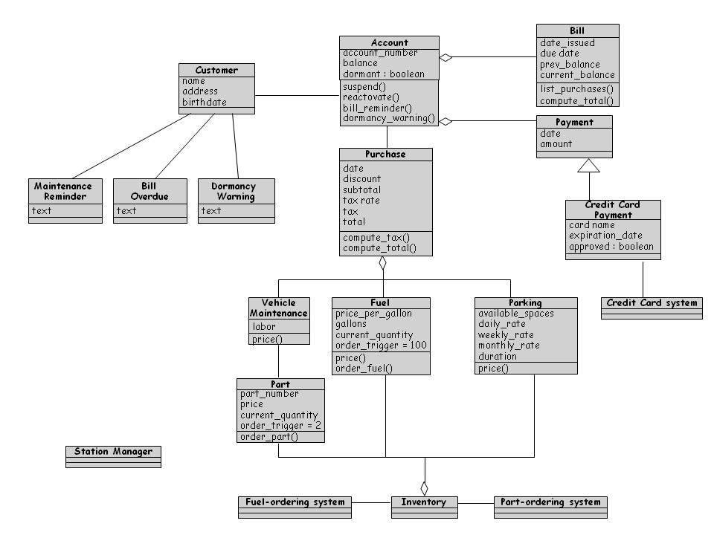
Representing OO Designs in the UML
First Cut for Royal Service Station Design
Messages to
customers
vadesi
geçmiş
fatura
Dormant→ not active account,
uyku halinde

Slide 52
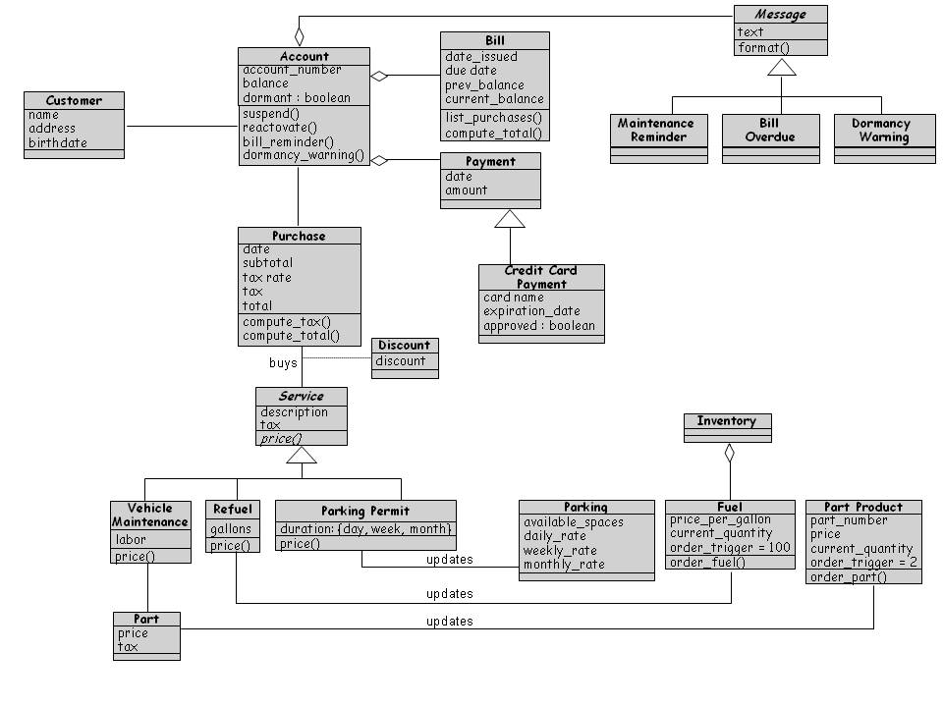
Representing OO Designs in the UML
Second Cut at Royal Service Station Design

Slide 53
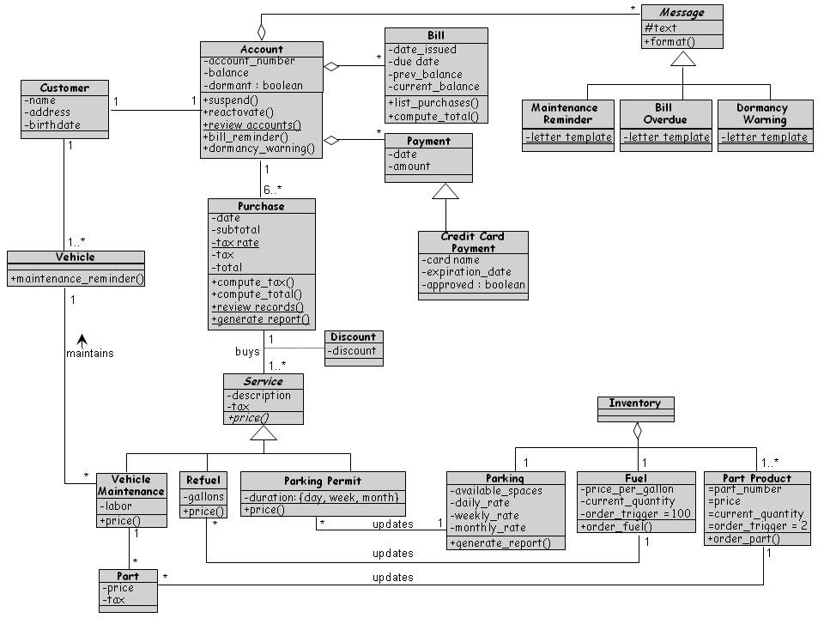
Representing OO Designs in the UML
Final Cut at Royal Service Station Design

Slide 54
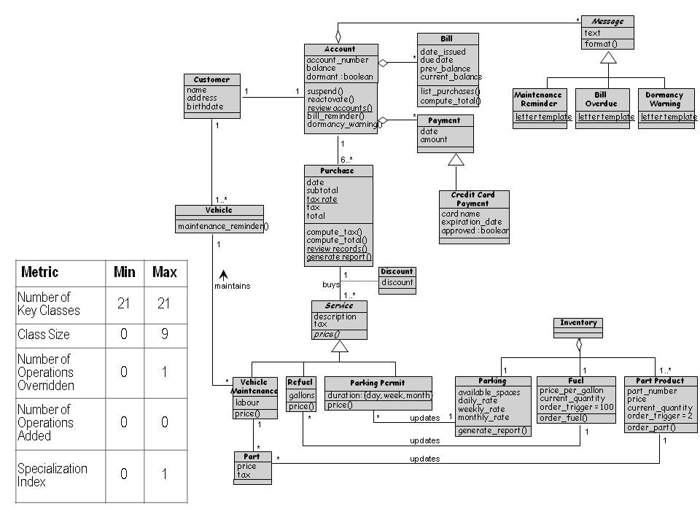
Class Hierarchy for the Royal Service Station

Slide 55
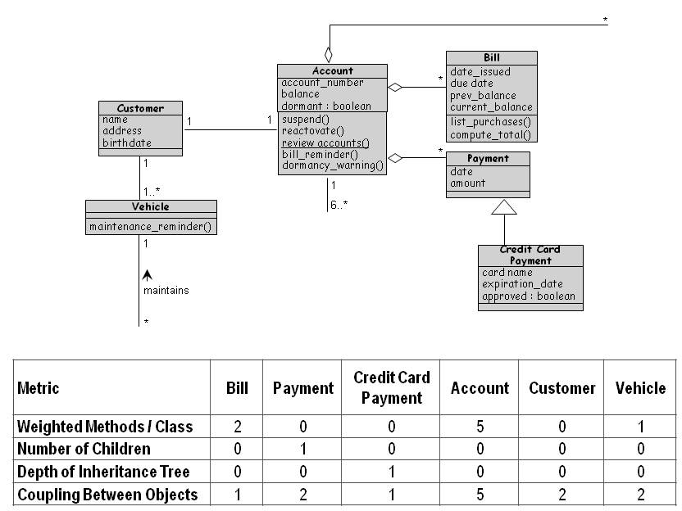
OO Measurement
Chidamber-Kemerer Metrics applied to the Royal Service Station’s System Design

Slide 56
Package Diagram

Slide 57
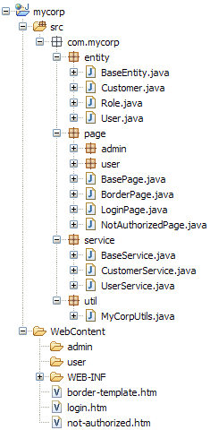
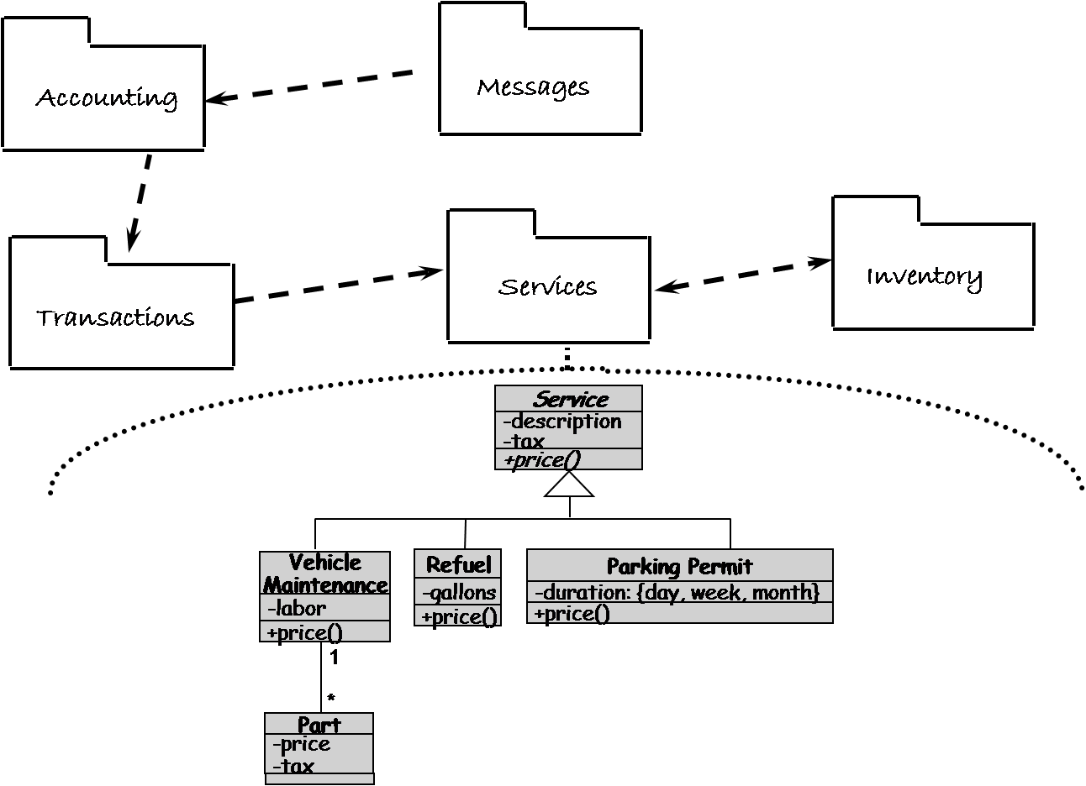
Package Diagram
UML package diagrams allow viewing a system as a small collection of packages each of which may be expanded to a larger set of classes

Slide 58
Class Hierarchy for the Royal Service Station

Slide 59
Communication Diagram

Slide 60
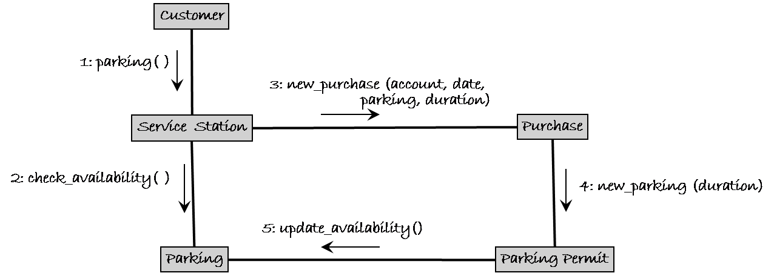
Communication Diagram
A communication diagram shows a sequence of messages between objects but it is assigned on an object and uses the links between object as communication channels.

Slide 61
Behavioral models

Slide 62
Topics covered
Context models
Interaction models
Structural models
Behavioral models (data-driven & events-driven)
Model-driven engineering

Slide 63
Behavioral models
Behavioral models are models of the dynamic behavior of a system as it is executing.
They show what happens or what is supposed to happen when a system responds to a stimulus/inputs from its environment.
You can think of these stimuli (uyaranlar) as being of two types:
  Data →Some data reaches that has to be processed by the system.
  Events→Some event happens that triggers system processing.
    Events may have related data, although this is not always the case.

Slide 64
Package Diagram
1.Data-driven modeling
2.Event-driven modeling

Slide 65
1. Data-driven modeling
Many business systems are data-processing systems that are primarily driven by data.
They are controlled by the data input to the system, with relatively little external event processing.
Data-driven models show the sequence of actions involved in processing input data and generating an associated output.
They are particularly useful during the analysis of requirements as they can be used to show end-to-end processing in a system.

Slide 66
An activity model of the insulin pump’s operation
Sensor
value
Calculation
process
Sensor device
Ready to read
Read process
BS
value
Calculation
process
command
Value data
Insulin
value
Pump is working
control
process
Calculation
process
Data-driven modeling example
Note: Data-driven: Some data reaches that has to be processed by the system… some sequence of actions are taken…

Slide 67
Order processing between Purchase Officer and Supplier
Satın alma
memuru
DB siparişler
Order form
confirm
OK
Order details
Order details
Data-driven modeling example
Note: Data-driven: Some data reaches that has to be processed by the system

Slide 68
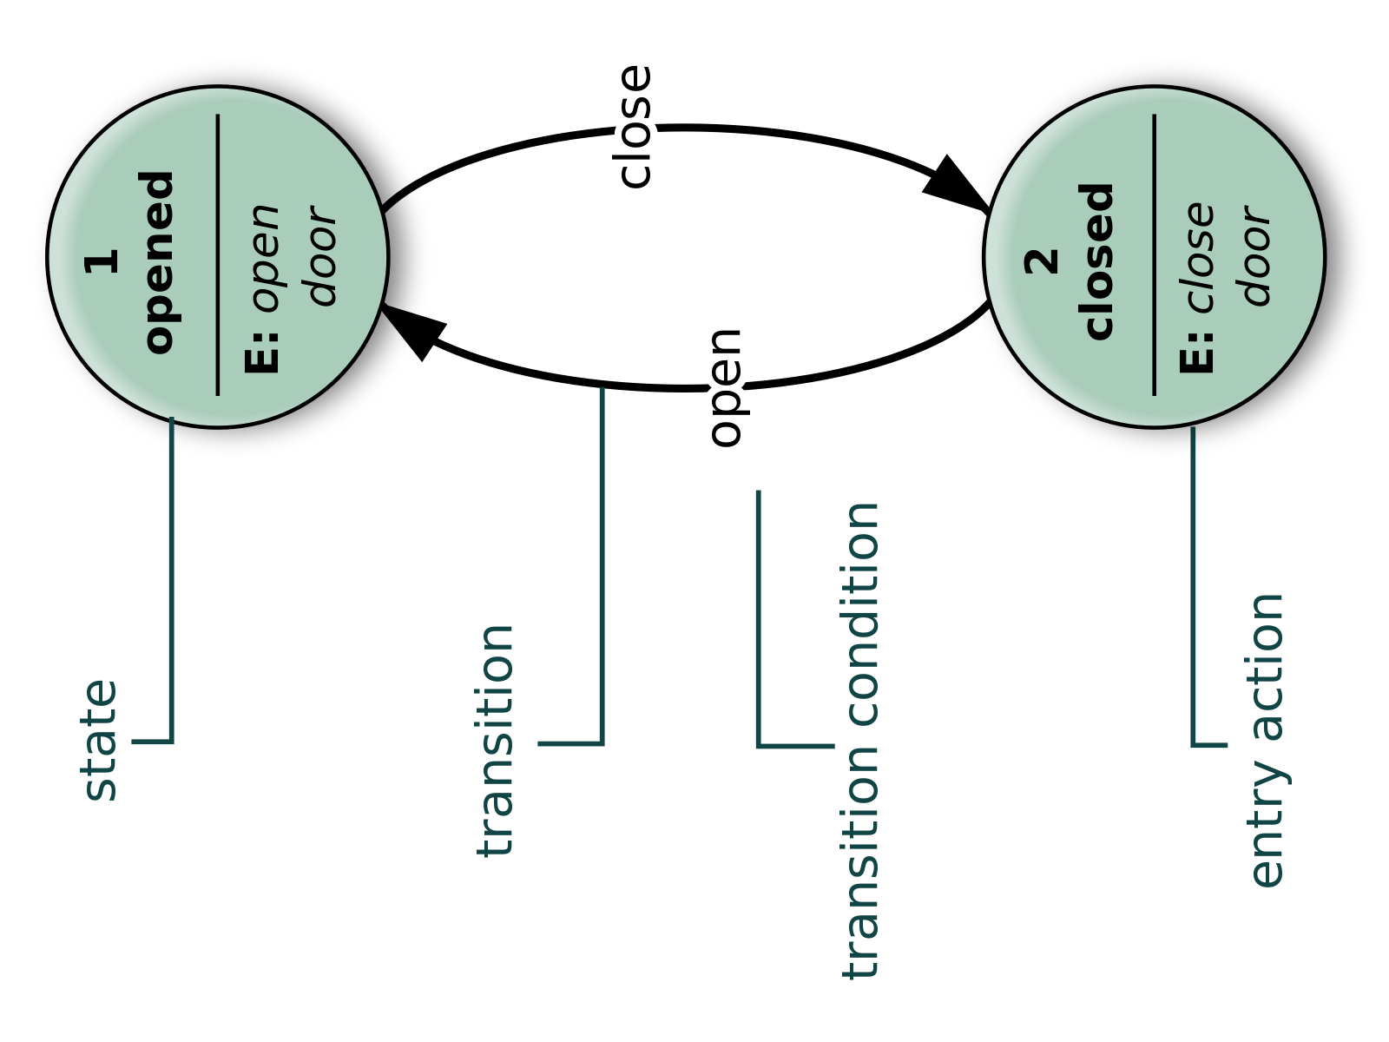
2. Event-driven modeling
REAL-TIME SYSTEMS ARE OFTEN EVENT-DRIVEN, with minimal data processing.
Event-driven modeling shows how a system responds to external and internal events.
It is based on the assumption that a system has a finite number of states and that events (stimuli) may cause a transition from one state to another.

Slide 69
State machine models
It models the behaviour of the system response to external and internal events.
They show the system’s responses to stimuli (input events) and they are often used for modelling real-time systems.
State machine models show system states as nodes and events as arcs between these nodes.
WHEN AN EVENT OCCURS, THE SYSTEM MOVES FROM ONE STATE TO ANOTHER.
State charts are an vital part of the UML and are used to represent state machine models.

Slide 70
Basic UML State Diagram Syntax
A state is drawn with a round box, with three sections for
  name
  state variables (if any)
  actions to be performed
A transition is drawn with an arrow, possibly labeled with
  event causing the transaction
  guard condition
  Action to perform
Variables→class attributes
Actions→class functions
Actions→class functions

Slide 71
Predefined Action Labels
“entry/???”
  identifies an action, specified by the corresponding action expression, which is performed upon entry to the state (entry action)
“exit/???”
  identifies an action, specified by the corresponding action expression, that is performed upon exit from the state (exit action)
“do/????”
  identifies an ongoing activity (“do activity”) that is performed as long as the modeled element is in the state or until the computation specified by the action expression is completed (the latter may result in a completion event being generated).
“include/”
  is used to identify a submachine invocation. The action expression contains the name of the submachine that is to be invoked.

Slide 72
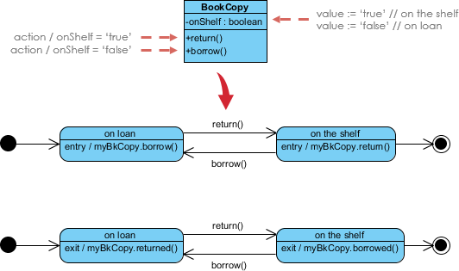
Simple Example
Two states for “onShelf” attribute: “true, false”
Book is returned
Book is borrowed

Slide 73
Combination of Entry/Exit Labels
onLoan=true
Entry/myBkCopy.Borrowed()
Exit/myBkCopy.returned()
onShelf=true
Entry/myBkCopy.returned()
Exit/myBkCopy.Borrowed()

Slide 74
Independent State Components
We can explore the phenomenon of rapid state diagram growth by examining a typical class with three attributes
Each combination of values of the attributes of this class constitute a different state for the class
Note that the attributes are effectively independent of each other
  any combination is valid

Slide 75
Hospital Management System - State Diagram
Here we have described different states of following Objects: Doctor, Patient, Ward (koğuş) and Diagnosis

Slide 76
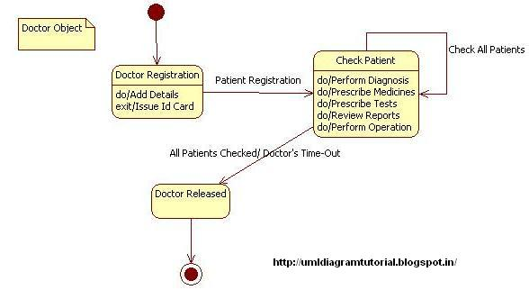
State Diagram for Doctor Object
Doktor sisteme bilgilerini girer ve hastalara bakmaya başlar
Doktor kayıt durumundan çıkmak için kimlik kartı girilir
Klinikte hasta muayene/aktiviteler
Status
Patient_registration();
Event/Activity

Slide 77
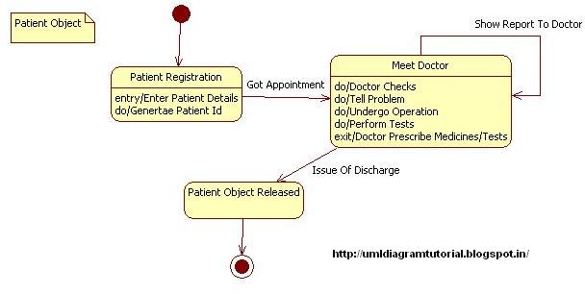
State Diagram For Patient Object:
Event/Activity
taburcu olma

Slide 78
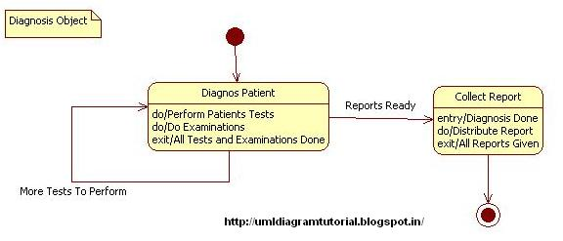
State Diagram For Diagnosis Object:

Slide 79
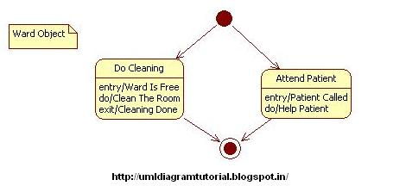
State Diagram For Ward Object:

Slide 80
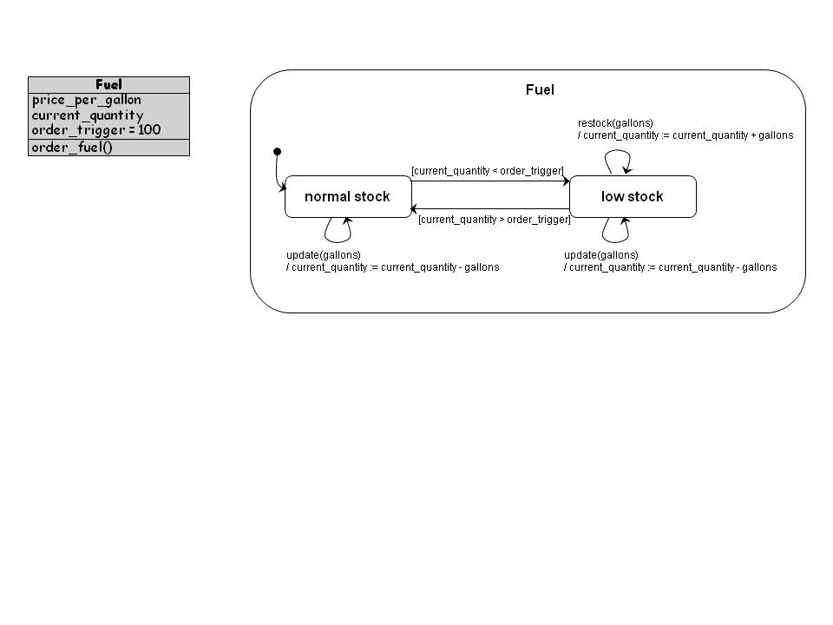
State Diagram Example
The state diagram shows the possible states a Fuel object can take, the events that trigger the transition between one state to the next, and the actions that result from each state change
Galon fiyatı, Güncel Stok Mik, Sipariş Galon Mik
If stock<order ➔ Low Stock ➔ buy/stock gallons
If stock>order➔ Normal Stock ➔ sell gallons
Stock gallons
Current<100
Current>100
Sell gallons
Sell gallons

Slide 81
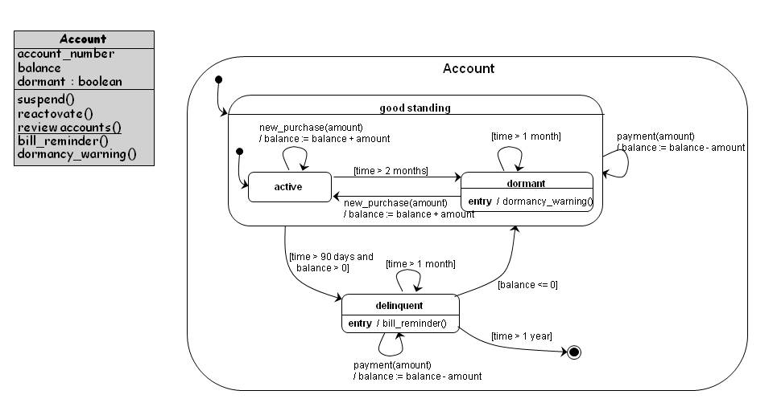
State Diagram Example

Slide 82
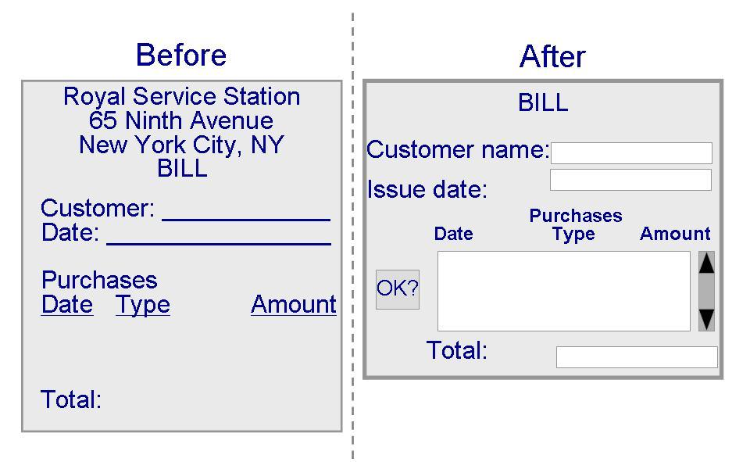
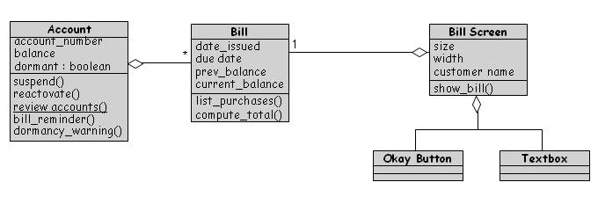
Designing User Interfaces

Slide 83
Another Example
State diagram of a microwave oven

Slide 84
State diagram of a microwave oven
NOTE: Events-driven: Some event happens that triggers system processing

Slide 85
States and stimuli for the microwave oven (a)
State | Description
Waiting | The oven is waiting for input. The display shows the current time.
Half power | The oven power is set to 300 watts. The display shows ‘Half power’.
Full power | The oven power is set to 600 watts. The display shows ‘Full power’.
Set time | The cooking time is set to the user’s input value. The display shows the cooking time selected and is updated as the time is set.
Disabled | Oven operation is disabled for safety. Interior oven light is on. Display shows ‘Not ready’.
Enabled | Oven operation is enabled. Interior oven light is off. Display shows ‘Ready to cook’.
Operation | Oven in operation. Interior oven light is on. Display shows the timer countdown. On completion of cooking, the buzzer is sounded for five seconds. Oven light is on. Display shows ‘Cooking complete’ while buzzer is sounding.

Slide 86
States and stimuli for the microwave oven (b)
Stimulus | Description
Half power | The user has pressed the half-power button.
Full power | The user has pressed the full-power button.
Timer | The user has pressed one of the timer buttons.
Number | The user has pressed a numeric key.
Door open | The oven door switch is not closed.
Door closed | The oven door switch is closed.
Start | The user has pressed the Start button.
Cancel | The user has pressed the Cancel button.

Slide 87
Last state: Microwave oven operation
NOTE: Events-driven: Some event happens that triggers system processing

Slide 88
Topics covered
Context models
Interaction models
Structural models
Behavioral models
Model-driven engineering

Slide 89
Model-driven engineering

Slide 90
Model-driven engineering
Model-driven engineering (MDE) is an approach to software development where models rather than programs are the principal outputs of the development process.
The programs that execute on a hardware/software platform are then generated automatically from the models.
Model-driven engineers said that: MDE increases the level of abstraction in software engineering
They support that developers no longer have to struggle programming language details or features of programming platforms.

Slide 91
Usage of model-driven engineering
Model-driven engineering is still at an early stage of development, and
it is unclear whether or not it will have a significant effect on software engineering practice.
Pros
  Allows systems to be considered at higher levels of abstraction
  Generating code automatically means that it is cheaper to adapt systems to new platforms.
Cons
  Models for abstraction and not necessarily right for implementation.
  Savings from generating code may be outweighed by the costs of developing translators for new platforms.

Slide 92
Model driven architecture
Model-driven architecture (MDA) was the ancestor of more general Model-driven Engineering
MDA is a model-focused approach to software design and implementation that uses a subset of UML models to describe a system.
Models at different levels of abstraction are created.
From a high-level, platform independent model, it is possible, in principle, to generate a working program without manual intervention.

Slide 93
Types of model
A computation independent model (CIM)
  These model the important domain abstractions used in a system.
  CIMs are sometimes called domain models.
A platform independent model (PIM)
  These model the operation of the system without reference to its implementation. The PIM is usually described using UML models that show the static system structure and how it responds to external and internal events.
Platform specific models (PSM)
  These are transformations of the platform-independent model with a separate PSM for each application platform. In principle, there may be layers of PSM, with each layer adding some platform-specific detail.

Slide 94
MDA transformations

Slide 95
Multiple platform-specific models

Slide 96
Agile methods and MDA
The developers of MDA claim that it is intended to support an iterative approach to development and so can be used within agile methods.
The notion of extensive up-front modeling contradicts the fundamental ideas in the agile manifesto and I suspect that few agile developers feel comfortable with model-driven engineering.
If transformations can be completely automated and a complete program generated from a PIM, then, in principle, MDA could be used in an agile development process as no separate coding would be required.

Slide 97
Adoption of MDA
A range of factors has limited the adoption of MDE/MDA
Specialized tool support is required to convert models from one level to another
There is limited tool availability and organizations may require tool adaptation and customisation to their environment
For the long-lifetime systems developed using MDA, companies are reluctant to develop their own tools or rely on small companies that may go out of business

Slide 98
Adoption of MDA
Models are a good way of facilitating discussions about a software design. Howeverthe abstractions that are useful for discussions may not be the right abstractions for implementation.
For most complex systems, implementation is not the major problem – requirements engineering, security and dependability, integration with legacy systems and testing are all more significant.

Slide 99
Adoption of MDA
The arguments for platform-independence are only valid for large, long-lifetime systems. For software products and information systems, the savings from the use of MDA are likely to be outweighed by the costs of its introduction and tooling.
The widespread adoption of agile methods over the same period that MDA was evolving has diverted attention away from model-driven approaches.

Slide 100
Key points
A model is an abstract view of a system that ignores system details. Complementary system models can be developed to show the system’s context, interactions, structure and behavior.
Context models show how a system that is being modeled is positioned in an environment with other systems and processes.
Use case diagrams and sequence diagrams are used to describe the interactions between users and systems in the system being designed. Use cases describe interactions between a system and external actors; sequence diagrams add more information to these by showing interactions between system objects.
Structural models show the organization and architecture of a system. Class diagrams are used to define the static structure of classes in a system and their associations.

Slide 101
Key points
Behavioral models are used to describe the dynamic behavior of an executing system. This behavior can be modeled from the perspective of the data processed by the system, or by the events that stimulate responses from a system.
Activity diagrams may be used to model the processing of data, where each activity represents one process step.
State diagrams are used to model a system’s behavior in response to internal or external events.
Model-driven engineering is an approach to software development in which a system is represented as a set of models that can be automatically transformed to executable code.

Slide 102
HOME WORK
PREPARE YOUR DIAGRAMS
- CONSIDER the SYSTEM OF YOUR TERM PROJECT-

Slide 103
HOME WORK- CONSIDER YOUR SYSTEM
Activity diagrams, which show the activities involved in a process or in data processing.
Use case diagrams, which show the interactions between a system and its environment.
Sequence diagrams, which show interactions between actors and the system and between system components.
Class diagrams, which show the object classes in the system and the associations between these classes.
State diagrams, which show how the system reacts to internal and external events.

Slide 104
INHERITANCE EXAMPLE IN JAVA

Slide 105
package staffmemberproject; public abstract class Employee { protected String ssn; protected String FirstName; protected String LastName protected double basepayment; // monthly payment or pay for per hour public Employee(String eName, String eAddress, String ePhone, String ssn, double basepayment) { super(eName, eAddress, ePhone); this.ssn = ssn; this.basepayment = basepayment; } public String justprint() { String result = "social Security Number:" + ssn + "\n"; result += "base payment:" + basepayment + "\n"; return result; } public abstract double paySalary(); //will be returned PaymentOfPerMounth or PaymentOfPerHour public abstract double CalcRaisedSalary();//will be returned the raised PaymentOfPerMounth or raised PaymentOfPerHour }

Slide 106
package staffmemberproject; public class Hourly extends Employee { private int hoursWorked; public Hourly(String eName, String eAddress, String ePhone, String ssn, double pay, int hoursWorked) { super(eName, eAddress, ePhone, ssn, pay); this.hoursWorked = hoursWorked; } public double paySalary() { return super.basepayment * hoursWorked; // return monthly payment = base payment for each hour * worked hours } public double CalcRaisedSalary() { double raisedPayPerHour = (super.basepayment + (super.basepayment * 0.10)); //find final raised payment per hour = base payment for each hour + by taking 10% of basepayment double monthlyPay = raisedPayPerHour * hoursWorked; // find double monthlyPay= final raised payment for each hour * worked hours return monthlyPay; // return monthlyPay as a raised salary for the month } public String justprint() { String result = super.justprint() + "\n"; result += "hoursWorked:" + hoursWorked + "\n"; return result; } }

Slide 107
package staffmemberproject; public class Executive extends Employee { private int bonusHours; // mesai=extra worked hours for the month public Executive(String eName, String eAddress, String ePhone, String ssn, double pay, int bonusHours) { super(eName, eAddress, ePhone, ssn, pay); this.bonusHours = bonusHours; } public double paySalary() { return super.basepayment; // return basepayment as monthly salary or payment } public double CalcRaisedSalary() { //Calculate Raised Monthly Salary through basepayment double hourlyPayment = (super.basepayment / 30) / 8; // calculate hourlyPayment=((monthly base Salary/ 30 days)/8 hours) return super.basepayment + hourlyPayment * bonusHours; // return monthly base salary + hourly Payment * bonus Hours } public String justprint() { String result = super.justprint() + "\n"; result += "bonus Hours:" + bonusHours + "\n"; return result; } }

Slide 108
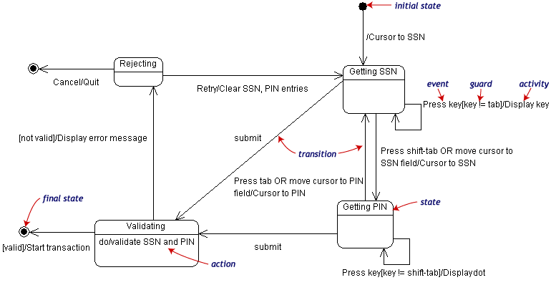
Another example
Notes:
Statechart diagrams
Objects have behaviors and state. The state of an object depends on its current activity or condition. A statechart diagram shows the possible states of the object and the transitions that cause a change in state.
Our example diagram models the login part of an online banking system. Logging in consists of entering a valid social security number and personal id number, then submitting the information for validation.
Logging in can be factored into four non-overlapping states: Getting SSN, Getting PIN, Validating, and Rejecting. From each state comes a complete set of transitions that determine the subsequent state.
States are rounded rectangles. Transitions are arrows from one state to another. Events or conditions that trigger transitions are written beside the arrows. Our diagram has two self-transition, one on Getting SSN and another on Getting PIN.
The initial state (black circle) is a dummy to start the action. Final states are also dummy states that terminate the action.
The action that occurs as a result of an event or condition is expressed in the form /action. While in its Validating state, the object does not wait for an outside event to trigger a transition. Instead, it performs an activity. The result of that activity determines its subsequent state.

