Slide 1
Chapter 7 – Architectural Design
https://www.youtube.com/watch?v=_07NtoK-Kns

Slide 2
Topics covered
Architectural design decisions
Architectural views
Architectural patterns
Application architectures

Slide 3
Architectural design
Architectural design is about understanding how a software system should be organized and designing the overall structure of that system.
Architectural design is the critical link between design and requirements engineering, as it identifies the main structural components in a system and the relationships between them.
The output of the architectural design stage is an ARCHITECTURAL MODEL that describes how the system is organized as a set of communicating components.
Refactoring/reformation the system architecture is usually expensive because it affects so many components in the system.
Early stages of SDLC.

Slide 4
Introduction
The software requires the architectural design to represents the design of software.
IEEE defines architectural design as “the process of defining a collection of hardware and software components and their interfaces to establish the framework for the development of a computer system.”

Slide 5
Architectural Styles
Software can display many architectural styles.
  A set of components (e.g.: a database, computational modules) that will perform a function required by the system.
  The set of connectors will help in coordination, communication, and cooperation between the components.
  Conditions that how components can be integrated to form the system.
  Semantic models that help the designer to understand the overall properties of the system.

Slide 6
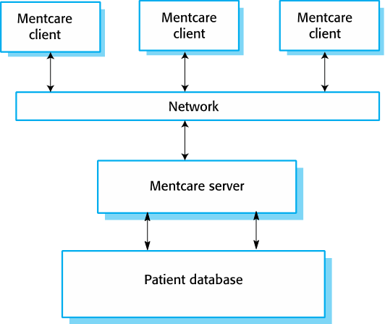
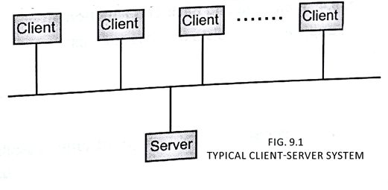
The architecture of Mentcare system

Slide 7
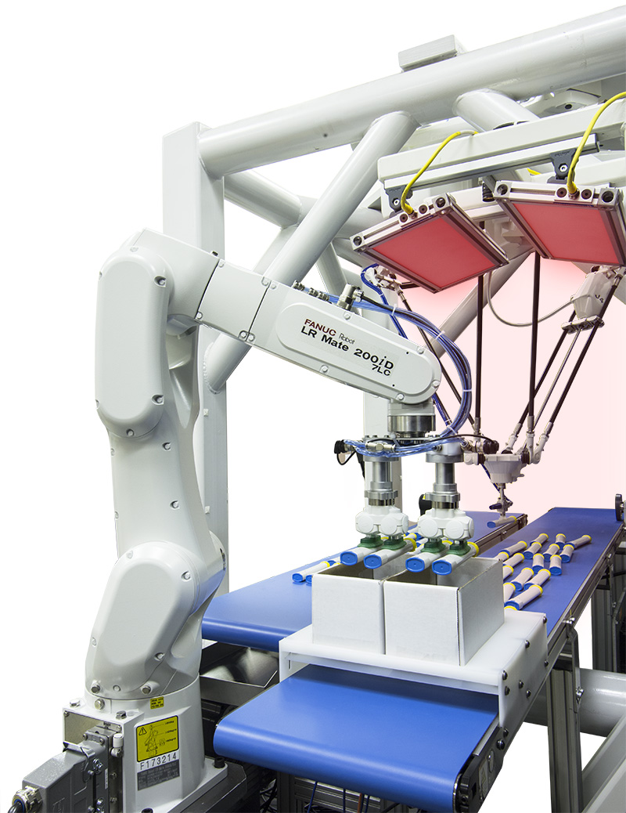
The architecture of a packing robot control system
kavrayıcı

Slide 8
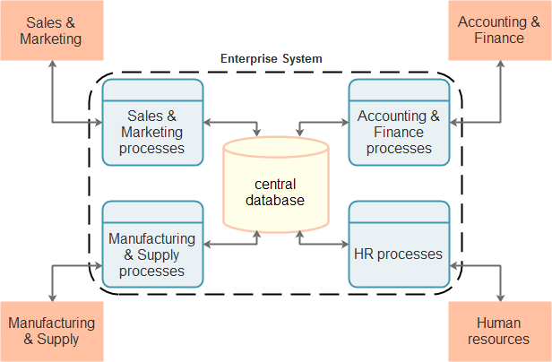
Architectural abstraction
If Architecture is small→
  We interest here how an individual program is divided into components/modules (generally no sub systems).
If Architecture is big→
  It is concerned with the architecture of complex enterprise systems that may include other systems, programs, and components.
  These enterprise systems are distributed over different computers, which may be owned and managed by different companies.

Slide 9
Architectural representations
Simple, informal block diagrams are the most commonly used method for documenting software architectures.
These diagrams are showing entities and relationships between the entities.
But the architectural representations can be discussable/argumentative because they lack semantics,
  → BECAUSE, they do not show the types of relationships between entities nor the visible properties of entities in the architecture.

Slide 10
Using Box and line diagrams
We are using box and line diagrams.
Very abstract - they do not show the nature of component relationships nor the externally visible properties of the sub-systems.
However, useful way to communicate with stakeholders and for project planning.

Slide 11
Use of architectural models
We are using architectural models:
  As a way of easing discussion about the system design,
    A high-level architectural view of a system is useful for communication with stakeholders and project planning because it is not messy with details.
    Stakeholders can relate to it and understand an abstract view of the system.
    They can then discuss the system as a whole without being confused by detail.
  As a way of documenting its architecture that has been designed,
    The aim here is to produce a complete system model that shows the different components in a system, their interfaces and their connections.

Slide 12
How should we make architectural design decisions?

Slide 13
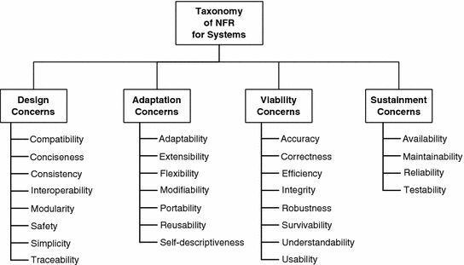
Architectural design decisions
It is a creative process,
so the design process differs depending on the type of system.
However, a set of common decisions covers all design processes, and these decisions affect the NFRs of the system.
Architectural design highly depend on NFRs
EXAMPLE: To increase a system’s performance several strategies can be employed, for instance:
◽ Caching techniques
◽ Increase your HW resources: memory, CPUs, networks
◽ Load balancing techniques
◽ Data partitioning / replication ,etc.

Slide 14
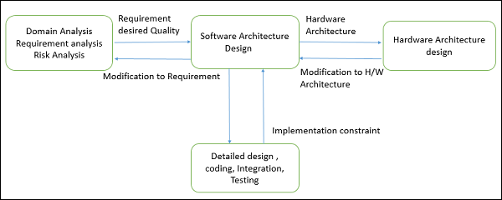
SW Architecture design plan are as follows −
Negotiate system requirements, and then set system expectations with customers, marketing, and management personnel.
Act as a blueprint/plan during the development process.
Guide the implementation tasks, including detailed design, coding, integration, and testing.
NFR: What capacity a server machine should I use to generate our reports within 1-2 mins monthly?

Slide 15
Software Architecture
Architecture serves as a blueprint (taslak) for a system.
It provides a communication and coordination mechanism among components.
It defines a structured solution to meet all the Operational Requirements, while optimizing the common quality attributes like performance and security.
Additionally, it involves a set of important decisions about the organization related to the software project’s development and
  each of these decisions can have a considerable impact on quality, maintainability, performance, and the overall success of the final product.

Slide 16
What are these decisions?
Selection of structural elements (e.g. HW components) and their interfaces by which the system is composed.
Behavior as specified in collaborations among those elements/components.
Composition of these structural and behavioral elements into large subsystem.
  We may need to compose them to create a subsystem.
Architectural decisions should match with business objectives.

Slide 17
Architectural design decisions
Similar system arch
design available?
Distribution of procesessors?
Which Arch Pattern is suit?
Decomposing components
Which ach. Structure
suitable for our NFRs
Documentation???

Slide 18
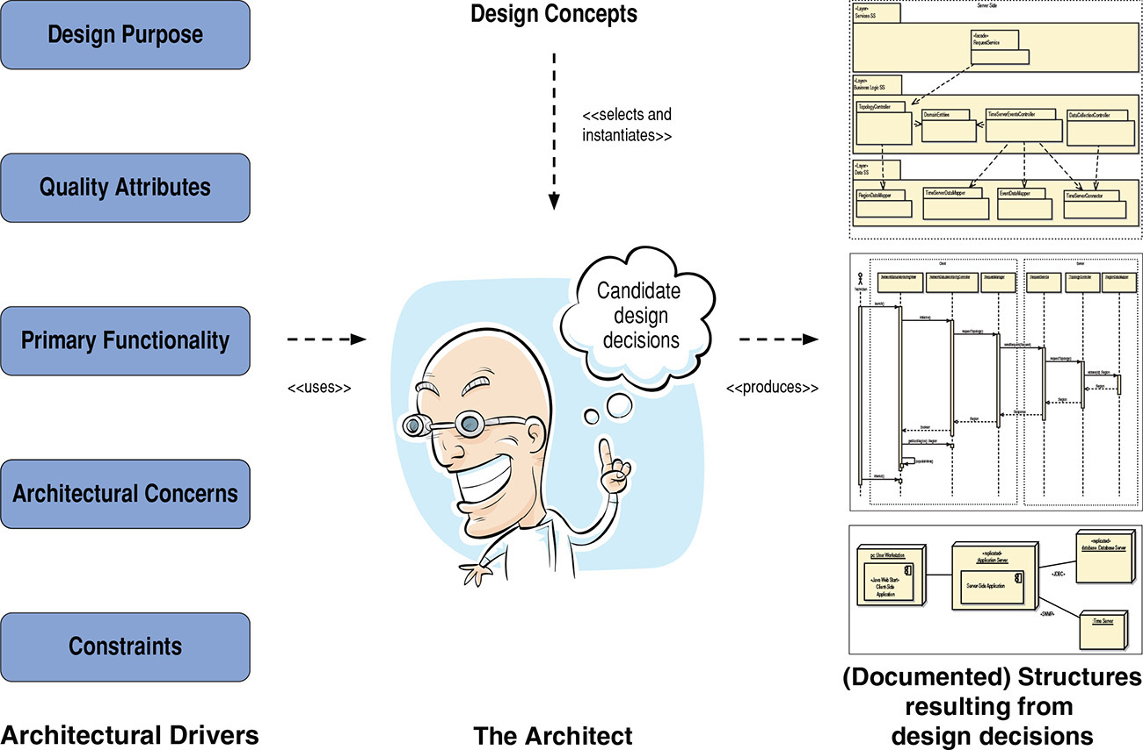
In architectural design, we make decisions to transform our design purpose, requirements, constraints, and architectural concerns—known as architectural drivers—into structures, as shown in the figure.
These structures are then used to guide the project. They guide analysis and construction, and serve as the basis for educating a new project member.
They also guide cost and schedule estimation, team formation, risk analysis and mitigation, and, of course, implementation.

Slide 19
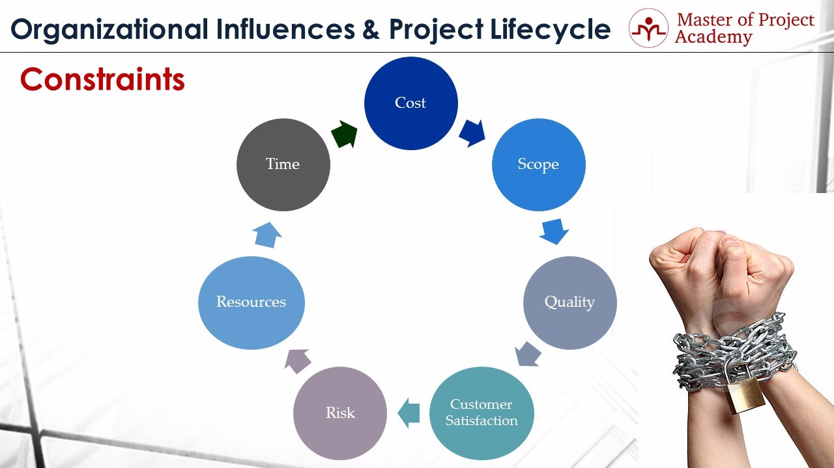
What are my constraints?
1-For instance, project sponsor might state that "I want this project to be completed till end of next year".
2- For instance, if you are working in a software vendor, development of an e-commerce website can be a project scope. And, if the scope is "development of an end-to-end operating e-commerce retail website" this is an example of project scope constraint.
3-For instance, he can say that "You need to complete this project with a one million dollar budget".
4-For instance, if there is a risk of losing a project team member, you may prepare a handover document for the activities of that team member is doing in the project. And if he leaves the project, or company, or in other words, if the risk occurs, you can use the handover documents to assign his tasks to a new team member and reduce the impact of this risk.
Notes:
Common Project Constraints #1: Cost
Cost is very important project constraint. At the beginning of the project, project sponsor will be stating his or her expectations from the project. And also, he or she can come with a project cost constraint. For instance, he can say that "You need to complete this project with a one million dollar budget". From this point onward, this one-million-dollar budget will be your project constraint, and you have to complete the project under this budget.
Common Project Constraints #2: Scope
Project scope defines what needs to be completed in a project, therefore it is a very important project constraint as well. For instance, if you are working in a software vendor, development of a e-commerce website can be a project scope. And, if the scope is "development of an end-to-end operating e-commerce retail website" this is an example of project scope constraint.
Common Project Constraints #3: Quality
Quality comes with cost. If there will be strict quality requirements in a project, this will affect the cost project constraint directly. For instance, if you are working in a construction project, the customer might expect the building to be resistant against 8.0 Richter earth quake. Construction of a more resistant building will cost higher for sure. And if more quality is a project constraint, you should be aligned with this constraint in the project.
Common Project Constraints #4: Customer Satisfaction
Customer satisfaction is a key factor for a sustainable and long-running business in the market. All companies do business for their customers in the end. Because, they are the source of money and if you cannot satisfy your customers, you will not be able to stand against competition during time. Therefore, customer satisfaction is a crucial project constraint.
Common Project Constraints #5: Risk
Risks can be either positive or negative in a project. Project managers must enhance the opportunities of positive risks and reduce the threats of negative risks in a project. For instance, if there is a risk of losing a project team member, you should prepare a handover document for the activities of that team member is doing in the project. And if he leaves the project, or company, or in other words, if the risk occurs, you can use the handover documents to assign tasks to a new team member and reduce the impact of this risk. Risk is a very critical project constraint in project management.
Common Project Constraints #6: Resources
Many project managers think that only project team members are considered as project resources. However, tools, equipment, or material that will be used during the project are all project resources, and project constraints respectively. For instance, cement, bulldozer, or a scheduling software that will be used during the project are all project resources and project constraints respectively.
Common Project Constraints #7: Time
Time is money! When starting a project, there will be deadlines that will be proposed by the project sponsor. For instance, project sponsor might state that "I want this project to be completed till end of next year". This will be your time constraint in the project.

Slide 20
Goals of Architecture
The primary goal of the architecture modelling is to identify requirements that affect the structure of the application.
A well-laid architecture model reduces the business risks related with building a technical solution and builds a bridge between business and technical requirements.
Some of the other goals are as follows −
  Provides to represent the structure of the system, but hide its implementation details.
  Provides to realize all the use-cases and scenarios.
  Provides to address the requirements of various stakeholders.
  Provides to handle both functional and quality requirements.
  Provides to improve the organization’s market position.
  Provides to improve quality and functionality offered by the system.
  Provides to improve external confidence in either the organization or system.

Slide 21

Architecture reuse
Similar systems (especially in the same domain) often have similar architectures that reflect domain concepts.
SW products are built/produced based on a core architecture with modifications that satisfy particular customer requirements.
The architecture of a system may be designed around one of more architectural patterns or ‘styles’.

Slide 22
Software Architecture Models
Software architecture involves the high level structure of software system abstraction, by using decomposition and composition, with architectural style and quality attributes.
A software architecture must describe its group of components, their connections, interactions among them and deployment configuration of all components.
A software architecture design must conform to the Major Functionality and Performance Requirements of the system, as well as satisfy the NON-FUNCTIONAL REQUIREMENTS such as Reliability, Scalability, Portability, And Availability.

Slide 23
Common Quality Attributes
The table lists the common quality attributes a software architecture must have −
Category | Quality Attribute | Description
Design Qualities | Conceptual Integrity | Defines the consistency and coherence of the overall design. This includes the way components or modules are designed.
 | Maintainability | Ability of the system to undergo changes with a degree of ease. Changeability degree of the system!
 | Reusability | Defines the capability for components and subsystems to be suitable for use in other applications.
Run-time Qualities | Interoperability | Ability of a system or different systems to operate successfully by communicating and exchanging information with other external systems written and run by external parties.
 | Manageability | Defines how easy it is for system administrators to manage the application.
 | Reliability | Ability of a system to continue operational over time.
 | Scalability | Ability of a system to either handle the load increase without impacting the performance of the system or the ability to be easily enlarged.
 | Security | Capability of a system to prevent malicious or accidental actions outside of the designed usages.
 | Performance | Indication of the responsiveness of a system to execute any action within a given time interval.
 | Availability | Defines the proportion of time that the system is functional and working. It can be measured as a percentage of the total system downtime over a predefined period. Idle time rate.

Slide 24
Common Quality Attributes
Category | Quality Attribute | Description
System Qualities | Supportability | Ability of the system to provide information helpful for identifying and resolving issues when it fails to work correctly.
 | Testability | Measure of how easy it is to create test criteria for the system and its components.
User Qualities | Usability | Defines how well the application meets the requirements of the user and consumer by being intuitive.
Architecture Quality | Correctness | Accountability for satisfying all the requirements of the system.
Non-runtime Quality | Portability | Ability of the system to run under different computing environment.
 | Integrality | Ability to make separately developed components of the system work correctly together.
 | Modifiability | Ease with which each software system can accommodate changes to its software.
Business quality attributes | Cost and schedule | Cost of the system with respect to time to market, expected project lifetime & utilization of legacy.
 | Marketability | Use of system with respect to market competition.

Slide 25
Architecture and system characteristics
Performance
  Localize critical operations and minimize communications. Use large rather than fine-grain components.
Security
  Use a layered architecture with critical assets in the inner layers.
Safety
  Localize safety-critical features in a small number of sub-systems.
Availability
  Include redundant (backup) components and mechanisms for fault tolerance.
Maintainability
  Use fine-grain, replaceable components.

Slide 26
EXAMPLES ON NFRs
PERFORMANCE EXAMPLE: To increase your system’s performance several strategies can be employed, for instance:
◽ Caching techniques
◽ Increase your hardware resources: memory, CPUs, networks
◽ Load balancing techniques
◽ Data partitioning / replication ,etc.
SCALING EXAMPLE: When planning for scaling, these are some considerations to take into account:
◽ Number of users
◽ Amount of data
◽ CPU, Memory, I/O intensive operations
◽ Asynchronous rather than Synchronous,etc.
NOTE: Scalable software typically refers to business processes that can adapt to support an increasing amount of data or a growing number of users. For example, a scalable database management system (DBMS) should be able to efficiently expand as more data is added to the database.

Slide 27
Architectural views

Slide 28
Architectural views (mimari görünüm???)
What views or perspectives are useful when designing and documenting a system’s architecture?
What notations should be used for describing architectural models?
Each architectural model only shows one view or one perspective of the system (e.g. physical view or logical view of the system).
  It might show how a system is decomposed into modules,
  how the run-time processes interact or
  the different ways in which system components are distributed across a network.
For both DESIGN and DOCUMENTATION, you usually need to draw multiple views (logical, physical, process, development views…) of the software architecture.

Slide 29
A software architecture can be defined in many ways −Representing architectural views −
UML (Unified Modeling Language) − UML is one of object-oriented solutions used in software modeling and design.
Architecture View Model (4+1 view model) − Architecture view model represents the functional and non-functional requirements of software application.
ADL (Architecture Description Language) − ADL defines the software architecture formally and semantically.

Slide 30
Architecture View Model (4+1 view model) for software architecture modelling

Slide 31
Architecture View Model (4+1 view model) for software architecture modelling
A logical view, which shows the key abstractions in the system as objects or object classes (e.g. class diagrams).
A process view, which shows how, at run-time, the system is composed of interacting processes (e.g. activity, BPMN, sequence, etc.).
A developer/implementation view, which shows how the software is decomposed to sub systems/components for development.
A physical/deployment view, which shows the system hardware and how software components are distributed across the processors in the system.
Scenario view or use case view → Related using use cases or scenarios (+1)

Slide 32
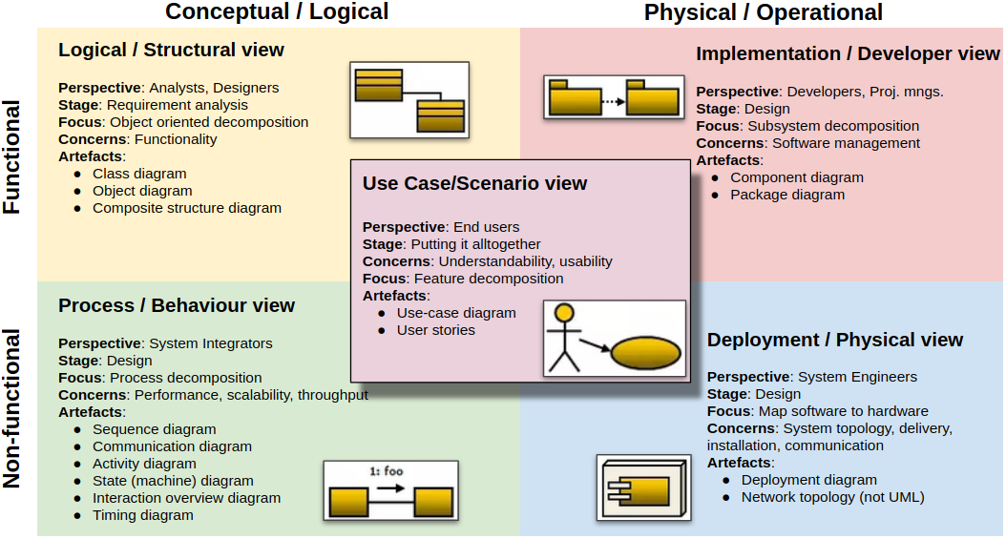
NOTE: This view model can be extended by adding one more view called scenario view or use case view for end-users or customers of software systems.
It is logically connected with other four views and are applied to illustrate the architecture serving as “plus one” view, (4+1) view model.

Slide 33
Architectural patterns
https://www.youtube.com/watch?v=JLbo9Lvvy5M

Slide 34
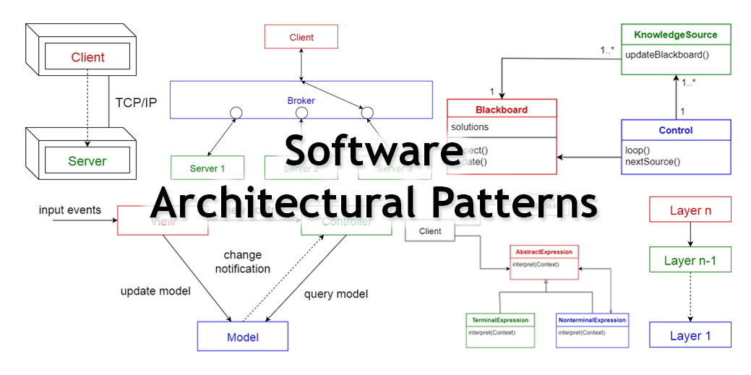
Layered pattern
Client-server pattern
Master-slave pattern
Pipe-filter pattern
Broker pattern
Peer-to-peer pattern
Event-bus pattern
Model-view-controller pattern
Blackboard pattern
Interpreter pattern

Slide 35
Architectural patterns
Patterns are a means of representing, sharing and reusing knowledge.
An architectural pattern is a stylized/schematized description of good design practice, which has been tried and tested in different environments.
Patterns may be represented using tabular and graphical descriptions.
Patterns should include information about when they are and when they are not useful.. See next.

Slide 36
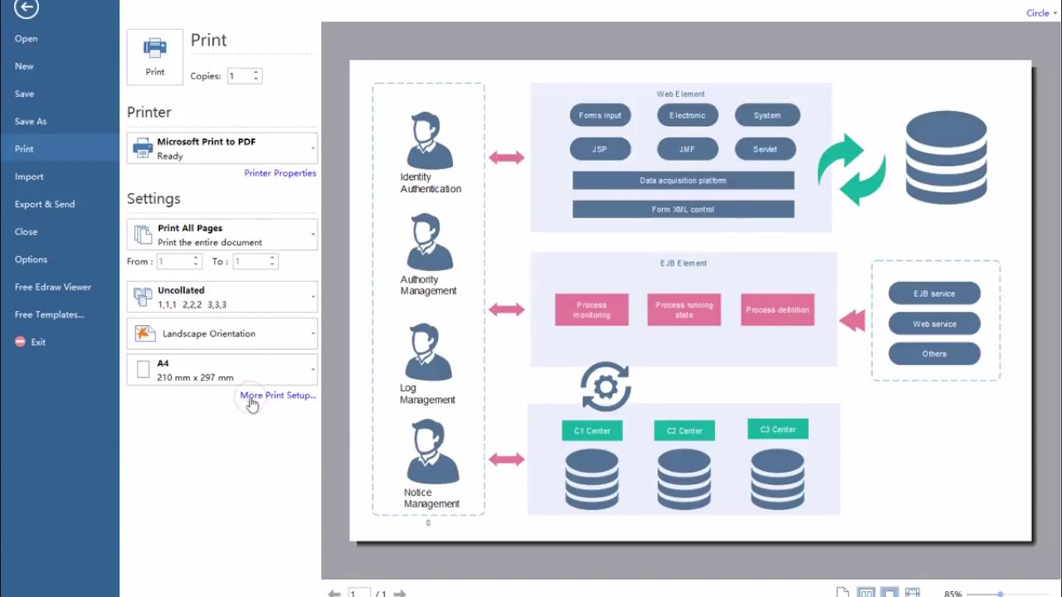
How to create it?
A tool for architecture pattern diagrammin: E-Draw
WATCH https://www.youtube.com/watch?v=IivOHc7LNtA

Slide 37
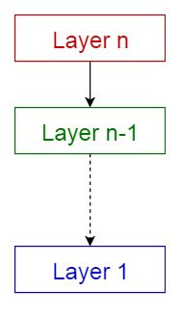
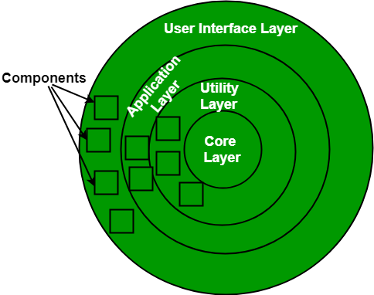
1- Layered architecture pattern
A number of different layers are defined with each layer performing a well-defined set of operations.
At the outer layer, the components receive the user interface operation.
Intermediate layers to utility services and application software functions
At the inner layers, components will perform the OS interfacing (communication and coordination with OS)
Each layer provides services to the next higher layer.
This model supports the incremental development of sub-systems in different layers.
When a layer interface changes, only the adjacent layer is affected.
Usage
General desktop applications.
E commerce web applications.

Slide 38
A generic layered architecture
The most commonly found 4 layers of a general information system are as follows.
Presentation layer (also known as UI layer)
Application layer (also known as service layer)
Business logic layer (also known as domain layer)
Data access layer (also known as persistence/data layer)
https://www.youtube.com/watch?v=V4RDMV0L-JM
Notes:
A number of different layers are defined with each layer performing a well-defined set of operations. Each layer will do some operations that becomes closer to machine instruction set progressively.
At the outer layer, components will receive the user interface operations and at the inner layers, components will perform the operating system interfacing(communication and coordination with OS)
Intermediate layers to utility services and application software functions.

Slide 39
The Layered architecture pattern
Name | Layered architecture
Description | Organizes the system into layers with related functionality associated with each layer. A layer provides services to the layer above it So the lowest-level layers represent core services that are likely to be used over all system. See Figure 6.6.
Example | A layered model of a system for sharing copyright documents held in different libraries, as shown in Figure 6.7.
When used | Used when building new services on top of existing systems; when the development is spread across several teams with each team responsibility for a layer of functionality; when there is a requirement for multi-level security.
Advantages | Allows replacement of entire layers so long as the interface is preserved. Redundant facilities (e.g., authentication) can be distributed in each layer to increase the dependability/safety of the system.
Disadvantages | In practice, providing a clean separation between layers is often difficult and a high-level layer may have to interact directly with lower-level layers rather than through the layer immediately below it. Performance can be a problem because of multiple levels of interpretation of a service request as it is processed at each layer.

Slide 40
Example: Layered architecture model of the iLearn system

Slide 41
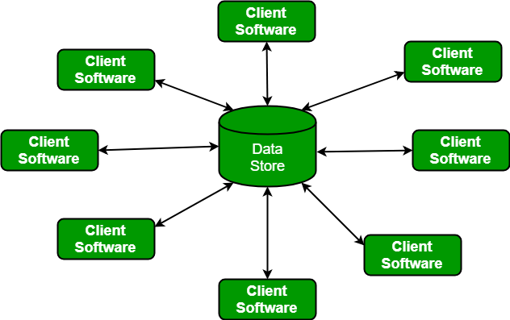
2- Client-server architecture pattern
This pattern consists of two parties; a server and multiple clients.
The server component provides services to multiple client components
Clients request services from the server and the server provides relevant services to those clients.
Furthermore, the server continues to listen to client requests.
Network which allows clients to access servers.
Usage
Online applications such as email, document sharing and banking.
Set of stand-alone servers which provide specific services such as printing, data management, etc.

Slide 42
The Client–server pattern
Name | Client-server
Description | In a client–server architecture, the functionality of the system is organized into services, with each service delivered from a separate server. Clients are users of these services and access servers to make use of them.
Example | Figure 6.11 is an example of a film and video/DVD library organized as a client–server system.
When used | Used when data in a shared database has to be accessed from a range of locations. Due to servers can be replicated/increased, may also be used when the load on a system is variable.
Advantages | The principal advantage of this model is that servers can be distributed across a network. General functions (e.g., a printing service) can be available to all clients and does not need to be implemented by all services.
Disadvantages | Each service is a single point of failure so susceptible to denial of service attacks or server failure. Performance may be unpredictable because it depends on the network as well as the system. May be management problems if servers are owned by different organizations.

Slide 43
A client–server architecture for a film library

Slide 44
3- The Model-View-Controller (MVC) pattern
This pattern, also known as MVC pattern, divides an interactive application in to 3 parts as,
Model — contains the core functionality and data
View — displays the information to the user (more than one view may be defined)
Controller — handles/manages the input coming from the user
MVC separates components and allows efficient code reuse.
Usage
Architecture for www applications in major programming languages.
Web frameworks such as Django and Rails.
https://www.youtube.com/watch?v=75agwXaGRbg
https://www.youtube.com/watch?v=4Qfk8MhtZJU

Slide 45
The Model-View-Controller (MVC) pattern
Name | MVC (Model-View-Controller)
Description | Separates presentation and interaction from the system data. The system is structured into three logical components that interact with each other. Model component manages the system data and associated operations on that data. View component defines and manages how the data is presented to the user. Controller component manages user interaction (e.g., key presses, mouse clicks, etc.) and passes these interactions to the View and the Model. See Figure 6.3.
Example | Figure 6.4 shows the architecture of a web-based application system organized using the MVC pattern.
When used/preffred | Used when there are multiple ways to view and interact with data. Also used when the future requirements for interaction and presentation of data are unknown.
Advantages | Allows the data to change independently of its representation and vice versa. Supports presentation of the same data in different ways with changes made in one representation shown in all of them.
Disadvantages | Can involve additional code and code complexity when the data model and interactions are simple.

Slide 46
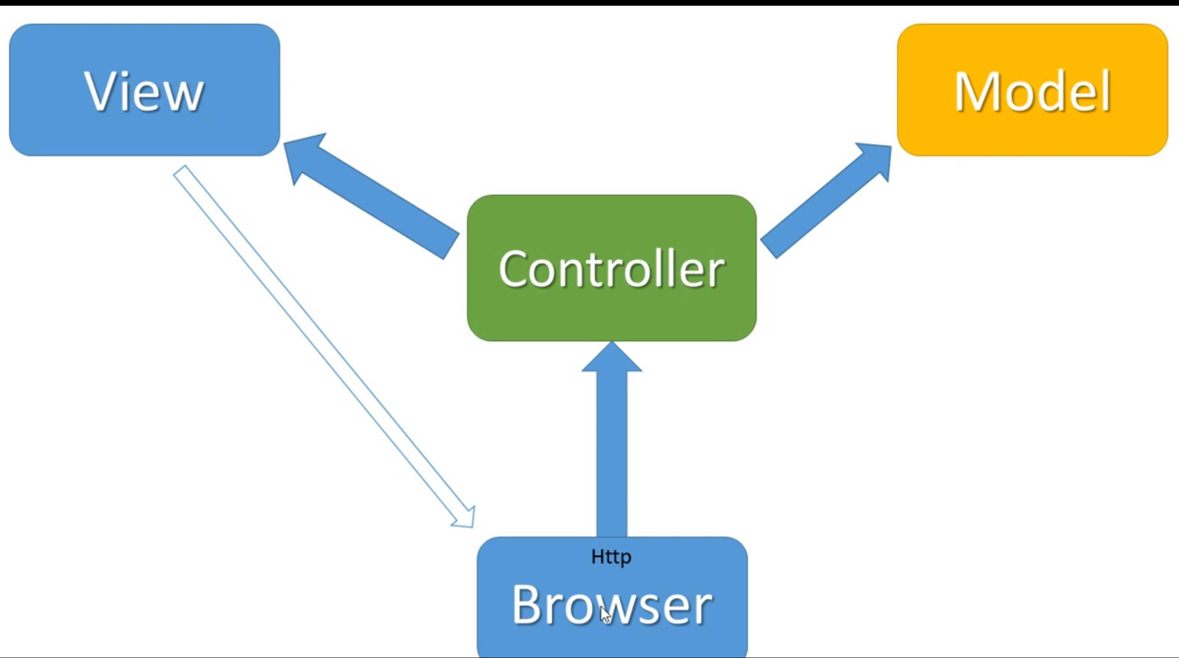
Web application architecture using the MVC pattern
manages user interaction (e.g., key presses, mouse clicks, etc.)
defines and manages how the data is presented to the user.
manages data and related operations on that data

Slide 47
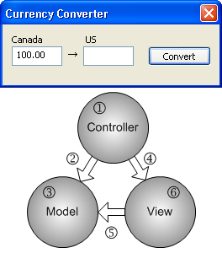
Here is a very simple scenario
Imagine that you make a currency conversion program from Canadian dollars to US dollars.
When a user click "Convert" button, what should your application do?

Slide 48
Here is a very simple scenario
Controller gets the button click event first.
Controller sends the input value to Model and requests the conversion.
Model converts the input to US dollars and save the result.
Controller requests View to display the result.
View gets the result from Model.
View displays the result on the screen.

Slide 49
Here is a very simple scenario
The major advantages of MVC design are clarity and modularity.
Since MVC separates an application into 3 logical components, it is cleaner and easier to understand the role of each component, and to maintain each module separately by multiple developers
Because of its efficient modularity, the components can be interchangeable and scalable.
  For example, you can customize the look-and-feel of View component without modifying Model and Controller modules, or can add multiple different views (table and chart) simultaneously.

Slide 50
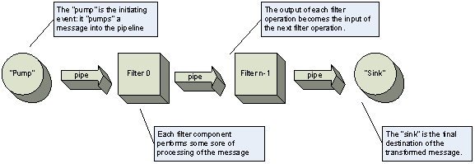
4- Pipe and filter architecture pattern
This pattern can be used to structure systems which produce and process a stream of data.
Each processing step is enclosed within a filter component.
  Each processing unit→ a filter
Data (e.g. message data) to be processed is passed through pipes.
  These pipes can be used for buffering or for synchronization purposes.
Usage
Compilers. The consecutive filters perform lexical analysis, parsing, semantic analysis, and code generation.
Workflows in bioinformatics.
Not really suitable for interactive systems.
https://www.youtube.com/watch?v=JLbo9Lvvy5M

Slide 51
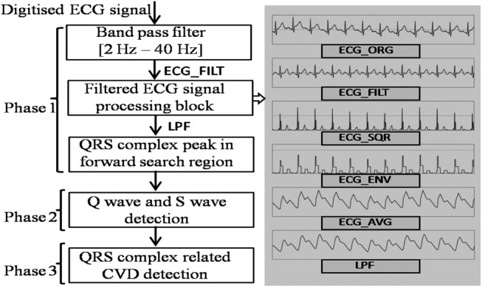
ECG Analyzer (real time stream data)

Slide 52
The pipe and filter pattern
Name | Pipe and filter
Description | The processing of the data in a system is organized so that each processing component (filter) is discrete and carries out one type of data transformation. The data flows (as in a pipe) from one component to another for processing.
Example | Figure 6.13 is an example of a pipe and filter system used for processing invoices.
When used | Commonly used in data processing applications (both batch- and transaction-based) where inputs are processed in separate stages to generate related outputs.
Advantages | Easy to understand and supports transformation reuse. Workflow style suitable the structure of many business processes. Evolution (enhancement of the system) by adding transformations is simple and straightforward. Can be implemented as either a sequential or concurrent system.
Disadvantages | The format for data transfer has to be agreed upon between communicating transformations. Each transformation must parse its input and unparse its output to the agreed form. This increases system overhead and may mean that it is impossible to reuse functional transformations that use incompatible data structures.
Notes:
Haberleşme dönüşümleri arasında veri aktarım formatı üzerinde anlaşılmalıdır. Her dönüşüm girdisini ayrıştırmalı ve çıktısını mutabık kalınan forma ayırmalıdır. Bu, sistem ek yükünü artırır ve uyumsuz veri yapıları kullanan işlevsel dönüşümlerin yeniden kullanılmasının imkansız olduğu anlamına gelebilir.

Slide 53
5- Repository architecture pattern
The Repository pattern is used to separate the business logic and the data access layers in your application.
Essentially, a repository mediates between the domain and the data mapping layers of your application.
Sub-systems must exchange the data.
This may be done in two ways:
  Shared data is kept in a central database or repository and may be accessed by all sub-systems;
  Or each sub-system maintains its own database and passes data explicitly to other sub-systems.
When large amounts of data are to be shared, the repository model of sharing is most commonly used a this is an efficient data sharing mechanism.

Slide 54
A repository architecture for an IDE

Slide 55
The Repository pattern
Name | Repository
Description | All data in a system is managed in a central repository that is accessible to all system components. Components do not interact directly, only through the repository.
Example | Figure 6.9 is an example of an IDE where the components use a repository of system design information. Each software tool generates information which is then available for use by other tools.
When used | You should use this pattern when you have a system in which large volumes of information are generated that has to be stored for a long time. You may also use it in data-driven systems where the inclusion of data in the repository triggers an action or tool.
Advantages | Components can be independent—they do not need to know of the existence of other components. Changes made by one component can be propagated to all components. All data can be managed consistently (e.g., backups done at the same time) as it is all in one place.
Disadvantages | The repository is a single point of failure so problems in the repository affect the whole system. May be inefficiencies in organizing all communication through the repository. Distributing the repository across several computers may be difficult.

Slide 56
Question
A system that reads a group of customer’s transaction details for the last 5 years from its DB table, on which you/user need to select season-wise transactions such as Transaction in Winter, Summer or Rainy seasons.
Then you need to group these transactions based on various types of customer such as Occasional Customer, Regular Customer, Permanent Customer, now sort these records based on customer type, and
Finally system prepares a report/view of the transactions and a statistical trend analysis (mean, median, etc.)
User usage examples:
1-Your First Selection may be: select Last 5 Year Data→choose Winter→ choose Sort for Occasional Customer Type→ print Report
2-Your Next Selection may be: select Last 5 Year Data→ choose Summer → choose Sort for Regular Customer Type→ print Report
HINT: We don’t know how the display format of the same data will be preferred by the user steps.
QUESTION: Which architectural style would you prefer to apply for developing the system; select one from the following and explain very shortly why?
1. Pipe and Filter
2. Broker
3. Model View Controller
4. Blackboard Feedback
5
WİNTER
OCC

Slide 57
Answer
Model View Controller. Because, multiple ways are needed to view and interact with the same data.
Also, it is good to use MVC here.
Because, the future customer requirements (user reqs?) about possible interactions and presentations using the same data are unknown yet.

Slide 58
Application architectures

Slide 59
Application architectures
Application systems are designed to meet an organisational need.
As businesses have much in common, their application systems also tend to have a common architecture that reflects the application requirements.
A generic application architecture is an architecture for a type of software system that may be configured and adapted to create a system that meets specific requirements.

Slide 60
Use of application architectures
As a starting point for architectural design.
As a design checklist.
As a way of organising the work of the development team.
As a means of assessing components for reuse.
As a vocabulary for talking about application types.

Slide 61
Examples of application types
Data processing applications
  Data driven applications that process data in batches without explicit user intervention during the processing.
Transaction processing applications
  Data-centred applications that process user requests and update information in a system database.
Event processing systems
  Applications where system actions depend on interpreting events from the system’s environment.
Language processing systems
  Applications where the users’ intentions are specified in a formal language that is processed and interpreted by the system.

Slide 62
Application type examples
Two very widely used generic application architectures are transaction processing systems and language processing systems.
Transaction processing systems
  E-commerce systems;
  Reservation systems.
Language processing systems
  Compilers;
  Command interpreters.

Slide 63
Transaction processing systems
Process user requests for information from a database or requests to update the database.
From a user perspective a transaction is:
  Any coherent sequence of operations that satisfies a goal;
  For example - find the times of flights from London to Paris.
Users make asynchronous requests for service which are then processed by a transaction manager.

Slide 64
The structure of transaction processing applications

Slide 65
The software architecture of an ATM system

Slide 66
Information systems architecture
Information systems have a generic architecture that can be organised as a layered architecture.
These are transaction-based systems as interaction with these systems generally involves database transactions.
Layers include:
  The user interface
  User communications
  Information retrieval
  System database

Slide 67
Layered information system architecture

Slide 68
The architecture of the Mentcare system

Slide 69
Web-based information systems
Information and resource management systems are now usually web-based systems where the user interfaces are implemented using a web browser.
For example, e-commerce systems are Internet-based resource management systems that accept electronic orders for goods or services and then arrange delivery of these goods or services to the customer.
In an e-commerce system, the application-specific layer includes additional functionality supporting a ‘shopping cart’ in which users can place a number of items in separate transactions, then pay for them all together in a single transaction.

Slide 70
Server implementation
These systems are often implemented as multi-tier client server/architectures (discussed in Chapter 17)
  The web server is responsible for all user communications, with the user interface implemented using a web browser;
  The application server is responsible for implementing application-specific logic as well as information storage and retrieval requests;
  The database server moves information to and from the database and handles transaction management.

Slide 71
Language processing systems
Accept a natural or artificial language as input and generate some other representation of that language.
May include an interpreter to act on the instructions in the language that is being processed.
Used in situations where the easiest way to solve a problem is to describe an algorithm or describe the system data
  Meta-case tools process tool descriptions, method rules, etc and generate tools.

Slide 72
The architecture of a language processing system

Slide 73
Compiler components
A lexical analyzer, which takes input language tokens and converts them to an internal form.
A symbol table, which holds information about the names of entities (variables, class names, object names, etc.) used in the text that is being translated.
A syntax analyzer, which checks the syntax of the language being translated.
A syntax tree, which is an internal structure representing the program being compiled.

Slide 74
Compiler components
A semantic analyzer that uses information from the syntax tree and the symbol table to check the semantic correctness of the input language text.
A code generator that ‘walks’ the syntax tree and generates abstract machine code.

Slide 75
A repository architecture for a language processing system

Slide 76
A pipe and filter compiler architecture

Slide 77
Key points
A software architecture is a description of how a software system is organized.
Architectural design decisions include decisions on the type of application, the distribution of the system, the architectural styles to be used.
Architectures may be documented from several different perspectives or views such as a conceptual view, a logical view, a process view, and a development view.
Architectural patterns are a means of reusing knowledge about generic system architectures. They describe the architecture, explain when it may be used and describe its advantages and disadvantages.

Slide 78
Key points
Models of application systems architectures help us understand and compare applications, validate application system designs and assess large-scale components for reuse.
Transaction processing systems are interactive systems that allow information in a database to be remotely accessed and modified by a number of users.
Language processing systems are used to translate texts from one language into another and to carry out the instructions specified in the input language. They include a translator and an abstract machine that executes the generated language.

Slide 79
Taxonomy of Architectural styles
Data centered architectures
Data flow architectures
Call and Return architectures
Object Oriented architecture
Layered architecture

