Slide 1
Sensors
Chapter#5

Slide 2
5.1 Introduction
A sensor is a simple device. A transducer has a complicated electrical circuit used for energy conversion. Examples of sensors are thermometer, pressure sensor, ultrasonic sensor, light sensor, etc. Examples of transducers are thermistor, potentiometer, piezoelectric transducer, Hall Effect transducer, etc.
Monitoring and control systems require sensors to measure physical quantities such as position, distance, force, strain, temperature, vibration, and acceleration.
The following sections present devices and techniques for measuring these and other physical quantities.

Slide 3
The other types of sensors are based on their detection properties such as variation mechanism, analog and digital. The detection properties of sensors include electric, magnetic, physical, chemical etc, and variation mechanism includes conversion of the input signal to output signal, whose examples are photoelectric, thermoelectric, electrochemical, electromagnetic etc.
Analog sensors produce an analog output, i.e. continuous output signals are produced with respect to the measured quantity, but a digital sensor is the opposite of analog sensors, with discrete characteristics and digital output in nature.
Sensors are also divided by their detection properties, given in Table 5.1

Slide 4
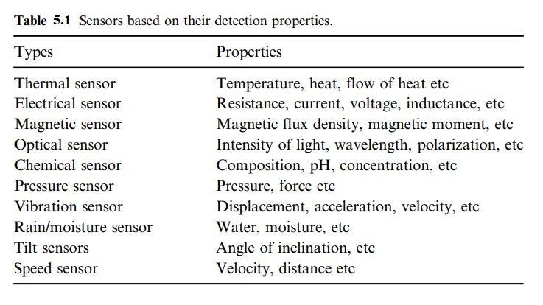

Slide 5
5.2 Proximity Sensors
A proximity sensor consists of an element that changes either its state or an analog signal when it is close to, but often not actually touching, an object. Magnetic, electrical capacitance, inductance, and eddy current methods are particularly suited to the design of a proximity sensor.
Typically, proximity sensors are classified based on their detection targets, such as a type of material or sense for something in the environment. According to the method of detection, proximity sensors are classified into four categories:
1. Inductive
2. Capacitive
3. Optical
4. Ultrasonic

Slide 6
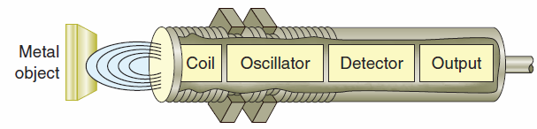
A) Inductive and Capacitive Proximity Sensors
Inductive proximity sensors are used to detect both ferrous metals (containing iron) and nonferrous metals (such as copper, aluminum, and brass).
Inductive proximity sensors operate with electromagnetic field which varies in strength relative to a target.

Slide 7
The working principle of the inductive proximity sensor is based on the electromagnetic induction. The coil will generate high frequency oscillation field. Electrical currents known as eddy currents are induced on the metal surface when a ferrous metal material enters the magnetic field. These eddy current induce power loss within the oscillator circuit and in turned caused a reduction in the amplitude of the oscillations this is known as echo or eddy currents kill oscillator principle. This change in amplitude sends a signal to the switch changing it to its normally open or normally closed configuration respectively. When the metal target is removed from the proximity inductive sensor range the oscillator will return to its normal state and the switch will return to its normally closed or open output.

Slide 8
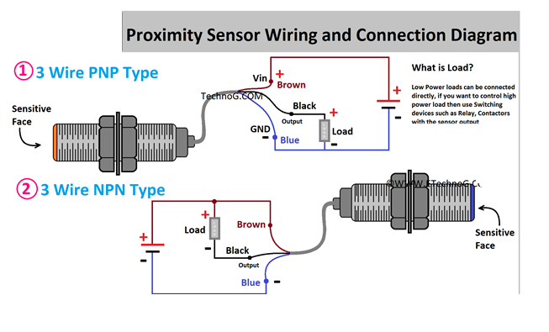
The inductive proximity sensors are available in two different types NPN and PNP. Both types are used for the same purpose; the only difference is in the wiring. The PNP type inductive proximity sensor will give positive voltage as the output, while the NPN type inductive sensor will give GND or 0 as the output signal. So, basically PNP type inductive proximity sensor is opposite of the NPN type proximity sensor.

Slide 9
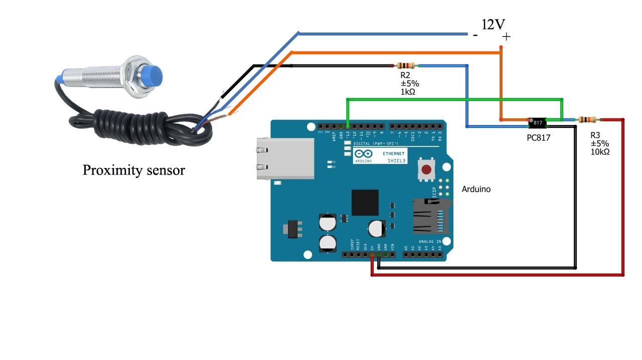
Inductive sensor with Arduino:
int limitswitch=13;
int state= LOW;
int value;
void setup()
{Serial.begin(9600);
pinMode(limitswitch,INPUT);}
void loop()
{
Value = digitalRead(limitswitch);
if(value!=state)
{state=value;
Serial.println("sensor value =");
if (state==0)
{Serial.println("target detected");}
else
{Serial.println("No target detected");}
}
}

Slide 10
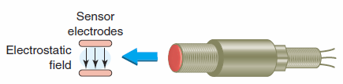
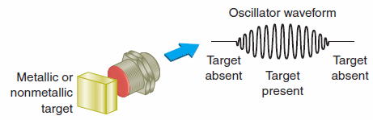
Capacitive proximity sensors on the other hand can detect dielectric materials such as liquid, plastic, glass, wood and granulated substances as long as it has a dielectric constant of 1.2 or more. Capacitive sensor can detect metallic and non-metallic objects material. Sensing range can depend on the material needed to be detected their range is from 2 millimeters to 15 millimeters depending on the dielectric material to be detected. Generally the sensing distance for proximity capacitive sensor is greater for larger or denser targets, but the effect on electrostatic field produced by the non-conductive material can be quite small.

Slide 11
Usually sensing distances with this material is short. Two small plates located in the front of sensor form a capacitor as a target enter the sensors range the capacitance of the two plate’s increases thus causing a change in the oscillator frequency which also activates the sensor output either normally open or normally closed respectively.
Capacitive sensor can detects any target that has a dielectric constant greater than air. The dielectric constant is an electrostatic field generated by the oscillator circuit. If an object enters this field and causes interference, oscillation than begins. The oscillator output is monitored by detector or trigger circuit. When it detects the sufficient change in the field, it switches on the output circuit.

Slide 12
The output circuit remains active when the target is in front of the sensor, the sensor will be active and the sensor will be in off state when the target is removed from the sensing field. Sensors can be used to detect liquid through a non-metallic material such as glass or plastic but they need to be mounted so that the sensor detects just the liquid and not the container.
Material such as un-grounded material can be sensed from further away because it causes more interference on the electrostatic field. Grounded conducted material causes even more interference and thus has the longest sensing distance. Since the composition of the material and ambient condition have impact on the sensing field. Many proximity capacitive sensors are equipped with sensitivity adjustment potentiometer. Capacitive proximity switches can detect materials at greater ranges from inductive sensors and have long operation life.

Slide 13
B) Optical proximity sensors
Optical proximity sensors are used for light detection and, typically, employ an infrared spectrum of light. The sensor consists of a light source, such as IR LED or laser diode, and a light detector, such as a photodiode or phototransistor. The light source transmits lR radiation, which is reflected by a nearby object. The reflected radiations are detected by the detector, which then generates a voltage output.
Optical sensors offer a short range of detection and can perceive several types of materials. However, its sensing capability can be affected by the nature of an object, the presence of dust, or other environmental factors.
These sensors are commonly used for object detection, product sorting, and contrast detection.

Slide 14
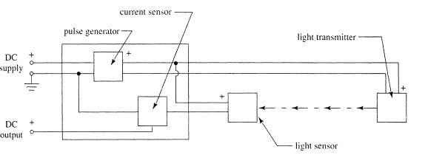
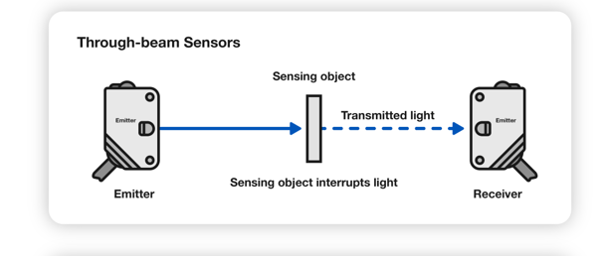
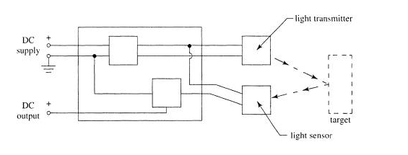
They are widely used in automated systems because they have been available longer and because some can fit into small locations. These sensors are more commonly known as light beam sensors of the thru-beam type or of the retro reflective type. Both sensor types are shown below.

Slide 15
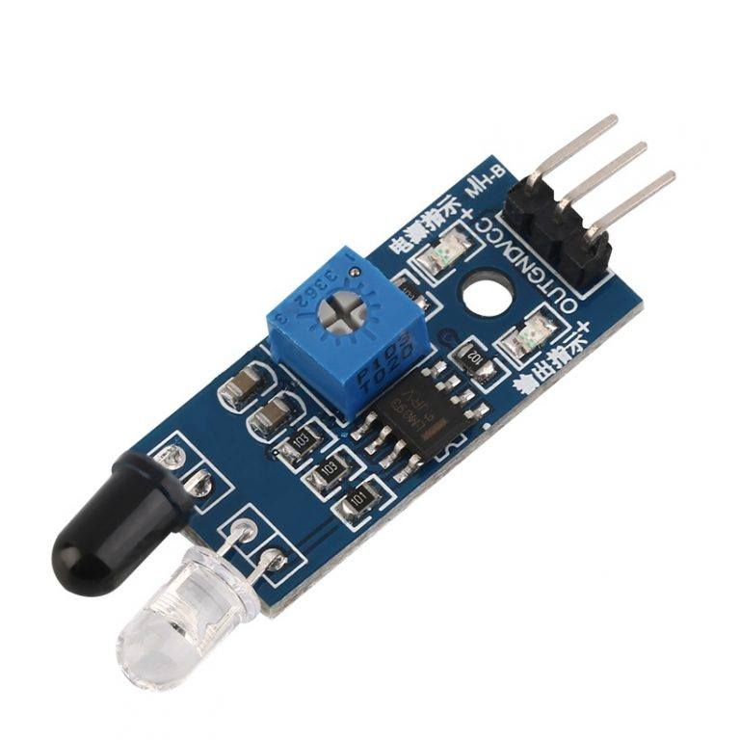
IR sensor is an electronic device, that emits the light in order to sense some object of the surroundings. An IR sensor can measure the heat of an object as well as detects the motion. Usually, in the infrared spectrum, all the objects radiate some form of thermal radiation. These types of radiations are invisible to our eyes, but infrared sensor can detect these radiations.
These proximity sensors are designed using active infrared sensors, consisting of a pair of IR source and an IR detector. The IR source can be either IR LED (Infrared Light Emitting Diode) or IR Laser Diode. The IR LED or IR Laser Diode transmits infrared light. This light is reflected by any object on which it falls. IR photodiodes that operate as IR detectors are placed in the sensor to capture the reflected IR radiations in a predefined range of distance and angle. Closer is the reflecting object; higher is the intensity of infrared radiation reflected, and lower IR photodiode resistance drops. As a result, IR photodiode passes through greater voltage than when there are no incident IR radiation.

Slide 16
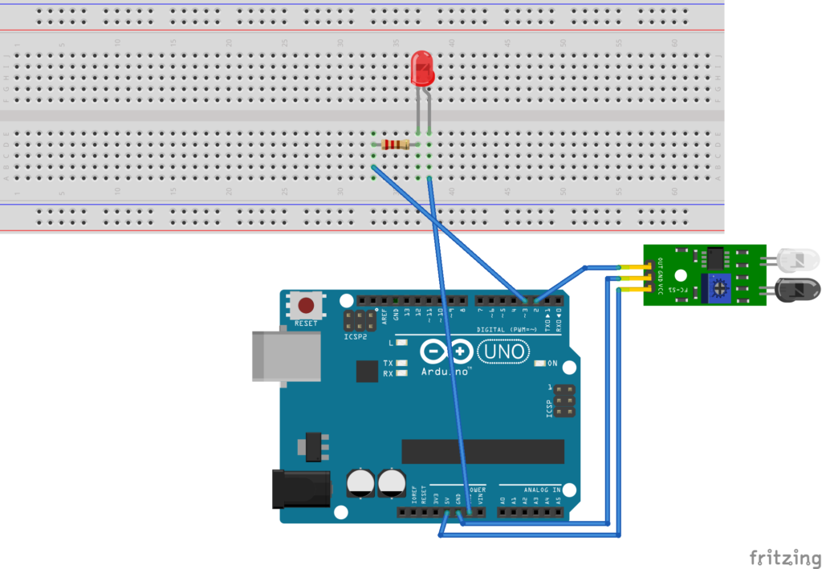
int LED = 8;
int isObstaclePin = 2; // This is our input pin
int isObstacle = HIGH; // HIGH MEANS NO OBSTACLE
void setup() {
pinMode(LED, OUTPUT);
pinMode(isObstaclePin, INPUT);
Serial.begin(9600);
}
void loop() {
isObstacle = digitalRead(isObstaclePin);
if (isObstacle == LOW)
{
Serial.println("OBSTACLE!!, OBSTACLE!!");
digitalWrite(LED, HIGH);
}
else
{
Serial.println("clear");
digitalWrite(LED, LOW);
}
delay(200);
}

Slide 17
C) Passive Infrared (PIR) sensor
All objects, including the human body, at temperatures above absolute zero (0 Kelvin / -273.15 °C) emit heat energy in the form of infrared radiation. The hotter an object is, the more radiation it emits. This radiation is not visible to the human eye because it is emitted at infrared wavelengths. The PIR sensor is specifically designed to detect such levels of infrared radiation.
A PIR sensor consists of two main parts:
A pyroelectric sensor, which you can see in the image below as a round metal with a rectangular crystal in the center.
A special lens called a fresnel lens which focuses the infrared signals on the pyroelectric sensor.

Slide 18
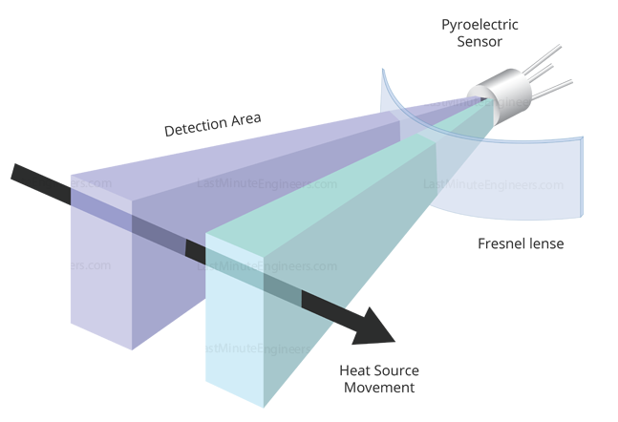
A pyroelectric sensor consists of a window with two rectangular slots and is made of a material (typically coated silicon) that allows infrared radiation to pass through. Behind the window, there are two separate infrared sensor electrodes, one responsible for producing the positive output and the other for producing the negative output.
The two electrodes are wired such that they cancel each other out. This is because we are looking for changes in IR levels and not ambient IR levels. That’s why when one half sees more or less IR radiation than the other, we get the output.
When there is no movement around the sensor, both slots detect the same amount of infrared radiation, resulting in a zero output signal.
But when a warm body like a human or an animal passes , it first intercepts half of the sensor. This causes a positive differential change between the two halves. When the warm body intercepts the other half of the sensor (leaves the sensing region), the opposite happens, and the sensor produces a negative differential change. By reading this change in voltage, motion is detected.

Slide 19
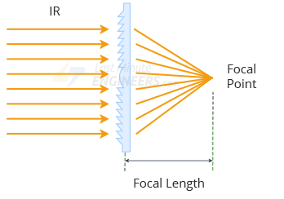
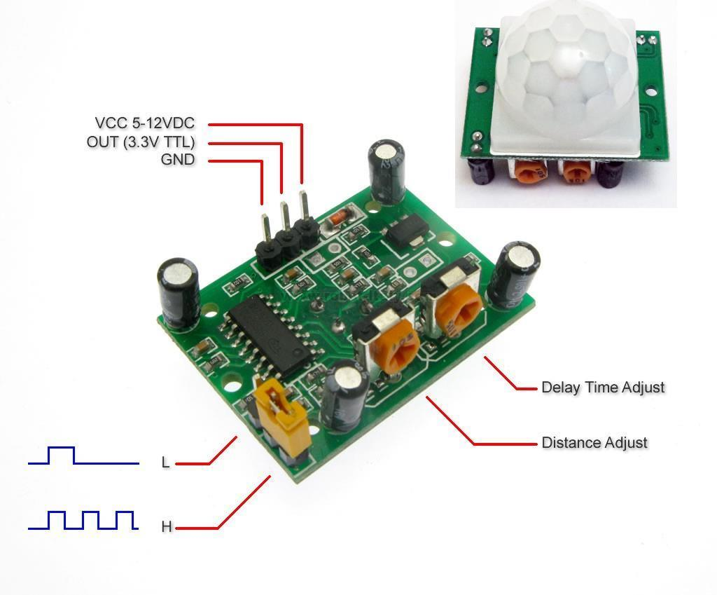
Fresnel Lenses are increased the range and field of view of the PIR sensor. Its slim, lightweight construction and excellent light gathering capability make it extremely useful for making PIRs small in size yet powerful.
HC-SR501 PIR Sensor

Slide 20
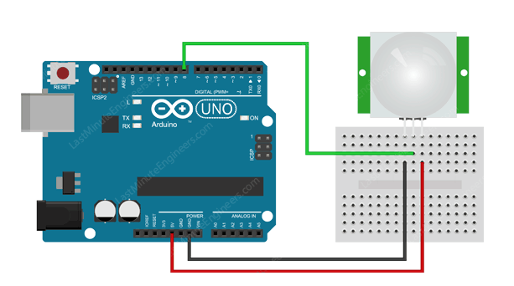
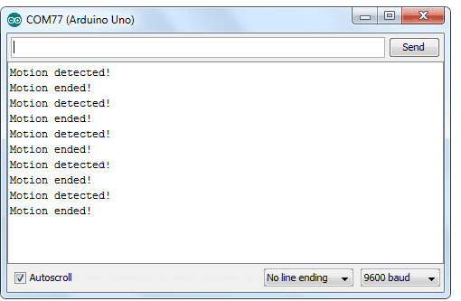
int ledPin = 8; // choose the pin for the LED
int inputPin = 2; // choose the input pin (for PIR sensor)
int pirState = LOW; // we start, assuming no motion detected
int val = 0; // variable for reading the pin status
void setup() {
pinMode(ledPin, OUTPUT); // declare LED as output
pinMode(inputPin, INPUT); // declare sensor as input
Serial.begin(9600); }
void loop(){
val = digitalRead(inputPin); // read input value
if (val == HIGH) // check if the input is HIGH
{
digitalWrite(ledPin, HIGH); // turn LED ON
if (pirState == LOW)
{
Serial.println("Motion detected!"); // print on output change
pirState = HIGH;
}
}
else
{
digitalWrite(ledPin, LOW); // turn LED OFF
if (pirState == HIGH)
{
Serial.println("Motion ended!"); // print on output change
pirState = LOW;
}
}
}

Slide 21
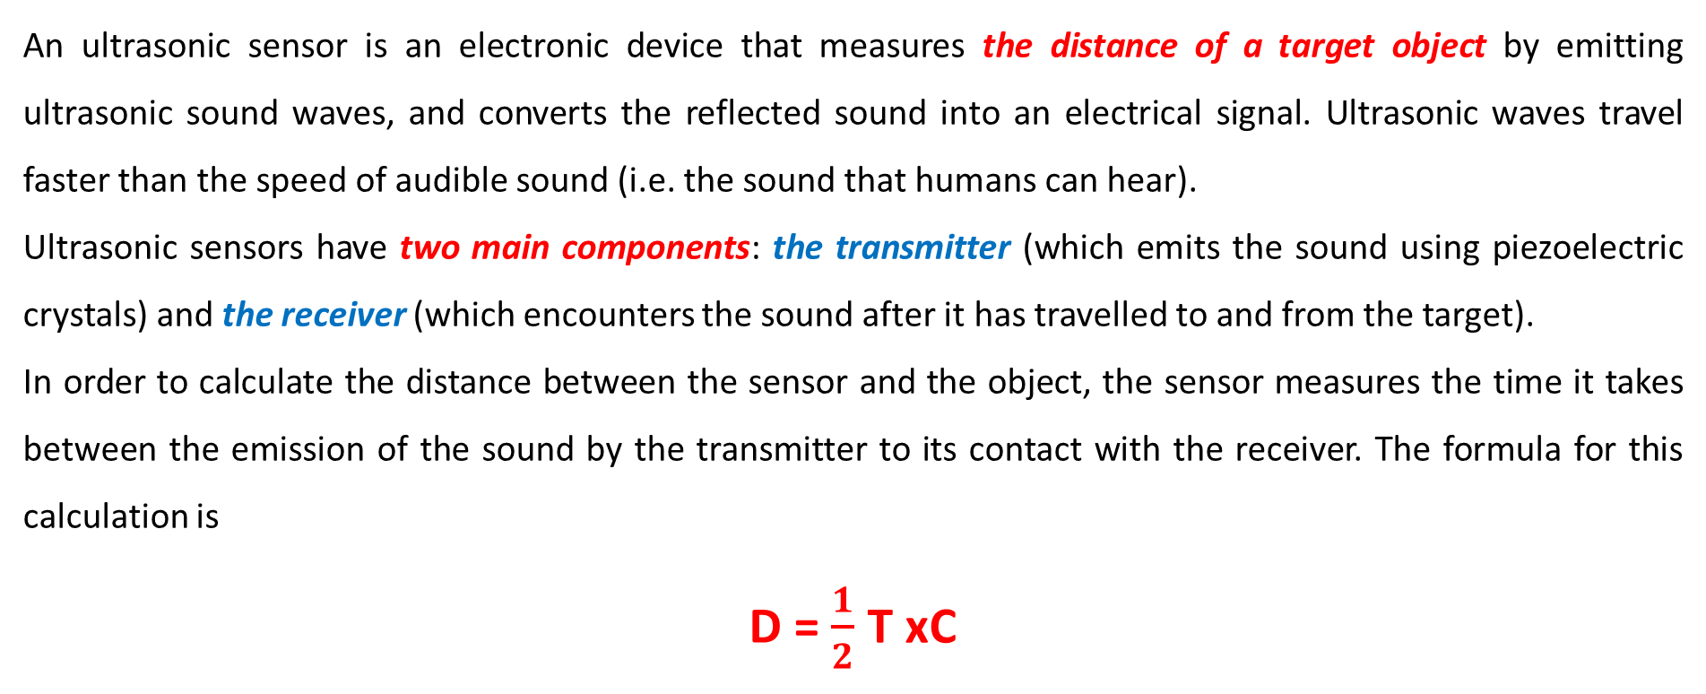
d) Ultrasonic Sensor
An ultrasonic sensor is an electronic device that measures the distance of a target object by emitting ultrasonic sound waves, and converts the reflected sound into an electrical signal. Ultrasonic waves travel faster than the speed of audible sound (i.e. the sound that humans can hear).
Ultrasonic sensors have two main components: the transmitter (which emits the sound using piezoelectric crystals) and the receiver (which encounters the sound after it has travelled to and from the target).
In order to calculate the distance between the sensor and the object, the sensor measures the time it takes between the emission of the sound by the transmitter to its contact with the receiver. The formula for this calculation is
D = $\frac{1}{2}$ T xC
where D is the distance, T is the time, and C is the speed of sound ~ 343 meters/second)

Slide 22
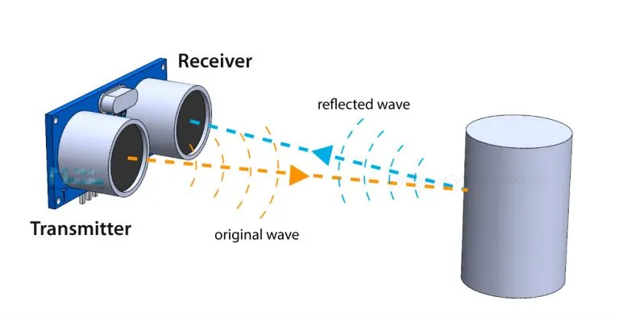
For example, if a scientist set up an ultrasonic sensor aimed at a box and it took 0.025 seconds for the sound to bounce back, the distance between the ultrasonic sensor and the box would be:
D = 0.5 x 0.025 x 343
or about 4.2875 meters.

Slide 23
Ultrasonic sensors are used primarily as proximity sensors. They can be found in automobile self-parking technology and anti-collision safety systems. Ultrasonic sensors are also used in robotic obstacle detection systems, as well as manufacturing technology. In comparison to infrared (IR) sensors in proximity sensing applications, ultrasonic sensors are not as susceptible to interference of smoke, gas, and other airborne particles (though the physical components are still affected by variables such as heat).
Ultrasonic sensors are also used as level sensors to detect, monitor, and regulate liquid levels in closed containers (such as vats in chemical factories). Most notably, ultrasonic technology has enabled the medical industry to produce images of internal organs, identify tumors, and ensure the health of babies in the womb.
When Not To Use an Ultrasonic Sensor
In some cases, the target object is so small that the reflected ultrasonic signal is insufficient for detection, and the distance cannot be measured correctly.

Slide 24
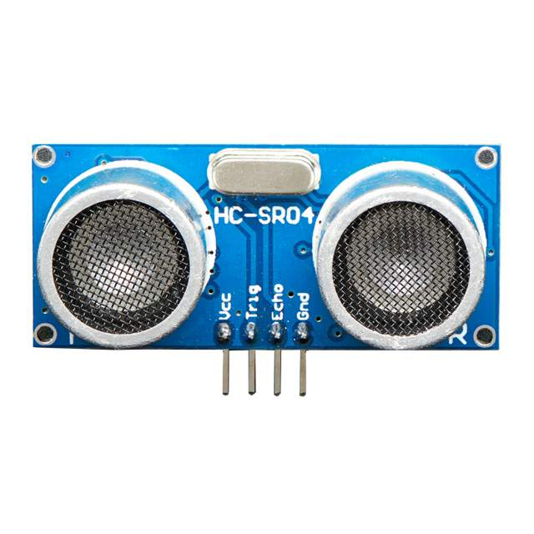
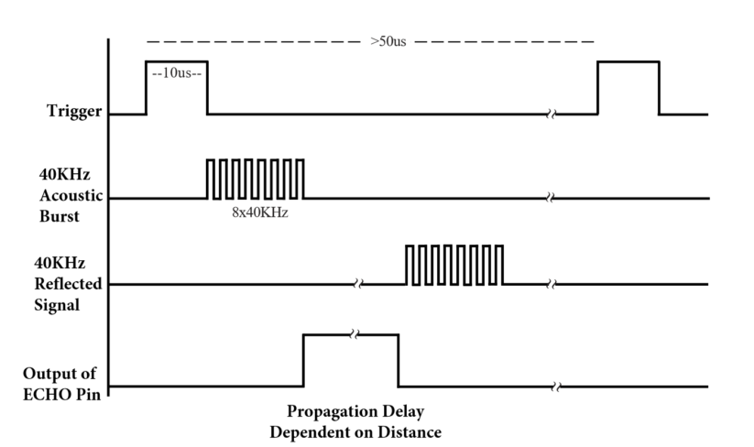
The HC-SR04 ultrasonic sensor uses SONAR to determine the distance of an object just like the bats do. It offers excellent non-contact range detection with high accuracy and stable readings in an easy-to-use package from 2 cm to 400 cm

Slide 25
The ultrasonic sensor (or transducer) works on the same principles as a radar system. An ultrasonic sensor can convert electrical energy into acoustic waves and vice versa. The acoustic wave signal is an ultrasonic wave traveling at a frequency above 18kHz. The famous HC SR04 ultrasonic sensor generates ultrasonic waves at 40kHz frequency.
The microcontroller sends a trigger signal to the ultrasonic sensor. The duty cycle of this trigger signal is 10µS for the HC-SR04 ultrasonic sensor. When triggered, the ultrasonic sensor generates eight acoustic (ultrasonic) wave bursts and initiates a time counter. As soon as the reflected (echo) signal is received, the timer stops. The output of the ultrasonic sensor is a high pulse with the same duration as the time difference between transmitted ultrasonic bursts and the received echo signal.

Slide 26
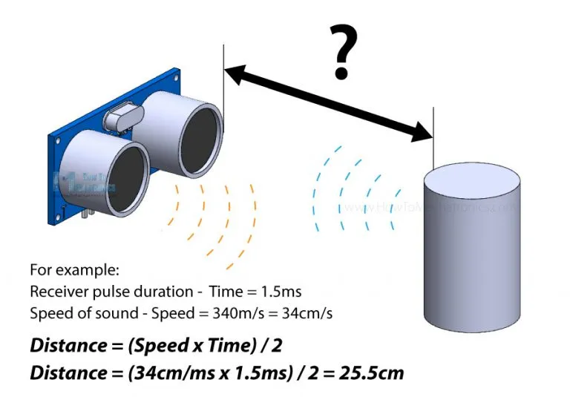

Slide 27
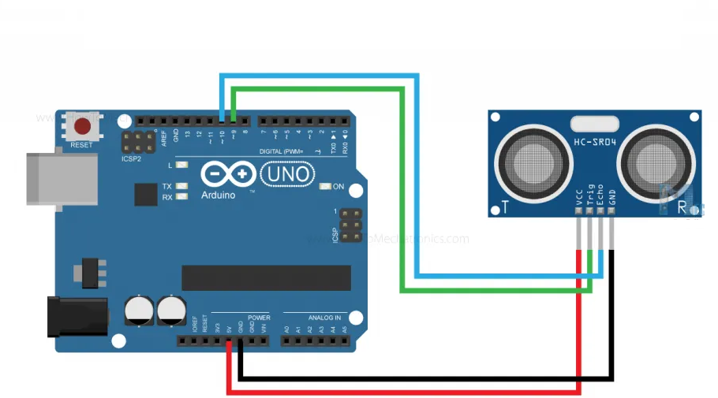
// defines pins numbers
const int trigPin = 9;
const int echoPin = 10;
// defines variables
long duration;
int distance;
void setup() {
pinMode(trigPin, OUTPUT); // Sets the trigPin as an Output
pinMode(echoPin, INPUT); // Sets the echoPin as an Input
Serial.begin(9600); // Starts the serial communication
}
void loop() {
// Clears the trigPin
digitalWrite(trigPin, LOW);
delayMicroseconds(2);
// Sets the trigPin on HIGH state for 10 micro seconds
digitalWrite(trigPin, HIGH);
delayMicroseconds(10);
digitalWrite(trigPin, LOW);
// Reads the echoPin, returns the sound wave travel time in microseconds
duration = pulseIn(echoPin, HIGH);
// Calculating the distance
distance = duration * 0.034 / 2;
// Prints the distance on the Serial Monitor
Serial.print("Distance: ");
Serial.println(distance);
}

Slide 28
5.3 Temperature Sensors
A temperature sensor is used to measure the amount of energy in the form of heat and cold produced by an object and system. It allows one to sense or detect any physical change to that energy and gives the output as analog or digital.
Temperature sensors are used in various applications such as notification of environmental temperature, medical instruments, automobiles etc. According to application and its characteristics, many different types of temperature sensors are available. There are basically two types of temperature sensors, contact temperature sensor and non-contact temperature sensor.
In contact temperature sensor, there is a physical contact with the object being sensed and to monitor the change in temperature, conduction is used. It is used to sense solids, liquids or gases over a wide range of temperatures.
In a non-contact temperature sensor, we use convection and radiation properties to measure the changes in temperature. It uses radiant energy in the form of heat and cold.

Slide 29
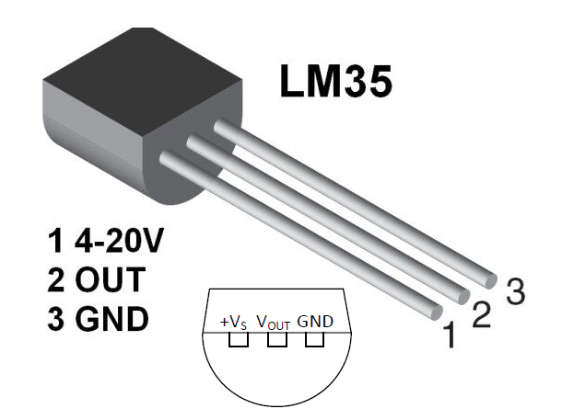
LM35 Semiconductor Temperature Sensor
LM35 is a temperature sensor that outputs an analog signal which is proportional to the instantaneous temperature. The output voltage can easily be interpreted to obtain a temperature reading in Celsius. The advantage of LM35 over thermistor is it does not require any external calibration. The coating also protects it from self-heating.
LM35 Temperature sensor Features
Calibrated Directly in Celsius (Centigrade)
Linear + 10-mV/°C Scale Factor
0.5°C Ensured Accuracy (at 25°C)
Rated for Full −55°C to 150°C Range
Suitable for Remote Applications
Operates from 4 V to 30 V
Less than 60-µA Current Drain
Low Self-Heating, 0.08°C in Still Air
Non-Linearity Only ±¼°C Typical
Low-Impedance Output, 0.1 Ω for 1-mA Load

Slide 30

LM35 can measure from -55 degrees centigrade to 150-degree centigrade. The accuracy level is very high if operated at optimal temperature and humidity levels.
The conversion of the output voltage to centigrade is also easy and straight forward. The input voltage to LM35 can be from +4 volts to 30 volts. It consumes about 60 microamperes of current.
In order to understand the working principle of LM35 temperature sensor we have to understand the linear scale factor. In the features of LM35 it is given to be +10 milli volt per degree centigrade. It means that with increase in output of 10 millivolt by the sensor Vout pin the temperature value increases by one. For example, if the sensor is output 100 mV at Vout pin the temperature in centigrade will be 10-degree centigrade. The same goes for the negative temperature reading. If the sensor is outputting -100 mills volt the temperature will be -10 degrees Celsius.

Slide 31
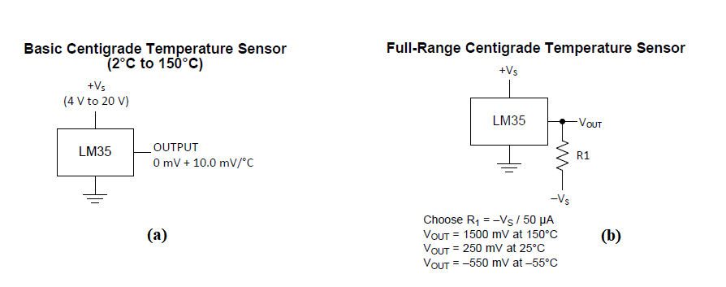
LM35 temperature sensor circuit configuration
LM35 can be used in two circuit configurations. Both yield different results. In the first configuration (a), you can only measure the positive temperature from 2 degrees Celsius to 150 degrees Celsius. In this first configuration, we simply power LM35 and connect the output directly to analog to digital converters. In the second configuration (b), we can utilize all the sensor resources and can measure the full range temperature from -55 degree centigrade to 150-degree centigrade. This configuration is a little complex but yields high results. We have to connect an external resistor, in this case, to switch the level of negative voltage upwards. The external resistor value can be calculated from the formula given below the configuration circuit.

Slide 32
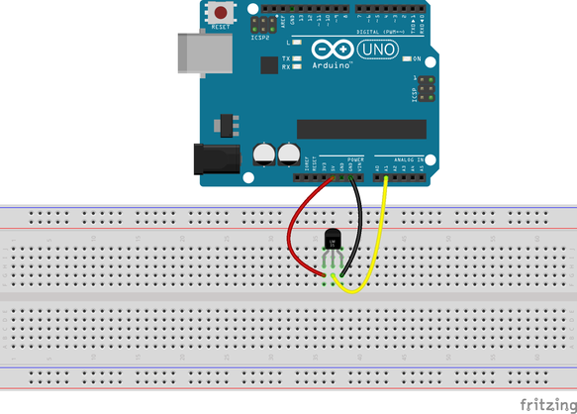
int pinTemp = A1; //This is where our Output data goes
void setup() {
Serial.begin(9600);
}
void loop() {
int temp = analogRead(pinTemp); //Read the analog pin
temp = temp * 0.48828125; // convert output (mV) to readable celcius
Serial.print("Temperature: ");
Serial.print(temp);
Serial.println("C"); //print the temperature status
delay(1000);
}
Once uploaded you will see the temperature status like this
Temperature: 29C
Temperature: 28C
Temperature: 29C
Temperature: 27.8C

Slide 33
As you can see in the wiring diagram above, the output of the LM35 is connected to one of the analog inputs of the Arduino. The value of this analog input can be read with the analogRead() function.
However, the analogRead() function does not actually return the output voltage of the sensor. Instead it maps the input voltage between 0 and the ADC reference voltage (technically it is the operating voltage i.e. 5V or 3.3V unless you change it) to 10-bit integer values ​​ranging from 0 to 1023. To convert this value back to the sensor’s output voltage, use this formula:
Vout = (reading from ADC) * (5 / 1024)
This formula converts the number 0-1023 from the ADC into 0-5V
Then, to convert volts into temperature, use this formula:
Temperature (°C) = Vout * 100

Slide 34
Thermistor
The thermistor is another type of temperature sensitive device or resistance whose electrical resistance changes as the object temperature changes. This is made up of semiconductor materials. When temperature of the object or surroundings increases or decreases, resistance will also increase or decrease. How much the resistance will increase or decrease depends on the properties of the semiconductor material. The thermistor is of two types: positive temperature coefficient, (PTC) and negative temperature coefficient, (NTC). In PTC, resistance value increases with an increase in the temperature and in NTC, its resistance value goes down with an increase in the temperature. Thermistors are used for precise temperature measurement, control and compensation. Thermistors are highly sensitive and exhibit non-linear characteristics of resistance versus temperature. Generally, these are made up of manganese, nickel, cobalt, copper and iron.

Slide 35
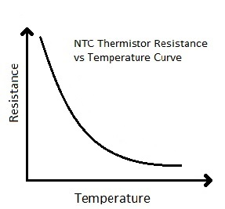
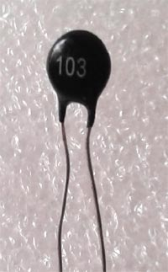
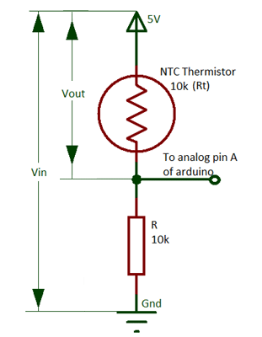



Calculating Temperature using Thermistor:
We know from the Voltage divider circuit that:

Slide 36

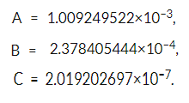
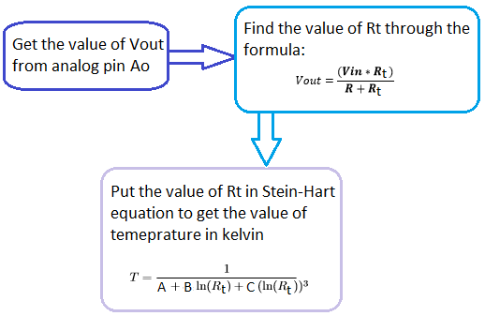
Mathematically the thermistor resistance can only be compute with the help of the Stein-Hart equation.
Where, A, B and C are the constants, Rt is the thermistor resistance

Slide 37
int ThermistorPin = 0;
int Vo;
float R1 = 10000;
float logR2, R2, T, Tc, Tf;
float c1 = 1.009249522e-03, c2 = 2.378405444e-04, c3 = 2.019202697e-07;
void setup() {
Serial.begin(9600);
}
void loop() {
Vo = analogRead(ThermistorPin);
R2 = R1 * (1023.0 / (float)Vo - 1.0);
logR2 = log(R2);
T = (1.0 / (c1 + c2*logR2 + c3*logR2*logR2*logR2));
Tc = T - 273.15;
Serial.print("Temperature: ");
Serial.print(Tc);
Serial.println(" C");
delay(500);
}

Slide 38
Thermocouple:
The thermocouple is a device which is used for the measurement of the temperature variation in a measurement of sensors. The thermocouples are coupled with two metals joined together forming a junction. Thus, there are two junctions in the metals, one is called hot junction and other is called cold junction, also referred as measuring junction and reference junction, respectively. These junctions are kept at different temperatures due to the change of EMF (electromotive force) induced in a thermocouple and output voltage obtained with the help of the relationship between the voltage and temperature.
When the two junctions are at different temperatures, a voltage is developed across the junction which is used to measure the temperature sensor. The thermocouple is based on three main effects: Thomson effect, Seebeck and Peltier effect. It has broadest range of temperatures of all the temperature sensors, covering from −200 °C to 2000 °C.

Slide 39
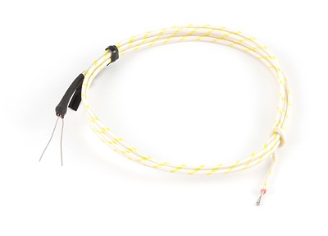
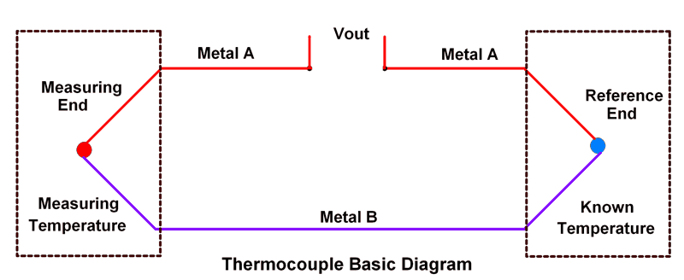
Thermocouple is made by two different metal wires (thermoelements) joined at one end called measuring end (also called as junction end). Another end is either joined or not joined, called as reference end of which temperature is known.
The temperature difference between these two ends produce voltage difference and this voltage is used to measure the temperature.

Slide 40
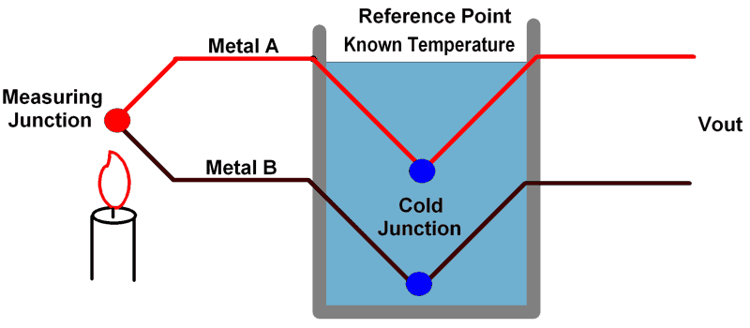
Thermocouples consist of two dissimilar metals (wires), metal A and metal B. These metals are joined at an end called as measuring junction, while the other end is called as reference point as shown in above figure.
Note that measuring Junction point is used to measure the temperature. The reference point in figure is a known temperature.
As per Seebeck effect, thermoelectric voltage is generated which is proportional to the temperature difference between two junctions. This voltage can be measured at reference point.
The Seebeck effect states that when two different or unlike metals are joined together at two junctions, an electromotive force (EMF) is generated at the two junctions.

Slide 41
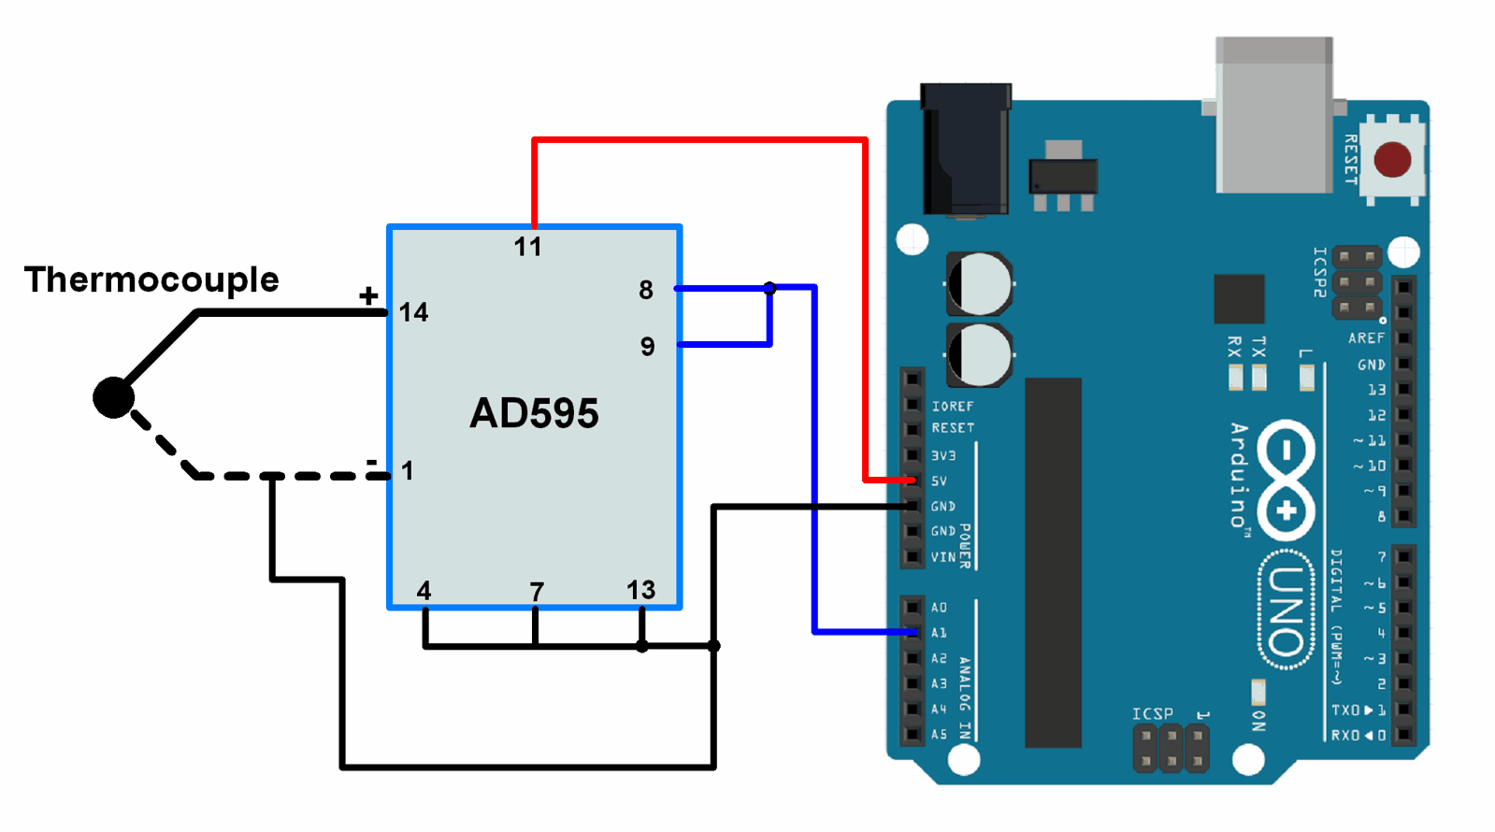

Here, AD595 is used to connect thermocouple to UNO board. The output voltage from AD595 is given to ADC of UNO board.
Here, AD595 is used to connect thermocouple to UNO board. The output voltage from AD595 is given to ADC of UNO board.The ADC value is then converted into ºC using the formula given below.
AD595 provides output as follows,
AD595 Output = (Type K Voltage + 11 uV) x 247.3
The above formula shows AD595 provides output with amplified offset voltage. So, we have to eliminate total offset voltage (11 uV * 247.3) to get accurate temperature value.

Slide 42
const int thermocouple_input = A1; /* AD595 O/P pin */
void setup() {
Serial.begin(9600); /* Define baud rate for serial communication */
}
void loop() {
int adc_val;
float temperature;
adc_val = analogRead(thermocouple_input);
temperature = ( ((adc_val * 4.88) - 0.0027 ) / 10.0 );
Serial.print("Temperature = ");
Serial.print(temperature);
Serial.print("\n\n");
delay(1000);
}

Slide 43
5.4 Rotary Encoder
A rotary encoder is a type of position sensor that converts the angular position (rotation) of a knob into an output signal that is used to determine which direction the knob is being turned.
There are two types of rotary encoders – absolute and incremental. The absolute encoder reports the exact position of the knob in degrees while the incremental encoder reports how many increments the shaft has moved. The rotary encoder used in this lecture is of the incremental type.
Rotary encoders are the modern digital equivalent of potentiometers and are more versatile than them.
They can rotate 360° without stopping.
https://lastminuteengineers.com/rotary-encoder-arduino-tutorial/

Slide 44
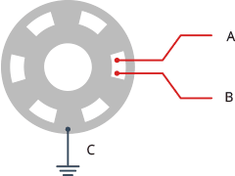
How Rotary Encoders Work?
Inside the encoder is a slotted disc that is connected to the common ground pin C. It also contains two contact pins A and B, as shown below.
When you turn the knob, A and B come into contact with the common ground pin C in a particular order according to the direction in which you are turning the knob.
When they come into contact with common ground, signals are generated. These signals are 90° out of phase with each other as one pin comes into contact with the common ground before the other pin. This is called quadrature encoding.

Slide 45
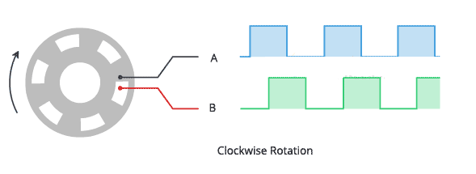
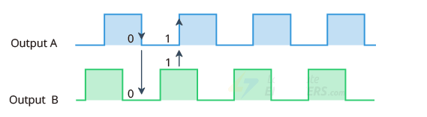
When you turn the knob clockwise the A pin connects to the ground before the B pin. And when you turn the knob counterclockwise, the B pin connects to the ground before the A pin.
By monitoring when each pin connects or disconnects from ground, we can determine the direction in which the knob is being rotated. This can be accomplished by simply observing the state of B when A’s state changes.
Counterclockwise rotation

Slide 46
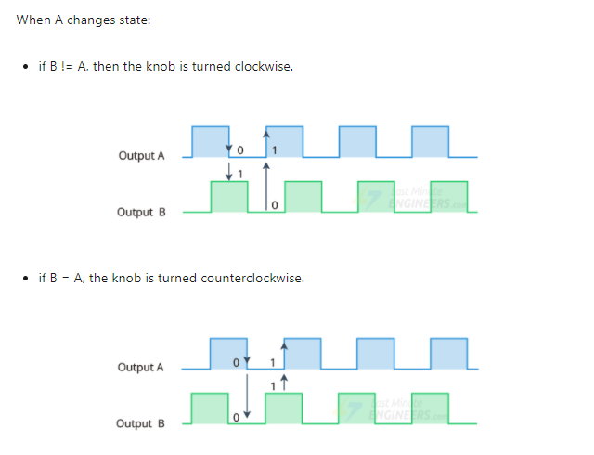

Slide 47
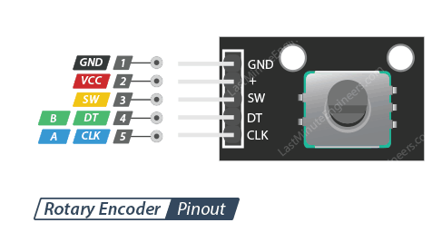
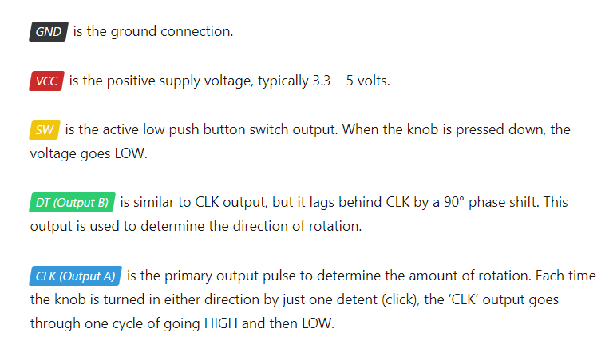

Slide 48
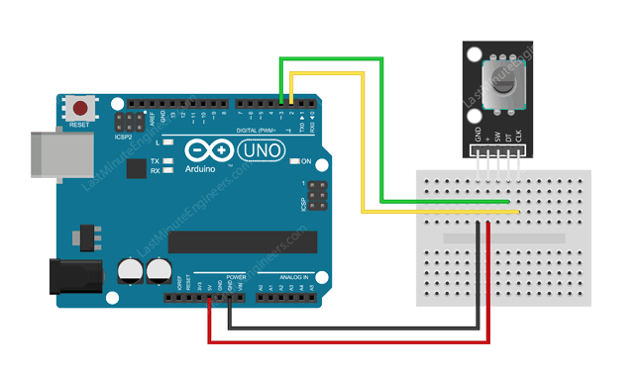

Slide 49
// Rotary Encoder Inputs
#define CLK 2
#define DT 3
#define SW 4
int counter = 0;
int currentStateCLK;
int lastStateCLK;
String currentDir ="";
unsigned long lastButtonPress = 0;
void setup() {
// Set encoder pins as inputs
pinMode(CLK,INPUT);
pinMode(DT,INPUT);
pinMode(SW, INPUT_PULLUP);
// Setup Serial Monitor
Serial.begin(9600);
// Read the initial state of CLK
lastStateCLK = digitalRead(CLK);
}
void loop() {
// Read the current state of CLK
currentStateCLK = digitalRead(CLK);
// If last and current state of CLK are different, then pulse occurred
// React to only 1 state change to avoid double count
if (currentStateCLK != lastStateCLK && currentStateCLK == 1){
// If the DT state is different than the CLK state then
// the encoder is rotating CCW so decrement
if (digitalRead(DT) != currentStateCLK) {
counter - -;
currentDir ="CCW";
} else {
// Encoder is rotating CW so increment
counter ++;
currentDir ="CW";
}

Slide 50
Serial.print("Direction: ");
Serial.print(currentDir);
Serial.print(" | Counter: ");
Serial.println(counter);
}
// Remember last CLK state
lastStateCLK = currentStateCLK;
// Read the button state
int btnState = digitalRead(SW);
//If we detect LOW signal, button is pressed
if (btnState == LOW) {
//if 50ms have passed since last LOW pulse, it means that the
//button has been pressed, released and pressed again
if (millis() - lastButtonPress > 50) {
Serial.println("Button pressed!");
}
// Remember last button press event
lastButtonPress = millis();
}
// Put in a slight delay to help debounce the reading
delay(1);
}

Slide 51
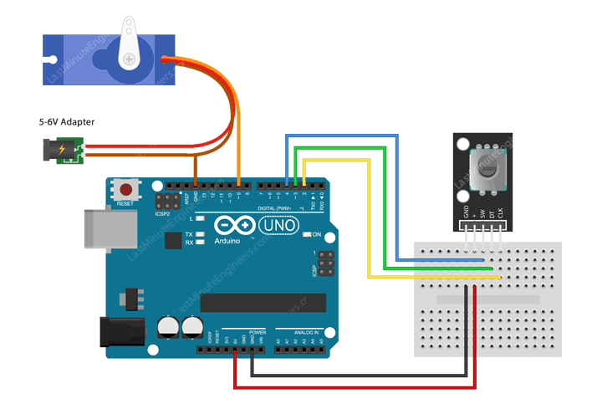
Controlling Servo Motor with Rotary Encoder
In the following example, we will use a rotary encoder to control the position of a servo motor.
This project can be very useful in a variety of situations. For example, if you want to operate a robotic arm, it can help you position the arm and its grip accurately.

Slide 52
// Include the Servo Library
#include <Servo.h>
// Rotary Encoder Inputs
#define CLK 2
#define DT 3
Servo servo;
int counter = 0;
int currentStateCLK;
int lastStateCLK;
void setup() {
// Set encoder pins as inputs
pinMode(CLK,INPUT);
pinMode(DT,INPUT);
// Setup Serial Monitor
Serial.begin(9600);
// Attach servo on pin 9 to the servo object
servo.attach(9);
servo.write(counter);
// Read the initial state of CLK
lastStateCLK = digitalRead(CLK);
}
void loop() {
// Read the current state of CLK
currentStateCLK = digitalRead(CLK);
// If last and current state of CLK are different, then pulse occurred
// React to only 1 state change to avoid double count
if (currentStateCLK != lastStateCLK && currentStateCLK == 1){
// If the DT state is different than the CLK state then
// the encoder is rotating CCW so decrement
if (digitalRead(DT) != currentStateCLK) {
counter --;
if (counter<0)
counter=0;
}
}

Slide 53
else {
// Encoder is rotating CW so increment
counter ++;
if (counter>179)
counter=179;
}
// Move the servo
servo.write(counter);
Serial.print("Position: ");
Serial.println(counter);
}
// Remember last CLK state
lastStateCLK = currentStateCLK;
}

Slide 54
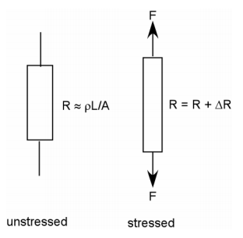
5.5 Stress and Strain Measurement
Stress and strain can be measured in many ways, typically based in some fashion upon the fact that a structure is deformed, or strained, when it experiences stress.
Metallic strain gages use the fact that a metal is deformed, or is strained, when it experiences stress.
The strain results in a change in its resistance.

Slide 55
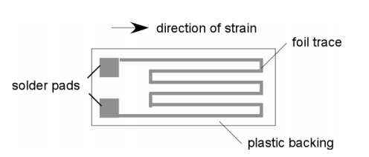
The most common form for metallic strain gages is for the wire grid. This metal foil is bonded to the element to be strained so that it will experience the same strain as that of the element. While this one type is most common, metallic-foil strain gages are manufactured from a variety of different metals and alloys, with a range of resistance values, a range of sensitivity of resistance to strain, and varying resistance-to-temperature characteristics. Common nominal resistance values (the resistance of the unstrained strain gage) are 120 Ω, 350 Ω, and 1000 Ω.

Slide 56
Applications
Strain gages can be related directly to stress through the elastic modulus (Young's modulus, E). Other typical measurements are force, torque, and pressure.
1.If the relationship between applied force and strain can be determined for a given structure, then strain gages can be used to measure the force.
2. If the relationship between applied torque and strain can be determined for a given structure, then strain gages can be used to measure the torque.
3. If the relationship between applied pressure and strain (examples include a container or a membrane) can be determined for a give structure, then strain gages can be used to measure the pressure.

Slide 57
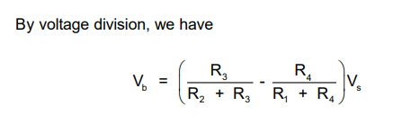
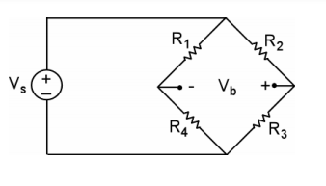
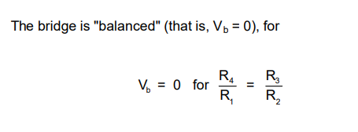
The Wheatstone Bridge is used to convert a change of resistance into a change of voltage
Now, let's replace one of the resistances on the bridge with a strain gage resistor and make the other three resistances the resistance of the strain gage's nominal resistance. Note that, when the strain gage experiences no strain, all four resistances in the bridge will have the same value.

Slide 58

