Slide 1
Architecture and Hardware (ITEC582 )
Eastern Mediterranean University
School of Computing and Technology
Master of Technology
Chapter 17
Parallel Processing

Slide 2
After studying this chapter, you should be able to:
Summarize the types of parallel processor organizations.
Present an overview of design features of symmetric multiprocessors.
Understand the issue of cache coherence in a multiple processor system.
Explain the key features of the MESI protocol.
Summarize key design issues for clusters.
Explain the concept of nonuniform memory access (NUMA).

Slide 3
Introduction
Traditionally, the computer has been viewed as a sequential machine. Each instruction is executed in a sequence of operations.
This view of the computer has never been entirely true. At the micro-operation level, multiple control signals are generated at the same time.
Instruction pipelining that overlaps fetch and execute operations, superscalar organization which exploits instruction-level parallelism are examples of performing functions in parallel.
Notes:
22

Slide 4
Introduction
As computer technology has evolved and the cost of computer hardware has dropped, more opportunities for parallelism become available.
Symmetric multiprocessors (SMPs) is one of the earliest and still the most common example of parallel organization.
In an SMP organization, multiple processors share a common memory. This organization raises the issue of cache coherence.
Notes:
22

Slide 5
1.Multiple Processor Organizations
List and briefly define three types of computer system organization.
Types of parallel processor systems are:
Single instruction, single data (SISD) stream
Single processor executes a single instruction stream to operate on data stored in a single memory
Uniprocessors fall into this category
Single instruction, multiple data (SIMD) stream
A single machine instruction controls the simultaneous execution of a number of processing elements on a lockstep basis
Vector and array processors fall into this category

Slide 6
Multiple Processor Organizations
Multiple instruction, single data (MISD) stream
A sequence of data is transmitted to a set of processors, each of which executes a different instruction sequence
Not commercially implemented
Multiple instruction, multiple data (MIMD) stream
A set of processors simultaneously execute different instruction sequences on different data sets
SMPs fit into this category

Slide 7
Multiple Processor Organizations
MIMDs can be further subdivided by the means in which the processors communicate.
If the processors share a common memory, then each processor accesses programs and data stored in the shared memory, and processors communicate with each other via that memory.
The most common form of such system is known as a symmetric multiprocessor (SMP).

Slide 8
Multiple Processor Organizations
In an SMP, multiple processors share a single memory.
The memory access time to any region of memory is approximately the same for each processor.
A more recent development is the nonuniform memory access (NUMA) organization.
The memory access time to different regions of memory may differ for a NUMA processor.
A collection of independent uniprocessors or SMPs may be interconnected to form a cluster.
Communication among the computers is either via fixed paths or via some network facility.

Slide 9
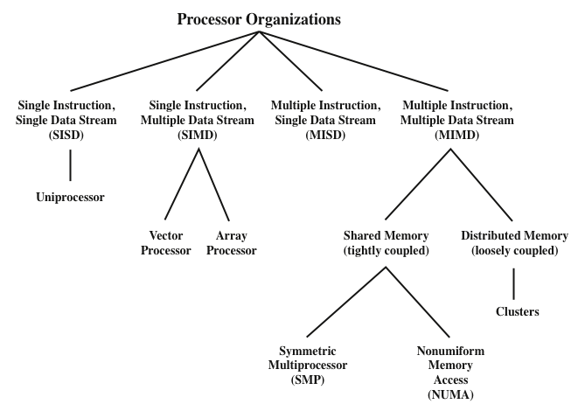
Multiple Processor Organizations

Slide 10
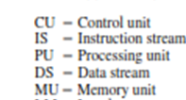
Parallel Organizations
The following figure shows the structure of an SISD. There is some sort of control unit (CU) that provides an instruction stream (IS) to a processing unit (PU). The processing unit operates on a single data stream (DS) from a memory unit (MU).

Slide 11
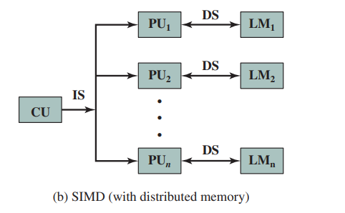
With an SIMD, there is still a single control unit, now feeding a single instruction stream to multiple PUs. Each PU may have its own dedicated memory (illustrated in figure b), or there may be a shared memory

Slide 12
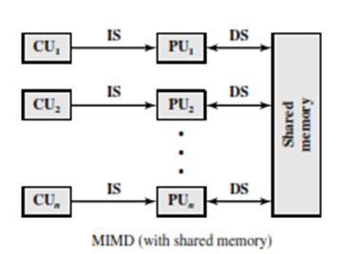
Finally, with the MIMD, there are multiple control units, each feeding a separate instruction stream to its own PU. The MIMD may be a shared-memory multiprocessor (figure below)

Slide 13
2. Symmetric Multiprocessors
Until fairly recently, virtually all single-user personal computers and most workstations contained a single general-purpose microprocessor. As demands for performance increase and as the cost of microprocessors continues to drop, vendors have introduced systems with an SMP organization.
The term SMP refers to a computer hardware architecture and also to the operating system behavior that reflects that architecture

Slide 14
What are the chief characteristics of an SMP?
A stand alone computer with the following characteristics:
There are two or more similar processors of comparable capacity
These processors share same memory and I/O facilities that are interconnected by a bus
All processors share access to I/O devices
All processors can perform the same functions (hence the term symmetric)
The system controlled by integrated operating system

Slide 15
Symmetric Multiprocessor (SMP)
The operating system (OS) of an SMP schedules processes or threads across all of the processors.
An SMP organization has a number of potential advantages over a uniprocessor organization.

Slide 16
What are some of the potential advantages of an SMP compared with a uniprocessor?
Performance:
Availability
Incremental growth:
Scaling:

Slide 17
Performance:
If the work to be done by a computer can be organized so that some portions of the work can be done in parallel, then a system with multiple processors will yield greater performance than one with a single processor of the same type.

Slide 18
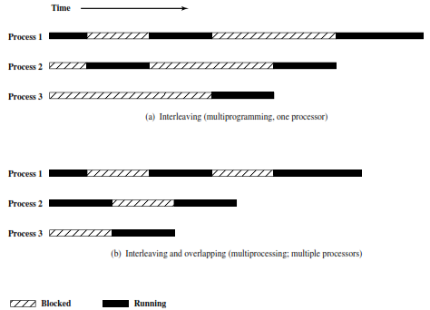
Multiprogramming and Multiprocessing

Slide 19
Availability:
In a symmetric multiprocessor, because all processors can perform the same functions, the failure of a single processor does not halt the machine. Instead, the system can continue to function at reduced performance.
Incremental growth:
A user can enhance the performance of a system by adding an additional processor.
Scaling:
Vendors can offer a range of products with different price and performance characteristics based on the number of processors configured in the system

Slide 20
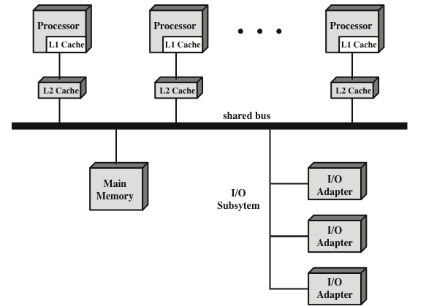
Symmetric Multiprocessor Organization

Slide 21
Symmetric Multiprocessor Organization
There are two or more processors. Each processor is self-contained, including a control unit, ALU, registers, and, typically, one or more levels of cache.
Each processor has access to a shared main memory and the I/O devices through the shared bus.
The processors can communicate with each other through memory.
The most common organization for personal computers, workstations, and servers is the time-shared bus.

Slide 22
Simplest mechanism for constructing multiprocessor system
Structure and interface similar to single processor system
Following features provided
Addressing - distinguish modules on bus
Arbitration - any module can be temporary master
Time sharing - if one module has the bus, others must wait and may have to suspend
Now have multiple processors as well as multiple I/O modules

Slide 23
What are the beneficial features and the limitations of a bus organization?
The bus organization has several advantages:
Simplicity
Simplest approach to multiprocessor organization
Flexibility
Generally easy to expand the system by attaching more processors to the bus
Reliability
The bus is essentially a passive medium and the failure of any attached device should not cause failure of the whole system

Slide 24
Symmetric Multiprocessor Organization
Disadvantages of the bus organization:
Low Performance
All memory references pass through the common bus
Performance is limited by bus cycle time
Each processor should have cache memory
Reduces the number of bus accesses
Leads to problems with cache coherence
If a word is altered in one cache it could conceivably invalidate a word in another cache
To prevent this the other processors must be alerted that an update has taken place
Typically addressed in hardware rather than the operating system

Slide 25
What are some of the key OS design issues for an SMP ?
Simultaneous concurrent processes
Scheduling
Synchronization
Memory management
Reliability and fault tolerance

Slide 26
■ Simultaneous concurrent processes:
OS routines need to be reentrant to allow several processors to execute the same IS code simultaneously. With multiple processors executing the same or different parts of the OS, OS tables and management structures must be managed properly to avoid deadlock or invalid operations.
■ Scheduling:
Any processor may perform scheduling, so conflicts must
be avoided. The scheduler must assign ready processes to available processors.

Slide 27
■ Synchronization:
With multiple active processes having potential access to shared address spaces or shared I/O resources, care must be taken to provide effective synchronization. Synchronization is a facility that enforces mutual exclusion and event ordering.

Slide 28
■ Memory management:
The paging mechanisms on different processors must be coordinated to enforce consistency when several processors share a page or segment and to decide on page replacement
■ Reliability and fault tolerance:
Scheduler and other portions of the operating system must recognize the loss of a processor and restructure accordingly

Slide 29
3. Cache Coherence
In contemporary multiprocessor systems, it is customary to have one or two levels of cache associated with each processor.
This organization is essential to achieve reasonable performance. It does, however, create a problem known as the cache coherence
The essence of the problem is this:
Multiple copies of the same data can exist in different caches simultaneously, and if processors are allowed to update their own copies freely, an inconsistent view of memory can result.

Slide 30
Two common write policies are defined:
■ Write back:
Write operations are usually made only to the cache. Main memory is only updated when the corresponding cache line is evicted from the cache.
■ Write through:
All write operations are made to main memory as well as to the cache, ensuring that main memory is always valid

Slide 31
In this section, we will briefly survey various approaches to the cache coherence problem and then focus on the approach that is most widely used: the MESI (modified/exclusive/shared/invalid) protocol.
Cache coherence approaches have generally been divided into software and hardware approaches.

Slide 32
Software Solutions
Attempt to avoid the need for additional hardware circuitry and logic by relying on the compiler and operating system to deal with the problem.
Compiler- based coherence mechanisms perform an analysis on the code to determine which data items may become unsafe for caching, and they mark those items accordingly. The operating system or hardware then prevents non-cacheable items from being cached.

Slide 33
The simplest approach is to prevent any shared data variables from being cached.
More efficient approaches analyze the code to determine safe periods for shared variables.
The compiler then inserts instructions into the generated code to enforce cache coherence during the critical periods.

Slide 34
Cache Coherence
Hardware-Based Solutions
Generally referred to as cache coherence protocols.
These solutions provide dynamic recognition at run time of potential inconsistency conditions.
Because the problem is only dealt with when it actually arises there is more effective use of caches, leading to improved performance over a software approach

Slide 35
Approaches are transparent to the programmer and the compiler, reducing the software development burden
Can be divided into two categories:
Directory protocols
Snoopy protocols

Slide 36
Directory Protocols
Directory protocols collect and maintain information about where copies of lines reside.
Typically, there is a centralized controller that is part of the main memory controller and a directory that is stored in main memory.
The directory contains global state information about the contents of the various local caches.

Slide 37
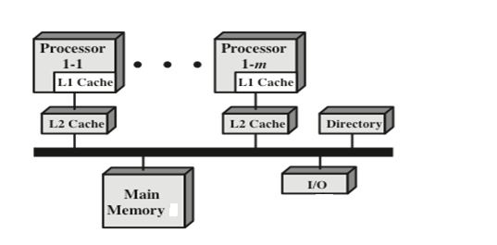

Slide 38
Directory Protocols
When an individual cache controller makes a request, the centralized controller checks and issues necessary commands for data transfer between memory and caches or between caches.
Typically, the controller maintains information about which processors have a copy of which lines.

Slide 39
Directory Protocols
Before a processor can write to a local copy of a line, it must request exclusive access to the line from the controller.
Before granting this exclusive access, the controller sends a message to all processors with a cached copy of this line, forcing each processor to invalidate its copy.

Slide 40
Directory Protocols
Directory schemes suffer from the drawbacks of a central bottleneck and the overhead of communication between the various cache controllers and the central controller.
However, they are effective in large-scale systems that involve multiple buses or some other complex interconnection scheme.

Slide 41
Snoopy Protocols
Distribute the responsibility for maintaining cache coherence among all of the cache controllers in a multiprocessor.
Each cache controller is able to “snoop” on the network to observe these broadcast notifications and react accordingly.
Suited to bus-based multiprocessor because the shared bus provides a simple means for broadcasting and snooping.
Two basic approaches to the snoopy protocol have been explored: write invalidate and write update.

Slide 42
Write Update
There can be multiple readers and writers.
When a processor wishes to update a shared line, the word to be updated is distributed to all others and caches containing that line can update it.

Slide 43
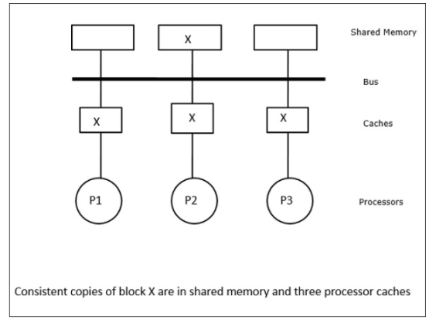
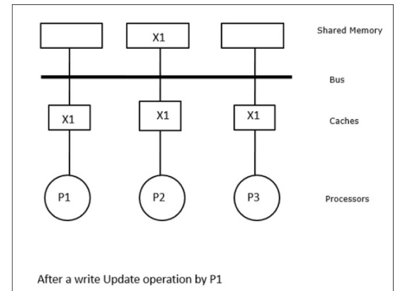

Slide 44
Write Invalidate
There can be multiple readers, but only one writer at a time.
When a write is required, all other caches of the line are invalidated.
Writing processor then has exclusive (cheap) access until line is required by another processor.
Most widely used in commercial multiprocessor systems such as the Pentium 4 and PowerPC.
State of every line is marked as modified, exclusive, shared or invalid. For this reason the write-invalidate protocol is called MESI.

Slide 45
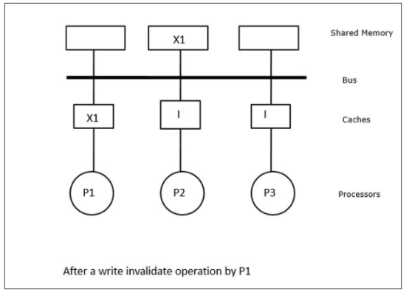

Slide 46
What is the meaning of each of the four states in the MESI protocol?
The MESI Protocol
The MESI protocol makes it possible to maintain the coherence in cached systems. It is based on the four states that a block in the cache memory can have. These four states are the abbreviations for MESI: modified, exclusive, shared and invalid. States are explained below:
Invalid:
It is a non-valid state. The data you are looking for are not in the cache, or the local copy of these data is not correct because another processor has updated the corresponding memory position.

Slide 47
Shared:
The line in the cache is the same as that in main memory and may be present in another cache.
Exclusive:
The line in the cache is the same as that in main memory and may be present in another cache.
Modified:
Actually, it is an exclusive-modified state. It means that the cache has the only copy that is correct in the whole system. The data which are in the main memory are wrong.

Slide 48
4. Clusters
Clustering is an alternative to SMP as an approach to providing high performance and high availability.
Defined as a group of interconnected whole computers working together as a unified computing resource that can create the illusion of being one machine.
Each computer in a cluster is called a node.

Slide 49
The above figure shows a two-node cluster in which the only interconnection is by means of a high-speed link that can be used for message exchange to coordinate cluster activity.
The link can be a LAN that is shared with other computers that are not part of the cluster or the link can be a dedicated interconnection facility. In the latter case, one or more of the computers in the cluster will have a link to a LAN or WAN so that there is a connection between the server cluster and remote client systems. Note that in the figure, each computer is depicted as being a multiprocessor. This is not necessary but does enhance both performance and availability.

Slide 50
In this case, there generally is still a message link between nodes. In addition, there is a disk subsystem that is directly linked to multiple computers within the cluster. In this figure, the common disk subsystem is a RAID system. The use of RAID or some similar redundant disk technology is common in clusters so that the high availability achieved by the presence of multiple computers is not compromised by a shared disk that is a single point of failure

Slide 51
What is RAID?
RAID (redundant array of independent disks) is a way of storing the same data in different places on multiple hard disks or solid-state drives (SSDs) to protect data in the case of a drive failure. There are different RAID levels, however, and not all have the goal of providing redundancy.

Slide 52
Cluster Computer Architecture

Slide 53
Cluster Computer Architecture
The individual computers are connected by some high-speed LAN or switch hardware.
Each computer is capable of operating independently. In addition, a middleware layer of software is installed in each computer to enable cluster operation.
The cluster middleware provides a unified system image to the user, known as a single-system image.
The middleware is also responsible for providing high availability, by means of load balancing and responding to failures in individual components.

Slide 54
Clusters Compared to SMP
Both clusters and symmetric multiprocessors provide (SMP) a configuration with multiple processors to support high-demand applications.
Both solutions are commercially available, although SMP schemes have been around far longer.
The main strength of the SMP approach is that an SMP is easier to manage and configure than a cluster.

Slide 55
Clusters Compared to SMP
The SMP is much closer to the original single-processor model for which nearly all applications are written.
The principal change required in going from a uniprocessor to an SMP is to the scheduler function.
Another benefit of the SMP is that it usually takes up less physical space and draws less power than a comparable cluster.
A final important benefit is that the SMP products are well established and stable.

Slide 56
Clusters Compared to SMP
Over the long run, however, the advantages of the cluster approach are likely to result in clusters dominating the high-performance server market.
Clusters are far superior to SMPs in terms of incremental and absolute scalability.
Clusters are also superior in terms of availability, because all components of the system can readily be made highly redundant.

Slide 57
What are some of the key benefits of clustering?
Absolute scalability:
It is possible to create large clusters that far surpass the power of even the largest standalone machines.
Incremental scalability:
A cluster is configured in such a way that it is possible to add new systems to the cluster in small increments. Thus, a user can start out with a modest system and expand it as needs grow, without having to go through a major upgrade in which an existing small system is replaced with a larger system.

Slide 58
High availability:
Because each node in a cluster is a standalone computer, the failure of one node does not mean loss of service.
Superior price / performance:
By using commodity building blocks, it is possible to put together a cluster with equal or greater computing power than a single large machine, at much lower cost

Slide 59
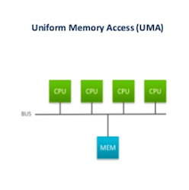
5.Nonuniform Memory Access (NUMA)
Before proceeding, we should define some terms often found in the NUMA literature.
■ Uniform memory access (UMA): All processors have access to all parts of main memory using loads and stores. The memory access time of a processor to all regions of memory is the same. The access times experienced by different processors are the same.

Slide 60
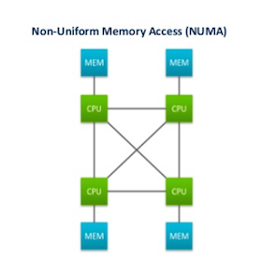
■ Nonuniform memory access (NUMA):
All processors have access to all parts of main memory using loads and stores
Access time of processor differs depending on which region of main memory is being accessed
Different processors access different regions of memory at different speeds

Slide 61
■ Cache- coherent NUMA (CC- NUMA):
A NUMA system in which cache coherence is maintained among the caches of the various processors
A NUMA system without cache coherence is more or less equivalent to a cluster
The commercial products that have received much attention recently are CC-NUMA systems, which are quite distinct from both SMPs and clusters.

Slide 62
Motivation
With an SMP system,
There is a practical limit to the number of processors that can be used.
How?
As the number of processors increases, this bus traffic also increases. At some point, the bus becomes a performance bottleneck. Performance degradation seems to limit the number of processors between 16 and 64 processors.

Slide 63
The processor limit in an SMP is one of the driving motivations behind the development of cluster systems.
With a cluster,
Each node has its own private main memory. Applications do not see a large global memory. In effect, coherency is maintained in software rather than hardware. This affects performance and, to achieve maximum performance, software must be tailored to this environment. One approach to achieving large - scale multiprocessing while retaining the flavor of SMP is NUMA

Slide 64
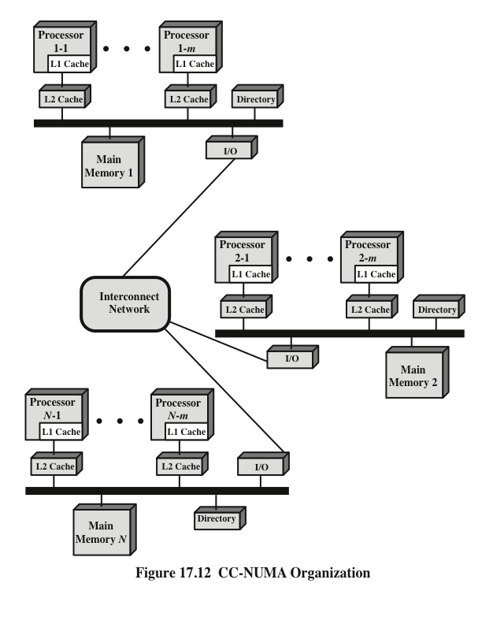
CC-NUMA Organization

Slide 65
CC-NUMA Organization
There are multiple independent nodes, each of which is, in effect, an SMP organization.
Thus, each node contains multiple processors, each with its own L1 and L2 caches, plus main memory.
The node is the basic building block of the overall CC-NUMA organization.
The nodes are interconnected by means of some communications facility.

Slide 66
CC-NUMA Organization
Each node in the CC-NUMA system includes some main memory. From the point of view of the processors, however, there is only a single addressable memory, with each location having a unique system wide address.
When a processor initiates a memory access, if the requested memory location is not in that processor’s cache, then the L2 cache initiates a fetch operation. If the desired line is in the local portion of the main memory, the line is fetched across the local bus.

Slide 67
CC-NUMA Organization
If the desired line is in a remote portion of the main memory, then an automatic request is sent out to fetch that line across the interconnection network, deliver it to the local bus, and then deliver it to the requesting cache on that bus.
All of this activity is automatic and transparent to the processor and its cache.
Each node maintains some sort of directory that gives it an indication of the location of various portions of memory and also cache status information for cache coherency.

Slide 68
Suppose that processor 3 on node 2 (P2-3) requests a memory location 798, which is in the memory of node 1. The following sequence occurs:
1. P2-3 issues a read request on the snoopy bus of node 2 for location 798.
2. The directory on node 2 sees the request and recognizes that the location is in
node 1.
3. Node 2’s directory sends a request to node 1, which is picked up by node 1’s
directory.
4. Node 1’s directory, acting as a surrogate of P2-3, requests the contents of 798, as if it were a processor.
5. Node 1’s main memory responds by putting the requested data on the bus.
6. Node 1’s directory picks up the data from the bus.
7. The value is transferred back to node 2’s directory.
8. Node 2’s directory places the data back on node 2’s bus, acting as a surrogate
for the memory that originally held it.
9. The value is picked up and placed in P2-3’s cache and delivered to P2-3.

Slide 69
NUMA Pros and Cons
Main advantage of a CC-NUMA system is that it can deliver effective performance at higher levels of parallelism than SMP without requiring major software changes.
Bus traffic on any individual node is limited to a demand that the bus can handle.

Slide 70
NUMA Pros and Cons
Even if the performance breakdown due to remote access is addressed, there are two other disadvantages for the CC- NUMA approach.

Slide 71
First
A CC -NUMA does not transparently look like an SMP; software changes will be required to move an operating system and applications from an SMP to a CC-NUMA sys - tem. These include page allocation, already mentioned, process allocation, and load balancing by the operating system
Second
Availability.
This is a rather complex issue and depends on the exact implementation of the CC-NUMA system.

