Slide 1
ITEC397 – Macro Coding
01 – What is Macro Coding

Slide 2
Office Works are :
Very Boring
Time Consuming
Repetitive Tasks
Also needs additional resources for controlling for
correctness
quality

Slide 3
So, automated solutions
are preferred,
instead of manual ones
There are some enterprise scale solution for office automation
But, they are complicated and expensive for small firms

Slide 4
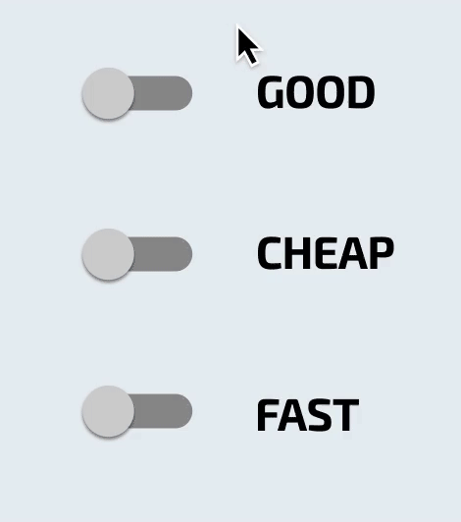
Small firms are looking for Solutions
Cheaper
Light weighted
Firms may need to develop their own solution.
HOW ???

Slide 5
Developing the solution with big brothers (programming languages)
C#, Java, C++, Python, Php, Visual Basic, Delphi, …
Handling the data within complex, expensive Database Management Systems
Oracle RDBMS, MSSQL Server, MySQL, MariaDB, PostgreSQL, …

Slide 6
These solutions are so expensive and complex
For many individuals and organizations
Is there any cheaper and simpler alternative
solution for this problem?

Slide 7
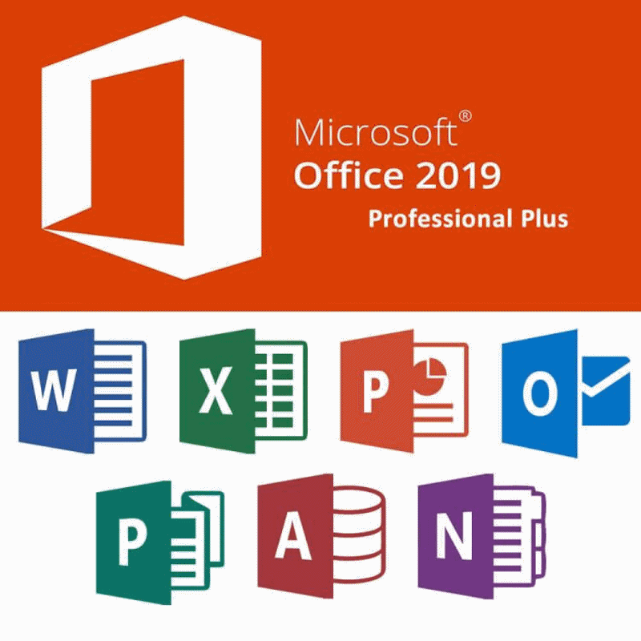
Today, almost all PCs are having MS Office
It needs minimum hardware requirements
Alternative Office Suites
OpenOffice
Polaris Office
Google DOCS,

Slide 8
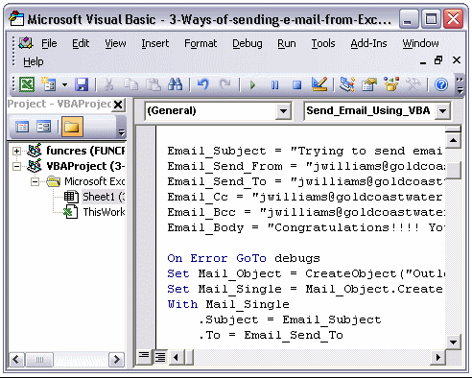
Office suites allows us to code for
simple and cheap solutions
This way of coding is named as
MACRO CODING

