Slide 1
INTRODUCTION TO LOGIC DESIGN Chapter 1 Digital Systems and Binary Numbers
gürtaçyemişçioğlu

Slide 2
OUTLINE OF CHAPTER 1
Digital
Systems
Binary
Numbers
Binary
Arithmetic
Number-base
Conversions
Octal &
Hexadecimal
Numbers
Complements
Signed Binary
Numbers
Binary
Codes
Binary Storage
& Registers
Binary Logic

Slide 3
1.1 DIGITAL systems

Slide 4
DIGITAL SYSTEMS
Digital age and information age
Digital computers
General purposes
Many scientific, industrial and commercial applications
Digital systems
Telephone switching exchanges
Digital camera
Electronic calculators, PDA's
Digital TV
Discrete information-processing systems
Manipulate discrete elements of information
For example, {1, 2, 3, …} and {A, B, C, …}…

Slide 5
DIGITAL SYSTEMS
DIGITAL SIGNAL
ANALOG SIGNAL
The physical quantities or signals can assume only discrete values.
Greater accuracy
The physical quantities or signals may vary continuously over a specified range.
X(t)
X(t)
t
t

Slide 6
DIGITAL SYSTEMS
Binary digital signal
An information variable represented by physical quantity.
For digital systems, the variable takes on discrete values.
Two level, or binary values are the most prevalent values.
Binary values are represented abstractly by:
Digits 0 and 1
Words (symbols) False (F) and True (T)
Words (symbols) Low (L) and High (H)
And words On and Off

Slide 7
DIGITAL SYSTEMS
Binary values are represented by values or ranges of values of physical quantities.
V(t)
Logic 1
undefine
Logic 0
t

Slide 8
1.2 Binary Numbers

Slide 9
BINARY NUMBERS
Decimal Number System
Base (also called radix) = 10
10 digits
{ 0, 1, 2, 3, 4, 5, 6, 7, 8, 9 }
Digit Position
Integer & fraction
Digit Weight
Weight = (Base) ^{Position}
Magnitude
Sum of “Digit x Weight”
Formal Notation
5
1
2
7
4
10²
10¹
10⁰
10⁻¹
10⁻²
100
10
1
0.1
0.01
5x100
1x10
2x1
7x0.1
4x0.01
500
+
10
+
2
0.7
+
0.04
d₂ x B² + d₁ x B¹ + d₀ x B⁰+d₋₁ x B⁻¹+d₋₂x B⁻²
(512.74)₁₀

Slide 10
BINARY NUMBERS
Octal Number System
Base = 8
8 digits
{ 0, 1, 2, 3, 4, 5, 6, 7}
Weights
Weight = (Base) ^{Position}
Magnitude
Sum of “Digit x Weight”
Formal Notation
5
1
2
7
4
8²
8¹
8⁰
8⁻¹
8⁻²
64
8
1
1/8
1/64
5x64
1x8
2x1
7x1/8
4x1/64
320
+
8
+
2
0.875
+
0.0625
o₂ x B² + o₁ x B¹ + o₀ x B⁰ + o₋₁ x B⁻¹+o₋₂ x B⁻²
(330.9375)₁₀
(512.74)₈

Slide 11
BINARY NUMBERS
Hexadecimal Number System
Base = 16
16 digits { 0, 1, 2, 3, 4, 5, 6, 7, 8, 9, A, B, C, D, E, F}
Weights
Weight = (Base) ^{Position}
Magnitude
Sum of “bit x Weight”
Formal Notation
1
E
5
7
A
16²
16¹
16⁰
16⁻¹
16⁻²
256
16
1
1/16
1/256
1x256
14x16
5x1
7x1/16
10x1/256
256
+
224
+
5
0.4375
+
0.039
H₂ x B² + H₁ x B¹ + H₀ x B⁰+H₋₁ x B⁻¹+H₋₂x B⁻²
(458.4765625)₁₀
(1E5.7A)₁₆

Slide 12
BINARY NUMBERS
Binary Number System
Base = 2
2 digits { 0, 1 }, called binary digits or “bits”
Weights
Weight = (Base) ^{Position}
Magnitude
Sum of “bit x Weight”
Formal Notation
Groups of bits
4 bits = Nibble, 8 bits = Byte
1
0
1
0
1
2²
2¹
2⁰
2⁻¹
2⁻²
4
2
1
0.5
0.25
1x4
0x2
1x1
0x0.5
1x0.25
4
+
0
+
1
0
+
0.25
b₂ x B² + b₁ x B¹ + b₀ x B⁰+b₋₁ x B⁻¹+b₋₂x B⁻²
(5.25)₁₀
(101.01)₂

Slide 13
BINARY NUMBERS
The power of 2
n | 2^{n}
0 | 2⁰=1
1 | 2¹=2
2 | 2²=4
3 | 2³=8
4 | 2⁴=16
5 | 2⁵=32
6 | 2⁶=64
7 | 2⁷=128
n | 2^{n}
8 | 2⁸=256
9 | 2⁹=512
10 | 2¹⁰=1024
11 | 2¹¹=2048
12 | 2¹²=4096
20 | 2²⁰=1M
30 | 2³⁰=1G
40 | 2⁴⁰=1T

Slide 14
1.3 Binary Arithmetic

Slide 15
BINARY ARITHMETIC
ADDITION
Decimal Addition
1
1
Carry
5
5
+
5
5
1
1
0
= Ten ≥ Base
➔ Subtract a Base

Slide 16
BINARY ARITHMETIC
ADDITION
Binary Addition - Column Addition
1
1
1
1
1
1
1
1
1
1
0
1
= 61
= 23
+
1
0
1
1
1
1
0
1
0
1
0
0
= 84
≥ (2)₁₀

Slide 17
BINARY ARITHMETIC
SUBTRACTION
Binary Subtraction - Borrow a “Base” when needed
1
2
= (10)₂
0
2
2
0
0
2
1
0
0
1
1
0
1
= 77
= 23
−
1
0
1
1
1
0
1
1
0
1
1
0
= 54

Slide 18
BINARY ARITHMETIC
MULTIPLICATION
Binary Multiplication – Bit by bit
1
0
1
1
1
x
1
0
1
0
0
0
0
0
0
1
0
1
1
1
0
0
0
0
0
1
0
1
1
1
1
1
1
0
0
1
1
0

Slide 19
1.4 Number-base conversion

Slide 20
NUMBER BASE CONVERSION
Evaluate Magnitude
Octal
(Base 8)
Decimal
(Base 10)
Evaluate Magnitude
Binary
(Base 2)
Hexadecimal
(Base 16)
Evaluate Magnitude

Slide 21
NUMBER BASE CONVERSION
Decimal to binary conversion
Divide the number by the ‘Base’ (=2)
Take the remainder (either 0 or 1) as a coefficient
Take the quotient and repeat the division

Slide 22
NUMBER BASE CONVERSION
Decimal (integer) to binary conversion
Example: (13)₁₀
Quotient
Remainder
Coefficient
13
/ 2 = 6
1 a₀ = 1
6
/ 2 = 3
0 a₁ = 0
3
/ 2 = 1
1 a₂ = 1
1
/ 2 = 0
1 a₃ = 1
Answer: (13)₁₀ = (a₃ a₂ a₁ a₀)₂ = (1101)₂
MSB LSB

Slide 23
NUMBER BASE CONVERSION
Decimal (fraction) to binary conversion
Multiply the number by the ‘Base’ (=2)
Take the integer (either 0 or 1) as a coefficient
Take the resultant fraction and repeat the division

Slide 24
NUMBER BASE CONVERSION
Decimal (fraction) to binary conversion
Example: (0.625)₁₀
Integer
Fraction
Coefficient
0.625
* 2 = 1 . 25
a₋₁ = 1
0.25
* 2 = 0 . 5
a₋₂ = 0
0.5
* 2 = 1 . 0
a₋₃ = 1
Answer: (0.625)₁₀ = (0.a₋₁ a₋₂ a₋₃)₂ = (0.101)₂
MSB LSB

Slide 25
NUMBER BASE CONVERSION
Decimal (integer) to octal conversion
Example: (175)₁₀
Quotient
Remainder
Coefficient
175
/ 8 = 21
7 a₀ = 7
21
/ 8 = 2
5 a₁ = 5
2
/ 8 = 0
2 a₂ = 2
Answer: (175)₁₀ = (a₃ a₂ a₁ a₀)₂ = (257)₈
MSB LSB

Slide 26
NUMBER BASE CONVERSION
Decimal (fraction) to octal conversion
Example: (0.3125)₁₀
Integer
Fraction
Coefficient
0.3125
* 8 = 2 . 5
a₋₁ = 2
0.5
* 8 = 4 . 0
a₋₂ = 4
Answer: (0.3125)₁₀ = (0.a₋₁ a₋₂ a₋₃)₂ = (0.24)₈
MSB LSB

Slide 27
1.5 Octal & hexadecimal Numbers

Slide 28
OCTAL & HEXADECIMAL NUMBERS
Binary to octal conversion
8 = 2³
Each group of 3 bits represents an octal digit
Octal | Binary
0 | 000
1 | 001
2 | 010
3 | 011
4 | 100
5 | 101
6 | 110
7 | 111
Example:
Assume Zeros
0
0
( 1 0 1 1 0 . 0 1 )₂
( 2 6 . 2 )₈
Works both ways (Binary to Octal & Octal to Binary)

Slide 29
OCTAL & HEXADECIMAL NUMBERS
Hex | Binary
0 | 0000
1 | 0001
2 | 0010
3 | 0011
4 | 0100
5 | 0101
6 | 0110
7 | 0111
8 | 1000
9 | 1001
A | 1010
B | 1011
C | 1100
D | 1101
E | 1110
F | 1111
Binary to hexadecimal conversion
16 = 2⁴
Each group of 4 bits represents a hexadecimal digit
Example:
Assume Zeros
000
( 1 0 1 1 0 . 0 1 )₂
00
( 1 6 . 4 )₁₆
Works both ways (Binary to Hex & Hex to Binary)

Slide 30
OCTAL & HEXADECIMAL NUMBERS
Octal to hexadecimal conversion
Convert to binary as an intermediate step
Example:
( 2 6 . 2 )₈
Assume Zeros
0
( 0 1 0 1 1 0 . 0 1 0 )₂
0 0
( 1 6 . 4 )₁₆
Works both ways (Octal to Hex & Hex to Octal)

Slide 31
OCTAL & HEXADECIMAL NUMBERS
Decimal | Octal | Hex | Binary
00 | 00 | 0 | 0000
01 | 01 | 1 | 0001
02 | 02 | 2 | 0010
03 | 03 | 3 | 0011
04 | 04 | 4 | 0100
05 | 05 | 5 | 0101
06 | 06 | 6 | 0110
07 | 07 | 7 | 0111
08 | 10 | 8 | 1000
09 | 11 | 9 | 1001
10 | 12 | A | 1010
11 | 13 | B | 1011
12 | 14 | C | 1100
13 | 15 | D | 1101
14 | 16 | E | 1110
15 | 17 | F | 1111

Slide 32
1.6 complements

Slide 33
COMPLEMENTS
Complements are used in digital computers to simplify the subtraction operation and for logical manipulation. Simplifying operations leads to simpler, less expensive circuits to implement the operations.
There are two types of complements for each base-r system:
diminished radix complement.
the radix complement

Slide 34
COMPLEMENTS
Diminished Radix Complement (r-1)’s Complement
Given a Number = N, base = r, digits = n,
The (r–1)’s complement of N is defined as:
(r^{n} –1) – N
Example for 6-digit decimal numbers:
9’s complement is (r^{n} – 1)–N = (10⁶–1)–N = 999999–N
9’s complement of 546700 is 999999–546700 = 453299

Slide 35
COMPLEMENTS
For decimal numbers r = 10 and
(r-1) = 9, this is called 9’s complement of N.
(10^{n}-1)-N.
10^{n} represents a number that consist of a single 1 followed by n 0’s.
10^{n}-1 is a number represented by n 9’s.
For binary numbers r = 2 and
r-1 = 1, this is called 1’s complement of N.
(2^{n}-1)-N.
2^{n} represents a binary number that consist of a 1 followed by n 0’s.

Slide 36
COMPLEMENTS
For Example: 0011
When subtracting binary digit from 1 we can have either 1-0 =1 or 1-1 =0 which causes bit to change from 0 to 1 or from 1 to 0.
1’s complement of a binary is formed by changing 1’s to 0’s and 0’s to 1’s.
Example: 0011011→1100100
(2⁴-1) – 0011
2⁴ = 10000
1111
- 1
- 0011
01111
1100

Slide 37
COMPLEMENTS
Example for 7-digit binary numbers:
1’s complement is (r^{n} – 1) – N = (2⁷–1)–N = 1111111–N
1’s complement of 1011000 is 1111111–1011000 = 0100111
Observation:
Subtraction from (r^{n} – 1) will never require a borrow
Diminished radix complement can be computed digit-by-digit

Slide 38
COMPLEMENTS
1’s Complement (Diminished Radix Complement)
All ‘0’s become ‘1’s
All ‘1’s become ‘0’s
If you add a number and its 1’s complement …
1
0
1
1
0
0
0
0
+
0
1
0
0
1
1
1
1
1
1
1
1
1
1
1
1

Slide 39
COMPLEMENTS
Radix Complement, the r's Complement
Given a Number = N, base = r, digits = n,
The r’s complement of N is defined as:
r^{n} - N, for N ≠ 0 and 0 for N = 0.
The r's complement is obtained by adding 1 to the (r − 1) 's complement, since
= [(r^{n} − 1) – N] + 1.
= r^{n}-N

Slide 40
COMPLEMENTS
10’s complement of N can be formed:
By leaving all least significant 0’s unchanged.
By subtracting first non-zero least significant digit by 10
By subtracting all higher significant digits from 9.
2’s complement of N can be formed:
By leaving all least significant 0’s and the first 1 unchanged and replacing 1’s with 0’s and 0’s with 1’s in all other higher significant digits.

Slide 41
COMPLEMENTS
Example: Base-10
The 10's complement of 012398:
The 10’s complement of 246700:
9
9
9
9
9
10
-
0
1
2
3
9
8
9
8
7
6
0
2
9
9
9
10
0
0
-
2
4
6
7
0
0
7
5
3
3
0
0

Slide 42
COMPLEMENTS
2’s Complement (Radix Complement)
Take 1’s complement then add 1
Toggle all bits to the left of the first ‘1’ from the right
Example:
Number:
1’s Comp.:
1
0
1
1
0
0
0
0
1 0 1 1 0 0 0 0
1
1
1
1
0
1
0
0
1
1
1
1
or
+
1
0
1
0
1
0
0
0
0
0
1
0
1
0
0
0
0

Slide 43
COMPLEMENTS
Example: Base-2
The 2's complement of 1101100 is 0010100
1
1
0
1
1
0
0
1 1 0 1 1 0 0
1
1
0
0
1
0
0
1
1
or
+
1
0
0
1
0
1
0
0
0
0
1
0
1
0
0

Slide 44
COMPLEMENTS
Example: Base-2
The 2's complement of 0110111 is 1001001
0
1
1
0
1
1
1
0 1 1 0 1 1 1
1
0
0
1
0
0
0
or
+
1
1
0
0
1
0
0
1
1
0
0
1
0
0
1

Slide 45
COMPLEMENTS
Complement of the complement restores the number to its original value
r’s complement of N is r^{n}-N
The complement of the complement is
r^{n}-(r^{n}-N) = N → original number

Slide 46
COMPLEMENTS
The subtraction of two n-digit unsigned numbers M – N in base r can be done as follows:
Add the minuend M to the r’s complement of the subtrahend N.
N r’s complement = r^{n}-N
= M + r^{n}-N
= M – N+r^{n}
If M ≥ N, the sum will produce an end carry r^{n}, which can be discarded; what is left is the result M – N.
If M < N, the sum does not produce an end carry and is equal to r^{n}-(N-M), which is the r’s complement of (N-M). To obtain the answer in a familiar form, take the r’s complement of the sum and place negative sign in front.

Slide 47
COMPLEMENT
Example 1.5
Using 10's complement, subtract 72532 – 3250.
M = 72532
N = 3250
Step1: Take 10’s complement of N
9
9
9
10
0
-
3
2
5
0
9
6
7
5
0

Slide 48
COMPLEMENT
Step2: To find the SUM, Add 10’s complement of N to M
72532
+
96750
SUM=
169282
Step3: To find the ANSWER discard end carry 10⁵, Subtract r^{n} from SUM
169282
-
100000
ANSWER=
69282

Slide 49
COMPLEMENT
Example 1.6
Using 10's complement, subtract 3250 - 72532.
M = 3250
N = 72532
Step1: Take 10’s complement of N
9
9
9
9
10
-
7
2
5
3
2
2
7
4
6
8

Slide 50
COMPLEMENT
Step2: To find the SUM, Add 10’s complement of N to M
03250
+
27468
There is no end carry!
SUM=
30718
Step3: To find the ANSWER take the –(10’s complement of SUM)
9
9
9
9
10
-
3
0
7
1
8
6
9
2
8
2
ANSWER=
-69282

Slide 51
COMPLEMENT
Example 1.7: Given the two binary numbers X = 1010100 and Y = 1000011, perform the subtraction (a) X – Y and (b) Y – X using 2’s complements.
(a) Step1: Take the 2’s complement of Y
1
0
0
0
0
1
1
0
1
1
1
1
0
1
Step2: Add 2’s complement of Y to X
1
0
1
0
1
0
0
+
0
1
1
1
1
0
1
There is an end carry!
1
0
0
1
0
0
0
1

Slide 52
COMPLEMENT
Step3: Discard the end carry.
1
0
0
1
0
0
0
1
+
1
0
0
0
0
0
0
0
ANSWER=
0
0
0
1
0
0
0
1
(b) Y – X: Step1: Take the 2’s complement of X
1
0
1
0
1
0
0
0
1
0
1
1
0
0

Slide 53
COMPLEMENT
Step2: Add 2’s complement of X to Y
1
0
0
0
0
1
1
+
0
1
0
1
1
0
0
There is no end carry!
SUM=
1
1
0
1
1
1
1
Step3: To find the answer Y – X = - (2’s complement of SUM)
1
1
0
1
1
1
1
-
0
0
1
0
0
0
1

Slide 54
COMPLEMENTS
Subtraction of unsigned numbers can also be done by means of the (r − 1)'s complement. Remember that the (r − 1) 's complement is one less then the r's complement.
Example 1.8 :Repeat Example 1.7, but this time using 1's complement.
X – Y = 1010100 – 1000011(84 – 67 = 17)
Step1: Take the 1’s complement of Y
1
0
0
0
0
1
1
0
1
1
1
1
0
0

Slide 55
COMPLEMENTS
Step2: Add1’s complement of Y to the X
Step3: Remove the end carry and add 1 (End-around carry)
1
0
1
0
1
0
0
There is an end carry!
Sum is 1 less than the correct difference when an end carry occurs!
+
0
1
1
1
1
0
0
SUM=
1
0
0
1
0
0
0
0
= 16
0
0
1
0
0
0
0
+
1
ANSWER=
0
0
1
0
0
0
1
= 17

Slide 56
COMPLEMENTS
Example 1.8 :Repeat Example 1.7, but this time using 1's complement.
Y – X = 1000011 – 1010100 (67 – 84 = -17)
Step1: Take the 1’s complement of X
1
0
1
0
1
0
0
0
1
0
1
0
1
1

Slide 57
COMPLEMENTS
Step2: Add1’s complement of X to the Y
Step3: To find the answer Y – X = - (1’s complement of SUM)
1
0
0
0
0
1
1
+
0
1
0
1
0
1
1
SUM=
1
1
0
1
1
1
0
There is NO end carry!
1
1
0
1
1
1
0
ANSWER=
-
0
0
1
0
0
0
1
= -17

Slide 58
1.7 Signed binary numbers

Slide 59
SIGNED BINARY NUMBERS
To represent negative integers, we need a notation for negative values.
It is customary to represent the sign with a bit placed in the left most position of the number since binary digits.
The convention is to make the sign bit
0 for positive and 1 for negative.
Example
Signed-magnitude representation: 10001001
Signed-1’s complement representation: 11110110
Signed-2’s complement representation: 11110111
Table 1.3 lists all possible four-bit signed binary numbers in the three representations.

Slide 60
SIGNED BINARY NUMBERS
Decimal | Signed-2’s Complement | Signed-1’s Complement | Signed Magnitude
+7 | 0111 | 0111 | 0111
+6 | 0110 | 0110 | 0110
+5 | 0101 | 0101 | 0101
+4 | 0100 | 0100 | 0100
+3 | 0011 | 0011 | 0011
+2 | 0010 | 0010 | 0010
+1 | 0001 | 0001 | 0001
+0 | 0000 | 0000 | 0000
-0 | - | 1111 | 1000
-1 | 1111 | 1110 | 1001
-2 | 1110 | 1101 | 1010
-3 | 1101 | 1100 | 1011
-4 | 1100 | 1011 | 1100
-5 | 1011 | 1010 | 1101
-6 | 1010 | 1001 | 1110
-7 | 1001 | 1000 | 1111
-8 | 1000 | - | -

Slide 61
SIGNED BINARY NUMBERS
Arithmetic addition
The addition of two numbers in the signed-magnitude system follows the rules of ordinary arithmetic.
If the signs are the same;
we add the two magnitudes and give the sum the common sign.
If the signs are different;
we subtract the smaller magnitude from the larger and give the difference the sign of the larger magnitude.

Slide 62
SIGNED BINARY NUMBERS
The addition of two signed binary numbers with negative numbers represented in signed-2's-complement form is obtained from the addition of the two numbers, including their sign bits.
A carry out of the sign-bit position is discarded.
Example:
+
6
0
0
0
0
0
1
1
0
-
6
1
1
1
1
1
0
1
0
+
13
+
0
0
0
0
1
1
0
1
+
13
+
0
0
0
0
1
1
0
1
+
19
0
0
0
1
0
0
1
1
+
7
0
0
0
0
0
1
1
1

Slide 63
SIGNED BINARY NUMBERS
Example:
+
6
0
0
0
0
0
1
1
0
-
6
1
1
1
1
1
0
1
0
-
13
+
1
1
1
1
0
0
1
1
-
13
+
1
1
1
1
0
0
1
1
-
7
1
1
1
1
1
0
0
1
-
19
1
1
1
0
1
1
0
1

Slide 64
SIGNED BINARY NUMBERS
Arithmetic Subtraction
In 2’s-complement form:
Take the 2’s complement of the subtrahend (including the sign bit) and add it to the minuend (including sign bit).
A carry out of sign-bit position is discarded.
$\text{(}\text{±}\text{A}\text{)}$ – (+B) = ($\text{±}\text{A}\text{)+}\left(\text{−}\text{B}\right)$
$\text{(}\text{±}\text{A}\text{)}$ – (-B) = ($\text{±}\text{A}\text{)+}\left(\text{+}\text{B}\right)$

Slide 65
SIGNED BINARY NUMBERS
Example:
(-6) – (-13) → (11111010 – 11110011)
-
6
1
1
1
1
1
0
1
0
+
13
-
0
0
0
0
1
1
0
1
+
7
0
0
0
0
0
1
1
1

Slide 66
1.8 Binary codes

Slide 67
BINARY CODES
BCD Code
A number with k decimal digits will require 4k bits in BCD.
Decimal 396 is represented in BCD with 12bits as:
Each group of 4 bits representing one decimal digit.
396
0011
1001
0110

Slide 68
BINARY CODES
A decimal number in BCD is the same as its equivalent binary number only when the number is between 0 and 9.
The binary combinations 1010 through 1111 are not used and have no meaning in BCD.
Decimal Symbol | BCD Digit
0 | 0000
1 | 0001
2 | 0010
3 | 0011
4 | 0100
5 | 0101
6 | 0110
7 | 0111
8 | 1000
9 | 1001

Slide 69
BINARY CODES
Example:
Consider decimal 185 and its corresponding value in BCD and binary:
(185)₁₀
(0001
1000
0101)_{BCD}
=
(10111001)₂

Slide 70
BINARY CODES
BCD Addition
Consider the addition of two decimal digits in BCD
Since each digit does not exceed 9
The sum cannot be greater than 9 + 9 + 1 = 19
the 1 in the sum being a previous carry
Suppose we add the BCD digits as if they were binary numbers
The binary sum will produce a result in the range from 0 to 19
In binary this will be from 0000 to 10011, but in BCD it is from 0000 to 1 1001
The first 1 being a carry and the next four bits being the BCD digit sum

Slide 71
BINARY CODES
BCD Addition
When binary sum is equal to or less than 1001 (without a carry)
The corresponding BCD digit is correct
When the binary sum is greater than or equal to 1010
The result is an invalid BCD digit
The addition of 6 = (0110)₂ to the binary sum converts it to the correct digit and also produces a carry as required
This is because the difference between a carry in the most significant bit position of the binary sum and a decimal carry.
16 – 10 = 6

Slide 72
BINARY CODES
BCD Addition
Consider the following three addition of two decimal digits in BCD
4
0
1
0
0
4
0
1
0
0
8
1
0
0
0

+
5
+
0
1
0
1
+
8
+
1
0
0
1
+
9
+
1
0
0
1
9
1
0
0
1
12
1
1
0
0
17
1
0
0
0
1
+
0
1
1
0
+
0
1
1
0
1
0
0
1
0
1
0
1
1
1
Carry
Correct BCD digit sum (2)
Carry
Correct BCD digit sum (7)

Slide 73
BINARY CODES
The addition of two n-digit unsigned BCD numbers follows the same procedure.
Consider the addition of 184 + 576 = 760 in BCD
1
1
0
0
0
1
1
0
0
0
0
1
0
0
1
8
4
+
0
1
0
1
+
0
1
1
1
+
0
1
1
0
+
5
7
6
Binary Sum
0
1
1
1
1
0
0
0
0
1
0
1
0
Add 6
+
0
1
1
0
+
0
1
1
0
BCD Sum
0
1
1
1
0
1
1
0
0
0
0
0
7
6
0

Slide 74
BINARY CODES
The representation of signed decimal numbers in BCD is similar to the representation of signed numbers in binary.
We can use either the familiar sign and magnitude system or the signed-complement system.
The sign of a decimal number is usually represented with four bits to conform to the 4-bit code of the decimal digits.
“+” with 0 0 0 0 and “-” with 1001 (BCD equivalent of 9)

Slide 75
BINARY CODES
The signed-complement system can be either the 9’s or the 10’s complement.
But the 10’s complement is the one most often used.
To obtain the 10’s complement of a BCD number:
First take the 9’s complement
9’s complement is calculated from the subtraction of each digit from 9.
Then add one to the least significant digit

Slide 76
BINARY CODES
The procedures developed for the signed-2’s complement system in the previous section apply also to the signed-10’s complement system for decimal numbers.
Addition is done by:
adding all digits,
including the sign digit and
discarding the end carry.
This assumes that all negative numbers are in 10’s complement form.

Slide 77
BINARY CODES
Consider the addition (+375) + (-240) = +135
Step1: Find the 10’s complement of (-240)
Step 2: Add 10’s complement of (-240) to 375 and discard the end carry.
9
10
0
-
2
4
0
7
6
0
0
375
+
9
760
0
135

Slide 78
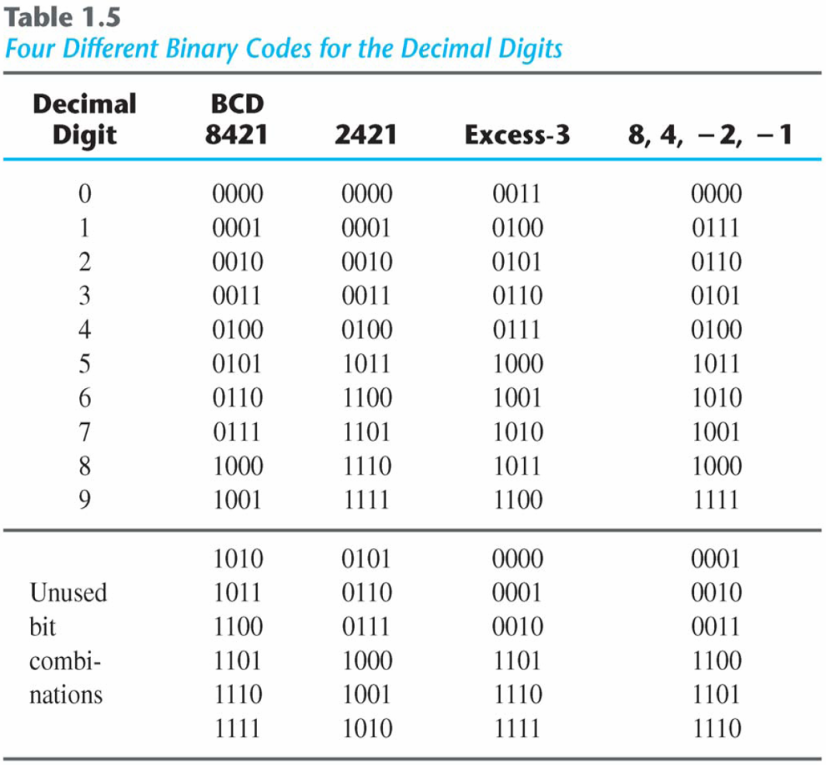
BINARY CODES

Slide 79
BINARY CODES
Gray code:
The output data of many physical systems produce quantities that are continuous.
These data must be converted into digital form before they are applied to a digital system.
Continuous or analog information is converted into digital form by means of an analog-to-digital converter.
X(t)
t

Slide 80
BINARY CODES
Gray Code | Decimal Equivalent
0000 | 0
0001 | 1
0011 | 2
0010 | 3
0110 | 4
0111 | 5
0101 | 6
0100 | 7
1100 | 8
1101 | 9
1111 | 10
1110 | 11
1010 | 12
1011 | 13
1001 | 14
1000 | 15
Gray code:
It is convenient to use gray code to represent the digital data when it is converted from analog data.
The advantage is that only bit in the code group changes in going from one number to the next.
Error detection.
Representation of analog data.
Low power design.

Slide 81
BINARY CODES
American Standard Code for Information Interchange (ASCII) Character Code (Refer to Table 1.7)
A popular code used to represent information sent as character-based data.
It uses 7-bits to represent 128 characters:
94 Graphic printing characters.
34 Non-printing characters.
Some non-printing characters are used for text format (e.g. BS = Backspace, CR = carriage return).
Other non-printing characters are used for record marking and flow control (e.g. STX and ETX start and end text areas).

Slide 82
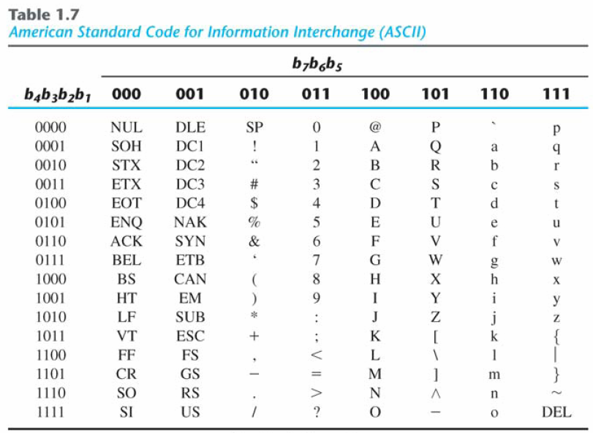
BINARY CODES

Slide 83
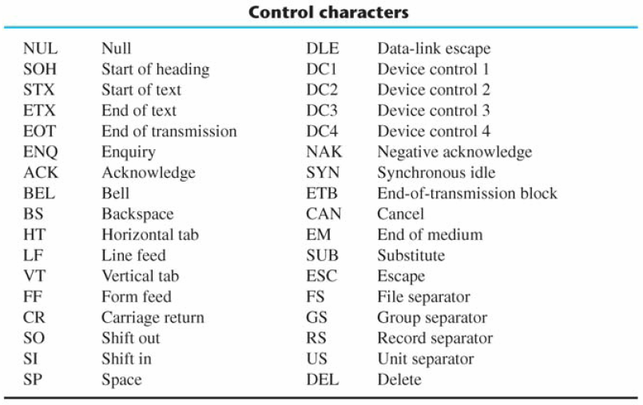
BINARY CODES

Slide 84
BINARY CODES
ASCII has some interesting properties:
Digits 0 to 9 span Hexadecimal values 30₁₆ to 39₁₆
Upper case A-Z span 41₁₆ to 5A₁₆
Lower case a-z span 61₁₆ to 7A₁₆
Lower to upper case translation (and vice versa) occurs by flipping bit 6.

Slide 85
BINARY CODES
Error-Detecting Code
To detect errors in data communication and processing, an eighth bit is sometimes added to the ASCII character to indicate its parity.
A parity bit is an extra bit included with a message to make the total number of 1's either even or odd.
Example:
Consider the following two characters and their even and odd parity:
 | With even parity | With odd parity
ASCII A = 1000001 | 01000001 | 11000001
ASCII T = 1010100 | 11010100 | 01010100

Slide 86
BINARY CODES
Error-Detecting Code
Redundancy (e.g. extra information), in the form of extra bits, can be incorporated into binary code words to detect and correct errors.
A simple form of redundancy is parity, an extra bit appended onto the code word to make the number of 1’s odd or even. Parity can detect all single-bit errors and some multiple-bit errors.
A code word has even parity if the number of 1’s in the code word is even.
A code word has odd parity if the number of 1’s in the code word is odd.
Example:
Message A: 10001001 1 (even parity)
Message B: 10001001 0 (odd parity)

Slide 87
1.9 Binary storage & registers

Slide 88
BINARY STORAGE & REGISTERS
Registers
A binary cell is a device that possesses two stable states and is capable of storing one of the two states.
A register is a group of binary cells. A register with n cells can store any discrete quantity of information that contains n bits.
1/0
0
1
1
0
1
0
1
1
n cells
2^{n} possible states

Slide 89
BINARY STORAGE & REGISTERS
A binary cell
Two stable state
Store one bit of information
Examples: flip-flop circuits, ferrite cores, capacitor
A register
A group of binary cells
AX in x86 CPU
Register Transfer
A transfer of the information stored in one register to another.
One of the major operations in digital system.
An example in next slides.

Slide 90
BINARY STORAGE & REGISTERS
Memory
CPU
Control Unit
Datapath
Inputs: Keyboard, mouse, modem, microphone
Input / Output
Outputs: CRT, LCD, modem, speakers
Synchronous or Asynchronous?

Slide 91
BINARY STORAGE & REGISTER
MEMORY UNIT
J
O
H
N
01001010 01001111 11001000 11001110
Memory Register
PROCESSOR UNIT
8 cells
8 cells
8 cells
8 cells
Processor Register
INPUT UNIT
8 cells
Input Register
Keyboard
Control
J
O
H
N
Figure 1.1 Transfer of information among register

Slide 92
BINARY STORAGE & REGISTERS
MEMORY UNIT
SUM
The other major component of a digital system
Circuit elements to manipulate individual bits of information
Load-store machine
LD R1;
LD R2;
ADD R3, R2, R1;
SD R3;
0100100011
Operand1
0011100001
Operand2
0001000010
0001000010
R1
Digital logic circuits for binary addition
0100100011
R3
0011100001
R2
PROCESSOR UNIT
Figure 1.2 Example of binary information processing

Slide 93
1.10 Binary logic

Slide 94
BINARY LOGIC
Definition of Binary Logic
Binary logic consists of binary variables and a set of logical operations.
The variables are designated by letters of the alphabet, such as A, B, C, x, y, z, etc., with each variable having two and only two distinct possible values: 1 and 0,
Three basic logical operations: AND, OR, and NOT.

Slide 95
BINARY LOGIC
AND operation is represented by a dot ($\text{∙}$) or by the absence of an operator.
Example: $\text{X} \text{∙} \text{Y}\text{ = }\text{Z}$or $\text{X} \text{Y} \text{=} \text{Z}$
“X AND Y is equal to Z”.
Z =1 if only X = 1 and Y = 1; otherwise Z = 0.
X, Y and Z are binary variables and can be equal either to 1 or 0, nothing else.

Slide 96
BINARY LOGIC
OR operation is represented by a plus (+).
Example: $\text{X} \text{+} \text{Y}\text{ = }\text{Z}$
“X OR Y is equal to Z”.
Z =1 if X = 1 OR Y = 1 or if both X = 1 OR Y = 1.
If both X = 0 OR Y = 0, then Z =0.

Slide 97
BINARY LOGIC
NOT operation is represented by a prim (’) sometimes by an overbar ( )
Example: $\text{X}\text{’}\text{ = }\text{Z}$ or $\overline{\text{X}}$ = Z
“NOT X is equal to Z”.
If X = 1, then Z =0, but if X = 0, then Z = 1.
The NOT operation is also referred to as the complement operation, since it changes a 1 to 0 and a 0 to 1.

Slide 98
BINARY LOGIC
Truth tables, Boolean expressions and Logic Gates
AND
OR
NOT
X
Y
Z
X
Y
Z
X
Z
0
0
0
0
0
0
1
0
0
1
0
0
1
1
0
1
1
0
0
1
0
1
1
1
1
1
1
1
$\text{Z}$= $\text{X} \text{∙} \text{Y}$
$\text{Z}$= $\text{X} \text{+} \text{Y}$
$\overline{\text{X}}$ = Z
$$\text{X}$$
$$\text{Z}$$
$$\text{X}$$
$$\text{Z}$$
$$\text{X}$$
$$\text{Z}$$
$$\text{Y}$$
$$\text{Y}$$

Slide 99
BINARY LOGIC
AND
OR

Slide 100
BINARY LOGIC
Example of binary signals
Volts
3
Signal range for logic 1
3
2
Logic 1
Transition occurs between these limits
2
undefined
1
1
Signal range for logic 0
Logic 0
0
0

Slide 101
BINARY LOGIC
Graphic Symbols and Input-Output Signals for Logic gates:
$$\text{X}$$
$$\text{Z}$$
$$\text{X}$$
$$\text{Z}$$
$$\text{X}$$
$$\text{Z}$$
$$\text{Y}$$
$$\text{Y}$$
(a) two input AND gate
(b) two input OR gate
(c) NOT gate or Inverter
$$\text{0}$$
$$\text{1}$$
$$\text{1}$$
$$\text{0}$$
$$\text{0}$$
$$\text{X}$$
$$\text{0}$$
$$\text{0}$$
$$\text{1}$$
$$\text{1}$$
$$\text{0}$$
$$\text{Y}$$
$$\text{0}$$
$$\text{0}$$
$$\text{1}$$
$$\text{0}$$
$$\text{0}$$
$$\text{X}\text{ ∙ }\text{Y}$$
$$\text{0}$$
$$\text{1}$$
$$\text{1}$$
$$\text{1}$$
$$\text{0}$$
$$\text{X}\text{ + }\text{Y}$$
$$\overline{\text{X}}$$
$$\text{1}$$
$$\text{0}$$
$$\text{0}$$
$$\text{1}$$
$$\text{0}$$

Slide 102
BINARY LOGIC
Graphic Symbols and Input-Output Signals for many input logic gates:
A
A
B
B
F = A$∙$ B $∙$C
F = A + B + C + D
C
C
D
(a) three input AND gate
(b) four input OR gate

