Slide 1
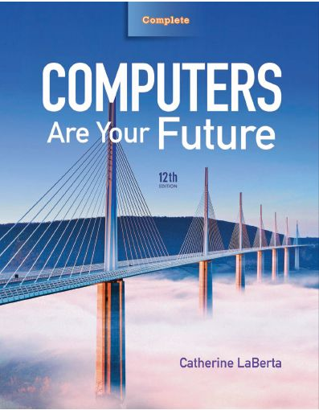
Computers Are Your Future Twelfth Edition
Chapter 9: Privacy, Crime, and Security

Slide 2
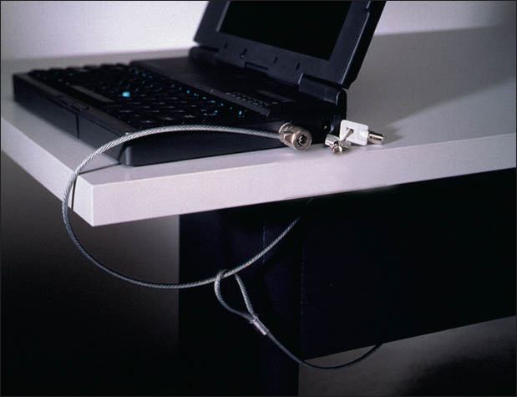
Privacy, Crime, and Security

Slide 3
Objectives
Understand how technological developments are eroding privacy and anonymity.
List the types of computer crime and cybercrime.
List the types of computer criminals.

Slide 4
Objectives
Understand computer system security risks.
Describe how to protect your computer system and yourself.
Define encryption and explain how it makes online information secure.

Slide 5
Objectives
Describe the issues the government faces when balancing the need to access encrypted data and the public’s right to privacy.
Distinguish between electronic discovery and computer forensics.

Slide 6
Privacy in Cyberspace
Privacy
Individual’s ability to restrict or eliminate the collection, use, and sale of confidential personal information

Slide 7
The Problem: Collection of Information Without Consent
Anonymity
Means to communicate without disclosing one’s identity
More difficult with the use of computers and the Internet

Slide 8
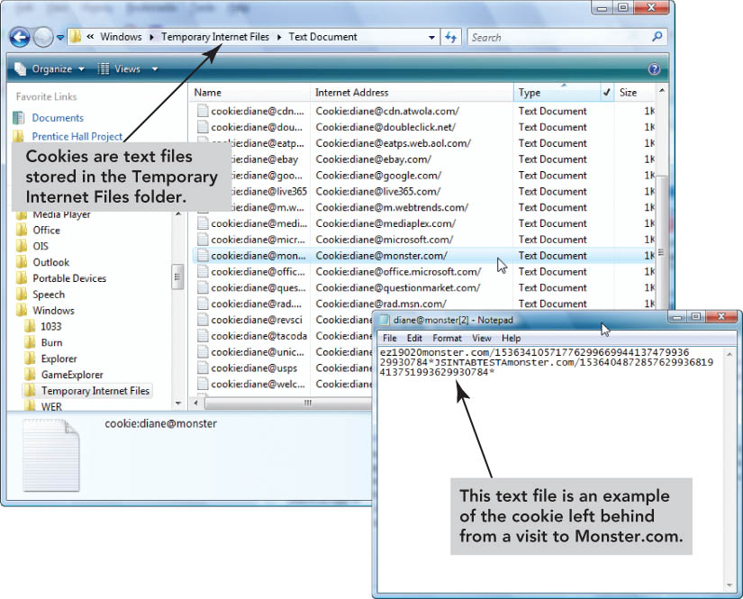
The Problem: Collection of Information Without Consent
Technologies that jeopardize anonymity
Cookies
Global unique identifiers
Ubiquitous computing
Radio frequency identification

Slide 9
The Problem: Collection of Information Without Consent
Cookies
Small files written to your hard disk by Web sites visited
Examples include:
Track your browsing habits
Gather personal information without your consent
Can be disabled
Banner ads—targeted display ads based on cookies

Slide 10
The Problem: Collection of Information Without Consent
Global unique identifer (GUID)
Identification number produced by software or a piece of hardware
Web servers read the GUID.
Users are not always aware of the GUID.
If used, companies typically allow users to opt out.
Civil liberties groups and public concern have decreased the use of GUIDs.

Slide 11
The Problem: Collection of Information Without Consent
Ubiquitous computing
Interacting with multiple networked devices
Example: adjusting heat or light based on signals sent by monitors built into clothing
Active badge—transmits infrared signals to create an electronic trail
Current devices—hold private information that can be exploited if the device is lost or stolen
Example: smartphones

Slide 12
The Problem: Collection of Information Without Consent
Radio frequency identification (RFID)
Uses radio waves to track a chip or tag
Used for inventory control in stores
Recognizes microchips in pets
May compromise anonymity and privacy if information stored on RFID tags attached to U.S. passports

Slide 13
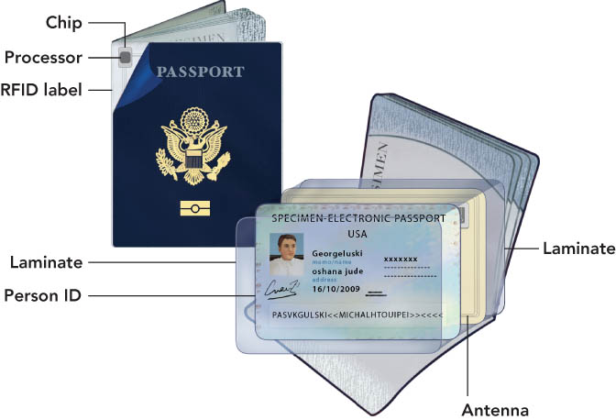
The Problem: Collection of Information Without Consent

Slide 14
The Problem: Collection of Information Without Consent
European Union
Be informed when information about them is being collected and how it will be used.
Give or deny consent to have their information collected and choose how collected information will be used.
Request that information about themselves be removed from marketing and other databases.
United States
Legislation currently in place includes:
Fair Credit Reporting Act
Health Insurance Portability and Privacy Act
Family Education Rights and Privacy Act
No comprehensive federal law governing the overall privacy rights of U.S. citizens.

Slide 15
The Problem: Collection of Information Without Consent
SPAM
Unsolicited messages sent in bulk over electronic mailing systems
CAN-SPAM Act of 2003
U.S. law that provided tools to combat spammers.

Slide 16
The Problem: Collection of Information Without Consent
Protecting privacy online
Use products such as Anonymous Surfing or IronKey Secure USB flash.
Use free Web-based throwaway e-mail addresses in chat rooms and for mailing lists.
Tell children not give out personal information.
Complete forms only if you see a privacy statement.
Turn off cookies
Prevent the activity of Web beacons
Transparent graphic images placed on a Web site or in an e-mail—used to monitor Web or e-mail behavior

Slide 17
The Problem: Collection of Information Without Consent
Protecting privacy at home
Create logins and passwords for each person using the computer.
Do not save account numbers or passwords.
Close a secured account site when not using a computer.
Use strong passwords
Do use: difficult to guess passwords; at least 14 characters or more long; uppercase letters, lowercase letters, numbers, and special characters
Don’t use: a recognizable word or phrase; name of anything or anyone close to you, including names of family members or pets; recognizable strings of numbers, such as social security numbers or birth dates

Slide 18
The Problem: Collection of Information Without Consent
Do not leave cell phones in public places.
Turn off services not in use, especially Bluetooth.
Verify that devices have secure configurations.

Slide 19
The Problem: Collection of Information Without Consent
Employee monitoring
Majority of large U.S. employers observe employee phone calls, e-mails, Web browsing habits, and computer files
Protecting privacy at work
Refrain from making personal calls on a work phone
Avoid using company e-mail for personal purposes
Assume you are monitored
Be aware of shoulder surfing
Do not allow others to tailgate

Slide 20
The Problem: Collection of Information Without Consent

Slide 21
Computer Crime and Cybercrime
Computer crimes
Computer-based activities that violate the law
Cybercrimes
Crimes perpetrated through the Internet
Many Web sites educate users about cybercrime and cybercriminals
Cyberlaw
Area of law dedicated to computer crime

Slide 22
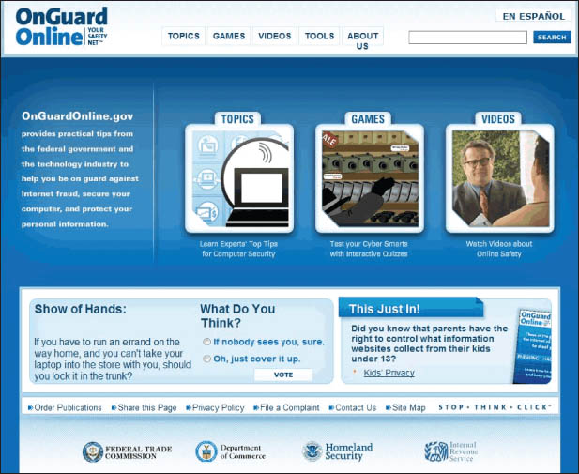
Computer Crime and Cybercrime

Slide 23
Computer Crime and Cybercrime
Types of computer crime
Identify theft—criminal access to personal information in order to impersonate someone
Dumpster diving—disgruntled employees or thieves go through a company’s trash to find information they can steal
Phishing attacks—legitimate-looking e-mails or Web sites created in an attempt to obtain confidential data about a person
Spear phishing (similar to phishing)—uses targeted fake e-mails and social engineering to trick recipients into providing personal information to enable identity theft

Slide 24
Computer Crime and Cybercrime
Types of computer crime (cont.)
Malware (short for malicious software)—programs that intentionally harm a computer system or allow individuals to gain access without permission
Tips to protect yourself from malware:
Know who you are dealing with
Keep your Web browser and operating system up to date
Back up important files
Protect children online
Use security software tools and keep them up to date
Use strong passwords
Learn what to do if something goes wrong

Slide 25
Computer Crime and Cybercrime
Types of computer crime (con’t.)
Spyware—software that gathers private information and tracks Web use
Adware—form of spyware that generates annoying pop-up and banner ads
Keyloggers—record keystrokes to provide cybercriminals with confidential data

Slide 26
Computer Crime and Cybercrime
Types of computer crime (con’t.)
Computer virus—code concealed inside a program that can harm or destroy files
Many spread through e-mail attachments
File infectors—attach themselves to files
Payload—refers to the dangerous actions a virus performs.
Macro viruses—attach to data files and take advantage of application macros
Boot sector viruses—execute each time you start the computer
SPIM—spam text message sent via a cell phone or instant messaging service

Slide 27
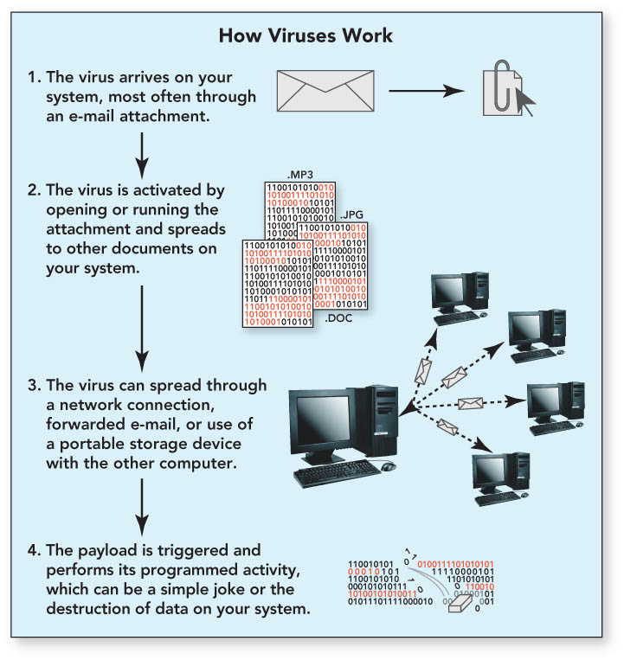
Computer Crime and Cybercrime

Slide 28
Computer Crime and Cybercrime
Rogue programs
Logic bomb—hidden computer code that sits dormant on a system until triggered
Time bomb—virus program that remains dormant on a computer system until activated
Worm—similar to a virus but does not need action of a user to execute

Slide 29
Computer Crime and Cybercrime
More rogue programs
Denial of service (DoS) attack—assaults an Internet server with so many requests it can’t function
Distributed denial of service (DD0S)—attack involves multiple computer systems
Commandeered computers form a botnet (robot network)
Bot (short for robot)—connects individual computers to the controller, usually a server under the control of the botnet controller
The individual computers are called zombies.

Slide 30
Computer Crime and Cybercrime
More rogue programs (con’t.)
Syn flooding—form of denial of service attack in which synchronization packets are repeatedly sent to every port on the server
Uses up all available network connections
Locks them until they time out
Rootkit—malicious program that is disguised as a useful program
Enables attacker to gain administrator level access
Allows attacker to have repeated and undetected access
Trojan horse—normal-looking program that includes concealed instructions to cause harm

Slide 31
Computer Crime and Cybercrime
Fraud, theft, and piracy
Memory shaving
Software piracy
Cybergaming crime
Tricks for obtaining passwords
Salami shaving and data diddling
Forgery

Slide 32
Computer Crime and Cybercrime
The attackers
Hackers—computer hobbyists attempting unauthorized access, generally subscribing to an unwritten code of conduct—hacker ethic
Cybergangs—groups of hackers working together to coordinate attacks
IP spoofing—sends a message with an IP address disguised as a message from a trusted source
Honeypots—computers baited with fake data and purposely left vulnerable to study how intruders operate to prepare stronger defenses

Slide 33
Computer Crime and Cybercrime
The Attackers (con’t.)
Crackers (also called black hats)—attempt to enter highly secure computer systems to destroy data or steal information
Ethical hackers (also called white hats) use expertise to shore up computer system defenses
Computer virus authors—create viruses and other types of malware to vandalize computer systems
Swindlers perpetuate frauds:
Bogus work-at-home opportunities
Illegal pyramid schemes
Bogus franchises
Phony goods that won’t be delivered
Over-priced scholarship searches

Slide 34
Computer Crime and Cybercrime
Cyberstalkers
Use the Internet, social networking sites, and e-mail to harass or threaten
Most perpetrators are men
Most victims are college-age women
Cyberbullying
Sending threatening messages via e-mail or text message
Usually involves minors

Slide 35
Security
Computer security risk
Any intentional or unintentional action resulting in damaging a computer system or its data
Increased by wireless LANs because transmissions occur over shared airwaves instead of dedicated lines

Slide 36
Security
Computer security risk (con’t)
Wireless LAN security options include:
WEP (Wired Equivalent Privacy)
WPA (WiFi Protected Access)
WPA2
Vacation hacking—tricking travelers into using phony WiFi hot spots—evil twins

Slide 37
Security
Computer system security threats
Corporate espionage—unauthorized access of corporate information, usually to the benefit of a competitor
Pod slurping—using removable storage media to create unauthorized copies of confidential data
Trap doors—security holes created by employees allowing entry to company systems after leaving the firm
Information warfare—use of information technologies to corrupt or destroy an enemy’s information and industrial infrastructure
Security loophole detection programs
Attacks on safety-critical systems
Terrorism

Slide 38
Security
Protecting your computer system
Uninterruptible power supply (UPS)—provides additional power during outages or electrical current fluctuations
Control access to computer systems through appropriate password selection and know-and-have authentication, which requires using tokens to generate a login code.

Slide 39
Security
Protecting your computer system (con’t.)
Biometric authentication—use of voice recognition, retinal scans, and fingerprint scans for authentication
Firewalls, hardware or software, to prevent unauthorized access

Slide 40
Security
Protect yourself—avoid scams
Do business with reputable companies.
Read documents carefully.
Don’t give out personal information
Do not post a user profile.
Be skeptical of chat room information.
Be cautious if meeting someone you’ve contacted online.
If you become uncomfortable or afraid, contact the police

Slide 41
The Encryption Debate
Cryptography
Study of transforming information into an encoded or scrambled format
Cryptographers
Individuals who practice cryptography
Encryption
Coding or scrambling process that renders a message unreadable by anyone other than the intended recipient

Slide 42
The Encryption Debate
Plaintext
Readable message that has not been encrypted
Encryption key
Formula that makes a plaintext message unreadable
Ciphertext
Coded message

Slide 43
The Encryption Debate
Symmetric key encryption
Uses same key for both encryption and decryption
Key interception
Occurs when a symmetric key encryption is stolen, allowing others to decrypt messages encrypted with that encryption key

Slide 44
The Encryption Debate
Public key encryption
Also referred to as asymmetric key encryption
Uses two keys:
Public key to encrypt
Private key to decrypt
Essential for e-commerce
Used to implement:
Digital signatures—guarantee messages are secure
Digital certificates—validate identity
Secure electronic transaction (SET)
Uses digital certificates
Enable parties engaged in Internet-mediated transactions to confirm each other’s identities

Slide 45
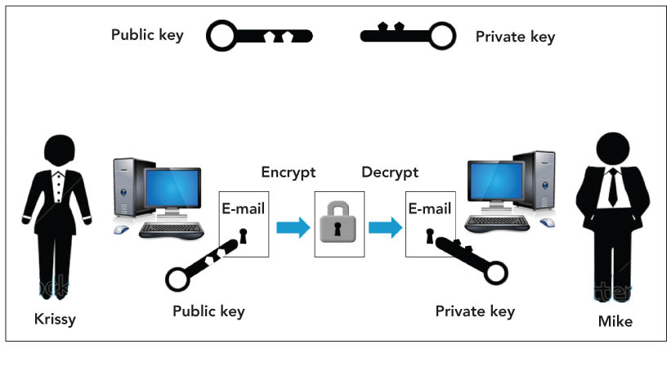
The Encryption Debate

Slide 46
The Encryption Debate
Public key infrastructure (PKI)
Uniform set of encryption standards
No dominant standard
Public fear of a monopoly if a PKI is chosen

Slide 47
The Encryption Debate
Encryption and public security issues
U.S. government continues search for ways to balance the public’s right to privacy and the government’s need to know

Slide 48
Prosecuting Violators
E-discovery
Obligation of parties to a lawsuit to exchange documents existing only in electronic form
Computer forensics
Legal evidence found in computers and digital storage media

Slide 49
Summary
Understand how technological developments are eroding privacy and anonymity.
List the types of computer crime and cybercrime.
List the types of computer criminals.

Slide 50
Summary
Understand computer system security risks.
Describe how to protect your computer system and yourself.
Define encryption and explain how it makes online information secure.

Slide 51
Summary
Describe the issues the government faces when balancing the need to access encrypted data and the public’s right to privacy.
Distinguish between electronic discovery and computer forensics.

Slide 52
All rights reserved. No part of this publication may be reproduced, stored in a retrieval system, or transmitted, in any form or by any means, electronic, mechanical, photocopying, recording, or otherwise, without the prior written permission of the publisher. Printed in the United States of America.
Copyright © 2012 Pearson Education, Inc.
Publishing as Prentice Hall

