Slide 1
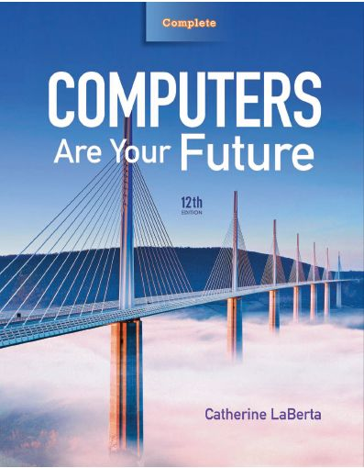
Computers Are Your Future Twelfth Edition
Spotlight 5: Cloud Computing

Slide 2
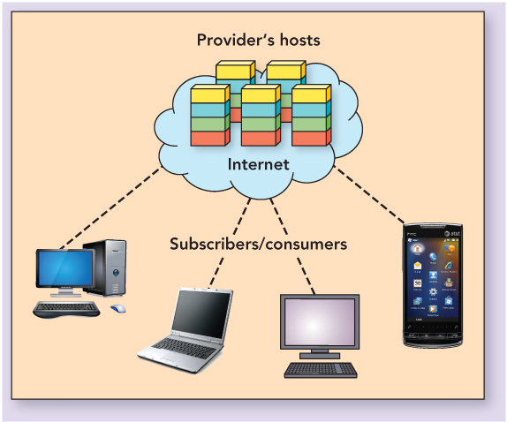
Cloud Computing

Slide 3
What is Cloud Computing?
Cloud computing
Hosting computers, or cloud providers, deliver services to subscribers over the Internet
Five general characteristics
On-demand self-service
Broad network access
Resource pooling
Rapid elasticity
Measured service

Slide 4
What is Cloud Computing?
Cloud computing (con’t.)
Hosting computers (servers) and subscribers (clients) main components—just as with client/server network
Three major differences:
Delivery of services must be over the Internet
Services are scalable
Services are managed completely by the cloud provider, the owner, or manager of the host

Slide 5
Cloud Computing Service Categories
Infrastructure-as-a-Service (IaaS)
Outsourcing of hardware—equipment used to sustain the operations of a company or enterprise
Hardware-as-a-Service (HaaS)
Virtual datacenter
Main factors in the use of IaaS:
Reduced budget outlay
Fast time to market with programs and ideas
Reassignment of IT personnel
Replacement of unknown with known costs

Slide 6
Cloud Computing Service Categories

Slide 7
Cloud Computing Service Categories
Platform-as-a-Service (PaaS)
Permits subscribers to have remote access to:
Application development
Interface development
Database development
Storage and testing

Slide 8
Cloud Computing Service Categories
Software-as-a-Service (SaaS)
Enables software to be deployed from provider, delivered over the Internet, and accessed by subscriber
Primary reason to subscribe:
Limited risk
Rapid deployment
Fewer upfront costs
Increased reliability
Standardized backup procedures
Lower total cost of ownership (TCO)

Slide 9
Cloud Deployment Methods
Three basic types of deployment models:
Private cloud
Public cloud
Hybrid cloud

Slide 10
Cloud Deployment Methods
Type of cloud deployment may be directly related to security.

Slide 11
Pros and Cons of Cloud Computing
Pros of cloud computing
Scale and cost
Organization doesn’t have to purchase equipment, license software, and hire personnel
Encapsulated change management
Hardware and associated technology can be maintained, redistributed, and redirected without major reconfiguration
Choice and agility
Subscriber deploys solutions that best suit current needs and trends
Next-generation architectures
Innovation and foresight in IT are not a threat to the bottom line or current operations

Slide 12
Pros and Cons of Cloud Computing
Cons of cloud computing
Lock-in
Able to switch providers without losing ability to access data
Reliability
Provider could lose power, run into trouble, burn down, or simply go out of business
Lack of Control
Control of resources is surrendered to someone in the cloud
Security
Concerns are centered on data being stored on servers owned and controlled by the cloud provider
Results in compromise between cost and risk management

Slide 13
Pros and Cons of Cloud Computing

