Slide 1
ITEC315
SYSTEM ANALYSIS AND DESIGN
Instructor: Halide Saricizmeli
Office no : CT111
Phone Number: 630- 1661
E-mail Address:
halide.saricizmeli@emu.edu.tr

Slide 2
OVERVIEW OF THE COURSE (cont.)
LAB HOURS
MS PROJECT
VISUAL PARADIGM
UML DIAGRAM

Slide 3
RESOURCE BOOK
Object Oriented Analysis and Design with the unified process
Author: Satzinger. Jackson. Burd
ISBN: 0-619-21643-3

Slide 4
GRADING
MIDTERM %25
FINAL EXAM %40
QUIZZES %20
Two Class Quiz(% 5 each)
Two Lab Quiz (%5 each)
MS PROJECT
VISUAL PARADIGM
Project %15 ➔phase1 %5 + phase2 %5+phase3 %5

Slide 6
Objectives
Explain the key role of a systems analyst in business
Describe the various types of systems an analyst might work on
Explain the importance of technical, people, and business skills for an analyst
Explain why ethical behavior is crucial for a systems analyst’s career

Slide 7
Objectives (continued)
Describe the many types of technology an analyst needs to understand
Describe various job titles and places of employment where analysis and design work is done
Discuss the analyst’s role in strategic planning for an organization
Describe the analyst’s role in a system development project

Slide 8
Overview
Systems analysis: comprehend information system functions
Systems design: specify physical implementation
Systems analyst: develops information systems
Unified Process: object-oriented analysis and design
Rocky Mountain Outfitters (RMO): case study

Slide 9
The Analyst as a Business Problem Solver
Analyst background: computer technology, object-oriented analysis and design
Chief task: define problem and outline solution
Challenge: develop alternatives consistent with corporate strategic
Develop system requirements and design models
Systems design models: databases, user interfaces, networks, operating procedures, conversion plans, and, software classes

Slide 10
Figure 1-1 The Analyst’s Approach to Problem Solving
Fig 1-1A
Fig 1-1B

Slide 11
Systems that Solve Business Problems
System make-up: set of interrelated components
System purpose: solve business problems
System tools: functions or modules
Functional decomposition: divide system into components to simplify analysis

Slide 12
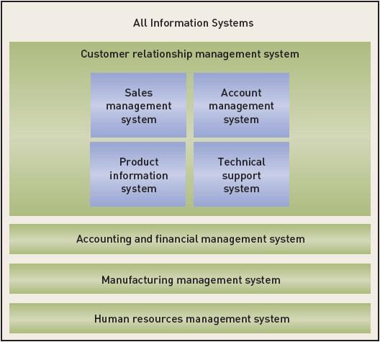
Figure 1-2
Information Systems and Subsystems

Slide 13
Information Systems
Information system: collects, processes, stores, and outputs information
Subsystem: components of another system
Components: hardware, software, inputs, outputs, data, people, and procedures
Supersystem: collection of systems
Automation boundary: separates automated part of system from manual (human)

Slide 14
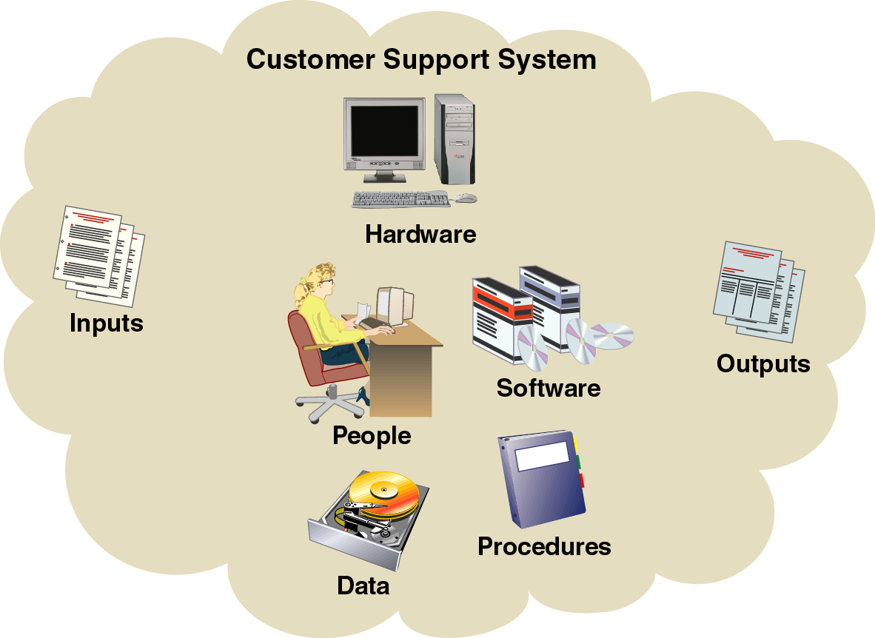
Figure 1-3
Information Systems and Component Parts

Slide 15
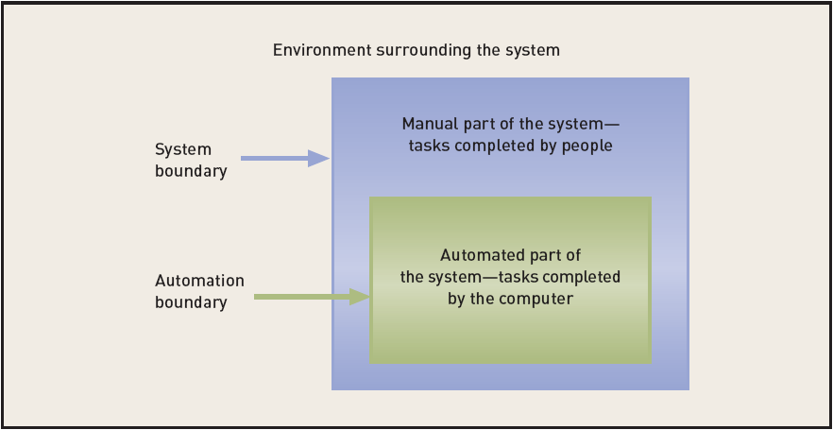
Figure 1-4
The System Boundary versus the Automation Boundary

Slide 16
Types of Information Systems
There are many types of information systems
Six common systems are found in most businesses
Business systems center around transactions
Systems must adapt to changing technology

Slide 17
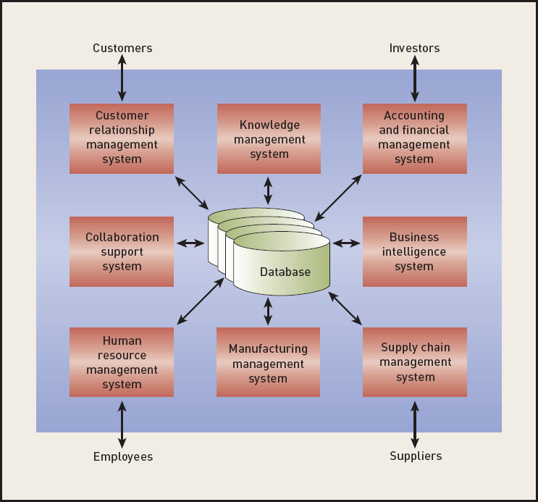
Figure 1-5
Types of Information Systems

Slide 18
Required Skills of the Systems Analyst
Analysts manage issues ranging from technical to interpersonal
Analyst must commit to lifelong learning

Slide 19
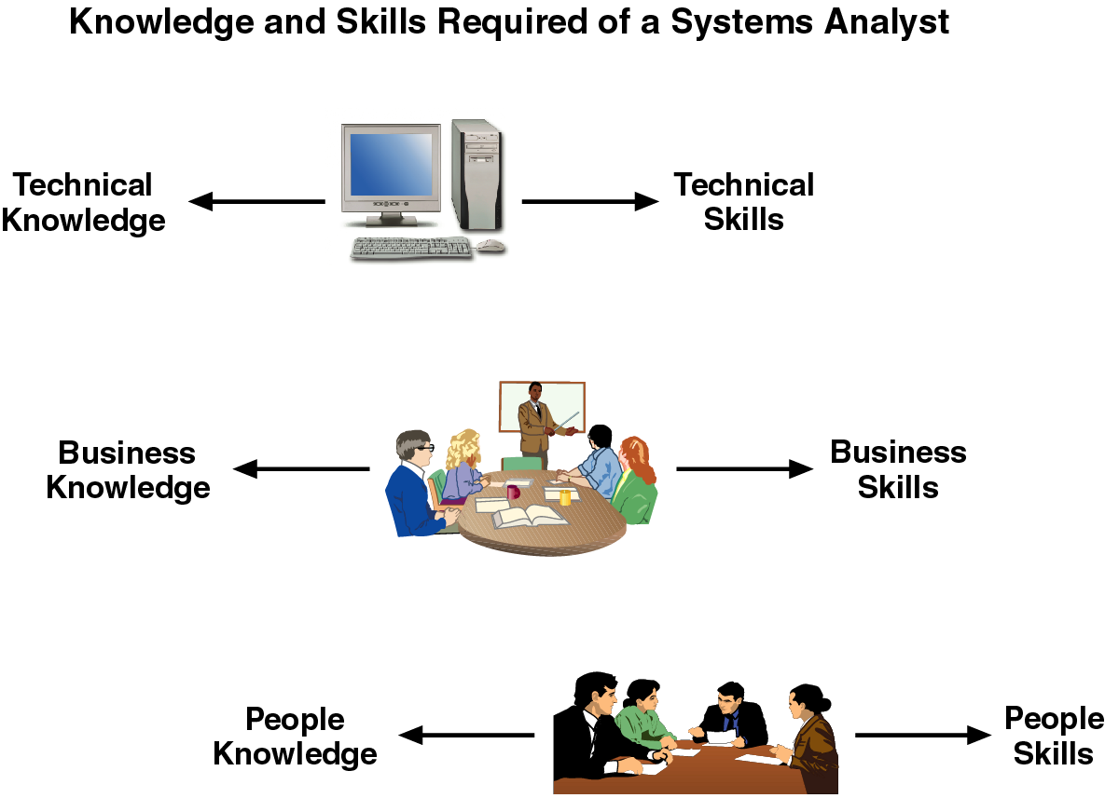
Figure 1-6
Required Skills of the Systems Analyst

Slide 20
Technical Knowledge and Skills
Analysts should grasp many types of technology
Analysts should be informed of tools and techniques
Common software tools: IDEs and CASE
Common techniques
Project planning
Cost-benefit analysis
Architectural Analysis

Slide 21
Technical Knowledge and Skills
An analyst should have fundamental technology knowledge of
Computers / peripheral devices (hardware)‏
Files and database systems
Input and output components and alternatives
Computer networks and protocols
Programming languages, operating systems, and utilities
Communication and collaboration technology

Slide 22
Technical Knowledge and Skills
Analyst uses tools
Software productivity packages
Integrated development environments (IDEs) for programming languages
Visual modeling tools and code generation tools
Analyst understands SDLC techniques
Project planning, cost/benefit, interviewing
Systems requirements modeling including
Design, database design, network configuration

Slide 23
Business Knowledge and Skills
Analyst must understand
Business functions performed by organization
Strategies, plans, traditions, and values of the organization
Organizational structure
Organization management techniques
Functional work processes
Systems analysts typically study business administration/management in college with a major in CIS or MIS

Slide 24
People Knowledge and Skills
Knowledge of people centers around thinking and feeling
People knowledge used to adapt systems to users
Most critical skill: ability to listen empathetically
Primarily a systems analyst must be an effective communicator
A systems analyst must be able to perform various roles such as negotiator, teacher, mentor, collaborator, and manager

Slide 25
Integrity and Ethics
Analyst has access to confidential information, such as salary, an organization’s planned projects, security systems, and so on.
Must keep information private
Any impropriety can ruin an analyst’s career
An analyst plans the security in systems to protect confidential information

Slide 26
The Environment Surrounding the Analyst
Occupational environment is not fixed
Analysts will encounter many types of technology
Analysts will work in many locations
Analysts are assigned a variety of job titles

Slide 27
Types of Technology
Wide range: from desktops to large scale information systems
Variety of computers connected by complex networks
Technology change is continuous
Innovation often drives information system change
Regular upgrades of knowledge and skills essential

Slide 28
Typical Job Titles and Places of Employment
Many job titles encompass duties of system analyst
Programmer analyst, system liaison, software engineer, Web developer, Project manager
Text assumptions
Analysts works on information systems
Information systems solve business problems
Work arrangements
In-house, consultancy, independent contracting, representing application service provider

Slide 29
A Few Words about Integrity and Ethics
Sense of personal integrity and ethics essential
Analysts often encounter personal information
Analysts encounter confidential proprietary information
Keep confidential and sensitive information private
Improprieties can ruin an analyst’s career

Slide 30
The Analyst’s Role in Strategic Planning
Analysts may advise senior management on strategic issues
Strategic problems involve long-range planning
Common forms of “extra-curricular” activities
Special projects
Strategic planning
Enterprise resource planning (ERP)

Slide 31
Special Projects
Prototype executive information systems
Business process reengineering study
Goal: raise efficiency
Activities
Analyze business processes
Redesign business processes
Provide computer support for re-engineered processes

Slide 32
Information Systems Strategic Planning
Purpose: anticipate problems
Large plan comprised of models and smaller plans
Organization model: maps business functions
Application architecture plan: lists integrated information systems
Technology architecture plan: defines hardware, software, and communications networks

Slide 33
Figure 1-7
Components of an Information Systems Strategic Plan

Slide 34
Enterprise Resource Planning
ERP adopts integrated set of software packages
ERP systems benefit: turnkey solution
ERP disadvantages: complex, expensive, and disruptive
Entire organization involved in ERP
Analyst plays significant role in ERP

Slide 35
Rocky Mountain Outfitters and Its Strategic Information Systems Plan
RMO serves role of case study for text
Business: manufacture and distribute sports clothing
Project: develop new customer support system
Initial activities
Understand the nature of the business
Investigate current information system
Define basic objectives of customer support system
Develop the information systems strategic plan

Slide 36
Figure 1-8
Early RMO Catalog Cover (Spring 1978)

Slide 37
Introducing Rocky Mountain Outfitters (RMO)
RMO founded by John and Liz Blankens in 1978
Staff consists of 600 people
Annual sales have risen to nearly $100 million
Mail-order operation contributes $60 million
In-store retail sales account for $7.5 million
Phone-order operation accounts for $30 million

Slide 38
Figure 1-9
Current RMO Catalog (Spring 2006)

Slide 39
RMO Strategic Issues
Founders commit to business expansion in 2002
Growth channel: business-to-consumer (B2C) e-commerce
Two key strategic thrusts support five year plan:
Supply chain management (SCM)
Customer relationship management (CRM)
Object-oriented technology and techniques shape system development projects

Slide 40
RMO’s Organizational Structure and Locations
John and Liz Blankens are chief executives
113 workers employed in Park City, Utah
Two retail store locations: Park City and Denver
Manufacturing facilities in Salt Lake City and Portland, Oregon

Slide 41
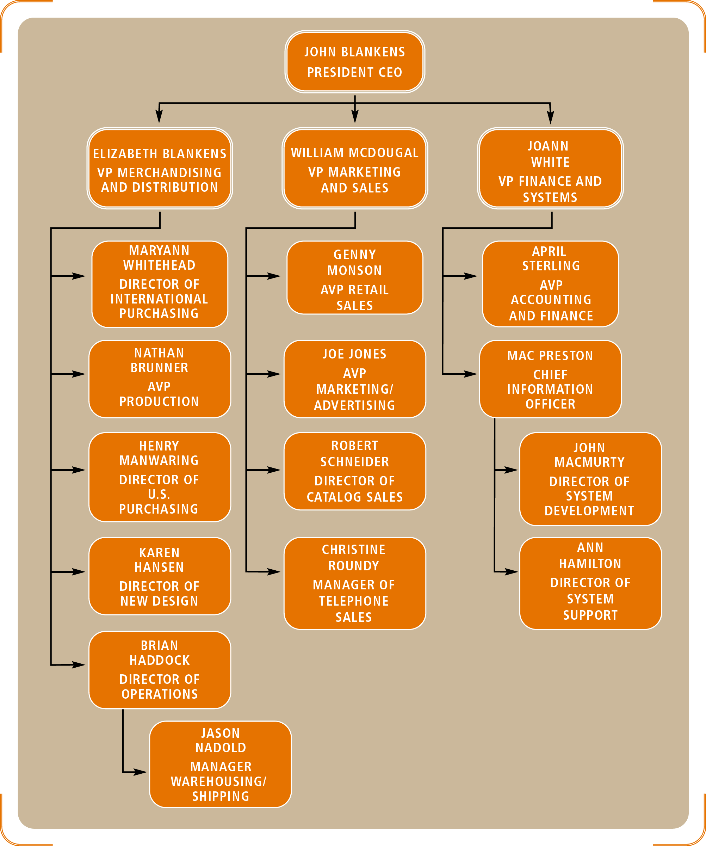
Figure 1-10
Rocky Mountain Outfitters’ Organizational Structure

Slide 42
RMO’s Organizational Structure and Locations (continued)
Three distribution/warehouse facilities: Salt Lake City, Albuquerque, and Portland
Mail-order processing in Provo, Utah
Phone-sales center in Salt Lake City

Slide 43
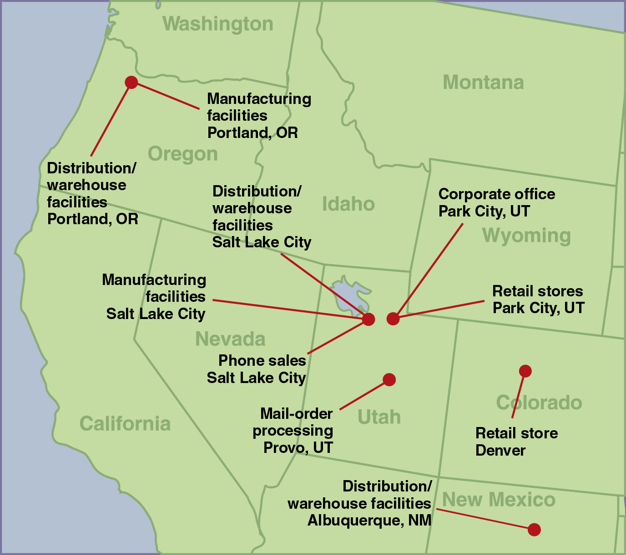
Figure 1-11
Rocky Mountain Outfitter’s Locations

Slide 44
The RMO Information Systems Department
50 employees in information systems department
Mac Preston: chief information officer (CIO)
Information system organization
System support: telecommunications, database administration, operations, and user support
System development team: four project managers, six systems analysts, ten programmer analysts, and support staff

Slide 45
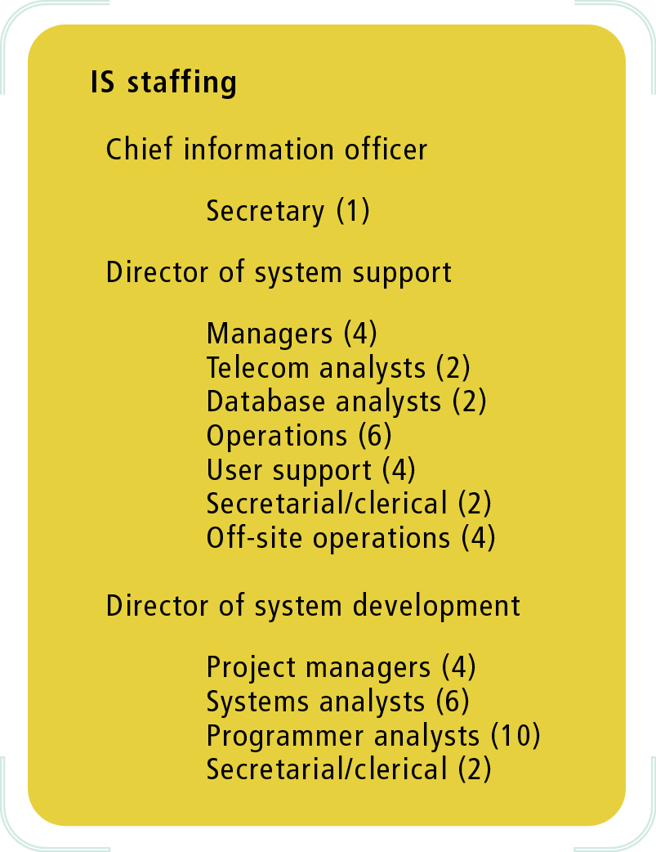
Figure 1-12
RMO Information Systems Department Staffing

Slide 46
Existing RMO Systems
Data center in Park City supports (8) systems:
Merchandising/Distribution
Mail Order
Phone Order
Retail Store Systems
Office Systems
Human Resources
Accounting/Finance
RMO Informational Web site

Slide 47
The Information Systems Strategic Plan
SCM and CRM provide vision for the plan
Two chief components
Technology Architecture Plan: emphasize distributed computing
Application Architecture Plan: seamlessly integrate replacements, upgrades and new packages
Timetable reflects implementation schedule

Slide 48
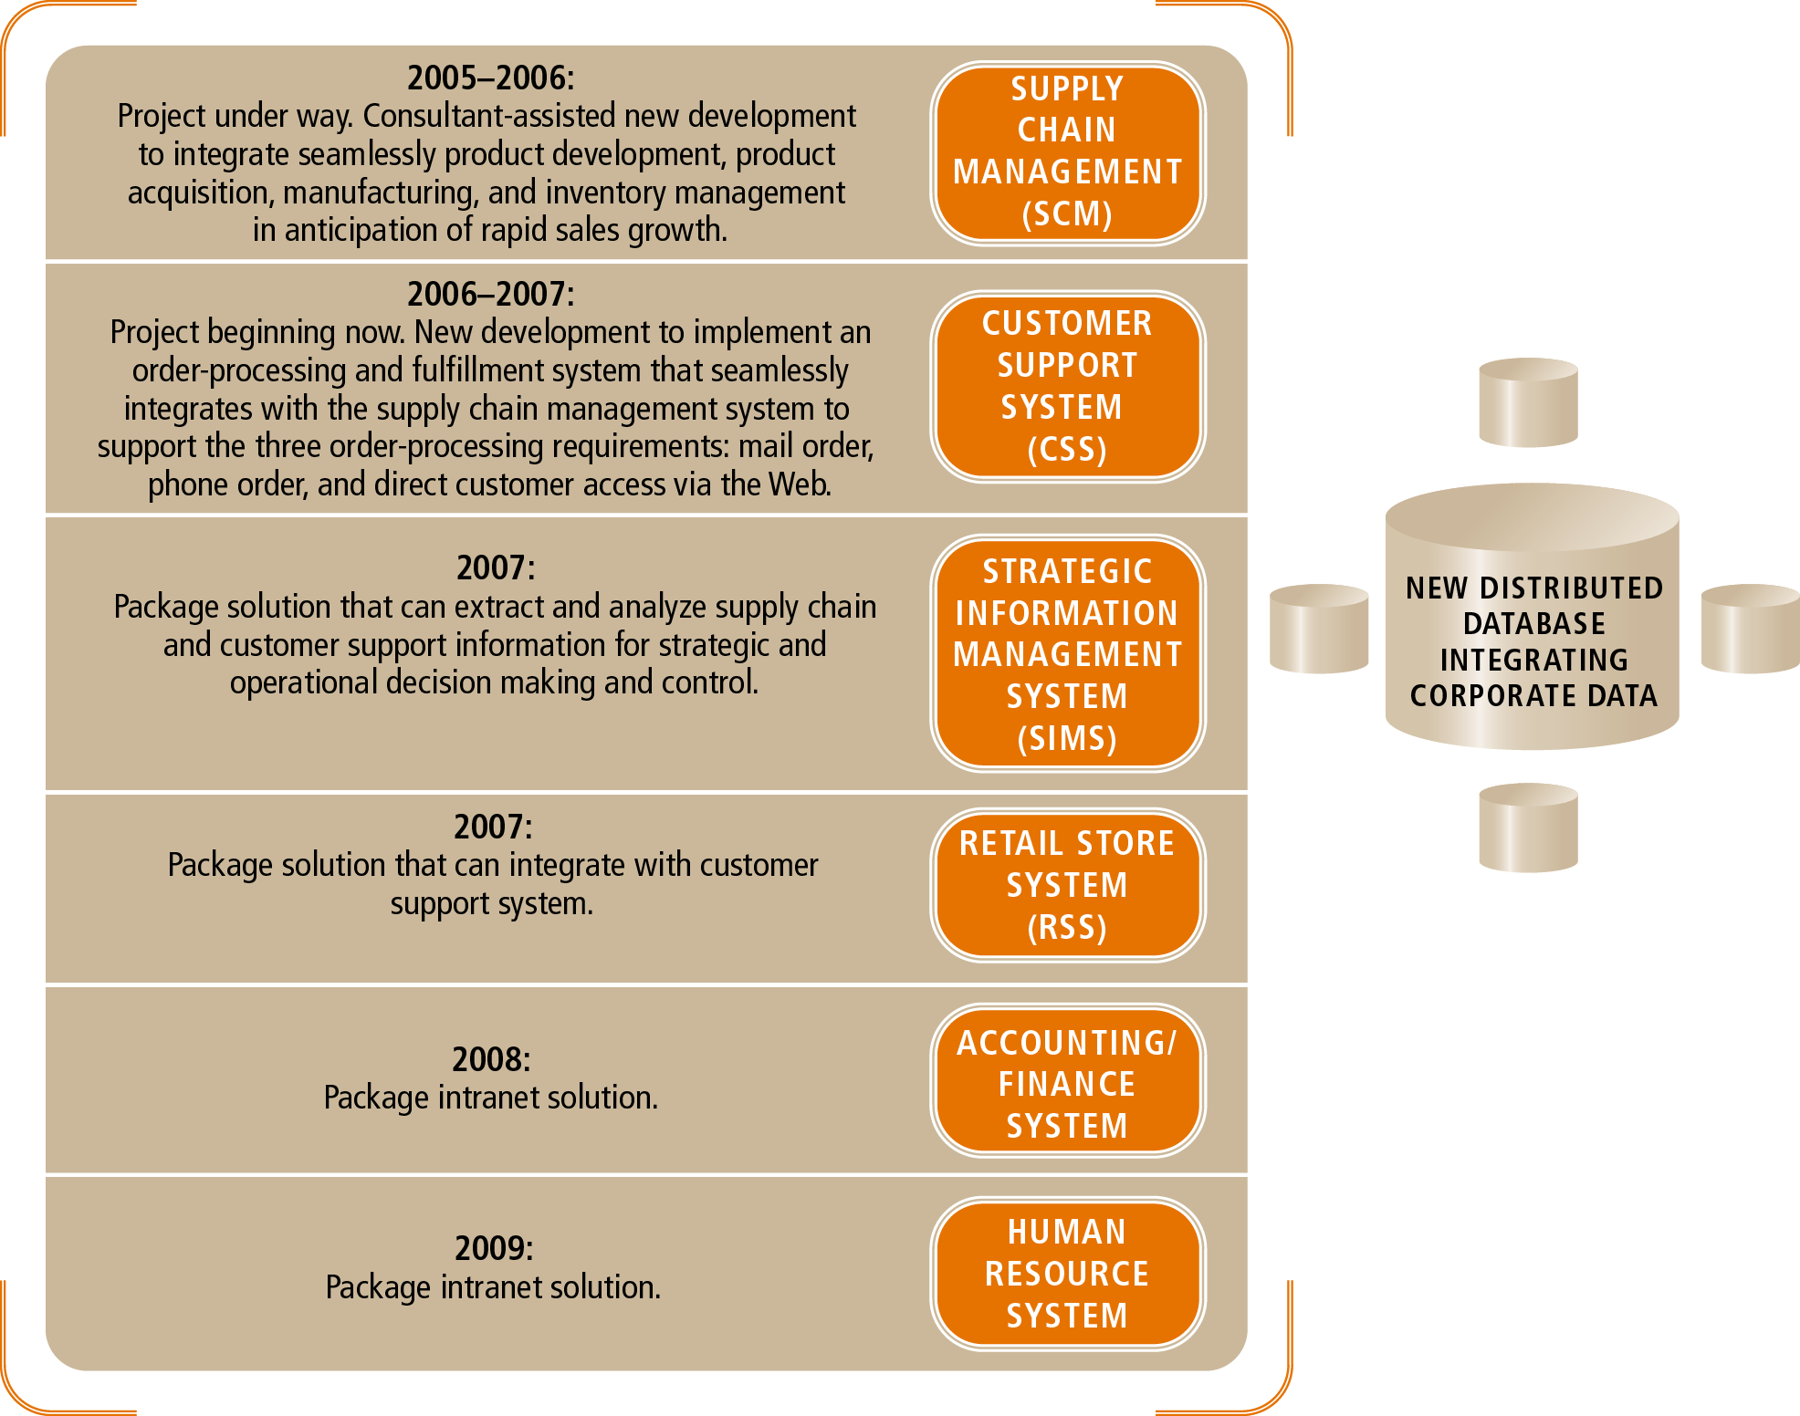
Figure 1-13
The Timetable for RMO’s Application Architecture Plan

Slide 49
The Customer Support System
Development project: customer support system (CSS)
RMO core competency: cultivating customer loyalty
Application architecture plan specifies CSS objectives
Includes functions associated with providing products
Supports customer relationship management strategy
Offers multiple sales channels: telephone, mail, retail, and Internet
System details worked out in requirements analysis

Slide 50
The Analyst as a System Developer (The Heart of the Course)
Central theme: planning and executing an information systems project
Text organized into four conceptual components
Barbara Halifax manages RMO customer support system

Slide 51
Summary
Systems analyst solves business problems with IS technology
Analyst chief role: define requirements, design software, write code, complete extensive testing
Systems analysis/design: included in many job titles
Unified Process: approach to system development
Object-oriented technology: incorporated in Unified Process

Slide 52
Summary (continued)
Problem solving: understand, design, implement
Writing code just one piece of the puzzle
System: contains set of interrelated components and outcome
Information systems: generate an information systems outcome
System types: transaction processing, management information, executive information, decision support, communication support, office support

Slide 53
Summary (continued)
Broad skill set: technical, business, people
Integrity and ethical behavior: critical to success
Strategic planning: special projects, process reengineering
Enterprise resource planning: turnkey solution
RMO customer support system project is an ongoing illustration

