Slide 45
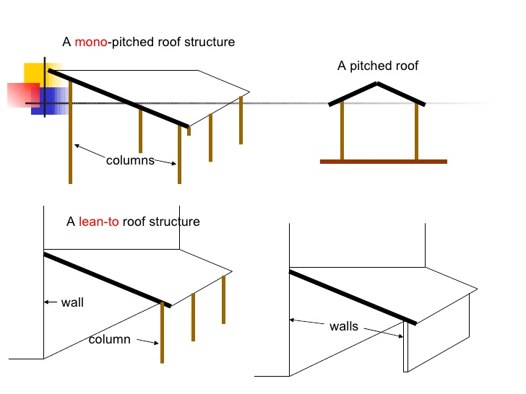

Slide 46
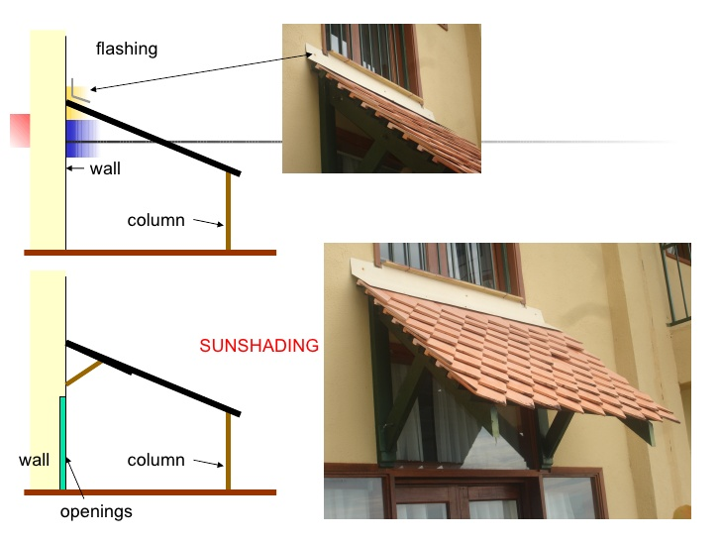

Slide 47
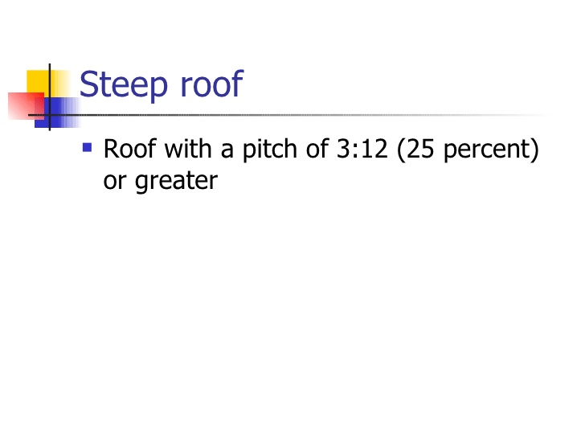

Slide 48
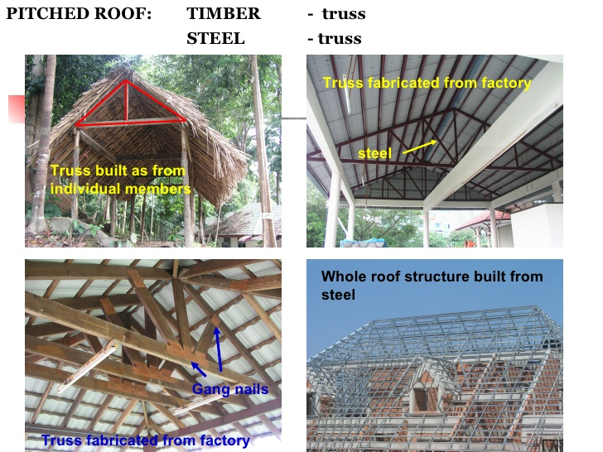

Slide 49
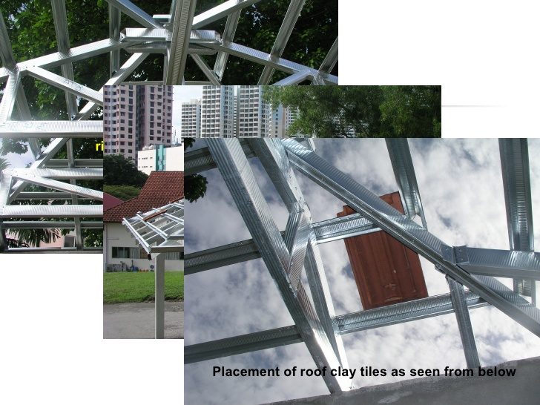

Slide 50
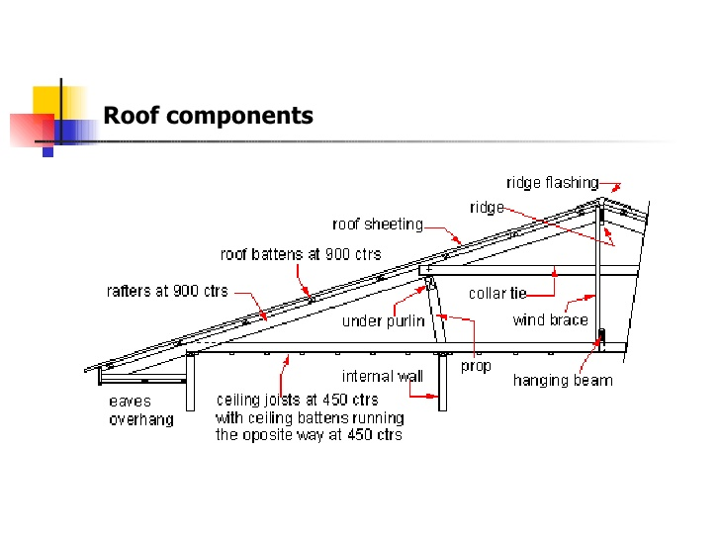

Slide 51
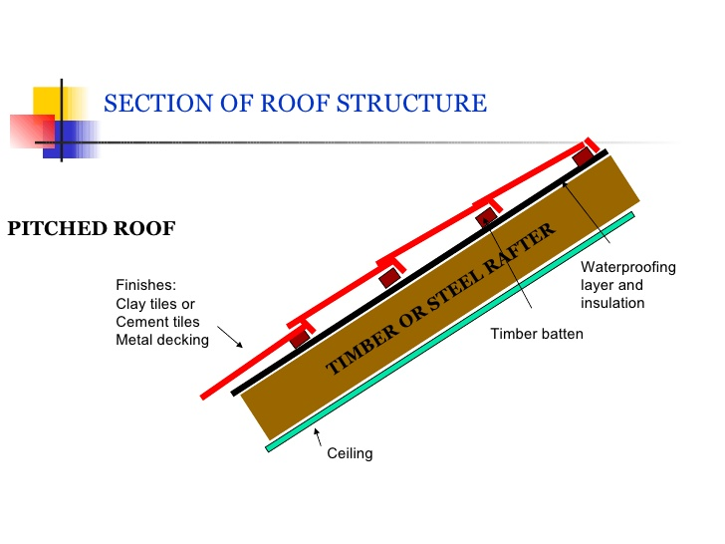

Slide 52
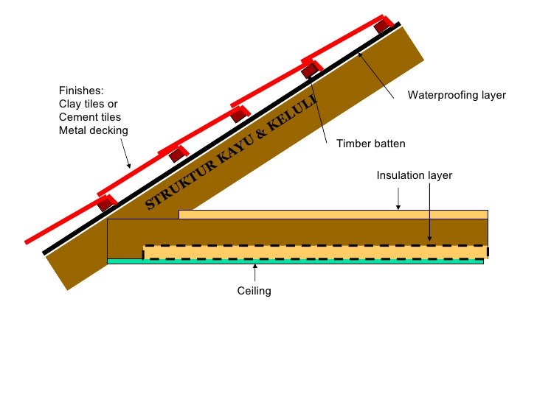

Slide 53
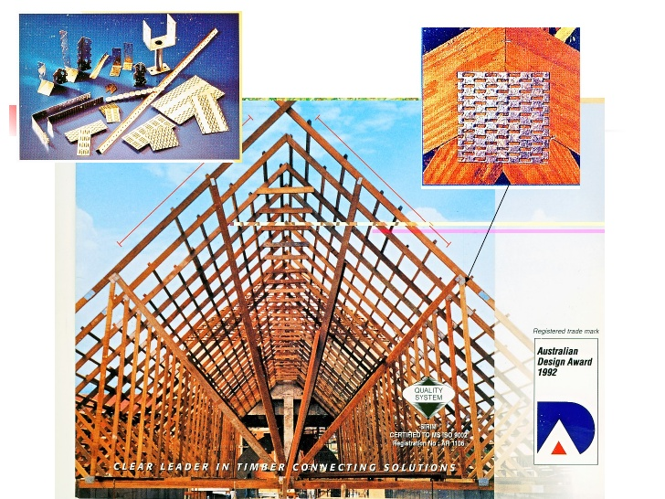

Slide 65
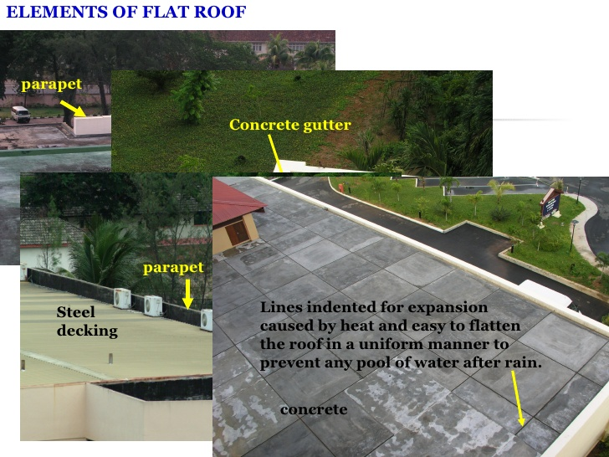

Slide 66
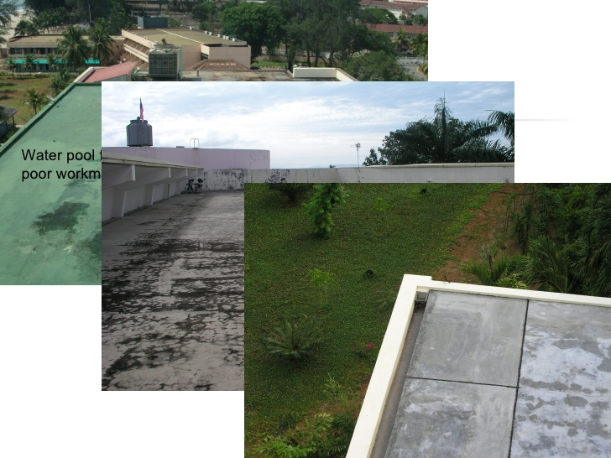

Slide 67
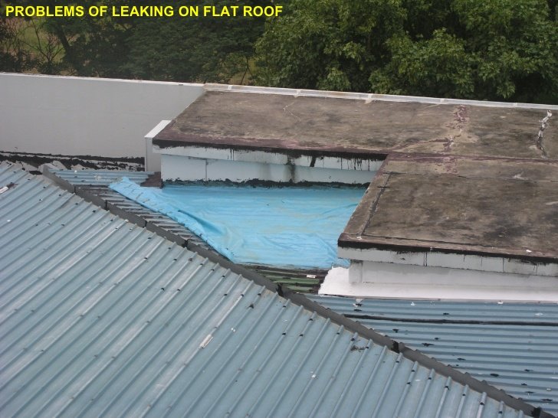

Slide 74
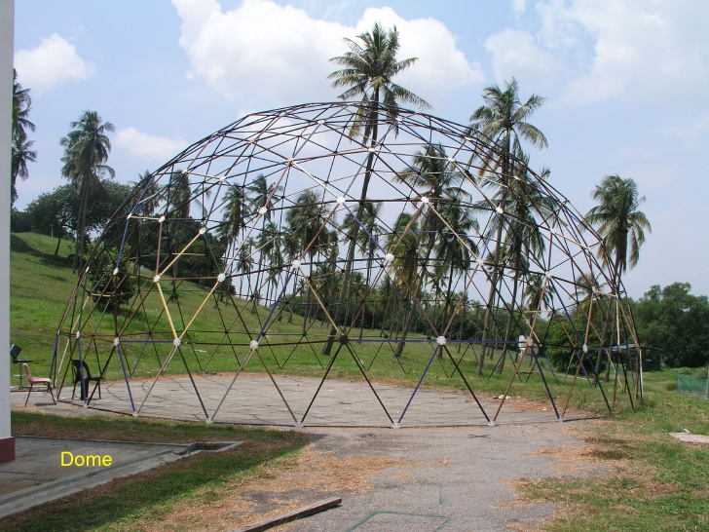

Slide 76
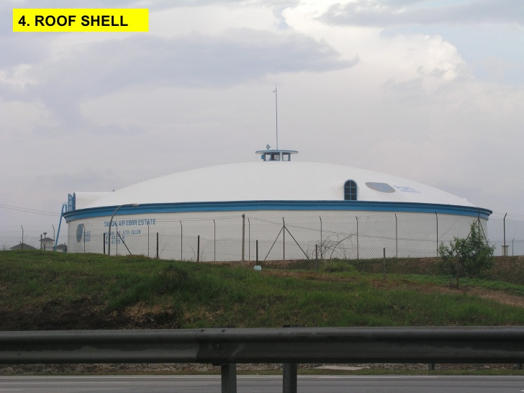

Slide 77
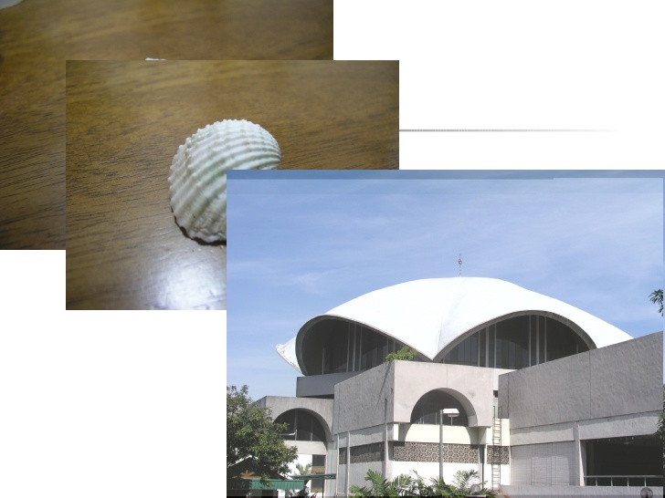

Slide 79
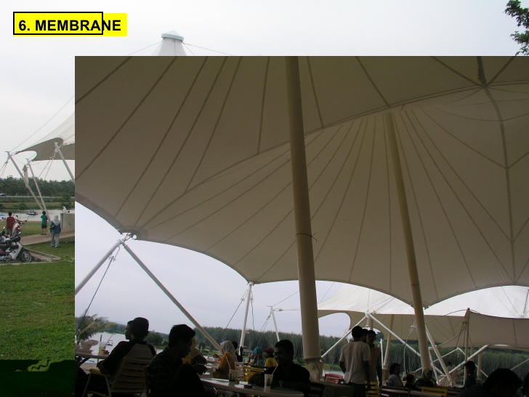

Slide 80
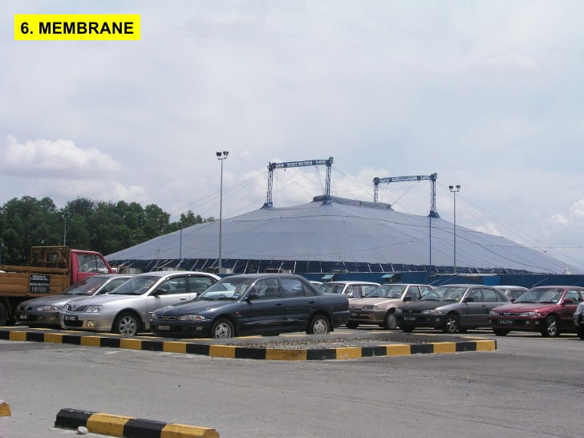

Slide 83
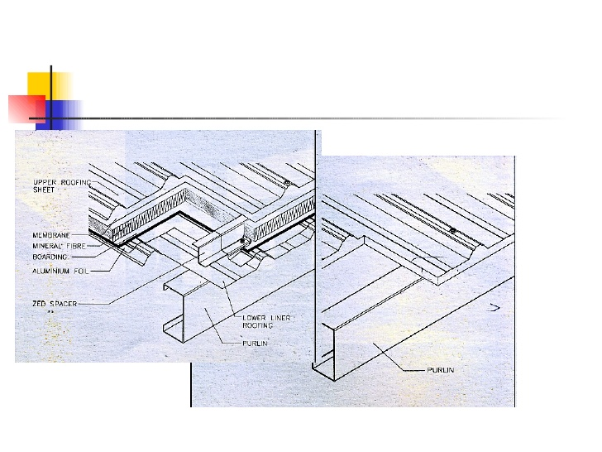

Slide 84
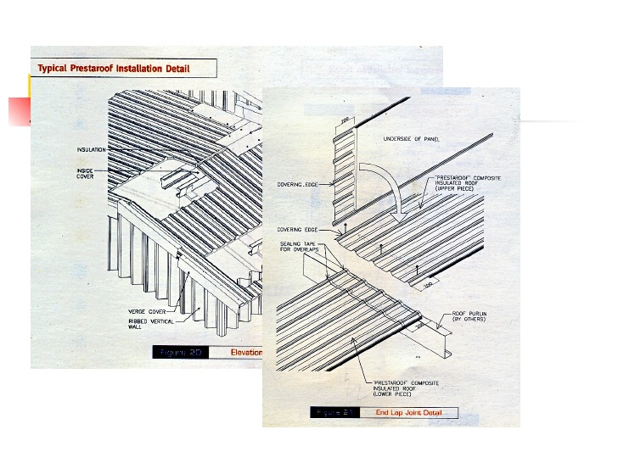

Slide 90
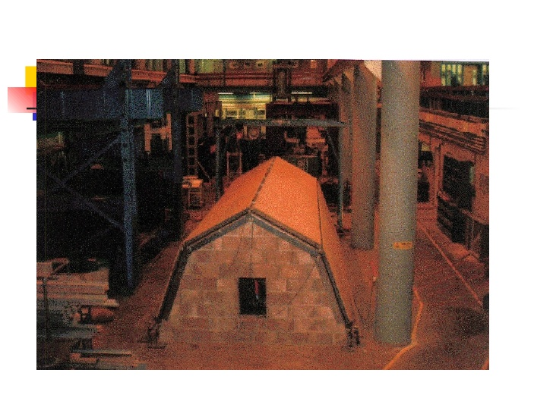

Slide 91
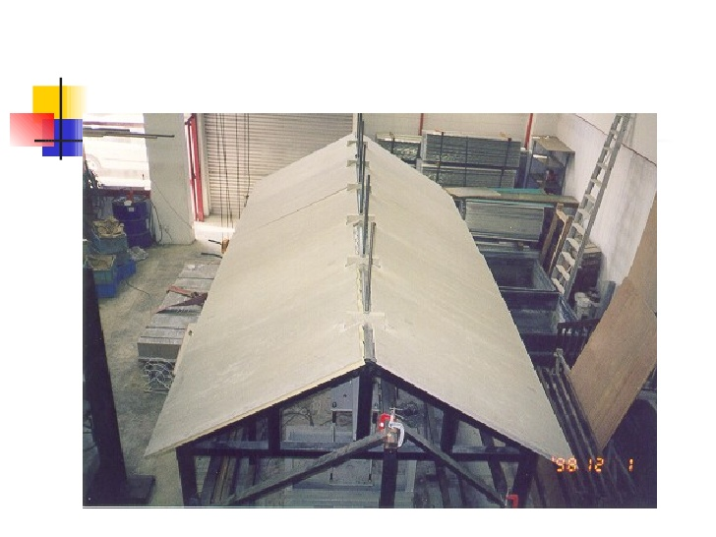

Slide 93
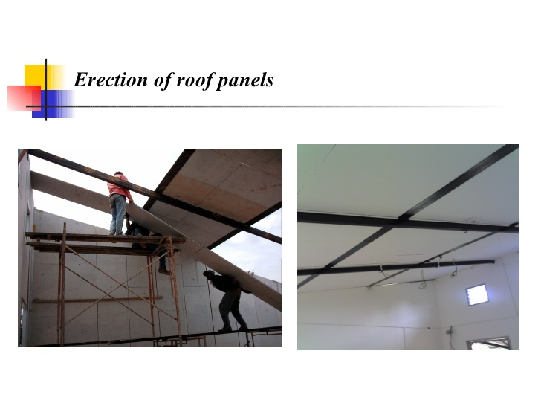

Slide 94
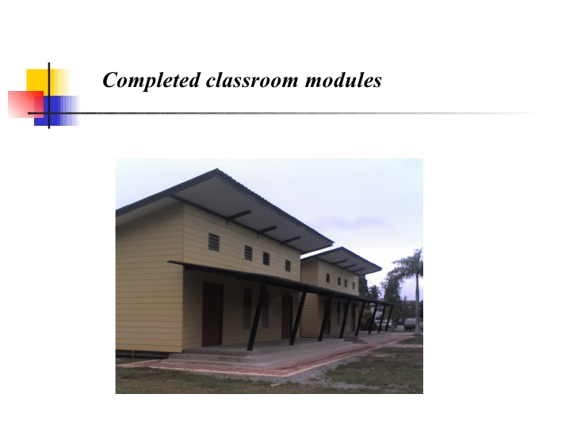

Slide 95
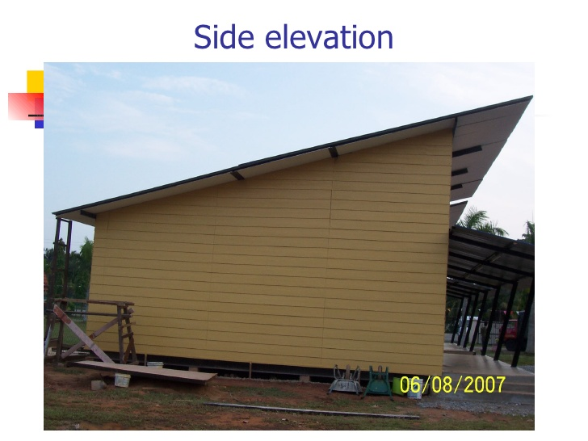

Slide 97
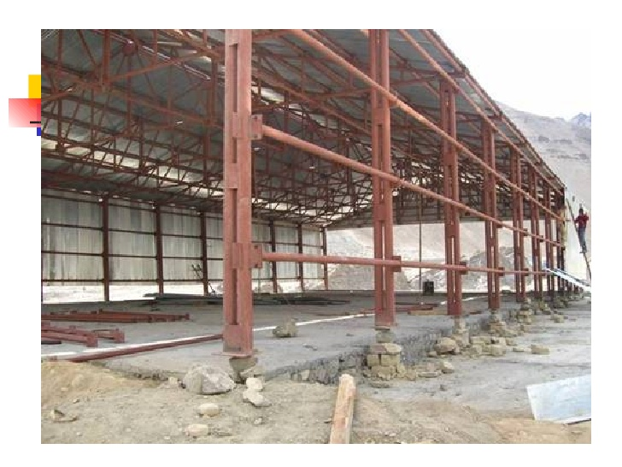

Slide 98
Trusses
2
•Fabricated from various steel sections available, jointed together by welding or by bolting usually via gusset plates.
•Plane trusses and space trusses.
•Bridge trusses and roof trusses.
•Members supporting heavy loads
•Members having longer span.
•Saving in weight.

Slide 99
Roof truss

Slide 100
Supporting truss

Slide 101
Bracing truss

Slide 102
Space truss - Truss System

Slide 103
Singapore Esplanade theatre

Slide 105
Roof Truss
▪Roof rafters spanning more than 20 m can be designed
▪Usual span-to-depth ratio of steep roof trusses is 7.5 to 12
▪Panel width should be constant
▪Even number of panels avoids cross-braces
▪Diagonal web members should be in tension under worst-case loading
▪Inclination angle of the diagonals should be between 35° and 50°
▪If at all possible, the purlins and verticals should closely coincide

Slide 106
Usual range of depths of roof trusses

Slide 107
Approximate mass for roof trusses

Slide 108
Approximate mass for roof trusses

Slide 109
(a)centre of gravity lines intersect at the node; (b)eccentric connection can be a practical way of detailing but additional bending stresses are induced

Slide 110
(a) to (f ): commonly used in welded construction (though (a), (c), (d) and (e) may be bolted) (g) to (k): common sections used for chord and web/diagonal members

Slide 111
(a) Gussetless construction using Tee-chords; (b) gussets are required where diagonals carry large forces; (c) Tee-diagonals and chords, gussetless; (d) and (e) node detail for heavy trusswork, and (f ) riveted/bolted nodes

Slide 112
(a) portal-type Pratt truss (b) Fink truss with large eaves overhang (c) alternative chord cross-sections

Slide 113
(a) sandwich plate splice; (b) sandwich plate splice at chord reduction; (c) jacket splice; (d) welded butt splice; (e) welded butt splice with reducer, and; (f ) flange splice

Slide 114
(a) Direct contact overlap connection without eccentricity; (b) direct contact overlap connection with eccentricity; (c) direct contact gap connection with/without eccentricity (with chord face reinforcing plate shown—without reinforcing plate is very common); (d) T-joint with chord face reinforcing plate (for very heavy loads—otherwise no reinforcing plate is also popular); (e) connection detail at support (note vertical stub portion with flange splice for lifting onto support); (f ) concentric reducer where chord section is stepped down (alternatively, if the overall section is not stepped down then the wall thickness is reduced—the latter applies for RHS/SHS); (g) slotted-gusset connections; (h) flattened end connections, and; (i) slit tube connections.

Slide 115
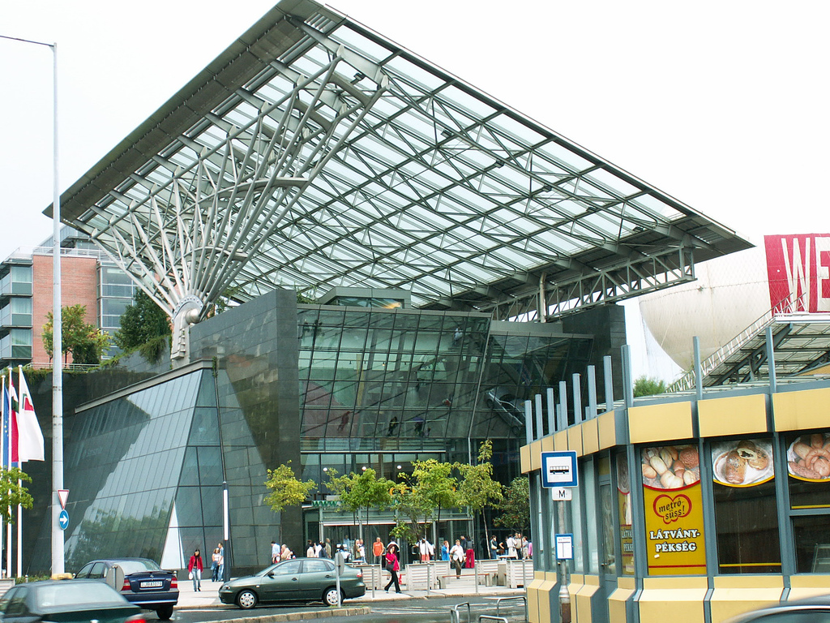

Slide 116
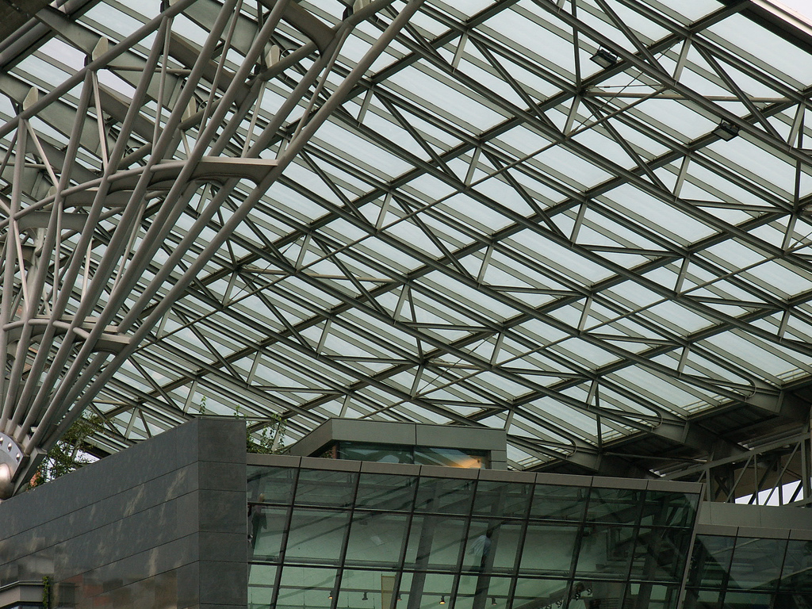

Slide 117
