Slide 1
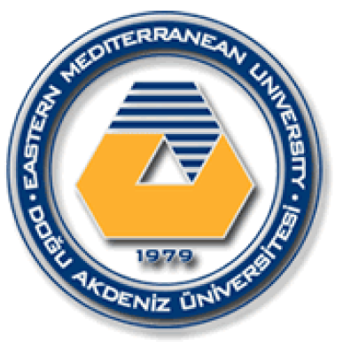
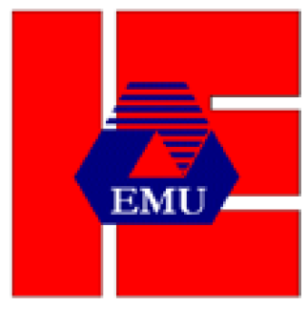
EASTERN MEDITERRANEAN UNIVERSITY DEPARTMENT OF INDUSTRIAL ENGINEERING
INFORMATION SYSTEMS AND TECHNOLOGY
IENG 372 / MANE 372
Spring 2021-2022
Chapter 3
Lecturer : Ms. Khaoula Chnina

Slide 2
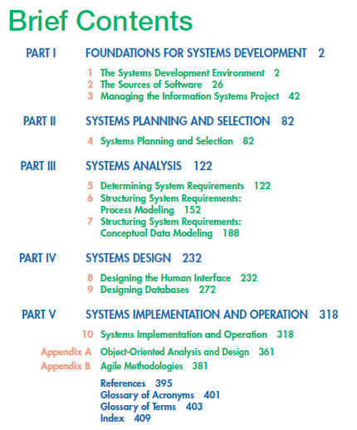

Slide 3
Chapter 3
Managing the Information Systems Project
Pine Valley Furniture Company Background
Managing the Information Systems Project
Initiating the Project
Planning the Project
Executing the Project
Representing and Scheduling Project Plans
Closing Down the Project
Using Project Management Software
Representing Project Plans
Calculating Expected Time Durations Using PERT
Constructing a Gantt Chart and Network Diagram at Pine Valley Furniture
Establishing a Project Starting Date
Entering Tasks and Assigning Task Relationships
Selecting a Scheduling Method to Review Project Reports

Slide 4
Learning Objectives
Discuss skills required to be an effective project manager
Describe skills and activities of a project manager during project initiation, planning, execution and closedown
Review commercial project management software packages
Explain Gantt Charts and Network Diagrams
Discuss critical path scheduling

Slide 5
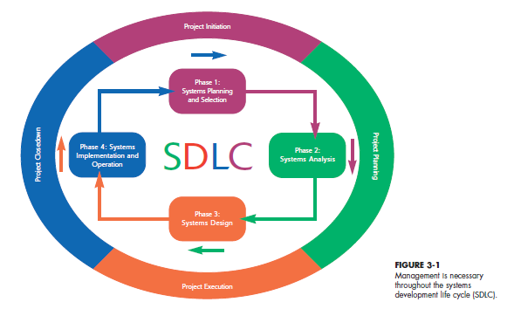
Functions of a systems analyst as a project manager of Information Systems Project

Slide 6
1- Pine Valley Furniture Company Background (PVF)
History of PVF
1980 | Garage | file folders and a filing cabinet
1984 | Warehouse Rented | part-time bookkeeper
1990 | Current location, functional areas | Manual: accounting ledgers and file folders
Mid 1990s | Current location, computer-based applications are located in the accounting and financial areas. | - Mini PC : automate order filling and invoicing, accounts receivable and payable, and inventory control , Payroll as well as general ledger . -Three computer applications : order filling, invoicing, and payroll -Each application had its own individual data files
late 1990s | Current location, functional areas | The company upgraded its computer hardware and software, hired new staff and implemented a Centralized database management system In-house. data are organized around entities, or subjects such as customers, invoices, and orders.
Manufacturing Company
Product: High-quality wood Furniture (dinette sets, stereo cabinets, wall units, living room furniture,bedroom)
Market: United States
Organized into 5 functional areas (Divisions):
Manufacturing ( 3 Subdivisions: fabrication, assembling, and finishing)
Sales
Orders
Accounting
Purchasing

Slide 7
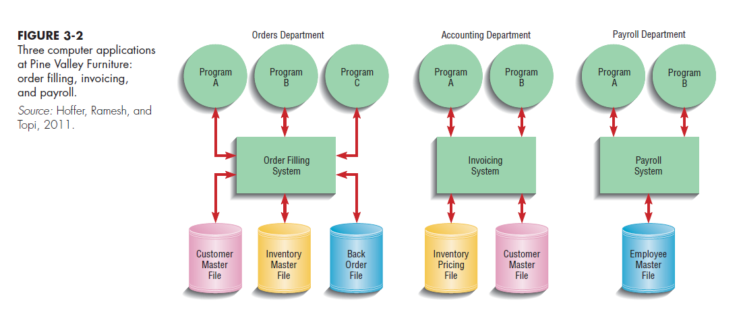

Slide 8
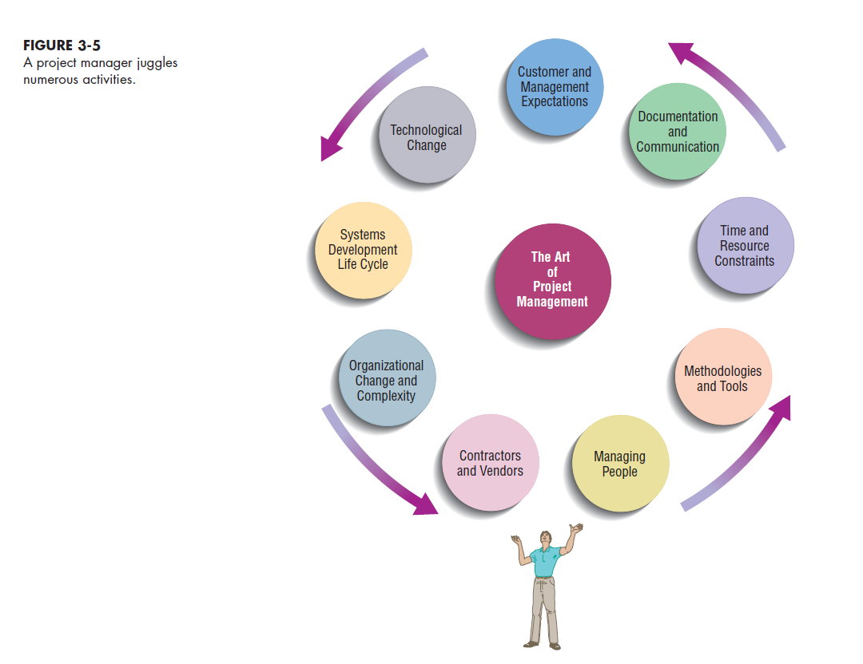
2- Managing the Information Systems Project
Focus of Project Management : To assure that information system projects meet customer expectations
Delivered in a timely manner
Meet constraints and requirements
Project Manager : Systems Analyst responsible for
Project initiation
Planning
Execution
Closing down
Requires diverse set of skills
Management (resource management)
Leadership
Technical
Conflict management
Customer relations

Slide 9
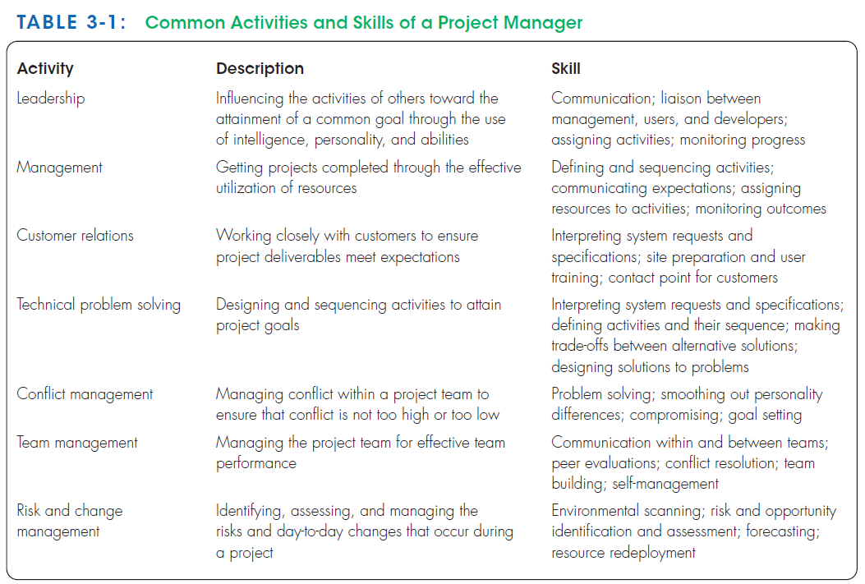

Slide 10
Project Management Process
Project : Planned undertaking of related activities to reach an objective that has a beginning and an end
Four Phases
Initiating
Planning
Executing
Closing down
Feasibility study: Determines whether the information system makes sense for the organization from an economic and operational standpoint.
Reasons of systems development projects :
to take advantage of business opportunities: innovative service to customers (Web page)
to solve business problems: more accurate or timely information is provided (password-protected intranet site)
to spend resources, attain or pad budgets, keep people busy, or help train people and develop their skills.

Slide 11
Phase 1 : Initiating the Project
Phase 2: Planning the Project
focuses on defining clear, discrete activities and the work needed to complete each activity within a single project.
Describe project scope, alternatives and feasibility Scope and Feasibility
Divide the project into manageable tasks
Estimate resources and create a resource plan
Develop a preliminary schedule
Develop a communication plan
Determine project standards and procedures
Identify and assess risk Identify sources of risk
Create a preliminary budget
Develop a project scope statement
Set a baseline project plan
activities are performed to assess the size, scope, and complexity of the project and to establish procedures to support later project activities:
The project initiation team
Relationship with the customer
The project initiation plan
Management procedures
Establish the project management environment and
Develop the project charter

Slide 12
Phase 3: Executing the Project
The plans created in the prior phases (project initiation and planning) are put into action.
Executing the baseline project plan
Monitoring project progress against the baseline project plan
Managing changes to the baseline project plan.
Maintaining the project workbook.
Communicating the project status
Phase 4: Closing Down the Project
Project closedown Is The final phase of the project management process, which focuses on bringing a project to an end.
Closing down the project
Conducting postproject reviews
Closing the customer contract

Slide 13
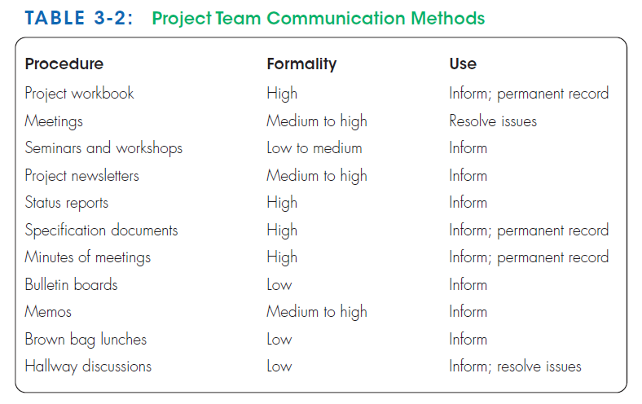

Slide 14
Phase 1 : Initiating the Project
activities are performed to assess the size, scope, and complexity of the project and to establish procedures to support later project activities:
Establish the project initiation team : organizing an initial core of project team
Establish a relationship with the customer :Assign a specific individual to work as a liaison between customer and team.
Establish the project initiation plan : organize the initiation team while it is working to define the scope of the project, by using agendas for several meetings.
Establish management procedures : developing team communication and reporting procedures, job assignments and roles, project change procedures, and determining how project funding and billing will be handled.
Establish the project management environment and workbook: collect and organize the tools to be used while managing the project and construct the project workbook.
Project workbook : An online or hard-copy repository, for all project correspondence, inputs, outputs, deliverables, procedures, and standards, that is used for performing project audits, orienting new team members, communicating with management and customers, identifying future projects, and performing postproject reviews.

Slide 15
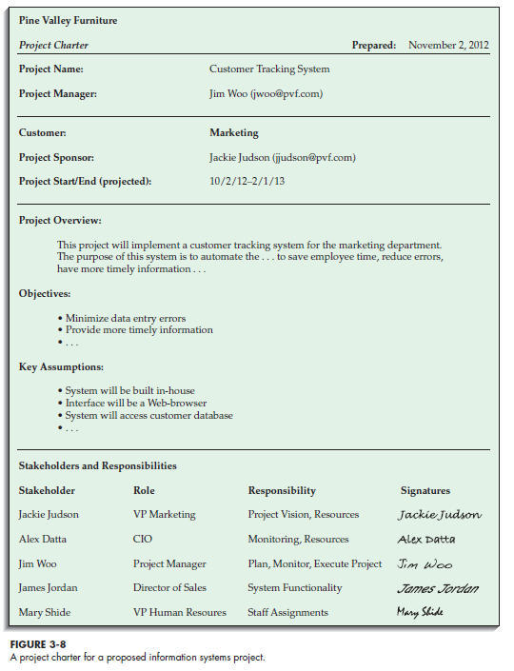
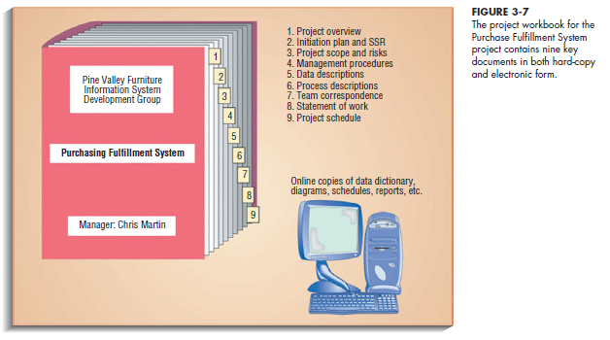
Develop the project charter : A short, high-level document prepared for both internal and external stakehoders to formally announce the establishment of the project and to briefly describe its objective, key assumptions, and stakeholders. It often includes :
Project title and date of authorization
Project manager name and contact information
Customer name and contact information
Projected start and completion dates
Project description and objectives
Key assumptions or approach
Key stakeholders, roles, responsibilities and signatures

Slide 16
Phase 2: Planning the Project
focuses on defining clear, discrete activities and the work needed to complete each activity within a single project.
Describe project scope, alternatives and feasibility Scope and Feasibility:
understand the content and complexity of the project and focus on defining the project scope.
The team members should share the same vision and agree about:
What problem or opportunity to be addressed
What are the quantifiable results to be achieved
What needs to be done?
Measures of success
Completion criteria
Identify and document general alternative solutions
assess the feasibility of each alternative
Divide the project into manageable tasks : divide the project into manageable tasks and then logically order them to ensure a smooth evolution between tasks. The definition of tasks and their sequence is referred to as the work breakdown structure (WBS). Gantt chart can be used

Slide 17
Estimate resources and create a resource plan : estimate resource requirements for each project activity and use this information to create a project resource plan. The resource plan helps assemble and deploy resources in the most effective manner. COCOMO (COnstructive COst MOdel) can be used.
Develop a preliminary schedule : use the information on tasks and resource availability to assign time estimates to each activity in the WBS , Utilise Network diagrams and Gantt chart
Develop a communication plan : Outline the communication procedures among management, project team members, and the customer. The communication plan includes when and how written and oral reports will be provided by the team, how team members will coordinate work, what messages will be sent to announce the project to interested parties, and what kinds of information will be shared with vendors and external contractors. The following questions should be answered:
Who are the stakeholders for this project?
What information does each stakeholder need?
When, and at what interval, does this information need to be produced?
What sources will be used to gather and generate this information?
Who will collect, store, and verify the accuracy of this information?
Who will organize and package this information into a document?
Who will be the contact person for each stakeholder, should any questions arise?
What format will be used to package this information?
What communication medium will be most effective for delivering this information to the stakeholder?

Slide 18
Determine project standards and procedures : specify how various deliverables are produced and tested
Identify and assess risk Identify sources of risk : Identify sources of project risk and estimate their consequences. Risks might arise from the use of new technology, prospective users’ resistance to change, availability of critical resources, competitive reactions or changes in regulatory actions due to the construction of a system, or team member inexperience with technology or the business area.
Create a preliminary budget: budget that outlines the planned expenses and revenues
Develop a project scope statement : This document outlines work that will be done and what the project will deliver. It helps understanding the intended project size, duration, and outcomes.
Set a baseline project plan : estimation of the project’s tasks and resource, and it is used to guide the next project phase execution. These answers should be answered:
Who will do What?
During What Time frame?
How much it will Cost?

Slide 19
Phase 3: Executing the Project
The plans created in the prior phases (project initiation and planning) are put into action.
Executing the baseline project plan : acquire and assign resources, orient and train new team members, keep the project on schedule, and ensure the quality of project
Monitoring project progress against the baseline project plan: If the project gets ahead of (or behind) schedule, you may have to adjust resources, activities, and budgets.
Managing changes to the baseline project plan: only approved changes to the project specification can be made ( change to the existing design) , and they must be reflected in the baseline plan and project workbook,
Changes outside control:
A slipped completion date for an activity
A bungled activity that must be redone
The identification of a new activity
An unforeseen change in personnel due to sickness, resignation, or termination
Maintaining the project workbook : Maintaining complete records of all project events is necessary because it helps new team members to assimilate project tasks quickly.
Communicating the project status : Clear communication is required to create a shared understanding of the activities and goals of the project; The project manager is responsible for keeping all team members (system developers, managers, and customers) abreast of the project status.

Slide 20
Phase 4: Closing Down the Project
Project closedown Is The final phase of the project management process, which focuses on bringing a project to an end. There are two types of termination :
A natural termination occurs when :
the requirements of the project have been met
the project has been completed and is a success.
An unnatural termination occurs when:
the project is stopped before completion.
the assumption used to guide the project proved to be false,
the performance of the system or the team was inadequate,
the requirements are no longer relevant or valid in the customer’s business environment.
to running out of time
to running out of money
Regardless of the termination type, several activities must be performed:
Closing down the project
Conducting postproject reviews
Closing the customer contract

Slide 21
1- Closing down the project
assess each team member and provide an appraisal for personnel files and salary determination.
provide career advice to team members,
write letters to superiors praising special accomplishments of team members,
send thank-you letters to those who helped but were not team members.
handle possible negative personnel issues, such as job termination, especially if the project was not successful.
notify all interested parties that the project has been completed
finalize all project documentation and financial records so that a
Conduct a final review of the project
celebrate the accomplishments of the team.
2- Conducting postproject reviews
Conduct final reviews of the project with management and customers in order to determine the strengths and weaknesses of
project deliverables,
the processes used to create them ( system development process) ,
the project management process
3- Closing the customer contract
Ensure that all contractual terms of the project have been met.

Slide 22
3- Representing and Scheduling Project Plans
Allow to check how changes in task duration affect the project completion date.
Help to examine the impact of “what if” scenarios for adding or reducing resources, such as personnel, for an activity.
Many techniques available for depicting and documenting project plans.
Document can be graphical or textual reports
Most project managers use computer-based systems to help develop their graphical and textual reports.
Graphical reports are more popular
The most used methods are Gantt charts and Network diagrams.

Slide 23
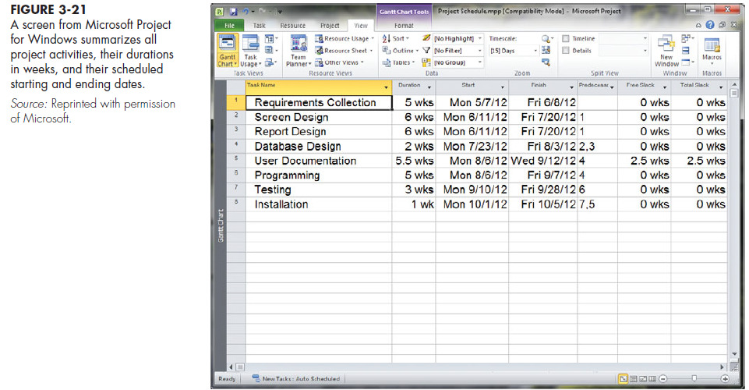
Gantt charts :
Do not show how tasks must be ordered (precedence)
simply show when a task should begin and when it should end
Useful for depicting simple projects or subparts of a larger project, the activities of a single worker, or for monitoring the progress of activities compared to scheduled completion dates
Network diagrams :
Show the ordering of activities by connecting a task to its predecessor and successor tasks
Textual reports
Depict resource utilization by tasks, complexity of the project, and cost distributions to control activities.

Slide 24
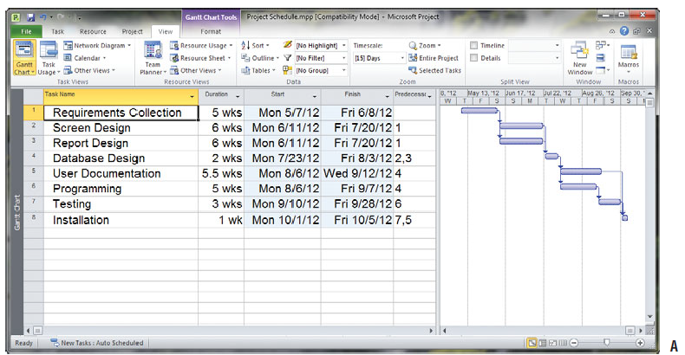
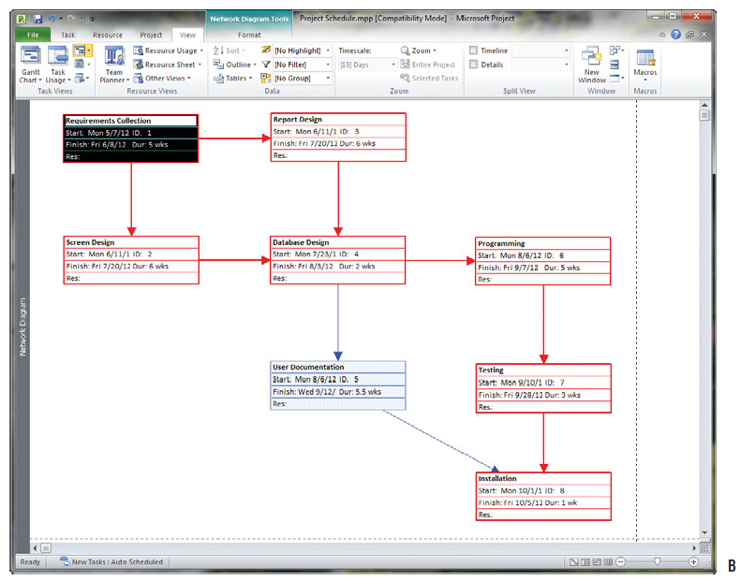
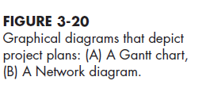

Slide 25
Gantt chart VS Network diagram
Gantt charts | Network diagrams
Visually show duration of tasks | Visually show dependencies between tasks
horizontal bar is drawn for each activity that reflects its sequence and duration | Arrows reflect the sequence of activities, and nodes (Rectangle or oval) reflect activities
Visually show time overlap between tasks | Visually shows which tasks can be done in parallel But it doesn’t show overlapping tasks
May not show direct interrelationships between activities | show precedence relationships
Visually show slack time | Show slack time by data in rectangles
Slack time : The amount of time that an activity can be delayed without delaying the project.

Slide 26
Chapter 3 - Part 2

Slide 27
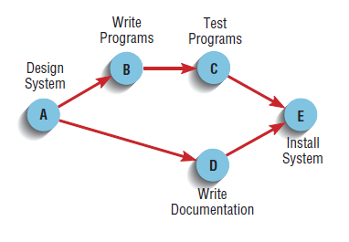
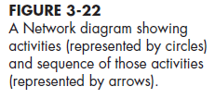
Representing Project Plans
Project scheduling and management requires that time, costs, and resources be controlled.
Network diagramming is a critical path scheduling technique used for controlling resources.
A major strength of Network diagramming is its ability to represent how completion times vary for activities
>> used more than Gantt charts to manage projects such as information systems development where variability in the duration of activities is the norm.
Network diagrams are usen when tasks :
Are well-defined and have a clear beginning and end point
Can be worked on independently of other tasks
Are ordered
Serve the purpose of the project
Resources are any person, group of people, piece of equipment, or material used In accomplishing an activity.
A critical path refers to a sequence of task activities whose order and durations directly affect the completion date of a project.

Slide 28

Calculating Expected Time Durations Using PERT
PERT (Program Evaluation Review Technique)
A technique that uses optimistic, pessimistic, and realistic time estimates to calculate the expected time for a particular task.
ET expected time for the completion for an activity
o optimistic completion time for an activity : the minimum possible period of time for an activity to be completed
r realistic completion time for an activity : or most likely time, reflects the project manager’s “best guess” of the amount of time the activity will require for completion
p pessimistic completion time for an activity: maximum possible period of time for an activity to be completed

Slide 29
Constructing a Gantt Chart and Network Diagram at Pine Valley Furniture
New Project : Design, develop, and implement Sales Promotion Tracking System (SPTS)
Purpose : Track and collect the sales purchases by college students for the next fall semester (the next major buying period) and And follow-up sales promotions to keep low sock level (e.g., a midterm futon sale).
Main Products: Students typically purchase low-priced beds, bookcases, desks, tables, chairs, and dressers.
Project Deadline: before the start of the fall term
Duration: twenty-four weeks to develop and implement the system.
Accompished stage: project initiation
Current Stage: the detailed project planning
Current Tasks: deside this week based on the feasibility of completing the project before the deadline; and Divide the project into manageable activities, estimate times for each, and sequence their order.
The next step : construct a Gantt chart and a Network diagram of the project to represent the baseline project plan in order to estimate the likelihood of completing the project within twenty-four weeks.

Slide 30
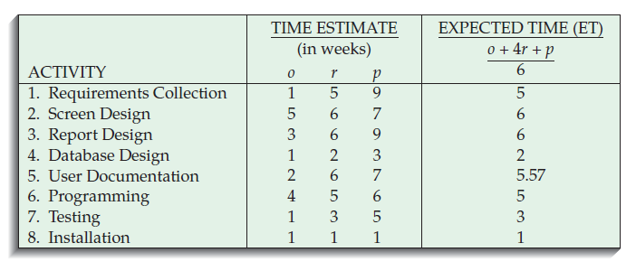
Steps :
Step 1: Identify each activity to be completed in the project.
Requirements collection
Screen design
Report design
Database design
User documentation creation
Software programming
System testing
System installation
Step 2 : Determine time estimates and calculate the expected completion time for each activity.
establishe optimistic, realistic, and pessimistic time estimates for each activity and compute the Expected completion Time (ET) for each activity

Slide 31
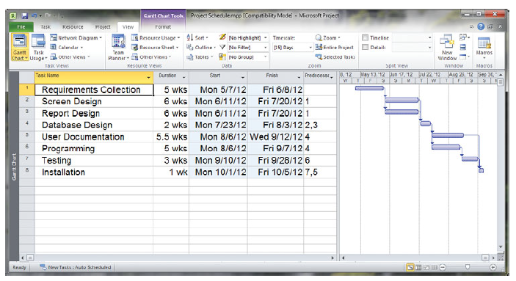
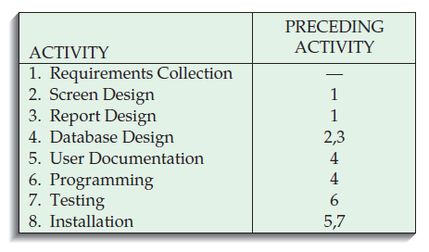

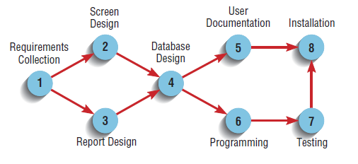
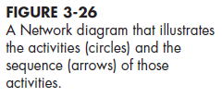
Step 3: Determine the sequence of the activities and precedence relationships among all activities by constructing a Gantt chart and Network diagram.
Determine the Order and Relations between activities

Slide 32
Step 4: Determine the critical path
The critical path represents the shortest time in which a project can be completed.
The critical path of a Network diagram is represented by the sequence of connected activities that produces the shortest overall time period.
It is possible to have multiple critical paths
All nodes and activities within this sequence are referred to as being “on” the critical path.
Any activity on the critical path that is delayed in completion delays the entire project.
Nodes not on the critical path can be delayed without delaying the final completion of the project. These nodes contain slack time and allow the project manager some flexibility in scheduling.
Slack time: The amount of time that an activity can be delayed without delaying the project.
Two types of slack are possible:
Free slack : without delaying the early start of any task immediately following.
Total slack : without delaying the completion of the project.
Understanding free and total slack allows the project manager to identify where trade-offs can be made if changes to the project schedule are needed.

Slide 33
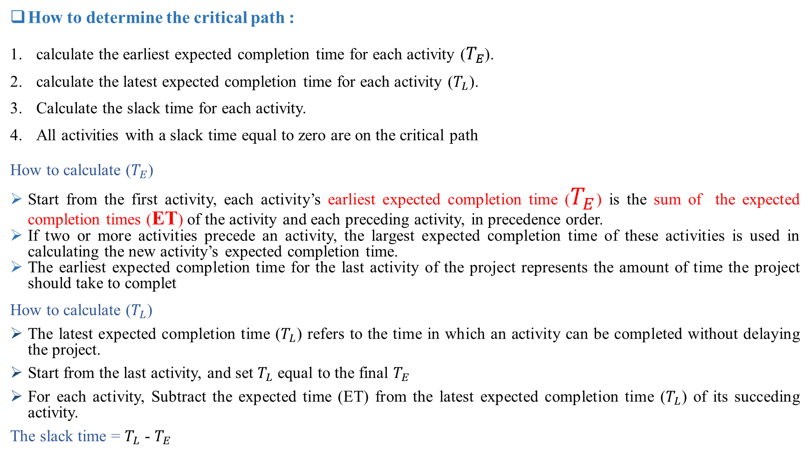
How to determine the critical path :
calculate the earliest expected completion time for each activity ($T_{E}$).
calculate the latest expected completion time for each activity ($T_{L}$).
Calculate the slack time for each activity.
All activities with a slack time equal to zero are on the critical path
How to calculate ($T_{E}$)
Start from the first activity, each activity’s earliest expected completion time ($T_{E}$) is the sum of the expected completion times (ET) of the activity and each preceding activity, in precedence order.
If two or more activities precede an activity, the largest expected completion time of these activities is used in calculating the new activity’s expected completion time.
The earliest expected completion time for the last activity of the project represents the amount of time the project should take to complet
How to calculate ($T_{L}$)
The latest expected completion time ($T_{L}$) refers to the time in which an activity can be completed without delaying the project.
Start from the last activity, and set $T_{L}$ equal to the final $T_{E}$
For each activity, Subtract the expected time (ET) from the latest expected completion time ($T_{L}$) of its succeding activity.
The slack time = $T_{L}$ - $T_{E}$

Slide 34
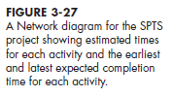
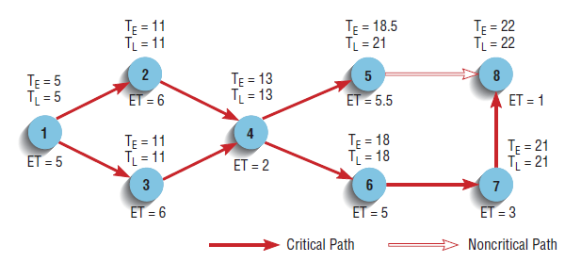
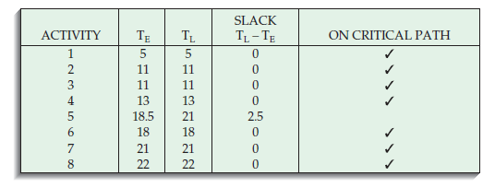

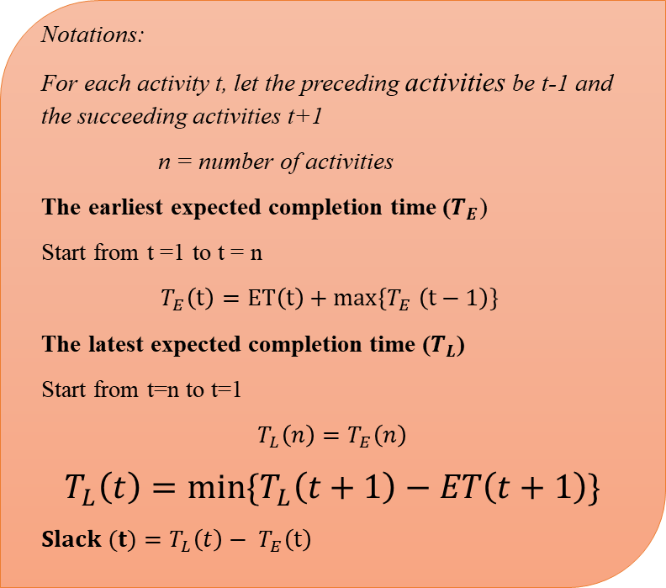
Notations:
For each activity t, let the preceding activities be t-1 and the succeeding activities t+1
n = number of activities
The earliest expected completion time ($T_{E}$)
Start from t =1 to t = n
$$T_{E}\left(t\right)=ET\left(t\right)+max⁡\{T_{E} \left(t−1\right)\}$$
The latest expected completion time ($T_{L}$)
Start from t=n to t=1
$$T_{L}\left(n\right)=T_{E}\left(n\right)$$
$$T_{L}\left(t\right)=min⁡\{T_{L}\left(t+1\right)−ET\left(t+1\right)\}$$
$$Slack (t)=T_{L}\left(t\right)− T_{E}\left(t\right)$$

Slide 35
4- Using Project Management (PM) Software
Many automated project management tools are available and they are continuously being developed.
features include the ability to define and order tasks, assign resources to tasks, and easily modify tasks and resources.
They vary in the number of task activities supported, the complexity of relationships, system processing and storage requirements, and cost.
Their prices range from a few hundred dollars to more than $100,000
Many tasks can be done with systems like Microsoft Project as well as public domain and shareware systems (e.g., OpenProj or EasyProjectPlan).
Three activities are required when using this system:
Establish a project starting or ending date.
Enter tasks and assign task relationships.
Select a scheduling method to review project reports.

Slide 36
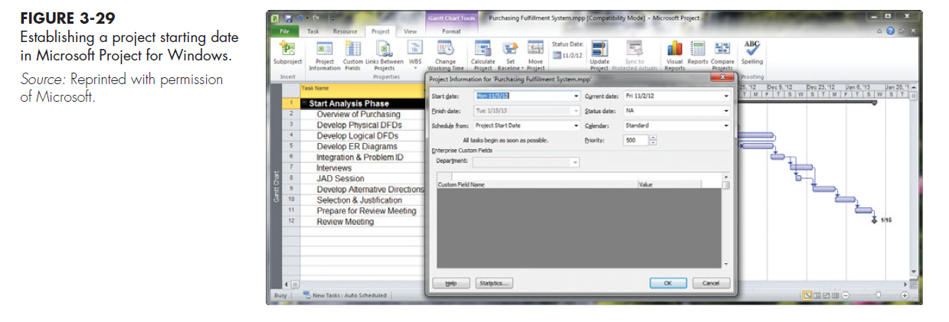
i- Establish a project starting or ending date.

Slide 37
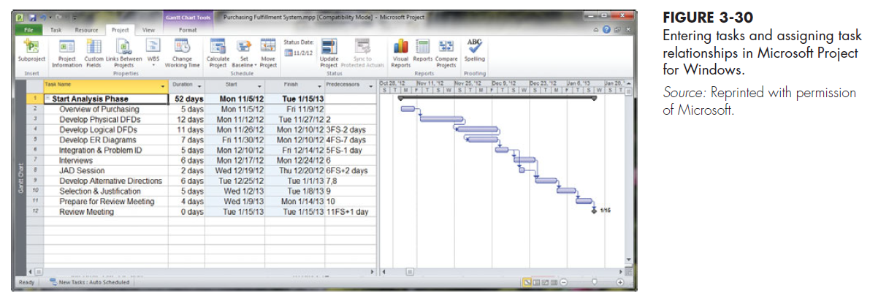
ii- Enter tasks and assign task relationships.

Slide 38
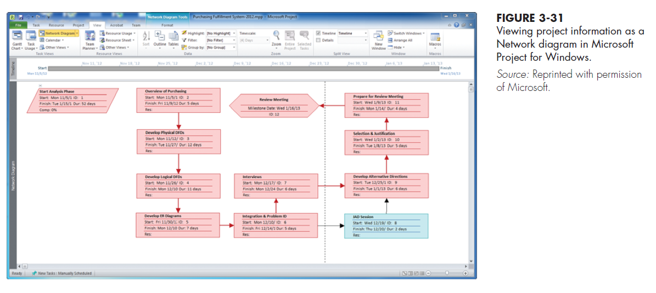
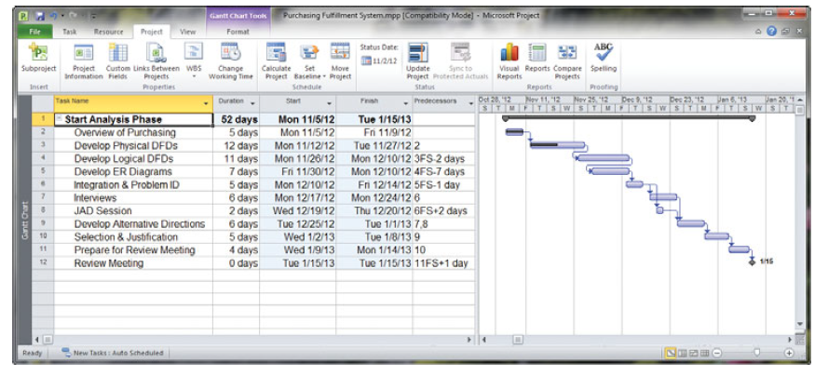
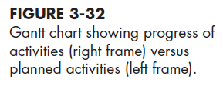
iii- Select a scheduling method to review project reports.

Slide 39
Summary
Skills of An Effective Project Manager
Activities of Project Manager
Initiation
Planning
Execution
Close down
Gantt Charts and Network Diagrams
Commercial PM Software

Slide 40
Thank you for your attention
Any Questions
???

