Slide 1
EASTERN MEDITERRANEAN UNIVERSITY DEPARTMENT OF INDUSTRIAL ENGINEERING INFORMATION SYSTEMS AND TECHNOLOGY IENG 372 / MANE 372 Spring 2021-2022 Summary of Chapter 4 -5 -6
Lecturer : Ms. Khaoula Chnina

Slide 2
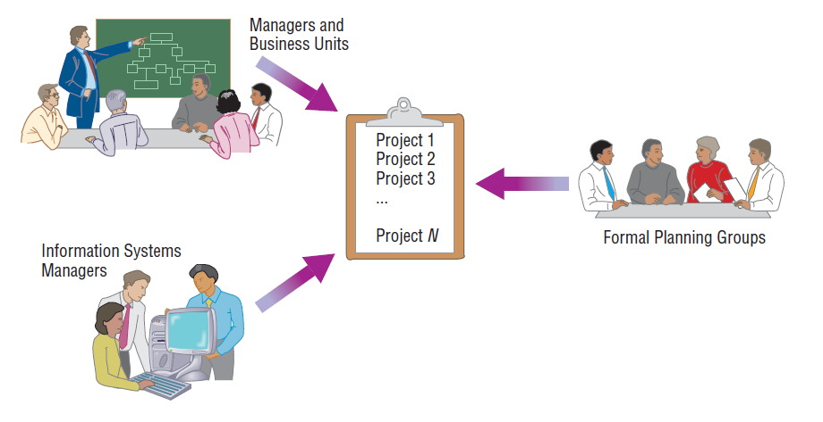
1- Identifying and Selecting Projects
In some organizations, project identification and selection is a formal process in which projects are outcomes of a larger overall planning process (e.g. comparing all competing projects).
Some organizations use informal project selection processes that allow the highest-ranking IS manager to select projects independently or allow individual business units to decide on projects after agreeing on funding.
Top-Down source | top management | the CEO of a small or medium-size organization or a senior executive in a larger organization | strategic organizational focus | having better understanding of overall business objectives and constraints, they reflect the broader(global) needs of the organization.
 | steering committee | a cross section of managers with an interest in systems | reflect the diversity and have a cross-functional focus
Bottom-Up source | User departments | the head of the requesting unit or a committee from the requesting department | narrow, tactical focus | designed for a particular business need they may not reflect the overall goals (broader) of the organization
 | The development group or a senior IS manager | IS staff | based on the ease with which existing hardware and systems will integrate with the proposed project.

Slide 3
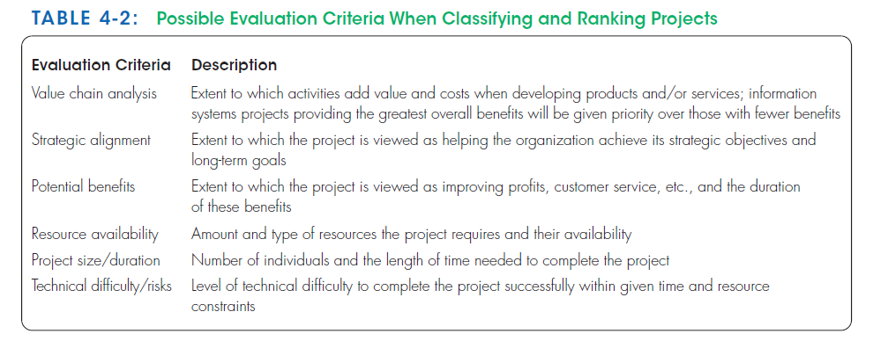
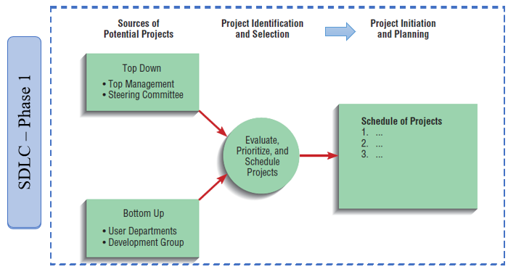
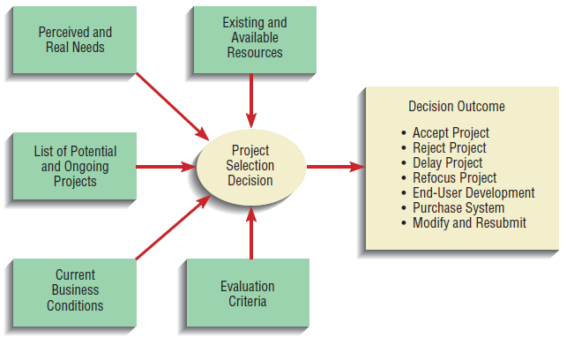
The principle of incremental commitment : after each subsequent SDLC activity, the project is reassessed to determine whether the business conditions have changed or whether a more detailed understanding of a system’s costs, benefits, and risks would suggest that the project is not as worthy as previously thought, thus a selected project does not necessarily result in a working system.

Slide 4
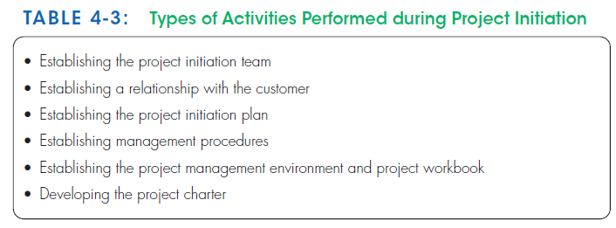
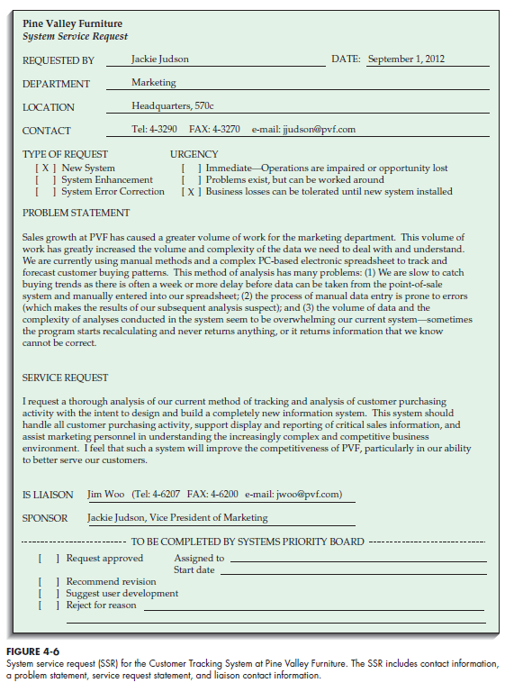
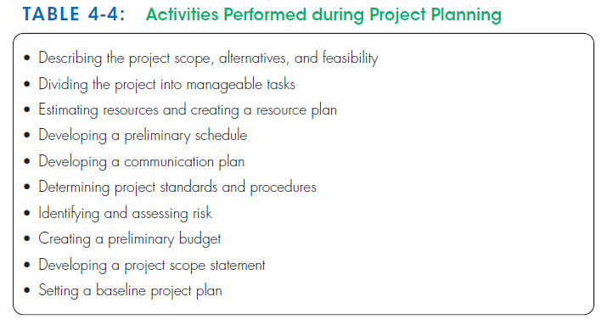
2- Initiating and Planning Systems Development Projects

Slide 5
3- Assessing Project Feasibility
Economic : cost-benefit analysis
Operational : Assessment of how a proposed system solves business problems or takes advantage of opportunities
Technical : Assessment of the development organization’s ability to construct a proposed system (hardware, software, and operating environments to be used, as well as, system size, complexity, and the group’s experience
Schedule : Assessment of time-frame and project completion dates with respect to organization constraints for affecting change
Legal and contractual : Assessment of legal and contractual ramifications of new system (copyright or nondisclosure infringements, labor laws, antitrust legislation)
Political : Assessment of key stakeholders’ view in organization toward proposed system (may take steps to block, disrupt, or change the project’s intended focus)
The analysis of these six factors forms the business case that justifies the expenditure of resources on the project.

Slide 6
A- Determining Project Benefits
Examples of the benefits of a new or renovated IS :
automate monotonous jobs,
reduce errors,
provide innovative services to customers and suppliers,
improve organizational efficiency, speed, flexibility, and morale.
Type of benefits | Tangible benefits | Intangible benefits
Definition | can be measured in dollars and with certainty | cannot be easily measured in dollars or with certainty
Examples | reduced personnel expenses lower transaction costs higher profit margins. | direct organizational benefits the improvement of employee morale broader societal implications reduction of waste creation or resource consumption.
Ease | Most often (but not always) easy to quantify in terms of hard dollar savings | Can be described in the final BPP
Categories | Cost reduction and avoidance Error reduction Increased flexibility Increased speed of activity Improvement of management planning and control Opening new markets and increasing sales opportunities | Competitive necessity Increased organizational flexibility Increased employee morale Promotion of organizational learning and understanding More timely information
Potential tangible benefits may have to be considered intangible during project initiation and planning because they could not be quantified in dollars or with certainty. During later stages, they can become tangible benefits

Slide 7
B- Determining Project Costs
Type | Tangible cost | Intangible cost | One-time cost | Recurring cost
Definition | an item that you can easily measure in dollars and with certainty | Cannot be easily measured in terms of dollars or with certainty. | associated with project initiation and development, or system start-up. May be staged over one or more years (One worksheet for each year) | resulting from the ongoing evolution and use of the system.
Examples | hardware costs labor costs operational costs employee training building renovations | Loss of customer goodwill Loss of employee morale operational inefficiency | System development New hardware and software purchases User training Site preparation Data or system conversion | Application software maintenance Incremental data storage expense Incremental communications New software and hardware leases Consumable supplies and other expenses (paper, forms, datacenter personnel)
 |  |  | consist of items that are fixed or variable in nature. Fixed costs refer to costs that are billed or incurred at a regular interval and usually at a fixed rate (facility lease payment) Variable costs refer to items that vary in relation to usage (Long distance phone charges)

Slide 8
The Time Value of Money (TVM)
Used to address the relationship between time and money.
TVM is The process of comparing present cash outlays to future expected returns.
many projects may be competing for the same investment dollars and may have different useful life expectancies, all costs and benefits must be viewed in relation to their present, rather than future value when comparing investment options.
Discount rate : The interest rate used to compute the present value of future cash flows (The interest rate at which money can be borrowed or invested, the cost of capital).
Present value : The current value of a future cash flow.
${PV}_{n}$ is the present value of Y dollars n years from now, when i is the discount rate.
$${PV}_{n}=Y×\frac{1}{{(1+i)}^{n}}$$
years
Present
Future
interest

Slide 9
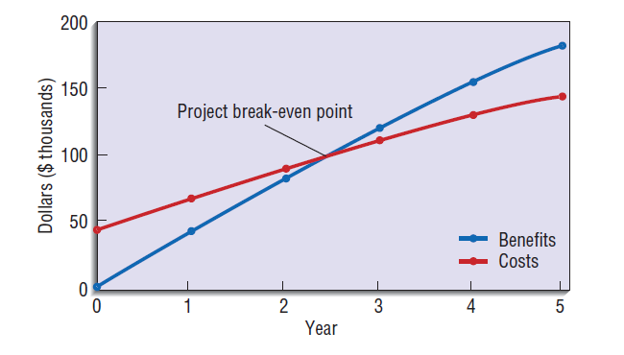
Summary Worksheet
A summary worksheet reflects the present values of all benefits and costs
The overall ROI value is useful for making project comparisons on an economic basis. An ROI analysis can be calculated for each year of the project.
Break-even analysis : A type of cost-benefit analysis to identify at what point (if ever) benefits equal costs.
To conduct this analysis, the NPV of the yearly cash flows is determined.
The yearly NPV cash flows = PV of the yearly benefits - ( the one-time cost + PV of the recurring costs).
The overall NPV of the cash flows reflect the total cash flows for all preceding years.
Overall NPV cash flows = NVP of benefits – NVP of costs
break-even occurs between the first year in which the overall NPV cash flows figure is non-negative the year before it.
Identifying the point when Break even occurs can be derived as follows:

Slide 10
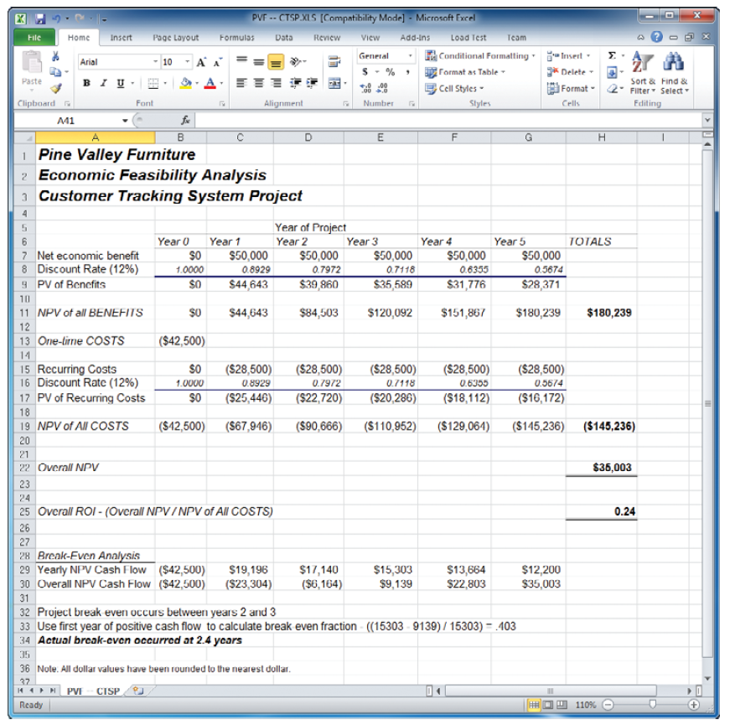
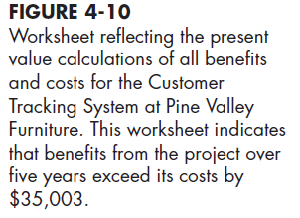
$${PV}_{n}=Y×\frac{1}{{(1+i)}^{n}}$$
Total yearly tangible benefits from the worksheet
Time Horizon
years | 1 | 2 | 3 | 4 | 5
Y | 50000 | 50000 | 50000 | 50000 | 50000
i | 0,12 | 0,12 | 0,12 | 0,12 | 0,12
PV | 44642,86 | 39859,69 | 35589,01 | 31775,9 | 28371,34
cost of capital (discount rate)
NPV of the total tangible benefits
NPV of the total costs
The NPV for the project
(benefits > costs).
The overall return on investment
First positive
break-even analysis
2 years and 4 months and 24 days

Slide 11
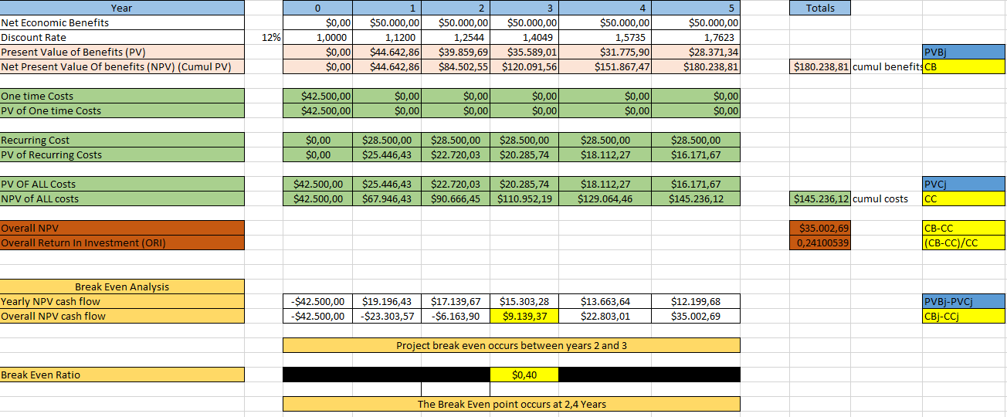

Slide 12
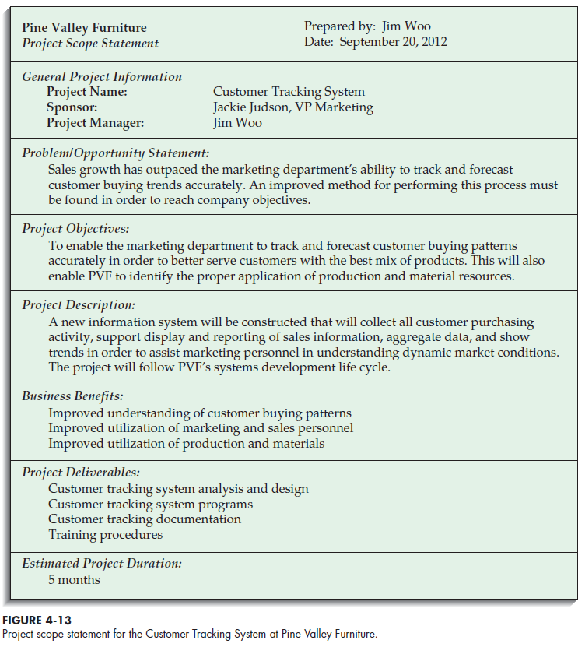
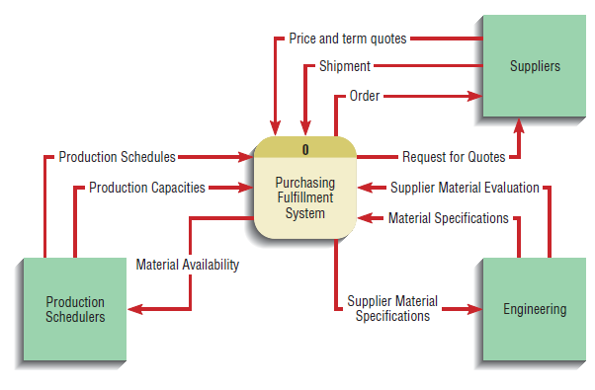
4- Building the Baseline Project Plan & Project Scope Statement
A- Project Scope Statement
A project scope statement provides a detailed description of the work that must be done to deliver the output of a project on time and within the allotted budget.
The document also places the objectives of the project and its output—which could be a product that a company is releasing to the marketplace or analysis that leadership will use to make an informed business decision—within the larger context of the organization’s goals and objectives.
Prepared for external and internal stakeholders, and outlines the objectives of the project for the customer (high-level Overview) .

Slide 13
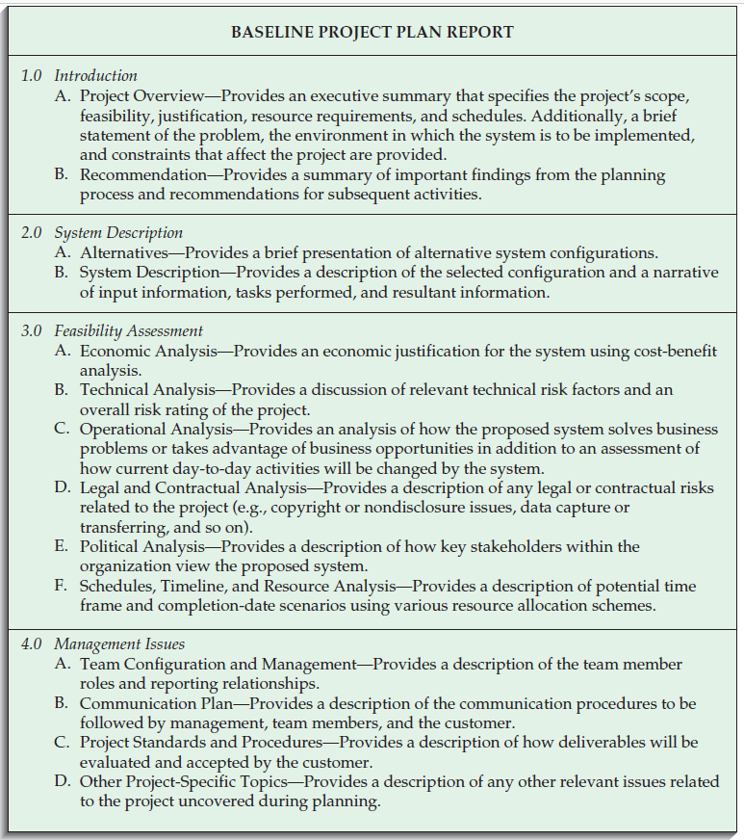
B- The Baseline Project Plan
It is an internal document that contains the best estimate of the project’s scope, benefits, costs, risks, and resource requirements.
contains all information collected and analyzed during the project initiation and planning activity.
The BPP specifies detailed project activities for the next life cycle phase (systems analysis) and provides less detail for subsequent project phases .
The project selection committee uses the BPP to help decide whether to continue, redirect, or cancel a project.
If the project is selected, the BPP becomes the foundation document for all subsequent SDLC activities
Objectives
Assures that customer and development group have a complete understanding of the proposed system and requirements
Provides sponsoring organization with a clear idea of scope, benefits and duration of project
Four Sections of a Baseline Project Plan:
Introduction
System description
Feasibility assessment
Management issues

Slide 14
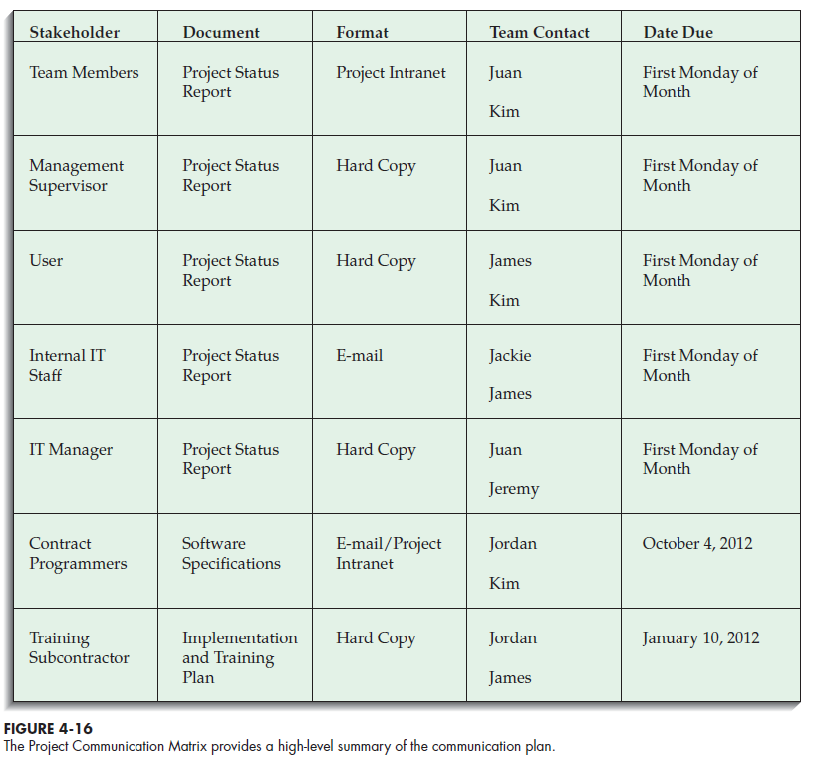
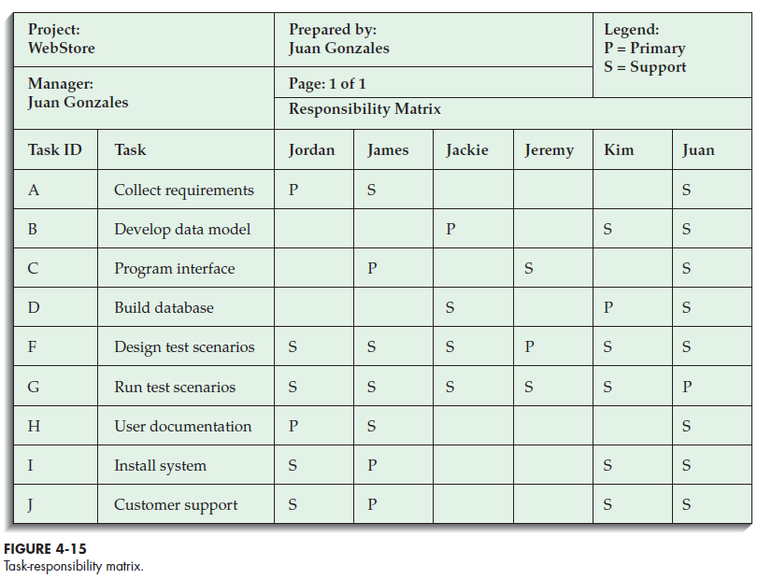

Slide 15
5- Reviewing the Baseline Project Plan
Objectives
Assure conformity to organizational standards
All parties agree to continue with project
Method for Reviewing:
Walkthrough : A peer group review of any product created during the systems development process; also called a structured walkthrough. They have a specific agenda and shown on the project schedule.
Advantage: to ensure that formal review points occur during the project
Activities
Walkthrough review form
Individuals polled
Walkthrough action list
Participants
Coordinator : plans the meeting and facilitates discussions.
Presenter : describes the work product to the group
User : makes sure that the product meets the needs of the customers
Secretary : takes notes and records decisions or recommendations
Standard Bearer : ensures that the work product adheres to organizational technical standards
Maintenance Oracle : make the system and its documentation easy to maintain.
In addition to reviewing the BPP, the walkthrough meetings can be used for System specifications, Logical and physical designs, Code or program segments, Test procedures and results, Manuals and documentation.

Slide 16
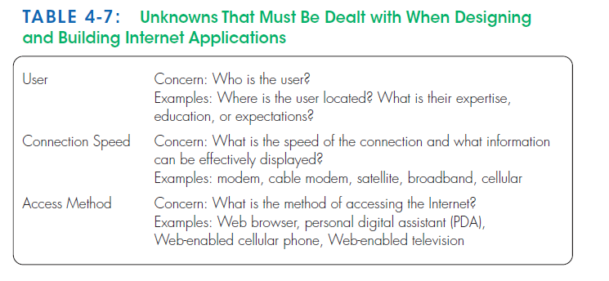
6 –Internet-based electronic commerce application
Development process for Internet projects is no different than other projects
Special issues need to be taken into account
Electronic commerce (EC)
Internet-based communication and other technologies that support day-to-day business activities (communicating with customers and selling goods and services online) .
EC can also refer to the use of non-Internet technologies such as telephone voice-messaging systems.
The three classes of Internet EC applications are Internet, intranet, and extranet
A. Internet
A network of interconnected individual networks that use a common protocol to communicate with each other (TCP/IP – transmission control protocol/Internet protocol); a global computing network to support business-to-consumer electronic commerce.
B. Intranet
Internet-based communication to support business activities within a single organization.
C. Extranet
Internet-based communication to support business-to-business activities.
Electronic data interchange (EDI)
The use of telecommunication technologies to transfer business documents directly between organizations.

Slide 17
1- Performing Requirements Determination
systems analysis
Determining requirements
Structuring requirements
- understand current problems and opportunities, as well as what is needed and desired in future systems.
- Gather information on what the system should do from as many sources as possible
Order the system requirement found in the determination step in tables, diagrams, and other formats that make them easier to translate into technical system specifications
Sources can be :
Users of the current system
Reports
Forms
Procedures
All of the system requirements are carefully documented and made ready for structuring
parallel and repetitive

Slide 18
Characteristics for Gathering Requirements
Impertinence
question everything
- Are all transactions processed the same way?
- Could anyone be charged something other than the standard price?
- Might we someday want to allow and encourage employees to work for more than one department?
Impartiality
find the best organizational solution
- Justify the purchase of new hardware
- Insist on incorporating what users think they want into the new system requirements
Relaxing of constraints
Attention to details
Reframing
Assume anything is possible and eliminate the infeasible
- Traditions are different from rules and policies
- Do not accept this statement: “We’ve always done it that way, so we have to continue the practice.”
an imprecise definition of who a customer is may mean that you purge customer data when a customer has no active orders; yet these past customers may be vital contacts for future sales.
Every fact must fit with every other fact
- Consider how each user views his or her requirements.
- Be careful not to jump to this conclusion:
“I worked on a system like that once—this new system must work the same way as the one I built before.”
View the organization in new ways and be creative

Slide 19
Types of Information to Be Discovered:
Opportunities to meet new needs (e.g., analysis of sales based on customer type)
Problems with existing systems (e.g., missing information or redundant steps) duplication of effort in two or more jobs.
Organizational direction (e.g., link customers and suppliers more closely)
Titles and names of key individuals (e.g., a sales manager)
Values of the organization or individuals (e.g., maintaining market share even if it means lower short-term profits)
Special information-processing circumstances that occur irregularly (e.g., special handling needed for a few large-volume customers who require use of customized customer ordering procedures)
The reason why current systems are designed as they are, suggest new ones (e.g., data about a customer’s purchase of competitors’ products not available when the current system was designed; these data now available from several sources)
Rules for processing data (e.g., each customer assigned exactly one sales department staff member as primary contact if customer has any questions)
the difference between formal systems and informal systems.
The business objectives : what and how work is done
The information needs : jobs’ Information
The data processing rules : When, how, and by whom or what the data are moved, transformed, and stored
Policies and guidelines : the nature of the business, the market, and the environment in which it operates
Key events : how they affect data values and when they occur
Informal Systems : The way a system actually works; information collected from interviews, questionnaires, and observation about how the organization operates and what information is required.
Formal system : The official way a system works, as described in organizational documentation.
>> Informal systems develop because of inadequacies of formal procedures and individual work habits, preferences, and resistance to control.

Slide 20
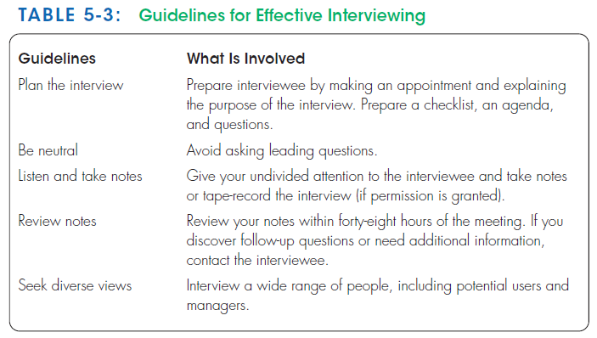
Traditional method 1- Interviewing and Listening
Interviewing people about their work, the information they use to do it, and the types of information processing that might supplement their work.
To understand organizational direction, policies, and expectations that managers have of the units they supervise
Gather facts, opinions, and speculations
Observe body language and emotions
Interview guidelines :

Slide 21
Choosing Interview Questions
Types Of questions | Closed-ended questions | Open-ended questions
Definition | Questions in interviews and on questionnaires that ask those responding to choose from among a set of specified responses | Questions in interviews and on questionnaires that have no prespecified answers.
Examples | -True or false -Multiple choice -Rating a response or idea on some scale -Ranking items in order of importance | -“What would you say is the best thing about the information system you currently use to do your job?” - “List the three most frequently used menu options.”
When to use | -the major answers to questions are well known -You can include an “other” option to encourage the interviewee to add unexpected responses. | To probe for information when you cannot anticipate all possible responses or when you do not know the precise question to ask.
Advantages | -Do not require a large time commitment -more topics can be covered. -an easy way to begin an interview and to determine which line of open-ended questions to pursue. | -previously unknown information can surface -They put the interviewees at ease -They give interviewees more of a sense of involvement and control
Disadvantages | -useful information may be overlooked -the respondent tries to make a choice instead of providing the best answer | -The length of time -Difficult to summarize -You must react quickly to answers and determine whether any followup questions are needed.

Slide 22
Traditional method 2- Directly Observing Users
watching people in work situations ( emails , calls).
obtain more firsthand and objective measures of employee interaction with information systems
Serves as a good method to supplement interviews (People are not always reliable )
not include important events or activities.
such methods are not always possible
these methods are not totally unbiased : People often work differently when being observed (nervous and make more mistakes/ follow procedures more carefully/ faster / slower
Not continuous, limited time, number of people, and number of sites (selection problem).
Observation yields only a small segment of data from a possibly vast variety of data sources
>> Pick both typical and atypical people and sites and observe during normal and abnormal conditions and times to receive the richest possible data from observation.

Slide 23
Traditional method 3- Analyzing Procedures and Other Documents
Interviewing and observing users for determining system requirements can be enhanced by examining system and organizational documentation to discover more details about current systems and the organization they support.
other important documents :
organizational mission statements (written work procedure)
business plans (business form)
reports from prior organizational studies
organization charts,
business policy manuals
Job descriptions
internal and external correspondence

Slide 24
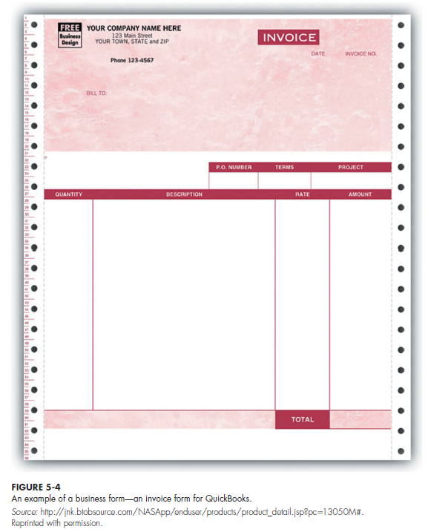
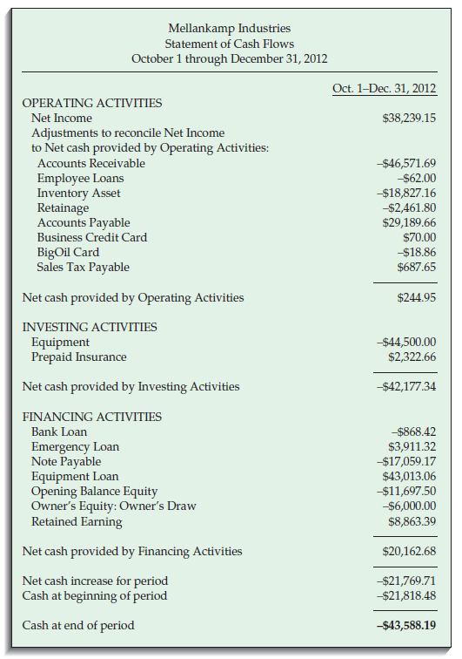

Slide 25
Modern method 1- Joint Application Design (JAD)
JAD started in the late 1970s at IBM .
It brings together the key users, managers, and systems analysts involved in the analysis of a current system.
The primary purpose of using JAD in the analysis phase is to collect systems requirements.
It allows analysts to see the areas of agreement and the areas of conflict.
It is an opportunity to resolve conflicts or to understand why a conflict may not be simple to resolve.
The result is an intense, structured, and highly effective process.
The end result of a completed JAD is a set of documents detailing the workings of the existing system and the features of a replacement system.
JAD sessions are usually conducted off-site, in order to limit distractions and help participants better concentrate on systems analysis.
held in special-purpose rooms where participants sit around horseshoe-shaped tables.
A JAD may last from four hours to an entire week and may consist of several sessions.
A JAD employs thousands of dollars (the time of the people involved, flying, hotels and feeding)

Slide 26
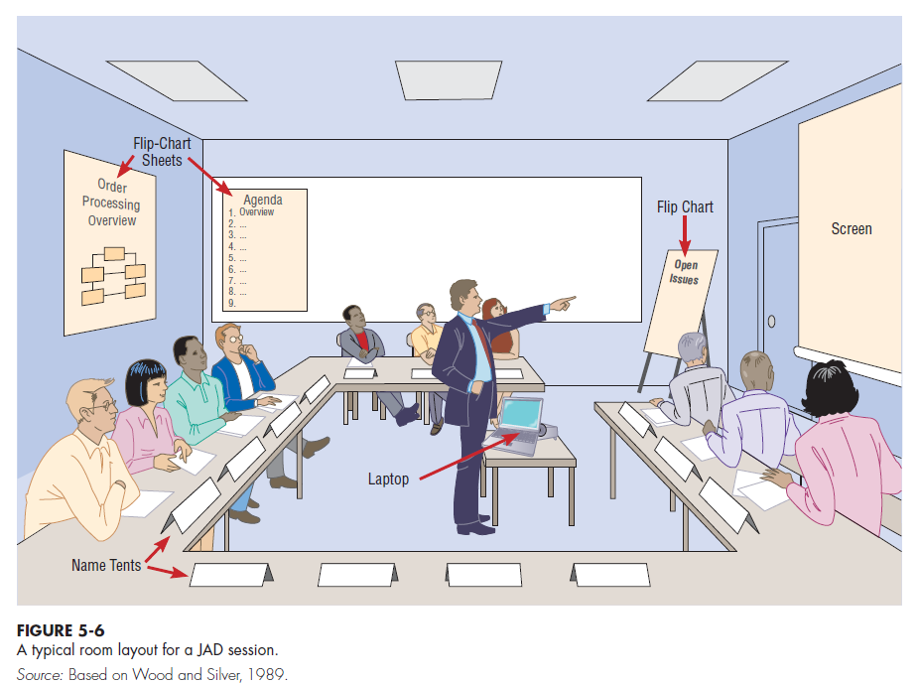
whiteboards (possibly electronic, with a printer)
magnetic symbols that can be easily rearranged
Flip-chart paper to track issues that are not resolved or require additional information.
Computers to create and display form, report designs or diagrams

Slide 27
Participants | Roles
Session leader | The trained individual who plans and leads joint application design sessions.
Users | key users understand what it means to use the system on a daily basis
Managers | provide insight into new organizational directions
Sponsor | a vice president or chief executive officer, Attends the sessions only at the beginning or the end
Systems analysts | learn from users and managers, but don’t run or dominate the process.
Scribe | makes detailed notes of the happenings at a JAD session.
IS staff | programmers,database analysts, IS planners, and data-center personnel. They learn from the discussion and can give their ideas on the technical feasibility of proposed ideas or on the technical limitations of current systems.

Slide 28
Modern method 2- Prototyping
Prototyping is a repetitive process in which analysts and users build a rudimentary version of an information system based on user feedback.
Prototyping could replace or augment the SDLC.
User quickly converts requirements to working version of system
Once the user sees requirements converted to system, will ask for modifications or will generate additional requests
The goal of prototyping is to develop concrete specifications for the ultimate system, not to build the ultimate system.
Most useful when:
User requests are not clear
Few users are involved in the system
Designs are complex and require concrete form to evaluate fully
History of communication problems between analysts and users
Tools are readily available to build prototype
Disadvantages
Systems Development Life Cycle (SDLC) checks are often bypassed (testing, bug checking is bypassed, security checks ignored)
A tendency to avoid creating formal documentation of system requirements, which can then make the system more difficult to develop into a fully working system.
Prototypes can become idiosyncratic to the initial user and difficult to diffuse or adapt to more general user audience
Prototypes are often built as stand-alone systems, thus Sharing data with other systems is often not considered

Slide 29
4 - Radical Methods for Determining System Requirements
The current way of doing things impacts the new system.
Radical increases in the quality of business processes can be achieved through creatively applying information technologies.
Radical improvement cannot be achieved by making minor changes but rather by changing the way work is performed and the information is shared and stored (“If we were a new organization, how would we accomplish this activity?”)
These ways may be radically different from how things are done now, but the payoffs may be enormous:
Fewer people may be needed to do the same work
Relationships with customers may improve dramatically
Processes may become much more efficient and effective
Profit increase
Business Process Reengineering (BPR) :
The overall process by which current methods are replaced with radically new methods
The search for, and implementation of, radical change in business processes to achieve breakthrough improvements in products and services (Golf Analogy Example) .
BPR will be a top IS priority in the future.
Goals of BPR :
Improve each business process
Reorganize the complete flow of data in major sections of an organization
Eliminate unnecessary steps
Combine steps
Become more responsive to future changes

Slide 30
BPR Step 1 - Identifying Processes to Reengineer
What processes need to change ??
what are the key business processes for the organization ??
First Step: Key business processes
The structured, measured set of activities designed to produce a specific output for a particular customer or market.
They are focused on some type of organizational outcome (the creation of a product or the delivery of a service)
They are customer focused
Include all activities used to design, build, deliver, support, and service a particular product for a particular customer.
BPR requires the understanding of the activities that are part of the organization’s key business processes and then to alter the sequence and structure of activities to achieve radical improvements in speed, quality, and customer satisfaction.
Second Step: Specific activities identification
ask three questions to identify activities for radical change:
1. How important is the activity to delivering an outcome?
2. How feasible is changing the activity?
3. How dysfunctional is the activity?
Those activities deemed important, changeable, yet dysfunctional, are primary candidates for alteration.
To identify dysfunctional activities, look for activities that involve excessive information exchanges between individuals, information that is redundantly recorded or needs to be rekeyed, excessive inventory buffers or inspections, and a lot of rework or complexity.

Slide 31
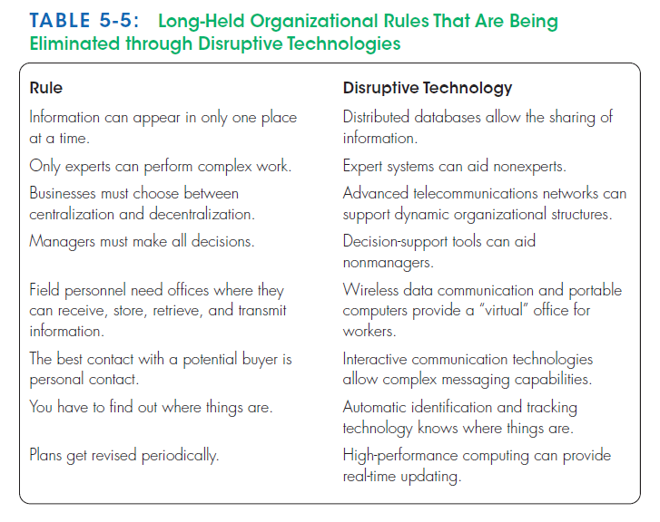
BPR Step 2 - Disruptive Technologies
Organizations think “inductively” about information technology.
Induction is the process of reasoning from the specific to the general, which means that managers must learn about the power of new technologies and think of innovative ways to alter the way work is done.
This approach is contrary to deductive thinking, in which problems are first identified and solutions then formulated.
managers especially consider disruptive technologies when applying deductive thinking.
Disruptive technologies : Technologies that enable the breaking of long-held business rules that inhibit organizations from making radical business changes.
For example, Toyota is using production schedule databases and electronic data interchange (EDI)—an information system that allows companies to link their computers directly to suppliers

Slide 32
1- Process Modeling
Process modeling
Graphically representing the processes that capture, manipulate, store, and distribute data between a system and its environment and among components within a system.
Data-flow diagrams (DFDs) :
Data-flow diagramming is one of several structured analysis techniques used to increase software development productivity and quality.
A tool analysts use to structure information.
A DFD is a graphical tool that allow to model how data flow through an information system, the relationships among the data flows, and how data come to be stored at specific locations.
Show the processes that change or transform data.
The IS can be physical or logical, manual or computer based.
Data-flow diagrams are a common form of process models, they concentrate on the movement of data between processes.
A graphic that illustrates the movement of data between external entities and the processes and data stores within a system.

Slide 33
Definitions and Symbols
2- Data-Flow Diagramming Mechanics
Data flow : data that are in motion and moving as a unit from one place in a system to another.
It could represent data on a customer order form or a payroll check.
It could represent the results of a query to a database, the contents of a printed report, or data on a data-entry computer display form.
It can be composed of many individual pieces of data that are generated at the same time and that flow together to common destination
It is drawn as an arrow.
The arrow is labeled with a meaningful name for the data in motion; for example, customer order, sales receipt, or paycheck.
The name represents the aggregation of all the individual elements of data moving as part of one packet, that is, all the data moving together at the same time.

Slide 34
Data store : data at rest.
It may represent one of many different physical locations for data, including a file folder, one or more computer-based file(s), or a notebook.
A data store might contain data about customers, students, customer orders, or supplier invoices.
Drawn as a rectangle with the right vertical line missing
Label includes name of the store as well as the number (e.g., D1 or D2) and a meaningful label, such as student file, transcripts, or roster of classes.
Process : the work or actions performed on data so that they are transformed, stored, or distributed.
When modeling the data processing of a system, it doesn’t matter whether a process is performed manually or by a computer.
Drawn as a rectangle with rounded corners
Number of process as well as name are recorded inside the rectangle, which indicates what the process does. For example, the process may generate paychecks, calculate overtime pay, or compute grade-point average.

Slide 35
source/sink : the origin and/or destination of the data, define the system’s boundaries.
Source/sinks are sometimes referred to as external entities because they are outside the system.
Data must originate outside a system from one or more sources, and the system must produce information to one or more sinks.
A source/sink might consist of :
Another organization or organizational unit (e.g., a supplier or an academic department)
A person inside or outside the business unit (e.g., a customer or a loan officer)
Another information system
Drawn as a square or a rectangle symbol
Its name states what the external agent is, such as customer, teller, Environmental Protection Agency (EPA) office, or inventory control system.

Slide 36
Context diagram
A data-flow diagram of the scope of an organizational system that shows the system boundaries, external entities that interact with the system, and the major information flows between the entities and the system. It contains NO data stores ,It has only one process labeled “0.”
Level-0 diagram
A data-flow diagram that represents a system’s major processes, data flows, and data stores at a high level of detail ( no details).
Each process has a number that ends in .0 (corresponding to the level number of the DFD).
Level-n diagram
A DFD that is the result of n nested decompositions of a series of subprocesses from a process on a level-0 diagram (More details).

Slide 37
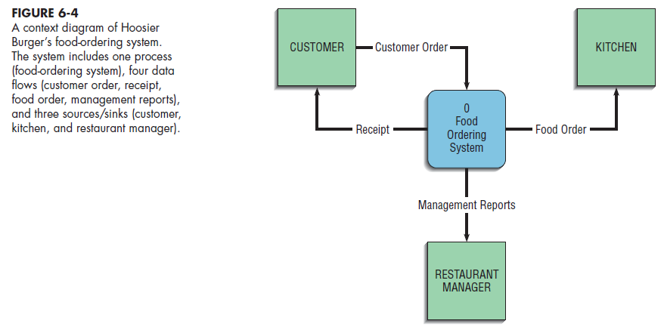
Developing DFDs: An Example
Consider Hoosier Burger, a fictional fast food restaurant in Bloomington, Indiana.
It is a favorite of students at nearby Indiana University.
Hoosier Burger uses an automated food-ordering system.
1- Context diagram :
A DFD that Represents the boundary or scope of this system, and the system’s relationship to its environment
The single process, labeled “0,” represents the entire system; The sources/sinks represent its environmental boundaries.

Slide 38
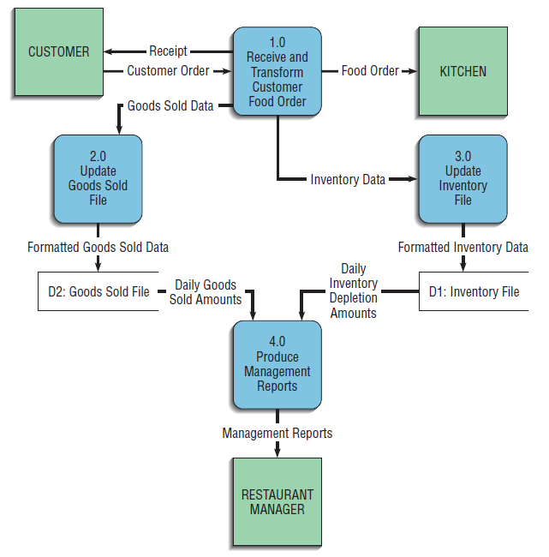
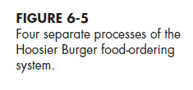
2- Level 0 Diagram :
which processes are represented by the single process ?
The main processes in the DFD represent the major functions of the system, and these major functions correspond to such actions as the following:
1. Capturing data from different sources (Process 1.0)
2. Maintaining data stores (Processes 2.0 and 3.0)
3. Producing and distributing data to different sinks (Process 4.0)
4. High-level descriptions of data transformation operations (Process 1.0)
The system begins with an order from a customer,
In the first process, labeled “1.0,” the customer order is processed.
The results are four streams or flows of data: (1) The food order is transmitted to the kitchen, (2) the customer order is transformed into a list of goods sold, (3) the customer order is transformed into inventory data, and (4) the process generates a receipt for the customer.

Slide 39
First, the data labeled Goods Sold go to Process 2.0. The output for this process is labeled Formatted Goods Sold Data updates a data store labeled Goods Sold File.
If the customer order were for two cheeseburgers, one order of fries, and a large soft drink, each of these categories of goods sold in the data store would be incremented appropriately.
The Daily Goods Sold Amounts are then used as input to Process 4.0, Produce Management Reports.
The Inventory Data, serves as input for Process 3.0, Update Inventory File. This process updates the Inventory File data store, based on the inventory that would have been used to create the customer order.
For example, an order of two cheeseburgers would mean that Hoosier Burger now has two fewer hamburger patties, two fewer burger buns, and four fewer slices of American cheese.
The Daily Inventory Depletion Amounts are then used as input to Process 4.0.
The data flow leaving Process 4.0, Management Reports, goes to the sink Restaurant Manager.
We know from this diagram that Process 1.0 produces this data flow and that Process 3.0 receives it. However, we do not know the timing of when this data flow is produced, how frequently it is produced, or what volume of data is sent.
Thus, this DFD hides many physical characteristics of the system it describes.

Slide 40
We know that this data flow is needed by Process 3.0 and that Process 1.0 provides this needed data.
whenever Process 1.0 produces the Inventory Data data flow , Process 3.0 must be ready to accept it. Thus, Processes 1.0 and 3.0 are coupled to each other.
The output from Process 2.0, Formatted Goods Sold Data, is placed in a data store, and when Process 4.0 needs such data, it reads Daily Goods Sold Amounts from this data store. In this case, Processes 2.0 and 4.0 are decoupled by placing a buffer, a data store (Goods Sold File), between them. Each of these processes can work at its own pace, and Process 4.0 does not have to be vigilant by being able to accept input at any time.
Further, the Goods Sold File becomes a data resource that other processes could potentially draw upon for data.

Slide 41
Data-Flow Diagramming Rules
Two DFD guidelines apply most of the time:
1- The inputs to a process are different from the outputs of that process:
The reason is that processes, to have a purpose, typically transform inputs into outputs, rather than simply passing the data through without some manipulation. The same input may go in and out of a process, but the process also produces other new data flows that are the result of manipulating the inputs.
2- Objects on a DFD have unique names:
Keep the diagram uncluttered.
You can repeat data stores and sources/sinks.
When two arrows have the same data-flow name, you must be careful that these flows are exactly the same.
It is a mistake to reuse the same data-flow name when two packets of data are almost the same but not identical. Because a data-flow name represents a specific set of data, another data flow that has even one more or one less piece of data must be given a different, unique name.

Slide 42
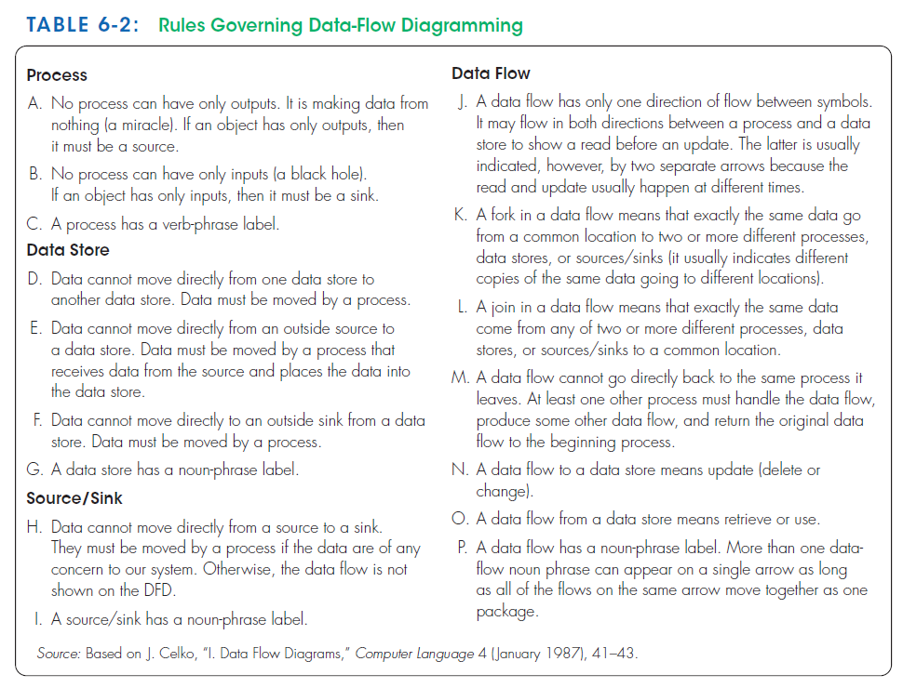
Naming conventions (rules C, G, I, and P)
How to interpret data flows in and out of data stores (rules N and O )

Slide 43
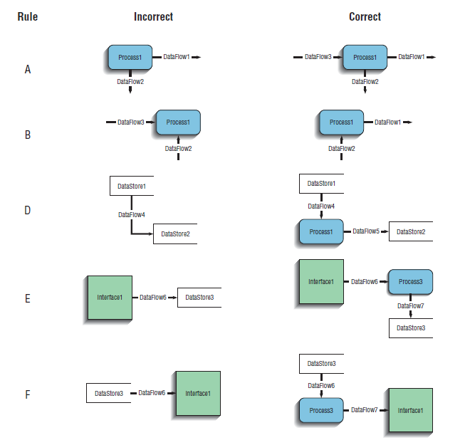
A process should use inputs and produce outputs, and has verb-phrase name.
A Data is moved from/to a source or a file by process, and has noun-phrase name.

Slide 44
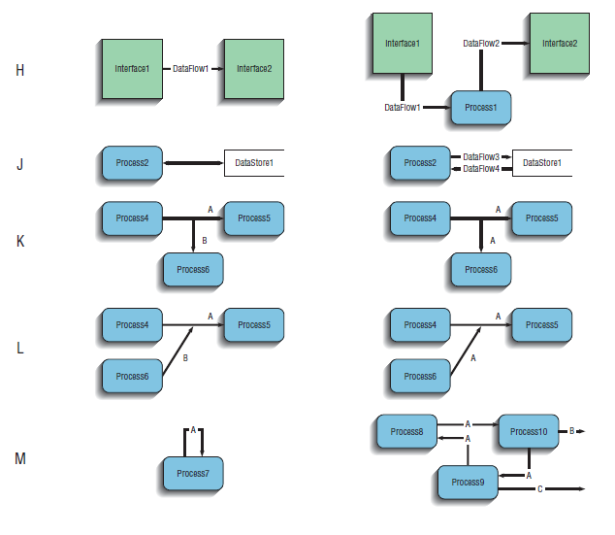
A Data is moved from/to a source by process, and source has noun-phrase name.
Data flow has one direction,
A fork and Join in data are a different copies of the same data,
A data flow cannot be an input and output of a process unless it moves through another process,
A data flow to a store is an update,
A data flow From a store is retrieved,
Data flow has a noun-phrase name,
Many data flows can move together on a single arrow,

Slide 45
Decomposition of DFDs
Functional decomposition :
The act of going from a single system to many component processes.
It is a repetitive procedure of breaking the description of a system down into finer and finer detail.
This process creates a set of hierarchically related charts in which one process on a given chart is explained in greater detail on another chart.
Each of those processes (or subsystems) is also a candidate for decomposition.
Each process may consist of several subprocesses.
Each subprocess may also be broken down into smaller units.
Decomposition continues until no subprocess can logically be broken down any further.
The lowest level of DFDs is called a primitive DFD

Slide 46
0
Food Ordering System
1.0
Receive and Transform Customer Food Order
3.0
Update
İnventory File
4.0
Produce Management
Reports
2.0
Update
Goods Sold File
1.1
Receive
a customer
order
1.5
Generate Inventory Decrements
1.3
Transform
Order to Kitchen Format
1.2
Generate Customer
Receipt
4.1
Access Goods Sold and Inventory Data
4.2
Aggregate Goods Sold and Inventory Data
4.3
Prepare Management Reports
1.4
Generate
Goods Sold Increments
4.3.1
Format Management Reports
4.3.2
Print Management Reports
Context DFD
Context DFD
Level-0 DFD
Level-0 DFD
Level-1 DFD
Level-2 DFD

Slide 47
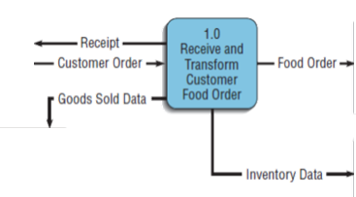
Level- 1 DFDs : Decomposition of level-0 DFD for Hoosier Burger’s food-ordering system
The first process in level-0 DFD (Figure 6-5 ) , called Receive and Transform Customer Food Order, transforms a customer’s verbal food order into four different outputs:
(1) The food order
(2) goods sold
(3) inventory data
(4) receipt for the customer.
At least these five logically separate functions occur in Process 1.0:
(1) Receive a customer order,
(2) transform the entered order into a printed receipt for the customer,
(3) transform the order into a form meaningful for the kitchen’s system,
(4) transform the order into goods sold data
(5) transform the order into inventory data
We can represent the decomposition of Process 1.0 as another DFD, as shown in Figure 6-7 ( level-1 DFD)

Slide 48
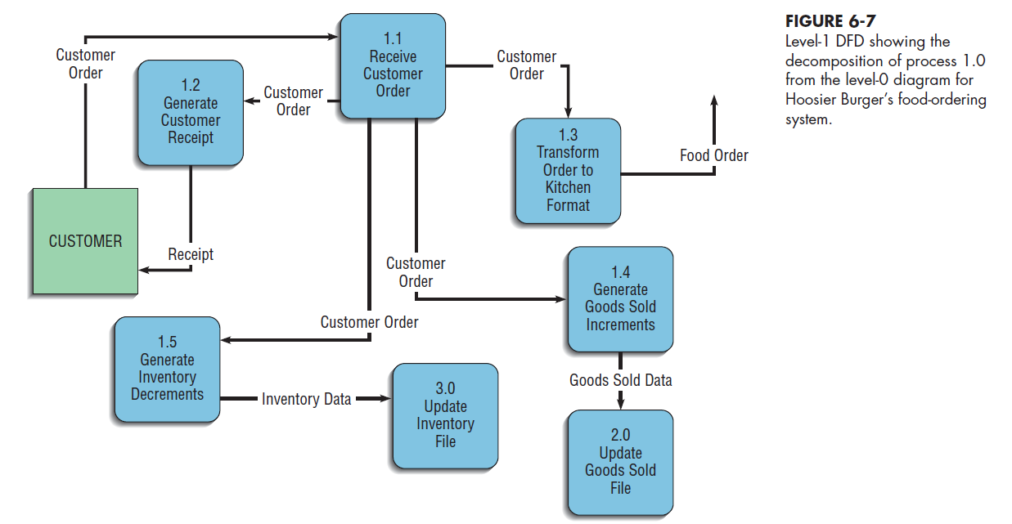
Note that each of the five processes in level-1 DFD are labeled as subprocesses of Process 1.0: Process 1.1, Process 1.2, and so on.
No sources or sinks are represented.
The context and level-0 diagrams show the sources and sinks.
The decomposition of Processes 2.0, 3.0, or 4.0 in a similar manner, the DFDs would also be called level-1 diagrams.
In general, a level-n diagram is a DFD that is generated from n nested decompositions from a level-0 diagram.

Slide 49
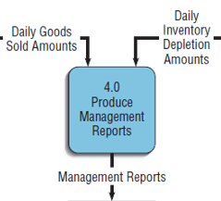
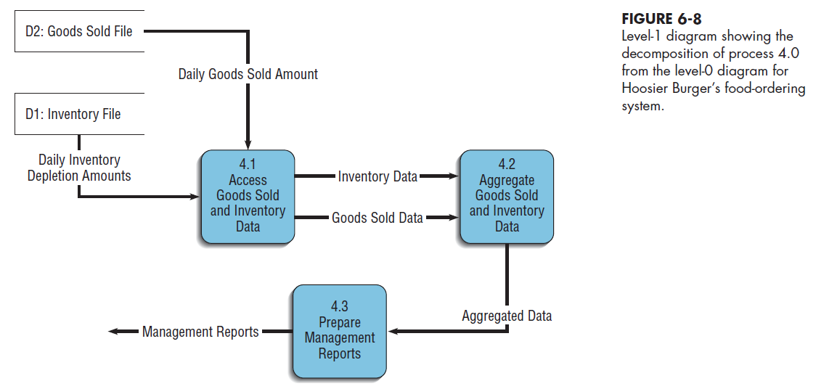
Processes 2.0 and 3.0 perform similar functions in that they both use data input to update data stores. Because updating a data store is a singular logical function, neither of these processes needs to be decomposed further.
Process 4.0, Produce Management Reports, can be decomposed into at least three subprocesses:
(1) Access Goods Sold and Inventory Data,
(2) Aggregate Goods Sold and Inventory Data
(3) Prepare Management Reports.
The decomposition of Process 4.0 is shown in the level-1 diagram of Figure 6-8.
Each level-1, -2, or -n DFD represents one process on a level-(n-1) DFD;
Each DFD should be on a separate page.
No DFD should have more than seven processes in it (too crowded and difficult to understand)

Slide 50
Level- 2 DFDs : Decomposition of level-1 DFDs for Hoosier Burger’s food-ordering system
we examine each of the subprocesses identified in the two level-1 diagrams, one for Process 1.0 and one for Process 4.0.
For example, if we decided to further decompose Process 4.3 in Figure 6-8, we would create a diagram that looks something like Figure 6-9 (level-2 DFD).

Slide 51
Context DFD
Level-0 DFD

Slide 52
Level-1 DFDs
Level-0 DFD

Slide 53
Level-1 DFD
Level-2 DFD

Slide 54
Balancing DFDs
When you decompose a DFD , You must conserve inputs and outputs to a process at the next level of decomposition.
In other words, Process 1.0, which appears in a level-0 diagram, must have the same inputs and outputs when decomposed into a level-1 diagram. This conservation of inputs and outputs is called balancing.
Example: Hoosier Burger’s food-ordering system
Context Diagram and Level-0 DFD
In the context diagram (Figure 6-4), there is one input to the system, the customer order
Three outputs: Customer receipt, Food order, Management reports
In the level-0 diagram (Figure 6-5). We have the same inputs and outputs
No new inputs or outputs have been introduced
We can say that the context diagram and level-0 DFD are balanced
Level-0 DFD and Level-1 DFD
Now look at Figure 6-7, where Process 1.0 from the level-0 DFD has been decomposed. Process 1.0 has one input and four outputs.
The single input and multiple outputs all appear on the level-1 diagram in Figure 6-7.
No new inputs or outputs have been added.
Compare Process 4.0 in Figure 6-5 to its decomposition in Figure 6-8. You see the same conservation of inputs and outputs.

Slide 55
What happened in this example?
Perhaps when drawing the level-0 DFD, the analyst realized that the system also needed C in order to compute B. A and C were both drawn in the level-0 DFD, but the analyst forgot to update the context diagram.
In making corrections, the analyst should also include SOURCE ONE and SOURCE TWO on the context diagram.
We can split a data flow into separate data flows on a lower level diagram. :
A data flow consisting of several sub flows on a level-n diagram can be split apart on a level-n+1 diagram for a process that accepts this composite data flow as input.
For example, consider the partial DFDs from Hoosier Burger illustrated in Figure 6-11.
In Figure 6-11A, we see that the payment and coupon always flow together and are input to the process at the same time.
In Figure 6-11B, the process is decomposed (sometimes called exploded or nested) into two subprocesses, and each subprocess receives one of the components of the composite data flow from the higher-level DFD.
These diagrams are still balanced because exactly the same data are included in each diagram.

Slide 56
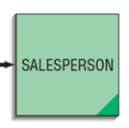
The principle of balancing and the goal of keeping a DFD as simple as possible lead to four additional, advanced, rules for drawing DFDs, summarized in Table 6-3.
Rule Q covers the situation illustrated in Figure 6-11(split).
Rule R covers a conservation principle about process inputs and outputs.
Rule S addresses one exception to balancing.
Rule T tells you how you can minimize clutter on a DFD.

Slide 57
Guidelines for Drawing DFDs
1- Completeness
The concept of DFD completeness refers to whether your DFDs include all of the components necessary for the system you are modeling.
If your DFD contains data flows that do not lead anywhere, or data stores, processes, or external entities that are not connected to anything else, your DFD is not complete.
Most CASE tools have built-in facilities to help find incompleteness in your DFDs.
When you draw many DFDs for a system, it is not uncommon to make errors; either CASE-tool analysis functions or walkthroughs with other analysts can help you identify such problems.
Each of the components must be fully described in the project dictionary.
A data-flow repository entry includes:
The label or name for the data flow as entered on DFDs
A short description defining the data flow
A list of other repository objects grouped into categories by type of object
The composition or list of data elements contained in the data flow
Notes supplementing the limited space for the description that go beyond defining the data flow to explaining the context and nature of this repository object
A list of locations (the names of the DFDs) on which this data flow appears and the names of the sources and destinations for the data flow on each of these DFDs

Slide 58
2 - Consistency
The concept of DFD consistency refers to whether the depiction of the system shown at one level of a DFD is compatible with the depictions of the system shown at other levels.
A gross violation of consistency would be a level-1 diagram with no level-0 diagram.
Another example of inconsistency would be a data flow that appears on a higher-level DFD but not on lower levels (a violation of balancing).
another example is a data flow attached to one object on a lower-level diagram but attached to another object at a higher level. For example, a data flow named Payment, which serves as input to Process 1 on a level-0 DFD, appears as input to Process 2.1 on a level-1 diagram for Process 2.
You can use the analysis facilities of CASE tools to detect such inconsistencies across nested (or decomposed) data-flow diagrams.
For example, to avoid making DFD consistency errors when you draw a DFD using a CASE tool, most tools will automatically place the inflows and outflows of a process on the DFD you create when you inform the tool to decompose that process.
In manipulating the lower-level diagram, you could accidentally delete or change a data flow, which would cause the diagrams to be out of balance; thus, a consistency check facility with a CASE tool is quite helpful.

Slide 59
3 - Timing
A given DFD provides no indication of whether a data flow occurs constantly in real time, once per week, or once per year. No indication of when a system would run is given either.
For example, many large transaction-based systems may run several large, computing-intensive jobs in batch mode at night, when demands on the computer system are lighter. A DFD has no way of indicating such overnight batch processing.
When you draw DFDs, then, draw them as if the system you are modeling has never started and will never stop.
4 - Iterative Development
The first DFD you draw will rarely perfectly capture the system you are modeling.
You should count on drawing the same diagram over and over again, in an iterative fashion.
With each attempt, you will come closer to a good approximation of the system or aspect of the system you are modeling.
Iterative DFD development recognizes that requirements determination and requirements structuring are interacting, not sequential, subphases of the analysis phase of the SDLC.
One rule of thumb is that it should take you about three revisions for each DFD you draw.
CASE tools make revising drawings easier

Slide 60
5 - Primitive DFDs
Lowest logical level of decomposition
Decision has to be made when to stop decomposition
Rules for when to stop decomposing are:
When you have reduced each process to a single decision or calculation or to a single database operation, such as retrieve, update, create, delete, or read
When each data store represents data about a single entity, such as a customer, employee, product, or order
When the system user does not care to see any more detail, or when you and other analysts have documented sufficient detail to do subsequent systems development tasks
When every data flow does not need to be split further to show that different data are handled in various ways
When you believe that you have shown each business form or transaction, computer online display, and report as a single data flow (e.g., often means that each system display and report title corresponds to the name of an individual data flow)
When you believe a separate process is shown for each choice on all lowest-level menu options

Slide 61
By the time you stop decomposing DFDs, a DFD can become quite detailed.
Seemingly simple actions, such as generating an invoice, may pull information from several entities and may also return different results depending on the specific situation.
For example, the final form of an invoice may be based on the type of customer (which would determine such things as discount rate), where the customer lives (which would determine such things as sales tax), and how the goods are shipped (which would determine such things as the shipping and handling charges).
At the lowest-level DFD, called a primitive DFD, all of these conditions would have to be met.
Given the amount of detail required in a primitive DFD, perhaps you can see why many experts believe analysts should not spend their time diagramming the current physical information system completely: much of the detail will be discarded when the current logical DFD is created.

Slide 62
Using DFDs as Analysis Tools
DFDs can be used for a process called gap analysis.
Gap analysis
The process of discovering discrepancies between two or more sets of data-flow diagrams or discrepancies within a single DFD.
Discrepancies : an illogical or surprising lack of compatibility or similarity between two or more facts.
DFDs allow to identify redundancies and inefficiencies.
Comparing a set of DFDs that models the current logical system to DFDs that model the new logical system can better determine which processes systems developers need to add or revise while building the new system.
Processes for which inputs, outputs, and internal steps have not changed can possibly be reused in the construction of the new system.
The logical DFDs for the new system can also serve as the basis for developing alternative design strategies for the new physical system. As we saw with the Hoosier Burger example, a process on a new logical DFD can be implemented in several different physical ways.

Slide 63
Redundancies:
Examine the details of individual DFDs for such problems as redundant data flows, data that are captured but not used by the system, and data that are updated identically in more than one location.
Redundant data flows may have been labeled with different names
Many CASE tools can generate a report listing all the processes that accept a given data element as input.
From the label of these processes, you can determine whether the data are captured redundantly or if more than one process is maintaining the same data stores.
In such cases, the DFDs may accurately mirror the activities occurring in the organization.
As the business processes being modeled took many years to develop, with participants in one part of the organization sometimes adapting procedures in isolation from other participants, redundancies and overlapping responsibilities may well have resulted.

Slide 64
Inefficiencies:
Some inefficiencies relate to violations of DFD drawing rules.
Consider rule R from Table 6-3: The inputs to a process must be sufficient to produce the outputs from the process. A violation of rule R could occur because obsolete data are captured but never used within a system.
Other inefficiencies are due to excessive processing steps.
Consider the correct DFD in rule M of Figure 6-6: Although this flow is mechanically correct, such a loop may indicate potential delays in processing data or unnecessary approval operations.

Slide 65
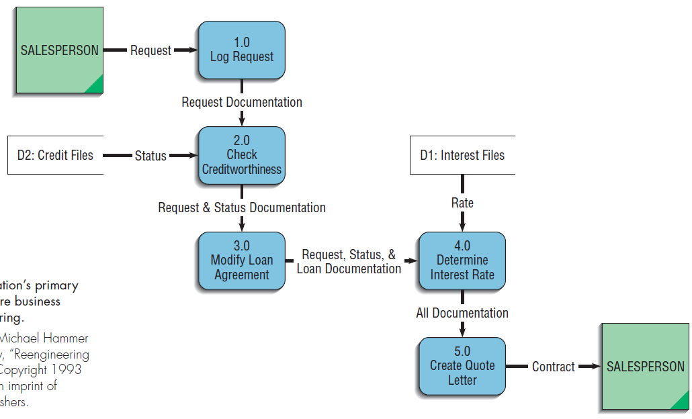
Using DFDs in Business Process Reengineering
The credit approval process steps
Step 1: the salesperson call was taken by one of six people sitting around a conference table. They logged it and wrote the details on a piece of paper.
A clerk then carried the paper to a second person, who enters the data into a computer system and checks the client’s creditworthiness.
Step 2 : This person wrote the details on a piece of paper and carried the paper, along with the original documentation, to a loan officer.
Step 3 : the loan officer modified the standard IBM loan agreement for the customer (another computer).
Step 4: Details of the modified loan agreement, along with the other documentation, were then sent on to the next station in the process, where a different clerk determined the appropriate interest rate for the loan.
Step 5: the interest rate from step 4 and all of the paper generated up to this point were then used to create the quote letter.
Once complete, the quote letter was sent via overnight mail back to the salesperson.

Slide 66
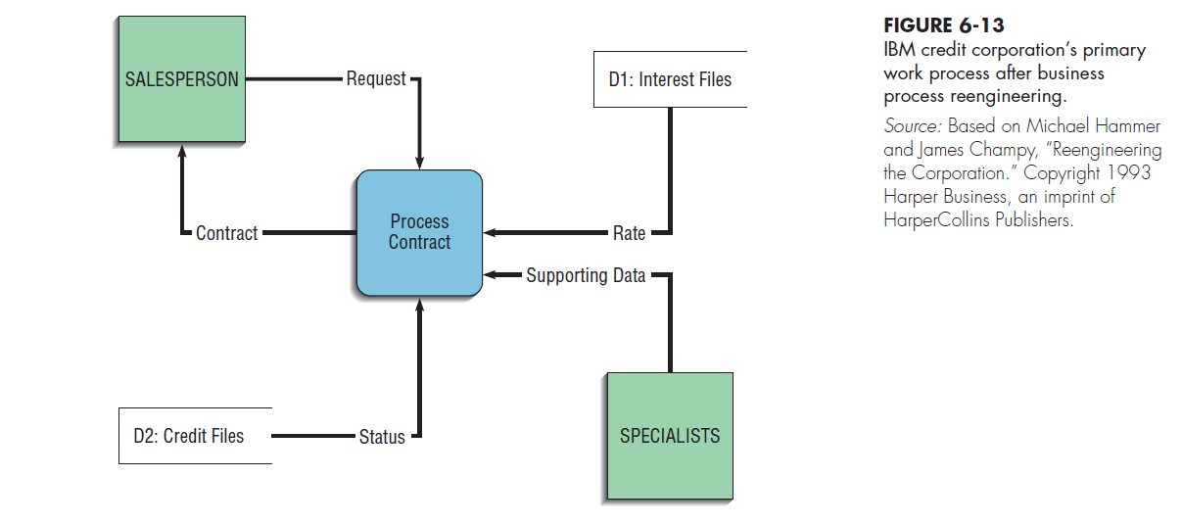
The most striking differences between the DFDs in Figures 6-12 and 6-13 :
the number of process boxes in each one,
the lack of documentation flow in Figure 6-13.
The resulting process is much simpler and cuts down dramatically on any chance of documentation getting lost between steps.
BPR allowed IBM Credit Corporation to handle a hundred times more work in the same amount of time and with fewer people!

Slide 67
Modeling Logic with Decision Tables
4 - Logic Modeling
Decision table
A common method for modeling system logic
Decision tables allow you to represent in a tabular format a set of conditions and the actions that follow from them. When several conditions and several possible actions can occur, decision tables help you keep track of the possibilities in a clear and concise manner.
It is a diagram of process logic where the logic is reasonably complicated. All of the possible choices and the conditions the choices depend on are represented in tabular form
A matrix representation of the logic of a decision, which specifies the possible conditions for the decision and the resulting actions.
The three parts to the table include the condition stubs, the action stubs, and the rules.

Slide 68
Condition stubs
That part of a decision table that lists the conditions relevant to the decision.
The condition stubs contain the various conditions that apply in the situation the table is modeling.
Indifferent Condition : Condition whose value does not affect which action is taken for two or more rules
In Figure 6-14, two condition stubs correspond to employee type and hours worked. Employee type has two values: “S,” which stands for salaried, and “H,” which stands for hourly.
Hours worked has three values: less than 40, exactly 40, and more than 40.
Action stubs
That part of a decision table that lists the actions that result for a given set of conditions.
contain all the possible courses of action that result from combining values of the condition stubs.
4 possible courses of action are indicated in this table: pay base salary, calculate hourly wage, calculate overtime, and produce Absence Report.
You can see that not all actions are triggered by all combinations of conditions.
Instead, specific combinations trigger specific actions.
Rules
That part of a decision table that specifies which actions are to be followed for a given set of conditions.
It links conditions to actions

Slide 69
Employee type is “S,” or salaried, and hours worked are less than 40. When both of these conditions occur, the payroll system is to pay the base salary.
In the next column, the values are “H” and “<40,” meaning an hourly worker who worked fewer than 40 hours. In such a situation, the payroll system calculates the hourly wage and makes an entry in the Absence Report.
Rule 3 addresses the situation when a salaried employee works exactly 40 hours. The system pays the base salary, as was the case for rule 1.
For an hourly worker who has worked exactly 40 hours, rule 4 calculates the hourly wage.
Rule 5 pays the base salary for salaried employees who work more than 40 hours. Rule 5 has the same action as rules 1 and 3 and governs behavior with regard to salaried employees.
Rule 6 calculates hourly pay and overtime for an hourly worker who has worked more than 40 hours.
Rules 1&3&5 Are condensed:
The number of hours worked does not affect the outcome for rules 1, 3, or 5. For these rules, hours worked is an indifferent condition, in that its value does not affect the action taken.
we can reduce the number of rules by condensing rules 1, 3, and 5 into one rule
The indifferent condition is represented with a dash.

Slide 70
Standard Procedures for Creating Decision Tables :
1. Name the conditions and the values each condition can assume. Determine all of the conditions that are relevant to your problem, and then determine all of the values each condition can take. For some conditions, the values will be simply “yes” or “no” (called a limited entry). For others, such as the conditions in Figures 6-14 and 6-15, the conditions may have more values (called an extended entry).
2. Name all possible actions that can occur. The purpose of creating decision tables is to determine the proper course of action given a particular set of conditions.
3. List all possible rules. Every possible combination of conditions must be represented. It may turn out that some of the resulting rules are redundant or make no sense, but these determinations should be made only after you have listed every rule so that no possibility is overlooked.
To determine the number of rules, multiply the number of values for each condition by the number of values for every other condition (2*3=6) .
Notice how we alternated the values of hours worked in Figure 6-14. We repeated “<40” for both values of type of employee, “S” and “H.” Then we repeated “40,” and then “>40.”
4. Define the actions for each rule. If an action doesn’t make sense, you may create an impossible” row in the action stubs in the table to keep track of impossible actions. If you can’t tell what the system ought to do in that situation, place question marks in the action stub spaces for that particular rule.
5. Simplify the decision table. Remove any rules with impossible actions. Consult users on the rules where system actions aren’t clear, and either decide on an action or remove the rule. Look for patterns in the rules, especially for indifferent conditions.

Slide 71
Process Modeling for Pine Valley Furniture’s WebStore
After completing the JAD session, senior systems analyst went to work on translating the WebStore system structure into a data-flow diagram.
His first step was to identify the level-0—major system—processes.
To begin, he carefully examined the outcomes of the JAD session that focused on defining the system structure of the WebStore. From this analysis, he identified six high level processes that would become the foundation of the level-0 DFD.
Next, He determined that it would be most efficient if the WebStore system exchanged information with existing PVF systems rather than capturing and storing redundant information. (the Purchasing Fulfillment System—a system for tracking orders (discussed in Chapter 3)—and the Customer Tracking System (discussed in Chapter 4).
These two existing systems will be “sources” (providers) and “sinks” (receivers) of information for the WebStore system.
When a customer opens an account, his or her information will be passed from the WebStore system to the Customer Tracking System.
When an order is placed (or when a customer requests status information on a prior order), information will be stored in and retrieved from the Purchasing Fulfillment System.
The system would need to access two additional data sources.
First, in order to produce an online product catalog, the system would need to access the inventory database.
Second, to store the items a customer wants to purchase in the WebStore’s shopping cart, a temporary database would need to be created.

Slide 72
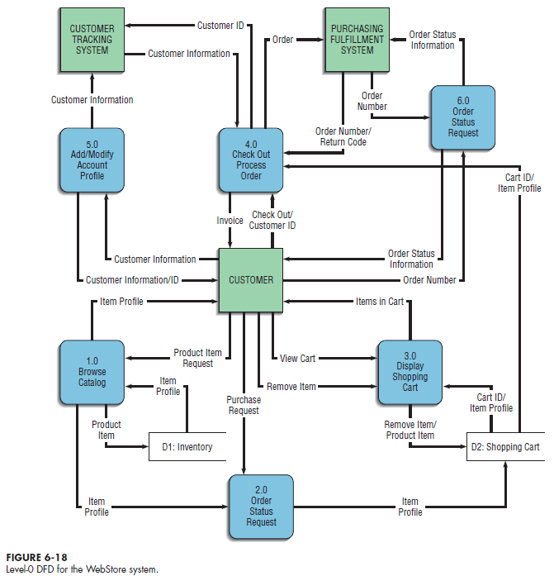
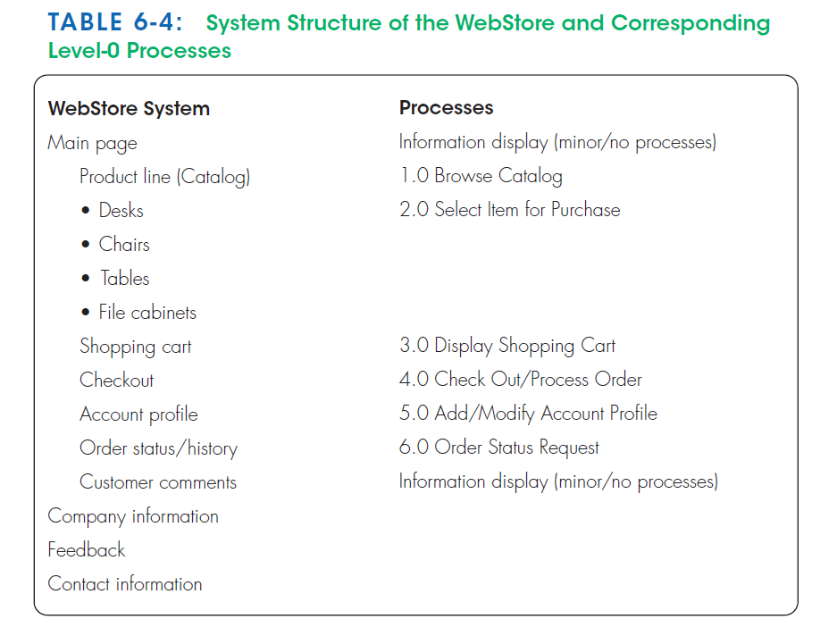

Slide 73
Thank you for your attention
Any Questions
???

