Slide 1
HYBRID SYSTEMS renewable energy resources and environment (itec 211)
Aro-Gordon Opeoluwa 128344
Ikoli Tari 128429

Slide 2
Overview
A look at Hybrids
Photovoltaic systems
Wind energy systems
Hybrid (PV+Wind)
The Future?

Slide 3
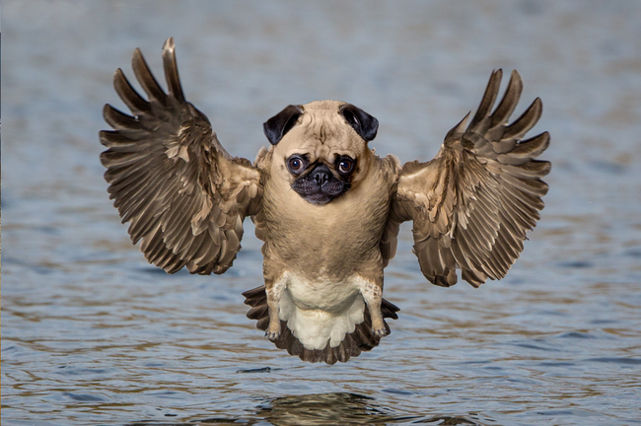
HyBRID?
Combination of two or more elements or units to form a single product.
Hybrid animals, food plants, computers.
Hybrid electrical systems.
Hybrid cars

Slide 4
Hybrid renewable energy system (hres)
They are stand-alone power systems
A hybrid energy system, or hybrid power, usually consists of two or more renewable energy sources used together
Capable of providing electricity in remote areas due to advances in renewable energy technologies and subsequent rise in prices and scarcity of petroleum products.

Slide 5
Hybrid renewable energy system (hres)
Able to provide increased system efficiency as well as greater balance in energy supply
Possible combinations such as Biomass-Wind-fuel cell, PV -Wind systems, Completely Renewable Hybrid Power Plant (solar, wind, biomass, hydrogen)
Hybrid Renewable Energy is guaranteed clean and safe source of energy.

Slide 6
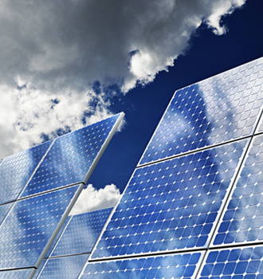
Photovoltaic Systems
Use of Sun rays to produce electrical energy
Electrons from the sun are trapped
100 percent clean
No need for turbines

Slide 7
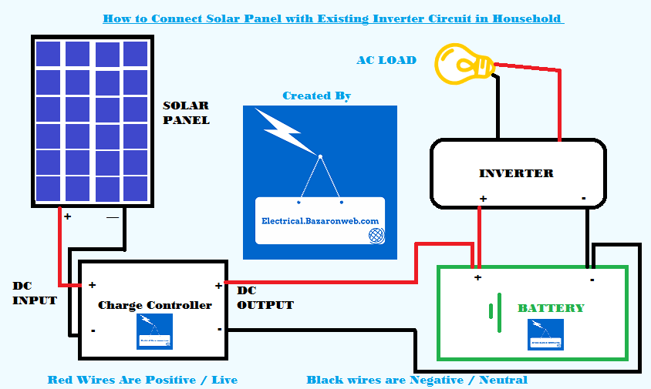
Photovoltaic Systems

Slide 8
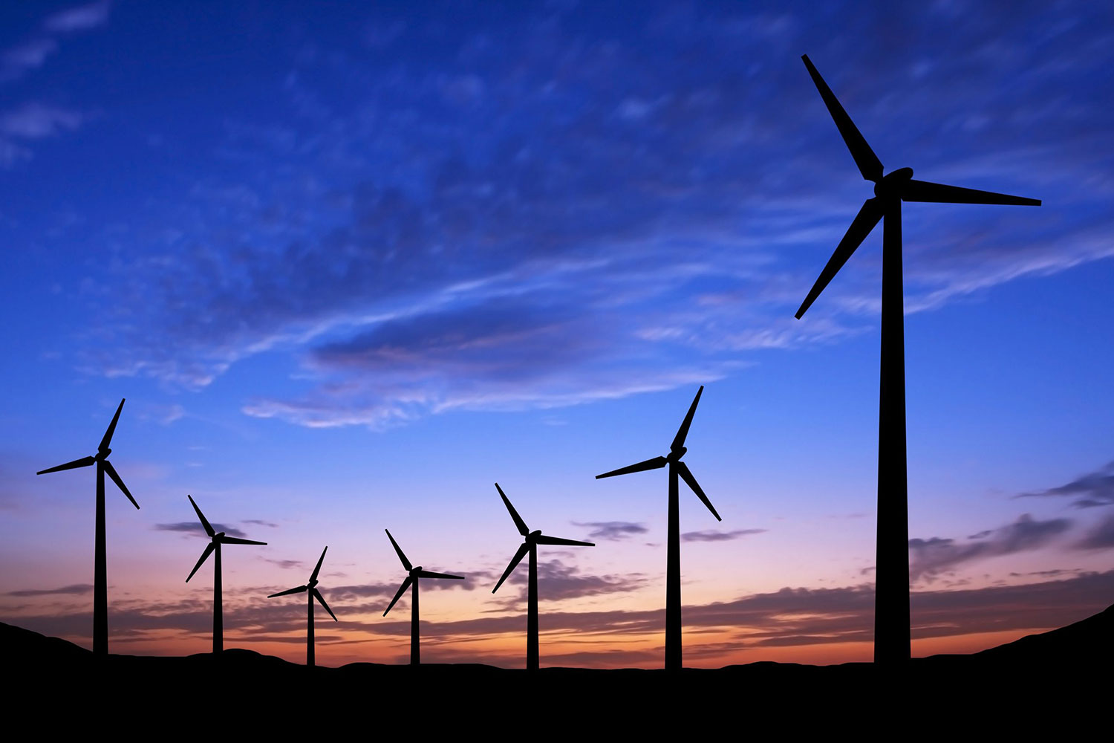
WIND energy SYSTEMS
Conversion of mechanical energy into electrical energy
Force from wind speed spins turbines
Speed incrementing gears are used to speed up turbines
Contributes about 3% of the worlds electricity supply

Slide 10
Wind systems

Slide 11
HYBRID SYSTEM (PV + WIND)
Consists of PV and Wind Systems
Renewable form of energy
Use of control and switching systems is highly required for efficiency
Using sustainable and free energy (wind and sun) which is good for the environment and helps promote energy independence
Average lifespan of 20 years

Slide 12
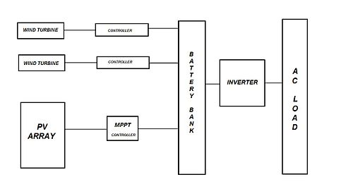
Pv + Wind Hybrid system

Slide 13
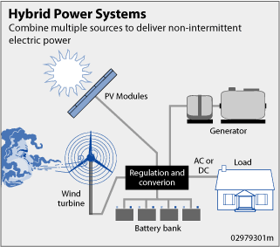

Slide 14
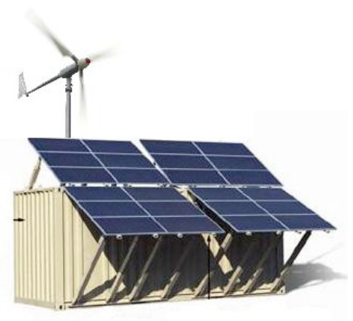
drawbacks
High initial costs (crystalline silicon, power inverters and batteries)
Sunlight is not available at night or cloudy days
wind turbines require regular maintenance to inspect the blades.

Slide 15
drawbacks
Complicated control systems and reliable switching devices are needed.
Energy is wasted when storage batteries are full
Maintaining voltage and frequency levels is not so easy
Excess or little wind damages wind turbine

Slide 16
How to overcome drawbacks
Combination of sources partially or completely prevents drawback
Usage of glass lenses or mirrors to spin turbines
Selling excess power created back to the power grid to cover maintenance costs

Slide 17
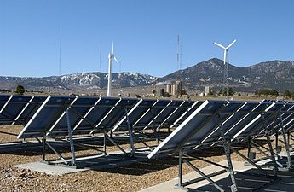
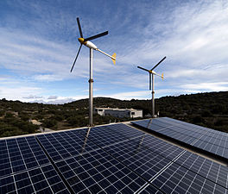
Typical wind and solar hybrid system
Hybrid on Žirje, Croatia

Slide 18
Areas of research
Improving the overall performance of the system
Establishing techniques to accurately predict their output
Reliably integrating the system with other conventional sources
Improving power storage equipment (Batteries)

Slide 19
The future?
Investments could reduce carbon emission by 12.3 billion tons of carbon pollutants.
Create over 600,000 jobs
Save 108 billion dollars in healthcare costs and economic damages
About 56% of the population of the world could become grid independent by 2020

Slide 20
Thank you any questions?

