Slide 1
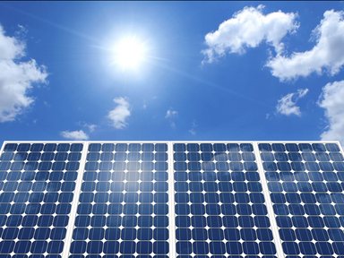
PHOTOVOLTAIC ENERGY
PHOTOVOLTAIC
ENERGY
PHOTOVOLTAIC ENERGY
Okan GÜVERCİN
Mahmut YALÇIN

Slide 3
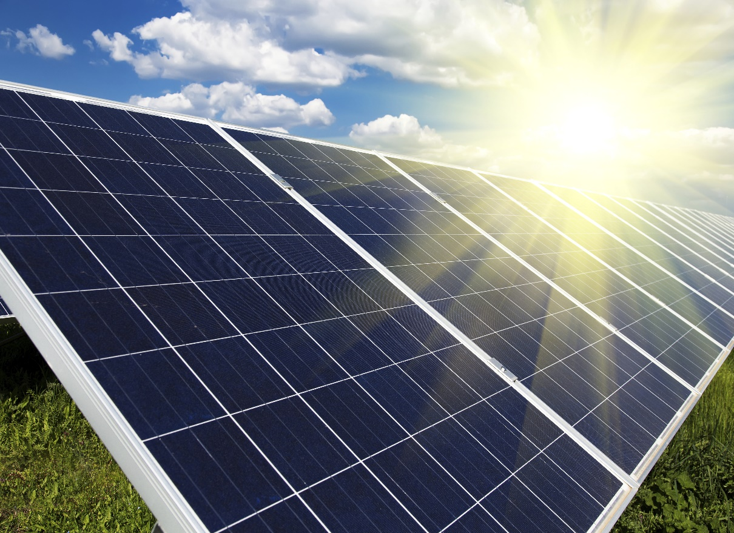
The sun as the brightest star in the Space’s solar system does not only give us light, but is also a valuable source of heat energy. Without the sun, many living organisms would not exist. However, it also create some problems for us. For example, extreme heat is undesirable as it may cause a sudden increase in bodily temperature.
SOLAR POWER

Slide 4
How much solar energy?
The surface receives about 47% of the total solar energy that reaches the Earth. Only this amount is usable.

Slide 5
What is Solar PV?
• Solar electricity systems capture the sun's energy using photovoltaic (PV) cells.
• The cells convert the sunlight into electricity, which can be used to run household appliances and lighting.
• PV cells don't need direct sunlight to work - you can still generate some electricity on a cloudy day

Slide 6
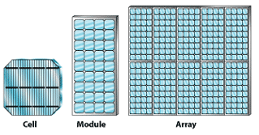

Slide 7
SOLAR CELL:- It is basically a bulk silicon cell where the bulk material is the p-type silicon. A thin layer of n-type silicon is formed at the top surface. There is anti-reflective coating, textured rear surface.
SOLAR PV MODULE:-It is the basic building block of a PV system. It is the interconnection of a number of cells and all these cells should have the same characteristics. Partial shadowing may damage the module.
SOLAR PV PANEL:-Several solar modules are connected in series/parallel to increase the voltage/current ratings. Solar panel is a group of several modules connected in series parallel combination in a frame that can be mounted on a structure. The combination of such panels are called as an SOLAR ARRAY.

Slide 8
Structure of a Solar Cell
A typical solar cell is a multi-layered unit consisting of a:
Cover - a clear glass or plastic layer that provides outer protection from the elements. Transparent Adhesive - holds the glass to the rest of the solar cell.
Anti-reflective Coating - this substance is designed to prevent the light that strikes the cell from bouncing off so that the maximum energy is absorbed into the cell.
Front Contact - transmits the electric current.
N-Type Semiconductor Layer - This is a thin layer of silicon which has been mixed (process called doping) with phosphorous.
P-Type Semiconductor Layer - This is a thin layer of silicon which has been mixed or doped with boron.
Back Contact - transmits the electric current.

Slide 10
Working of A solar cell
Photoelectric effect
When a light of certain frequency falls on the surface of a metal
Electrons will absorb the energy
If incident light energy is greater than the work function(minimum energy required to remove the loosely bound valence electrons)of the metal
Then the photo electrons will be emitted and
The excess energy is converted to the kinetic energy of electron.

Slide 11
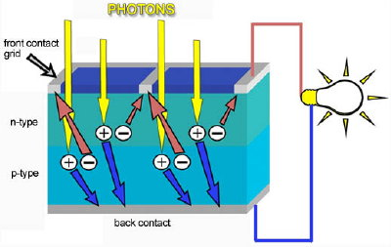
When solar panels are placed in the sunlight , photons will strike the surface and emits electrons.
As a result electron hole pair is created in the solar cell.
When external circuit is connected to the solar cell , electrons flow in the circuit and the current is generated.

Slide 12
Comparison of Types of solar cell
Material | Efficiency (%)
Monocrystalline silicon (It is the Most Efficient Solar Panel Type) | 14-17
Polycrystalline silicon | 13-15
Amorphous silicon | 5-7

Slide 13
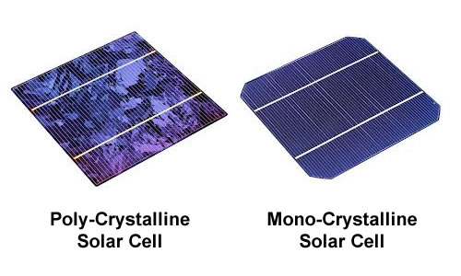
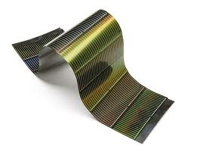
Amorphous Silicon

Slide 14
Energy Losses and Efficiency:-The Conversion efficiencies of commercially produced single crystal cells are in the range of 12-15%. Various loss mechanisms lead to limit the conversion efficiency.
Maximizing the performances:-Maximum values of open circuit voltage and short-circuit current, low series resistance and high shunt resistance will lead to high fill factor.
Cell Sizes:- Size of the cell affects the performance of the cell. So as per current industry standards cells are of various types:- round single crystalline, square single crystalline, square multicrystalline.

Slide 16
Using present solar techniques some of the solar energy reaching the earth is utilized for generating heat, electricity Even then the energy demand met by using solar energy is very less

Slide 17
Advantages of Solar PV System
It converts solar energy directly into electrical energy without going through thermal-mechanical link. It has no moving parts.
Solar PV systems are reliable , modular , durable and generally maintenance free.
These Systems are quiet , compatible with almost all environments, expected life span of 20 years or more.
It can be located at the place of use and hence no distribution network is required.

Slide 18
Disadvantages of Solar PV System
At present the costs of solar cells are high, making them economically uncompetitive with other conventional power sources.
The efficiency of solar cells are low.
Large no. of solar cell modules are required to generate power.
As solar energy is intermittent, some kind of electrical energy storage is required, which makes the whole system more expensive.

Slide 20
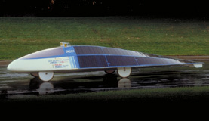
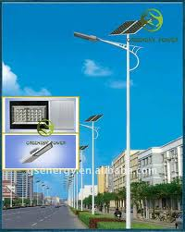
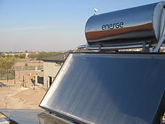
Some Applications
Solar car
Solar heater
Solar lights

Slide 21
USES OF SOLAR ENERGY
Heaters
Cars
Lights
Satellites
Dryers
Calculators
Commercial use
On an office building , roof areas can be covered with solar panels .
Remote buildings such as schools , communities can make use of solar energy.
In developing countries , this solar panels are very much useful.
Even on the highways , for every five kilometres ,solar telephones are used.

Slide 22
Better ways of usage
Government should take measures and see that solar lights are used as street lights in all the areas.
We can place solar panels in the barren lands instead of keeping it away uselessly.
Building a new home is the best time to design and orient the home to take the advantage of the sun’s rays.

Slide 23
For build a better future!!!
We should use solar energy and renewable
energy sources

