Slide 1
Chapter 6:
Privacy and the
Government

Slide 2
Chapter Overview (1/2)
Introduction
US legislation restricting information collection
Information collection by the government
Covert government surveillance
US legislation authorizing wiretapping
USA PATRIOT Act

Slide 3
Chapter Overview (2/2)
Regulation of public and private databases
Data mining by the government
National identification card
Information dissemination
Invasion

Slide 4
6.1 Introduction

Slide 5
A Balancing Act
Federal, state, and local governments in United States have had significant impact on privacy of individuals
Government must balance competing desires of citizens
  desire to be left alone
  desire for safety and security
National security concerns increased significantly after 9/11 attacks

Slide 6
Solove’s Taxonomy of Privacy different harms that may arise from infringements in privacy
Information collection: Activities that gather personal information
Information processing: Activities that store, manipulate, and use personal information that has been collected
Information dissemination: Activities that spread personal information
Invasion: Activities that intrude upon a person’s daily life, interrupt someone’s solitude, or interfere with decision-making

Slide 7
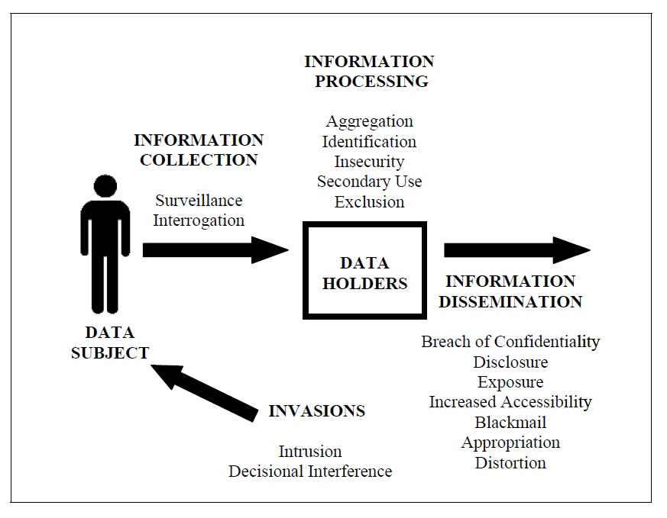
Solove’s Taxonomy of Privacy

Slide 8
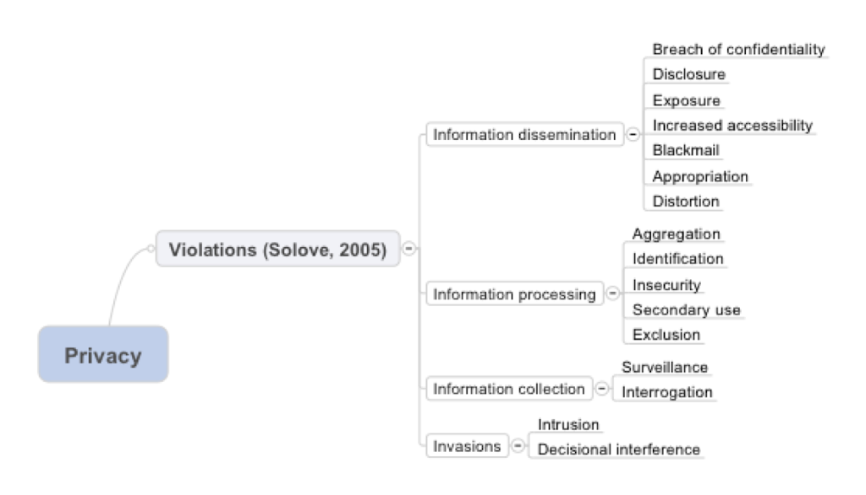
Solove’s Taxonomy of Privacy

Slide 9
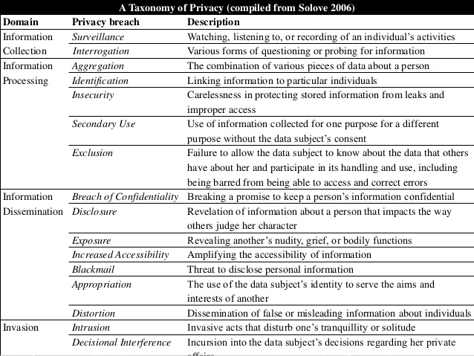

Slide 10
6.2 US Legislation Restricting Information Collection

Slide 11
Employee Polygraph Protection Act
Passed in 1988
Prohibits private employers from using lie detector tests under most conditions
Cannot require test for employment
Exceptions
  Pharmaceutical companies and security firms may give test to certain classes of employees
  Employers who have suffered a theft may administer tests to reasonable suspects
  Federal, state, and local governments exempt

Slide 12

Children’s Online Privacy Protection Act
Reduces amount of public information gathered from children
Online services must gain parental consent before collecting information from children 12 and under

Slide 13
Genetic Information Nondiscrimination Act
Health insurance companies
  Can’t request genetic information
  Can’t use genetic information when making decisions about coverage, rates, etc.
  Doesn’t apply to life insurance, disability insurance, long-term care insurance
Employers
  Can’t take genetic information into account when hiring, firing, promoting, etc.
  Small companies (< 15 employees) are exempt

Slide 14
6.3 Information Collection by the Government

Slide 15
Census Records
Census required to ensure every state has fair representation
Number of questions steadily rising
Sometimes Census Bureau has broken confidentiality requirement
  World War I: draft resistors
  World War II: Japanese-Americans

Slide 16
Japanese-Americans on Way to Internment Camp in 1942
National Archives, file #210-G-3B-414)

Slide 17
Internal Revenue Service Records
The 16th Amendment to the US Constitution gives the federal government the power to collect an income tax
IRS collects more than $2 trillion a year in income taxes
Income tax forms contain a tremendous amount of personal information: income, assets, to whom you make charitable contributions, medical expenses, and more

Slide 18
FBI National Crime Information Center 2000
NCIC
  Collection of databases related to various crimes
  Contains > 39 million records
Successes
  Helps police solve hundreds of thousands of cases every year
  Helped FBI tie James Earl Ray to assassination of Dr. Martin Luther King, Jr.
  Helped FBI apprehend Timothy McVeigh for bombing of federal building in Oklahoma City

Slide 19
Timothy McVeigh
© Bob E.Daemmrich/Sygma/Corbis

Slide 20
OneDOJ Database
central database that allows local law enforcement in the United States to search and read federal criminal cases.
constructed by US Department of Justice
Gives state and local police officers access to information provided by five federal law enforcement agencies
  Incident reports
  Interrogation summaries
  Other information not available through NCIC
Criticisms
  OneDOJ gives local police access to information about people who have not been charged with a crime
  There is no way to correct misinformation in raw police reports

Slide 21
Closed-circuit Television Cameras
First use in Olean, New York in 1968
Now more than 30 million cameras in US
New York City’s effort in lower Manhattan
  $201 million for 3,000 new cameras
  License plate readers
  Radiation detectors
Effectiveness of cameras debated

Slide 22
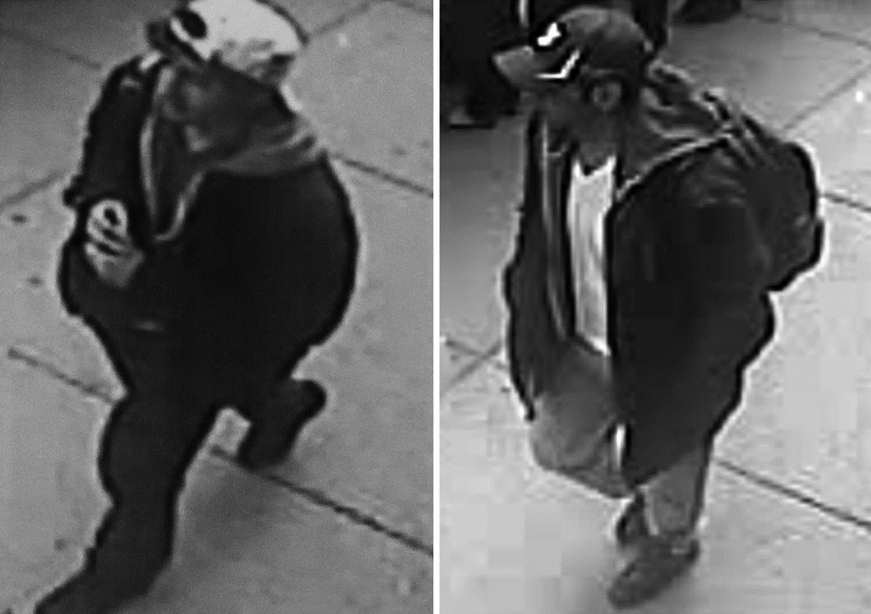
Surveillance Camera Images of Boston Marathon Bombing Suspects

Slide 23
Police Drones
A few police departments in US operate small unmanned drones
FAA puts restrictions on use
Public opinion mixed
  Yes: Search and rescue
  No: Identify speeders
Should police be required to get a search warrant before surveillance of a residence?

Slide 24
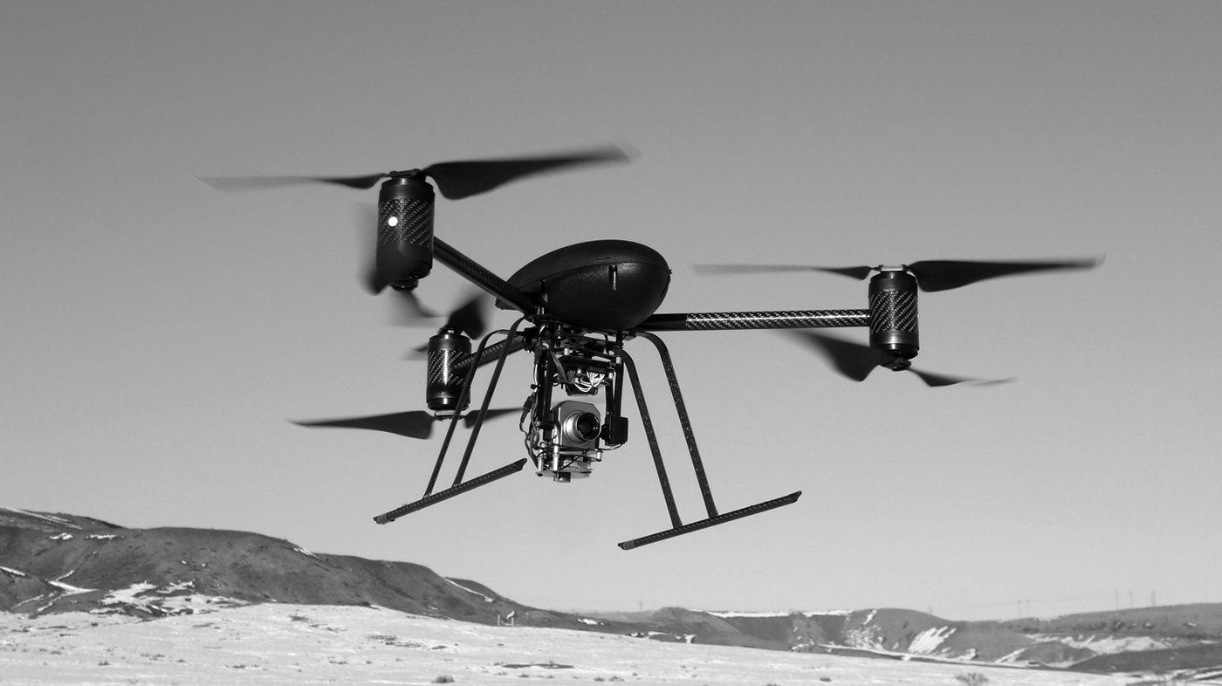
Police Drone Surveillance Platform

Slide 25
6.4 Covert Government Surveillance

Slide 26
4th Amendment to US Constitution
“The right of the people to be secure in their persons, houses, papers, and effects, against unreasonable searches and seizures, shall not be violated, and no Warrants shall issue, but upon probable cause, supported by Oath or affirmation, and particularly describing the place to be searched, and the persons or things to be seized.”

Slide 27
Wiretaps and Bugs
Omstead v. United States ⎯
wiretapping OK
Federal Communications Act ⎯ wiretapping made illegal
Nardone v. United States ⎯
wiretapping not OK
FBI continues secret wiretapping
Katz v. United States ⎯ bugs not OK

Slide 28
J. Edgar Hoover
© Bettmann/CORBIS

Slide 29
Operation Shamrock
Continuation of World War II interception of international telegrams
National Security Agency (1952)
Expanded to telephone calls
Kennedy
  Organized crime figures
  Cuba-related individuals and businesses
Johnson and Nixon
  Vietnam war protesters
Nixon
  War on drugs

Slide 30
Carnivore Surveillance System
Created by FBI in late 1990s
Monitored Internet traffic, including email exchanges
Carnivore = Windows PC + “packet-sniffing” software
Captured packets going to/from a particular IP address
Used about 25 times between 1998 and 2000
Replaced with commercial software

Slide 31
Covert Activities after 9/11
September 11, 2001 attacks on World Trade Center and Pentagon
President Bush authorized new, secret, intelligence-gathering operations inside United States

Slide 32
National Security Administration Wiretapping
President Bush signed presidential order
  OK for NSA to intercept international phone calls & emails initiated by people inside US
  No search warrant required
Number of people monitored
  About 500 people inside US
  Another 5,000-7,000 people outside US
Two al-Qaeda plots foiled
  Plot to take down Brooklyn bridge
  Plot to bomb British pubs and train stations

Slide 33
TALON Database
Created by US Department of Defense in 2003
Supposed to contain reports of suspicious activities or terrorist threats near military bases
Reports submitted by military personnel or civilians
Reports assessed as “credible” or “not credible” by military experts
Reports about anti-war protests added to database
Many of these reports later deleted from database
In 2007 new Under Secretary of Defense for Intelligence recommended that TALON be terminated

Slide 34
6.5 US Legislation Authorizing Wiretapping

Slide 35
Title III
Part of Omnibus Crime Control and Safe Streets Act of 1968
Allows a police agency with a court order to tap a phone for up to 30 days
In 1972 US Supreme Court again rejected warrantless wiretapping, even for national security

Slide 36
Foreign Intelligence Surveillance Act
FISA provides judicial and congressional oversight of covert surveillance of foreign governments and agents
Allows electronic surveillance of foreign nationals for up to one year without a court order
Amended in 2007 to allow government to wiretap communications to/from foreign countries without oversight by FISA Court

Slide 37
PRISM Program
Documents provided by Edward Snowden revealed NSA had obtained access to servers at Microsoft, Yahoo, Google, Facebook, YouTube, Skype, AOL, and Apple
PRISM program enabled NSA to access email messages and monitor live communications of foreigners outside US
All companies contacted by the Guardian denied knowledge of the PRISM program

Slide 38
Electronic Communications Privacy Act
Passed by Congress in 1986
Allows police to attach two kinds of surveillance devices to a suspect’s phone line
  Pen register: displays number being dialed
  Trap-and-trace device: displays caller’s phone number
Court order needed, but prosecutors do not need to show probable cause
Allows police to do roving wiretaps (following suspect from phone to phone)

Slide 39
Stored Communications Act
Part of Electronic Communications Privacy Act
Government does not need a search warrant to obtain from an Internet service provider email messages more than 180 days old
Advent of cloud computing raises new privacy concerns
Digital Due Process organization (nearly 50 companies and privacy rights organizations) lobbying Congress to change law

Slide 40
Communications Assistance for Law Enforcement Act
Passed in 1994
Designed to ensure police can still do wiretapping as digital networks are introduced
FBI asked for new abilities, such as ability to intercept digits typed by caller after phone call placed
Federal Communications Commission included these capabilities in its guidelines to phone companies
Privacy-rights advocates argued that new capabilities went beyond Congress’s intent

Slide 41
6.6 USA PATRIOT Act

Slide 42
USA PATRIOT Act
Provisions
  Greater authority to monitor communications
  Greater powers to regulate banks
  Greater border controls
  New crimes and penalties for terrorist activity
Critics say Act undermines 4th Amendment rights
  Pen registers on Web browsers
  Roving surveillance
  Searches and seizures without warrants
  Warrants issued without need for showing probable cause

Slide 43
National Security Letters
FBI can collect Internet, business, medical, educational, library, and church/mosque/ synagogue records without showing probable cause
Issues a National Security Letter stating the records are related to an ongoing investigation; no approval from judge needed
Gag orders prevent recipients (e.g., libraries) from disclosing receipt
FBI issued 50,000 National Security Letters a year between 2003 and 2006

Slide 44
Tribune Media Services TMS Reprints

Slide 45
Patriot Act Successes
Charges against 361 individuals
  Guilty pleas or convictions for 191 people
  Shoe-bomber Richard Reid
  John Walker Lindh
More than 500 people removed from United States
Terrorist cells broken up in Buffalo, Seattle, Tampa, and Portland (“the Portland Seven”)

Slide 46
Patriot Act Failure
March 11, 2004 bombings in Madrid Spain
FBI makes Brandon Mayfield a suspect
  Claims partial fingerprint match
  Conducts electronic surveillance
  Enters home without revealing search warrant
  Copies documents and computer hard drives
Spanish authorities match fingerprint with an Algerian
  Judge orders Mayfield released
  FBI apologizes
Civil rights groups: Mayfield was targeted for his religious beliefs

Slide 47
Patriot Act Renewal
Nearly all provisions have been made permanent
Four-year sunset clause on two provisions
  Roving wiretaps
  FBI ability to seize records from financial institutions, libraries, doctors, and businesses with approval from secret Foreign Intelligence Surveillance Court

Slide 48
NSA Access to Telephone Records
Edward Snowden leaked documents to the Guardian newspaper
Guardian revealed Foreign Intelligence Surveillance Court had ordered Verizon to provide NSA with all of its telephone metadata for 3-month period in 2013 (date, time, location, and length of call, but not contents of call)
Guardian critique: NSA’s mission now “focuses increasingly on domestic communications”
Obama administration: Court orders for telephone records “are something that have been in place a number of years now”

Slide 49
6.7 Regulation of Public and Private Databases

Slide 50
Genesis of Code of Fair Information Practices
1965: Director of Budget asked committee of economists to look at problems caused by decentralization of statistical data across federal agencies
Committee recommended creation of a National Data Center
Citizens and legislators expressed concerns about possible abuses of such a system
Another group formed to draft guidelines for government databases

Slide 51
Code of Fair Information Practices
No secret databases
People should have access to personal information in databases
Organizations cannot change how information is used without consent
People should be able to correct or amend records
Database owners, users responsible for reliability of data and preventing misuse

Slide 52
Privacy Act of 1974 Falls Short
Applies only to government databases
Only covers records indexed by a personal ID
No federal employee responsible to enforcing Privacy Act provisions
Allows agencies to share records with other agencies

Slide 53
Legislation for Private Institutions
Fair Credit Reporting Act
Fair and Accurate Credit Transactions Act
Financial Services Modernization Act

Slide 54
Fair Credit Reporting Act
Promotes accuracy and privacy of information used by credit bureaus
Major credit bureaus: Equifax, Experian, Trans Union
Negative information kept only 7 years
Exceptions
  Bankruptcies: 10 years
  Criminal convictions: indefinitely

Slide 55
Fair and Accurate Credit
Transactions Act
Passed in 2004
Requires three major credit bureaus to provide consumers a free copy of their credit report every 12 months
Not automatic: consumers must request credit reports
Provisions to reduce identity theft

Slide 56
Financial Services Modernization Act
Also called Gramm-Leach-Bliley Act of 1999
Creates “financial supermarkets” offering banking, insurance, and brokerage services
Privacy-related provisions
  Privacy policies must be disclosed to customers
  Notices must provide an opt-out clause
  Companies must develop procedures to protect customers’ confidential information

Slide 57
6.8 Data Mining by the Government

Slide 58
Definition of Data Mining
Data mining: Process of searching through one or more databases looking for patterns or relationships among the data

Slide 59
IRS Audits
IRS uses computer matching and data mining to look for possible income tax fraud
Computer matching: matching tax form information with information provided by employers, banks, etc.
Data mining: searching through forms to detect those that appear most likely to have errors resulting in underpayment of taxes

Slide 60
Syndromic Surveillance Systems
Syndromic surveillance system: A data mining system that searches for patterns indicating the outbreak of an epidemic or bioterrorism
  911 calls
  emergency room visits
  school absenteeism
  Internet searches
Example: A system in New York City detected an outbreak of a virus in 2002

Slide 61
Telecommunications Records Database
Created by National Security Agency after 9/11
Contains phone call records of tens of millions of Americans
NSA analyzing calling patterns to detect terrorist networks
Phone records voluntarily provided by several major telecommunications companies
USA Today revealed existence of database in May 2006
Several dozen class-action lawsuits filed
August 2006: Federal judge in Detroit ruled program illegal and unconstitutional
July 2007: US Court of Appeals overturned ruling, saying plaintiffs did not have standing to bring suit forward

Slide 62
Predictive Policing
Criminals behave in a predictable way
  Times of crimes fall into patterns
  Some areas have higher incidence of crimes
Predictive policing: use of data mining to deploy police officers to areas where crimes are more likely to occur
Police in Santa Cruz and Los Angeles saw significant declines in property crime

Slide 63
6.9 National Identification Card

Slide 64
Social Security Number
Social Security cards first issued 1936
Originally used only for Social Security purposes
Use of SSN has gradually increased
SSN is a poor identification number
  Not unique
  Rarely checked
  No error-detecting capability

Slide 65
Arguments for National ID Card
Current ID cards are second-rate
Would reduce illegal entry to US
Would prevent illegal aliens from working
Would reduce crime
Other democratic countries have national ID cards

Slide 66
Arguments against National ID Card
No card positively guarantees identification
No biometric-based system is 100% accurate
No evidence it will reduce crime
Makes government data mining simpler
Make law-abiding people more vulnerable to fraud and indiscretions

Slide 67
1. A national identification card would be more reliable than existing forms of identification.
Social Security cards and driver’s licenses are too easy to forge. A modern card could
incorporate a photograph as well as a thumbprint or other biometric data.
2. A national identification card could reduce illegal immigration.
Requiring employers to check a tamper-proof, forgery-proof national identification card would prevent illegal immigrants from working in the United States. If illegal immigrants couldn’t get work, they wouldn’t enter the United States in the first place.
3. A national identification card would reduce crime.
Currently it’s too easy for criminals to mask their true identity. A tamper-proof national identification card would allow police to positively identify the people they apprehend.
4. National identification cards do not undermine democracy.
Many democratic countries already use national ID cards, including Belgium, France, Germany, Greece, Luxembourg, Portugal, and Spain.

Slide 68
The REAL ID Act
Signed in May 2005
Significantly changes driver’s licenses in the United States
New licenses
  Issued by end of 2013
  Required to open bank account, fly on commercial airplane, or receive government service
  Requires applicants to supply 4 different IDs
  Will probably contain a biometric identifier
  Must contain data in machine-readable form
Most states missed 2013 deadline; temporary deferments being granted

Slide 69
Possible Consequences of New Licenses
Better identification means better law enforcement
People won’t be able to change identities
  Parents ducking child support
  Criminals on the run
New, centralized databases could lead to more identity theft

Slide 70
6.10 Information Dissemination

Slide 71
Legislation to restrict information dissemination
  Family Education Rights and Privacy Act
  Video Privacy Protection Act
  Health Insurance Portability and Accountability Act
Examples of information dissemination
  Freedom of Information Act
  Toll booth records used in court

Slide 72
Family Education Rights and Privacy Act (FERPA)
Rights given to
  Students 18 years and older
  Parents of younger students
Rights include
  Reviewing educational records
  Requesting changes to erroneous records
  Preventing release of records without permission

Slide 73
Video Privacy Protection Act
Videotape service providers cannot disclose rental records without consumer’s written consent
Rental stores must destroy personal information related to rentals within a year of when it is no longer needed

Slide 74
Judge Robert Bork
AP Photo/Charles Tasnadi

Slide 75
Health Insurance Portability and Accountability Act
Limits how doctors, hospitals, pharmacies, and insurance companies can use medical information
Health care providers need signed authorization to release information
Health care providers must provide patients with notice describing how they use medical information

Slide 76
Freedom of Information Act
Federal law designed to ensure public has access to US government records
Signed by President Johnson (1966)
Applies only to executive branch
Nine exemptions
  Classified documents
  Trade secrets or financial information
  Documents related to law enforcement investigations

Slide 77
Toll Booth Records
E-ZPass: an automatic toll-collection system used on most toll roads, bridges, and tunnels between Illinois and Maine
Drivers with E-ZPass tags pass through without stopping to pay attendant
Records have been provided in response to court orders in criminal and civil cases

Slide 78
6.11 Invasion

Slide 79
Government actions to prevent invasion
  Do Not Call Registry
  CALM Act
Invasive government actions
  Requiring identification for pseudoephedrine purchases
  Advanced Imaging Technology scanners at airports

Slide 80
National Do Not Call Registry
FTC responded to public opinion
  Created Do Not Call Registry in 2003
  More than 50 million phone numbers registered before it even took affect
Example of how privacy is treated as a prudential right
  Benefit of shielding people from telemarketers judged to be greater than harm caused by limiting telephone advertising

Slide 81
CALM Act
Television watchers have complained to FCC about loud commercials since 1960s
CALM Act signed by President Obama in 2010
Requires FCC to ensure television commercials are played at same volume as programs they are interrupting

Slide 82
Pseudoephedrine Purchases
Pseudoephedrine an ingredient of Sudafed and other cold medications
It is also an ingredient of methamphetamine (“meth”)
Federal and state governments have passed laws limiting access to pseudoephedrine
  Limits quantity that can be purchased in a month
  Identification and signature required for purchase in most states

Slide 83
Advanced Imaging Technology Scanners
Transportation Security Administration began installing AIT scanners in 2007
AIT scanners revealed anatomical features
Electronic Privacy Information Center sued government in 2010, saying systems violated 4th Amendment and various laws
TSA announced it would develop new software that would replace passenger-specific images with generic outlines
All body scanners producing passenger specific images removed in 2013

Slide 84
Advanced Imaging Technology Scanner
© PAUL ELLIS/AFP/Getty Images/Newscom

