Slide 2
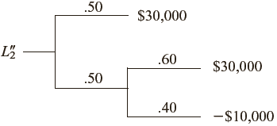

Slide 3
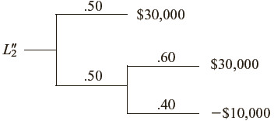

Slide 5
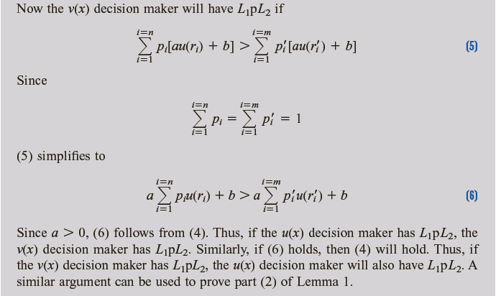

Slide 6
-3400

Slide 7
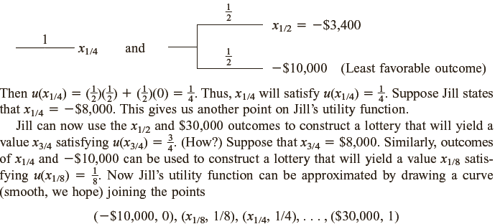

Slide 8
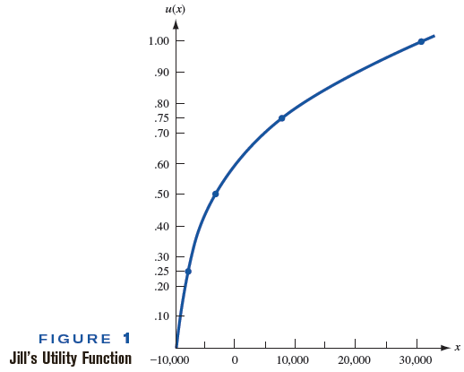
EV(L)
CE(L)
RP(L)=EV(L)-CE(L)>0

Slide 9
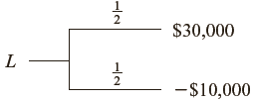

Slide 10
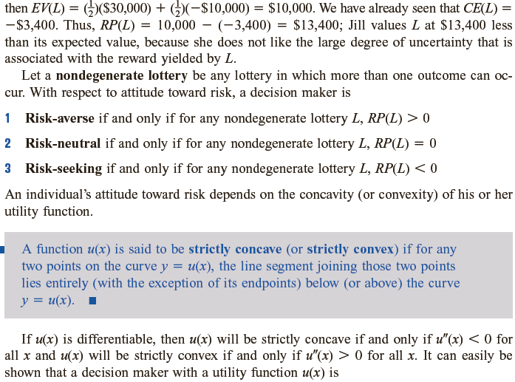

Slide 11
Concave Function
Convex Function
Linear Function
From the above figures it can seen that:
u(x) is a concave if
this means that if you draw a line parallel with y axiom this line first will cut the curve
of u(x) and then the cord between and .
2. u(x) is a convex if
this means that if you draw a line parallel with y axiom this line first will cut the cord
between and then the curve of u(x) .
3. u(x) is a linear function if

Slide 12
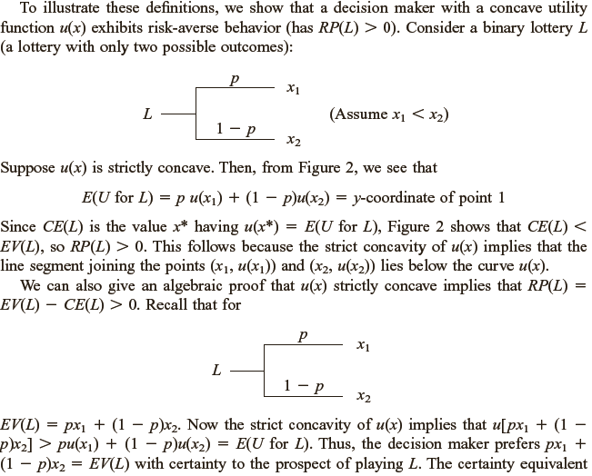

Slide 13
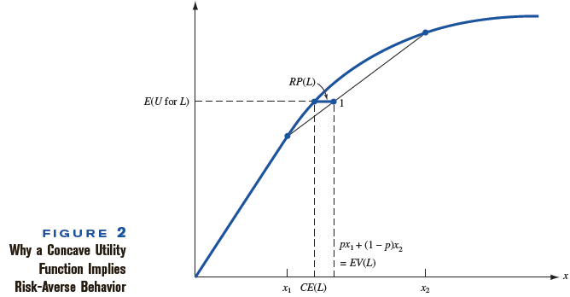

Slide 14
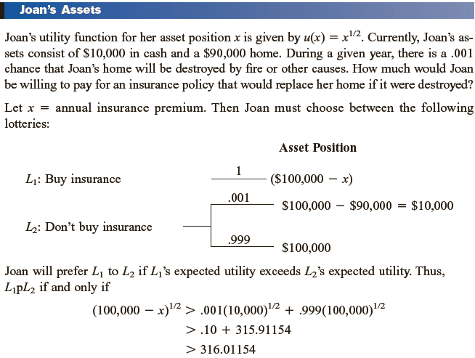

Slide 15
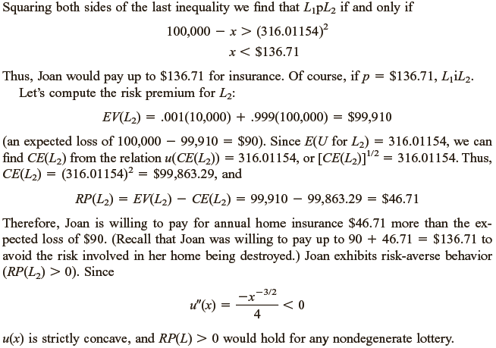

Slide 16
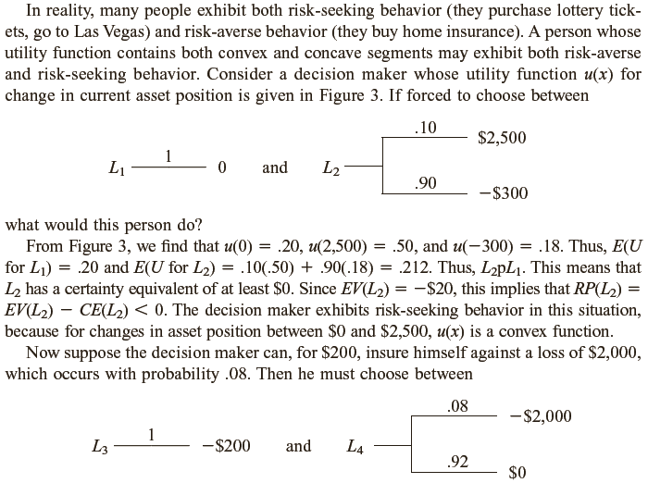

Slide 17
