Slide 1
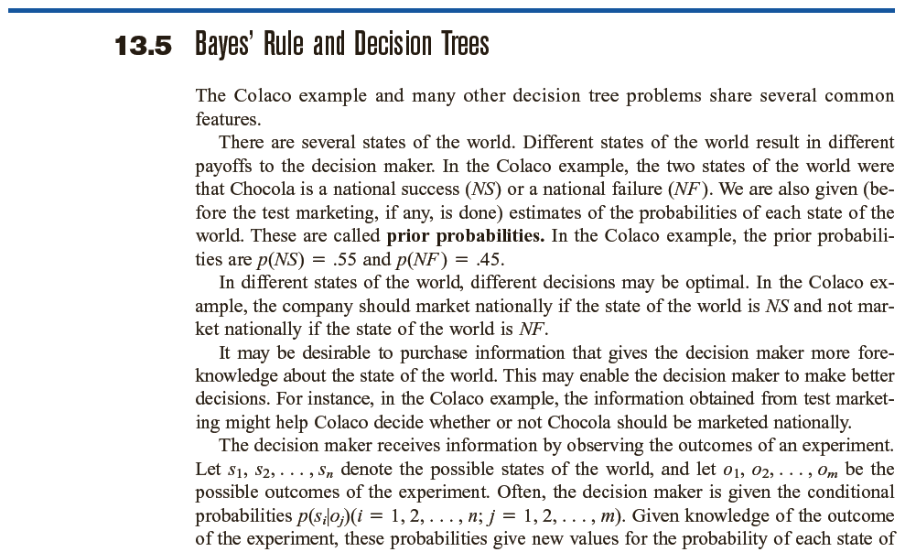

Slide 2
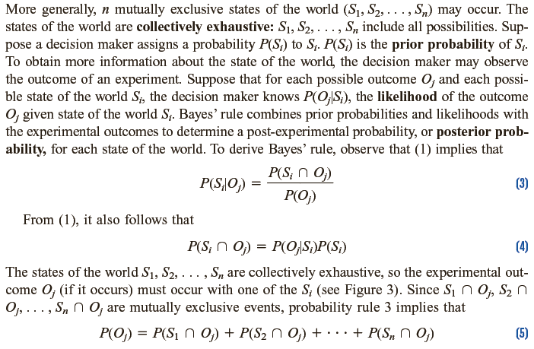

Slide 5
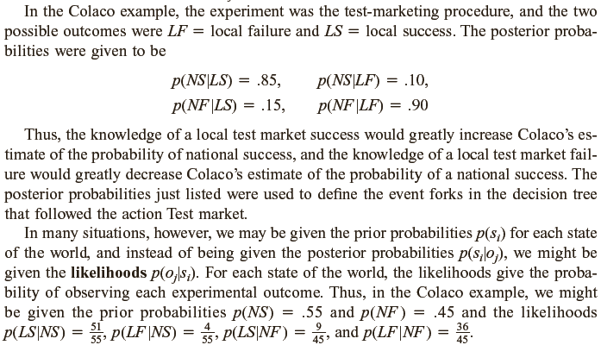
S₁: National Success(NS) |  | S₂:National Failure (NF)
 |  |  | O₁: Local Success (LS)
 |  |  | O₂: Local Failure (LF)

Slide 6
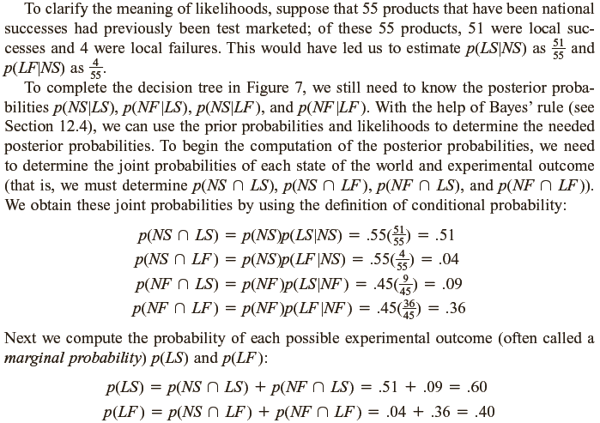

Slide 7
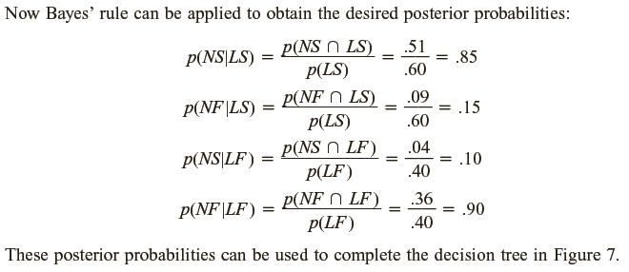
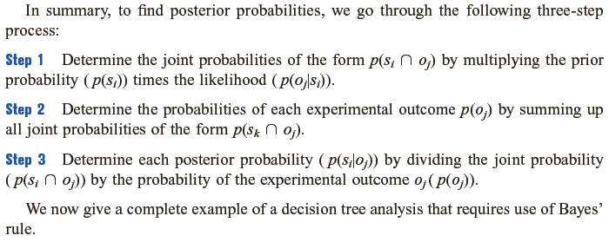

Slide 8
S₁: Batch is Good (G) |  | S₂:Batch is Bad (B)
 |  |  | O₁: Defective (D)
 |  |  | O₂: Non Defective (ND)

Slide 9
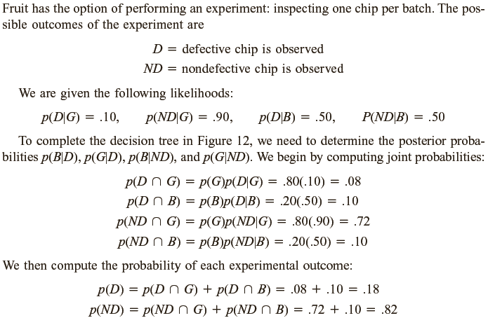
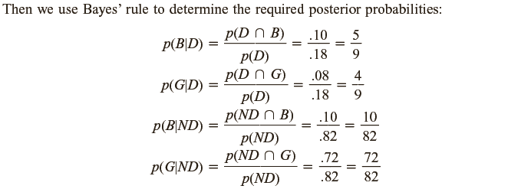

Slide 10
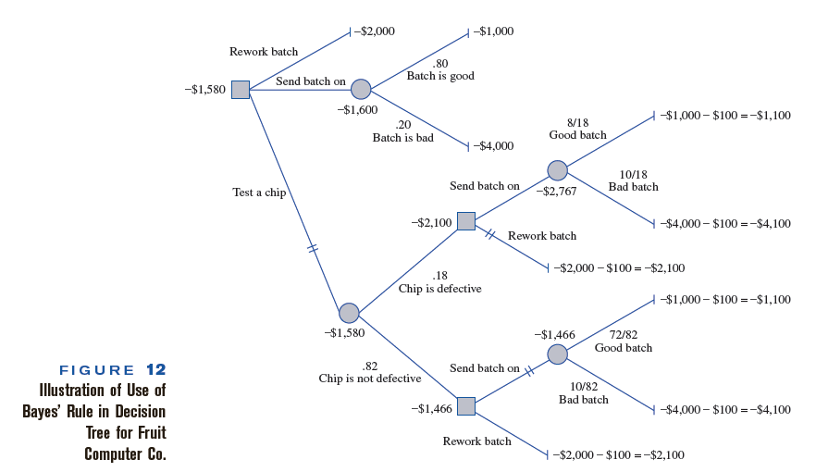
EVWOI=-1600
(With cost -100)
EVWSI=-1580-(-100)=-1480

