Slide 2
where
When α is an integer number say n it can shown that

Slide 3
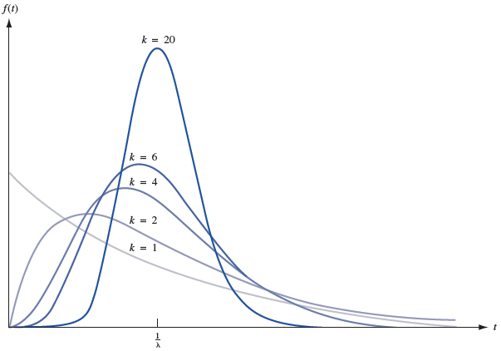
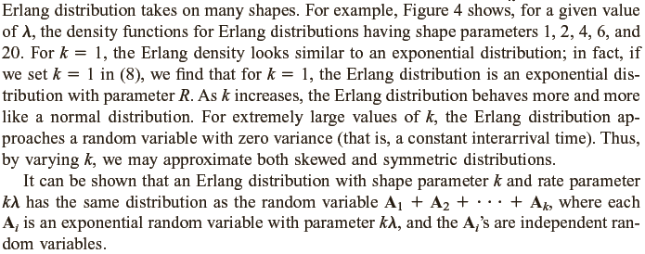

Slide 4
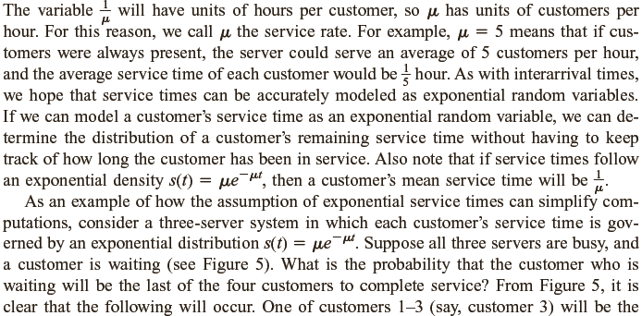

Slide 5
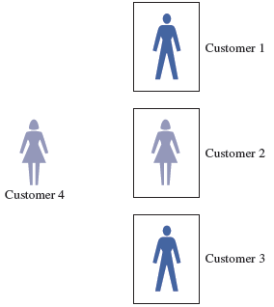

Slide 6
Carwash Example
A carwash consists of two sections: outside washing and inside cleaning. The average service time at each of these parts is 20 minutes. What is the average and variance of waiting time for a car which start to get its service? What is the probability that the waiting time for this car be between 30 and 45 minutes?
We knew that when each part of total service point governs by exponential with mean 20 minutes or hours (parameter λ=3), the total service time will govern by an Erlang distribution with parameters k=2 and µ= 3 . Then

Slide 7
Erlang With parameters k=2 and λ=3
Outside
Inside
Exponential With parameter λ=3
Exponential With parameter λ=3
Integration by part can help us to solve the above integration. Then lets assume that

