Slide 1
Barbershop Example
In a barber there are 5 barbers and the average service time for each is 20 minutes. The average number of customers of this barber is 4 at each hour. Assume that the customers can take their service from each of the barbers.
What is the probability that this barber received exactly 7 customers in next one and half hour?
What is the probability that next customer comes to the barber after 30 minutes?
What is the probability that a customer cut his hair between 15 and 30 minutes?
What is the probability that the number of the customers who cut their hair be more than 3 in 40 minutes?
If a customer wants the first barber cut his hair what is the average waiting time for get service from first barber for this customer?
P{N(1.5)=7}=?
P{A>0.5}=?
P{0.25<T<0.5}=?
P{N(0.667)>3}=?
E(T₁) = ?
1

Slide 3
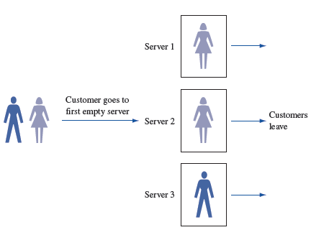
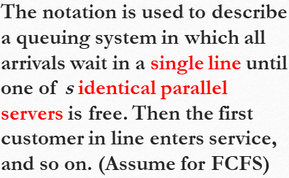

Slide 4
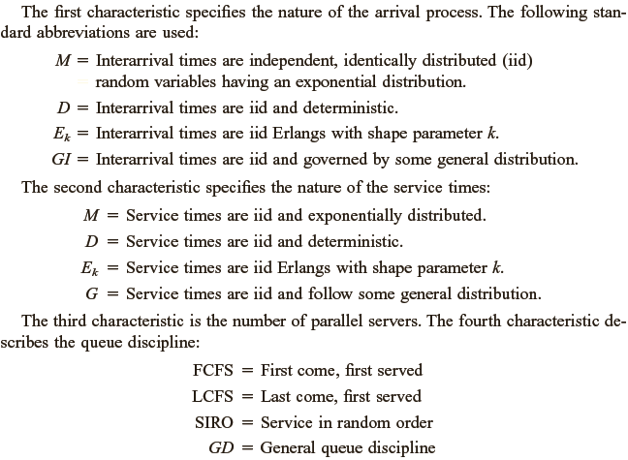

Slide 5
Company A has 1000 employees and 50% of them are workers. A queue system serves only workers. The arrival process is exponential. Service process have Erlang distribution with shape parameter 3. First in first out. 5 servers are available.
Arrival/Service/Servers/Discipline/Customers/Population
M/E3/5/FCFS/500/1000
For Barber Example: M/M/5/FCFS/120/20000

Slide 6
Health clinic M/E2/8/FCFS/10/∞
8 doctors, exponential interarrival times, two-phase Erlang service times, an FCFS queue discipline, and a total capacity of 10 patients.
M/M/1/GD/∞/∞
Can be written as M/M/1

