Slide 1
CHAPTER 3- ENERGY METHODS FOR COMPUTING DEFLECTIONS

Slide 2
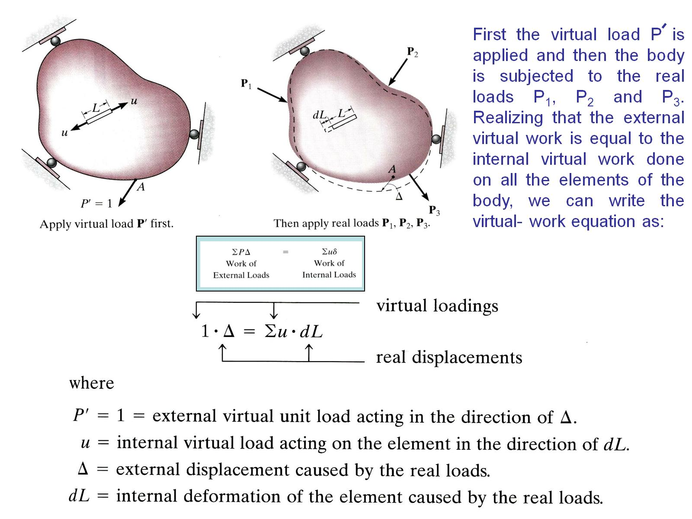

Slide 3
