Slide 1
REINFORCEMENT LEARNING
BY
ADNAN ACAN

Slide 2
Learning Methods
The focus of learning is acquiring skills or knowledge from experience.
As such, there are many different types of learning methods in the field of AI/Machine Learning.
The three well-known and widely studied learning problems in research and practice are:
1. Supervised Learning
2. Unsupervised Learning
3. Reinforcement Learning

Slide 3
Supervised Learning
Supervised learning describes a class of learning problems that involve using a model to learn a mapping between input examples and the target variable.
Models are fit on training data comprised of inputs and outputs and used to make predictions on test sets where only the inputs are provided and the outputs from the model are compared to the withheld target variables and used to estimate the skill of the model.
There are two main types of supervised learning problems:
Classification: Supervised learning problem that involves predicting a class label.
Regression: Supervised learning problem that involves predicting a numerical value.
Both classification and regression problems may have one or more input variables and input variables may be any data type, such as numerical or categorical.

Slide 4
2. Unsupervised Learning
Unsupervised learning describes a class of learning problems that involve using a model to describe or extract relationships in data.
Compared to supervised learning, unsupervised learning operates upon only the input data without outputs or target variables. As such, unsupervised learning does not have a teacher correcting the model, as in the case of supervised learning.
There are many types of unsupervised learning, although there are two main problems that are often encountered :
Clustering: Unsupervised learning problem that involves finding groups in data.
Density Estimation: Unsupervised learning problem that involves summarizing the distribution of data.

Slide 5
3. Reinforcement Learning
Reinforcement learning describes a class of learning problems where an agent operates in an environment and must learn how to operate using feedback.
Reinforcement learning is learning what to do — how to map situations to actions—so as to maximize a numerical reward signal. The learner is not told which actions to take, but instead must discover which actions yield the most reward by trying them.
The use of an environment means that there is no fixed training dataset, rather a goal or set of goals that an agent is required to achieve, actions it may perform, and feedback about performance toward the goal.
An example of a reinforcement problem is playing a game where the agent has the goal of getting a high score and can make moves in the game and receive feedback in terms of punishments or rewards.

Slide 6
In a typical Reinforcement Learning (RL) problem, there is a learner and a decision maker called agent and the surrounding with which it interacts is called environment. The environment, in return, provides rewards and a new state based on the actions of the agent.
So, in reinforcement learning, we do not teach an agent how it should do something but present it with rewards whether positive or negative based on its actions.

Slide 7
The Agent-Environment Relationship:
Agent : Software programs that make intelligent decisions and they are the learners in RL. These agents interact with the environment by actions and receive rewards based on these actions.
Environment: It is the demonstration of the problem to be solved. We can have a real-world environment or a simulated environment with which our agent will interact.
State : This is the position of the agents at a specific time-step in the environment. So, whenever an agent performs an action, the environment gives the agent a reward and a new state where the agent reached by performing the action.

Slide 8
Transition : Moving from one state to another is called Transition (or state transition).
Transition Probability: The probability that the agent will move from one state, s to another state s’ is called transition probability, P_{ss’}.
The Markov Property states that :
“Future is Independent of the past given the present”
Mathematically we can express this statement as :

Slide 9
S_{t} denotes the current state of the agent and S_{t+1} denotes the next state. What this equation means is that the transition from state S_{t} to S_{t+1} is entirely independent of the past. So, the RHS of the Equation means the same as LHS if the system has a Markov Property. Intuitively meaning that our current state already captures the information of the past states.
State Transition Probability :
As we now know about transition probability we can define state transition probability as follows :
For Markov States from S_{t} to S_{t+1} i.e. any other successor state , the state transition probability is given by,

Slide 10
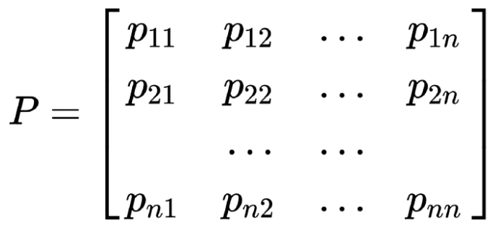
We can formulate the state transition probability into a state transition probability matrix by :
Each row in the matrix represents the probability from moving a particular state (starting state) to any successor state. Sum of each row is equal to 1.

Slide 11
Markov Process or Markov Chains
A Markov Process is the memoryless random process i.e. a sequence of random states S₁, S₂,….S_{n} with a Markov Property. So, it’s basically a sequence of states with the Markov Property. It can be defined using a set of states(S) and transition probability matrix (P).The dynamics of the environment can be fully defined using the States (S) and Transition Probability matrix (P).
But what random process means ?
To answer this question let’s look at an example:

Slide 12
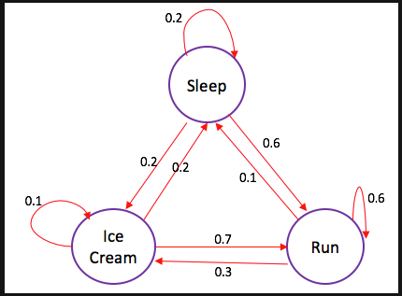
The edges of the tree denote transition probabilities. Now, suppose that we were sleeping and the according to the probability distribution there is a 0.6 chance that we will Run and 0.2 chance we sleep more and again 0.2 that we will eat ice-cream.
Now, we can take any state sequence from this MDP and compute the corresponding probability of this state chain as follows:

Slide 13
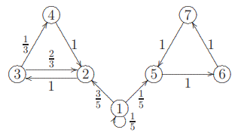
Given the state sequence X₀->X₁->X₂->...->X_{k}, the probability of P(X₀,X₁,X₂,...,X_{k}) is defined as
P(X₀,X₁,X₂,...,X_{k})=P(X₀)xP₀₁xP₁₂x...xP_{(k-1)xk}.
For Example:
Let P(X₀) ∼ ( 3/4 , 0, 1/4 , 0, 0, 0, 0). What is the probability of the state trajectory (or path) 1, 2, 3, 2, 3, 4?

Slide 14
Rewards and Returns
Rewards are the numerical values that the agent receives on performing some action at some state (s) in the environment. The numerical value can be positive or negative based on the actions of the agent.
In Reinforcement learning, we care about maximizing the cumulative reward (all the rewards agent receives from the environment) instead of, the reward agent receives from the current state (also called immediate reward).
This total sum of reward the agent receives from the environment is called returns.
G_{t}= R_{t+1}+ R_{t+2}+ R_{t+3}+ .....+ R_{T}

Slide 15
where: R[t+1] is the reward received by the agent at time step t[0] while performing an action (a) to move from one state to another. Similarly, R[t+2] is the reward received by the agent at time step t[1] by performing an action to move to another state. And, R[T] is the reward received by the agent by at the final time step by performing an action to move to another state.
Episodic and Continuous Tasks
Episodic Tasks: These are the tasks that have a terminal state (end state). We can say that they have finite states. For example, in racing games, we start the game (start the race) and play it until the game is over (race ends!). This is called an episode. Once we restart the game it will start from an initial state and hence, every episode is independent.
Continuous Tasks : These are the tasks that have no ends i.e. they don’t have any terminal state. These types of tasks will never end. For example, Learning how to code!

Slide 16
Now, it’s easy to calculate the returns from the episodic tasks as they will eventually end but what about continuous tasks, as it will go on and on forever. The returns sum up to infinity! So, how we define returns for continuous tasks?
This is where we need Discount factor(ɤ).
Discount Factor (ɤ): It determines how much importance is to be given to the immediate reward and future rewards. This basically helps us to avoid infinity as a reward in continuous tasks. It has a value between 0 and 1. A value of 0 means that more importance is given to the immediate reward and a value of 1 means that more importance is given to future rewards.
In practice, a discount factor of 0 will never learn as it only considers immediate reward and a discount factor of 1 will go on for future rewards which may lead to infinity. Therefore, the optimal value for the discount factor lies between 0.2 to 0.8.

Slide 17
So, we can define returns using discount factor as follows :
Markov Reward Process
Till now we have seen how a Markov chain defined the dynamics of an environment using set of states (S) and Transition Probability Matrix (P). But, we know that Reinforcement Learning is all about the goal to maximize the reward. So, let’s add reward to our Markov Chain. This gives us Markov Reward Process.

Slide 18
Markov Reward Process (MRP): As the name suggests, MRPs are the Markov chains with values judgement. Basically, we get a value from every state our agent is in.
Mathematically, we define Markov Reward Process as :
What this equation means is how much reward (R_{s}) we get from a particular state S[t]. This tells us the immediate reward from that particular state our agent is in. We will see how we maximize these rewards from each state our agent is in; that is maximizing the cumulative reward we get from each state.
We define a Markov Reward Process (MRP) (S,P,R,ɤ) as follows:

Slide 19
Where:
S is a set of states,
P is the Transition Probability Matrix,
R is the Reward function,
ɤ is the discount factor.
Markov Decision Processes: Policy and Value Functions
A Value Function determines how good it is for the agent to be in a particular state s. Of course, to determine how good it will be to be in a particular state, it must depend on some actions that it will take. This is where policy comes in.
A policy defines what actions to perform in a particular state s.

Slide 20
A policy is a simple function, that defines a probability distribution over Actions (a∈ A) for each state (s ∈ S).
If an agent at time t follows a policy π then π(a|s) is the probability that agent takes action (a ) at particular time step (t) in state s. In Reinforcement Learning, the experience of the agent determines the change in policy.
Mathematically, a policy is defined as follows :

Slide 21
Now, how we find a value of a state. The value of state s, when agent is following a policy π, which is denoted by V_{π}(s), is the expected return starting from state s and following a policy π for the next states, until we reach the terminal state. We can formulate this as (This function is also called State-value Function):
This equation gives us the expected returns starting from state(s) and going to successor states thereafter, with the policy π. Note that the value of a terminal state (if there is any) is zero.

Slide 22
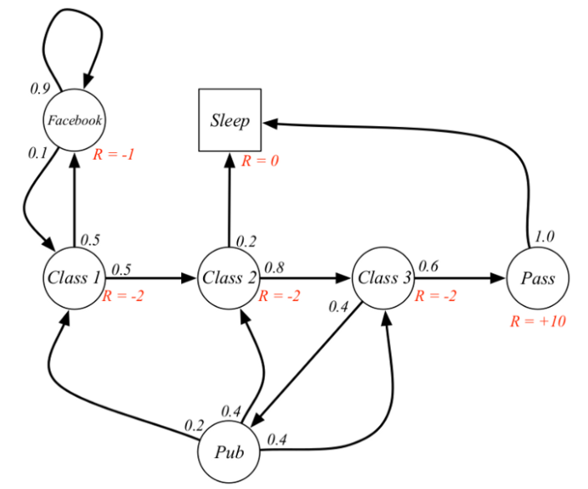
Example: Suppose our start state is Class 2, and we follow the state sequence: Class 2 > Class 3 > Pass > Sleep. The expected return with discount factor 0.5 is:
-2 + (-2 * 0.5) + 10 * 0.25 + 0 = -0.5
Hence the return of state Class 2 for this sequence state transitions (moves) is -0.5.

Slide 23
Bellman Equation for Value Function
Bellman Equation helps us to find optimal policies and value functions. We know that our policy changes with experience so we will have different value functions according to different policies.
Optimal value function is one which gives maximum value compared to all other value functions.
Bellman Equation states that value function can be decomposed into two parts:
Immediate Reward, R[t+1] and Discounted value of successor states. Mathematically, we can define Bellman Equation as :
We want to know the value of state s. The value of state (s) is the reward we got upon being in that state, plus the discounted value of the state we landed upon.

Slide 24
What is a Markov Decision Process (MDP) ?
Markov Decision Process : It is Markov Reward Process with decisions. Everything is same like MRP but now we have actual agency that makes decisions or take actions.
It is a tuple of (S, A, P, R, 𝛾) where:
S is a set of states,
A is the set of actions agent can choose to take,
P is the transition Probability Matrix,
R is the Reward accumulated by the actions of the agent,
𝛾 is the discount factor.
P and R will have slight changes w.r.t actions as follows :

Slide 25
Transition Probability:
Reward Function:
Now, our reward function is dependent on the action. Till now we have talked about getting a reward (R) when our agent goes through a set of states (s) following a policy π. Actually, in Markov Decision Process(MDP) the policy is the mechanism to take decisions . So now we have a mechanism which will choose to take an action.

Slide 26
Policies in an MDP depends on the current state. They do not depend on the history. That’s the Markov Property. So, the current state we are in characterizes the history.
We have already seen how good it is for the agent to be in a particular state (State-value function). Now, let’s see how good it is to take a particular action following a policy π from state s (Action-Value Function).
The Bellman Expectation equation under a policy π can be stated as:
The above equation tells us that the value of a particular state is determined by the immediate reward plus the value of successor states when we are following a certain policy (π).

Slide 27
State-action value function or Q-Function:
This function specifies the how good it is for the agent to take action (a) in a state (s) with a policy π. This function can be mathematically expressed as:
Basically, it tells us the value of performing a certain action(a) in a state(s) with a policy π.

Slide 28
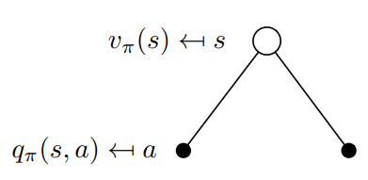
Similar to V_{π}(s), we can express our state-action Value function (Q-Function) as follows :
From the above equation, we can see that the State-Action Value of a state can be decomposed into the immediate reward we get on performing a certain action in state(s) and moving to another state(s’) plus the discounted value of the state-action value of the state(s’) with respect to the some action(a) our agent will take from that state on-wards.
Now, let’s go deeper into Bellman Expextation Equation:
Consider the diagram on the right. From the state s, we
Take several actions with some probability distribution.
There is a Q-value(State-action value function) for each
of the action. Now, we can average the Q-values which
tells us how good it is to be in a particular state.
Basically, it defines V_{π}(s)

Slide 29
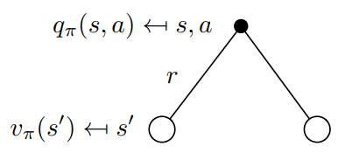
This equation also tells us the connection between State-Value function and State-Action Value Function.
Now, let’s look at the following diagram for State-Action Value Function:
This diagram says that suppose we start off by taking some action (a). So, because of the action (a) the agent might move into any of neigbour states in the environment. Now: how good it is to take action(a)?
We again average the state-values of neighbour states, added with an immediate reward which tells us how good it is to take a particular action (a).This defines the q_{π}(s,a).

Slide 30
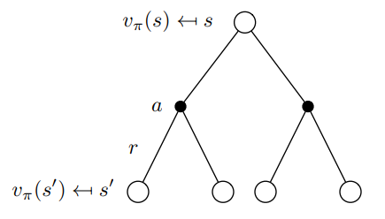
Mathematically, this can be expressed as follows :
where P is the Transition Probability Matrix .
Now let’s stitch these backup diagrams together to define State-Value Function, Vπ(s):
Note that the probability of the action the agent might take from state s is weighted by our policy and after taking that action the probability that we land in any of the states(s’) is weighted by the environment.

Slide 31
Now our question is, how good it is to be in state(s) after taking some action and landing on another state(s’) and following our policy(π) after that?
It is similar to what we have done before, we are going to average the value of successor states(s’) with some transition probability(P) weighted with our policy.
Mathematically, we can define it as follows:

Slide 32
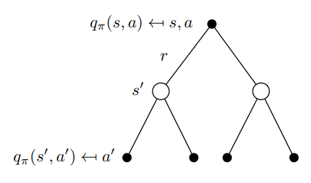
Now, let’s do the same for State-Action Value Function, q_{π}(s,a) :
It’s very similar to what we did in State-Value Function, so this diagram basically says that our agent take some action (a) because of which the environment might land us on any of the states (s’), then from that state we can choose to take any actions (a’) weighted with the probability of our policy (π). Again, we average them together and that gives us how good it is to take a particular action following a particular policy (π) all along.

Slide 33
Mathematically, this can be expressed as :
So, this is how we can formulate Bellman Expectation Equation for a given MDP to find it’s State-Value Function and State-Action Value Function.
But, it does not tell us the best way to behave in an MDP.
For that let’s talk about what is meant by Optimal Value and Optimal Policy Function.

Slide 34
Optimal Value Function
In an MDP environment, there are many different value functions according to different policies. The optimal Value function is one which yields maximum value compared to all other value function. When we say we are solving an MDP it actually means we are finding the Optimal Value Function.
So, mathematically Optimal State-Value Function can be expressed as :
In the above formula, v∗(s) tells us what is the maximum reward we can get from the system.

Slide 35
Defining Optimal State-Action Value Function (Q-Function)
Similarly, Optimal State-Action Value Function tells us the maximum reward we are going to get if we are in state s and taking action a from there on-wards.
Mathematically, It can be defined as :
Optimal State-Value Function :It is the maximum Value function over all policies.
Optimal State-Action Value Function: It is the maximum action-value function over all policies.

Slide 36
Optimal Policy
Before we define Optimal Policy, let’s know, what is meant by one policy better than other policy?
We know that for any MDP, there is a policy (π) better than any other policy (π’). But How?
We say that one policy (π) is better than other policy (π’) if the value function with the policy π for all states is greater than the value function with the policy π’ for all states. Intuitively, it can be expressed as :

Slide 37
Now, let’s define Optimal Policy :
Optimal Policy is one which results in optimal value function.
Note that, there can be more than one optimal policy in a MDP. But, all optimal policies achieve the same optimal value function and optimal state-action Value Function(Q-function).
Now, the question arises how we find Optimal Policy.
We find an optimal policy by maximizing over q*(s, a) i.e. our optimal state-action value function. We solve q*(s,a) and then we pick the action that gives us most optimal state-action value function (q*(s,a)). That is:

Slide 38
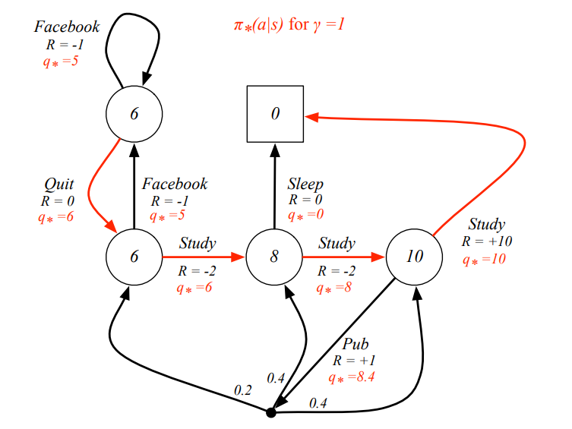
That is, for a state s we pick the action a with probability 1, if it gives us the maximum q*(s,a). So, if we know q*(s,a) we can get an optimal policy from it.
Let’s consider the following example:
In this example, the red arcs are the optimal policies which means that if our agent follows this path it will yield maximum reward from this MDP. Also, by seeing the q* values for each state we can say the actions our agent will take that yields maximum reward. So, optimal policy always takes action with higher q* value (State-Action Value Function). For example, in the state with value 8, there is q* with value 0 and 8. Our agent chooses the one with greater q* value i.e. 8.

Slide 39
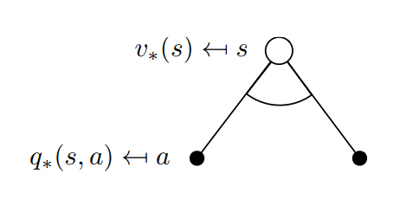
Now, the question arises, How do we find these q*(s,a) values ?
This is where Bellman Optimality Equation comes into play.
Bellman Optimality equation is the same as Bellman Expectation Equation but the only difference is instead of taking the average of the actions our agent can take the action with the max value.
Let’s look at the Backup diagram:
Suppose our agent is in state s and from that state it can take two actions. So, we look at the action-values for each of the actions and our agent takes the action with greater q* value. This gives us the value of being in the state s.

Slide 40
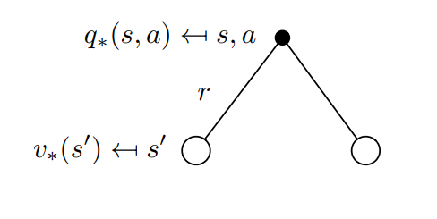
Hence, mathematically, the Bellman optimality equation for state-value function is
Similarly, let’s define Bellman Optimality Equation for State-Action Value Function (Q-Function):
Suppose, our agent has taken an action a in some state s. We still take the average of the values of both the states, but the only difference is in Bellman Optimality Equation, we know the optimal values of each of the states:

Slide 41
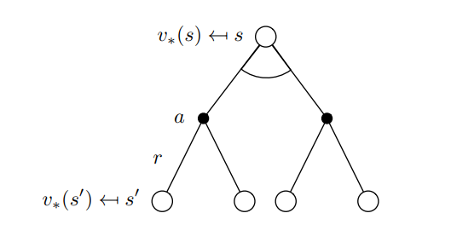
Let’s again stitch these backup diagrams for State-Value Function :
Suppose our agent is in state s and from that state it took some action (a) where the probability of taking that action is weighted by the policy. And because of the action (a), the agent might get blown to any of the states(s’) where probability is weighted by the environment. In order to find the value of state s we simply average the Optimal values of the states (s’). This gives us the value of being in state s.
The max in the equation is because we are maximizing the actions the agent can take in the upper arcs. This equation also shows how we can relate V* function to itself.

Slide 42
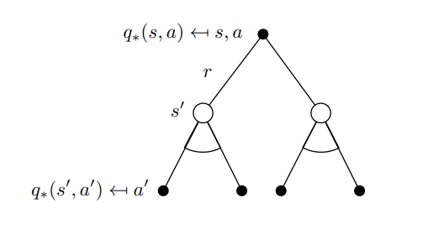
Now, let’s look at the Bellman Optimality Equation for State-Action Value Function, q*(s,a) :
Suppose, our agent was in state s and it took some action (a). Because of that action, the environment might land our agent to any of the states (s’) and from these states we get to maximize the action our agent will take i.e. choosing the action with maximum q* value. We back that up to the top and that tells us the value of the action a.
Mathematically, this can be expressed as :

Slide 43
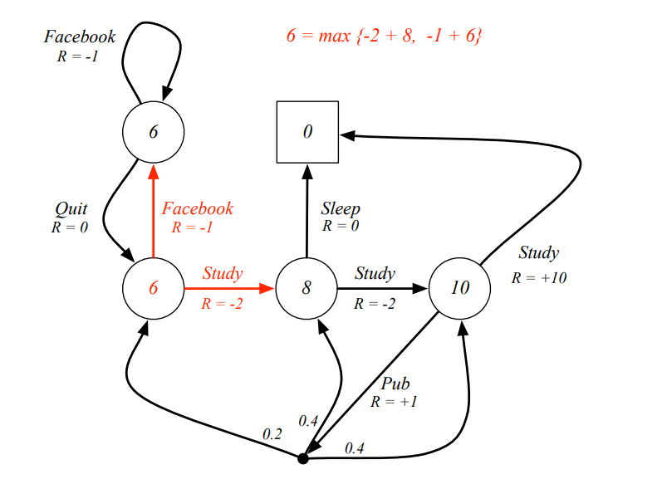
Let’s look at the following example to understand it better :
Look at the red arrows, suppose we wish to find the value of state with value 6 (in red), as we can see we get a reward of -1 if our agent chooses Facebook and a reward of -2 if our agent choose to study. In order to find the value of state in red, we will use the Bellman Optimality Equation for State-Value Function i.e. considering the other two states have optimal value we are going to take an average and maximize for both the action (choose the one that gives maximum value). So, from the diagram we can see that going to Facebook yields a value of 5 for our red state and going to study yields a value of 6 and then we maximize over the two which gives us 6 as the answer.

Slide 44
Now, how do we solve Bellman Optimality Equation for large MDPs. In order to do so we use Dynamic Programming algorithms like Policy iteration and Value iteration.
What is Dynamic Programming?
Dynamic Programming is a lot like divide and conquer approach which is breaking down a problem into sub-problems but the only difference is instead of solving them independently (like in divide and conquer), results of a sub-problem are used in similar sub-problems.
A problem can be solved using dynamic programming if it satisfies two properties:

Slide 45
Optimal Substructure: This means that a problem can be divided into sub-problems and if we find optimal solutions to those sub-problems, then we can use this optimal solution to find an optimal solution for the overall problem.
Overlapping Sub-problems: Being said before, Dynamic Programming is used if a problem has similar sub-problems. The solution of one sub-problem is saved and then used to solve similar sub-problems.
Do Markov Decision Process have these two properties?

Slide 46
For the first property, recall, Bellman equation is defined as follows:
Remember what the Bellman Equation said: the value of a state is equal to the immediate reward our agent gets leaving the state plus the value of the next state. So, the equation is breaking down the process of finding the value function of a state by dividing it into sub-problems.
For overlapping sub-problems, we have Value functions. Value functions have already stored how good a particular state is so we don’t need to recompute the value of that state again and again. For example, suppose there are two states(s1 and s2) and we are in state s1 and we have already computed the value of state s2 so when calculating the value of state s1 we will not re-compute the value of state s2. (The value of s1 relies on state s2)

Slide 47
What we mean when we say we are going to solve a Markov Decision Process?
It means that we are going to find the Value Function that will satisfy the Bellman Equation. Once we have found the optimal value function, then we can use it to find the optimal policy.
This process is broken down into two parts:
Prediction: Suppose we have a Markov Decision Process defined as (S, A, P, R, γ) and given some policy π. Our job in prediction is to find the value function. We find the value function by evaluating a policy using the Bellman Expectation Equation.
Control: This process involves optimizing the value function, we calculated during the prediction process. We find optimal value function and optimal policy for our Markov Decision Process.

Slide 48
Policy Evaluation
Synchronous Backups: It means that we are going to take into consideration every state in our Markov Decision Process for calculating the value of a state.
Policy Evaluation means how much reward our agent is going to get by following a particular policy π. But how we evaluate a policy π?
We evaluate a given policy π using Bellman Expectation Equation. Recall that, Bellman Expectation Equation tells how much reward our agent is going to get following a policy π and is defined as:
Initially we start with our value function of each state initialize to zero.

Slide 49
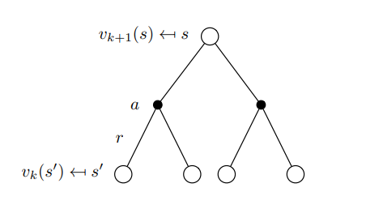
Now, to evaluate a policy we are going to use this equation in an iterative fashion. Meaning, we will calculate the value of the next state by backing up the value of the current state from the previous iteration. Lets understand this with an example:
We know that the value of the root node [s] is given by the reward we got by taking the action [a] plus the value of the state [s’]. Now, what we are doing is we are using the Bellman Expectation equation in an iterative fashion for dynamic programming. That is, we will use the value of the leaves (state [s’] here) which is from the previous iteration, when we were computing the value of state s, to calculate the value of the state [s]. This happens in every iteration. Now, for the second iteration, we are going to use the value of state we computed in the previous iteration that is v [k+1] to compute the value of the next state, that is, v [k+2].

