Slide 1

Lecture
Genetic Algorithms

Slide 2
Introduction To Genetic Algorithms (GAs)

Slide 3
Agenda
Short overview of Local Search and Local Search-based Metaheuristics
Introduction to Genetic Algorithms

Slide 4
Local Search
Basic Idea: Improve the current solution
Start with some solution
Find a set of solutions (called neighbors) that are ”close” to the current solution
If one of these neighbors are better than the current solution, move to that solution
Repeat until no improvements can be made

Slide 5
Local Search
Variations
  Best Improvement (always select the best neighbor)
  First Improvement (select the first improving neighbor)
  Random Descent (select neighbors at random)
  Random Walk (move to neighbors at random)
Problem: Gets stuck in a local optimum
  (except Random Walk, which isn’t a good method anyway)

Slide 6
Local Search Based Metaheuristics
Main goal
  To avoid getting stuck in local optima
Additional goals
  Explore a larger part of the search space
  Attempt to find the global (not just a local) optimum
  Give a reasonable alternative to exact methods (especially for large/hard problem instances, and where the solution time is important)

Slide 7
Local Search Based Metaheuristics
The different methods employ very different techniques in order to escape local optima
  Simulated Annealing relies on controlled random movement
  Tabu Search relies on memory structures, recording enough information to prevent looping between solutions

Slide 8
Local Search Based Metaheuristics
The different methods employ very different techniques in order explore a larger part of the search space
  Simulated Annealing relies on controlled random movement
  Tabu Search relies on memory structures, recording enough information to guide the search to different areas of the search space (e.g., frequency based diversification)

Slide 9
Local Search Based Metaheuristics
Which method is better?
Depends on your needs
  SA is easier to implement?
  SA is easier to use/understand?
  TS is more flexible and robust?
  TS requires a better understanding of the problem?
  TS requires more ”tuning”?
  TS produces better overall results?

Slide 10
Genetic Algorithms
We have now studied many Metaheuristics based on the idea of a Local Search
It is time to look at methods that are based on different mechanisms
The first such method will be the Genetic Algorithm

Slide 11
What is Metaheuristics?
Metaheuristics are high-level problem-solving strategies designed to find good (often near-optimal) solutions to complex optimization problems where exact methods are too slow or impractical.
“Smart search strategies that guide simpler heuristics to explore the solution space efficiently.”
They don’t guarantee the absolute best answer, but they aim for very good solutions in reasonable time.

Slide 12
Where Are Metaheuristics Used?
Logistics (routing, delivery)
Manufacturing (scheduling)
AI & machine learning
Finance (portfolio optimization)
Engineering design

Slide 13
What Are Genetic Algorithms (GAs)?
Genetic Algorithms are search and optimization techniques based on Darwin’s Principle of Natural Selection.
Notes:
What exactly are Genetic Algorithms?
As the name suggests, Genetic Algorithms or Gas borrow their basic working principle from natural genetics.
Genetic Algorithms are search and optimization methods based on Darwin’s principle of Natural Selection.

Slide 14
Darwin’s Principle Of Natural Selection
IF there are organisms that reproduce, and
IF offsprings inherit traits from their progenitors, and
IF there is variability of traits, and
IF the environment cannot support all members of a growing population,
THEN those members of the population with less-adaptive traits (determined by the environment) will die out, and
THEN those members with more-adaptive traits (determined by the environment) will thrive
The result is the evolution of species.

Slide 15
Basic Idea Of Principle Of Natural Selection
“Select The Best, Discard The Rest”
Notes:
Darwin’s principle of Natural Selection can be stated very simply as “ select the best and discard the rest”.
Let us consider an example. Consider a population of animals of a particular species in a jungle. This population of animals has some animals which are stronger than the others and have characteristics that help them survive better in that environment as compared to the others. Now, the resources, like food,water,etc in the jungle are limited. So, these animals have to compete with one another for these resources. Ultimately, only the strongest, or fittest individuals survive and the rest perish. In other words, in this “struggle for existence” , nature selects the best, and discards the rest.
Now, these surviving animals mate amongst themselves and propagate their favorable characteristics from one generation to another.
What is mating? At the genetic level it can be seen as the crossover of 2 chrmosomes, one from each parent. They exchange some genetic matter and give rise to the new chromosome of the child that has both the parents’ features.Thus the favorable characteristics of the parents that helped them survive in that environment are propagated from one generation to the next till the species becomes best adapted to it’s environment. This is called evolution.

Slide 16
The Genetic Algorithm
Directed search algorithms based on the mechanics of biological evolution
Developed by John Holland, University of Michigan (1970’s)
  To understand the adaptive processes of natural systems
  To design artificial systems software that retains the robustness of natural systems

Slide 17
Genetic Algorithms
Provide efficient, effective techniques for optimization and machine learning applications
Widely-used today in business, scientific and engineering circles

Slide 18
Genetic Algorithms (GA)
Function Optimization
AI (Games, Pattern recognition ...)
Basic idea:
  intelligent exploration of the search space based on random search
  analogies from biology

Slide 19
GA - Analogies with biology
Representation of complex objects by a vector of simple components
Chromosomes
Selective breeding
Darwinistic evolution
Classical GA: Binary encoding

Slide 20
Classes of Search Techniques

Slide 21
Core Idea
“Survival of the fittest”
We evolve a population of candidate solutions over time using:
  Selection
  Crossover
  Mutation

Slide 22
Basic Principle of Evolutionary Algorithms
Objective (Fitness) Function
Candidate Solution
Difficult Problem
Fitness
Evolutionary Algorithm
Mutation
Replacement
Selection
Recombination

Slide 23
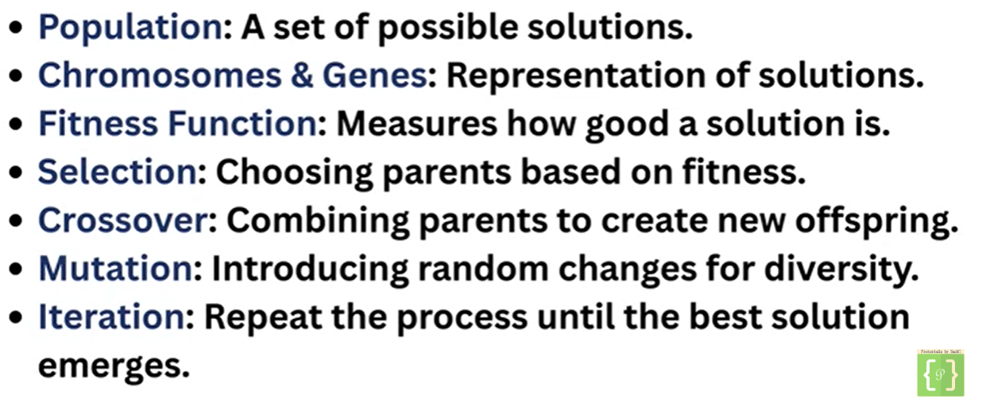
Key Concepts

Slide 24
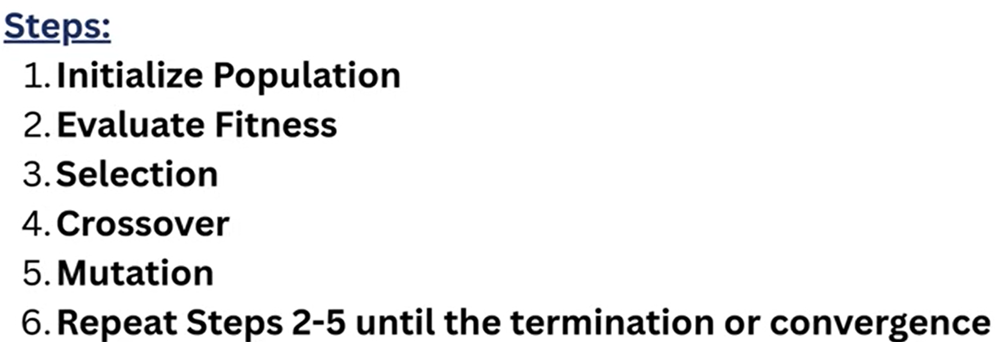
Genetic Algorithm

Slide 25
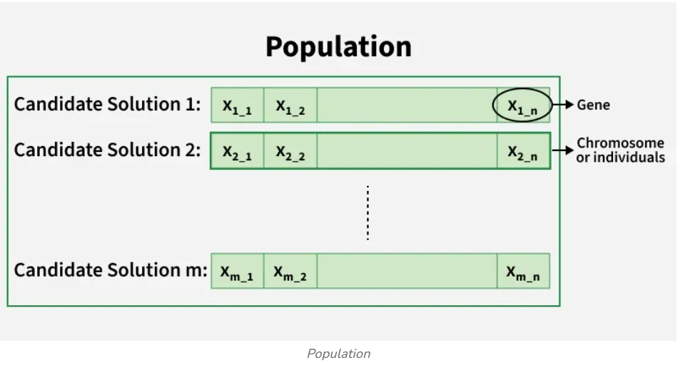
Key Concepts

Slide 26
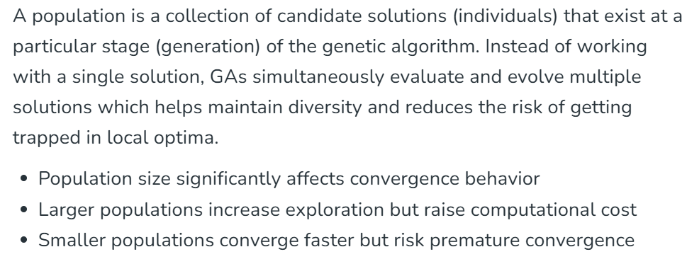

Slide 27
Population
A set of chromosomes.
Example:
Population = {
10101,
11100,
00011,
01010
}

Slide 28
Chromosome (Solution Representation)
A chromosome represents a complete candidate solution to the problem. It is a structured collection of genes that encodes all decision variables required to evaluate a solution using the fitness function.
Gene:
A gene is the smallest unit of information in a chromosome and represents a single variable, parameteror trait of the solution.
The collective behavior of all genes determines the quality of the chromosome.
  A solution encoded as a string.
  Examples:
    Binary: 101101
    Integer: [3,1,4,2]
    Real values: [0.2, 1.5, 3.7]

Slide 29
Encoding Methods:
Encoding refers to the way candidate solutions are represented inside chromosomes. Choosing an appropriate encoding is critical because it directly impacts the effectiveness of genetic operators.
a. Binary Encoding
Uses binary strings (0 and 1)
Simple and easy to implement
Commonly used in theoretical GA models
b. Real-Valued Encoding
Genes are real numbers
Suitable for continuous optimization problems
Faster convergence and higher precision
c. Permutation Encoding
Chromosomes represent ordered sequences
Used in routing, schedulingand sequencing problems
Requires specialized crossover and mutation operators

Slide 30
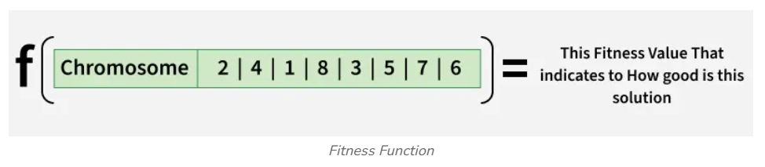

Fitness Function
Measures how good a solution is.
Example:
$$f\left(x\right)=x^{2}$$
Higher fitness → better solution

Slide 31
The fitness function is a mathematical formulation that evaluates how well a chromosome solves the given problem. It acts as the guiding force of the genetic algorithm by determining which individuals are more likely to reproduce.
Higher fitness implies better solution quality
Fitness function is problem-specific
Can be designed for maximization or minimization

Slide 32
Termination Criteria
Termination criteria define the conditions under which the genetic algorithm stops executing. Proper termination prevents unnecessary computation while ensuring solution quality. Common termination conditions:
  Maximum number of generations reached
  Desired or threshold fitness achieved
  No improvement in fitness for several generations
  Computational time limit exceeded

Slide 33
Genetic Operators
Operator | Purpose
Selection | Choose parents
Crossover | Combine parents
Mutation | Introduce randomness

Slide 34
GA Algorithm Flow
1. Initialize population randomly
2. Evaluate fitness
3. Repeat until stopping condition:
a. Select parents
b. Apply crossover
c. Apply mutation
d. Evaluate new population
4. Return best solution

Slide 35
Working Mechanism Of GAs
Begin
Initialize population
Evaluate Solutions
T =0
Optimum Solution?
N
Selection
Y
T=T+1
Stop
Crossover
Mutation
Notes:
GAs implement optimization techniques by simulating this natural law of evolution in the biological world.
We start with a population of randomly generated solutions. Each of these solutions is evaluated to determine how good or bad it is.In other words to determine how “fit” that solution is. We then check a terminating condition, to see if our solutions are good enough? If yes, we stop. If not, we have to optimize the solutions.
So, we select the best solutions from the initial population (selection). This is similar to “natural selection”.
Then we allow these good solutions to exchange their information, in order to get even better solutions. This step is similar to reproduction among animals or crossover among chrmosomes and is called “cross-over”. We may then randomly mutate some small % of the solutions thus obtained after crossover.
Mutation is very imp. It could be a bad thing, it could be a good thing. In the boliogical sense it mean, making a small change in a gene. In GAs, it means, making a small change to the solution.
Then again, we evaluate each of the sokutions, and check the termination condition. As you see , this is an optmization method.

Slide 36
Genetic Algorithms Implement Optimization Strategies By Simulating Evolution Of Species Through Natural Selection.

Slide 37
Taxonomy
Search Techniques
Informed
Uninformed
DFS
BFS
A*
Hill Climbing
Evolutionary Algorithms
Simulated Annealing
Evolutionary Strategies
Swarm Intelligence
Genetic Programming
Genetic Algorithms

Slide 38
Simple Genetic Algorithm
Simple_Genetic_Algorithm()
{
Initialize the Population;
Calculate Fitness Function;
While(Fitness Value != Optimal Value)
{
Selection;
//Natural Selection, Survival Of Fittest
Crossover;
//Reproduction, Propagate favorable characteristics
Mutation;
//Mutation
Calculate Fitness Function;
}
}

Slide 39
Nature to Computer Mapping
Nature | Computer
Population Individual Fitness Chromosome Gene Reproduction | Set of solutions. Solution to a problem. Quality of a solution. Encoding for a Solution. Part of the encoding of a solution. Crossover
Notes:
So after this discussion, it should be clear to you that Gas mimic the natural process of evolution to a large extent. To summarize the similarities , I have a slide here.

Slide 40
Components of a GA
A problem to solve, and ...
  Encoding technique (gene, chromosome)
  Initialization procedure (creation)
  Evaluation function (environment)
  Selection of parents (reproduction)
  Genetic operators (mutation, recombination)
  Parameter settings (practice and art)
Notes:
Encoding technique = representation, i.e. How do we represent potential solutions to the problem?

Slide 41
Some Terms Used in Evolutionary Computation
Algorithm Type
  Generational
  Steady State
  Elitist
Recombination (Crossover)
  Single-point
  Multi-point
  Uniform
Selection
  Rank-Biased
  Roulette Wheel
  Tournament
Replacer
  Weakest
  First weaker
Mutation
Parameters
  Population size
  Generations/iterations
  Mutation rate
  Crossover rate
  Tournament size….
  Etc

Slide 42
GA terminology
Population
  The collection of potential solutions (i.e. all the chromosomes)
Parents/Children
  Both are chromosomes
  Children are generated from the parent chromosomes
Generations
  Number of iterations/cycles through the GA process

Slide 43
Genotype, Phenotype, Population
Genotype
  chromosome
  Coding of chromosomes
  coded string, set of coded strings
Phenotype
  The physical expression
  Properties of a set of solutions
Population – a set of solutions

Slide 44
The GA cycle
chosen
parents
recombination
children
selection
modification
modified
children
parents
population
evaluation
evaluated children
deleted
members
discard
Notes:
Modifications are stochastically triggered
Operator types are:
Mutation
Crossover (recombination)

Slide 45
GA Operators and Parameters

Slide 46
Encoding
The process of representing the solution in the form of a string that conveys the necessary information.
Just as in a chromosome, each gene controls a particular characteristic of the individual, similarly, each bit in the string represents a characteristic of the solution.
Chromosomes could be:
  Bit strings (0101 ... 1100)
  Real numbers (43.2 -33.1 ... 0.0 89.2)
  Permutations of element (E11 E3 E7 ... E1 E15)
  Lists of rules (R1 R2 R3 ... R22 R23)
  Program elements (genetic programming)
  ... any data structure ...
Notes:
The very first step in Gas, is coming up with a random population of solutions. Each of these solutions is represented in the form of a string and this process is called encoding.
Just as we have chromosomes in animals that are made up of a string of genes, similarly the solutions in Gas are represnted in the form of strings, which are made up of characters, each of which stand for and control a particular aspect of the solution.
There are many methods of encoding, the common ones are binary encoding, real encoding ,etc. The method chosen depends on the problem at hand.

Slide 47
Encoding Methods
Binary Encoding – Most common method of encoding. Chromosomes are strings of 1’s and 0’s and each position in the chromosome represents a particular characteristic of the problem.
Chromosome A
10110010110011100101
Chromosome B
11111110000000011111

Slide 48
Genetic Algorithms:
Binary-Coded Representations
For Example, let’s say that we are trying to optimize the following function,
  f(x) = x²
  for 2 ≥ x ≥ 1
If we were to use binary-coded representations we would first need to develop a mapping function form our genotype representation (binary string) to our phenotype representation (our Candidate Solution). This can be done using the following mapping function:
  d(ub,lb,l,chrom) = (ub-lb) decode(chrom)/2^{l}-1 + lb

Slide 49
Binary-Coded Representations
d(ub,lb,l,c) = (ub-lb) decode(c)/(2^{l}-1) + lb , where
  ub = 2,
  lb = 1,
  l = the length of the chromosome in bits
  c = the chromosome
The parameter, l, determines the accuracy (and resolution of our search).

Slide 50
Binary Coded Representations
2.69
1.65
f(1.65)=2.69

Slide 51
Encoding Methods (contd.)
Permutation Encoding – Useful in ordering problems such as the Traveling Salesman Problem (TSP). Example. In TSP, every chromosome is a string of numbers, each of which represents a city to be visited.
Chromosome A
1 5 3 2 6 4 7 9 8
Chromosome B
8 5 6 7 2 3 1 4 9

Slide 52
Encoding Methods (contd.)
Value Encoding – Used in problems where complicated values, such as real numbers, are used and where binary encoding would not suffice.
Good for some problems, but often necessary to develop some specific crossover and mutation techniques for these chromosomes.
Chromosome A
1.235 5.323 0.454 2.321 2.454
Chromosome B
(left), (back), (left), (right), (forward)

Slide 53
Real-Coded Representations

Slide 54
Fitness Function
A fitness function quantifies the optimality of a solution (chromosome) so that that particular solution may be ranked against all the other solutions.
A fitness value is assigned to each solution depending on how close it actually is to solving the problem.
Ideal fitness function correlates closely to goal + quickly computable.
Example. In TSP, f(x) is sum of distances between the cities in solution. The lesser the value, the fitter the solution is.

Slide 55
Recombination
The process that determines which solutions are to be preserved and allowed to reproduce and which ones deserve to die out.
The primary objective of the recombination operator is to emphasize the good solutions and eliminate the bad solutions in a population, while keeping the population size constant.
“Selects The Best, Discards The Rest”.
“Recombination” is different from “Reproduction”.

Slide 56
Recombination
Identify the good solutions in a population.
Make multiple copies of the good solutions.
Eliminate bad solutions from the population so that multiple copies of good solutions can be placed in the population.

Slide 57
Selection
Selection is the process of choosing chromosomes from the current population to act as parents for the next generation. The goal is to give preference to fitter individuals while still maintaining population diversity.
Types of solutions include:
a. Roulette Wheel Selection
b. Tournament Selection

Slide 58
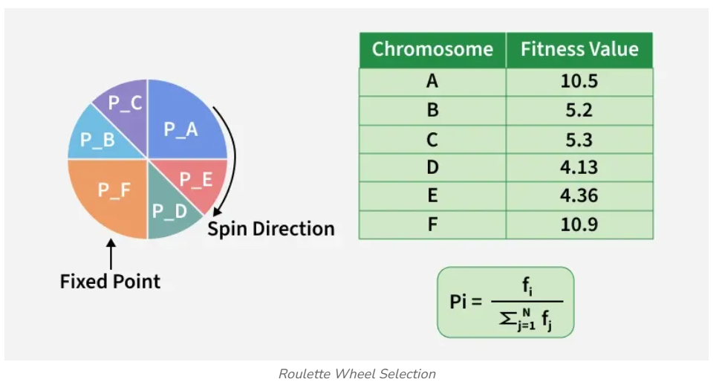
Roulette Wheel Selection:
It is a fitness-proportionate selection technique where each individual’s probability of being selected is directly proportional to its fitness value. Individuals with higher fitness occupy larger segments of the roulette wheel, making them more likely to be chosen.

Slide 59
Roulette Wheel Selection
Parent Selection Methods
Each current string in the population has a slot assigned to it which is in proportion to it’s fitness.
We spin the weighted roulette wheel thus defined n times (where n is the total number of solutions).
Each time Roulette Wheel stops, the string corresponding to that slot is created.
Strings that are fitter are assigned a larger slot and hence have a better chance of appearing in the new population.

Slide 60
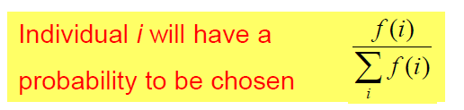
Example Of Roulette Wheel Selection
No. | String | Fitness | % Of Total
1 | 01101 | 169 | 14.4
2 | 11000 | 576 | 49.2
3 | 01000 | 64 | 5.5
4 | 10011 | 361 | 30.9
Total |  | 1170 | 100.0

Slide 61
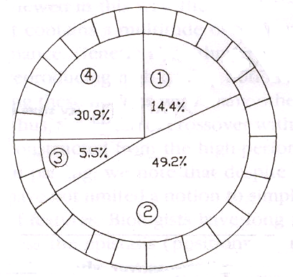
Roulette Wheel For Example

Slide 62
Roulette wheel selection can be implemented as follows
1. Sum the fitnesses of all the population members. Call this TF (total fitness).
Total=1170
2. Generate a random number m, between 0 and TF.
m=300
3. Return the first population member whose fitness added to the preceding population members is greater than or equal to m.
sum=169, sum=169+576 >m select second individual.

Slide 63
Pseudo code of Selection process
Function select(popsize, sumfitness, population) {
  Begin
    Partsum=0 j=0
    rand= rand*sumfitness
    Repeat
      j=j+1
      partsum=partsum+pop[j].fitness
      Until(partsum>=rand) or (j=popsize)
      Return individual number
      Select=j
      end

Slide 64
Tournament Selection
It randomly selects a small group of individuals from the population and chooses the fittest among them as a parent. This process is repeated until the required number of parents is selected.
In Tournament Selection, q individuals are randomly selected from the population and the best of the q individuals is returned as a parent.
Selection Pressure increases as q is increased and decreases a q is decreased.

Slide 65
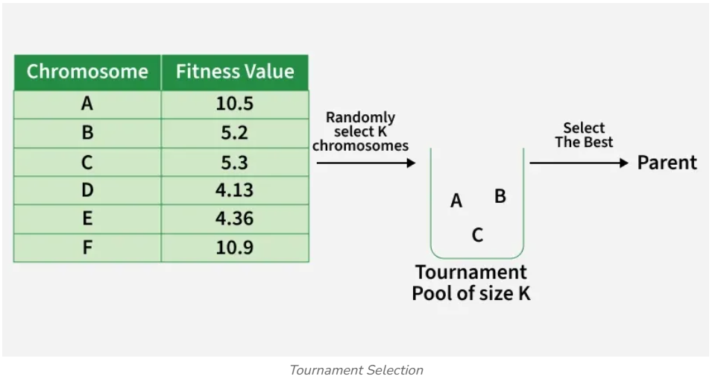

Slide 66
Genetic Algorithms:
Genetic Procreation Operators
Genetic Algorithms typically use two types of operators:
  Crossover and
  Mutation
Crossover is usually the primary operator with mutation serving only as a mechanism to introduce diversity in the population.
However, when designing a GA to solve a problem it is not uncommon that one will have to develop unique crossover and mutation operators that take advantage of the structure of the CSs comprising the search space.

Slide 67
Crossover
It is the process in which two chromosomes (strings) combine their genetic material (bits) to produce a new offspring which possesses both their characteristics.
Two strings are picked from the mating pool at random to cross over.
The method chosen depends on the Encoding Method.

Slide 68
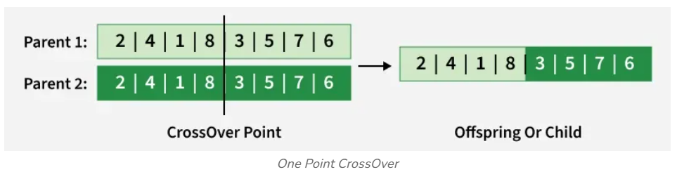
Crossover Methods
Single(One) Point Crossover- A random point is chosen on the individual chromosomes (strings) and the genetic material is exchanged at this point.

Slide 69
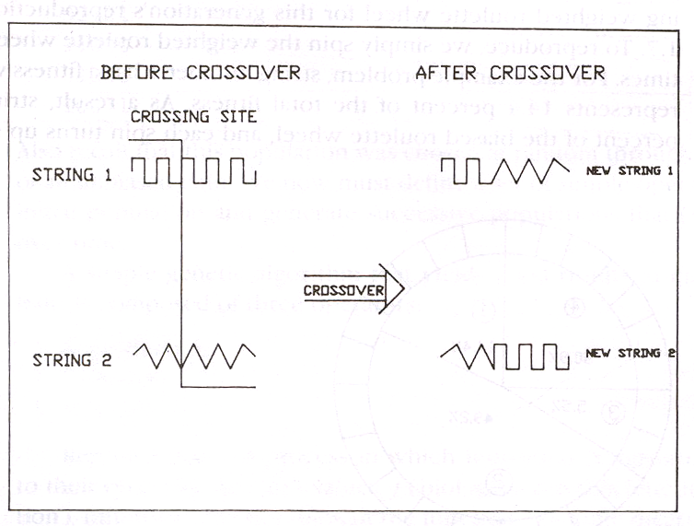

Slide 70
Crossover Methods (contd.)
Single Point Crossover
Chromosome1 | 11011 | 00100110110
Chromosome 2 | 11011 | 11000011110
Offspring 1 | 11011 | 11000011110
Offspring 2 | 11011 | 00100110110

Slide 71
Crossover Methods (contd.)
Two-Point Crossover- Two random points are chosen on the individual chromosomes (strings) and the genetic material is exchanged at these points.
Chromosome1 | 11011 | 00100 | 110110
Chromosome 2 | 10101 | 11000 | 011110
Offspring 1 | 10101 | 00100 | 011110
Offspring 2 | 11011 | 11000 | 110110
NOTE: These chromosomes are different from the last example.

Slide 72
Crossover Methods (contd.)
Uniform Crossover- Each gene (bit) is selected randomly from one of the corresponding genes of the parent chromosomes.
Chromosome1 | 11011 | 00100 | 110110
Chromosome 2 | 10101 | 11000 | 011110
Offspring | 10111 | 00000 | 110110
NOTE: Uniform Crossover yields ONLY 1 offspring.

Slide 73
Crossover (contd.)
Crossover between 2 good solutions MAY NOT ALWAYS yield a better or as good a solution.
Since parents are good, probability of the child being good is high.
If offspring is not good (poor solution), it will be removed in the next iteration during “Selection”.

Slide 74
Real-Coded Crossover Operators
For Real-Coded representations there exist a number of other crossover operators:
  Mid-Point Crossover,
  Flat Crossover (BLX-0.0),
  BLX-0.5

Slide 75
Mid-Point Crossover
Given two parents where X and Y represent a floating point number:
  Parent 1: X
  Parent 2: Y
  Offspring: (X+Y)/2
If a chromosome contains more than one gene, then this operator can be applied to each gene with a probability of P_{mp}.

Slide 76
Flat Crossover (BLX-0.0)
Flat crossover was developed by Radcliffe (1991)
Given two parents where X and Y represent a floating point number:
  Parent 1: X
  Parent 2: Y
  Offspring: rnd(X,Y)
Of course, if a chromosome contains more than one gene then this operator can be applied to each gene with a probability of P_{blx-0.0}.

Slide 77
BLX-α
Developed by Eshelman & Schaffer (1992)
Given two parents where X and Y represent a floating point number, and where X < Y:
  Parent 1: X
  Parent 2: Y
  Let Δ = α(Y-X), where α = 0.5
  Offspring: rnd(X-Δ, Y+ Δ)
Of course, if a chromosome contains more than one gene then this operator can be applied to each gene with a probability of P_{blx-α}.

Slide 78
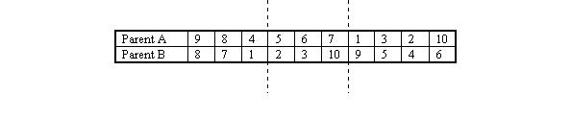
Partially Matched Crossover (PMX)
PMX is similar to order-based crossover in that it can be used for problems such as the travelling salesman problem. An example is probably the best way to shows how PMX operates. This example is taken from (Goldberg).
Given two parents, A and B, two crossover points are chosen.

Slide 79
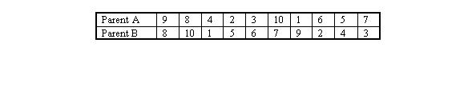
Now, looking at B, we consider the genes between the crossover site. The first, 2, maps to 5 in parent A. Therefore, we swap gene 2 with gene 5 in parent B. Following the same principle we swap 3 and 6 and 10 and 7.
A similar procedure is followed for parent A (swapping 5 and 2, 6 and 3 and 7 and 10). The resulting chromosomes are shown below.

Slide 80
Mutation
It is the process by which a string is deliberately changed so as to maintain diversity in the population set.
Mutation Probability- determines how often the parts of a chromosome will be mutated.

Slide 81
Example Of Mutation
For chromosomes using Binary Encoding, randomly selected bits are inverted.
Offspring | 11011 00100 110110
Mutated Offspring | 11010 00100 100110
NOTE: The number of bits to be inverted depends on the Mutation Probability.

Slide 82
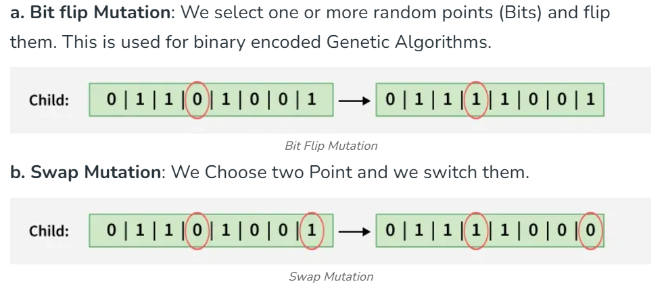
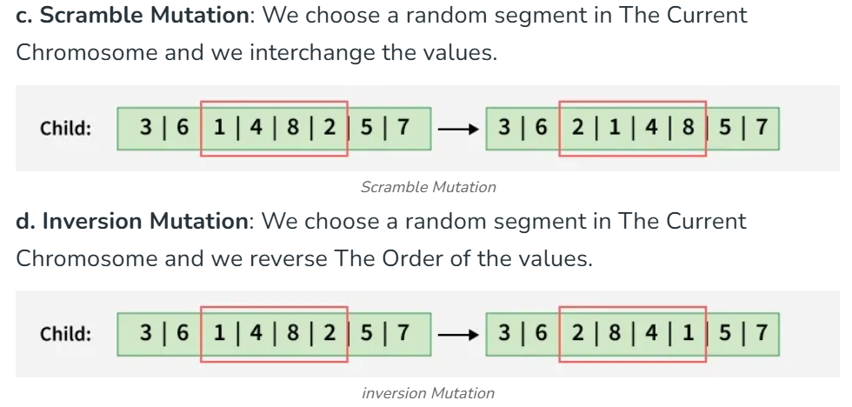

Slide 83
Elitism
Elitism is a method which copies the best chromosome to the new offspring population before crossover and mutation.
When creating a new population by crossover or mutation the best chromosome might be lost.
Forces GAs to retain some number of the best individuals at each generation.
Has been found that elitism significantly improves performance.

Slide 84
Genetic Algorithms:
Selection Who Survives
Basically, there are two types of GAs commonly used.
These GAs are characterized by the type of replacement strategies they use.
A Generational GA uses a (μ,μ) replacement strategy where the offspring replace the parents.
A Steady-State GA usually will select two parents, create 1-2 offspring which will replace the 1-2 worst individuals in the current population even if the offspring are worse than the individuals they replace.

Slide 85
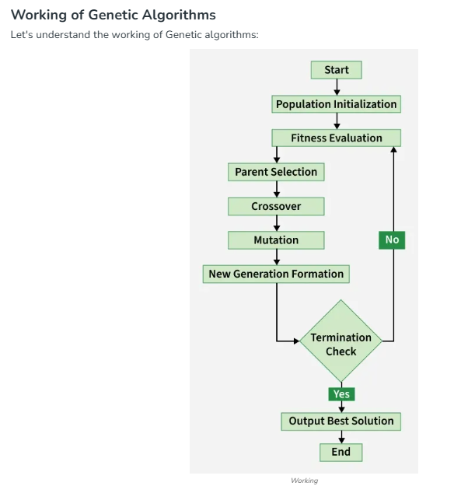

Slide 86
Genetic Algorithm:
Example by Hand
Now that we have an understanding of the various parts of a GA let’s evolve a simple GA (SGA) by hand.
A SGA is :
  binary-coded,
  Uses Roulette Wheel selection
  uses single-point crossover (with a crossover usage rate between 0.6-1.0),
  uses a small mutation rate, and
  is generational.

Slide 87
Genetic Algorithms:
Example
The SGA for our example will use:
  A population size of 6,
  A crossover usage rate of 1.0, and
  A mutation rate of 1/7.
Let’s try to solve the following problem
  f(x) = x², where -2.0 ≤ x ≤ 2.0,
  Let l = 7, therefore our mapping function will be
    d(2,-2,7,c) = 4*decode(c)/127 - 2

Slide 88
Genetic Algorithms:
An Example Run (by hand)
Randomly Generate an Initial Population
Genotype Phenotype Fitness
Person 1: 1001010 0.331 Fit: ?
Person 2: 0100101 - 0.835 Fit: ?
Person 3: 1101010 1.339 Fit: ?
Person 4: 0110110 - 0.300 Fit: ?
Person 5: 1001111 0.488 Fit: ?
Person 6: 0001101 - 1.591 Fit: ?

Slide 89
Genetic Algorithms:
An Example Run (by hand)
Evaluate Population at t=0
Genotype Phenotype Fitness
Person 1: 1001010 0.331 Fit: 0.109
Person 2: 0100101 - 0.835 Fit: 0.697
Person 3: 1101010 1.339 Fit: 1.790
Person 4: 0110110 - 0.300 Fit: 0.090
Person 5: 1001111 0.488 Fit: 0.238
Person 6: 0001101 - 1.591 Fit: 2.531

Slide 90
Genetic Algorithms:
An Example Run (by hand)
Select Six Parents Using the Roulette Wheel
Genotype Phenotype Fitness
Person 6: 0001101 - 1.591 Fit: 2.531
Person 3: 1101010 1.339 Fit: 1.793
Person 5: 1001111 0.488 Fit: 0.238
Person 6: 0001101 - 1.591 Fit: 2.531
Person 2: 0100101 - 0.835 Fit: 0.697
Person 1: 1001010 0.331 Fit: 0.109

Slide 91
Genetic Algorithms:
An Example Run (by hand)
Create Offspring 1 & 2 Using Single-Point Crossover
Genotype Phenotype Fitness
Person 6: 00|01101 - 1.591 Fit: 2.531
Person 3: 11|01010 1.339 Fit: 1.793
Child 1 : 0001010 - 1.685 Fit: ?
Child 2 : 1101101 1.433 Fit: ?

Slide 92
Genetic Algorithms:
An Example Run (by hand)
Create Offspring 3 & 4
Genotype Phenotype Fitness
Person 5: 1001|111 0.488 Fit: 0.238
Person 6: 0001|101 - 1.591 Fit: 2.531
Child 3 : 1011100 0.898 Fit: ?
Child 4 : 0001011 - 1.654 Fit: ?

Slide 93
Genetic Algorithms:
An Example Run (by hand)
Create Offspring 5 & 6
Genotype Phenotype Fitness
Person 2: 010|0101 - 0.835 Fit: 0.697
Person 1: 100|1010 0.331 Fit: 0.109
Child 5 : 1101010 1.339 Fit: ?
Child 6 : 1010101 0.677 Fit: ?

Slide 94
Genetic Algorithms:
An Example Run (by hand)
Evaluate the Offspring
Genotype Phenotype Fitness
Child 1 : 0001010 - 1.685 Fit: 2.839
Child 2 : 1101101 1.433 Fit: 2.054
Child 3 : 1011100 0.898 Fit: 0.806
Child 4 : 0001011 - 1.654 Fit: 2.736
Child 5 : 1101010 1.339 Fit: 1.793
Child 6 : 1010101 0.677 Fit: 0.458

Slide 95
Genetic Algorithms:
An Example Run (by hand)
Population at t=0
Genotype Phenotype Fitness
Person 1: 1001010 0.331 Fit: 0.109
Person 2: 0100101 - 0.835 Fit: 0.697
Person 3: 1101010 1.339 Fit: 1.793
Person 4: 0110110 - 0.300 Fit: 0.090
Person 5: 1001111 0.488 Fit: 0.238
Person 6: 0001101 - 1.591 Fit: 2.531
Is Replaced by:
Genotype Phenotype Fitness
Child 1 : 0001010 - 1.685 Fit: 2.839
Child 2 : 1101101 1.433 Fit: 2.053
Child 3 : 1011100 0.898 Fit: 0.806
Child 4 : 0001011 - 1.654 Fit: 2.736
Child 5 : 1101010 1.339 Fit: 1.793
Child 6 : 1010101 0.677 Fit: 0.458

Slide 96
Genetic Algorithms:
An Example Run (by hand)
Population at t=1
Genotype Phenotype Fitness
Person 1: 0001010 - 1.685 Fit: 2.839
Person 2: 1101101 1.433 Fit: 2.054
Person 3: 1011100 0.898 Fit: 0.806
Person 4: 0001011 - 1.654 Fit: 2.736
Person 5: 1101010 1.339 Fit: 1.793
Person 6: 1010101 0.677 Fit: 0.458

Slide 97
Genetic Algorithms:
An Example Run (by hand)
The Process of:
  Selecting six parents,
  Allowing the parents to create six offspring,
  Mutating the six offspring,
  Evaluating the offspring, and
  Replacing the parents with the offspring
Is repeated until a stopping criterion has been reached.

Slide 98
Genetic Algorithms:
An Example Run (Steady-State GA)
Randomly Generate an Initial Population
Genotype Phenotype Fitness
Person 1: 1001010 0.331 Fit: ?
Person 2: 0100101 - 0.835 Fit: ?
Person 3: 1101010 1.339 Fit: ?
Person 4: 0110110 - 0.300 Fit: ?
Person 5: 1001111 0.488 Fit: ?
Person 6: 0001101 - 1.591 Fit: ?

Slide 99
Genetic Algorithms:
An Example Run (Steady-State GA)
Evaluate Population at t=0
Genotype Phenotype Fitness
Person 1: 1001010 0.331 Fit: 0.109
Person 2: 0100101 - 0.835 Fit: 0.697
Person 3: 1101010 1.339 Fit: 1.790
Person 4: 0110110 - 0.300 Fit: 0.090
Person 5: 1001111 0.488 Fit: 0.238
Person 6: 0001101 - 1.591 Fit: 2.531

Slide 100
Genetic Algorithms:
An Example Run (Steady-State GA)
Select 2 Parents and Create 2 Using Single-Point Crossover
Genotype Phenotype Fitness
Person 6: 00|01101 - 1.591 Fit: 2.531
Person 3: 11|01010 1.339 Fit: 1.793
Child 1 : 0001010 - 1.685 Fit: ?
Child 2 : 1101101 1.433 Fit: ?

Slide 101
Genetic Algorithms:
An Example Run (Steady-State GA)
Evaluate the Offspring
Genotype Phenotype Fitness
Child 1 : 0001010 - 1.685 Fit: 2.839
Child 2 : 1101101 1.433 Fit: 2.054

Slide 102
Genetic Algorithms:
An Example Run (Steady-State GA)
Find the two worst individuals to be replaced
Genotype Phenotype Fitness
Person 1: 1001010 0.331 Fit: 0.109
Person 2: 0100101 - 0.835 Fit: 0.697
Person 3: 1101010 1.339 Fit: 1.790
Person 4: 0110110 - 0.300 Fit: 0.090
Person 5: 1001111 0.488 Fit: 0.238
Person 6: 0001101 - 1.591 Fit: 2.531

Slide 103
Genetic Algorithms:
An Example Run (Steady-State GA)
Replace them with the offspring
Genotype Phenotype Fitness
Person 1: 1001010 0.331 Fit: 0.109
Child 1 : 0001010 - 1.685 Fit: 2.839
Person 3: 1101010 1.339 Fit: 1.790
Child 2 : 1101101 1.433 Fit: 2.054
Person 5: 1001111 0.488 Fit: 0.238
Person 6: 0001101 - 1.591 Fit: 2.531

Slide 104
Genetic Algorithms:
An Example Run (Steady-State GA)
This process of:
  Selecting two parents,
  Allowing them to create two offspring, and
  Immediately replacing the two worst individuals in the population with the offspring
Is repeated until a stopping criterion is reached
Notice that on each cycle the steady-state GA will make two function evaluations while a generational GA will make P (where P is the population size) function evaluations.
Therefore, you must be careful to count only function evaluations when comparing generational GAs with steady-state GAs.

Slide 105
Advantages Of GAs
Global Search Methods: GAs search for the function optimum starting from a population of points of the function domain, not a single one. This characteristic suggests that GAs are global search methods. They can, in fact, climb many peaks in parallel, reducing the probability of finding local minima, which is one of the drawbacks of traditional optimization methods.

Slide 106
Advantages of GAs (contd.)
Blind Search Methods: GAs only use the information about the objective function. They do not require knowledge of the first derivative or any other auxiliary information, allowing a number of problems to be solved without the need to formulate restrictive assumptions. For this reason, GAs are often called blind search methods.

Slide 107
Advantages of GAs (contd.)
GAs use probabilistic transition rules during iterations, unlike the traditional methods that use fixed transition rules.
This makes them more robust and applicable to a large range of problems.

Slide 108
Advantages of GAs (contd.)
GAs can be easily used in parallel machines- Since in real-world design optimization problems, most computational time is spent in evaluating a solution, with multiple processors all solutions in a population can be evaluated in a distributed manner. This reduces the overall computational time substantially.

Slide 109

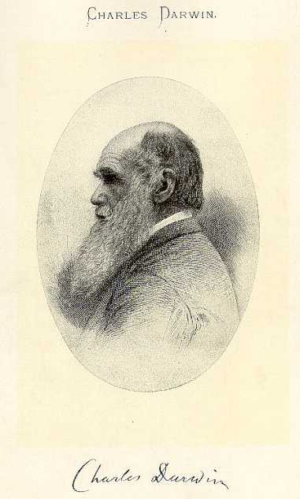
Knapsack Problem
Problem Description:
You are going on a picnic.
And have a number of items that you could take along.
Each item has a weight and a benefit or value.
You can take one of each item at most.
There is a capacity limit on the weight you can carry.
You should carry items with max. values.

Slide 110
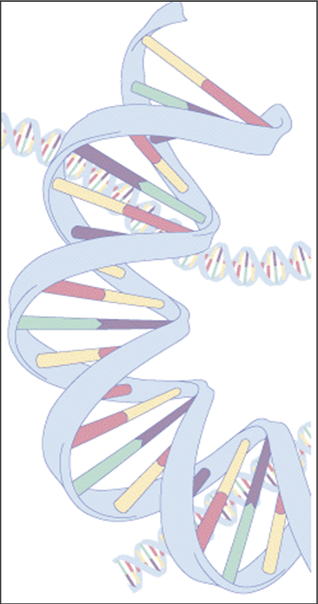

Knapsack Problem
Example:
Item: 1 2 3 4 5 6 7
Benefit: 5 8 3 2 7 9 4
Weight: 7 8 4 10 4 6 4
Knapsack holds a maximum of 22 pounds
Fill it to get the maximum benefit

Slide 111

Genetic Algorithm
Outline of the Basic Genetic Algoritm
[Start]
  Encoding: represent the individual.
  Generate random population of n chromosomes (suitable solutions for the problem).
[Fitness] Evaluate the fitness of each chromosome.
[New population] repeating following steps until the new population is complete.
[Selection] Select the best two parents.
[Crossover] cross over the parents to form a new offspring (children).

Slide 112
Genetic Algorithm
Outline of the Basic Genetic Algoritm Cont.
[Mutation] With a mutation probability.
[Accepting] Place new offspring in a new population.
[Replace] Use new generated population for a further run of algorithm.
[Test] If the end condition is satisfied, then stop.
[Loop] Go to step 2 .

Slide 113
Basic Steps
Start
Encoding: 0 = not exist, 1 = exist in the Knapsack
  Chromosome: 1010110
  => Items taken: 1, 3 , 5, 6.
Generate random population of n chromosomes:
  0101010
  1100100
  0100011
7 | 6 | 5 | 4 | 3 | 2 | 1 | Item.
0 | 1 | 1 | 0 | 1 | 0 | 1 | Chro
n | y | y | n | y | n | y | Exist?

Slide 114
Basic Steps Cont.
Fitness & Selection
✗
0101010: Benefit= 19, Weight= 24
1100100: Benefit= 20, Weight= 19.
0100011: Benefit= 21, Weight= 18.
7 | 6 | 5 | 4 | 3 | 2 | 1 | Item
0 | 1 | 0 | 1 | 0 | 1 | 0 | Chro
4 | 9 | 7 | 2 | 3 | 8 | 5 | Benefit
4 | 6 | 4 | 10 | 4 | 8 | 7 | Weight
✓
✓
=> We select Chromosomes b & c.

Slide 115
Basic Steps Cont.
Crossover & Mutation
Parent 1
1 1 0 0 1 0 0
Parent 2
0 1 0 0 0 1 1
Child 1
1 1 0 0 0 1 1
Child 2
0 1 0 0 1 0 1
Mutation
0 1 0 0 1 0 0

Slide 116
Basic Steps Cont.
Accepting, Replacing & Testing
Place new offspring in a new population.
Use new generated population for a further run of algorithm.
If the end condition is satisfied, then stop. End conditions:
  Number of populations.
  Improvement of the best solution.
Else, return to step 2 [Fitness].

Slide 117
Genetic Algorithm
Conclusion
GA is nondeterministic – two runs may end with different results
There’s no indication whether best individual is optimal

Slide 118
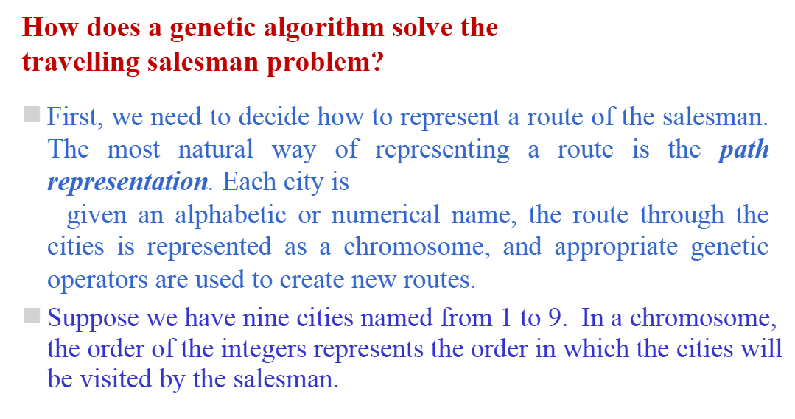

Slide 119
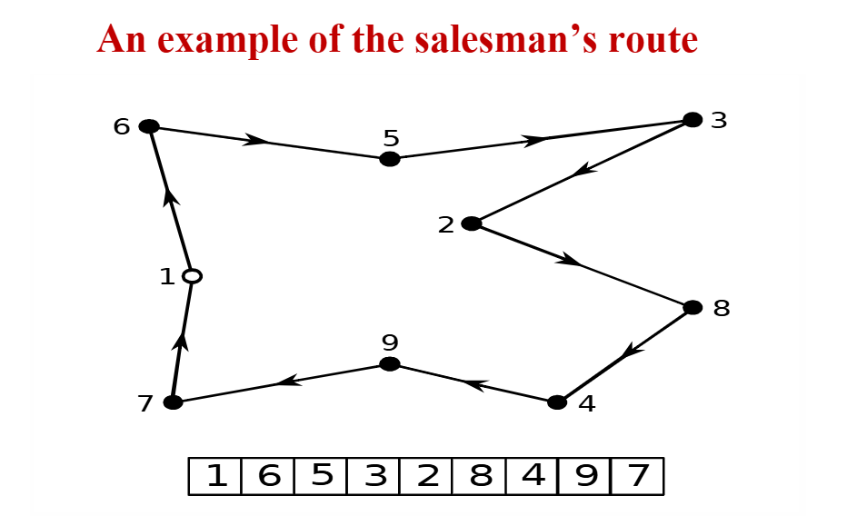

Slide 120
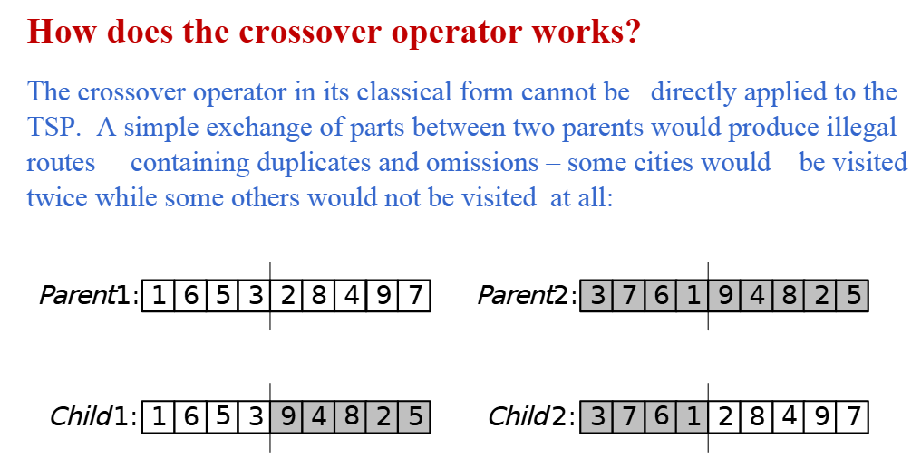

Slide 121
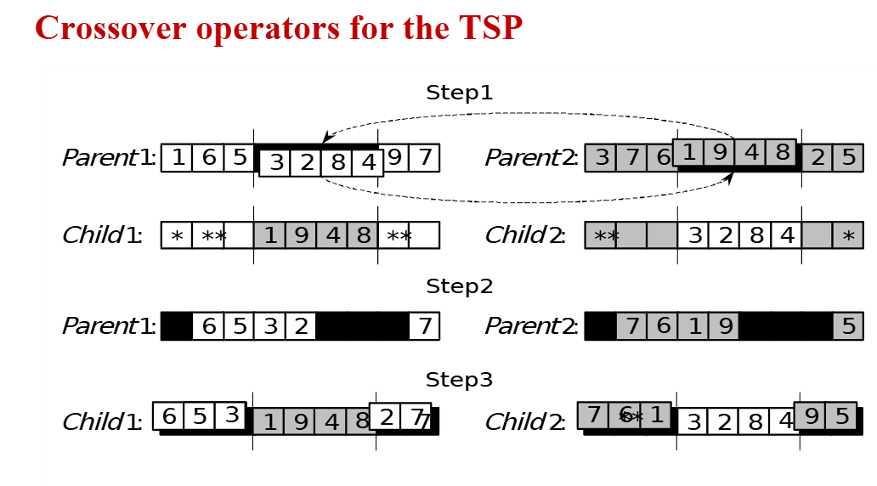

Slide 122
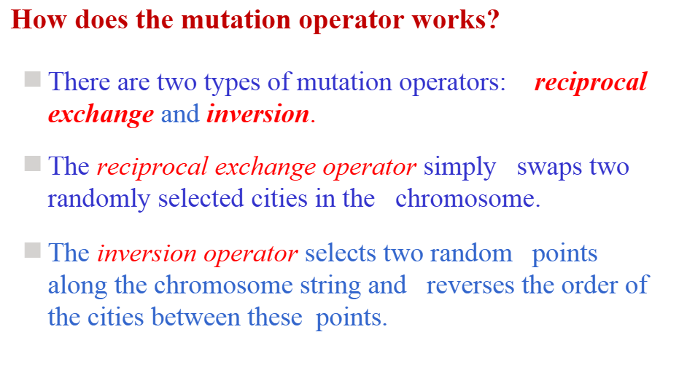

Slide 123
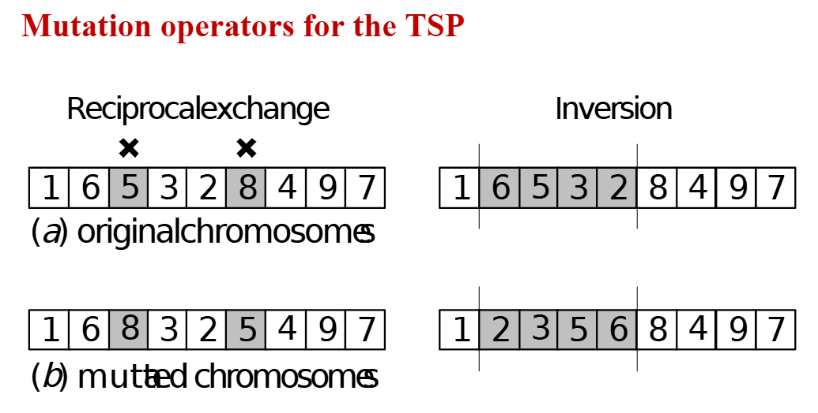

Slide 124
Example: Solving the 8 queen problem using genetic algorithm
The 8 queen problem is a classic, well-known problem in artificial intelligence and combinatorial optimization.
Objective
The goal is to place eight queens on an 8x8 chessboard so that no two queens threaten or attack each other. To prevent the queens from attacking one another, no two queens should be in the same row, column, or diagonal.

Slide 125
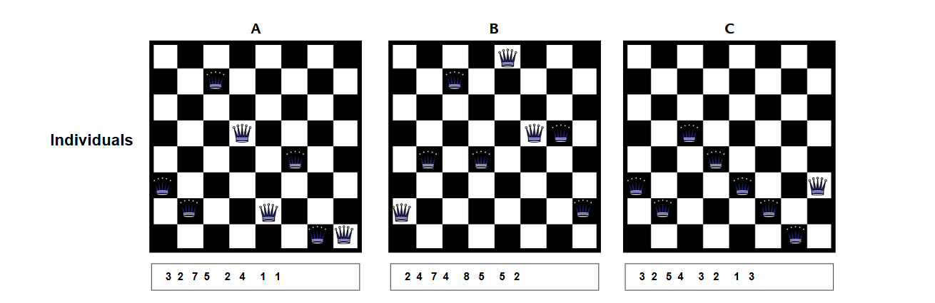
Steps in the Genetic Algorithm:
Initialization: Create a randomized population of potential solutions (board states). These arrays represent the queen's positions on the chessboard. The index represents the column, and the row represents the value.

Slide 126
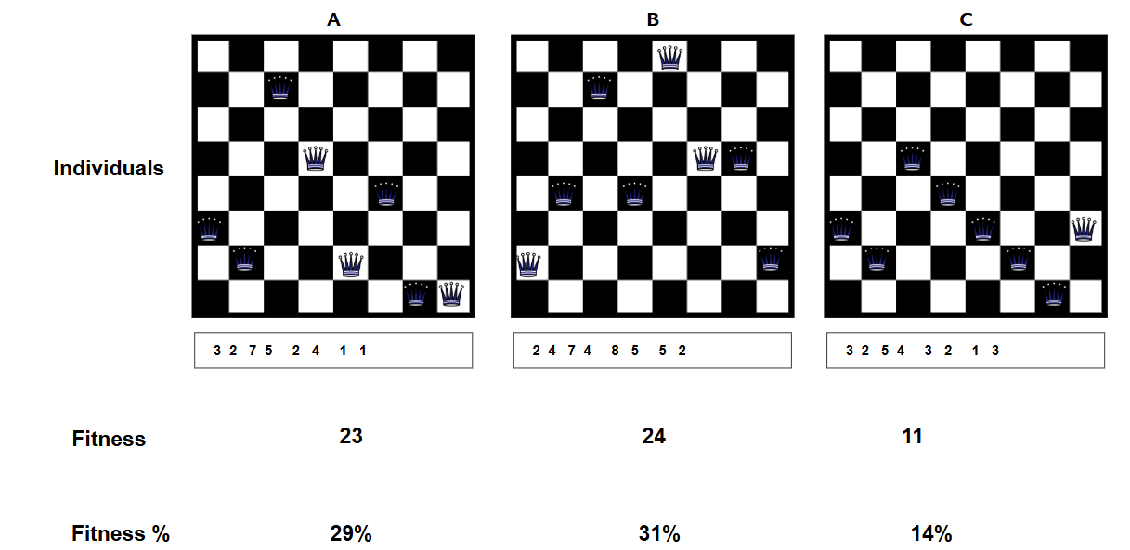
Fitness evaluation: Calculate each potential solution's fitness. The number of non-attacking pairs in the 8-Queens puzzle determines its fitness function.

Slide 127
The fitness is calculated by adding the number of non-attacking pairs for each queen. For instance, for board A, the queen positions are [3, 2, 7, 5, 2, 4, 1, 1] , the queen at index 1, value 3 has 6 non-attacking pairs, the queen at index 2, value 2 has 5 non-attacking pairs, the queen at index 3, value 7 has 4 non-attacking pairs and it goes on for the remaining queens till the 8th index. The number of non-attacking pairs for each queen in the board is added and fitness is evaluated.
Selection: Select parents from the current population to create the next generation. Standard selection methods include:
Tournament selection
Roulette wheel selection
Crossover: Perform crossover between pairs of parents to create new offspring. Crossover involves exchanging genetic information to create a child solution.
Note: In case of the 8 queen problem, typically a single-point crossover is employed.

Slide 128
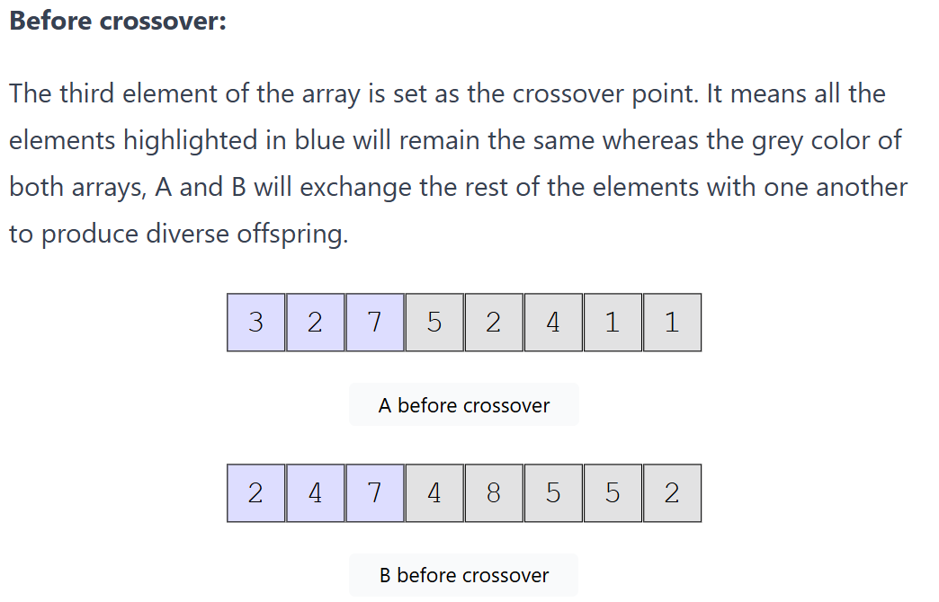

Slide 129
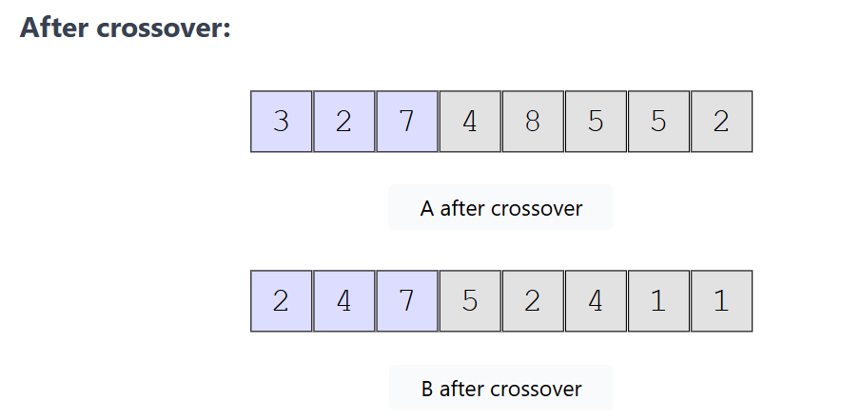

Slide 130
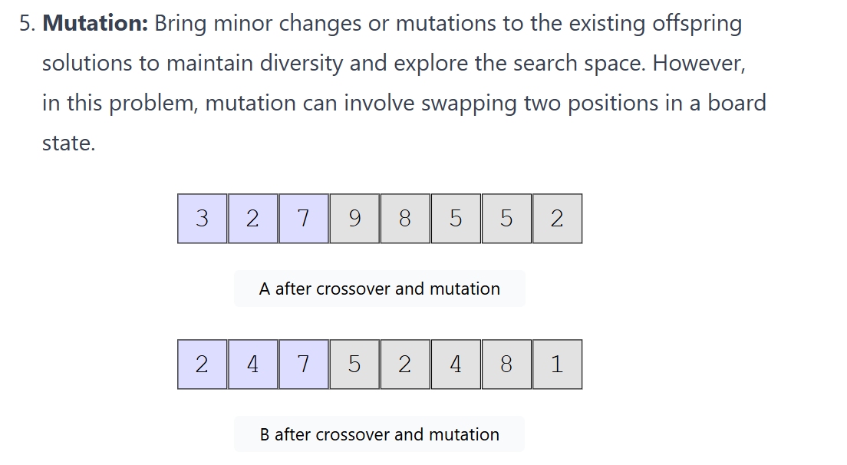

Slide 131
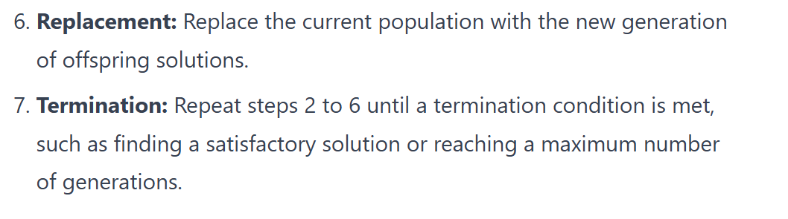

Slide 132
Why GA Work?
• In each generation we check several solutions at once. Thus GA is a kind of a parallel search.
• Fitness and selection filter out bad solutions from good ones.
• Offspring inherit properties of mostly good solutions.

Slide 133
Variations in GA
• Different selection strategies: roulette wheel, ranked, tournament selection.
• Different forms of the crossover operator: two-point, uniform.
• Static or variable population size
• Variable mutation rates
• Some “good” parts of the chromosomes may be kept intact. They are usually called schemas.
• Some very good individuals may survive for several generations (elitism).

