Slide 1
Heuristics & Local search algorithms in AI

Slide 2


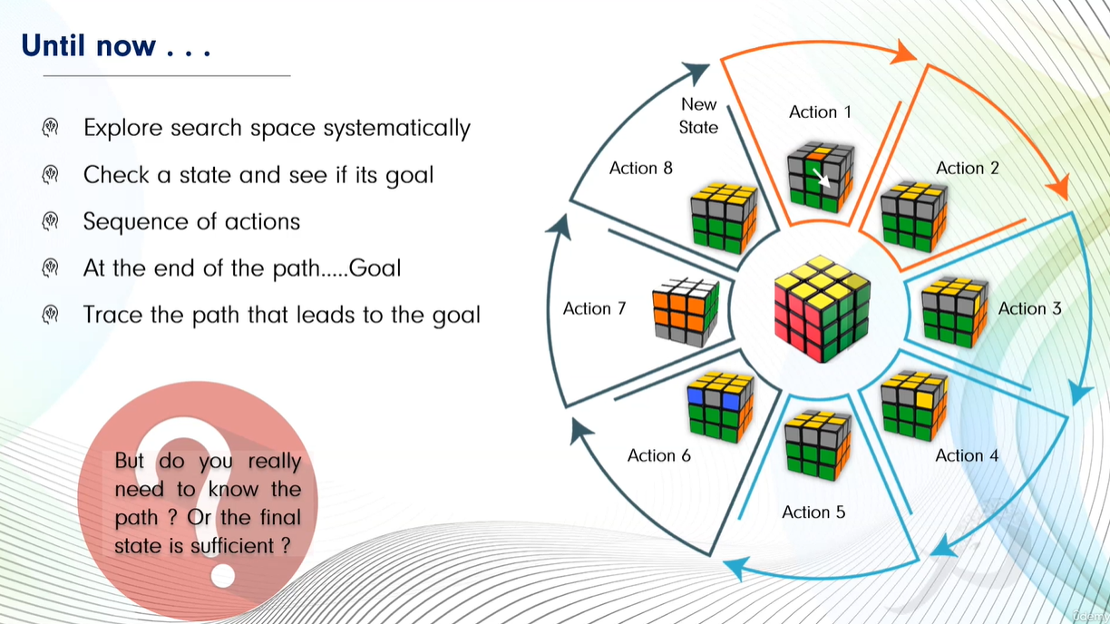

Slide 3


Slide 4


Slide 5
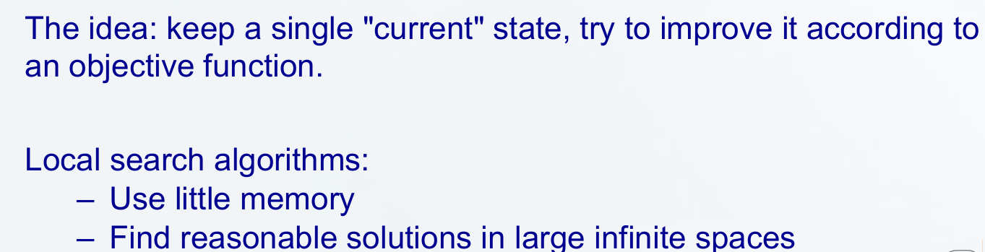
Local search algorithms allow us to find goal states without worrying about the path to get there. In local search problems, the state space consists of sets of “complete” solutions. We use these algorithms to try to find a configuration that satisfies some constraints or optimizes some objective function.

Slide 6
Local search algorithms are important in artificial intelligence as they can quickly find good answers, especially when finding the perfect solution would take too long or too much effort. They are useful for big or complex problems where checking every possible option isn't practical.
It focus only on the current solution and the ones directly related to it rather than looking everywhere.
Ideal for real-world tasks like puzzles, timetables or route finding.

Slide 7
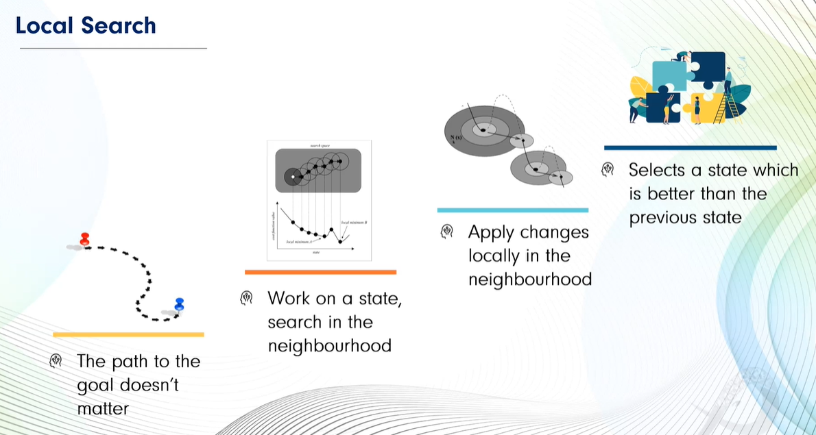


Slide 8



Slide 9

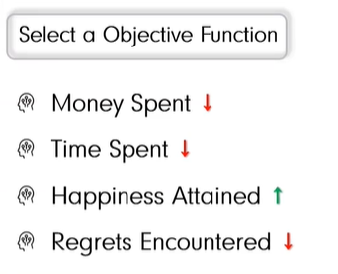

Slide 10
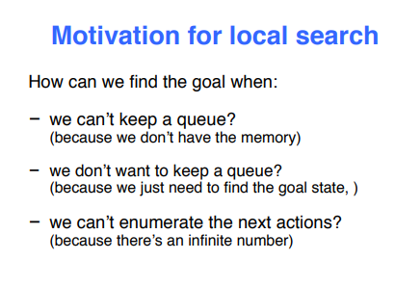
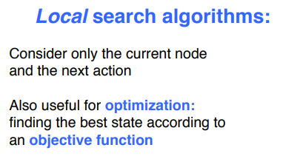
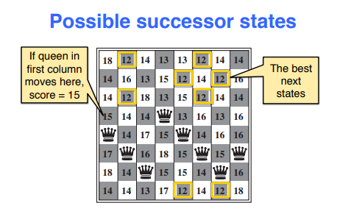
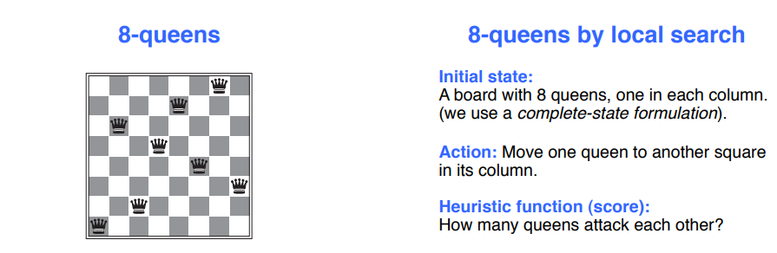

Slide 11
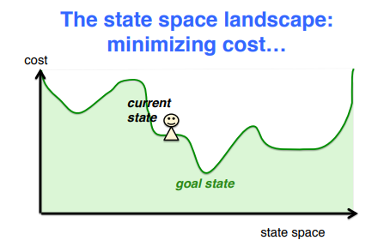
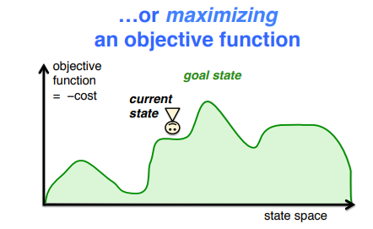
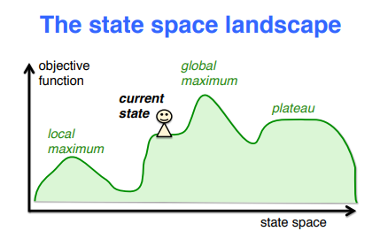


Slide 12
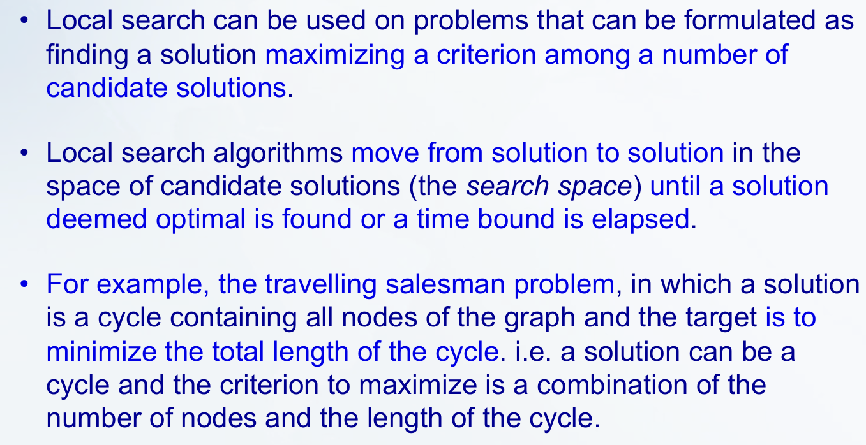

Slide 13
Working of Local Search Algorithms
Step 1: Pick a starting point: Start with a possible solution which is often random but sometimes based on rule.
Step 2: Find the neighbours:
  Neighbours are similar solutions we can get by making small, simple changes to the current one.
  For example, in a puzzle, swapping two pieces creates a neighbour.
Step 3: Compare: Look around at all neighbours to see if any are better.
Step 4: Move: If a better neighbour exists, move to it, making it our new “current” solution.
Step 5: Repeat: Keep searching from the new point, following the same steps.
Step 6: Stop: When none of the neighbours are better or after enough tries.

Slide 14
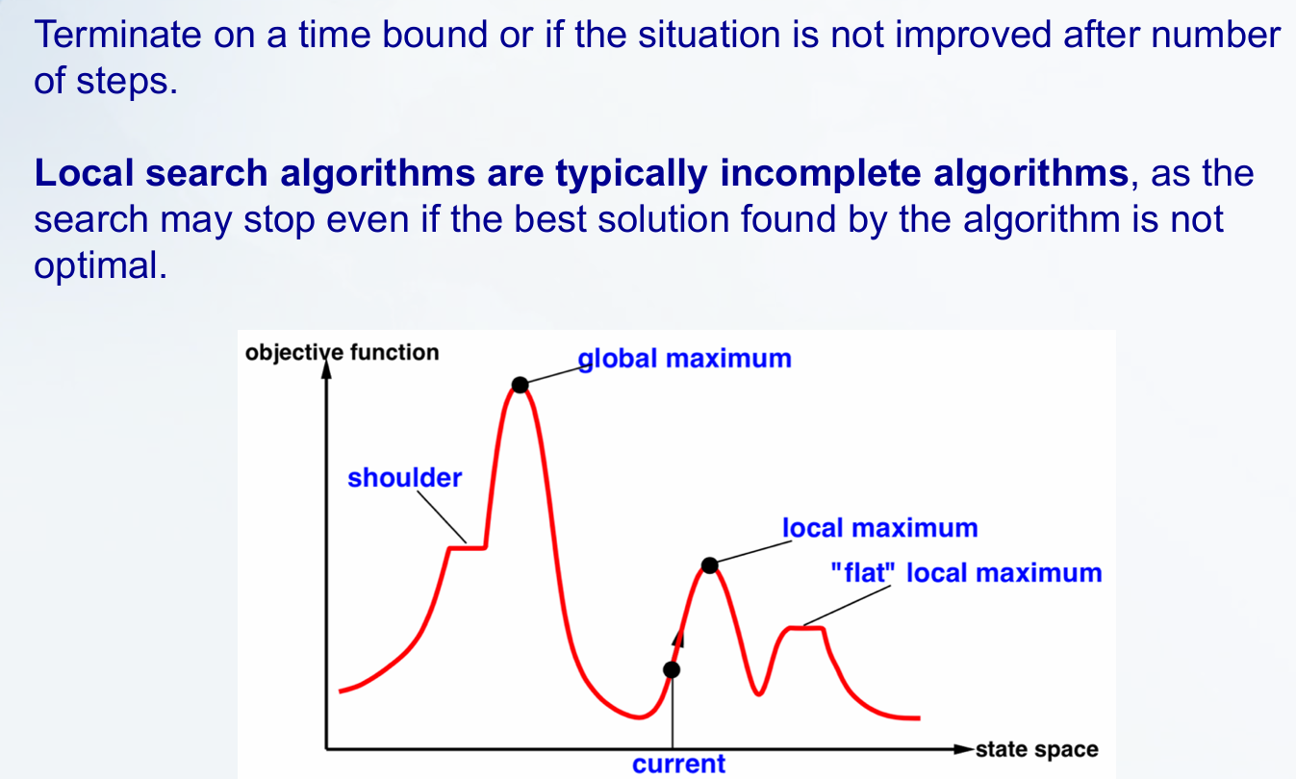

Slide 15
Hıll clımbıng method (local search)

Slide 16
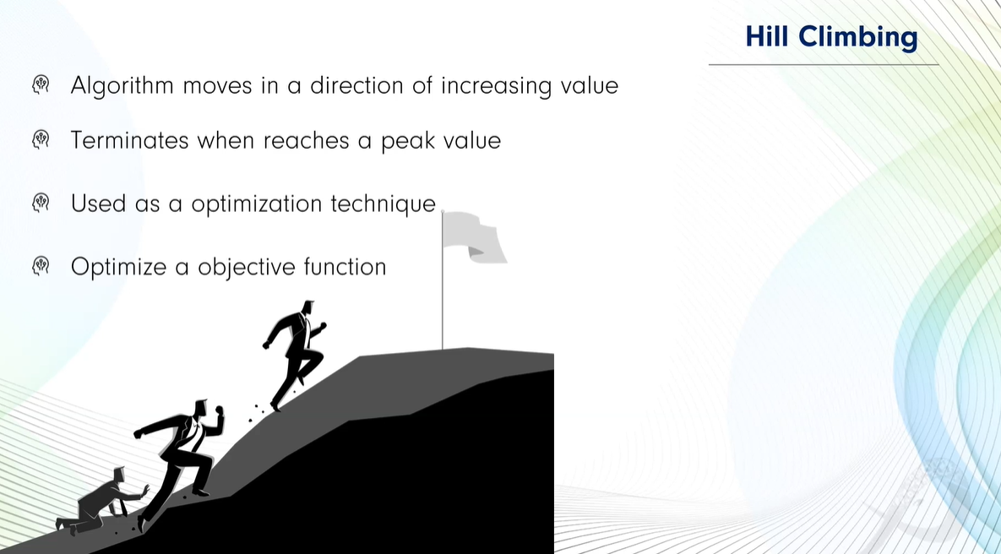


Slide 17
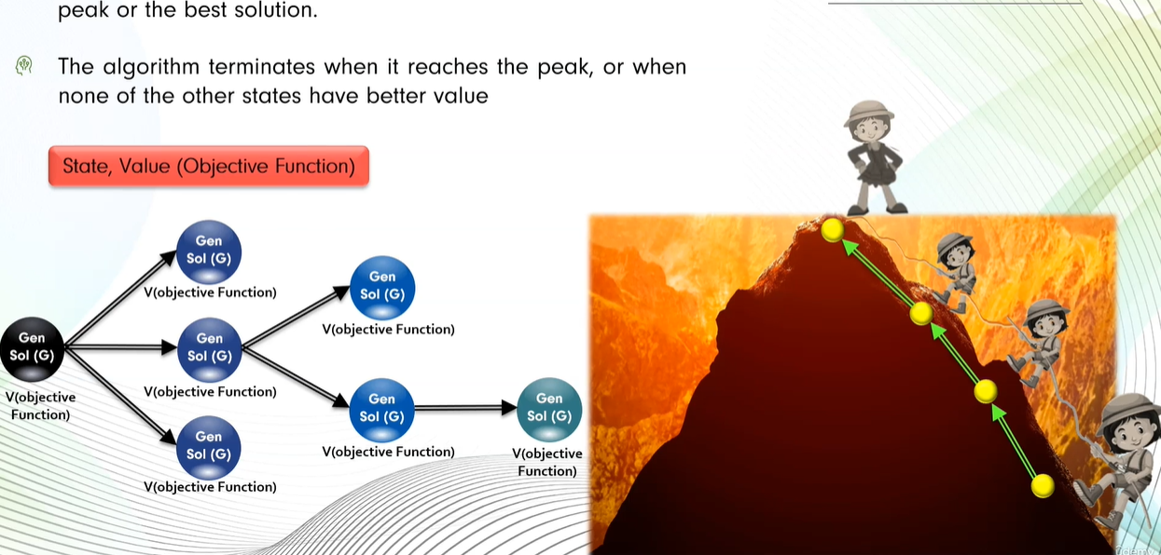

Slide 18
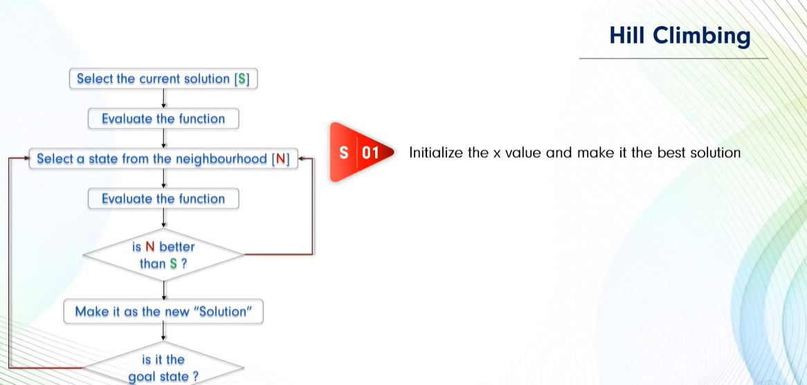





Slide 19
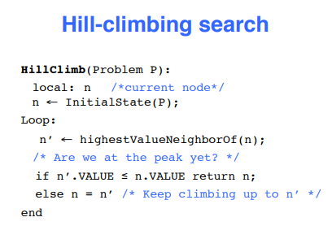
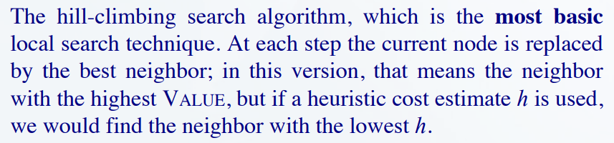

Slide 20
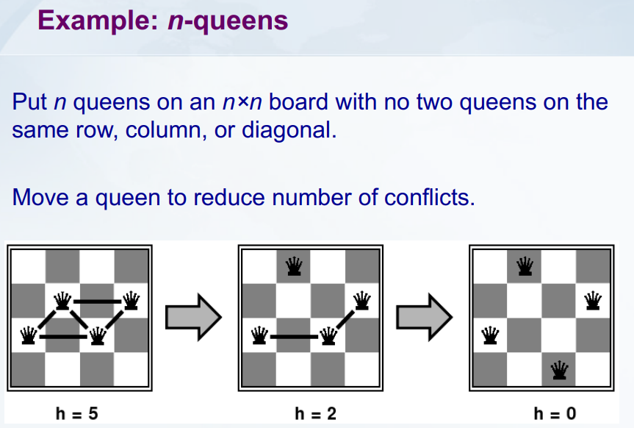

Slide 21
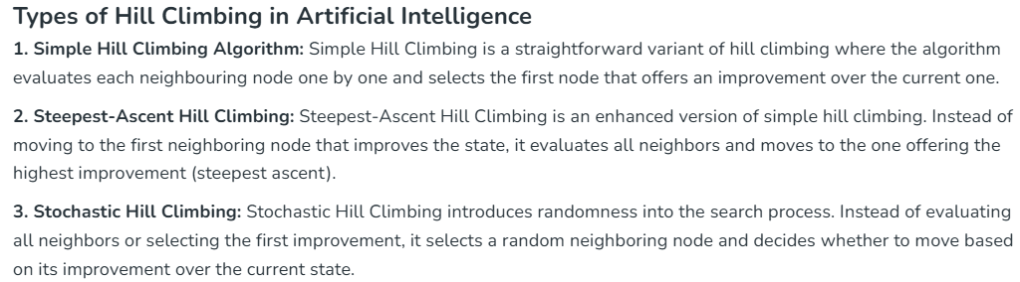

Slide 22
1. Simple Hillclimbing algorithm examples
Example: 4 Queens problem
We need to place 4 queens on a 4×4 chessboard so that no two queens attack each other (no same row, column, or diagonal).
We can represent a state as an array of column positions for each row.
For example:
[2, 4, 1, 3]
Means:
Row 1 → Column 2
Row 2 → Column 4
Row 3 → Column 1
Row 4 → Column 3

Slide 23
Step 1: Define the Heuristic
A common heuristic h(n) counts number of pairs of queens attacking each other.
Goal: h(n) = 0 → solution
Step 2: Start with a Random State
Random initial state: [1, 3, 2, 4]
Heuristic (number of attacking pairs):
Q1 and Q4 → diagonal attack
Q2 and Q3 → diagonal attack
So, h = 2

Slide 24
Step 3: Generate Neighbours (Successors)
Move each queen in its row to a different column and calculate h:
Move each queen in its row to a different column and calculate h:
Row 1 moves:
[2,3,2,4] → h = 2
[3,3,2,4] → h = 2
[4,3,2,4] → h = 3
Row 2 moves:
[1,1,2,4] → h = 3
[1,2,2,4] → h = 4
[1,4,2,4] → h = 2
Row 3 moves:
[1,3,1,4] → h = 2
[1,3,3,4] → h = 4
[1,3,4,4] → h = 3
Row 4 moves:
[1,3,2,1] → h = 4
[1,3,2,2] → h = 2
[1,3,2,3] → h = 2
In simple Hill Climbing go one by one to find next best solution.

Slide 25
Step 4: Choose Next First Best Successor
First Best successor has lowest h (1). Let’s pick:
[2,3,2,4] → h = 2
Step 5: Repeat
Now move queens again to reduce h.
Best move:
[2,4,1,3] → h = 0

Slide 26
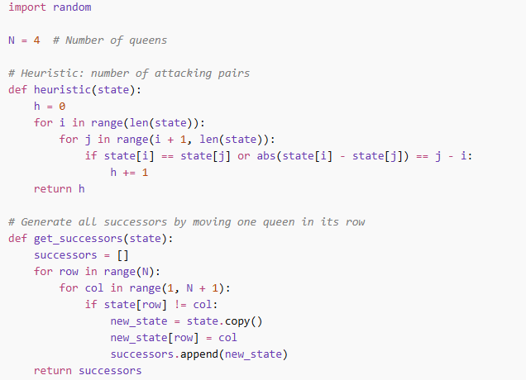
Pythone Code:

Slide 27
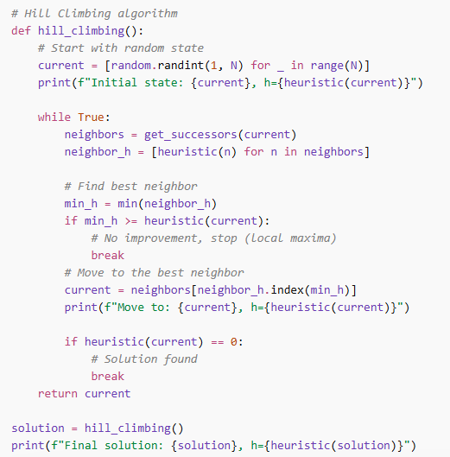

Slide 28
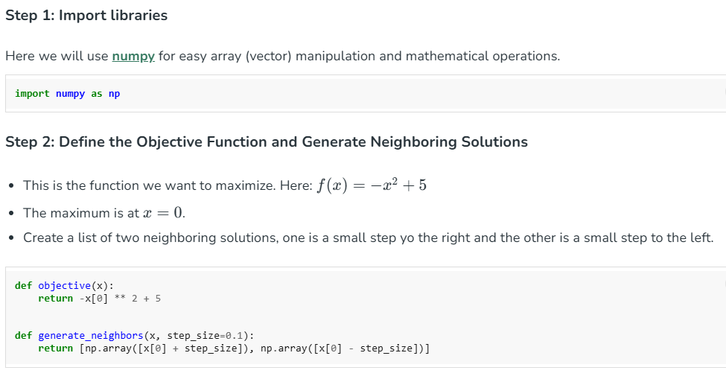
Example:

Slide 29
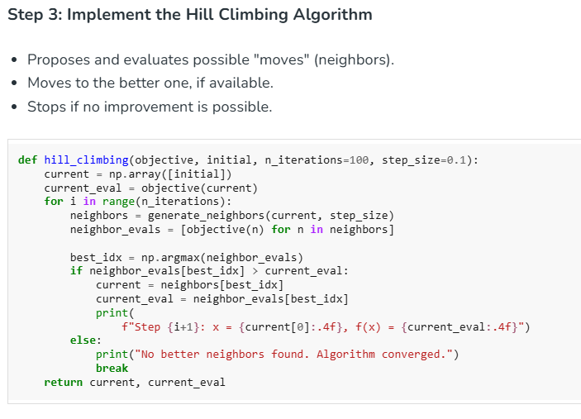

Slide 30
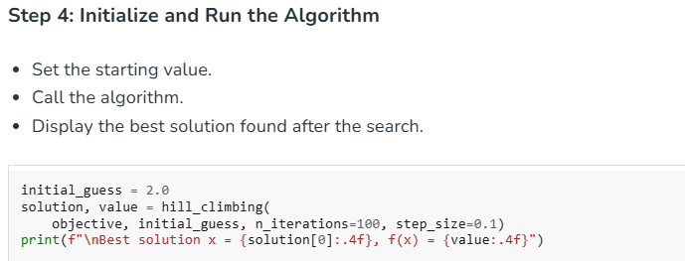
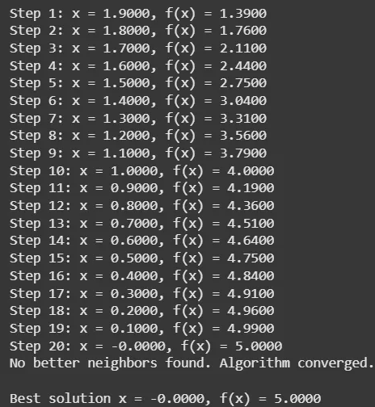

Slide 31
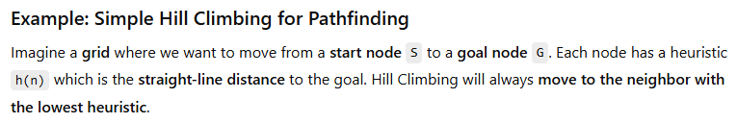
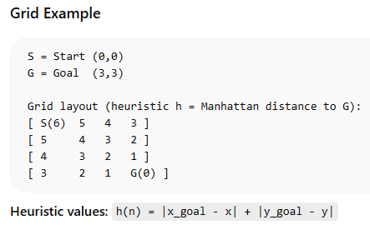

Slide 32
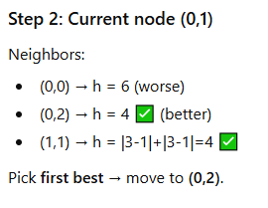
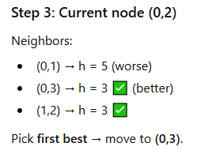
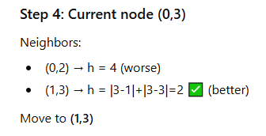
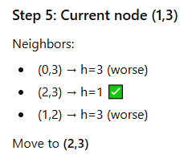
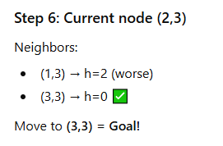

Slide 33
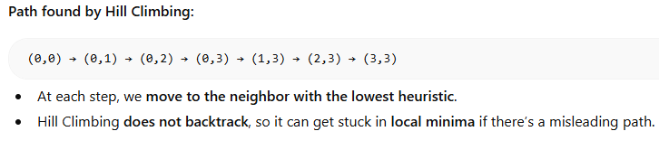

Slide 34
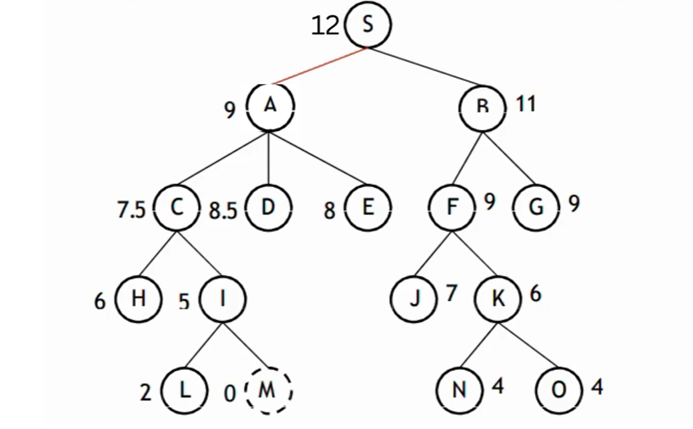
Simple Hill Climbing Graph search

Slide 35
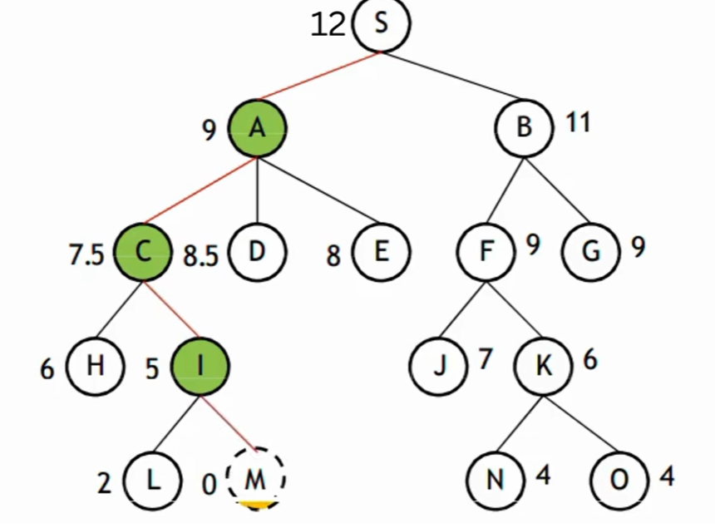

Slide 36
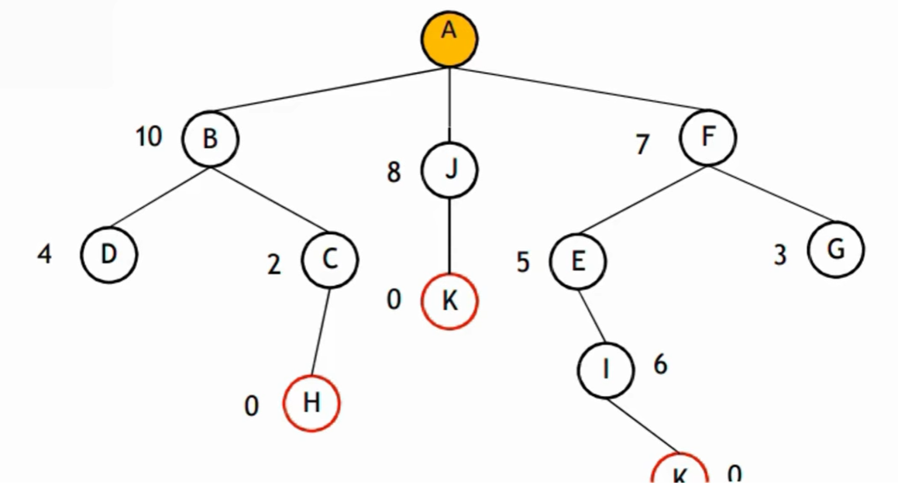

Slide 37
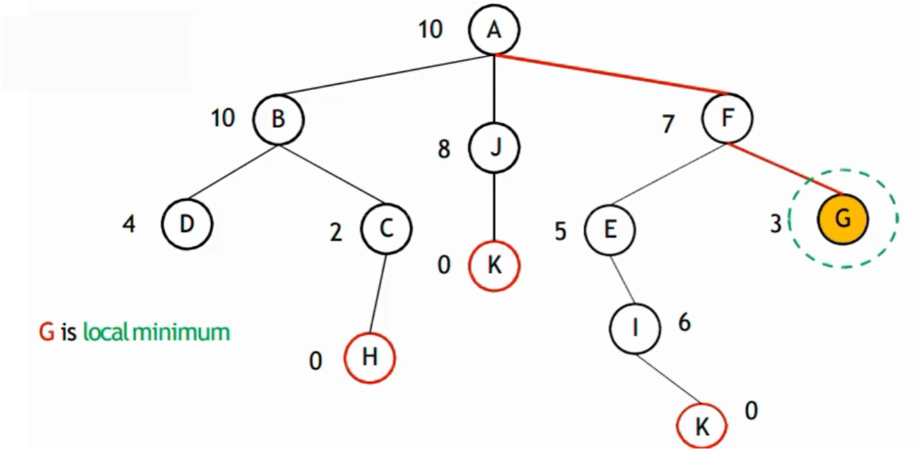

Slide 38
2. Steepest-Ascent Hill Climbing
Steepest-Ascent Hill Climbing is an enhanced version of simple hill climbing. Instead of moving to the first neighboring node that improves the state, it evaluates all neighbors and moves to the one offering the highest improvement (steepest ascent).

Slide 39
3. Stochastic Hill Climbing
Stochastic Hill Climbing introduces randomness into the search process. Instead of evaluating all neighbors or selecting the first improvement, it selects a random neighboring node and decides whether to move based on its improvement over the current state.

Slide 40
Simulated annealing (local search method)

Slide 41
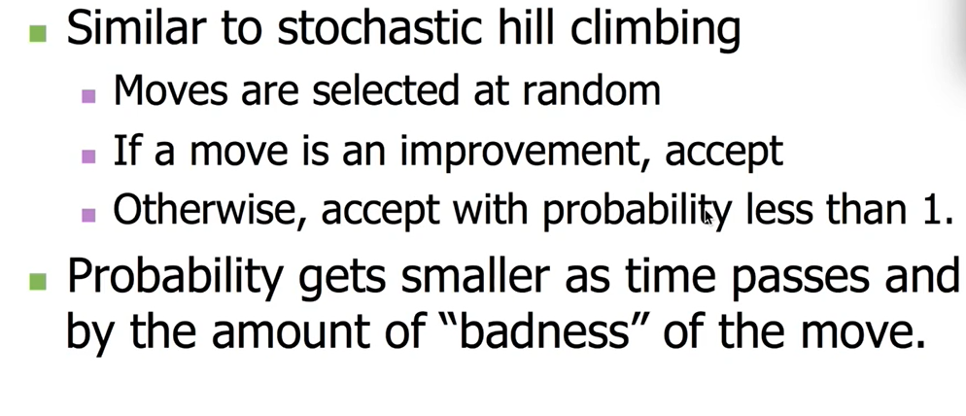

Slide 42
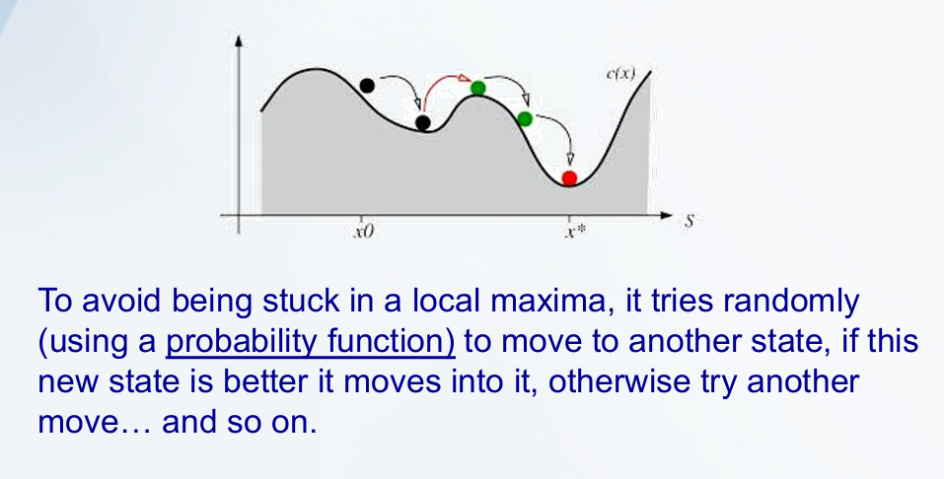

Slide 43
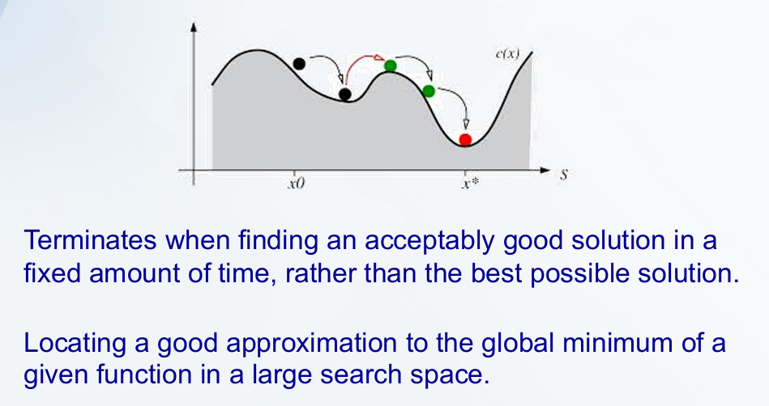

Slide 44
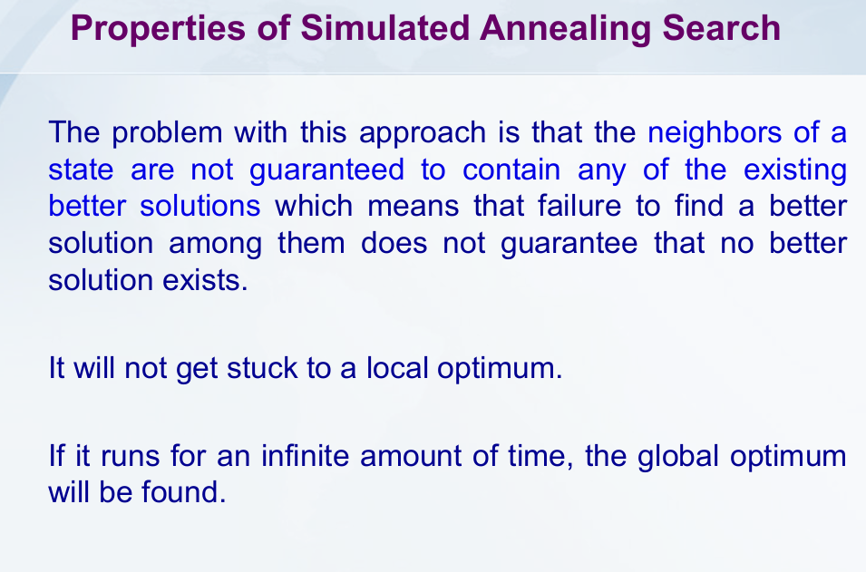

Slide 45
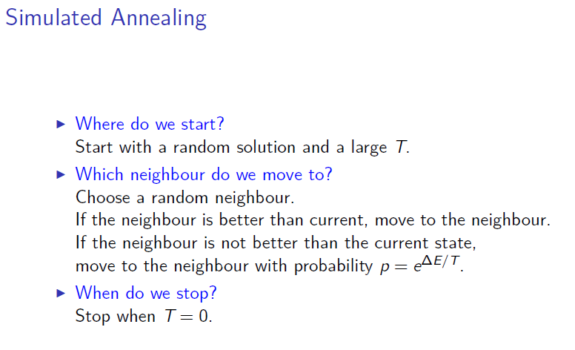

Slide 46
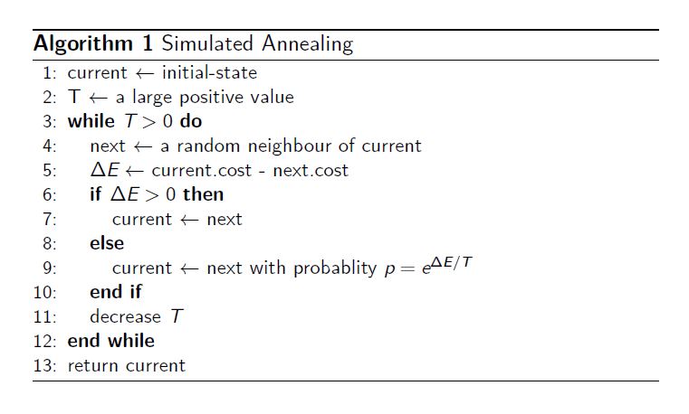

Slide 47
