Slide 1
Uninformed Search Algorithms in Artificial Intelligence
Lecture 2 A. Ünveren

Slide 2
Introduction to Uninformed Search
What is Search in AI?
In Artificial Intelligence, search is the process of finding a sequence of actions that leads from an initial state to a goal state.
A search problem is defined by:
  Initial state
  State space
  Actions (successor function)
  Goal test
  Path cost

Slide 3
What is Uninformed (Blind) Search?
Uninformed search algorithms:
Use no domain-specific knowledge
Rely only on the problem definition
Do not know how close a state is to the goal
They differ only in how they expand nodes.

Slide 4
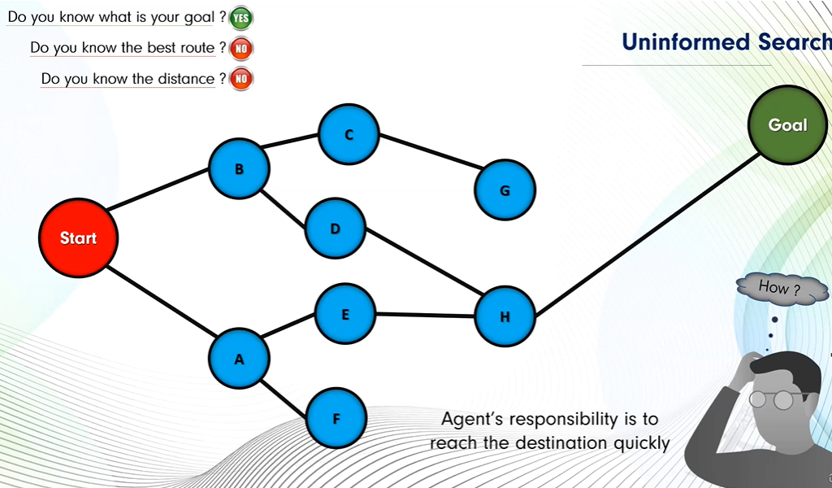

Slide 5
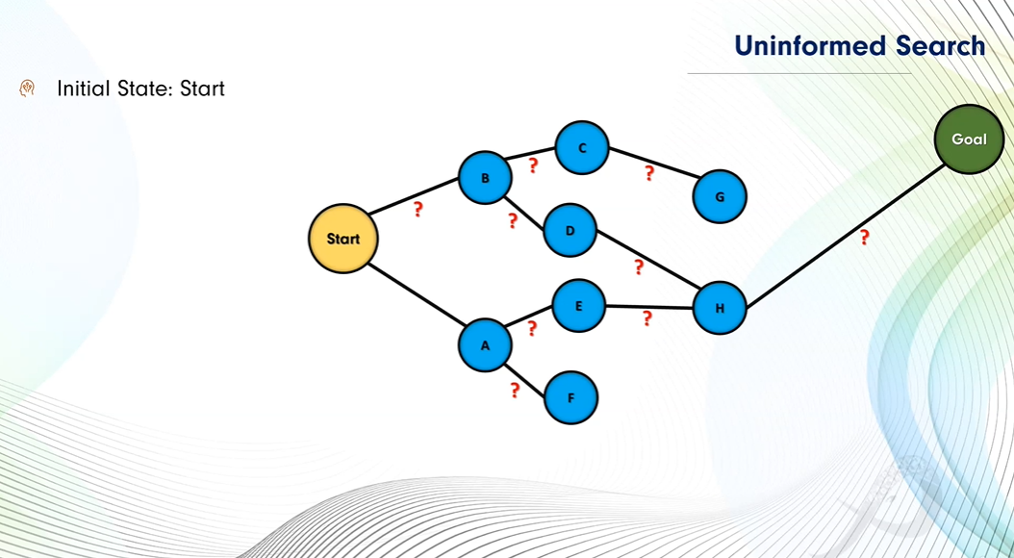

Slide 6
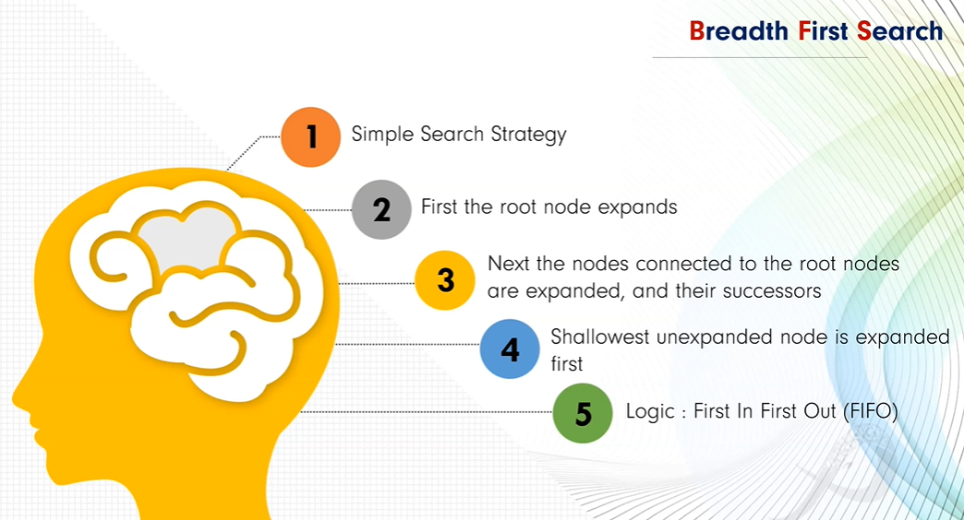
Breadth-First Search (BFS)
Idea
Expands the shallowest nodes first
Explores the search tree level by level
Uses a FIFO queue
Algorithm Behavior
Start from the root
Expand all nodes at depth 0
Then depth 1, depth 2, and so on
Stop when the goal is found

Slide 7
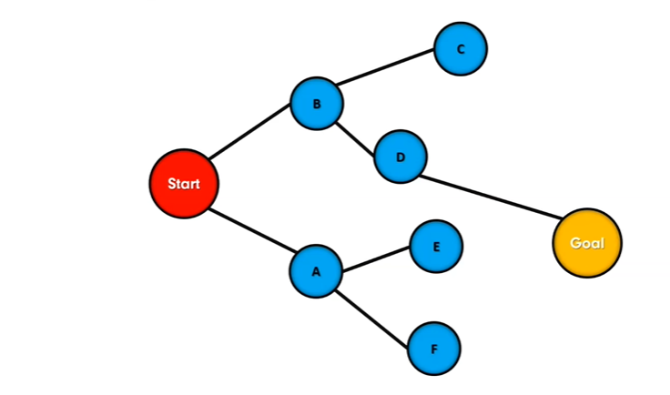
Implementatıon of BFS ın Python
Example
For representing this graph you have to define adjacency list first.

Slide 8
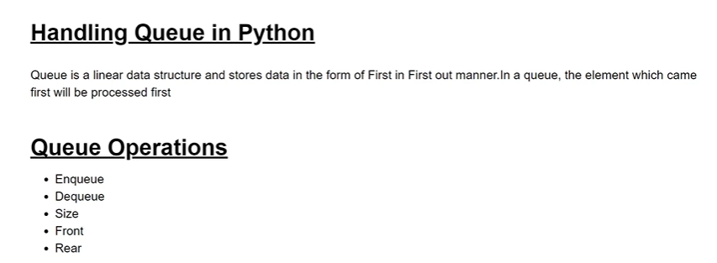
Adjacency list in Python:
my_adj={
‘Start’:[‘A’,’B’],
‘A’:[‘Start’,’E’,’F’],
‘B’:[‘Start’,’D’,’C’],
‘C’:[’B’],
‘D’:[‘B’,’Goal’],
‘E’:[’A’],
‘F’:[’A’],
‘Goal’:[’D’]
}

Slide 9
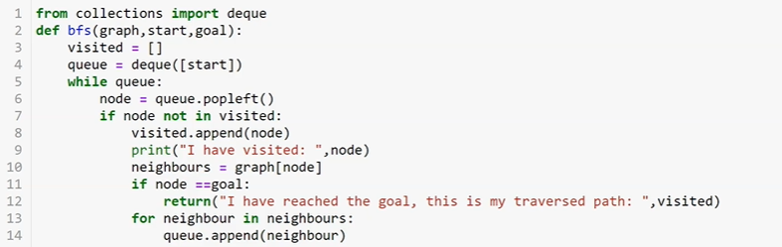
graph={
‘Start’:[‘A’,’B’],
‘A’:[‘Start’,’E’,’F’],
‘B’=[‘Start’,’D’,’C’],
‘C’:[’B’],
‘D’:[‘B’,’Goal’],
‘E’:[’A’],
‘F’:[’A’],
‘Goal’:[’D’]
}
Output:
bfs(graph,’Start’,’Goal’)

Slide 10
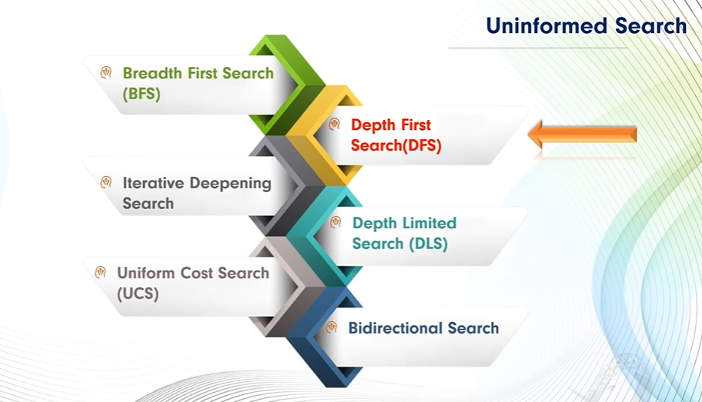
Depth First Search (DFS)

Slide 11
Depth First Search (DFS) is a fundamental graph traversal algorithm.
It explores a graph by going as deep as possible along one branch before backtracking.
DFS can be applied to:
  Graphs (directed and undirected)
  Trees
  Maze solving
  Cycle detection
  Topological sorting
  Connected components

Slide 12
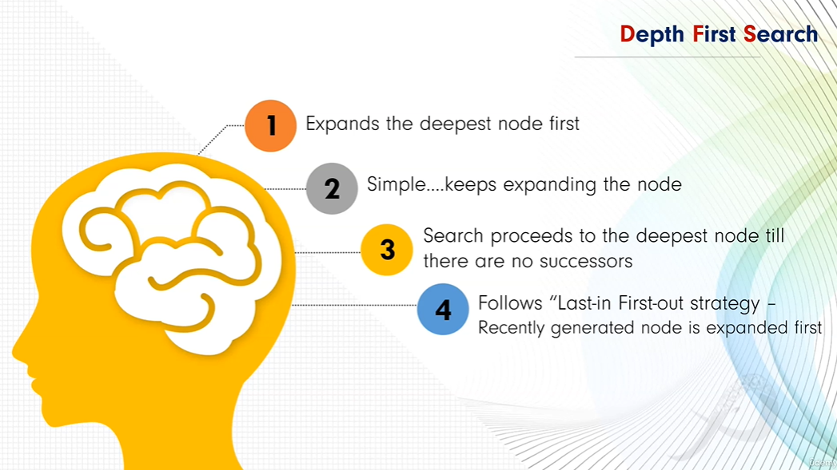

Slide 13
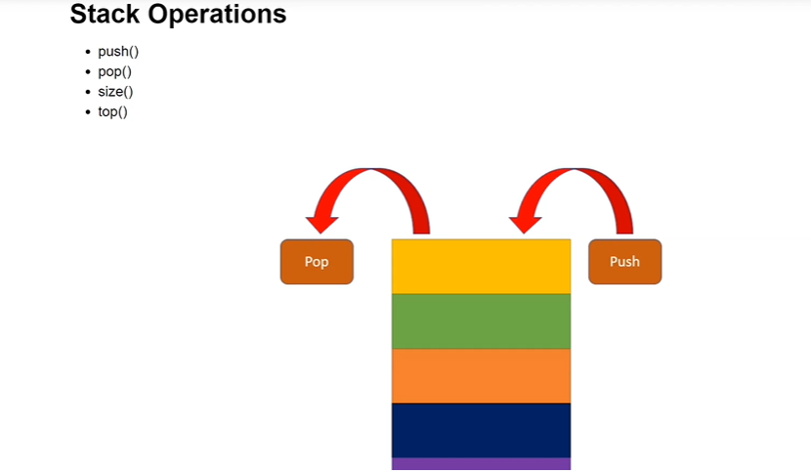
Key Idea
  DFS starts from a source node and:
  Visits the node
  Marks it as visited
  Recursively visits one unvisited adjacent node at a time
  Backtracks when no unvisited neighbors remain
  This behavior resembles stack-based exploration.

Slide 14
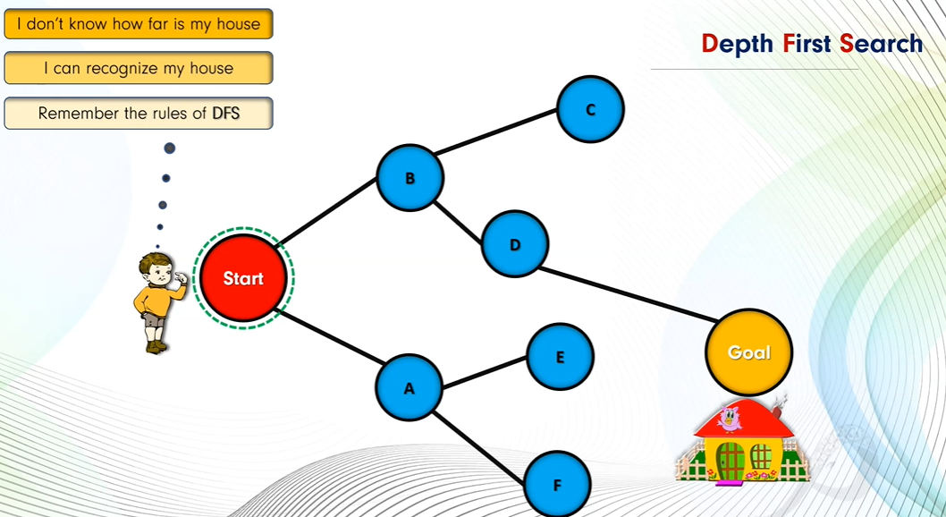

Slide 15
Implementatıon of DFS ın Python
Example
For representing this graph you have to define adjacency list first.

Slide 16
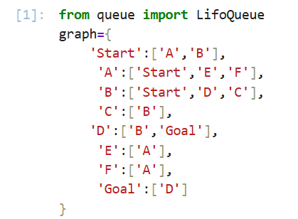
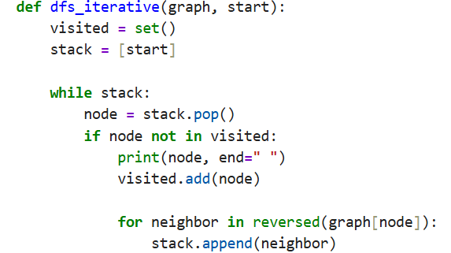

Pythone code for Dfs

Slide 17
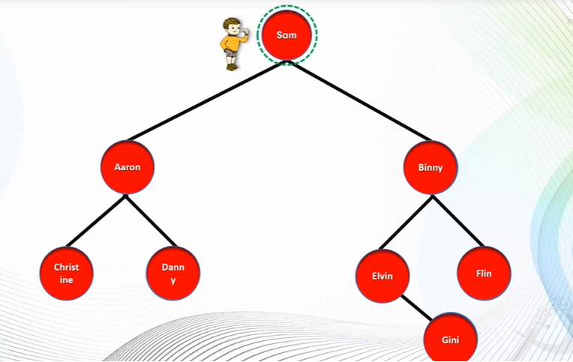
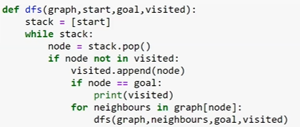
Home Work
Rewrite DFS for finding Goal.

Slide 18
Applications of DFS
Maze solving
Cycle detection
Topological sorting
Connected components
AI game search
Path existence checking

Slide 19
Maze Solving Problem
Maze represented as a 2D grid
0 → open path
1 → wall
S → start
E → exit
Goal: Find path from S to E

Slide 20
Maze Representation
DFS Maze Solving – Logic
maze = [
['S', 0, 1, 0],
[1, 0, 1, 0],
[0, 0, 0, 'E'],
[1, 1, 0, 1]
]
Start from S
Explore all directions:
Up, Down, Left, Right
Mark visited cells
Backtrack if path blocked
Stop when E is found

Slide 21
Maze DFS python code
def dfs_maze(maze, x, y, visited, path):
rows, cols = len(maze), len(maze[0])
if x < 0 or y < 0 or x >= rows or y >= cols:
return False
if maze[x][y] == 1 or (x, y) in visited:
return False
visited.add((x, y))
path.append((x, y))
if maze[x][y] == 'E':
return True
if (dfs_maze(maze, x+1, y, visited, path) or
dfs_maze(maze, x-1, y, visited, path) or
dfs_maze(maze, x, y+1, visited, path) or
dfs_maze(maze, x, y-1, visited, path)):
return True
path.pop()
return False
visited = set()
path = []
dfs_maze(maze, 0, 0, visited, path)
print("Path to exit:", path)

Slide 22
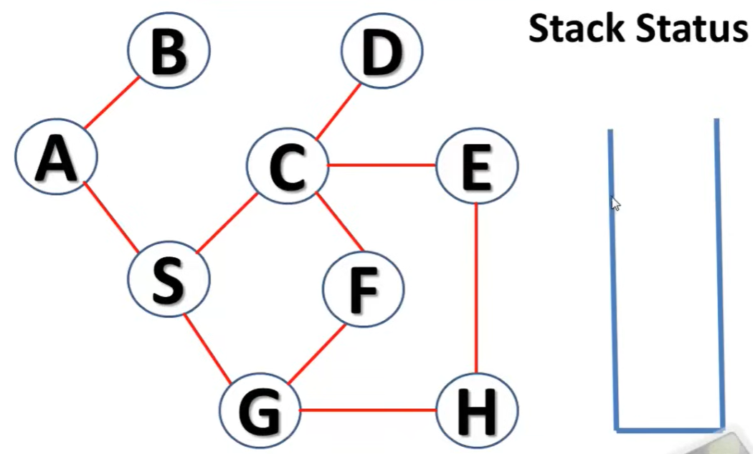
Example: Graph Search: DFS

Slide 23
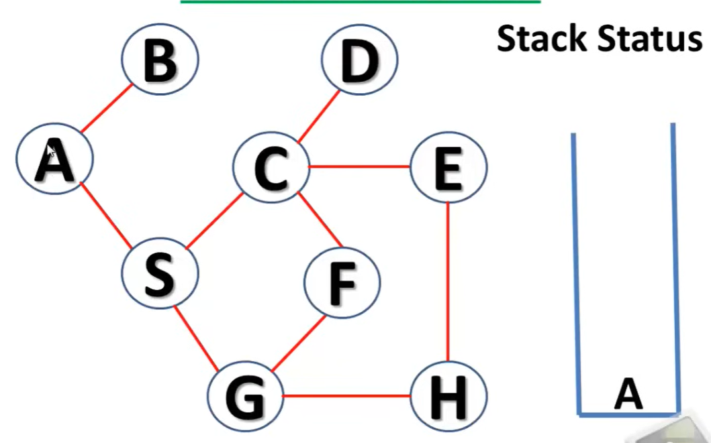

Slide 24
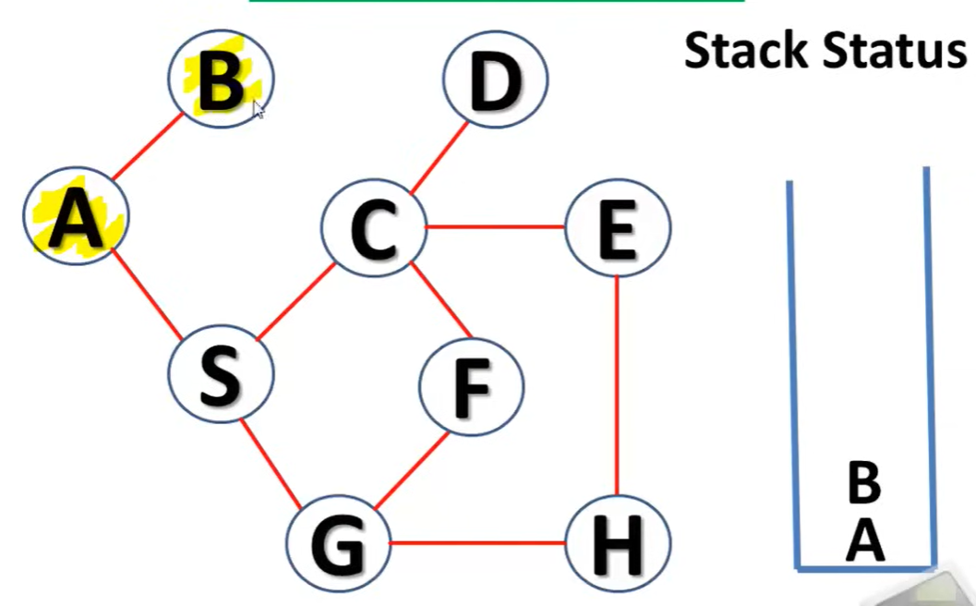

Slide 25
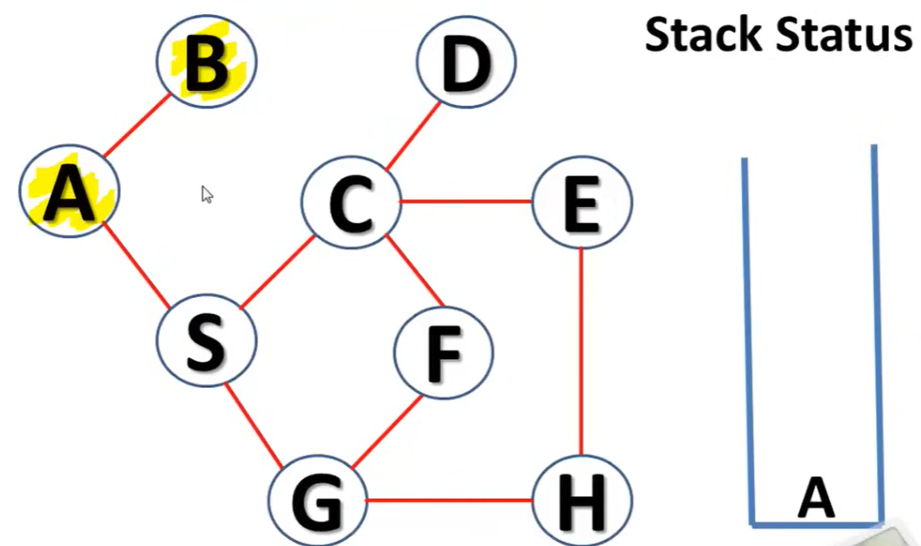

Slide 26
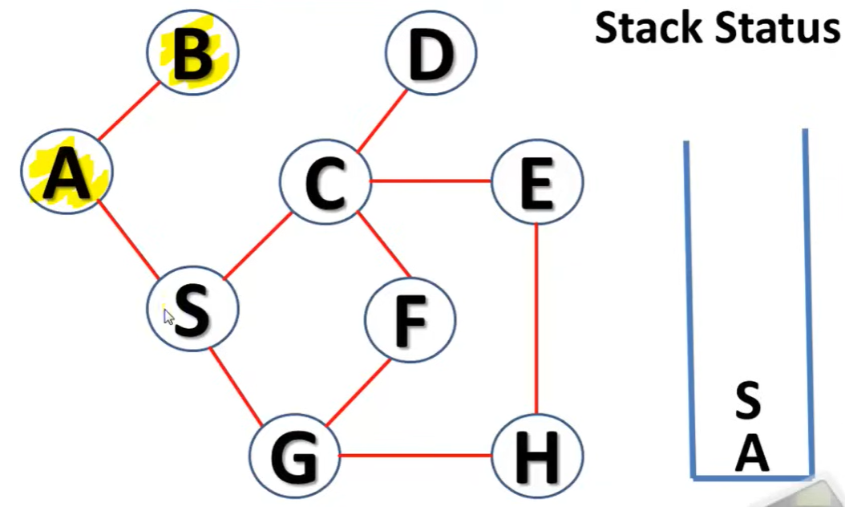

Slide 27
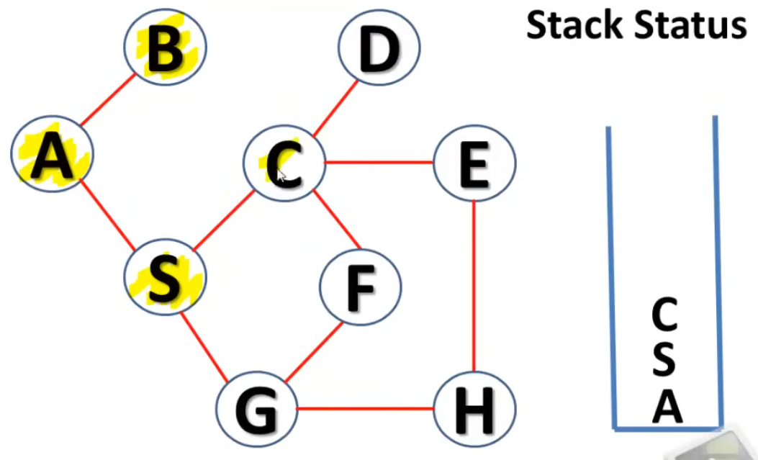

Slide 28
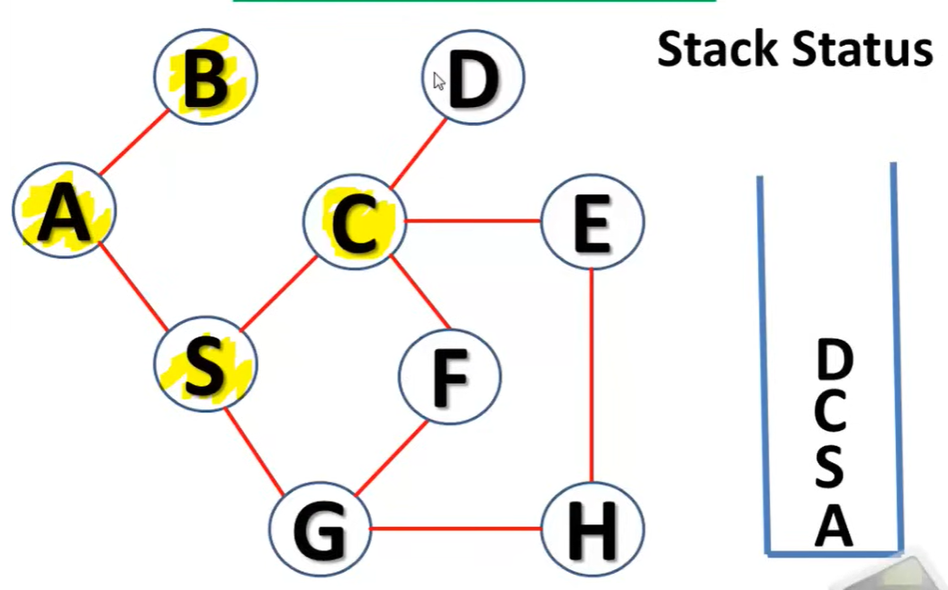

Slide 29
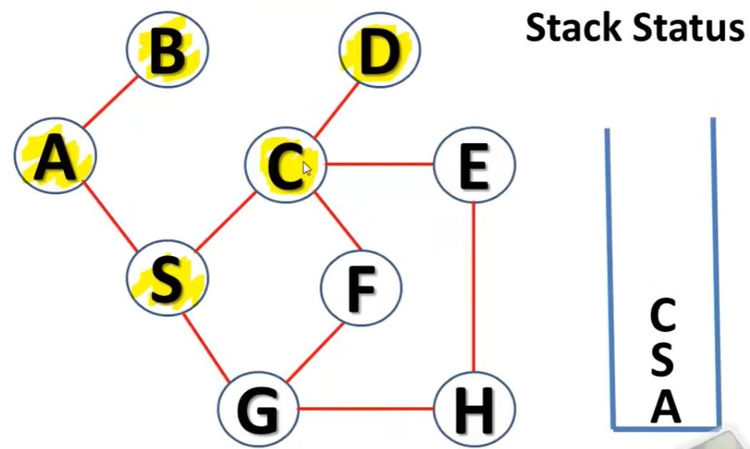

Slide 30
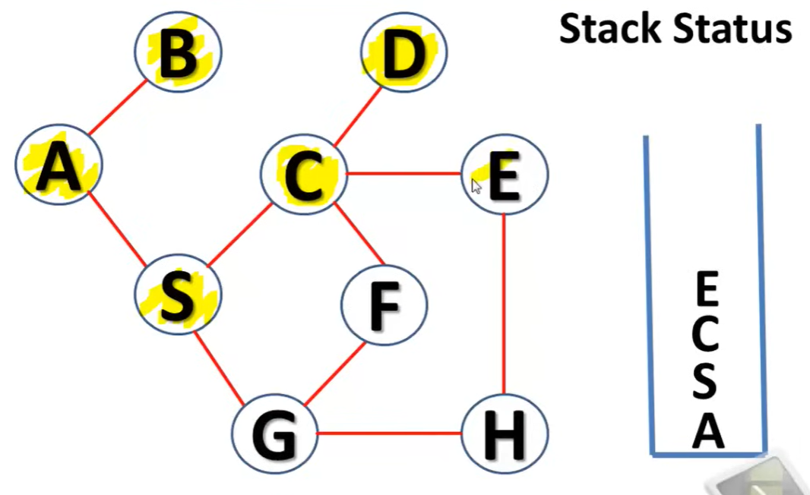

Slide 31
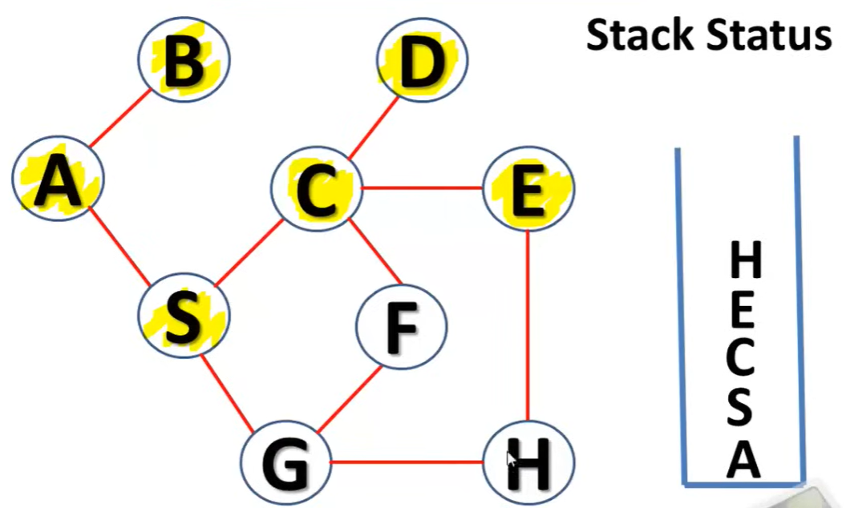

Slide 32
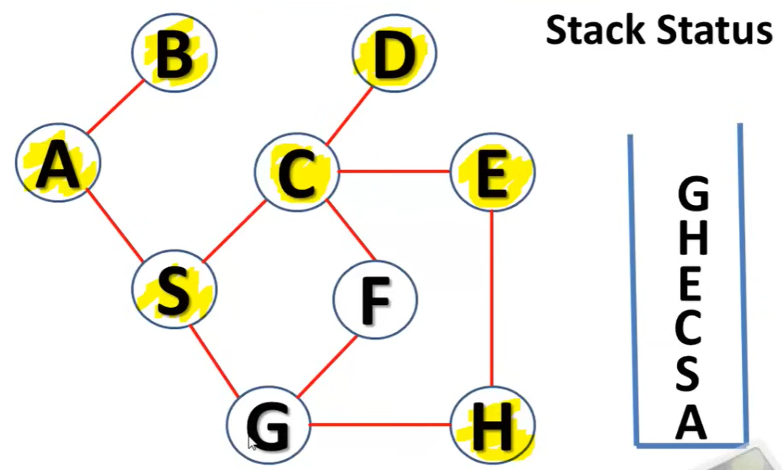

Slide 33
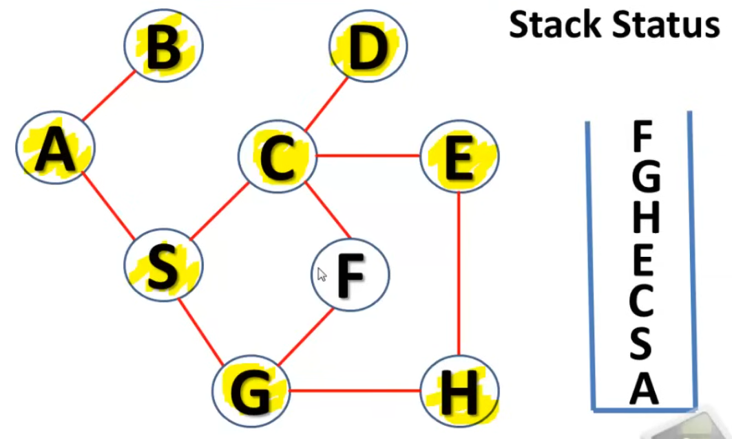

Slide 34
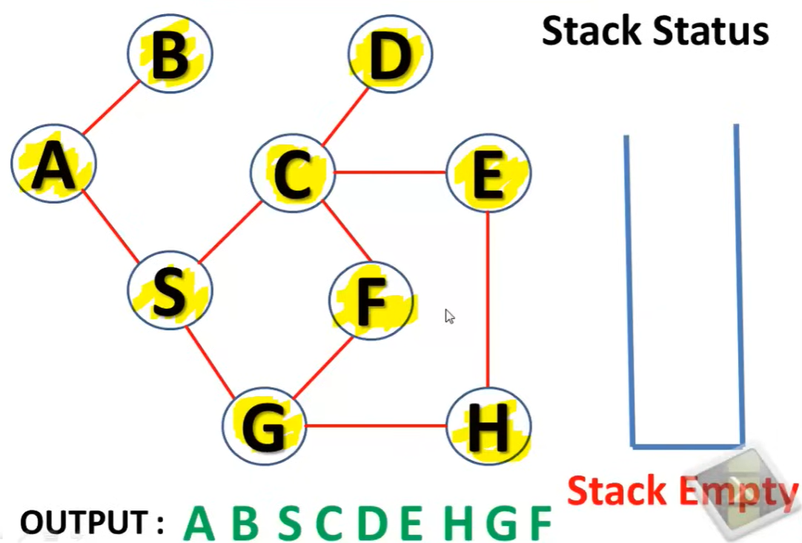

Slide 35


Slide 36
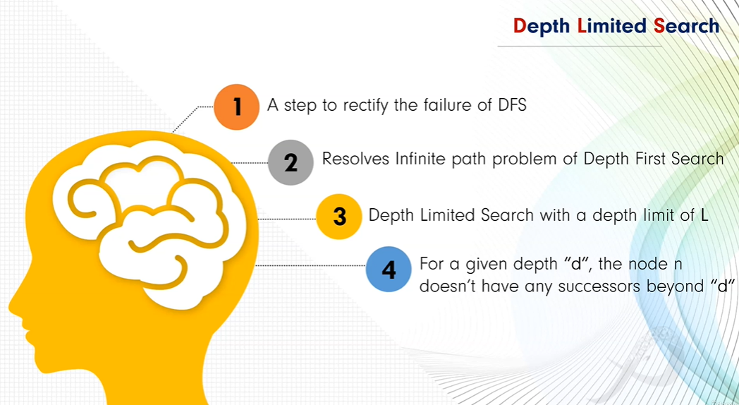

Slide 37
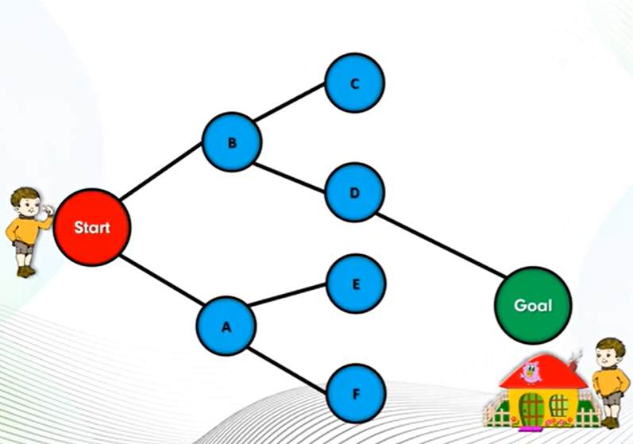

Slide 38
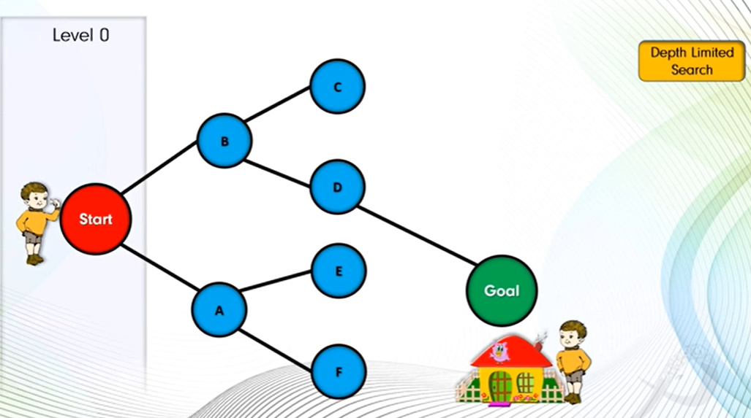

Slide 39
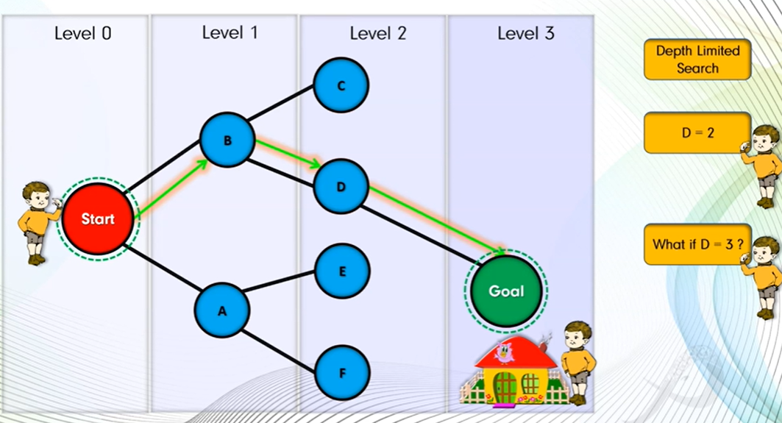

Slide 40
graph={ 'Start':['A','B'],
'A':['Start','E','F'],
'B':['Start','D','C'],
'C':['B'],
'D':['B','Goal'],
'E':['A'],
'F':['A'],
'Goal':['D’]}
def dls_stack(graph, start, goal, limit,path):
stack = [(start, 0)]
visited = set()
while stack:
print(stack)
node, depth = stack.pop()
if node == goal:
return True
if node not in visited:
visited.add(node)
path.append(node)
if depth < limit:
# Push neighbors in reverse order for correct DFS behavior
for neighbor in reversed(graph[node]):
if neighbor not in visited:
stack.append((neighbor, depth + 1))
# path.pop(node) return False
path = []
# print(dls_stack(graph, 'Start', 'Goal', 3,path))
if dls_stack(graph, 'Start', 'Goal', 2,path)==True:
path.append('Goal')
print("Goal Found",path)else: print("Goal Not Found",path)

Slide 41


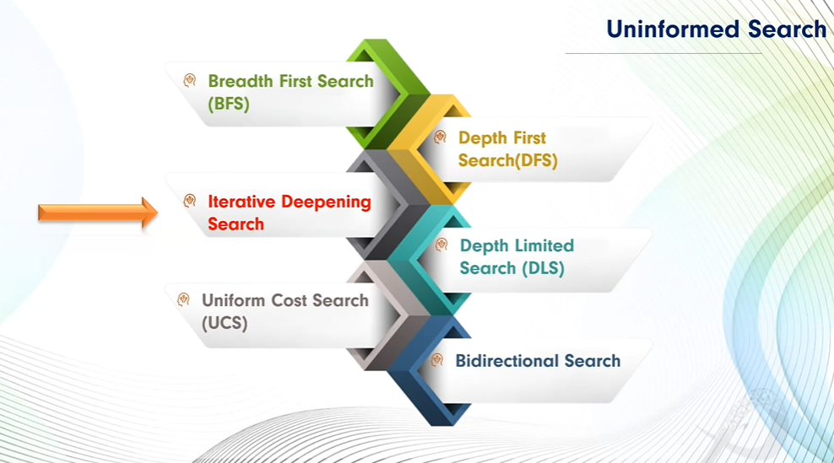

Slide 42
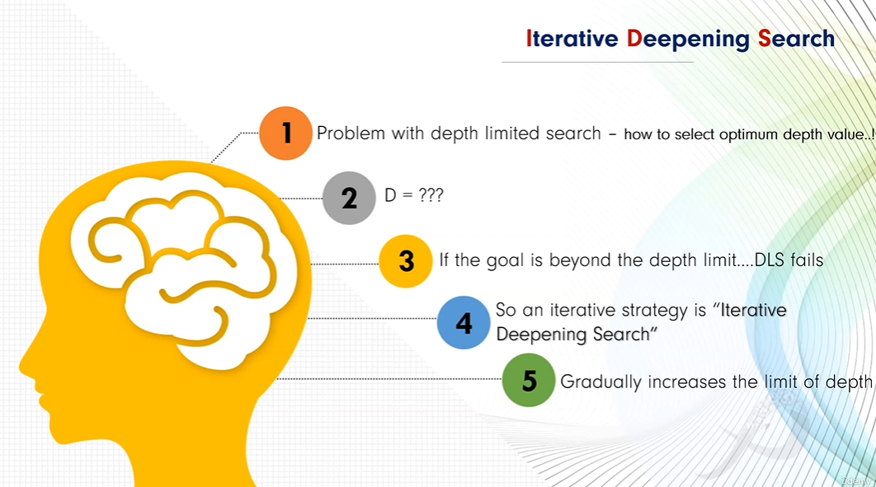

Slide 43
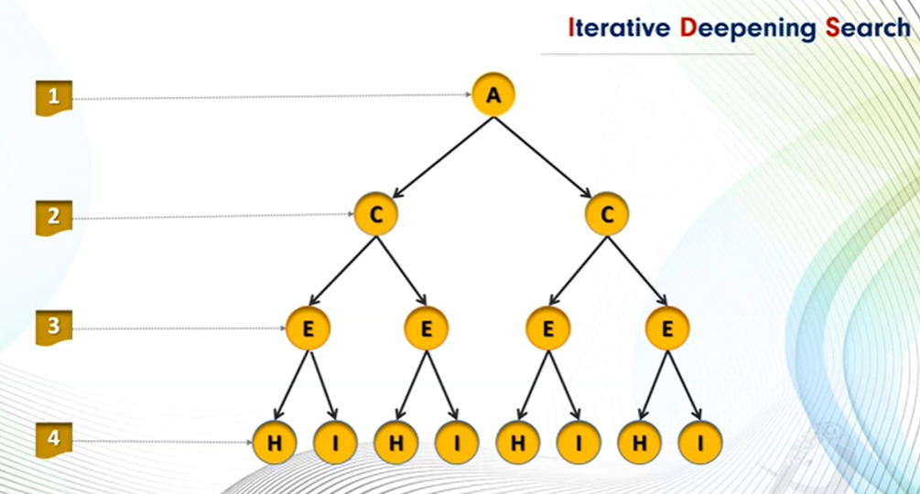

Slide 44
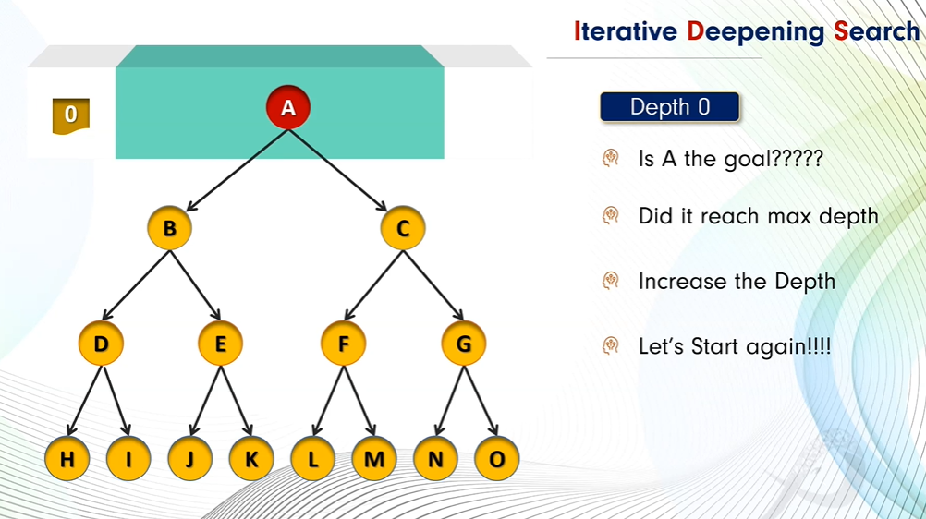

Slide 45
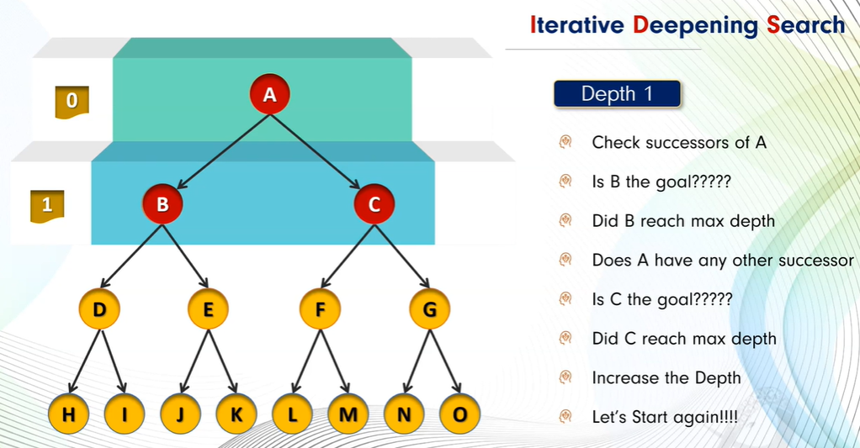

Slide 46
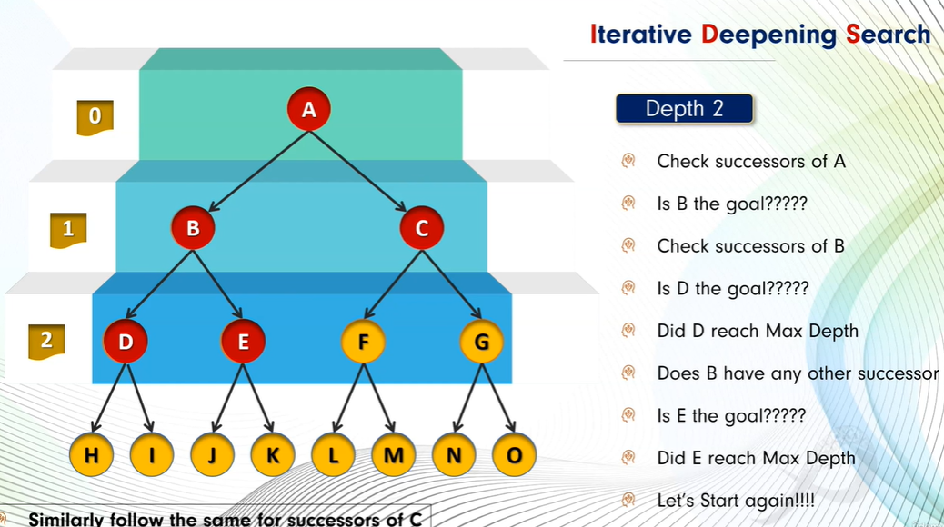

Slide 47
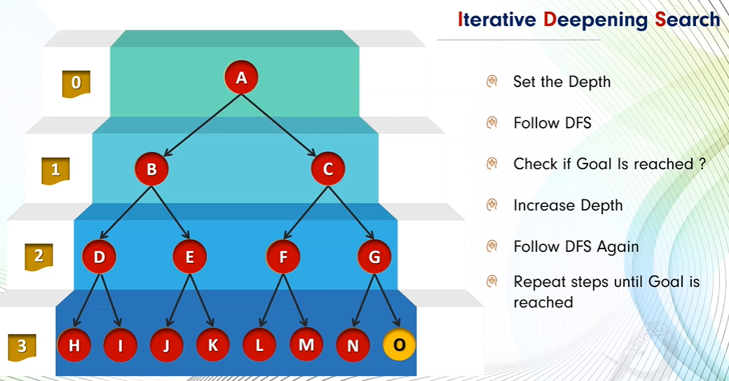

Slide 48
graph={ 'Start':['A','B'],
'A':['Start','E','F'],
'B':['Start','D','C'],
'C':['B'],
'D':['B','Goal'],
'E':['A'],
'F':['A'],
'Goal':['D’]}
def dls_stack(graph, start, goal, limit,path):
stack = [(start, 0)]
visited = set()
while stack:
print(stack)
node, depth = stack.pop()
if node == goal:
return True
if node not in visited:
visited.add(node)
path.append(node)
if depth < limit:
# Push neighbors in reverse order for correct DFS behavior
for neighbor in reversed(graph[node]):
if neighbor not in visited:
stack.append((neighbor, depth + 1))
# path.pop(node) return False
dl=0
while dl<4:
path = []
if dls_stack(graph, 'Start', 'Goal', dl,path)==True:
path.append('Goal')
print("Goal Found",path)
break
else:
print("Goal Not Found",path)
dl=dl+1

Slide 49
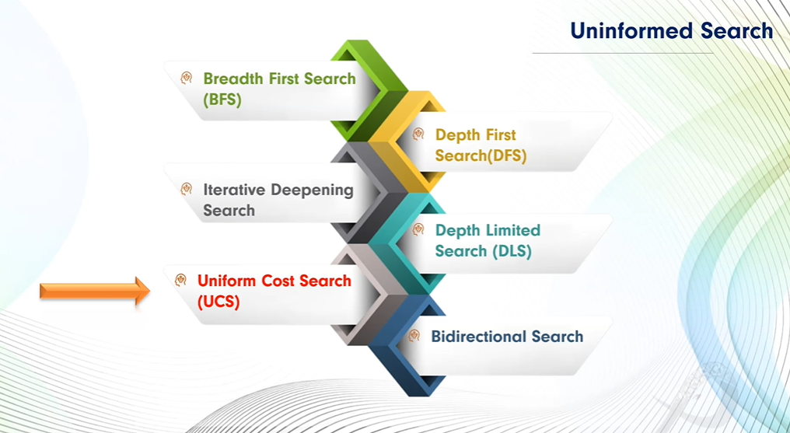

Slide 50
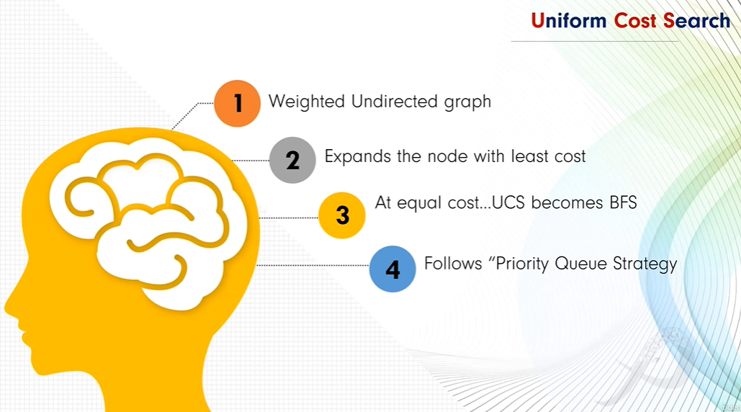

Slide 51
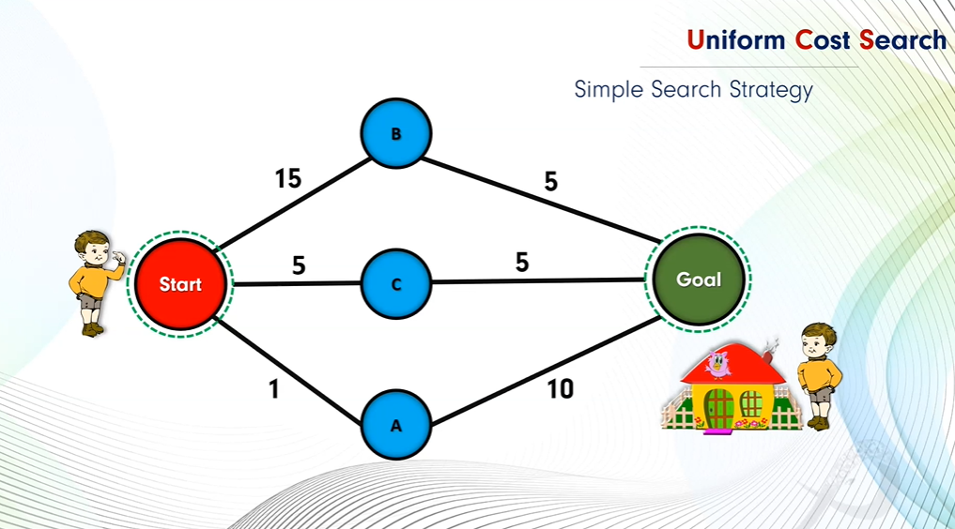

Slide 52
Uniform Cost Search (UCS) is a search algorithm used in artificial intelligence (AI) for finding the least cost path in a graph. It is a variant of Dijkstra's algorithm and is particularly useful when all edges of the graph have different weights, and the goal is to find the path with the minimum total cost from a start node to a goal node. In this article, we will explore the fundamentals of UCS, its working mechanism, and its applications in AI.
Uniform Cost Search is a pathfinding algorithm that expands the least cost node first, ensuring that the path to the goal node has the minimum cost. Unlike other search algorithms like Breadth-First Search (BFS), UCS takes into account the cost of each path, making it suitable for weighted graphs where each edge has a different cost.

Slide 53
Key Concepts of Uniform Cost Search
Priority Queue: UCS uses a priority queue to store nodes. The node with the lowest cumulative cost is expanded first. This ensures that the search explores the most promising paths first.
Path Cost: The cost associated with reaching a particular node from the start node. UCS calculates the cumulative cost from the start node to the current node and prioritizes nodes with lower costs.
Exploration: UCS explores nodes by expanding the least costly node first, continuing this process until the goal node is reached. The path to the goal node is guaranteed to be the least costly one.
Termination: The algorithm terminates when the goal node is expanded, ensuring that the first time the goal node is reached, the path is the optimal one.

Slide 54
Working Uniform Cost Search
UCS operates under a simple principle: among all possible expansions, pick the path that has the smallest total cost from the start node. This is implemented using a priority queue to keep the partial paths in order, based on the total cost from the root node.
Here’s the step-by-step process of how UCS works:
Initialization: UCS starts with the root node. It is added to the priority queue with a cumulative cost of zero since no steps have been taken yet.
Node Expansion: The node with the lowest path cost is removed from the priority queue. This node is then expanded, and its neighbors are explored.
Exploring Neighbors: For each neighbor of the expanded node, the algorithm calculates the total cost from the start node to the neighbor through the current node. If a neighbor node is not in the priority queue, it is added to the queue with the calculated cost. If the neighbor is already in the queue but a lower cost path to this neighbor is found, the cost is updated in the queue.
Goal Check: After expanding a node, the algorithm checks if it has reached the goal node. If the goal is reached, the algorithm returns the total cost to reach this node and the path taken.
Repetition: This process repeats until the priority queue is empty or the goal is reached.

Slide 55
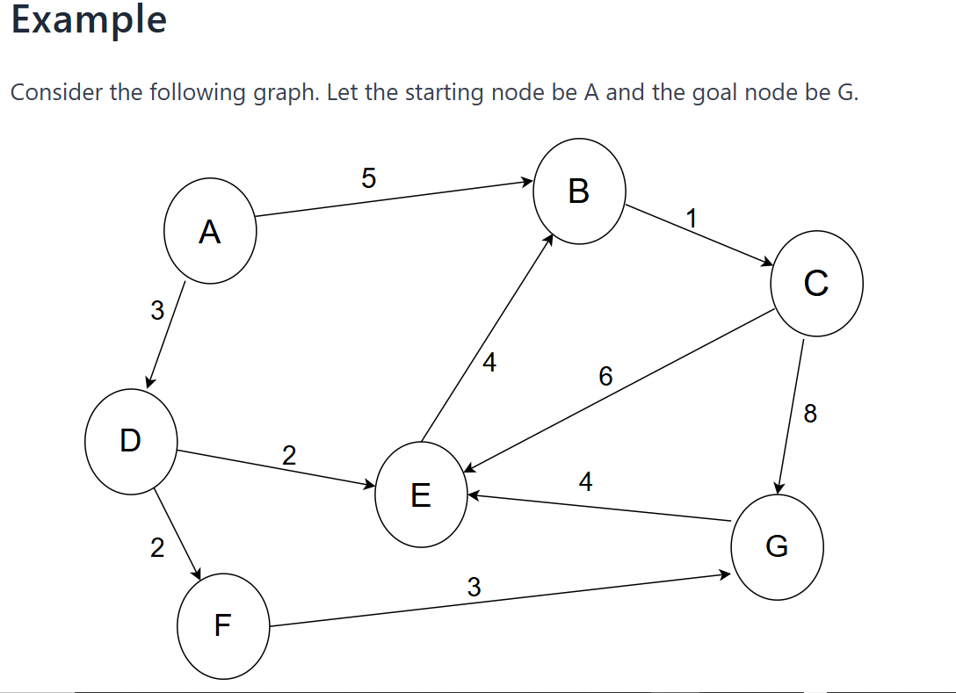

Slide 56
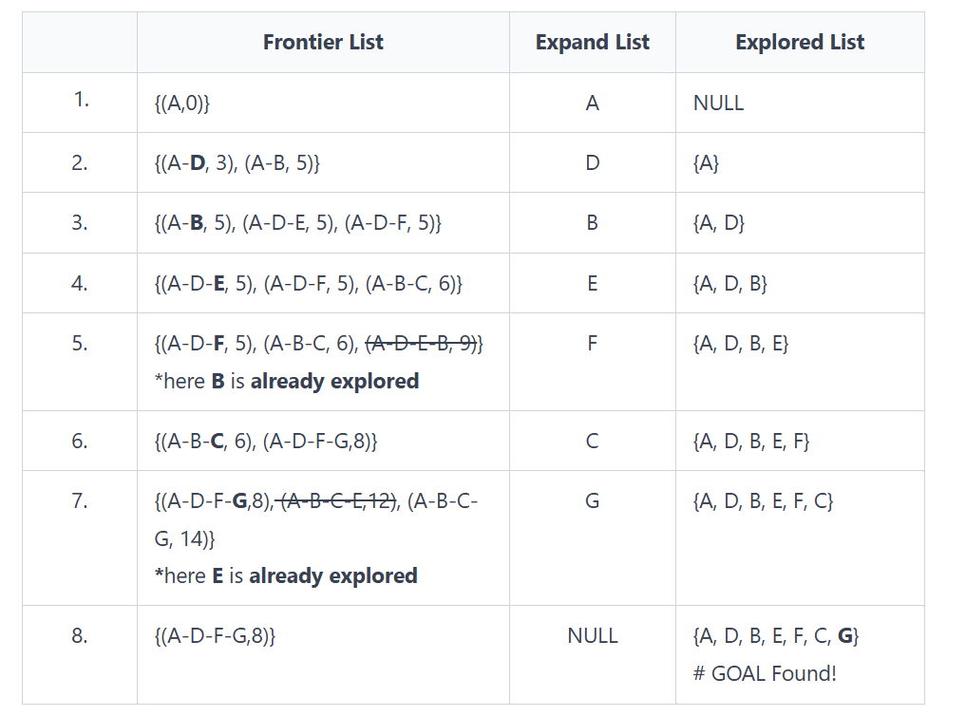
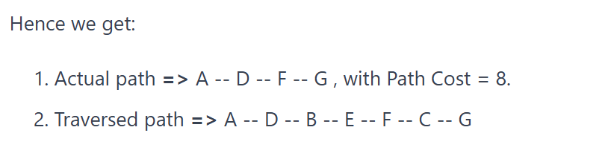

Slide 57
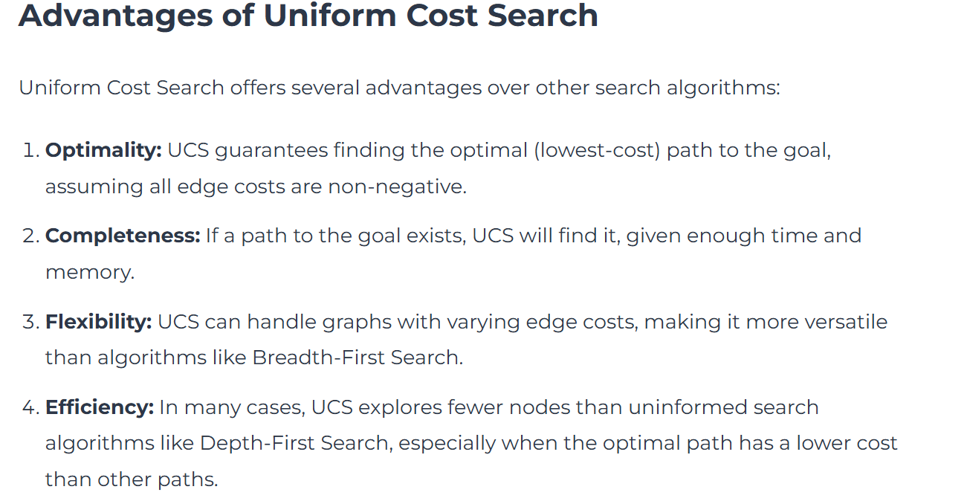

Slide 58
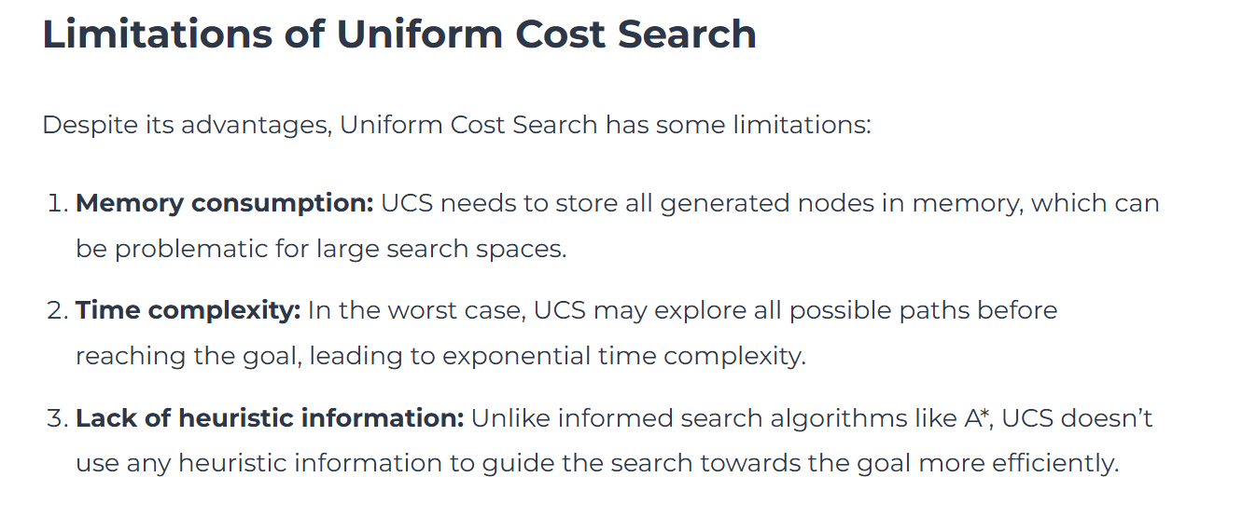

Slide 59
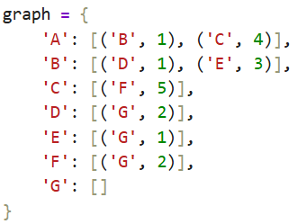
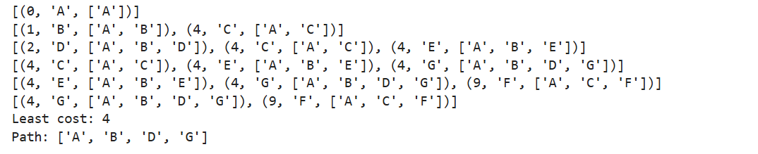

Slide 60
import heapq
# Example graph represented as an adjacency list
graph = {
'A': [('B', 1), ('C', 4)],
'B': [('D', 1), ('E', 3)],
'C': [('F', 5)],
'D': [('G', 2)],
'E': [('G', 1)],
'F': [('G', 2)],
'G': []
}

Slide 61
def uniform_cost_search(graph, start, goal):
priority_queue = [(0, start)]
# Dictionary to store the cost of the shortest path to each node
visited = {start: (0, None)}
while priority_queue:
# Pop the node with the lowest cost from the priority queue
current_cost, current_node = heapq.heappop(priority_queue)
# If we reached the goal, return the total cost and the path
if current_node == goal:
return current_cost, reconstruct_path(visited, start, goal)
# Explore the neighbors
for neighbor, cost in graph[current_node]:
total_cost = current_cost + cost
# Check if this path to the neighbor is better than any previously found
if neighbor not in visited or total_cost < visited[neighbor][0]:
visited[neighbor] = (total_cost, current_node)
heapq.heappush(priority_queue, (total_cost, neighbor))
return None

Slide 62
def reconstruct_path(visited, start, goal):
# Reconstruct the path from start to goal by following the visited nodes
path = []
current = goal
while current is not None:
path.append(current)
current = visited[current][1] # Get the parent node
path.reverse()
return path

Slide 63
# Example usage of the UCS function
start_node = 'A'
goal_node = 'G'
result = uniform_cost_search(graph, start_node, goal_node)
if result:
total_cost, path = result
print(f"Least cost path from {start_node} to {goal_node}: {' -> '.join(path)} with total cost {total_cost}")
else:
print(f"No path found from {start_node} to {goal_node}")

