Slide 1
Simulated annealing (local search method)

Slide 2


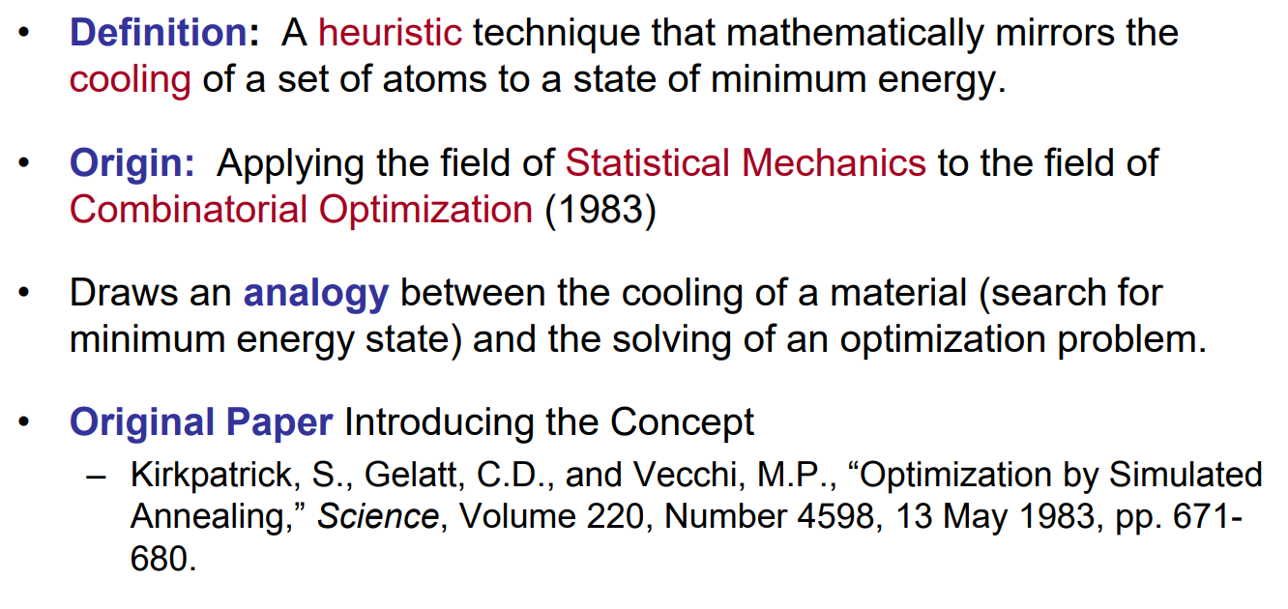

Slide 3
Failing on neighbourhood search
  Propensity to deliver solutions which are only local optima
  Solutions depend on the initial solution
Reduce the chance of getting stuck in a local optimum by allowing moves to inferior solutions
Developed by Kirkpatrick 1983: Simulation of the cooling of material in a heat bath could be used to search the feasible solutions of an optimization problem

Slide 4
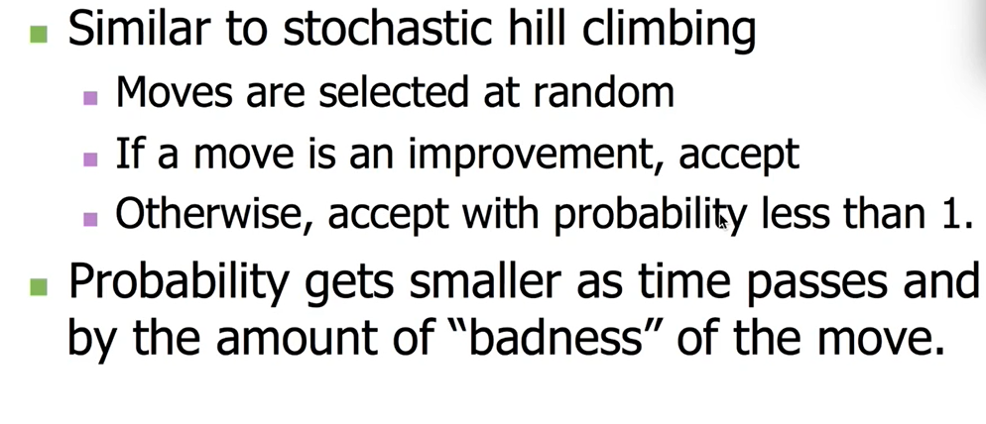

Slide 5
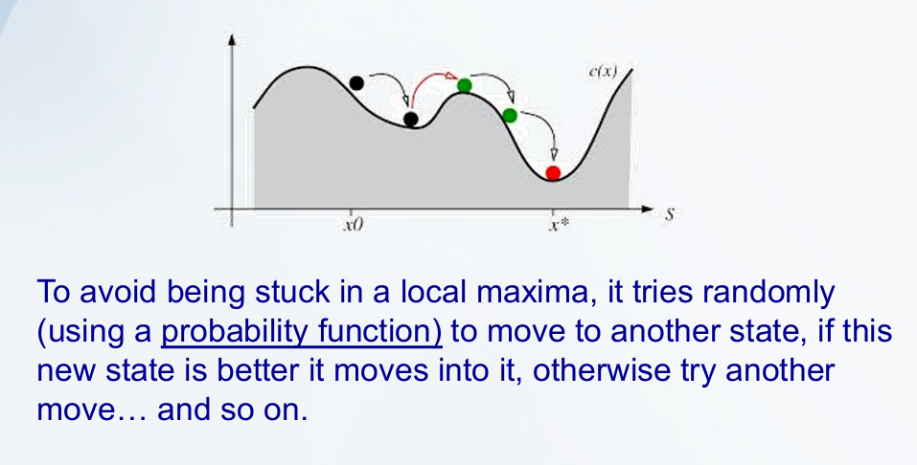

Slide 6
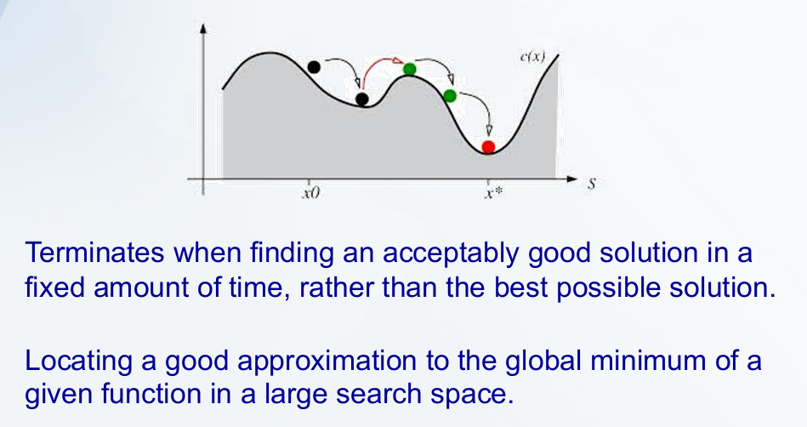

Slide 7
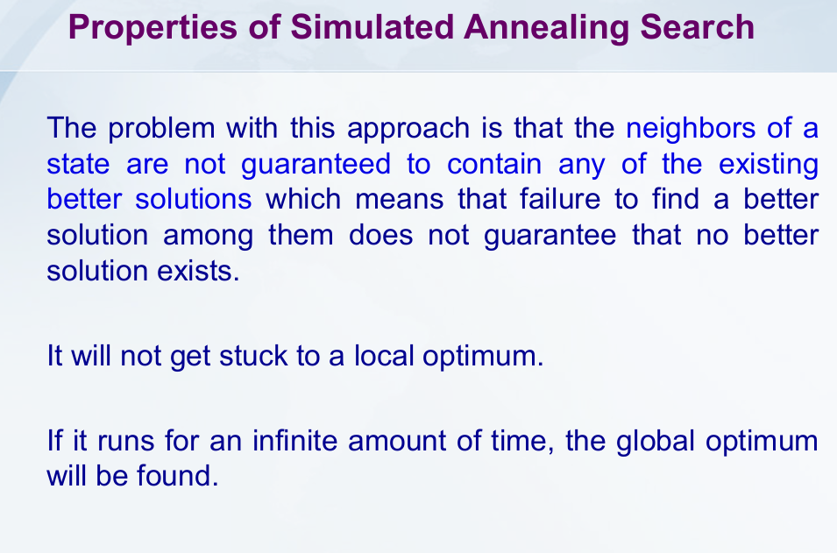

Slide 8
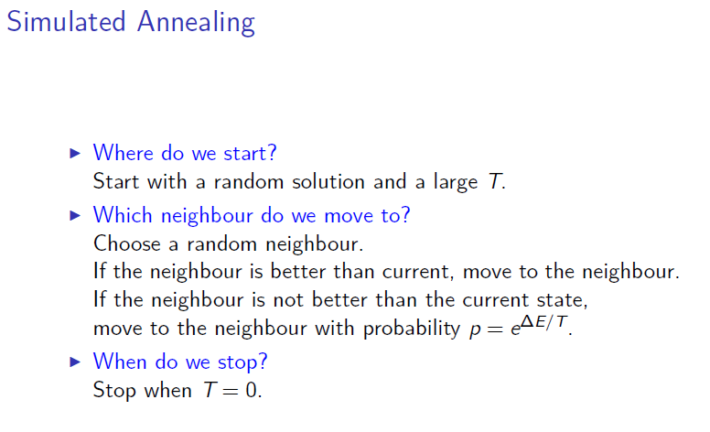

Slide 9
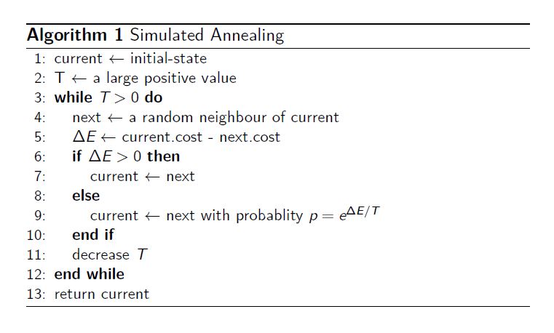
T (temperature) – control parameter
R in [0,1] – uniform random number

Slide 10
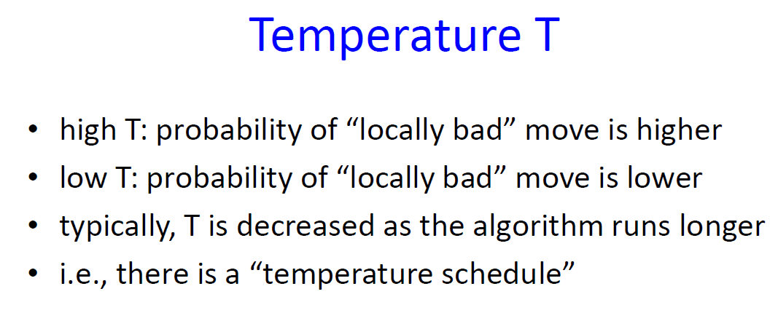

Slide 11
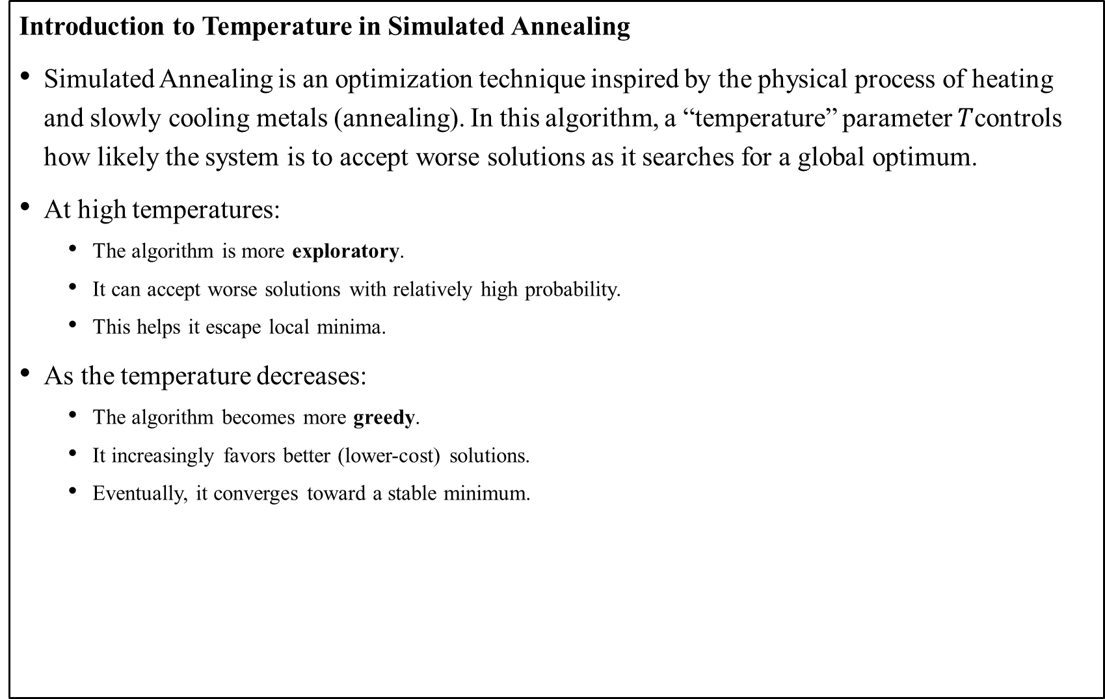
Introduction to Temperature in Simulated Annealing
Simulated Annealing is an optimization technique inspired by the physical process of heating and slowly cooling metals (annealing). In this algorithm, a “temperature” parameter $T$controls how likely the system is to accept worse solutions as it searches for a global optimum.
At high temperatures:
  The algorithm is more exploratory.
  It can accept worse solutions with relatively high probability.
  This helps it escape local minima.
As the temperature decreases:
  The algorithm becomes more greedy.
  It increasingly favors better (lower-cost) solutions.
  Eventually, it converges toward a stable minimum.

Slide 12
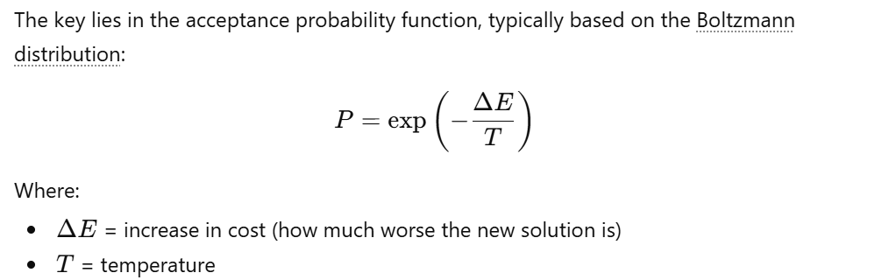

Why Does Decreasing $T$ Reduce the Probability of Selection?

Slide 13
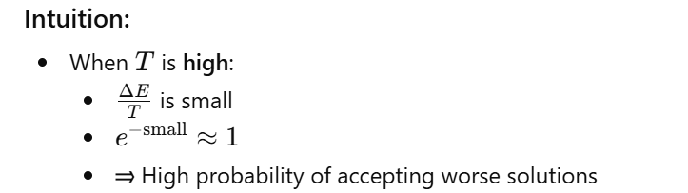
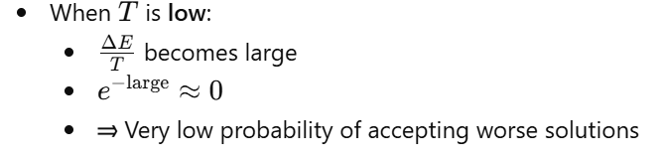

Slide 14
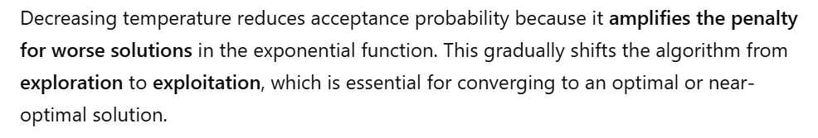
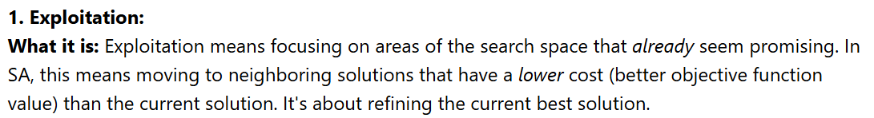
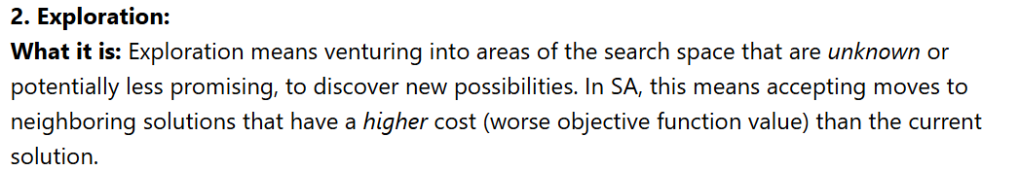

Slide 15
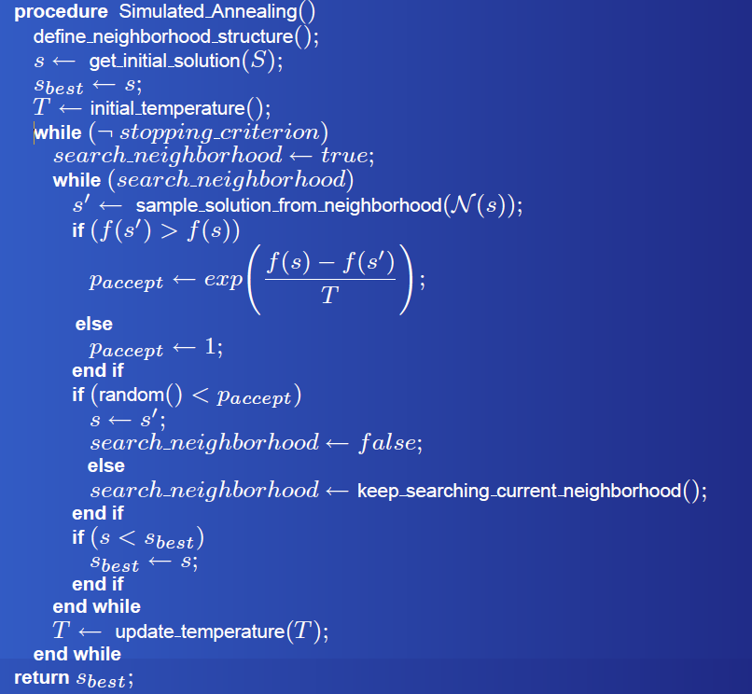

Slide 16
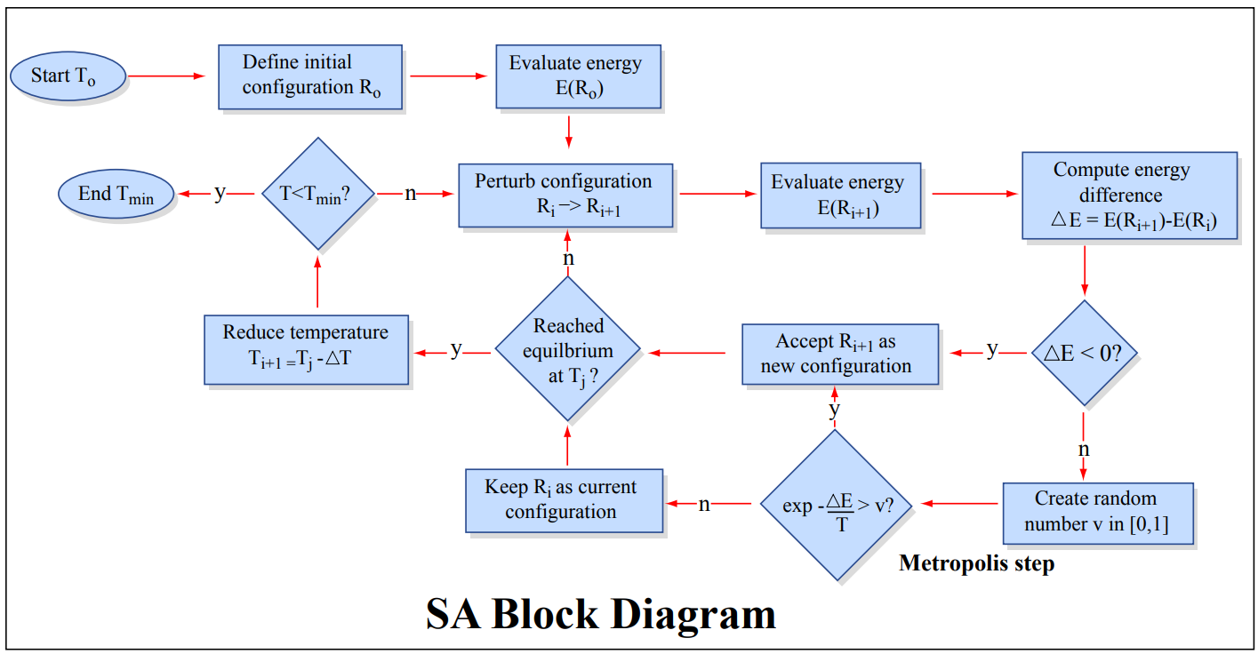

Slide 17
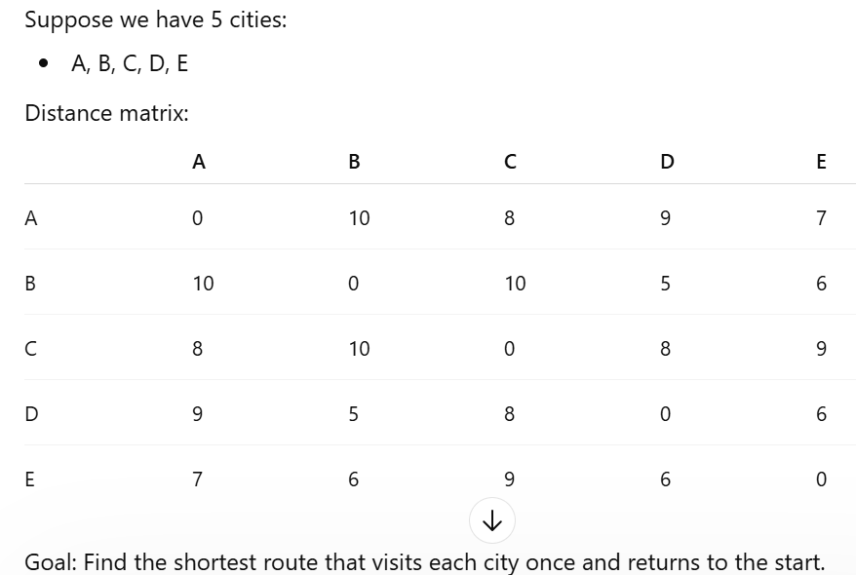
Problem Setup (TSP)

